Slide 1
Noise Textures
Environment Mapping
CS580
(Computer Graphics Rendering)
Ulrich Neumann

Slide 2
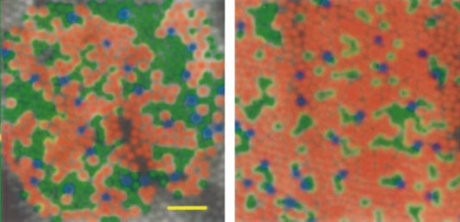
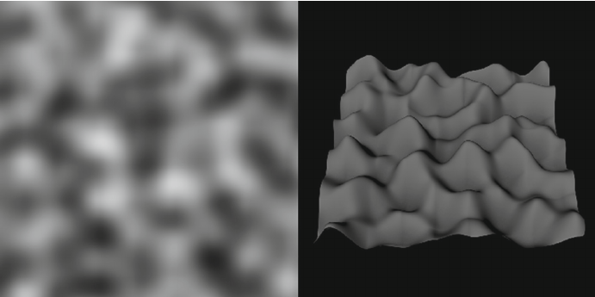
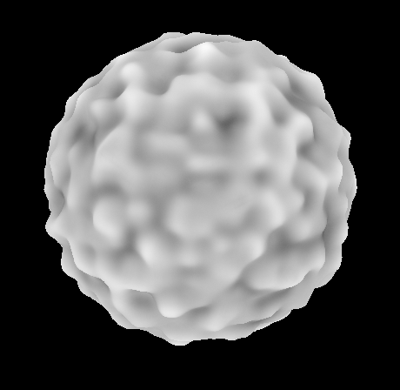
Perlin Noise Examples
Noise scalar function f(u,v) used for color, pseudocolor, or surface height displacement, …

Slide 3
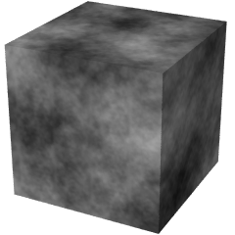
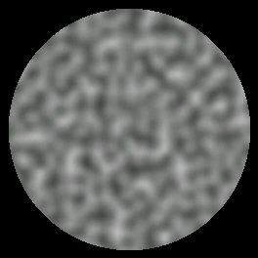
3D Noise Texture
(Perlin Noise)
d = noise(point)
point is 3D coord (u,v,w)
d is scalar texture value
g = dnoise(point)
g is gradient vector at point
Band-limited
LUT approach limits high frequencies and ensures smooth variations

Slide 4
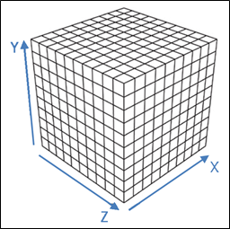
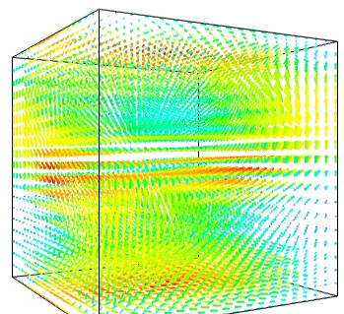
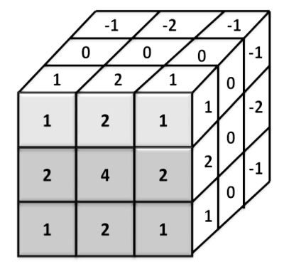
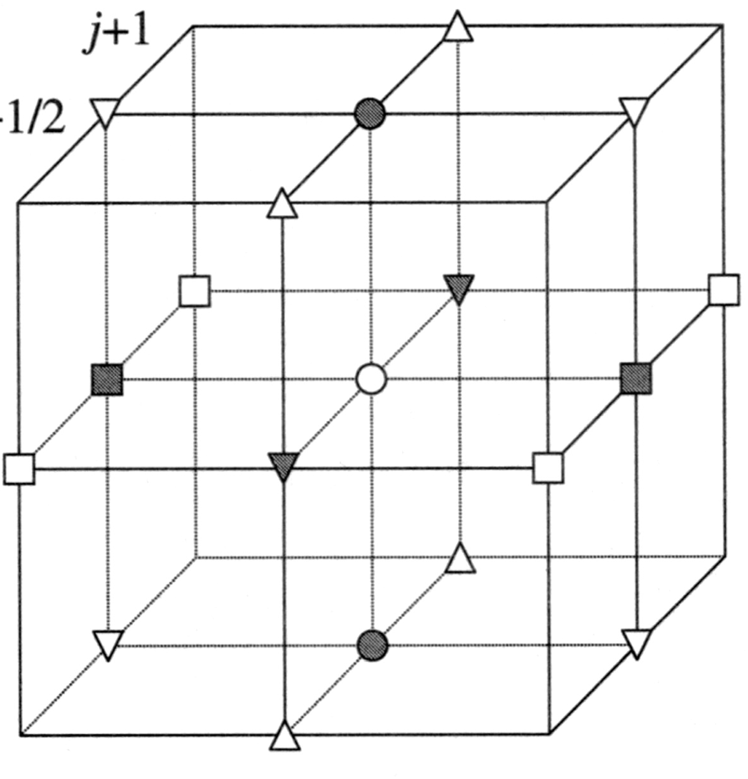
3D Noise Volume
3D grid (array or lattice) of data values
Data (d) are known (tabulated) at vertices
Gradient (g) at each point is derived from vertex values
g is often computed by Sobel operator (3x3) or simpler central-differences

Slide 5
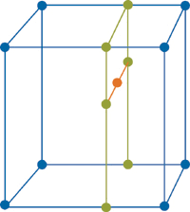
3D Interpolation
Values of d and g are interpolated (reconstruction) at arbitrary sample points in the volume
d(u,v,w) = noise sample
g(u,v,w) = gradient sample
Reconstruction is often done with 3D linear (tri-linear) interpolation
  (7x 1D interpolations)

Slide 6
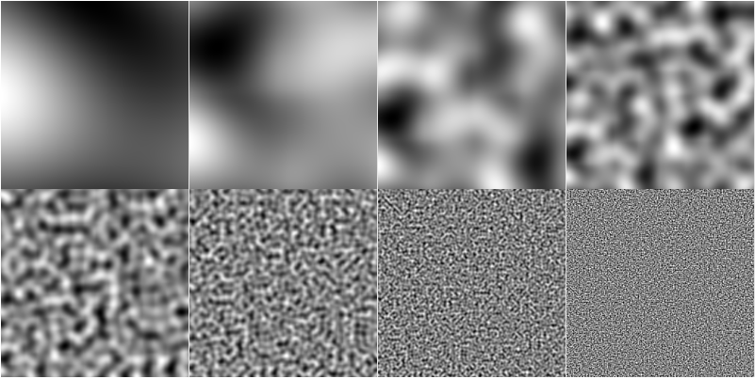
Noise Scale Examples
Scaling of u,v range to noise function is variable
  factors of 4x shown below

Slide 7
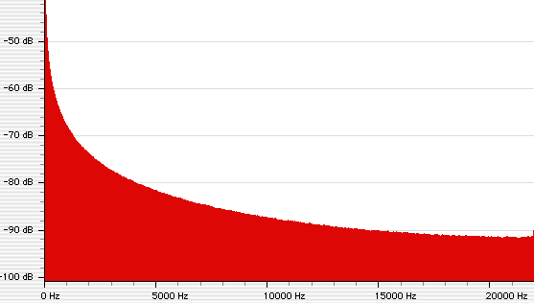
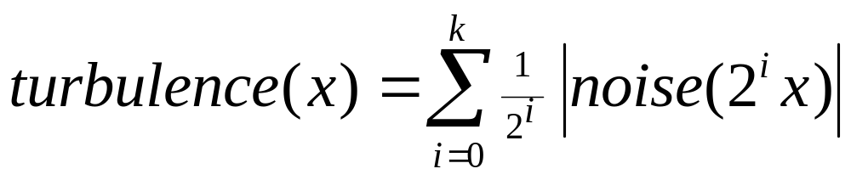
Turbulence
Noise with self-similarity
Sum octaves of noise with
diminishing amplitude (1/f)
1/f amplitudes are often found in nature
  String vibrations, terrain height, …

Slide 8
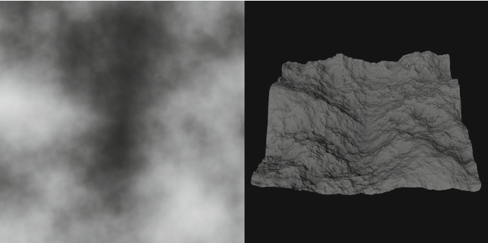
Turbulence Examples
7 octaves of noise

Slide 9
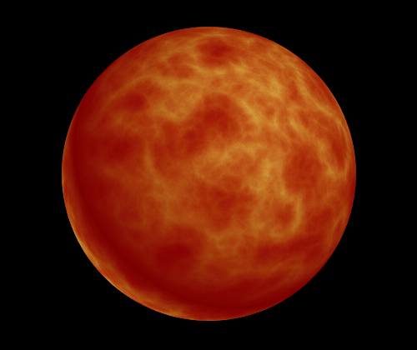
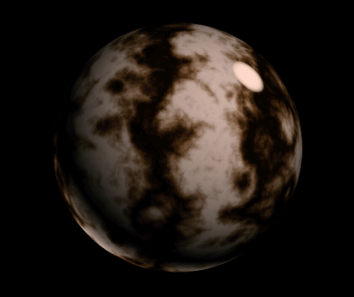
Turbulence Textures
turbulence(u,v)
sin (v + turbulence(u,v) )

Slide 10
Band-limited procedural noise
[Perlin, Siggraph ‘85] used for creating water, marble, fire
  Create a 3D lattice of points (x,y,z) with values for scalar random noise and its gradient at each lattice point] H(x,y,z) = [a,b,c,d]
    H is basically a 3D hash function (i.e. LUT)
    d is a scalar amplitude (computed by some noise/random function evaluation)
    a,b,c are gradient of d in x,y,z,
    a.b.c.d are within some +/- range (clamped)
  noise(point) = d (scalar amplitude of texture)
  dnoise(point) = (a,b,c) (vector direction texture)
    off-lattice values are found by tri-cubic interpolation (smooth, 4-point filter)
    lattice addressing is modulo its size - addresses wrap for edge continuity
  color = surface color * noise(point) simply modulates color by noise
    point is either (x,y,z) model space coord, or (u,v,w), or (u,v,k)
    u,v = 2D surface texture coord, k=constant
  color = pseudo(noise(point)) to create colorful surfaces
    pseudo is LUT color function (scalar noise : vector color)
  bump map = normal += dnoise(point)
    normal perturbation by noise-gradient vector (in tangent space) defined by Normal, Bi-normal, and cross-product (tangent space)

Slide 11
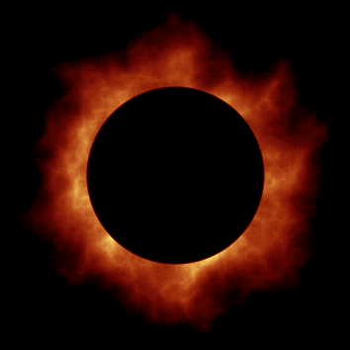
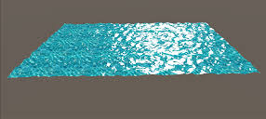

Animating Turbulence
Use an extra dimension (w) as time

Slide 12
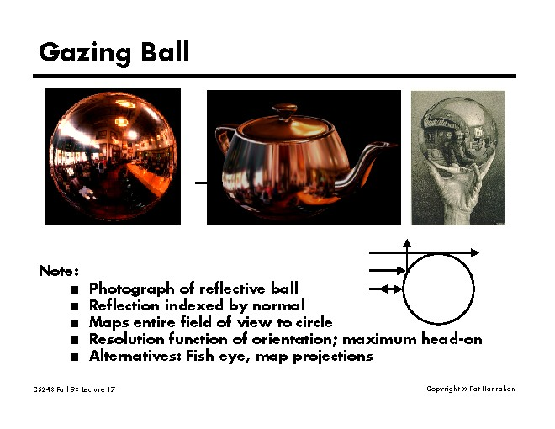
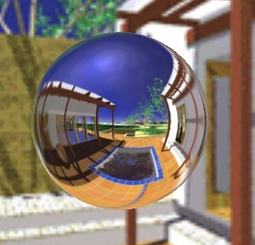
Environment (Reflection) Mapping
a.k.a.: poor-man’s global illumination
Ned Green, CG&A Nov. 1986).
  A simple idea (an approximation) but fast and effective
A texture can approximate global and complex lighting (area sources) and reflections of scenery, windows, sunsets, etc.

Slide 13
Environment Mapping
During rendering, compute the reflection of the Eye vector (not the light vector like in Phong shading).
  Reflection direction is used to map into a "far" scene texture (env map)
  Ignore position of surface point in scene. Treat every reflection vector as emanating from the same point. (centroid or origin of world)
Lights and scenery are all merged into environment texture.
Approximate environment (global illumination) geometry and light sources
Reflections into environment treats all objects encountered as light sources
No object inter-reflections or shadows (limited at best)
Planar environment approximation (like infinite lights)
One-bounce specular reflection direction doesn’t capture diffuse inter-reflections
Blur/filter texture to simulate diffuse lighting/reflection
Sharp texture (no blur) can simulate highly specular material reflections (e.g., chrome dinosaurs)

Slide 14
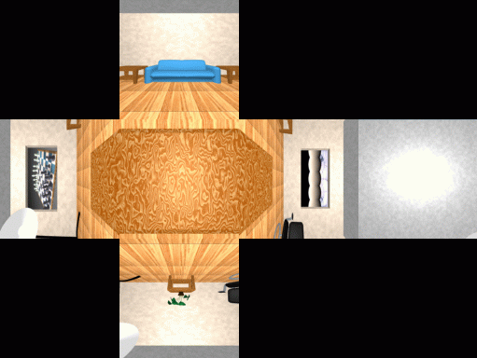
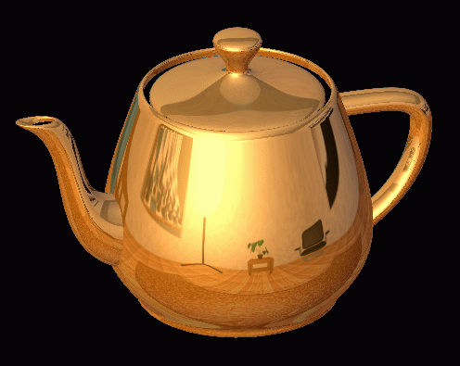
Cube map
Use a cube - 6 faces.
Create texture by rendering 6 views of environment model or use panoramic imagery.

Slide 15
Using a Cube map
Align cube center with scene center
Transform each Eye reflection vector R (image space) back to world space find Max component : that indicates which face of cube it would intersect
Compute intersection of R with cube face (from origin along reflection direction)
Scale R so that the Max component equals a fixed value (1.0)
Remaining R components are scaled indices into environment texture image [0, 1]
Other mappings are also possible, latitude/longitude, spherical, etc...
Convert into cylindrical coords to use 360 degree panoramic images as textures
  phi, angle in horizontal plane = tan⁻¹(z/x)
  y = y

Slide 16
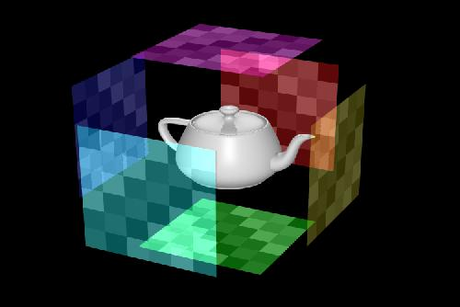
Geometry of Environment Mapping
This instance shows Max component Y = +1 Scaled R = (x, 1, z)
Reflection ray R
Is scaled so Max component = +/- 1.0
The x, z values (scaled) are used to index the texture-pixel in the image
Reflection ray R
Move all Reflection ray tails to center of cube (origin) whose extent is +/- 1.0 in x,y,z
Surface Normal N
Surface Normal N
y
z
x
View of cube with +Z into image.
Origin at cube center
Eye ray E
Eye ray E

Slide 17
Environment Map Problems
Wide variation of surface curvatures create wide variation of sampling positions and scale factors
  projected pixel positions and areas of texture
Sampling problems can occur in all texturing (mapping) process
High curvature (teapot handle) means that neighboring pixels may reflect widely spaced environment map texels

Slide 18
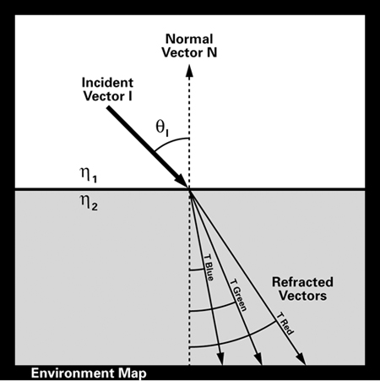
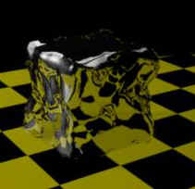
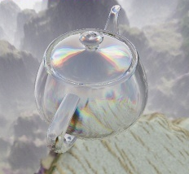
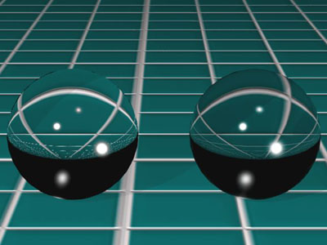
Refraction Maps
Environment map for refraction
  Use Snell’s law to compute refraction vector for index into environment map
  Color aberration simulated with f(λ) refraction angle for multiple colors bands

Slide 19
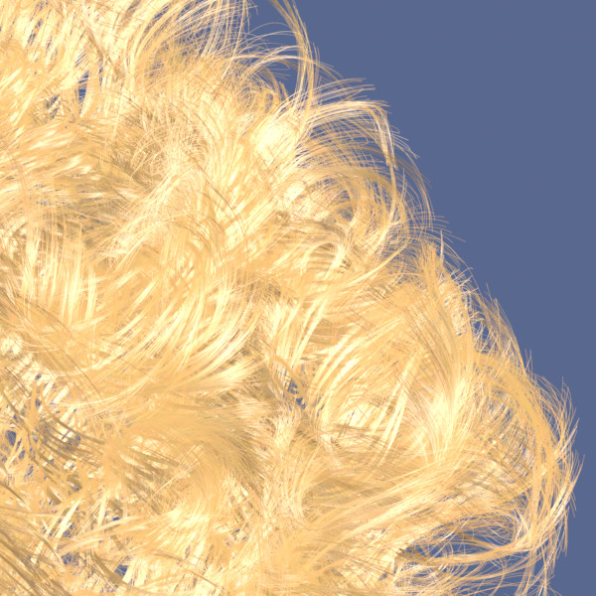
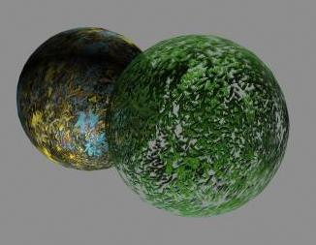
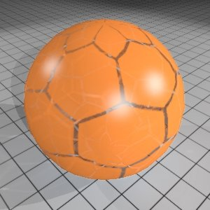
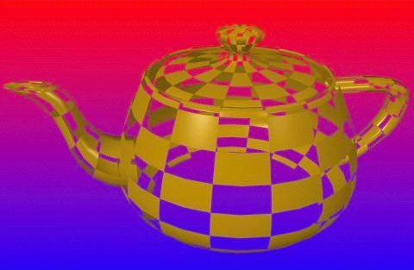
Opacity Maps
Texture controls opacity of surface
(or volume …
more about this after HW6)

Slide 20
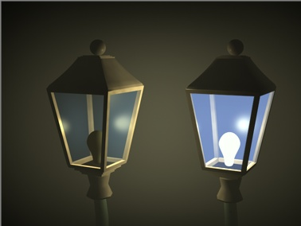
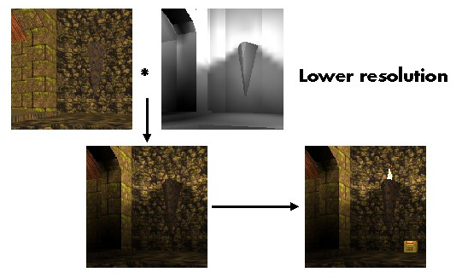
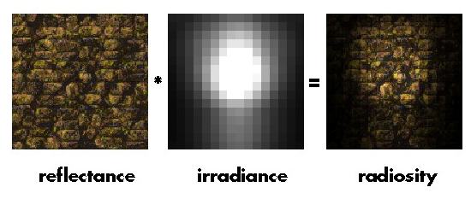
Illumination Maps
Texture can represent or simulate illumination sources and effects
  Simple source intensity variations and shadows

Slide 21
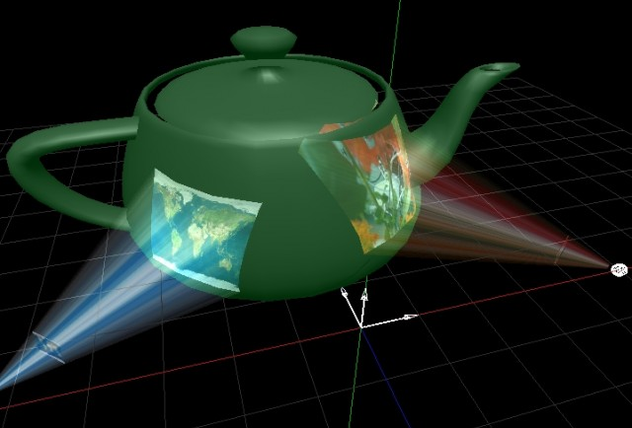
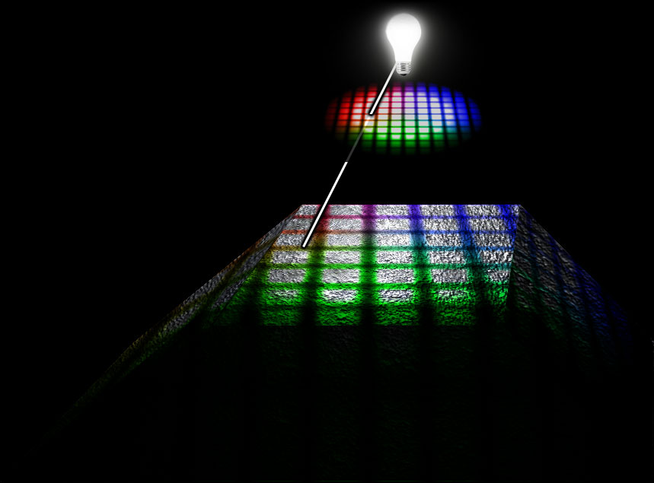
Projected Textures
From each scene point compute vector to projector focal point and determine intersection with projector image plane
  Fig (left) uses transparent lines to simulate light-rays

Slide 22
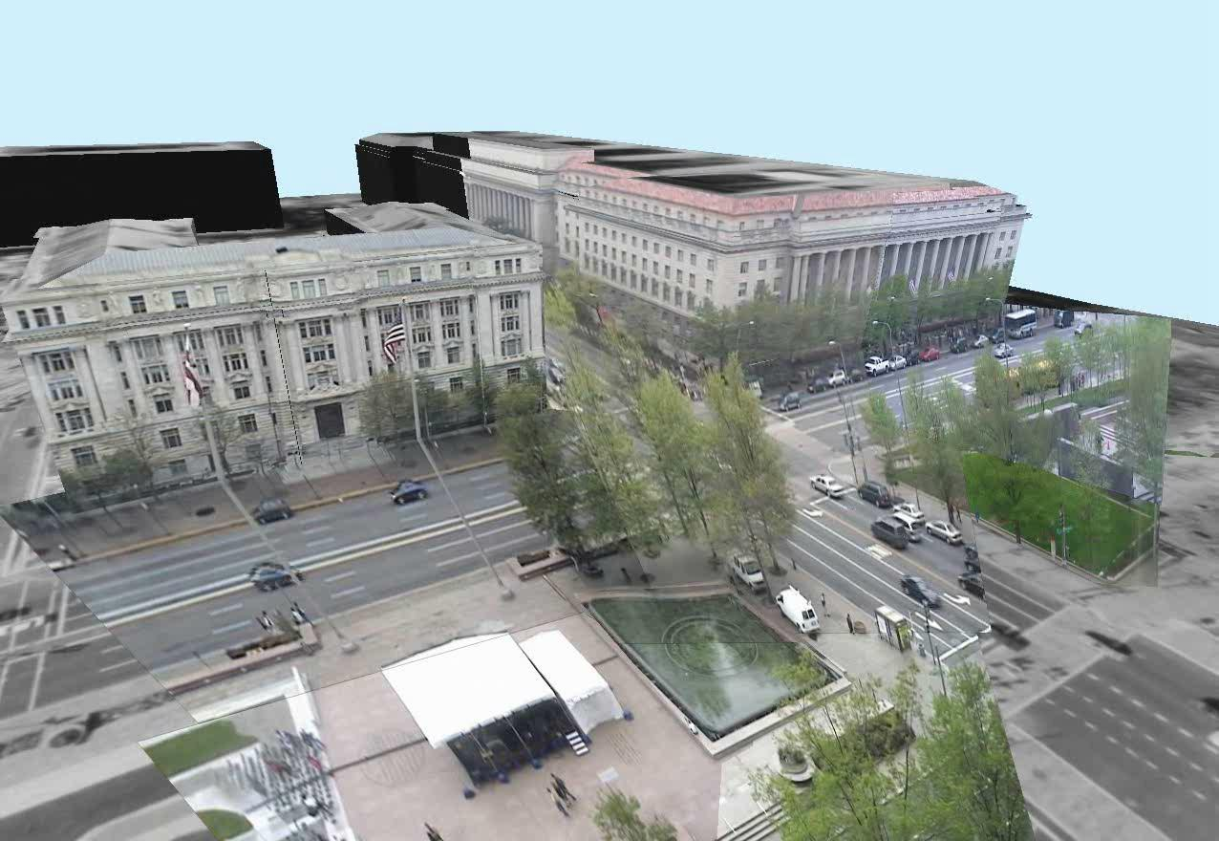
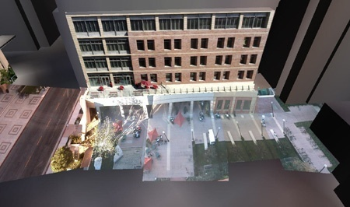
Projected Video Texture
Embed real-time video into accurate 3D models
Real-time virtual view visualizations

Slide 23
Summary of control at various levels of detail
 | Geometry (X,Y,Z) | Surface Properties (colors, norms) | Lighting & Shading
Global | Placement or physical interaction | Micro-facet displacement maps | Area light sources, global illumination (radiosity, environment maps)
Model - poly | point samples at vert coords (planar surface continuity) | per-model, per-poly (no continuity of norms) | per-model or poly lighting / uniform color (no shading)
Vertex - pixel | patches (higher-order surface continuity >C0) | per-vertex or node (C0 continuity of norms) | per-vertex lighting / color interpolation (continuity and radial symmetry)
pixel | displacement/cut texture dx,dy,dz (function, image) | Textured surface parameters Ka,Kd,Ks,s,a,N | per-pixel lighting with interpolated or textured N (Phong, bump-maps,…)
Pixel-sub-pixel BRDF | Micro-facet displacement maps | BRDF model /texture (No radial symmetry assumed in BRDF(λ,η,α,β) | BRDF volume or surface lighting evaluation (No radial symmetry)

