Slide 1
Shading Observations and Related Topics
CS580
Computer Graphics Rendering
Ulrich Neumann

Slide 2
Observations
Highlights usually affect only a small portion of model surface
  Classic problem for adaptive methods
    Cho'94 580 project
  For mobile platforms, web graphics, or games the specular term is disabled for efficiency and to hide coarse model tessellation
  A subset of Gouraud (color interpolation) shading that only computes ambient and diffuse terms – a subset of the shading equation

Slide 3
Non-Uniform Scaling
All transforms for our HW contain only R, T, S – where S is a uniform scale applied equally to all dimensions
If we allow non-uniform scale factors, we have to solve a problem that arises with the scaling of Normals
For example – consider a non-uniform scale of 0.5 in X :
………
A non-uniform scaling alters the relationship between the surface orientation and the Normal vector
This occurs if we use the same matrix M for transforming the Normals that is used for transforming the vertex coordinates
We can fix this by using a different transformation Q = f(M) for transforming the Normals
N
N’
X - axis
0,0,0
0,0,0

Slide 4
Q for Non-Uniform Scaling
N
Take any point P in a plane and the plane norm N
  <N•P> = 0 (P plane includes the origin)
N and P written as column vectors
  N = (A, B, C)^{T}, P = (x, y, z)^{T}
N^{T} P = 0 is the matrix-product form of the dot product above
If we transform the point P by M (any rotation or scaling transform), then we need to find Q so that (QN)^{T} (MP) = 0
  N^{T} Q^{T} M P = 0, since (AB)^{T} = B^{T} A^{T}
  If Q^{T} M = K I, the above eq is satisfied (K can be any constant)
  Let's pick K = 1, then Q^{T} = M⁻¹ or Q = (M⁻¹)^{T}
Transform Norms by: Q = transposed-inverse of Xim = (Xim⁻¹)^{T}
  Build the transformation stack so that: Xn = (Xim⁻¹)^{T}
  For HW4, Xim has uniform scaling, so after removing translation:
  Xim = Q = (Xim⁻¹)^{T}
  If Xim has non-uniform scaling, we must compute Q on Xn stack
  If we compute Q = (M⁻¹)^{T} for each M pushed on the Xim transform stack, the resulting Xn stack has Q and therefore allows non-uniform scaling
P
0,0,0

Slide 5
Concatenated Xn Transformation
So, the transposed-inverse of the Xim transformation will produce the correct transformation of the normal
However, we should verify:
  If we push multiple transposed-inverse transformations Q on Xn do we get the correct transposed-inverse on the stack?
First we push A, then we push B:
  ((A B) ⁻¹) ^{T} = ((B⁻¹ A⁻¹)^{T} = (A⁻¹)^{T} (B⁻¹)^{T}
So, yes, if we push the transposed-inverse of A and B, we get the transposed-inverse of AB (concatenated)
*** Reminder: For a unitary rotation matrix, the inverse transpose is itself. There is no need or point in computing Q for HW4 since we limit Xim to uniform scaling. Translation and Scale are removed to leave only pure rotations for Xn.

Slide 6
Option: Model Space lighting (MSL)
In this case, we need to transform L and E back to model space using inverse transforms
Since lights could be in world or image space, we may need two inverses
For HW4 we have image-space lights so we can build and use Xn, but we need to invert it
If we ensure Xn is pure rotation R, the inverse is simply R⁻¹ = R^{T} and vector lengths are not affected by transform
Transform all image-space L vectors into model space each time the Xn matrix is changed so when triangles are passed into renderer, shading can be done in model space
Eye/camera direction is known in image space (0,0,-1), it also must also be transformed into model space each time the Xn matrix is changed

Slide 7
Orthonormal Rotation Matrix
Matrix Normalization is needed to keep scaling uniform and remove shears during sequence of incremental rotations from GUI manipulations or animation script
  not a HW issue – but needed when 100’s of sequential transformations are done (interactive apps)
Gram–Schmidt Orthogonalization process uses matrix rows r1, r2, r3, (or cols) to form orthogonal basis R1, R2, R3. Normalize R1, R2, R3 to yield an orthonormal or pure rotation transformation.
  R1 = r1
  R2 = r2 - R1 (r2•R1)/(R1•R1)
  R3 = r3 - R2 (r3•R2)/(R2•R2) - R1 (r3•R1)/(R1•R1)

Slide 8
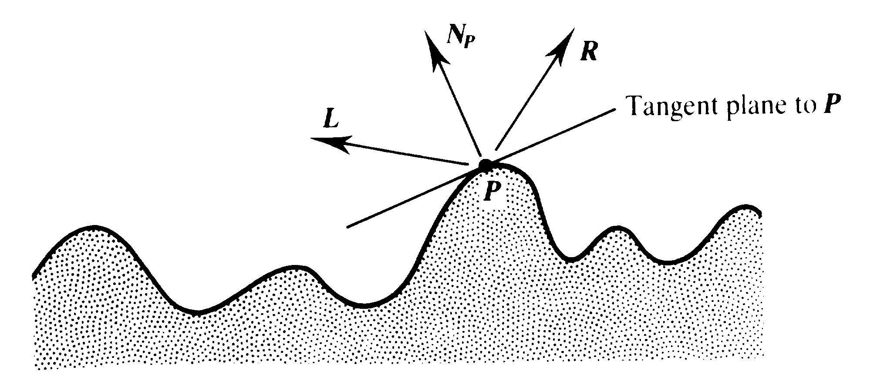
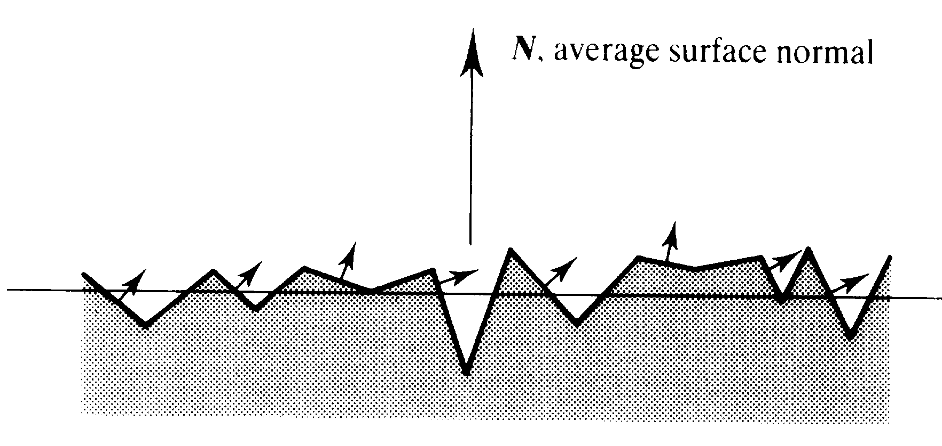
Shading Physics
Many materials are not really smooth or uniform at microscopic scale
  Small-scale N variations are averaged over macro-scale area
The surface structure impacts light reflection in ways that are not captured in our simple reflectance function
  Specular intensity changes with incident angle
  Highlight color changes with incident angle due to diffraction effects at varied wavelengths

Slide 9
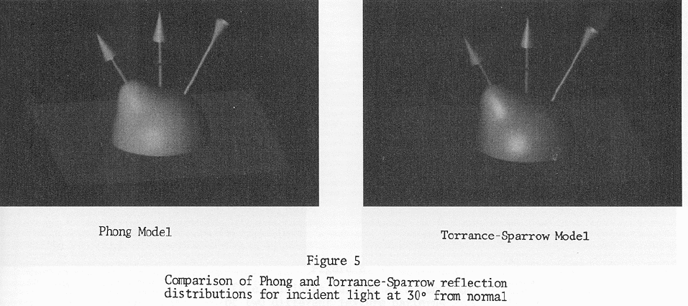
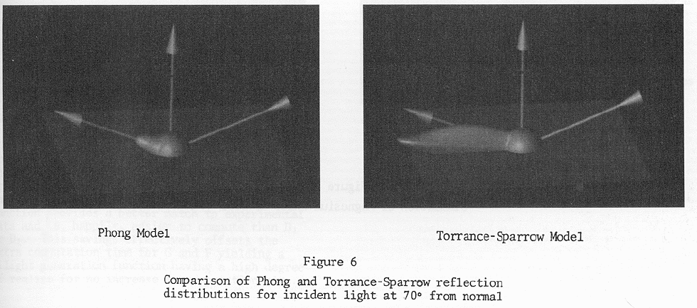
Other Shading Models
There are other models of illumination that approximate various reflectance effects
Torrance Sparrow (1966) model
  based on microfacet distribution
  (FvD chapt. 16)
  Increased specular reflectance at grazing angles

Slide 10
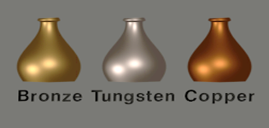
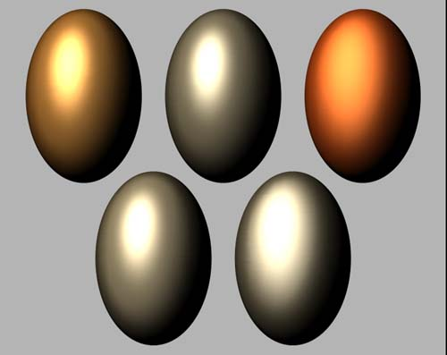
Other Shading Models (2)
Cook Torrance (~1978) models
  Color shift of specular reflections at gazing angles (see yellow outlined areas)
  Color at grazing angles becomes light source color
  Metals (and most natural materials) show similar diffuse and specular color (Kd, Ks) at nominal angles
  Plastics have different Kd, Ks at nominal angles (Ks is often just white)

Slide 11
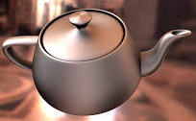
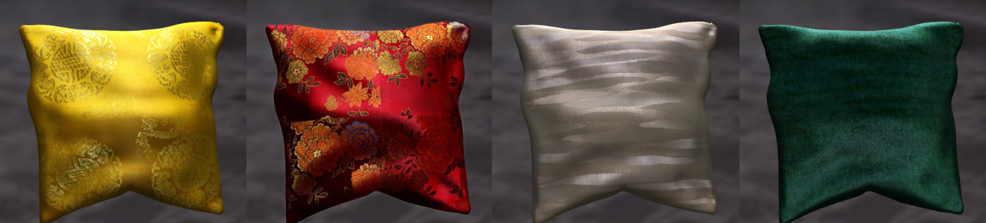
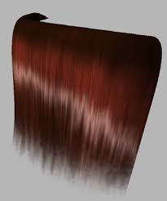
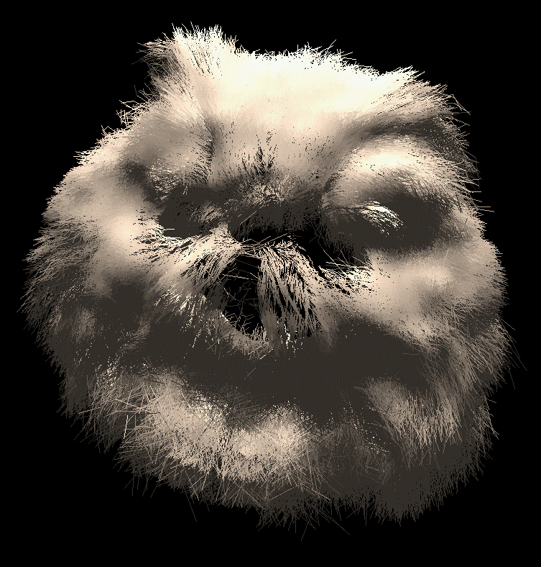
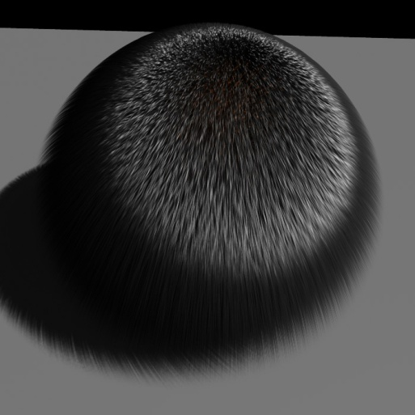

Other Shading Models (3)
Kajiya (1985) modeled anisotropic shading based on Cook Torrance model
  Reflectivity (K) is not symmetric about the surface normal
  Directional shading is needed for brushed metal, cloth, hair, etc.
  Surface normal and tangent define surface orientation (grain-direction)
  Cross product produces "binormal" to create local coordinate frame at all surface points

Slide 12
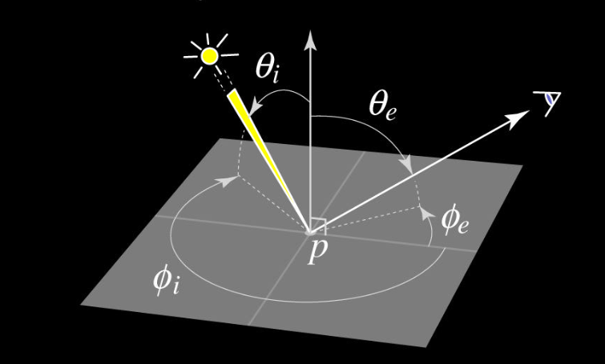
BRDF Definition
General case of reflectance ratio ρ at a point p is defined by:
Bi-direction Reflectance Distribution Function (BRDF)
ρ(p) = f(λ, φ_{i}, θ _{i}, φ _{e}, θ _{e})
5D function of:
  Wavelength λ and Light and Eye directions (each 2D angles)

Slide 13
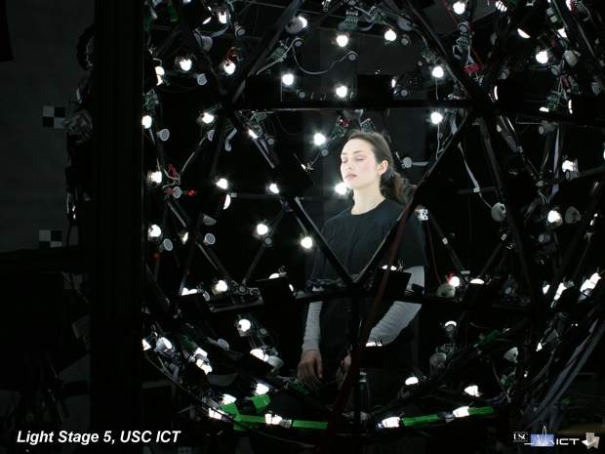
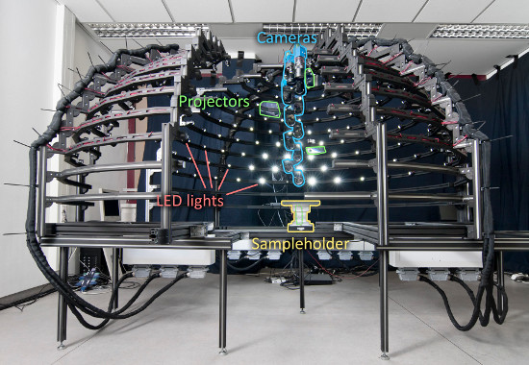
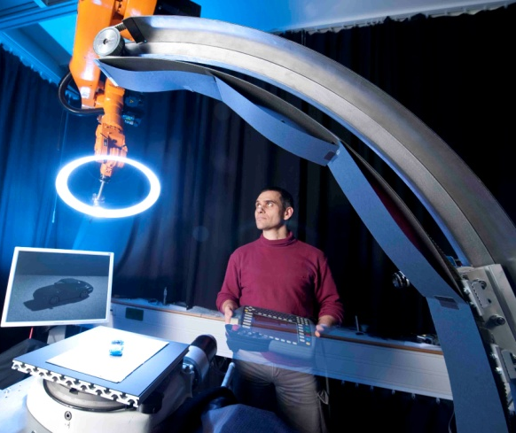
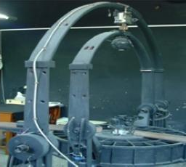
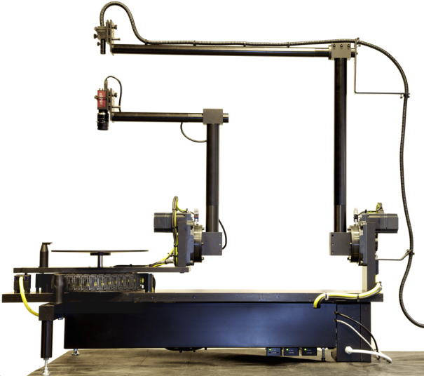
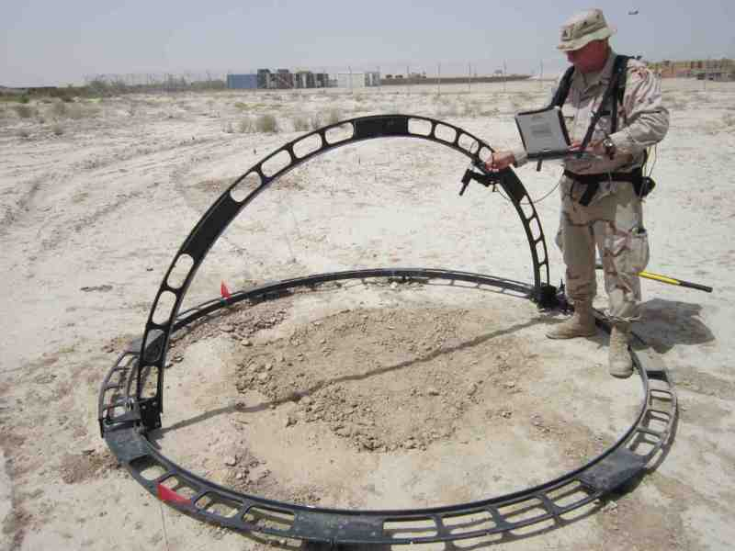
BRDF Measures
5D reflectance function is measured with special instruments called a goniometer, or a light stage, or similar …

Slide 14
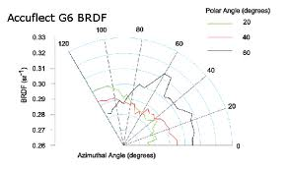
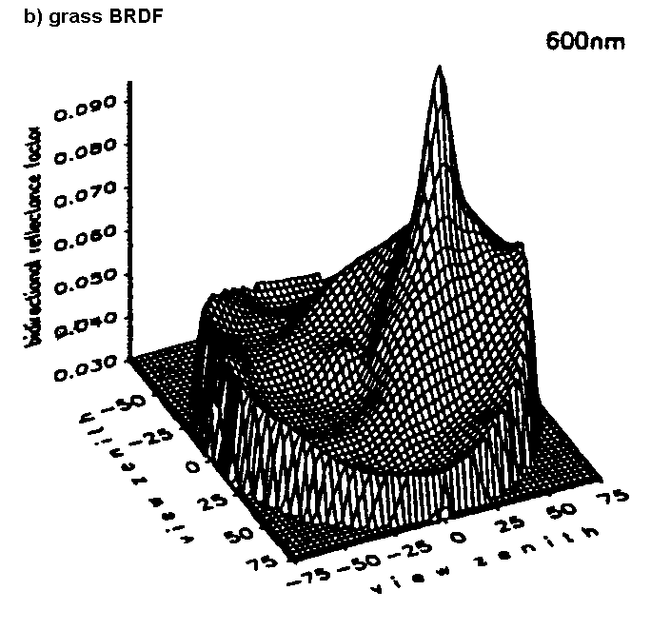
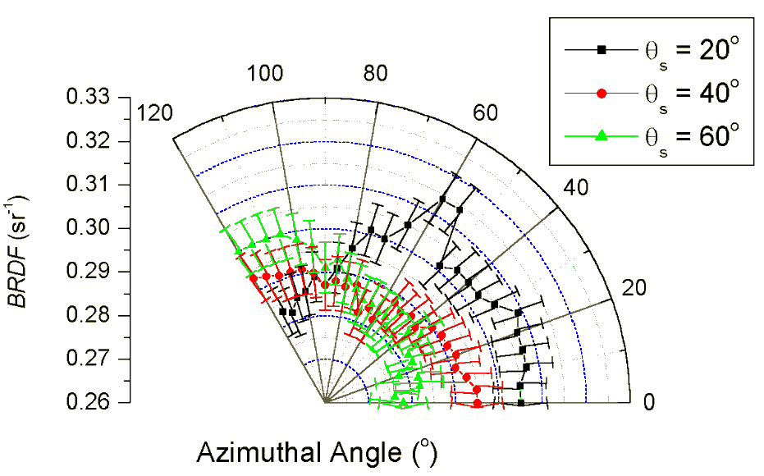
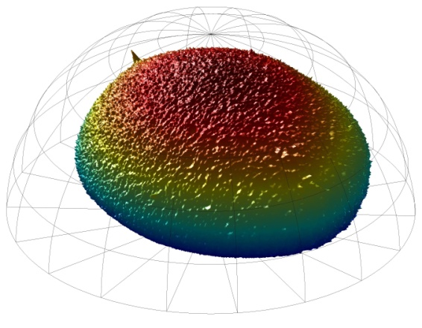
BRDF Representations
Approximate BRDFs with coefficients of basis functions
(spherical harmonics) or look up tables (LUTs)
Note: texture-maps are LUTs
structured for fast calculations
during the shading process

Slide 15
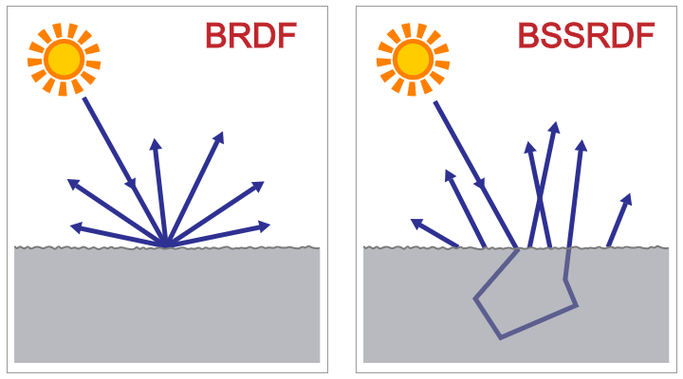
Semi-Local Shading
SSS = Subsurface Scattering
Bi-Directional Scattering-Surface
Reflectance Distribution Function
A Practical Model for Subsurface Light Transport
  Henrik Wann Jensen, Stephen R. Marschner, Marc Levoy, Pat Hanrahan, Stanford University
  Siggraph 2001
A “local” volume
phenomena
Many incoming rays
interact with the
surface to impact a
single outgoing ray
E
E

Slide 16
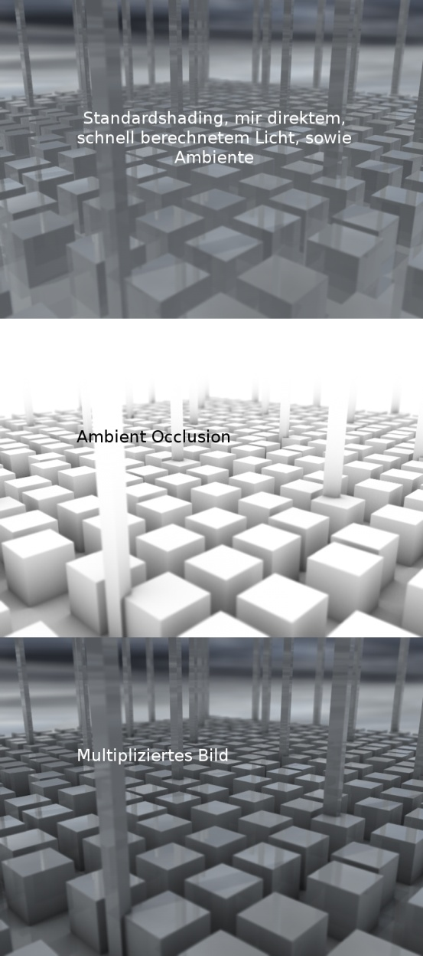
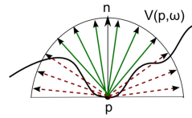
Simi-Local Shading
AO = Ambient Occlusion
Local geometry impacts how much ambient light reaches a surface point
Estimate fraction of hemisphere that is open to ambient light at each shading calculation point
  Rays sample local geometry over a hemisphere
Nelson Max (1986) Shadows for
Bump-Mapped surfaces. In: Kunii TL (ed) Advanced Computer Graphics. Springer, Tokyo Berlin Heidelberg New York, pp 145–156

Slide 17
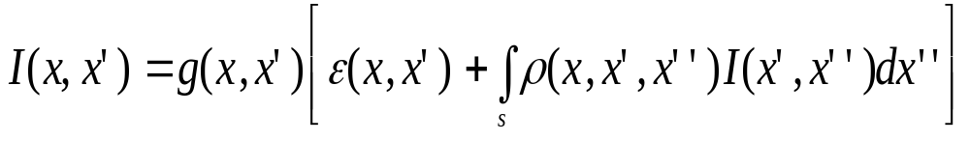
The General Rendering Equation
A generalization is presented as a "rendering equation" by Kajiya (1986)
x, x', x'' are points in environment (set x as camera focal point, for example)
I(x,x') is radiance of all light reflected from x' to x.
g(x,x') is geometry term that models occlusion between x' and x (0 or 1/r²)
ε(x,x') is radiance of light emitted from x' to x (light sourced at x')
Integral is taken over all environment points x'' of light heading to point x' and reflecting to x.
I(x',x'') is radiance of light from x'' to x'.
ρ(x, x', x'') is surface reflectivity function (BRDF) of surface point x', given x and x'' – also has to include light transmission if x' is translucent material.
Solving this for any case depends on what we set constant, what we ignore, and what functions we use to model/approximate real physical behaviors.

