Slide 1
Transformations
CS580
(Computer Graphics Rendering)
Ulrich Neumann

Slide 2
Transformations
Linear transformations (Xforms) define a mapping of coordinates (coords) in one coordinate frame to another
  the mappings are 1:1 and invertible
V_{b} = X_{ba} V_{a}
  homogeneous vectors (V) are 4x1 columns (x,y,z,w)^{T}
  homogeneous transforms (X) are 4x4 matricies
  Projection of 4D points into a subspace (w = 1) yields Euclidean 3-space values (examples shown later)
General Xforms can be decomposed into scale, translate, rotate, shear, reflection, …
View Xforms in graphics are a subset based on S T R
  Scale, Translate, Rotate
    we do not allow shears and other
    non-shape-preserving transforms

Slide 3
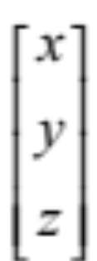
Basic Types
Scalars: s
3D Points:
3D Direction vectors:

Slide 4
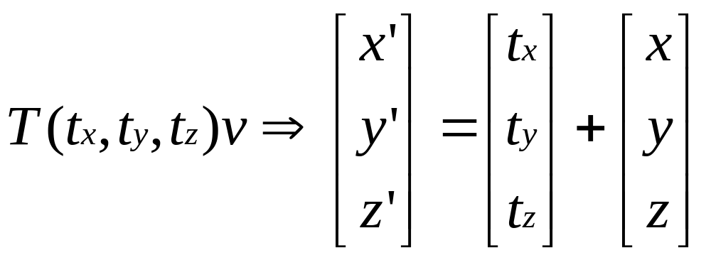
3D Translations
Translations occur along the axes of the space
Axis directions are preserved, but origin changes
Translation is vector addition

Slide 5





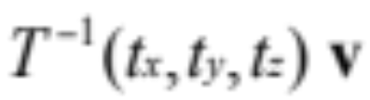

Properties of Translations
=
=
=
=

Slide 6


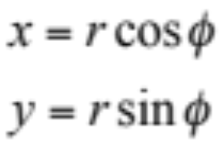

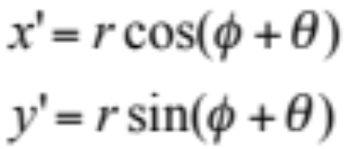



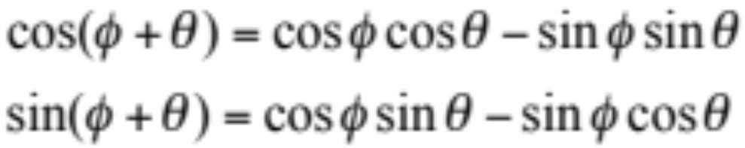
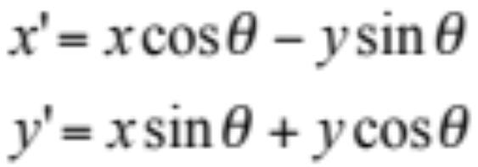
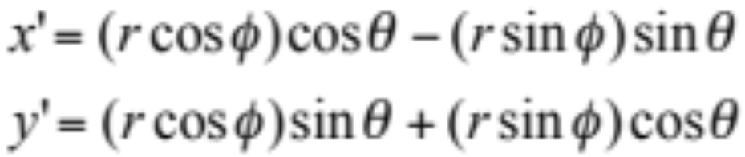
Rotations (2D)
x
y
rotation of point about origin
by angle theta

Slide 7
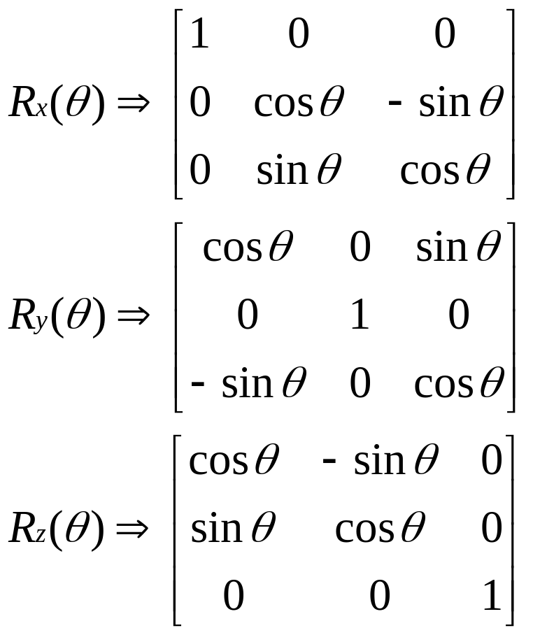
3D Rotations about Axes
Rotations occur about the origin of the space
The origin does not change (fixed-point), but the axis directions do
The input axes prior to rotation (e.g., (1,0,0) … ) become non-axis vectors

Slide 8
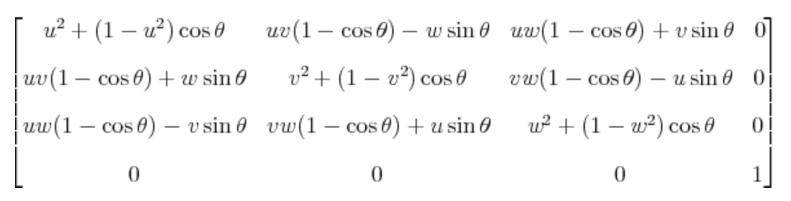
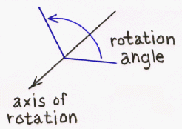
3D General Rotation
This matrix rotates the point (x,y,z) about the vector ⟨u,v,w⟩ by the angle θ, under the assumption that ⟨u,v,w⟩ is a unit vector; i.e., that u² + v² + w² = 1
http://inside.mines.edu/~gmurray/ArbitraryAxisRotation/

Slide 9
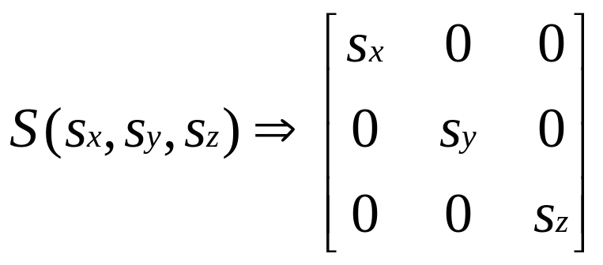
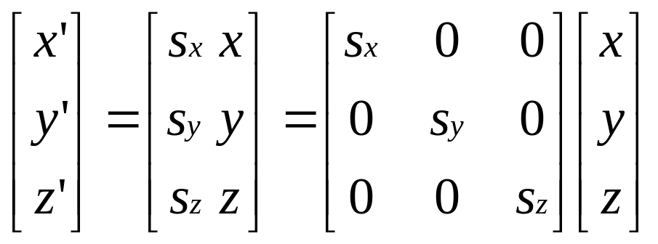

3D Scaling
Scaling occurs about the origin of the space
The origin does not change (fixed-point)
The axis directions do not change (preserves axes)
Distances between points change
Uniform scaling iff

Slide 10
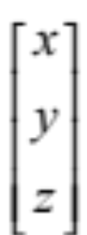
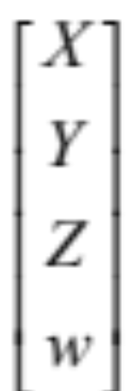
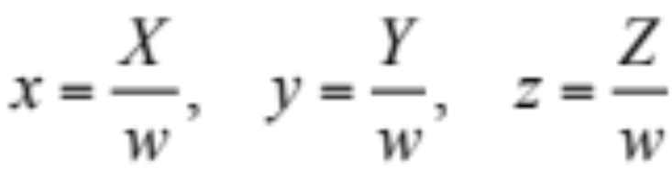
4D Homogeneous Coordinates
can be represented as
where
A 3D coord (x,y,z) is represented by an infinite locus of 4D coords of varying w
The projection of 4D coords to manifold w=1 is the 3D coord system
Projection of 4D coord is done by scaling about the origin (0,0,0,0) with a divide by w
(x,y,z) <==> (x,y,z,1) <==> (X/w, Y/w, Z/w, w/w) <==> (X, Y, Z, w)

Slide 11
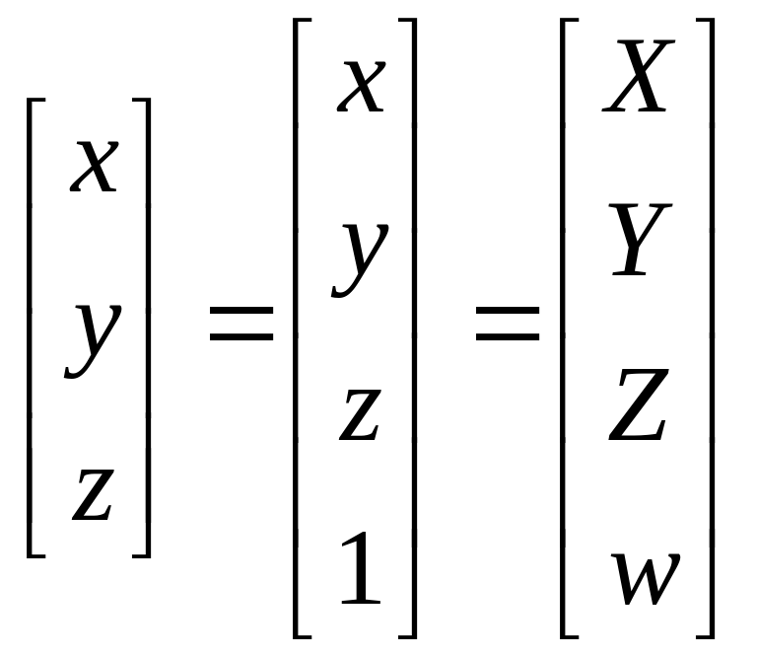
4D to 3D Conversions
Convert 3D to 4D by adding a w=1 term
Convert 4D to 3D by dividing all terms by w

Slide 12
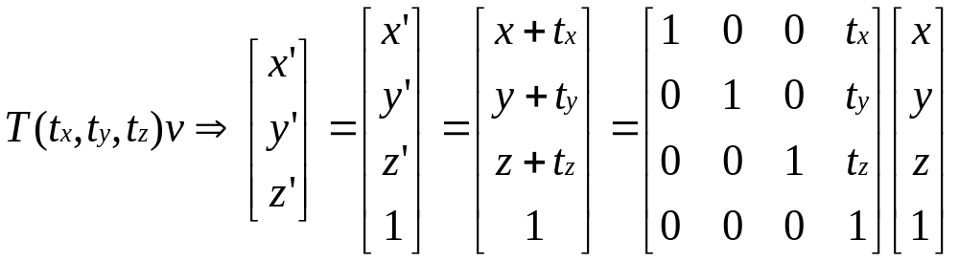
4D Translation homogeneous transformation

Slide 13
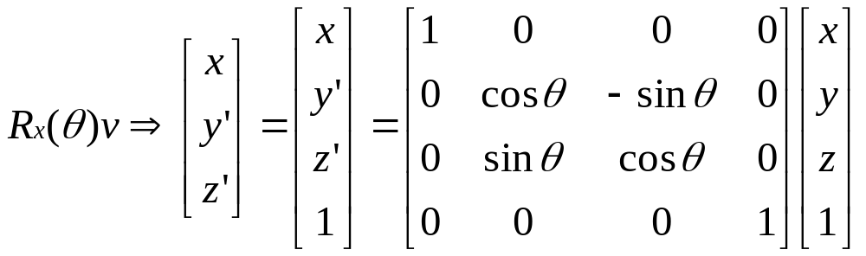
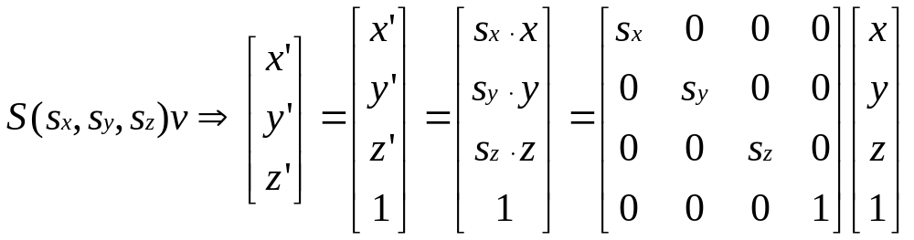
4D Rotation & Scaling homogeneous transformation
The term along the axes of rotation is unchanged (x in this case)
We will always assume Sx = Sy = Sz uniform scaling,
unless clearly noted otherwise

Slide 14
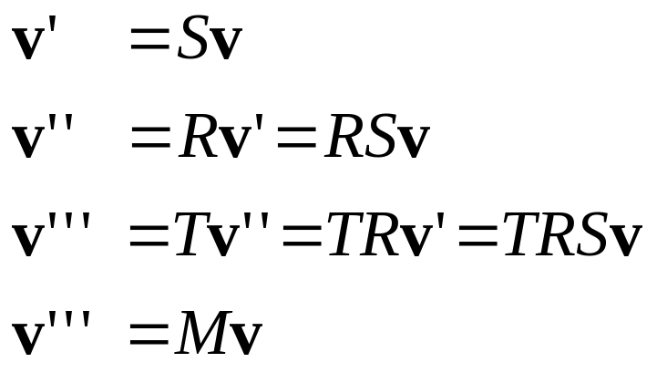

Combining Transformations
where
The result of a sequence of transformations [T] [R] [S] v
is the same as the result of a single transformation [M] v
where M is the concatenated (or combined) transform M = [T] [R] [S]

Slide 15
Scale and Rotation Combined
Xad = Xab Xbc Xcd
  chain any S,R,T matrices to arbitrary length
  fully associative (combine any adjacent xforms)
X = S R = R S (commutative property is for S,R only)
  rotation and scaling commute - neither change origin
    assume uniform scaling in all dimensions
  translations do not commute with R or S
    due to change of origin (fixed-point)
Start with v…
apply SR or RS
to arrive at the
same result
v
R
Origin
RSv = SRv
S

Slide 16
Translation
Translations do not commute with R or S
TR ≠ RT TS ≠ ST
TRv
RTv
TSv
v
STv
v
Origin
Origin

Slide 17
Rotation and Translation Combined
A 4x4 matrix combining rotation and translation X_{ab} = T R
  Rotation about origin in space-b occurs first
  Then, translation using axis of space-a is applied
X_{ab} = =
A different transformation (and matrix) is obtained if we reorder the operations as: X_{ab} = R T
  The translation occurs first, shifting the origin along the axes in space-b
  The rotation follows about the new origin and axes of space-b
(Note that R can also contain a scale xform S, but RS=SR so they commute)
cos ø 0 sin ø xt
0 1 0 yt
-sin ø 0 cos ø zt
0 0 0 1
1 0 0 xt
0 1 0 yt
0 0 1 zt
0 0 0 1
cos ø 0 sin ø 0
0 1 0 0
-sin ø 0 cos ø 0
0 0 0 1

Slide 18
Decomposing Transformations
Given a 4x4 view/projection matrix - we can decompose it into T R S or T S R (assume S is uniform scaling)
  T is upper three elements of right column
  M is 3x3 in upper left corner and M = R S or S R
    R is normalized M so all ||columns|| and ||rows|| = 1
    S is built from the scale factor used for normalization
M=RS
T
a b c xt
d e f yt
g h i zt
0 0 0 1

Slide 19
Normalizing R
R is normalized M so all ||columns|| and ||rows|| = 1
S is built from scale factor used for normalization
Compute any row or col magnitude of M as scale factor
K = ||M_{row}|| = (a² + b² + c²)^{1/2} (a,b,c, are top row of M, for example)
divide all elements of 3x3 M by K : R = (M)/K
R is a normalized (unitary or “pure”) 3x3 rotation matrix
S is a 3x3 diagonal matrix with elements = K : the scale factor extracted from M
a b c xt
d e f yt
g h i zt
0 0 0 1
M=RS

Slide 20
Inverse Transformations
Given [Rac], its inverse [Rca] = [Rac]⁻¹ = [Rac] ^{t}
  transpose = inverse for unitary (pure) rotation
  transpose 3x3 elements of rotation matrix
    row and col vectors are orthogonal (row•col = 0)
    ||row|| = ||col|| = 1
Given [Tac], its inverse [Tca] = [Tac]⁻¹ = [-Tac]
  negate 3 elements of translation matrix
Given [Sac], its inverse [Sca] = [Sac]⁻¹ = [1/Sac]
  replace 3 diagonal elements with their reciprocals
Given [Xac] = T S R
  build the inverse : [Xac]⁻¹ = R⁻¹ S⁻¹ T⁻¹
  it must be the inverse because:
    I = [Xac]⁻¹ [Xac] = [R⁻¹ S⁻¹ T⁻¹] [T S R]

Slide 21
Perspective Projection
Perspective projection of (0,Y,Z) onto the Z=0 plane occurs at point a=(0,y,0)
Camera focal point is at z = -d (0,0,-d)
Use similar triangles ratio to compute y-coord at point a
y/d = Y/(Z+d)
y = Yd/(Z+d) = Y/[(Z/d)+1]
Do the same for X and Y coords to find a projected point (x,y,0) on the image plane x=X/[(Z/d)+1] y=Y/[(Z/d)+1]
y-axis within Z=0 plane
0,Y,Z
a
z= -d
z-axis

Slide 22
Projection Transformation
X, Y, and Z are projected by a 4D transformation
[ X, Y, Z, (Z/d)+1 ] =
Divide by w = (Z/d)+1 to
get projected point [x, y, z] =
  Note : screen-space 3D coords require divide after perspective transformation (divide by w = (Z/d)+1)
  Note: other projection formulations are also used
    e.g., view point is z=0, and image plane at z=d
    Geometry and results are the same for any coordinate system
1 0 0 0
0 1 0 0
0 0 1 0
0 0 1/d 1
X
Y
Z
1
X
(Z/d)+1
Y
(Z/d)+1
Z
(Z/d)+1
, ,

Slide 23
Interpolating Z-Projections
Z= 0
Point B is the mid-point between edge points A and C
  The projection b is not at the mid-point of projected points a and c on the image plane (Z=0)
  Linear interpolation of Z values from a (Z=21) to c (Z=1) would produce Z=11 at point b, not at point b
  Interpolated point b would have Z>11, which is incorrect for a z buffer test at that pixel (e.g., the small square vertex)
For interpolation of Z during rasterization, we must do the perspective transformation of Z onto the Z = 0 plane and interpolate the transformed z-values z = Z/[(Z/d)+1]
a
bc
Z= -d
Z=1 Z=11 Z=21
C B A

Slide 24
Z - Interpolation Example
Setup known geometry (green edge in x=0 plane) with d = 1
A = (0, -h, 0) B = (0, 2h, 3) Affine
a = (0, -h, 0) b = (0, 2h/4, 3/4) = (0, h/2, 3/4) Perspective
Z_{M} = d = 1 z_{m} = ½ from z = Z/(Z/d)+1 Z and z for pt M on edge
Interp (z_{a}, z_{b}) = ½ at zm correct z from interpolation
Interp (Z_{a}, Z_{b}) = 2 at Zm incorrect z from interpolation
B
Y
2h
b
m
1
2
3
Z
d = 1
M
h
a
A

Slide 25
Examine projected value of z = Z/(Z/d+1)
For Z=0 (points in view plane): X=x, Y=y, z=0
  Points in view plane (Z=0) project to themselves
For Z=-d, z = -∞ (at Z of the focal point)
  FP exceptions (singularity) occur with Z = -d !
  Implement a clip (cull) plane at Z = 0 to discard any tri with a negative Z value at any vertex --- test Z before divide by w
For large Z (∞ distance), perspective z --> d
  Asymptotic curve of Z vs. z approaches d and causes resolution problems for points at high values of Z
  different Z values map to the same z
See Graphics Hardware Workshop
1998 - 2002 for
"Optimal Depth Buffer” or
“Low-Cost Graphics Hardware"
papers
z
d
Z

