Slide 1
Illumination and Shading
CS580
(Computer Graphics Rendering)
Ulrich Neumann

Slide 2
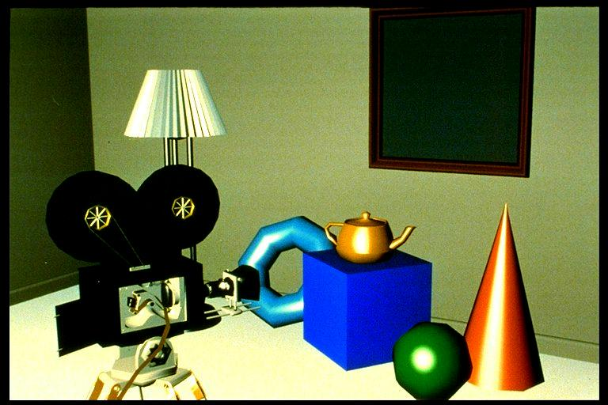
Illumination and shading
Illumination (lighting) and shading
  models simulation of light interactions with scene
  light sources, geometry, propagation, interaction with surfaces, imaging process in camera

Slide 3
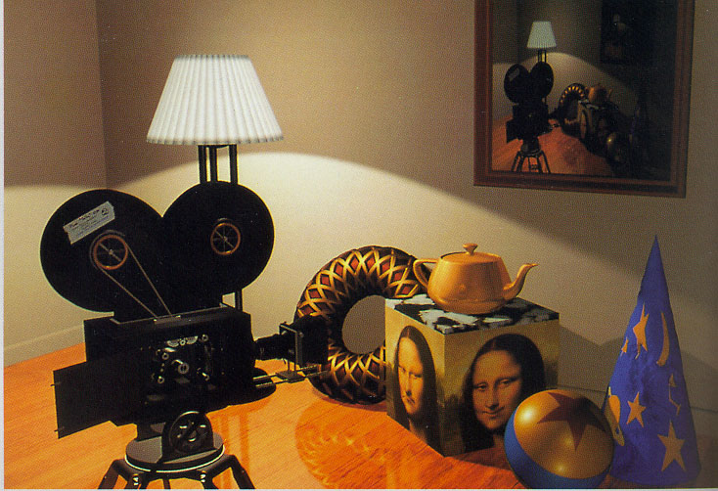
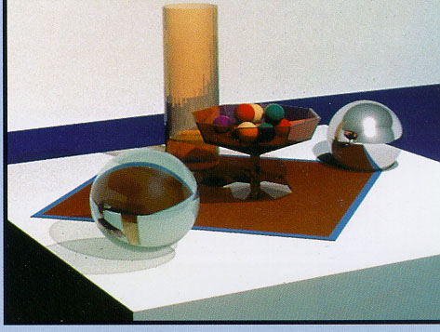
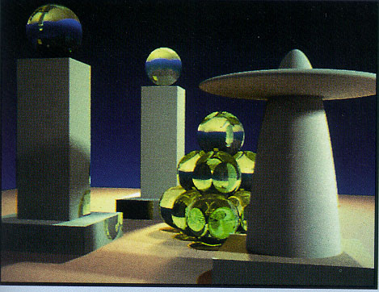
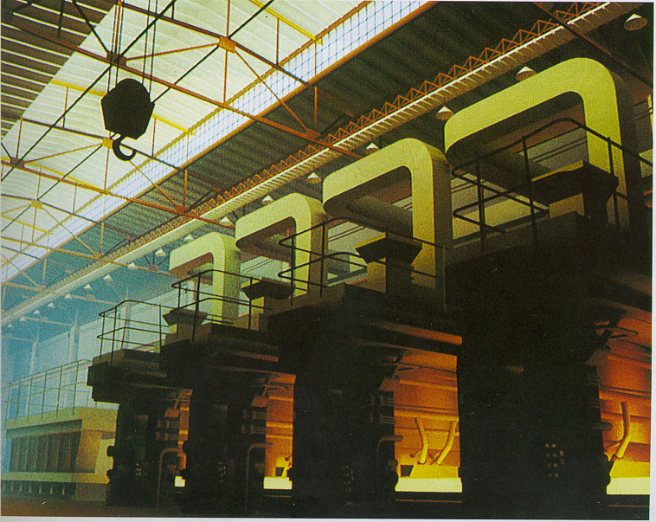
Shading Examples
Images courtesy of Watt, Watt & Watt, and Foley & van Dam

Slide 4


Global versus Local Illumination
Direct
Illumination
Indirect Illumination

Slide 5
Global versus Local Illumination
Global Illumination
  Models indirect illumination and occlusions
    Reflection
    Refraction
    Shadows
Local Illumination
  Only models
  direct illumination
    No reflection
    No refraction
    No shadows

Slide 6
Global versus Local Illumination
Shadows are based on light visibility.
Inter-reflections are based on reflection path.
Every pixel color is a function of entire scene.
Local Illumination
Local illumination is a simplified model in that every pixel color is only a function of parameters at that one surface point.
Global Illumination

Slide 7
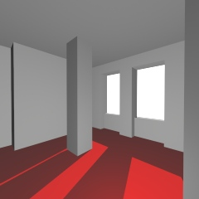
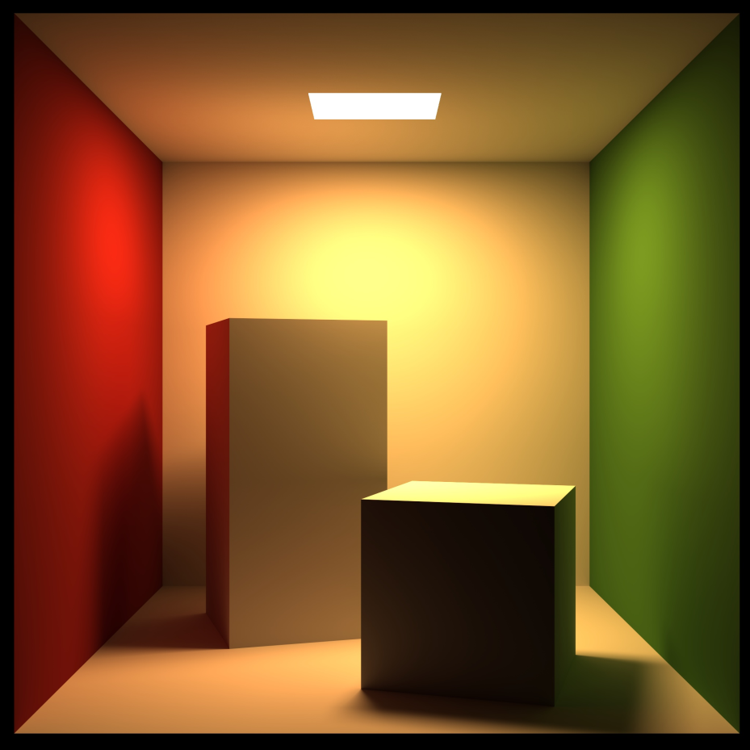
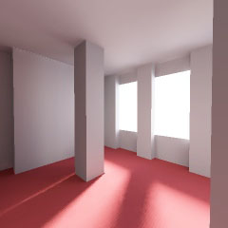
Fidelity of Global Illumination
Simple shadows result from binary light visibility tests
Light diffusion produces soft shadows
Global illumination effects are modeled with varying degrees of fidelity. Algorithms produce simple or complex diffusion and shadow effects.

Slide 8
Light Terminology
Radiant Intensity (I = W/sr)
  Illuminating energy emitted by a light source
Irradiance or Illuminance (E = W/m² )
  Light energy falling on a surface area
Radiance or Luminance (L = W/m²/sr)
  Light energy reflected by a surface area

Slide 9


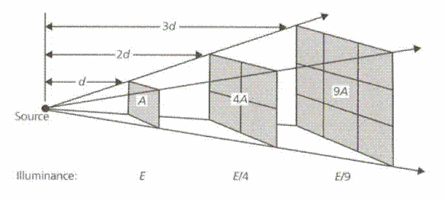
Light Source Radiant Intensity
Radiant Intensity per steradian
  Ie = power/sr (Watts/steradian)
  constant in vacuum at all distances
Ie is constant over distance for a
fixed solid angle
Solid angle
  sr = surface area (a) of portion of sphere divided by r²
    sr = a/r²
  Area of sphere surface = 4 pi r²
  sr = (4pi r²)/r² sr = 4pi steradians over sphere of any radius
E = Watt/m²
  Energy hitting a surface
  Radiance or Power Density
  diminishes with “square” of
  distance from source
Ie = Power over these areas

Slide 10
Light Color and Intensity
Ie is specified as coefficients of color spectrum or basis function (RGB, HSV...)
Ie = (R,G,B) | R,G,B ∈ [0,1]
  three color channels model colored light
    Based on human perception (next slide)
  arbitrary scale and units
    e.g., Ie = (0.1, 0.6, 0.9)
  “Color” of light is determined by the relative levels of RGB intensities
  “Brightness” is determined by aggregate or sum of RGB intensities

Slide 11
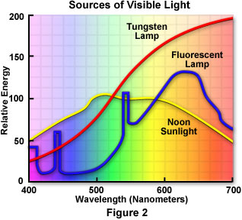
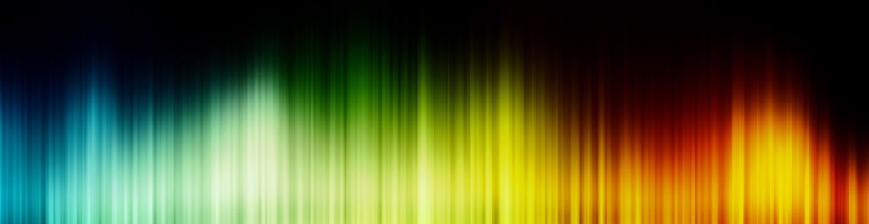
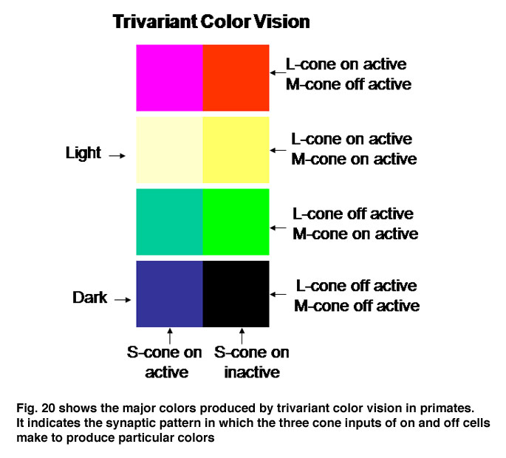
Color and Perception
Natural light has energy over a
continuous spectrum
We perceive “color”
based on energy
at different frequencies
  Energy vs freq histogram
Human eyes have 3 “cone”
sensors that have peaked
sensitivities over different
frequency ranges
  3 dimensions (trivariant)
  color perception

Slide 12
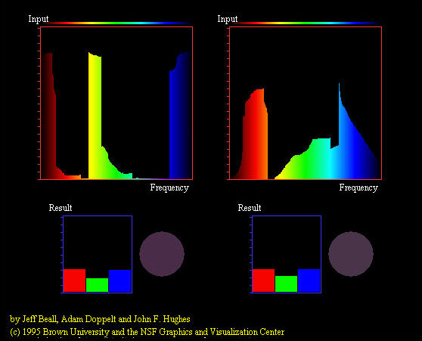
Color Metamers
Two different spectrums may look like the same color to us since we only sense the levels of three sensor ranges
  Differing spectrums that produce the same perceived color are called metamers
RGB color produces a range of perceived colors
that are metamers for
natural light spectrums
  What matters is that the three
  cone sensors produce the
  same brain signals
  Metamers are the basis for all
  display (and print) technologies
  that produce a range of colors
  from a mix of basis colors

Slide 13
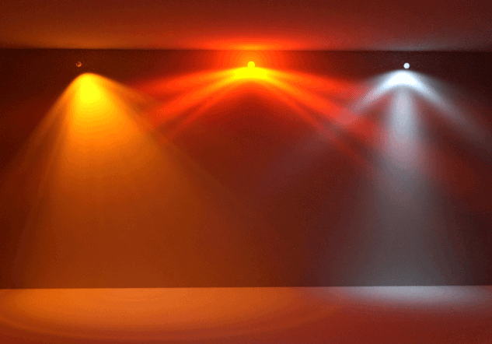
Modeling Light Source Geometry
Geometry parameters that affect illumination of a scene
  Size and shape
  Position and orientation
  Directional distribution
Ie = f(θ) Directional distribution of intensity can vary for a point-source or a region of an area light-source
  Occlusions in the light source structure also modify the intensity and distribution of light energy over different regions in the scene
A large-area source can be approximated
as multiple uniform-intensity regions that
each contribute independently to the scene
  Light is addative so complex sources can be
  decomposed into a sum of simpler sources
When the source and scene-areas are
small (relative to distance between souce and scene), incident intensity can be approximated as a uniform fixed-direction distribution
  a far-away source produces a uniform illumination over a scene

Slide 14
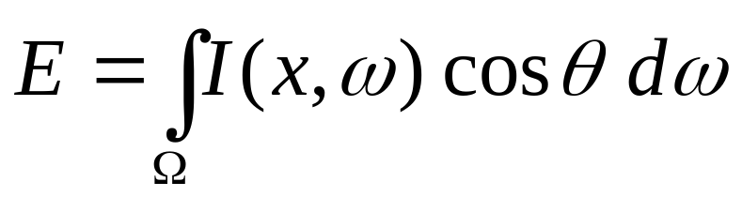
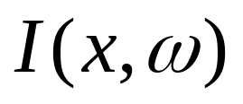
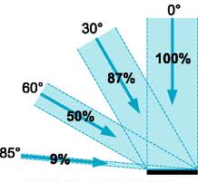


Irradiance
Irradiance E: Incident radiant energy per unit area
  Diminishes with the cosine of the incident angle
I(x, w) is the light intensity arriving from all directions and entering hemisphere Ω over unit surface area.

Slide 15
Simplified Lighting
The total irradiance E falling on some surface area of a scene requires integral of Ie function over visible hemisphere (prior slide)
  even fairly simple cases can be difficult to compute
For simplicity (for HW4) … assume distant point-light sources (e.g., sun, or light bulb in a large room)
  Source has uniform radial intensity distribution
  E = ~ constant within distances in scene - neglect distance falloff
    Solid angle per unit surface area is ~ constant everywhere
  Direction to source is constant within scene
This simple approximation of actual physics only requires two parameters to define a light
    direction (x,y,z) - vector from surface to light source
    intensity (r,g,b) of the light

Slide 16
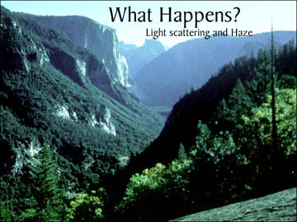
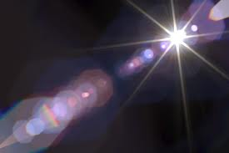
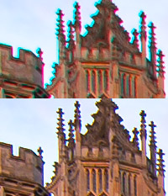
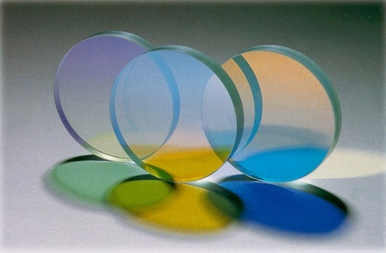
Propagation
Light interaction in medium or camera
  Atmosphere effect, lens effects
We use simple approximations
  vacuum – no haze, smoke, thermal shimmer
  opaque scene objects – no transparency
  ideal camera imaging – no lens flare, color
  aberration
FYI: Papers by Ron Henry (USC)
  Color Perception through Atmospheric Haze
These are global effects that require
more complex models of lighting,
shading, and cameras than
used for HWs

Slide 17
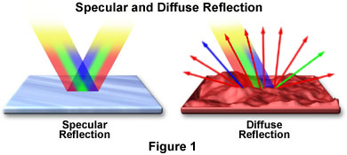
Interaction with opaque surfaces
Light hitting an opaque surface reflects a fraction of that light back into the environment.
  Two extremes are observed
  Mirrors – specular reflection
    Incoming ray reflects about
    the surface’s normal
    perfect mirror has no scattering – just perfect reflection
    color shift is possible by attenuation of RGB components
  Ideal white chalk – diffuse reflection
    Incoming ray scatters equally in all directions (ideal case)
    color shift is possible by attenuation of RGB components

Slide 18


Ideal Specular Reflection
Reflection occurs in the “mirror” direction
L is reflected about the normal vector (N) to create R
Ij = Ie Ks Reflected light is attenuated (colored) by Ks
Ks is RGB vector of “specular color” coefficients [0,1]
Ie
Ij
R
Ie and Ij are both RGB color intensity values in their respective vector directions L and R

Slide 19
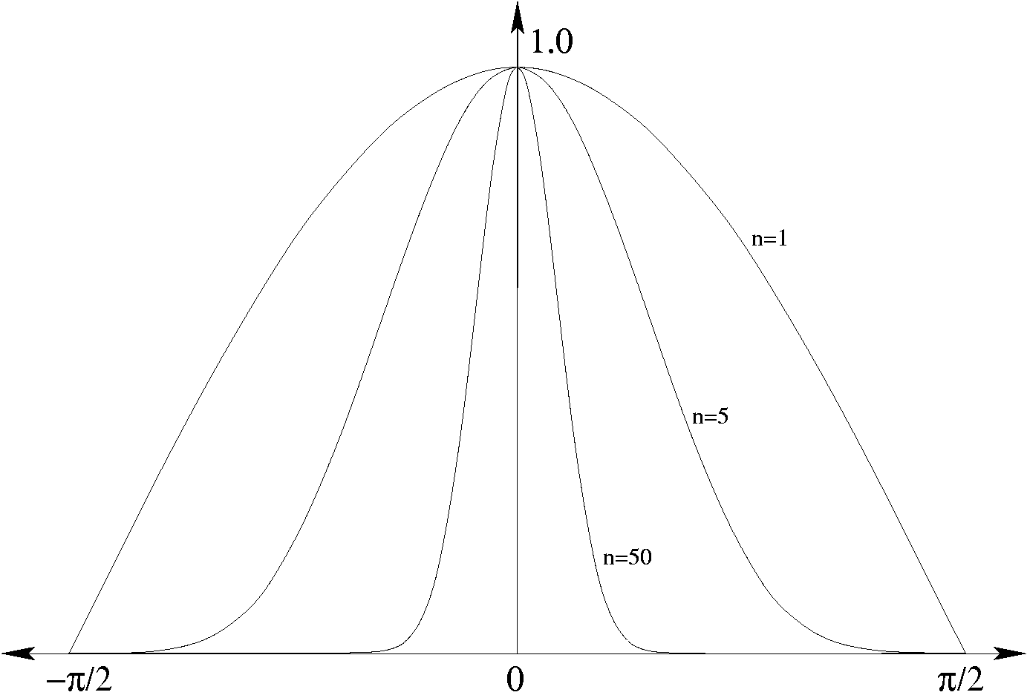
General Specular Model
Reflection occurs mainly in the “mirror” R direction, but there is some spread in similar directions V (view vector)
Ij(V) = Ie Ks (V•R)^{spec} is the reflected specular intensity in the direction of vector V (for normalized V and R)
  Specular reflection is attenuated (colored) by Ks and by the angle between R and V
“spec” exponent controls the
distribution of intensity about R
Ie and Ij(V) are both RGB color intensity values in their respective vector directions L and V
(V • R)^{spec}
Ie
R
n = spec
V
Ij(V)
Angle of R and V

Slide 20
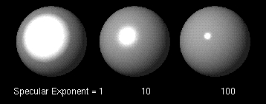
Specular Power
Ij(V) = Ie Ks (V•R)^{spec}
“spec” exponent controls the distribution of energy about R
These images show it’s effect:
Higher values of “spec” produce
smaller, tighter specular
highlights that also make
surfaces appear smoother
Ie
R
V
Ij(V)

Slide 21
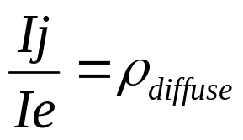
Ideal Diffuse Reflection
Reflection or scattering is equal in all directions
for all wavelengths
Ie
Ij
Rho (ρ) is the ratio of output intensity (in any direction) to input intensity
  models the case where L and N are coincident and the surface scatters all wavelengths equally

Slide 22
Colored Diffuse Absorption
  Reflected intensity Ij = Ie Kd in any direction over the exit hemisphere
    Still restricted to case where N and L are coincident
Kd models the absorption (color) of a surface
    Kd is RGB vector of “diffuse color” coefficients [0,1] that scale light source Ie RGB components
Ie
Ij and Ie are RGB color intensity vectors
Ij

Slide 23
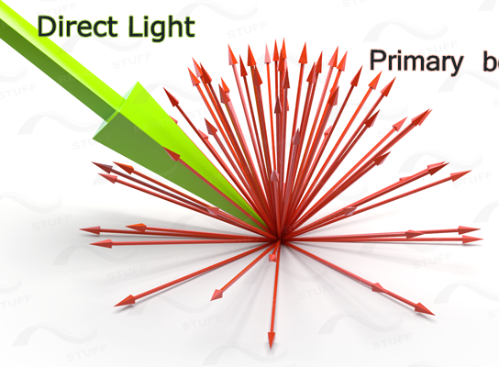
General Diffuse Model
In the more general case where the direction L varies
  Ij = Ie Kd cos(θ) or Ij = Ie Kd (L•N)
  cos(θ) accounts for the change in projected surface area of incident light Ie and surface orientation toward/away from light
  L•N computes cos (θ) function if L and N are normalized vectors
    For either formulation, surfaces facing away from light receive NO illumination
    For || θ || > 90, cos term is clamped to zero. For (L•N) < 0, result is clamped to zero.
Ij and Ie are RGB color intensity values
Ie has a direction L
Note that Ij has no specific direction vector associated with it since it is the same over the entire hemisphere defined by N
Ie
θ
Ij
Ij

Slide 24
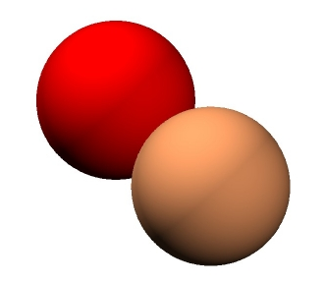
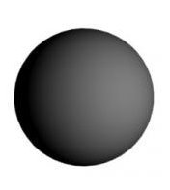
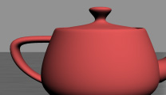
General Diffuse Example
  Ij = Ie Kd cos(θ) or Ij = Ie Kd (L•N)
  cos(θ) accounts for the change in projected surface area of incident light Ie and surface orientation toward/away from light
  L•N computes cos (θ) function if L and N are normalized vectors
  Kd is RGB vector of “diffuse color” coefficients in range [0,1]
Diffuse reflection on a sphere from one light
diffuse reflection on a teapot
How many lights?
Two lights (UL and LR) produce diffuse reflections on spheres

Slide 25
Combined Specular and Diffuse Reflection
Real materials exhibit a mix of both diffuse and specular reflection characteristics
The diffuse intensity is constant and a bulge or peak of specular intensity occurs near the R direction
A camera “sees” the energy emitted in it’s direction (V or E)
Ie
N
R
L
E
V or E direction
points toward
the viewer, eye, or camera

Slide 26
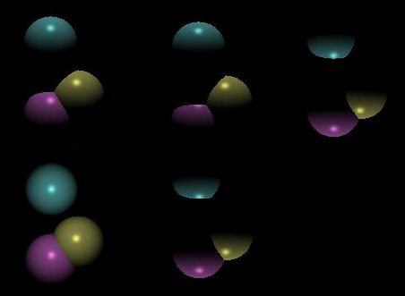
Examples of Combined Model
The reflection distribution can be a sharp-peak or a broad-bump of reflected energy in the R direction, controlled by the specular-power “spec”
The diffuse reflection produces smooth color variation over the model portion facing the light(s) (view-independent)
The specular reflection produces a highlight that moves as the viewpoint (E) changes (view-dependent)
Ie
N
R
L
E
Where is the sphere bottom?

Slide 27
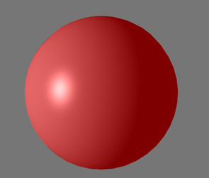
Ambient Light
Without ambient light
Surfaces facing away from a light will be black
  No diffuse or specular reflection intensity
To avoid this, create a special light that hits all surfaces
A lumped omnidirectional source is called the ambient light
Ambient light Ia is an fixed intensity vector and
considered “normal” to all surfaces
Ambient light produces an additional diffuse-like
reflection called an ambient reflection
Ka is specified for materials as the “ambient color”
  Use separate Ka for HW4
  other systems may set Ka = Kd
Only one ambient light is needed and allowed
With ambient light

Slide 28
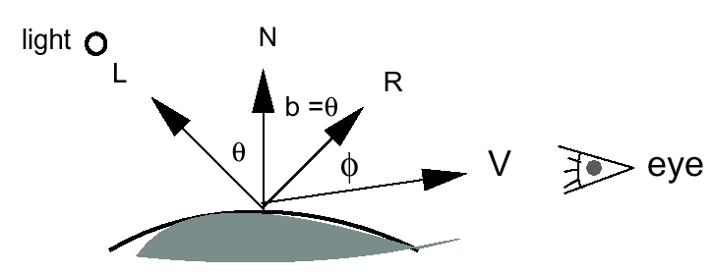
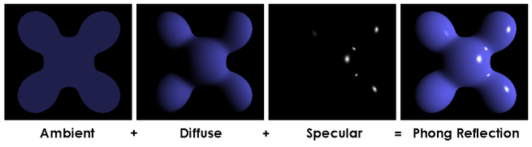
Specular, Diffuse, and Ambient
Reflection Components
All 3 reflection behaviors create a complete shading model
Specular reflection intensity
  specular component = Ie Ks (R•E)^{spec}
Diffuse reflection intensity
  diffuse component = Ie Kd (N•L)
Ambient reflection intensity
  ambient component = Ia Ka
E or V

Slide 29
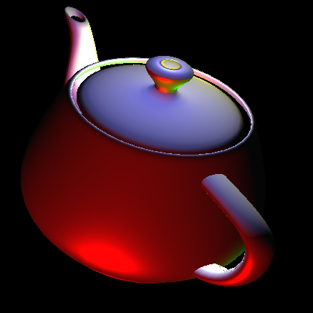
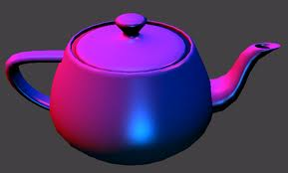
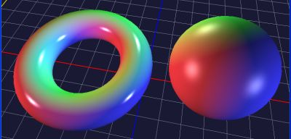
Complete Shading Equation
Surface color seen by camera at a surface point is modeled by summing the light-surface interactions over all lights
Color C = Σ_{lights} specular + diffuse + ambient components
  = (Ks Σ[Ie (R•E)^{s}]) + (Kd Σ[Ie (N•L)]) + (Ka Ia)
S is a scalar
C, Ie, Ks, Kd, Ka, Ia – are all RGB color vectors (∈ [0, 1])
R = reflected ray direction vector (normalized)
E = eye ray direction vector (normalized)
N = surface normal vector (normalized)
L = light ray direction vector (normalized)

Slide 30
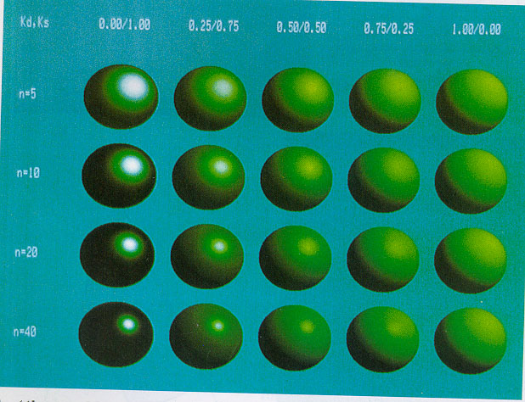
Parameter Example with varied Kd, Ks, and s

Slide 31
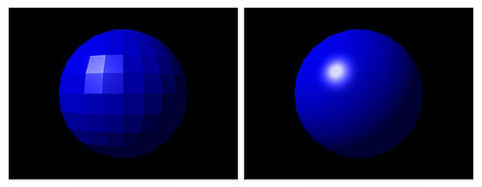
Observations about Specular, Diffuse, and Ambient Reflection Components
Absorption (or color) for each reflection component is modeled by
  Ks, Kd, Ka ---- each is a vector of fractional attenuations [0,1]
For most real materials, these equations are only approximate
Cos laws approximate the behavior of light with real materials
  K terms are often a function of incident/reflection angle and wavelength
Surface appearance is set by specifying Kd, Ks, Ka and spec power s
  Kd, Ks, Ka ∈ [0,1] for each rgb vector element
  Sharpness of specular highlight is controlled by specular power “s”
  “s” is often constrained
  to be a binary power
  for fast calculation
  (1, 2, 4, 8, 16, 32, … )
The surface reflection model
applies to any geometry, but
Normal vector at each point
determines appearance

Slide 32
Implementing the Shading Equation
Color C = Σ_{lights} specular + diffuse + ambient components
  = (Ks Σ[Ie (R•E)^{s}]) + (Kd Σ[Ie (N•L)]) + (Ka Ia)
C, Ie, Ks, Kd, Ka, Ia – are all RGB color vectors (∈ [0, 1])
R = reflected ray direction vector (normalized)
E = eye ray direction vector (normalized)
N = surface normal vector (normalized)
L = light ray direction vector (normalized)
This is an approximate model of illumination of opaque surfaces
  But…, geometry is involved -- dot products, cosines
Recall that the rasterizer operates on coordinates after perspective projection. Perspective does not preserve angles or lengths.
Lighting calculations must be done in some space before the perspective projection.
  Model, world, or image space?

