Slide 1
Sampling and Reconstruction Introduction to Signal Processing
CS580
(Computer Graphics Rendering)
Ulrich Neumann

Slide 2
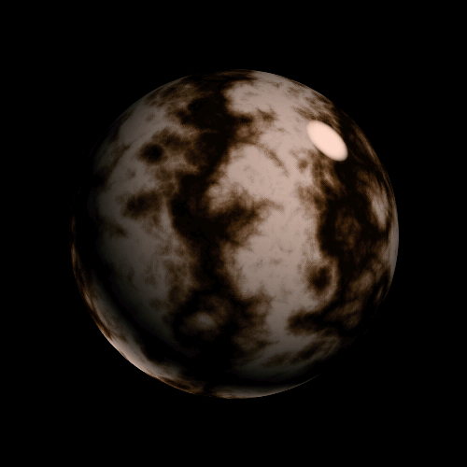
Images are Continuous Functions
Computers represent everything with discrete samples
Intuition tells us that with enough samples (of enough precision) we can capture the continuous function and re-express it everywhere, if needed (reconstruction)
Signal processing theory helps us understand how and why, and models the process
Intensity function of a scan line
Pixels values are samples with finite spacing

Slide 3


Quantization and Aliasing Errors
Quantization errors arise from insufficient accuracy of samples
  compression artifacts
Aliasing errors arise from insufficient samples in space (or time)
  Accuracy of samples is not the issue
  Aliasing creates information that is not really there
    e.g., Moire patterns (a form of noise), staircase steps along smooth edges (edge/corner features)
  Aliasing omits/distorts scene features
    e.g., small-scale geometry between pixels is lost
In contrast, image blurring removes or reduces detail

Slide 4
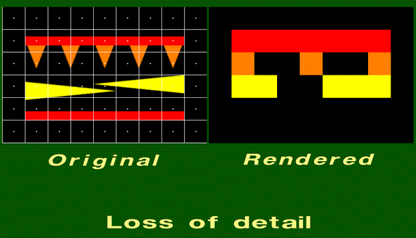
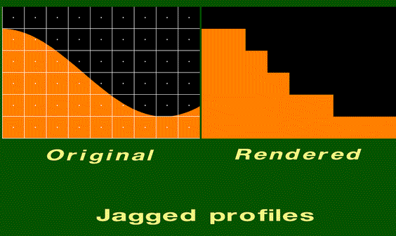
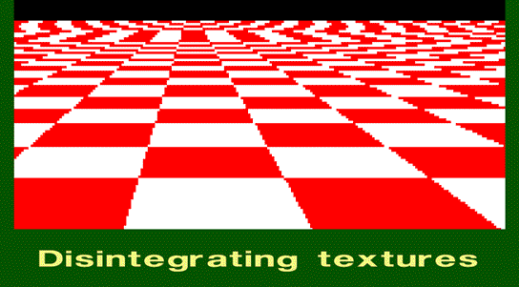
Aliasing Effects

Slide 5
Aliasing Artifacts Occur Throughout the Rendering Process
Everywhere we use discrete representations of continuous functions
  artifacts shows up unless effort is made to manage them
Sampling artifacts occur in
  rasterization (edge uncertainty)
  texturing (sample “far-apart” pixels in environment mapping)
  shading (Gauraud interpolation misses specular highlights)
  animation (samples in time produce backwards wheel rotation)
Reconstruction artifacts occur in
  texture lookup when we interpolate between texel samples
  blocky texture when you zoom into a textured surface
  display device fills pixel areas between FB sample points
    Actual cause of staircases along straight lines

Slide 6
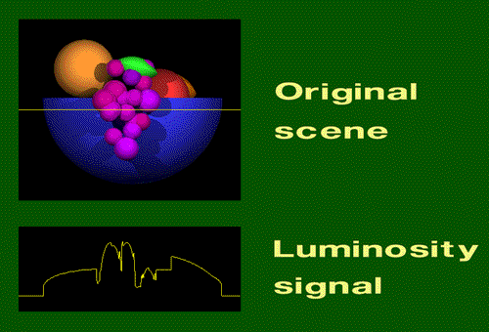
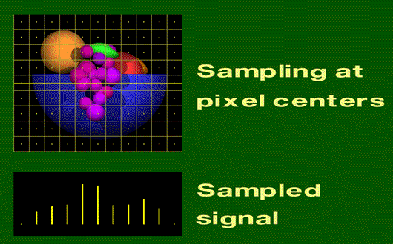
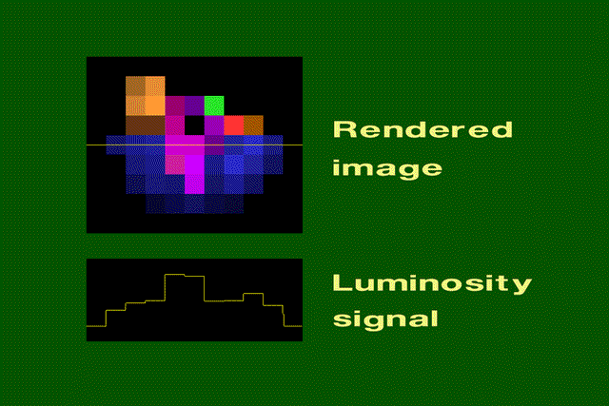
Sampling and Reconstruction in Rendering
Note that the sample values are correct, but there are too few samples and the signal values between the samples are a piece-wise constant reconstruction. Leads to highly visible block-edges (similar to the effects of flat shading)

Slide 7
What to do? How to manage it?
Short answer: Nyquist Theorem
A bandlimited signal f(t) with cutoff frequency ω_{F}, sampled with interval T₀ such that (2π/T₀) ≥ 2ω_{F}, may be perfectly reconstructed from its samples f(nT₀) (n = +/- integers) by convolution with the reconstruction filter r(t) = sinc (ω_{F}/2π (t-nT₀))
  Note: 1/T = f = ω/2π
  Summarize as: sample at least twice the rate of highest frequency present in the signal

Slide 8
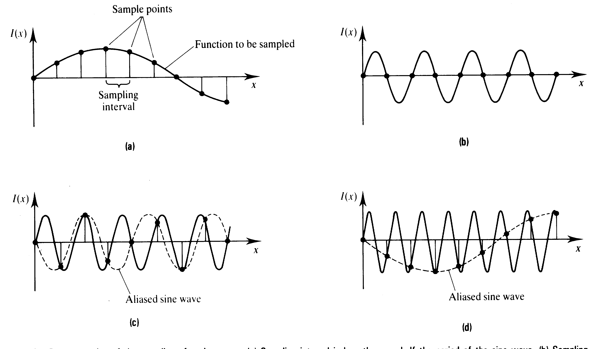
Signal Sampling
Sufficient samples for accurate reconstruction
Insufficient samples and unfortunate sample placement
Insufficient samples create aliasing during reconstruction
The original signal is lost and a new/different signal is created

Slide 9
Nyquist Requirements
f(t) filtered for cutoff freq ω_{F}
(remove high frequencies before sampling)
Sample rate 1/T₀ is greater than 2 ω_{F}
Reconstruct (interpolate) with sinc function
(recreate a continuous signal from samples)
Seems simple – just do the above and get perfect results! But can we do it…?

Slide 10
Modeling the Graphics Process
Begin by modeling signals of interest
  Simplify with1D functions (e.g., scan line)
  Consider domain time (t) or space (x) equivalent
Impulse or Dirac delta function
  δ(t) is infinitely narrow and high at zero
  ∫δ(t) = 1 (area is one)
Use impulse to model point sample
  f(t₀) = ∫f(t) δ(t-t₀) dt
  at t=t₀ integrand is nonzero
  and samples signal f at time t₀
δ(t)
0

Slide 11
Comb, Step and Box Functions
Comb or Shah function is a repeating delta function at intervals of T
  I_{T}(t) = ∑_{k} δ(t - kT)
Comb is a good model for
pixel samples at regular intervals
Step function u(t) = ∫₀^{t} δ(τ)dτ
Box function b_{w}(t) = 1 where |t| < w/2,
b_{w}(t) = 0 elsewhere
Note that Step and Box are good models
of polygon edge functions (in/out)
I_{T}(t)
… -2T -T 0 T 2T …
1
u(t)
-1 0 1
1
b_{w}(t)
-w/2 0 w/2

Slide 12
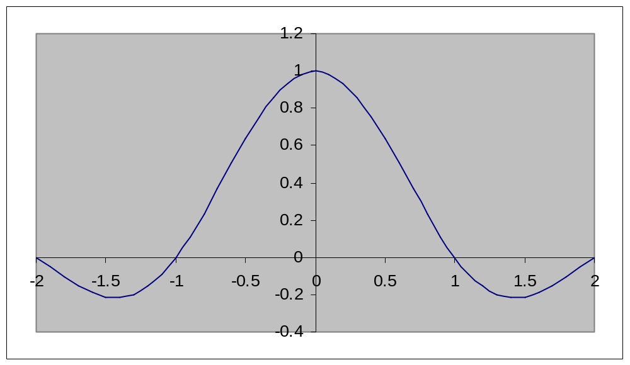
Sinc Function
sinc(t) = sin(πt) / (πt).
  By definition: sinc(0) = 1
  sinc(t) = 0 for integer values of t
  Note that sinc amplitude decreases as t increases, but it has infinite extent

Slide 13
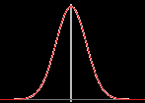
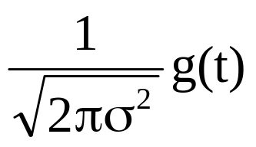
Gaussian
Gaussian g(t) = exp(-t²/(2σ²) )
  σ (sigma) the standard deviation
  is proportional to width of curve
  Gaussian also has infinite extent
  as σ --> infinity, g(t) --> 1 constant
Normalized Gaussian
  G(t) = “normalized” means that ∫±∞G(t) dt = 1
  as σ --> 0, Normalized Gaussian G(t) --> δ(t) delta function
Triangle Function (pyramid or hat)
Λ_{T}(t) = 1- |t| for (-T < t < T), else 0
Triangle is a model of linear interpolation or linear filter
A
Λ_{T}(t)
-T 0 T

Slide 14
Fourier Transform
F{x(t)} is an alternate signal representation based on frequency content or spectrum of signal
  Nyquist theorem requires we bandlimit frequency content of signal prior to sampling
In the Fourier domain signals are represented as a series of weighted sines and cosines
The coefficients describe the signal frequency content as a spectrum
f(w)
f(t)
=
0
0

Slide 15
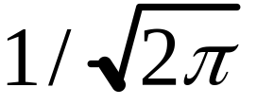
Fourier Transform Definition
For notation convenience, define
k =
F{x(t)} = X(ω) = k ∫ x(t) e^{-jωt} dt
F⁻¹{X(ω)} = x(t) = k ∫ X(ω) e^{jωt} dω
e^{-jωt} = cos(ωt) - j sin(ωt)
e^{jωt} = cos(ωt) + j sin(ωt)

Slide 16
Fourier Pairs
x(t) and X(ω) are called Fourier pairs
x(t) X(ω)
δ(t) | k
I_{T}(t) | (1/(kT)) I_{2π/T}(ω)
a | (a/k) δ(ω)
cos(at) | k/2 [δ (ω+a) + δ (ω-a)]
sin(at) | jk/2 [δ (ω+a) - δ (ω-a)]
b_{w}(t) | kW sinc(Wω/2π)
kW sinc(Wt/2π) | b_{w}(ω)
exp(-t²/(2σ²) ) | exp(-ω²σ²/2)
Λ_{T}(t) (triangle) | AT sinc² (Tπω)

Slide 17
Fourier Pair Properties
Note duality and inverse relationships between sampling rates
  Higher rates in time (tighter sample spacing) produce lower repetition rates (looser spacing) in frequency domain (and vice versa)
  This relationship is essential to both the cause and solution of the sampling problem
Note that the whole signal (in time or space) is represented by a spectrum
We can’t transform a point in the signal (or image or scene)
  There is no frequency content of a point
  The two representations provide either
  Value at a signal point in time (Spatial domain), or
  Spectrum of a signal region (Frequency domain)

Slide 18
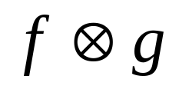



Convolution
A property of linear time-invariant (LTI) systems is
  H{af + bg} = aH{f} + bH{g} (for scalars a and b)
  2D sampling and reconstruction of a rendering system is a LTI system
In LTI systems, convolution is defined as:
f(t)*g(t) = ∫±∞ f(τ) g(t-τ) dτ (also = ∫±∞ f(t-τ) g(τ) dτ)
  Integrate over τ for fixed t offset between functions
  Net effect is that g defines spatial weighting function (filter) whose effect depends on overlap of signals f and g at offsets of t
    NOTE: convolution of f(t) * δ(t) = f(t) → convolution with delta is identity
=
t
Overlap area for shift of t
leads to value of convolution at t
t

Slide 19
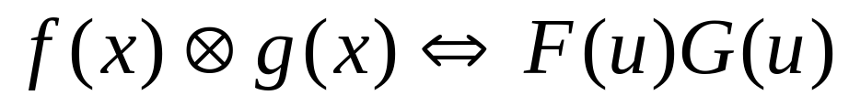
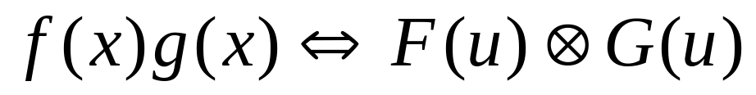
Multiplication Property
Multiplication property is a “payoff” for introducing Fourier Transforms and Convolution
  F(ω) H(ω) = F{ f(t) * h(t) } and f(t) h(t) = F⁻¹{ F(ω) * H(ω) }
By using this property we can better understand graphics sampling, reconstruction, and aliasing by how these processes are modeled in both the spatial and frequency domains
Convolution in the spatial domain represents the same signal as
multiplication in the frequency domain
Multiplication in the spatial domain represents the same signal as
convolution in the frequency domain

Slide 20
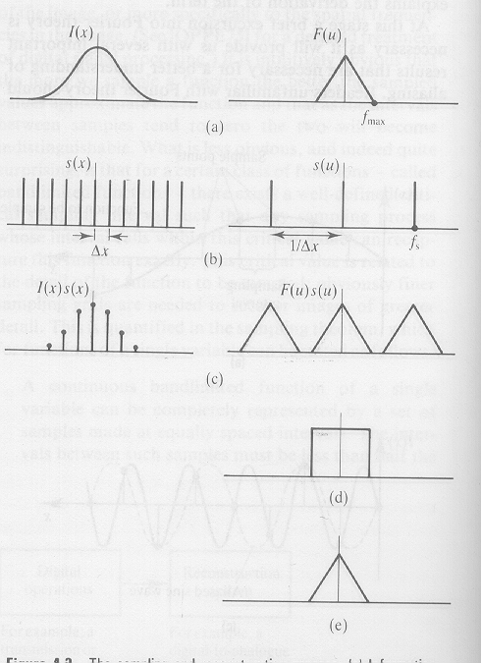

Ideal Rasterization / Sampling
Bandlimited image signal
Bandlimited spectrum of input signal
Sampling function is selected for sufficient rate given Fmax
Transform of comb sampling function is a comb at inverse rate
Sampling function is multiplied by initial signal to produce a sampled version of initial signal
Multiplication in spatial domain is convolution in Fourier
domain, producing multiple copies of initial spectrum

Slide 21
Ideal Reconstruction
Given the sampled function, recover the original continuous function by convolution with sync in spatial domain – or – multiplying the spectrum by a box in the Fourier domain
Multiplication by box in Fourier domain is a convolution with sinc function in time domain
Multiplication by box in Fourier domain
isolates the spectrum of the initial signal
Convolution produces multiple sinc copies,
one on each of sample signal points, to produce exact copy of initial signal
Images courtesy of Watt & Watt, Advanced Animation and Rendering Techniques

Slide 22


Sampling in a Graphics Renderer
Spatial domain
Frequency domain
Triangle representation in the spatial-domain is a Box
A Sinc (in F-domain) has significant amplitude at high-freq’s, so cut-off frequency (the point of negligible amplitude) is very high
Sampling at modest pixel rates leads to overlapping spectra
Reconstruction can not isolate a single spectrum copy of the original signal
Production of overlapping spectra is called
pre-aliasing
Box
Sinc
Multiply
Operation
Convolution
Comb
Comb
Sampled Box
Result
Overlapping Spectra

Slide 23
Sampling Requirements
Ideal sampling has two requirements:
  bandlimit the initial function
  sample at over twice the band-limit rate
Then, copies of the signal spectrum are non-overlapping
and reconstruction can isolate one copy
If you do not bandlimit the initial function, or if sample rate is too low
  reconstruction includes overlapping spectrum copies
  No reconstruction filter can isolate a single copy (pre-aliasing)
0

