Slide 1
Texture Antialiasing
CS580
(Computer Graphics Rendering)
Ulrich Neumann

Slide 2
Filtering Textures
We now know about aliasing and how it arises from sampling geometry edge functions
How do we address the problem of aliasing texture “edges” that appear on triangle surfaces?

Slide 3
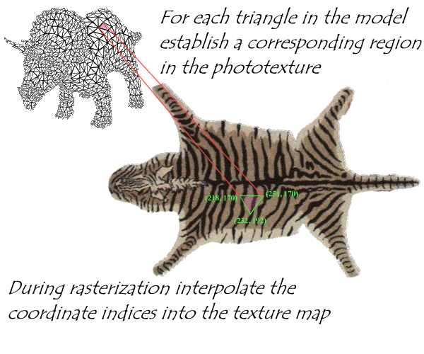
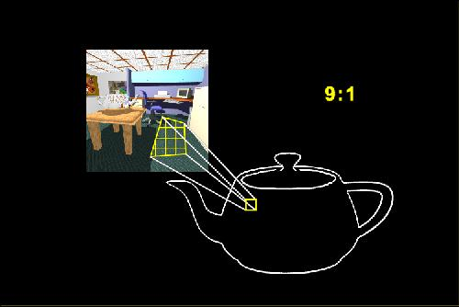
Sample Rate Mismatch
Rendering samples scene geometry and textured surfaces
  Texture has its pixels (texels) resampled onto rendered image pixels
  Texture (texel) sampling rate generally does not match screen pixel sample rate (Texel:Pixel ratio)

Slide 4
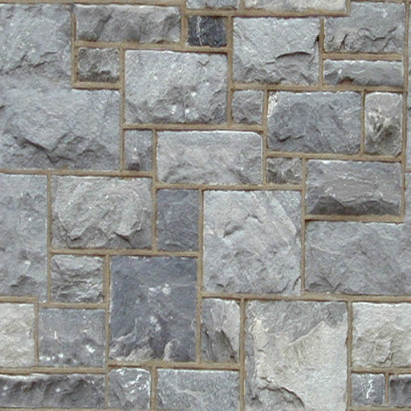
Magnifying Image Textures
Projected texture in screen image should sample near same rate: 1:1, to optimally reproduce texture map
If we zoom in… texture image blurs
  1 Texel : many Pixels
  No aliasing problem here - just no data
  Fix by using higher resolution textures - nothing else we can do - can't invent data for image textures
  Procedural textures have an advantage since many provide detail over a range of scale-levels (fractals)

Slide 5
Magnifying Image Textures
Zooming into a small
region of texture
leads to a blurred
image

Slide 6
Minifying Image Textures
Texture image aliases when we zoom out – sample rate violates Nyquist rate
  Multiple texels fall in one screen pixel (Many Texels : Pixel)
  We can't easily increase or control scene sample rate
    Camera and FB resolution determine screen sample rate of scene
  Filter texture (reduce F_{max}) so screen pixel sample rate is twice highest freq in texture (like pre-filtering triangle edges)
    Match the texel resolution (rate) and screen pixel resolution (rate)
  Filter can be applied to whole texture image as a pre-process, or on the fly for each pixel’s u,v sample point
  in the texture map

Slide 7
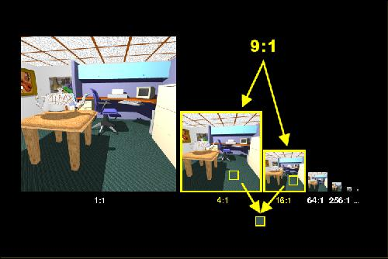
MIP Maps: Precomputed Filtering
Pyramidal Parametrics - Lance Williams [SIG 83]
Precompute filtered versions of texture image at octave scale/size intervals
  Create images with half-size in X and Y per pyramid step
  Top of pyramid is single pixel with "average" color of whole image texture
Filter high
resolution image
to produce
a half-size image
Use filter kernel
  Bilinear
  Cubic
  Gaussian

Slide 8
Storage of MIP maps
R
G
Space cost is 33% increase over texture image itself
R
G
B
R
G
B
R
G
B
B
Trivia: MIP = Multum In Parvo (many things in a small place)

Slide 9
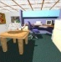
MIP Map Scale
Define a “scale" parameter for each level of the texture-map pyramid based on du/dx and dv/dy (change in u or v per texel)
  Low scale values for hi-res images at base of pyramid
  e.g., for 256x256 image level, scale = du/dx = dv/dy = 1/256 (below)
  Scale increases as we move to the top of the pyramid where
  du/dx = dv/dy = 1/1 and a single pixel represents the whole texture
    For square textures, both scale ratios are equal (du/dx = dv/dy) so only one number is needed to represent scale at each level of the pyramid
u,v = 0,0
1,0
x-axis is also u-axis
y-axis is also v-axis
Scale = 1/1
. . .
. . .
Scale = 1/16
Scale = 1/256
Scale = 1/128
0,1

Slide 10
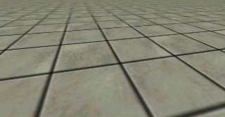
MIP Maps: matching scale
Pixel scale during rendering is more complex since it is projection-dependent, non-axis-aligned, and it varies over the face of a polygon due to perspective
  pixel scale = du/dx, du/dy, dv/dx, dv/dy (4-tuple)
Pixel scale values are projection-dependent texture sampling rates at each image pixel and these four scale components (derivatives) are generally unequal at each tri vertex and vary
from pixel to pixel
x
y
v
u

Slide 11
Estimating Pixel Scale
In rendering, we interpolate perspective-space U,V
We compute dU/dy, dV/dy along edges, and dU/dx, dV/dx along spans, but we need affine scale ratios to select pyramid level
  Offset samples (or prior-pixel and prior-scanline) u,v values can be used to estimate a local scale per pixel based on sample differences
Simpler choice is to approximate derivatives from vertex u,v
  Use affine u,v values before perspective warp
  Estimate derivatives using screen vertex positions
  Select a constant scale for whole poly based on average (or peak) du/dx, du/dy and dv/dx, dv/dy values computed along edges
    Reasonable approximation for small triangles
    Use of peak scale values produces over-filtering (blur)
    Blur is often preferred over aliasing (under-filtering)

Slide 12
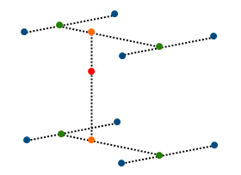
3D Interpolation
4:1 scale level
9:1 scale
interpolation
16:1 scale level
Given continuous texture scale values we can
  sample between levels (3D filter) as Heckbert describes, or
  resample in nearest pyramid plane using 2D filter
  Nearest-level rounding or truncation is faster (2D rather than 3D), but causes visible jumps as scale level switches occur
Most hardware now offers full mipmaps with trilinear (3D) interpolation

Slide 13
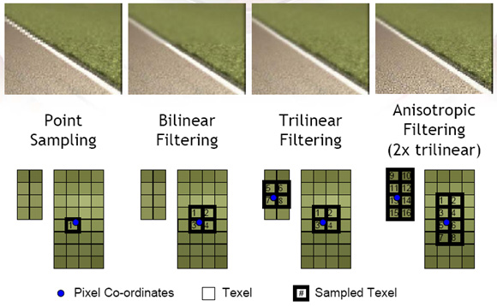
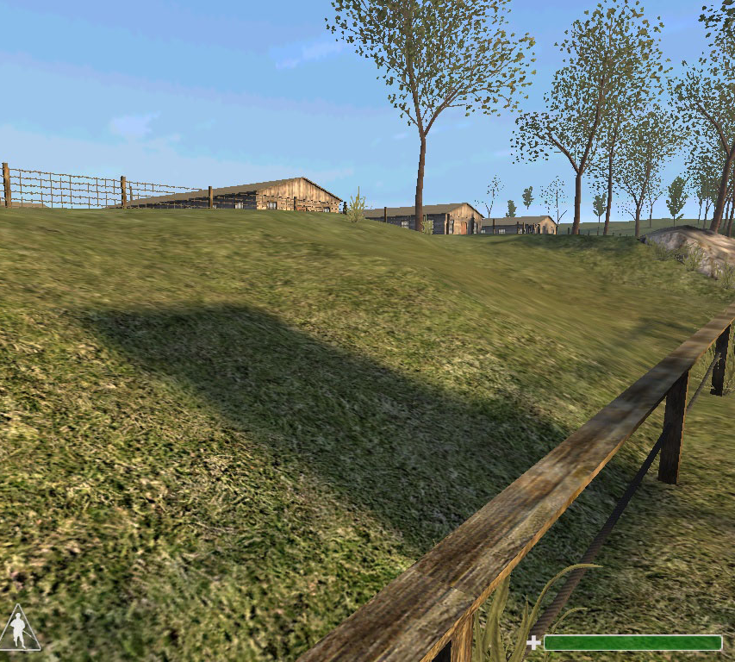

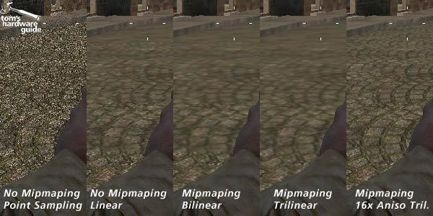
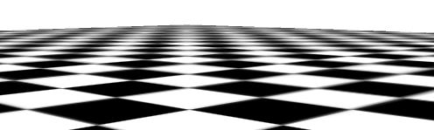
2D vs 3D MIP Map Examples

Slide 14
MIP-Map Weakness
v
u
Weakness of classic MIP maps is that it is isotropic (same) scale filtering for both u and v
The problem is acute in perspective planes
  Ground plane textures are a common problem case
Texture scale is greater in one screen axis than the other
  d*/dy is typically greater than d*/dx along horizon in ground plane
To keep one dimension (y) from aliasing, the other (x) must be excessively blurred
  Solution is to filter anisotropically (asymmetrically)
  Where an anisotropic filter is needed, a lower resolution mipmap scale is used, and several texels are sampled and merged along the direction of needed additional filtering (increases cost/accesses)

Slide 15
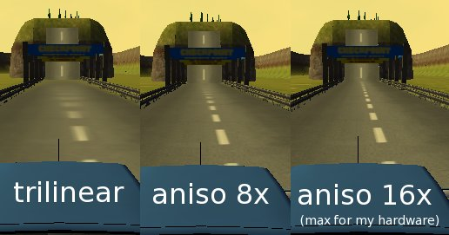
Anisotropic MIP Map Filters
Combine more than 4 texels per MM level to approximate anisotripic filter extent
  Acesses ~ time cost
Filter shape and orientation is determined by max and min scale values

Slide 16
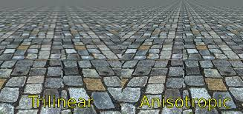

Slide 17
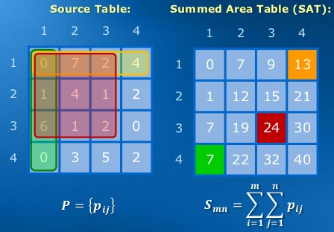
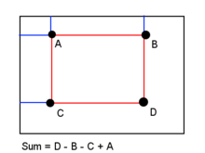
Summed-Area Tables
[Frank Crow SIG 84]
Compute a texture table T so that each texel has sum of all texels above and to left (computed off-line)
  Assume 8-bit per RGB, 16-bits per RGB texel are needed for 256x256 texture
  Also known as an “Integral Image”
Sum of values of any rectangle region of arbitrary width-height ratio can be computed from 4-corner positions (4 texture accesses)
  Sum of all colors in a region = T(D) – T(B) – T(C) + T(A)

Slide 18
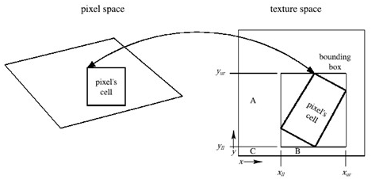
Summed-Area Table as Texture Filter
  Pixel corner u,v coods are computed and projected into texture map
    Approximated as ½ the differences between u,v of neighbor pixels in x, y
  Compute u,v-aligned bounding box in texture space
  Sum of all texel colors in a region = T(D) – T(B) – T(C) + T(A)
Divide the sum by the number of texels in the region to obtain the average color of the region (anisotropic box-filtered color)

Slide 19
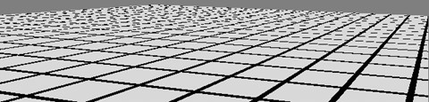
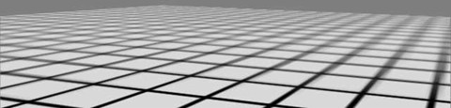
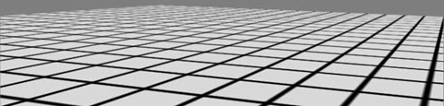
SAT as Anisotropic Texture Filter
Computes a box filter of the anisotropic rectangle region
  Do 3 separate calculations for R,G, and B
All rectangular integral evaluations at all scales are constant time!!!
Nearest texel sample
(no filter)
Tri-linear Isotropic
MIPMAP
Anisotropic SAT

Slide 20
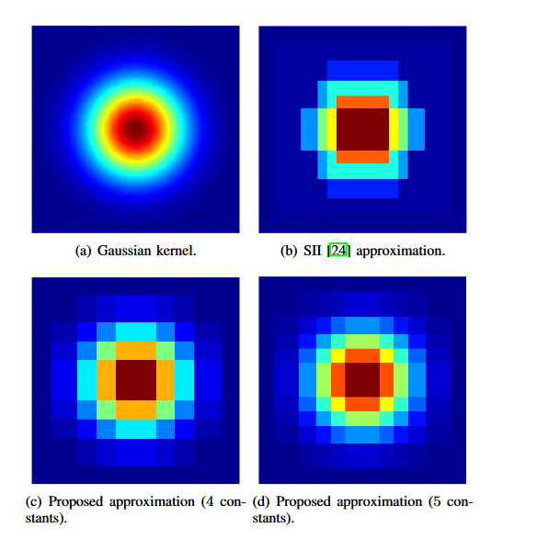
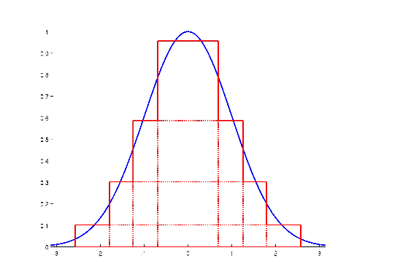
Summed-Area Table Extensions
Arbitrary kernel shapes from multiple rectangle approximations
  Evaluate a fixed small number of regions to approximate smooth filters
  Weighted combination of multiple regions
“Efficient and Accurate Gaussian Image Filtering Using Running Sums,” Elhanan Elboher and Michael Werman arXiv:1107.4958v1 [cs.CV] 25 Jul 2011
“Fast Summed-Area Table Generation and its Applications,” Justin Hensley, Thorsten Scheuermann, Greg Coombe, Montek Singh, Anselmo Lastra, EUROGRAPHICS 2005, Vol 24, 2005, No 3

Slide 21
END OF ALL HW MATERIAL
Second exam covers from
Shading (HW4) up to this point
Nov. 6 (Tues after HW6 due date)
Next Class: Projects

