Slide 1
Shadows
CS580
(Computer Graphics Rendering)
Ulrich Neumann

Slide 2
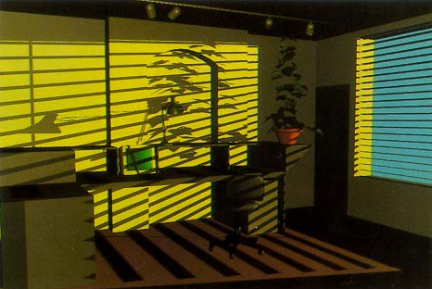

Slide 3
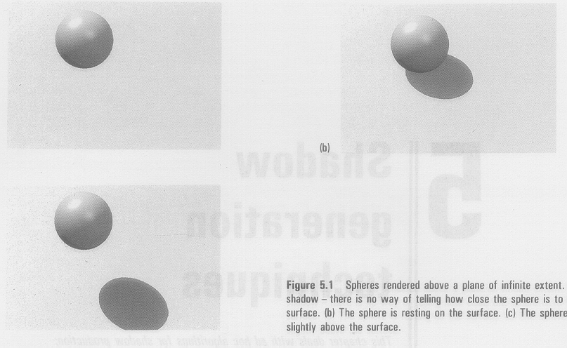
Shadow Benefits
Perception of depth and distance

Slide 4
Shadows
Improves realism of lighting
First step toward global illumination
Consider light occlusion just like visibility occlusion
  Another form of the visible surface problem
  Z-buffer, BSP, ray tracing, … are all viable approaches
Phong/Gouraud models assume no occlusion
  Shading Eq must be modified to test pixel-by-pixel light visibility
  Introduce a Shadow term that diminishes or skips a light source
  Ambient light always non-zero to keep surfaces non-black
Simple methods for computing shadows based on light visibility fall short of capturing surface inter-reflections
  Inter-reflections are more complex than just light visibility
  Radiosity methods compute shadows and inter-reflections

Slide 5
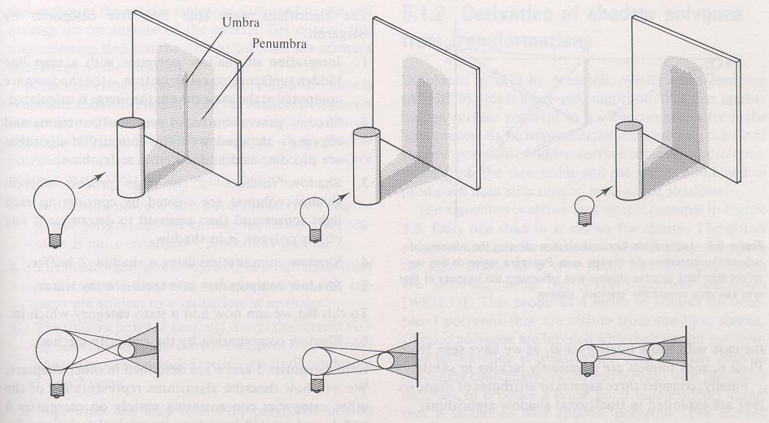
Umbra and Penumbra
Umbra – light source totally blocked
Penumbra – light source partially blocked
Depends on light source size, object size
and source-blocker-receiver distances

Slide 6
Properties of Shadows
Only area sources create penumbras
If the scene is static,
  the shadows can be precomputed
  since it’s view-independent
If the eye and light are coincident,
  no shadows are seen

Slide 7
Shadow algorithms
Sig 77, Frank Crow published a survey of shadow algorithms - good reference for basic ideas and principles
More recent work offers many elaborations and improvements, as well as a few new methods
The following five methods come from the survey The last (sixth) method is a current method
  Projected Shadows
  Two Pass Object Space
  Ray Casting / Tracing
  Shadow Volumes
  Two-Pass Z-Buffer
  Antialiased Depth Maps

Slide 8
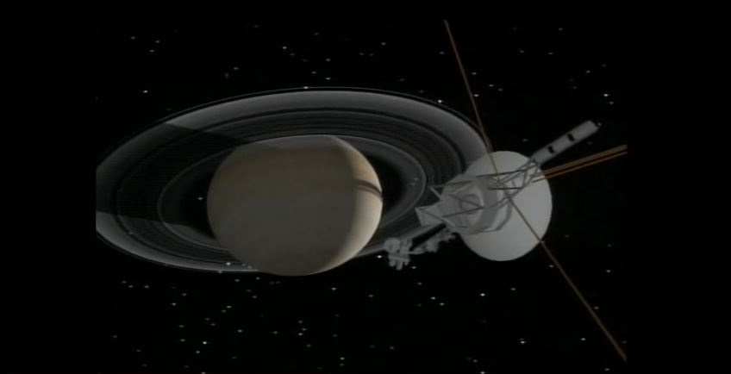
Projected Shadows (Blinn 70’s)
Compute the shadow area by projection. Project rays from light through vertices of object and intersect on ground plane to create a set of 2D regions (triangles) rendered as dark overlay (transparent) or fixed dark color. For simplicity, a simplified model or subset of vertices can be used.
Limited to simple environments - ground plane, fixed direction lights, rigid objects, simple object motions – E.g., Blinn’s Voyager visualizations

Slide 9
Two-Pass Object-Space Method
Atherton, Weiler, Greenberg (1978) – Introduction of Two-Pass approach
First pass renders scene from perspective of light source(s)
  Polys are clipped into dark and light fragments (analytical clipping)
  Lit fragments are retained and transformed back into model space
  Lit fragments (per light) are linked with their parent polys
Second pass renders the scene from the camera view point
  Polys are rendered and default to being in shadow (ambient shading)
  Linked fragments are rendered over polys and indicate which pixels have direct light – pixels accumulate one light per fragment
Limitations
  Increased size of data set
  Recompute fragments when lights or models move
  Analytical clipping is hard and costly process

Slide 10
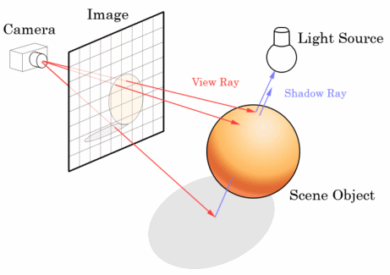
Ray Casting
Primary rays: start from focal point and pass through pixels into the scene
  Test all objects (triangles) for intersections with primary rays
  Keep the closest intersection (visible surface point) and shade it by computing the shading equation (loop over all lights)
Shadow rays: from each visible surface point, cast rays to each light source
For each shadow ray
  Test all objects for intersection
  If any intersection
    That light is occluded – the surface
    point is in shadow of that light
    Skip that light in the
    shading calculation
Shadow region

Slide 11
Ray Casting Shadows
Appel'68 - accepted terminology for this method of computing images with shadows is "ray-casting"
  (L+1)N rays must be intersected for each pixel in brute-force solution (L = # lights, N = # polys)
  Lights are modeled as point sources
Turner Whitted’s paper in 1980 added reflection and refraction rays in addition to shadow-test rays
  These additional rays allow computation of specular reflections and refractions between scene objects
  The method called “ray tracing” includes shadow, reflection, and refraction rays

Slide 12
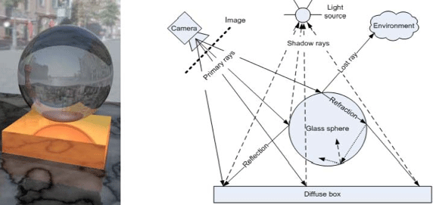
Ray Tracing Example
http://oivdoc91.vsg3d.com/content/513-what-real-time-ray-tracing

Slide 13
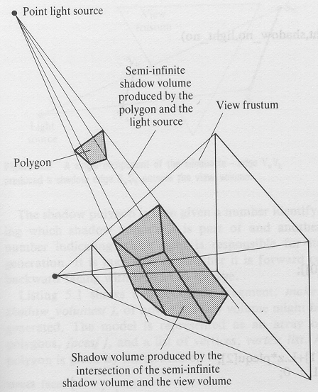
Shadow Volumes (1)
Crow77 - image-space shadow calculation
Construct shadow quadrilateral (two triangles) from each light source and each scene poly edge
  Quads extend through scene and form the boundary between shadow volume and lit volume
  Quad norms point outward into lit volume
  Clip quads to view frustum

Slide 14
Shadow Volumes (2)
Render all the scene polys using any hidden surface algorithm
  Compute and save the depth (Z) of visible surface at each pixel
Render shadow quads for each light source over scene (one light source at a time)
  accumulate signed sum of shadow
  quad function Q at each pixel for
  quads in front of scene surface Z
  Function at each pixel:
  Q = signof(N•E) ---> (+1 or -1)
  Q = +1 ---> shadow quad norm
  toward viewpoint increments count
  Q = -1 ---> shadow quad norm away
  from viewpoint decrements count
  If final sum is >0 (positive),
  pixel is in shadow
  if sum = 0, pixel is lit
    The sum may be negative
    if the camera is in a shadow volume

Slide 15
Shadow Volumes (3)
Compute shading equation (per pixel) based on lit/shadow state for current light
  Delayed or deferred shading equation evaluation has costs associated with storing all the shading variables at each pixel during rasterization until each light visibility can be computed
  Deep frame buffer is needed

Slide 16
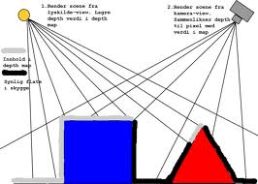
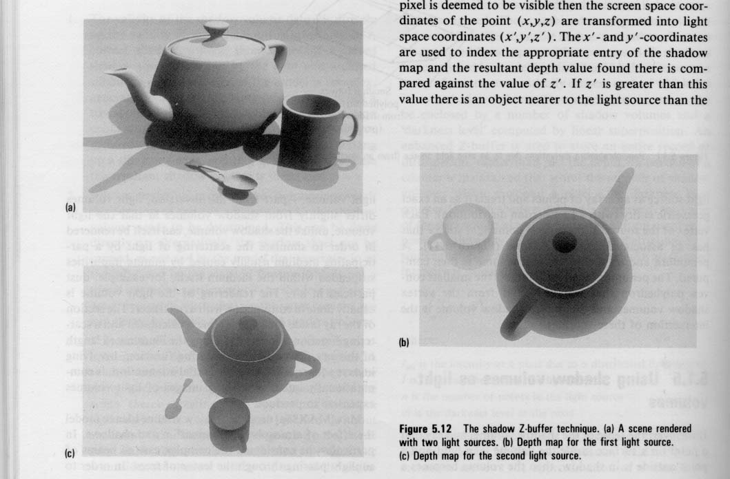
Two-Pass Z-Buffer (pass1)
Image-space shadow calculation (a.k.a. Shadow Maps)
Render Z-buffer depth image(s) from light source(s)
  compute depth image(s) with Z at each pixel (L_{Z})
  keep entire scene in view or render multiple images of scene subsets
Example depth-image
from one light source
L_{z}

Slide 17
Two-Pass Z-Buffer (pass2)
Render scene from viewpoint
  for each pixel x,y,z (screen space point P_{s})
  transform P_{s} point to “light image” point (P_{L})
  We know transforms for both camera and light views of scene
  - Invert view-camera transformation and compose with light-image transformation to get the transformation X_{LS} from P_{s} to P_{L}
P_{L} = X_{LS} P_{s}
L_{z} = Interpolated neighbor depth image Z-value at location of transformed point P_{L}
Compare interpolated L_{Z} with Z coordinate of point P_{L} (P_{Lz})
  if P_{Lz} ≤ L_{Z}, P is lit
  if P_{Lz} > L_{Z}, P is behind a lit surface and therefore in shadow
P_{L}
P_{s}
P

Slide 18
Shadow Maps Example
Light-A
depth image
Light-B
depth image
Camera image
with shadows from two lights

Slide 19
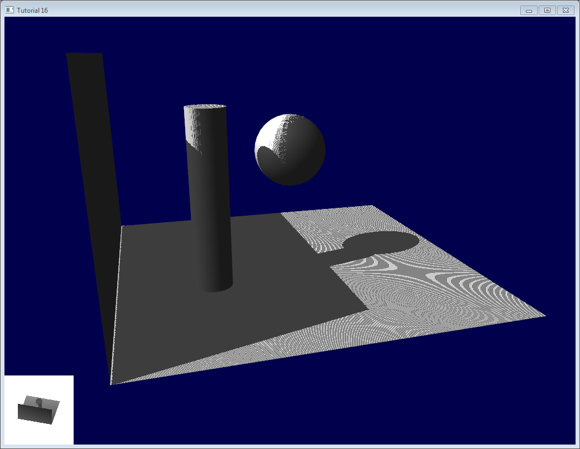
Two-Pass Z-Buffer (limitations)
  Light-space images must be re-rendered if any objects or lights move
  Transformation cost for each view-image pixel to one or more light-images
  Aliasing occurs due to depth reconstruction
    Shadow is modeled as a binary (in/out) edge function, so there are sample rate problems
      Interpolated Z leads to aliased binary shadow decision
    Depth interpolation produces
    shadow acne and “Peter Panning”
      Bias and offset fixes
See http://www.opengl-tutorial.org/intermediate-tutorials/tutorial-16-shadow-mapping/

Slide 20
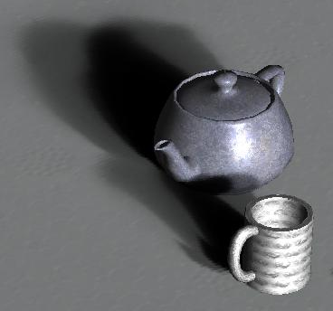
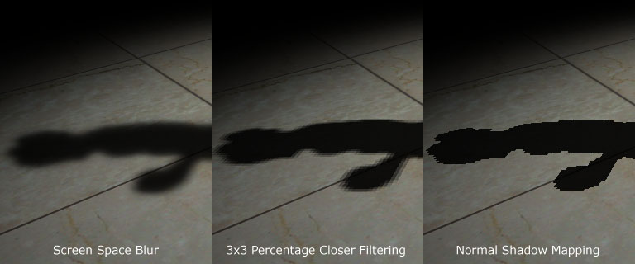
Antialiased Depth Maps (1)
W. Reeves, D. Salesin, R. Cook (87 Siggraph, Pixar)
Based on Two-Pass Z-Buffer method
The first method for practical soft shadows
Filter the shadow function to create soft penumbrae
  Gradual rather than binary
  occlusion function produces
  gradual/soft shadow boundaries
  Control over boundary aliasing
    Acne and Peter Panning remain
Softer Soft Hard

Slide 21
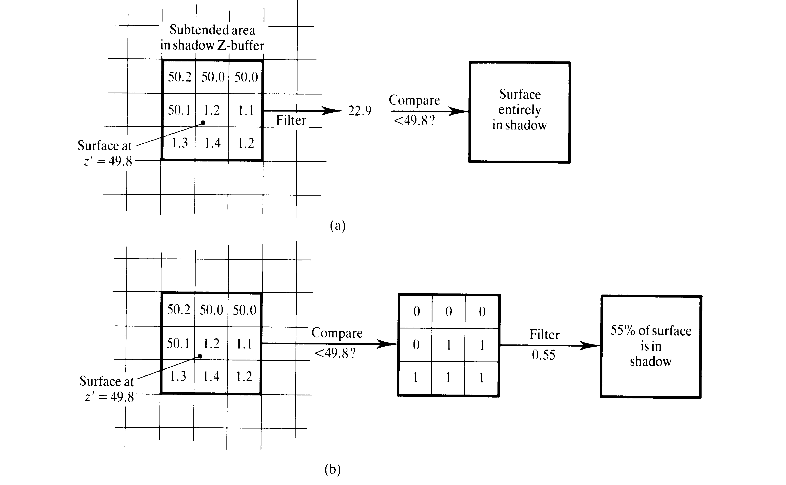
Antialiased Depth Maps (2)
Two problems with simple shadow maps:
binary shadow decision based on an interpolated z-value
  Interpolated Z value is poor reconstruction of true Z values
  A binary Z-compare (< / >) leads to sharp-edge shadow boundaries
    step function, not band-limited - aliased by sampling
Binary compare leads to decision that surface is in shadow

Slide 22
Antialiased Depth Maps (3)
Solution: Rather than interpolate Z for a binary comparison at a point, compute many shadow decision-functions over a region and filter those decision results
  Produce a smoothly-varying continuous “shadow probability” estimate
  The filter size/extent determines the size of the soft shadow penumbra
  Filtering shadow function over an area is equivalent to modeling shadows from an area light source (next slide)
55% probability that surface is in shadow
box filter (average) or pyramid or Guassian…

Slide 23
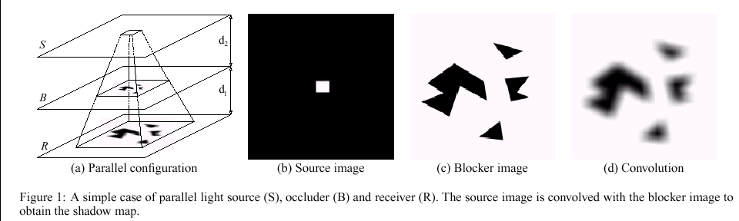
Area Lights and Shadow Maps
Shadow map is computed for a point source - the focal point for the light-image depth-map
The shadow filter convolution can be viewed either as
a) a filter of shadow-edge function (for anti-aliasing), or
b) extending a point light-source to an area source
Filtering the blocker-edge or extending the light-area shape produces the same soft shadow function

Slide 24
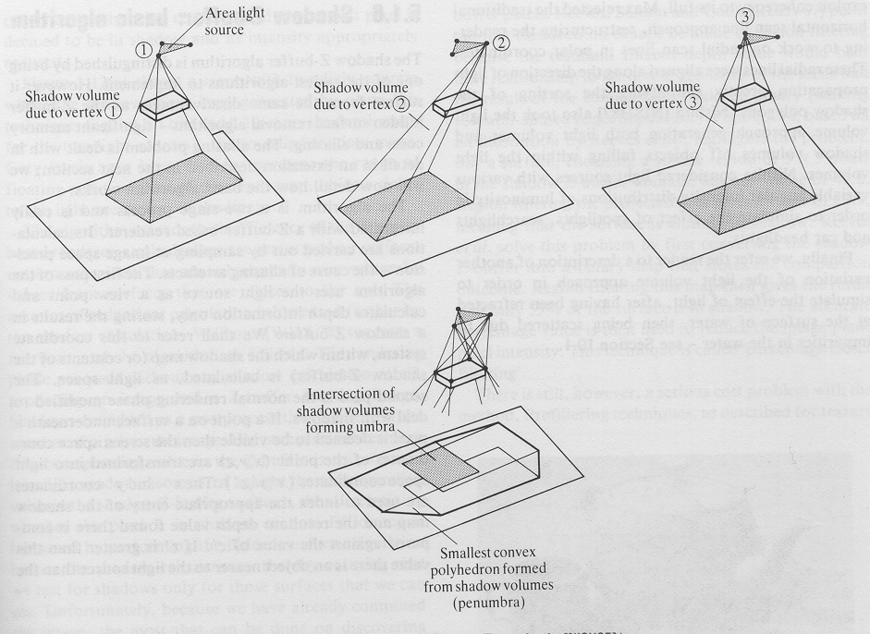
Area Lights for Soft Shadows
Area light source can be modeled as a sum of
many point sources (discrete convolution)
Umbra is the intersection of all shadow volumes
Penumbra is the convex hull of union of volumes

Slide 25
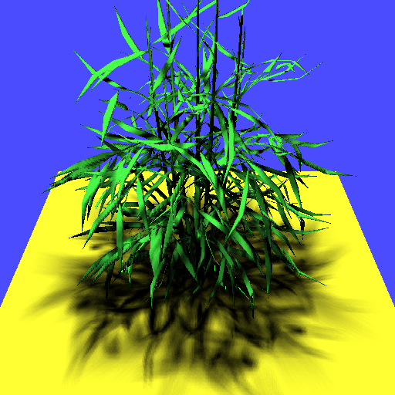
Layered Attenuation Maps
Several layers of shadow maps – each with soft edge attenuation
Each layer attenuates
light transmission to lower
surfaces / shadow maps
Attenuation accumulates
Attenuation vs binary
shadow function leads to
soft shadows

Slide 26
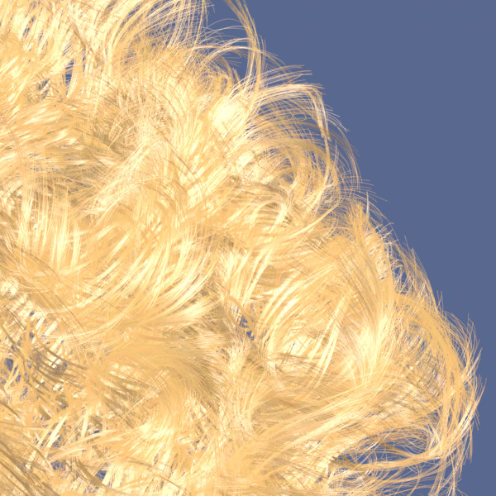
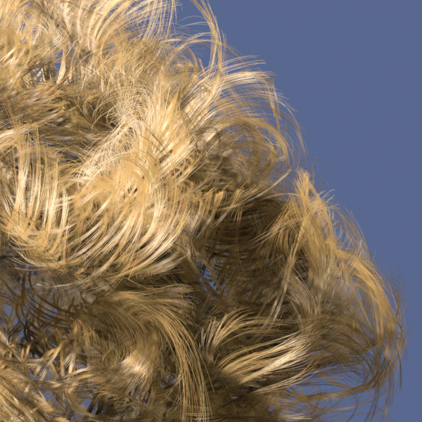
Deep Shadow Maps
Construct a continuous visibility function at each pixel of a shadow map to attenuate light as a function of depth

