Slide 1
Radiosity
CS580
(Computer Graphics Rendering)
Ulrich Neumann

Slide 2
Global Illumination
Shadows are great, but there is more to natural scenes than just shadows, which are light source occlusions modulating Phong shading
In real scenes, all portions of the scene interact
  Basic theory comes from thermodynamics study of heat transfer and radiation
  Each surface point reflects light so it is a light source to all other surface points (N-to-N occlusion terms)
Survey two of the early approaches to radiosity based on linear approximations

Slide 3
Hemi-Cube Method (1)
Cindy Goral, Ken Torrance, Don Greenberg, Bennett Battaile [Sig’84]
Michael Cohen, Don Greenberg, Cornell [Sig’85]
Produces lighting calculations that are view-independent
  Accounts for shadows, diffuse reflections, area lights, inter-reflections
  Computes diffuse and ambient reflections accurately and explicitly
  - Improvement over local models with point lights, fixed ambient terms, and binary shadow decisions
  Specular reflections are not computed - they are view-dependent
Once solution is computed, render/view the image from any viewpoint without recomputing the radiosity solution
  Very fast rendering – shading is completely pre-computed
  Incremental (adaptive) methods allow movement of objects and lights without complete recalculation of entire radiosity solution
  Specular shading terms can be added to radiosity solution

Slide 4
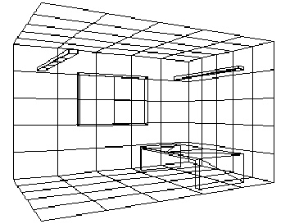
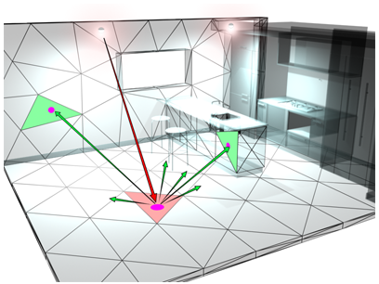
Hemi-cube method (2)
In the limit, the radiosity parameter space is infinite
  An infinite number of points interact in a scene
  A local method cannot solve the radiosity equation at a point since the solution is a function of all scene points – solve all points simultaneously
Approximation is based on finite elements (discrete samples)
  A discrete (sampled) representation of the 3D scene (mesh)
  Partitioning (patches) usually not same as polys in scene model
Assume ideal diffuse reflecting surface
  Surfaces reflect same radiosity in all directions over the hemisphere about normal
Reflected radiosity at a point is related to incoming intensity, angle of incidence (cos law), and reflectivity of material (Kd)

Slide 5
Hemi-cube method (3)
Radiosity(i) = Emission(i) + Reflectivity(i) ∫ Radiosity(j)
  the diffuse and ambient terms of shading Eq
  Integrates all contributions from environment (at some sample density)
B_{i} = E_{i} + P_{i} ∑ R_{j} A_{j}
  R_{j} accounts for B_{j} radiosity of other scene elements
  Aj accounts for the fraction of patch j that is visibility to patch i (visibility prob)
  P_{i} is surface i reflectivity parameter (Kd)
O(N²) complexity
  N elements interacting (dependent) on N-1 elements
Total incident energy = ∫ Radiosity(j) = ∑ R_{j} A_{j}
s
p
Reflected energy
Radiosity of surface
Energy per unit area
watts/m²
Surface_{i}
with P_{i} as
BRDF approx
D
C
Emitted energy

Slide 6
Hemi-cube method (4)
Introduce the form-factor F_{ij} to account for visibility
  F_{ij} is fraction [0,1] of hemisphere i covered by radiosity leaving surface j (or, visibility of patch j from patch i)
  ∑ F_{ij} = 1, over all i, for all j
  Assumes a closed world : no surface sees “empty space” and no transparency
Substitute R_{j} A_{j} = B_{j} F_{ij} into prior eq:
  B_{i} = E_{i} + P_{i} ∑ B_{j} F_{ij}
t
∑ B_{j} F_{ij} Total incident energy
s
p
B_{i} = Radiosity of patch i
energy per unit area
watts/m²
P_{i} ∑ B_{j} F_{ij} Reflected energy
patch i
D
C
E_{i} Emitted energy

Slide 7
Hemi-cube method (5)
B_{i} = E_{i} + P_{i} ∑ B_{j} F_{ij}
B_{i} is light emitted from current patch i – (rgb) sent out into world/scene
E_{i} is light actually generated at patch i -- known for each light source patch (area lighting!) as an (rgb) vector
P_{i} is reflectivity of material surface, Kd -- (rgb) reflectance known for each surface patch (material property)
Light hitting surface i (∑ B_{j} F_{ij}) requires form factors for all surfaces (visibility calculations)
  F is an array of scalars computed off line (show later)
    F_{ij} is form-factor visibility of patch j from i -- n per patch, n² total (F_{ii} = 0)
B_{j} is light emitted from all other surfaces (i ≠ j)
B_{j}’s are constant but unknown -- we need to compute these values
NOTE: all terms are view-independent and all terms are linear
  N eq’s and unknowns – solve as linear system of eq’s
  Rewrite to put into matrix form to solve for B’s

Slide 8
Rewrite as E_{i} = B_{i} - P_{i} ∑ B_{j} F_{ij}
Gathering form of equation system
  Emitted energy = patch radiosity minus the reflected gathered/accumulated energy from other patches
Note 1-PF terms on diagonal (actually = 1 since F_{ii} = 0)
System is diagonally-dominant – so the solution is stable
  P<1, F_{ij}<1, and ∑_{j} F_{ij} ≤ 1

Slide 9
Solve Equation
Bs can be solved for using linear solution methods...
  Gaussian elimination (slow but works)
  Gauss-Seidel iterative method converges for diagonally dominant systems (see linear algebra ref)
    Initial guess for B’s is E’s
    Iterate until change is less than threshold - typical 6-8 iterations
Since P’s and E’s are vectors (RGB), solve for 3 values (RGB vector) of B’s as well
  Set up 3 systems and solve for RGB separately - same F’s for all
  Alternative is to solve only for intensity - gray scale and use that value for scaling the fixed colors (Kd) of surfaces or textures
Final B’s are radiosity of patch - one value associated with each whole patch : need to use this during rendering (discuss later)

Slide 10
How to Compute F’s (1)
F_{ij} = (1/A_{i}) ∫A_{i} ∫A_{j} (cosφ_{i} cosφ_{j} / πr²) H_{ij} dA_{j} dA_{i}
F_{ij} is fraction of hemispheric solid angle at patch i covered by visible portion of patch j (when viewed from i)
H is an occlusion term
  0 when dA is occluded, 1 when visible
Double integral is hard to evaluate directly
  Approximate angles φ as constant under constraint that area A’s are small relative to distance r
  May have to subdivide A_{i} or A_{j} to keep approximation valid
φ_{j}
φ_{i}
r
A_{j}
A_{i}

Slide 11
How to solve for F’s (2)
F_{ij} = (1/A_{i}) ∫A_{i} ∫A_{j} (cosφ_{i} cosφ_{j} / πr²) H_{ij} dA_{j} dA_{i}
Evaluate cos terms and r from center of patches and hold constant for inner integral
  Outer integral is a multiply by A_{i} that is canceled by 1/A_{i} term
The integral can be approximated for any patch pair, given an H term – occlusion between patches
  Hidden surface problem, again…
  Simplified integral approximation is evaluated over portion of hemisphere, over which patches are visible to each other

Slide 12
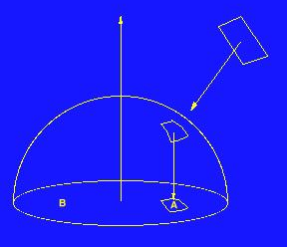
Solve H and F by “divide and conquer” …Enter the Hemicube (1)
A graphic interpretation: The form factor is equal to the fractional area formed by the projection of a patch j onto the hemi circle of patch i
  Patch area projection accounts for cos law missing in fixed reflectance Pi
  Sum of all form factors F_{ij} for a given patch i = 1
Render hemicube image from each patch i to create array of F_{ij} samples
  Solves/approximates F_{ij} by sampling visibility of patch j’s from patch i
Each hemicube pixel has a known (fixed) fractional F weight
  Fixed pixel weight W for its projected area onto the hemi circle is precomputed
  Typical hemicube has 50x50 to 100x100 pixels on each of 5 sides
  Hemicube pixels store Z
  and j - index to patch
  that’s visible
“Nusselt analog”
Estimates form factor as:
Area A / Area B

Slide 13
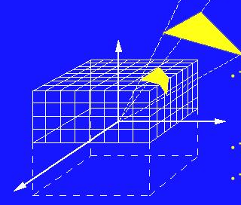
F_{ij} from the Hemicube Pixels
Visibility computed at hemicube on patch i lets us accumulate W’s (visible samples) for all possible surfaces j
Five Z buffer renderings (one per hemicube surface) with viewpoint at center of patch i determines which patches j are visible
Accumulate all pixel W’s into bins indexed by j’s (visible patches) to create F_{ij} = ∑ W_{j}
Construct hemicubes at each patch i
and render scene images to
compute F’s
Need to compute all patches
since F_{ij} is not equal to F_{ji}
Form factors do obey a reciprocity
relation A_{i}F_{ij} = A_{j}F_{ji}

Slide 14
Rendering a model with radiosity
Once patch radiosities (B’s) are known, patch B’s are mapped to model polygons
Compute poly vertex colors by interpolating/extrapolating from patch center points, where B’s are assumed to be correct
Ensure continuity of reconstruction
  Smoothness is main concern
Render scene from any viewpoint and shade by interpolating precomputed vertex colors

Slide 15
Radiosity Summary
Read in polys
Create patch mesh (separate issue)
Determine F’s using hemi cube rendering
Set up linear eq system with F’s, E’s, and P’s (known from scene data)
Solve system for RGB B-values
Interpolate/extrapolate poly vertex RGB colors from patch radiosities
Render from arbitrary viewpoint (no shading, just color interpolation)
Order N² in memory and time
  Bulk of work lies in computing form factors
  Large memory needed in solving simultaneous system
Aliasing in form factors and patch density
  miss small lights, jagged/smeared shadow edges
Patch determination strategy is problematic
  3D scene sampling problem
  Adaptive techniques are employed to refine patches based on shading gradient

Slide 16
Faster Radiosity
Sig’88 - Cornell again
  Progressive Refinement
Get coarse solution fast, and refine in each iteration
  Improve quality as time permits
Reduce time and memory requirement to O(N) from N²
"Shooting" rather than "gathering" approach to the problem
New formulation is B_{j} = B_{j} + ∑_{i} B_{i} (P_{j} F_{ij})

Slide 17
“Shooting” Formulation (1)
B_{j} = B_{j} + P_{j} ∑_{i} B_{i} (F_{ij})

Slide 18
“Shooting” Formulation (2)
B_{i} column (right) is in descending-order of radiosity values for all patches in environment
  Shoot light from strongest emitters or sources first
A patch can only shoot once, updating the whole scene in one pass
Continue until all patches shoot or until time permits
Non-emitting patches can start with an "ambient" intensity as their initial B value
  speed convergence – effect decays to zero as iterations proceed
Dim patches never shoot, so their F is never needed
  Possible lazy evaluation of F to support moving objects, lights, etc.
Tests on 500 patch scenes required 25-100 F values for good results

Slide 19
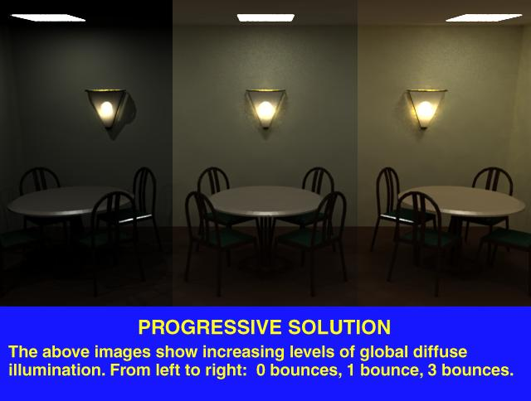
Examples
https://www.siggraph.org/education/materials/HyperGraph/radiosity/overview_2.htm

Slide 20
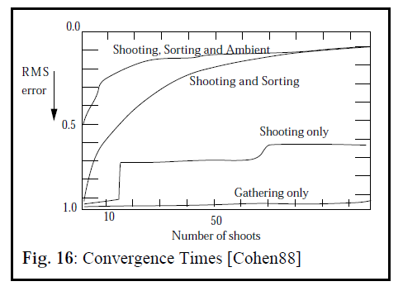
Efficiency and Error
Compare convergence of gathering vs shooting approach
When shooting, also consider
  Sorting for largest emitter every pass
  Starting non-emitters with ambient term

Slide 21
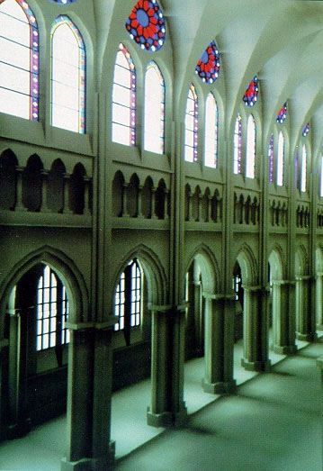
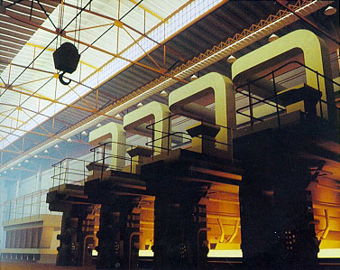
Shooting Examples
Cornell University

Slide 22
Adding Specular Effects
What about view-dependent specular effects?
Paul Heckbert (and others) added ray tracing to radiosity for specular reflections
Compute view-independent radiosity solution and store as a texture on surfaces
Perform specular-only ray tracing for view dependent component of lighting
Do adaptive sampling of rays (based on 2D image gradient) to improve specular highlight edges and reflection/shadow boundaries

Slide 23
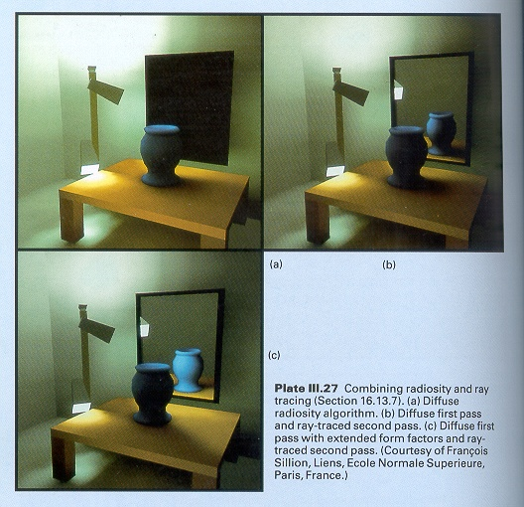
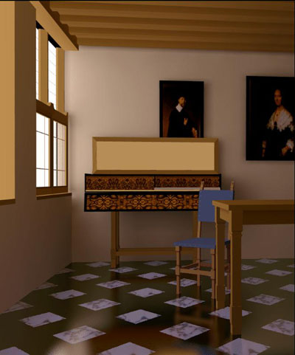
Combined radiosity and specular reflections

Slide 24
Other improvements
Cornell '91 adds BRDF
P_{i}(u,v) is function of light direction into/out of hemicube
  Material reflectance property is function of incident and reflection angles
Hierarchical Radiosity (Hanrahan et.al. '91)
Create an adaptive resolution hemicube
  group far-away clusters of objects as single objects with a single radiosity
  effectively reduces the number of patches and Fs, and therefore also iterations

Slide 25
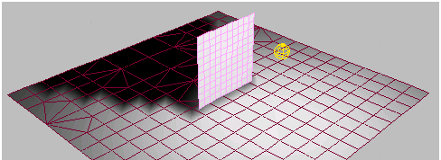
Meshing
Hierarchical Radiosity and Discontinuity Meshing (Dani Lischinski, Cornell 93)
  Better ways to mesh (patch creation) based on gradient (discontinuity) of initial radiosity solution
  The idea is to reduce the number of patches by defining their edges and densities along gradients

Slide 26
Compute in Two Directions
Model two separate processes…
Light propagation (photon transport)
  compute spread of light from sources and surfaces – no camera considerations
  compute radiosity distribution of all surfaces over all directions (photon density distribution)
  View independent distribution of light energy in scene
Camera sampling
  Given the above distributions from each surface, compute the light samples gathered by a camera
  View-dependent sampling of light reflections to camera

Slide 27
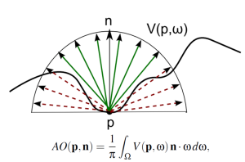
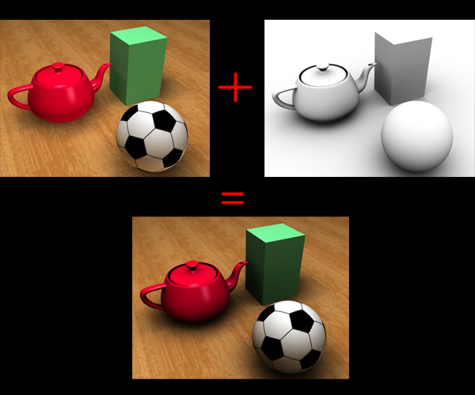
Ambient Occlusion
In many cases the perceived radiosity benefit is in modeling indirect illumination (ambient light) rather than the color bleeding effects
  Darker room corners, under objects, …
  Nearby geometry impacts how much light
  reaches these areas
    Approximate a global problem with a
    semi-global problem
    Consider only spatial-neighborhood
    geometry in approximating ambient light
    Global --- Neighborhood --- Local
      spectrums of problem formulation
Brute force implement as ray tracer

Slide 28
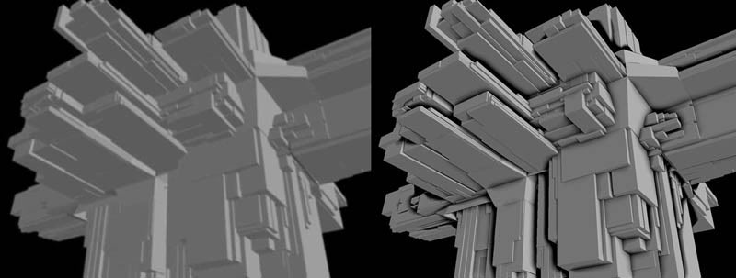
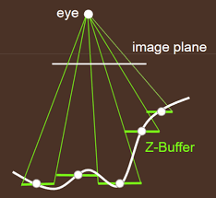
Screen Space Ambient Occlusion
SSAO – and similar (HDAO, …)
Gavin Miller "Efficient algorithms for local and global accessibility shading". Siggraph 1994
Implement AO using screen pixel-depths
  Neighborhood geometry is in the z-buffer of surrounding pixels
  No need to sort or do ray-tri intersections for whole scene data
Find surrounding z-depths closer than shading point “p”
  Filter the closer Z-values to produce an approx occlusion factor used to scale ambient light in shading Eq.

