Slide 1
Inventory Management System (IMS)
Leonid Gornovskiy

Slide 2
My Background
Physics graduate with significant experience in Python and Fortran 95 programming.
Have recently acquired knowledge in Java, JS, MySQL and HTML.
Have previously worked on a DB management project with MongoDB.
Currently training in CSS, Java, JS, HTML CSS among other tools.

Slide 3
Technologies and Prerequisites
Visual Studio Code
MySQL Workbench
JDK 18
Maven Integration
GitHub and GitBash or Terminal if using a Unix-based system.
JUnit

Slide 4
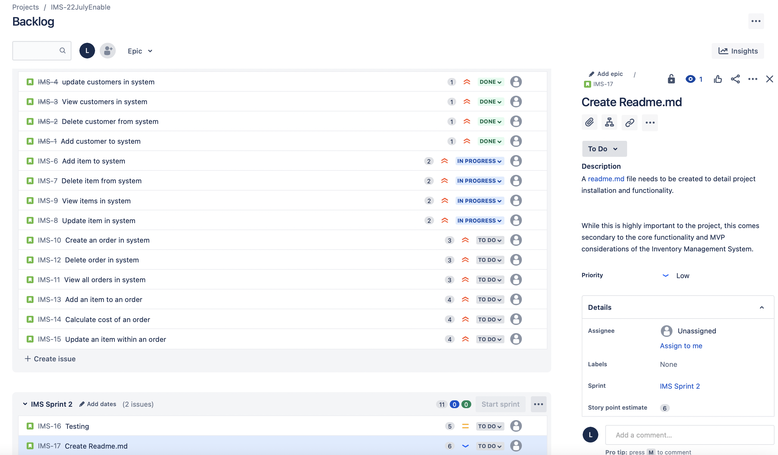
Project Management with Jira

Slide 5
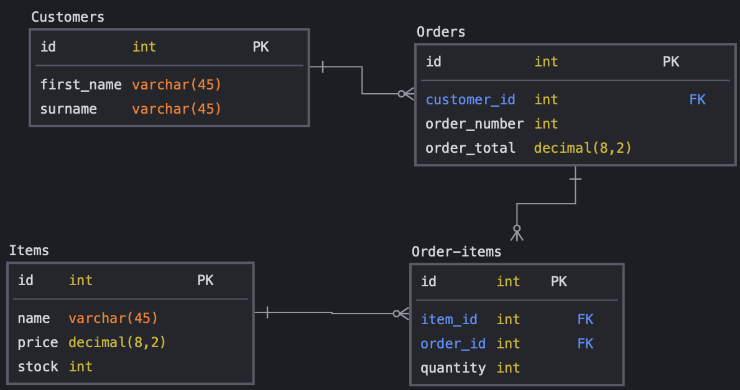
Designing a Database Schema with and ERD

Slide 6
A Demonstration of Application Function
The IMS gives the user the ability to manipulate Customers, Orders and Items, which have unique attributes and relationships as per the database schema shown earlier. The attributes for each of the entities are as follows:
Customers
First Name
Surname
Customer ID
Orders
Customer ID
Order Number
Order Total
Items
Item ID
Name
Price
Stock
These attributes can be viewed and amended with the Create, Read, Update and Delete (CRUD )functionality of the IMS.
As CRUD functionality is similar between the entities, it is demonstrated for Customer here. The other entities will have differing attributes based on the above lists but are otherwise identical in editing or viewing.

Slide 7
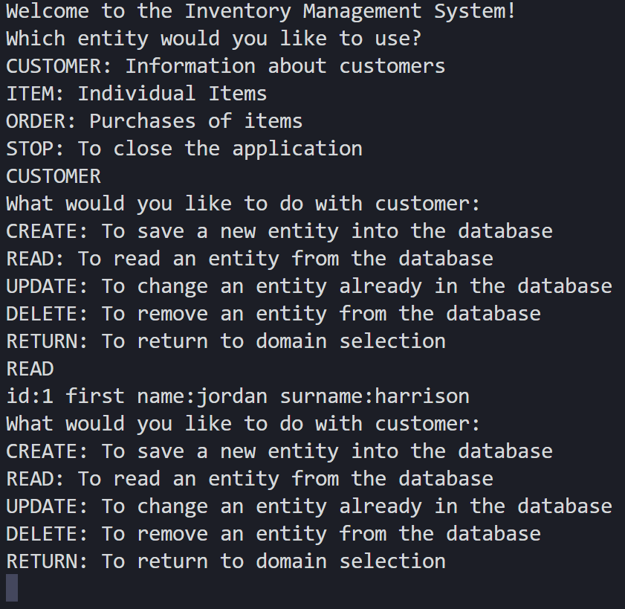
A Demonstration of Application Function

Slide 8
Testing and Coverage
Tests need to be run to ensure the IMS functions as intended and to give an opportunity for any unanticipated bugs to be ironed out. The tests are run each of the objects in the IMS, which include:
Customer
CustomerDAO
CustomerController
Item
ItemDAO
ItemController
Order
OrderDAO
OrderController

Slide 9
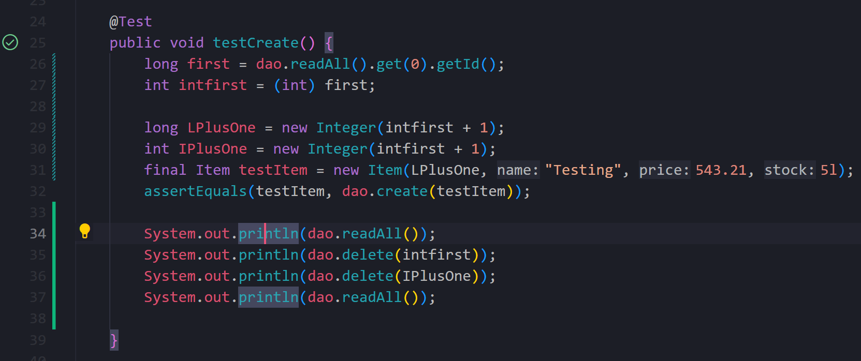
Running Tests

Slide 10
Overview of Time Management and Completion
Successes
Project was planned successfully
Well-planned sprints and issues were instrumental in keeping a good flow of work
Versioning worked well for separating the different aspects of the project such as building the IMS, testing and adding documentation.
Readme documentation is thorough that a user familiar with some use of IDEs and Git will be easily able to run the project
Improvements
Time management was not always perfect and sprints/issues failed to account for serious delays or impediments.
Some parts of the IMS were hard-coded and this could pose a challenge to future improvements.
Versioning was imperfect as I generally preferred to use a single branch when working only with building the IMS.
There is currently limited flexibility in the IMS and no easy way for the user to clear it, which could be.
There is a known bug with order value calculations.

Slide 11
Conclusion
The project helped combine and consolidate skills learned in the previous weeks.
MVP has been achieved though future updates could include such things as:
A friendlier user interface (GUI).
More ability to interact and amend the IMS from said database.
More flexible coding to allow for easy improvements.

