Slide 1
MC311 Requests Pattern Analysis
Han Le

Slide 2
What is MC311?

Slide 3

Data Ingestion + Wrangling
Tools:
Python (Google Colab)
MC311 Requests Dataset
Source: datamontgomery
Filtered to January 2025 to April 2026
Filtered to 3 service areas and 5 ZIP codes
Created `response_time`, `day_of_week`, `month`, and `season` variables

Slide 4
Data Ingestion + Wrangling
Maryland Weather Dataset
Source: National Oceanic and Atmospheric Administration
Created `avg_temp` variable
ZIP Code Tabulation Areas Dataset
Source: Maryland.gov
Maryland Median Income Dataset
Source: Data Commons

Slide 5
Basic Descriptive Statistics
Merged all datasets together by either date or ZIP Code
Final dataset contains:
10,000+ service requests
Service areas and their respective detailed topics
Response time and SLA variables
Demographic and income statistics across 5 ZIP codes
Max, min, and average temperature every day

Slide 6
Goals
-01-
-02-
-03-
Explore how weather, location, and demographics may influence service patterns
Test if factors in dataset can predict service outcomes
/efficiency
Identify any other trends

Slide 7
Final Data Product

Slide 8
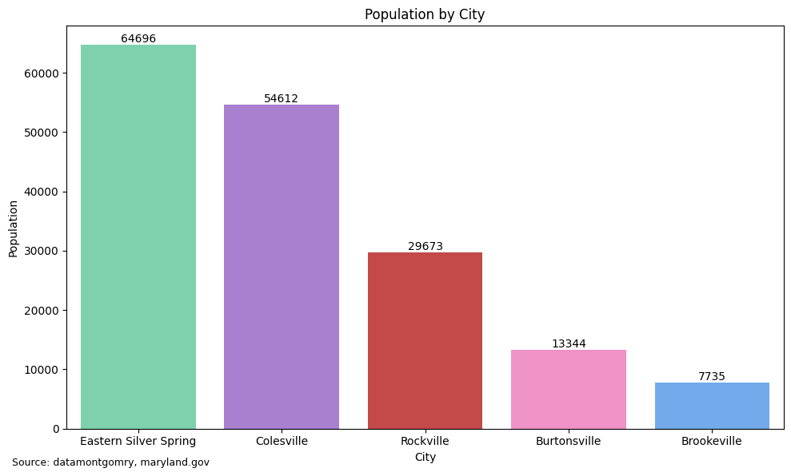
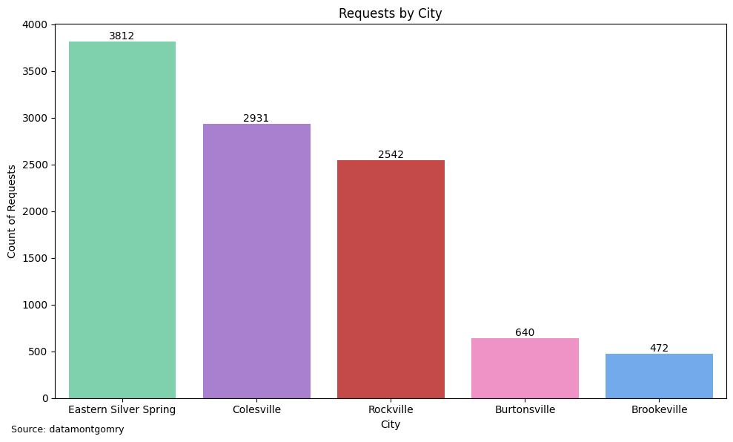
Population by City
# of Requests by City

Slide 9
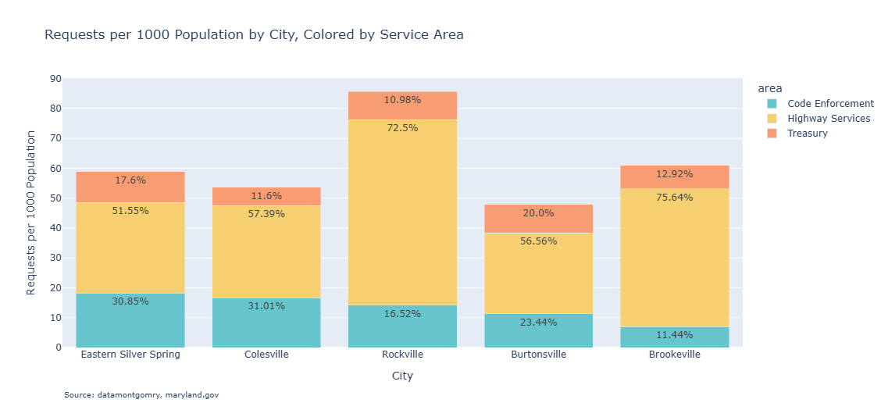
Insight 1: Population by City
Requests per Capita (1000 people)
Rockville has disproportionately high request rates
Dominance of Highway Services across cities

Slide 10
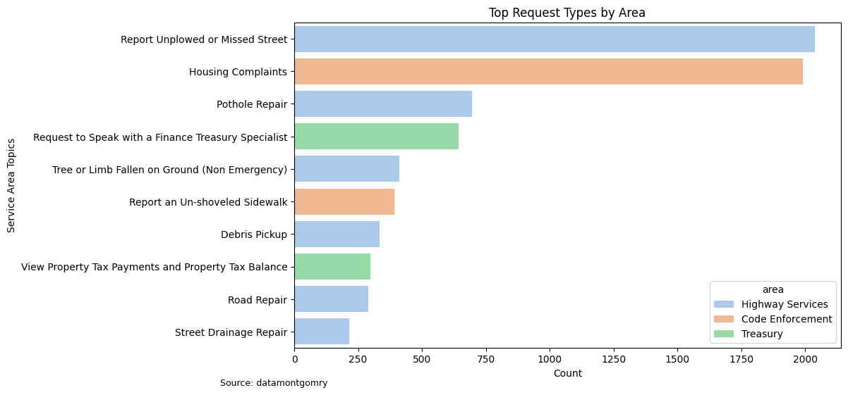
Insight 1: Population by City
Top Requests Topics, Colored by Area

Slide 11
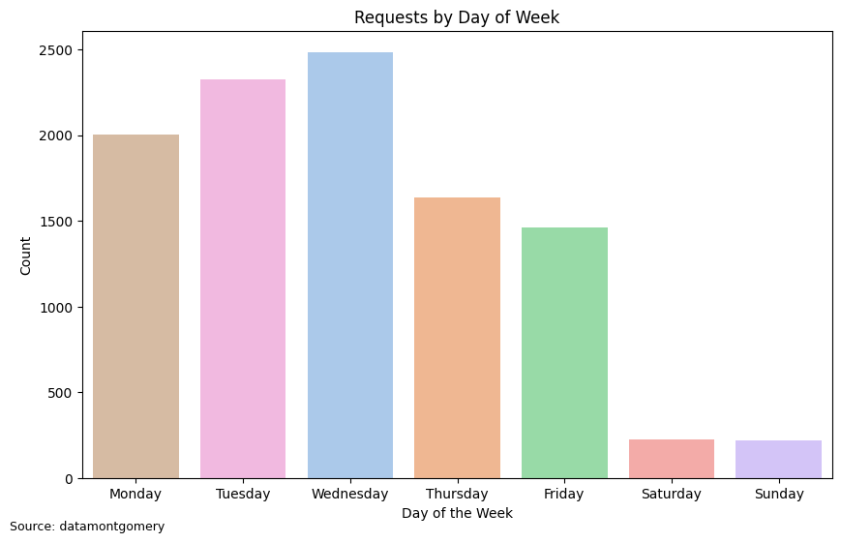
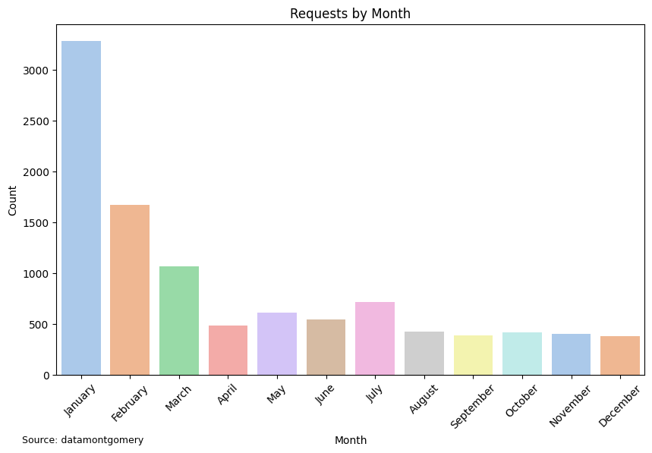
Requests by Day of the Week
Requests by Month

Slide 12
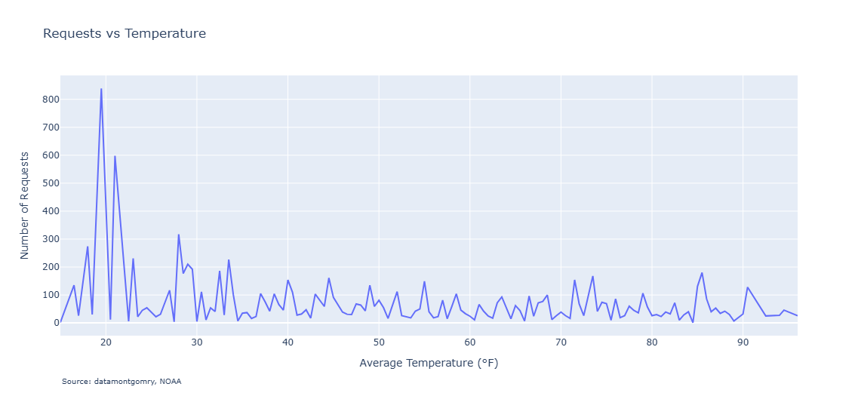
Requests vs Temperature

Slide 13
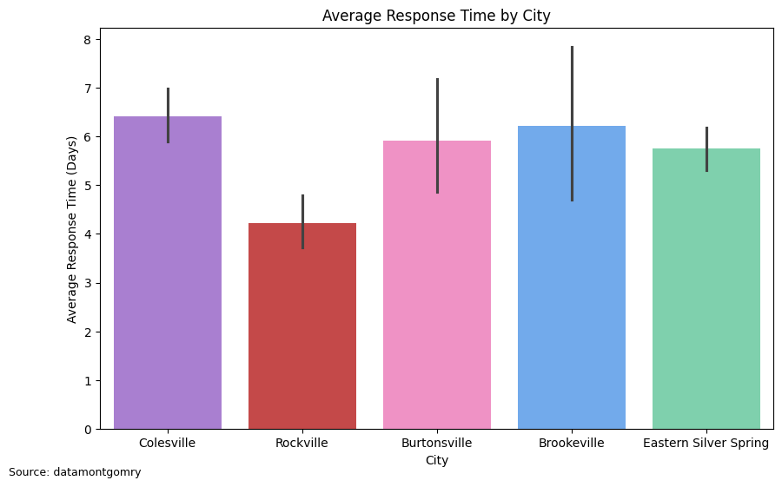
Average Response Time by City
Chi-Squared test results show that there is a statistically significant association between city and SLA compliance
(p-value < 0.05)

Slide 14
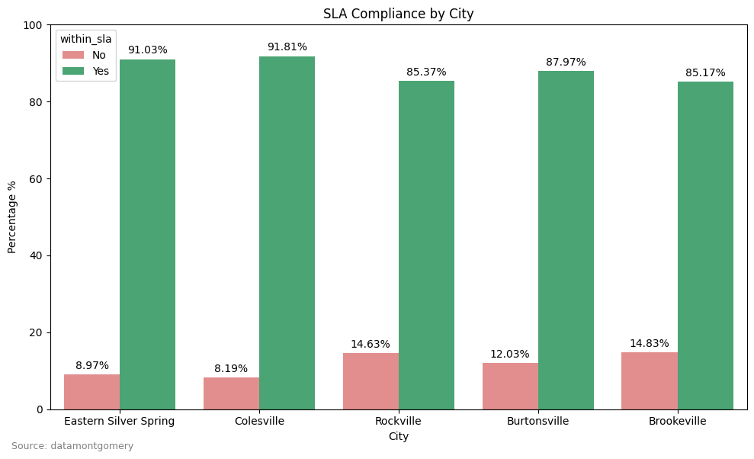
SLA Compliance by City
Multiple regression indicators:
SLA Days
Population
Average Temperature
Income
Housing Units
Ethnicity
Median Age
R-Squared = 0.126

Slide 15
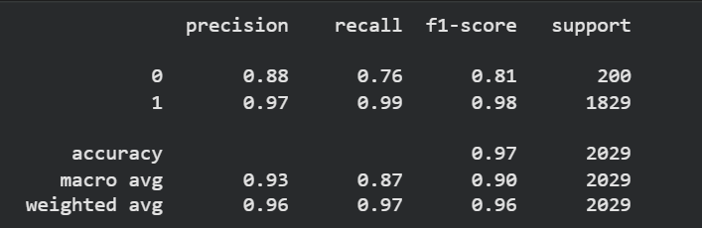
Classification Model for SLA Yes/No
97% accuracy - Dataset is imbalanced
Better on for Yes (F1 = 0.98) compared to No (F1 = 0.81).
Effective at identifying Yes SLA cases, but with the recall of 0.76, it is less reliable in detecting No SLA cases.

Slide 16
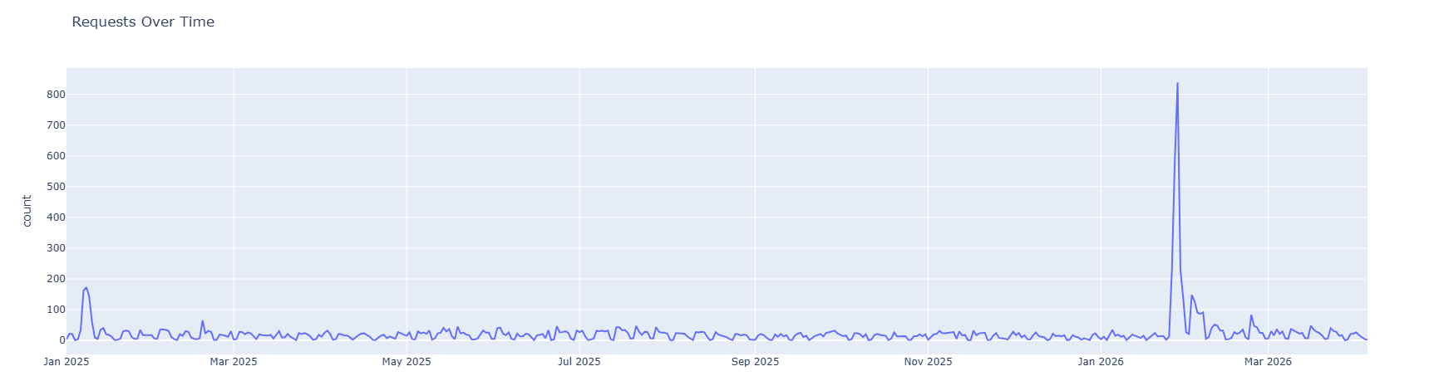
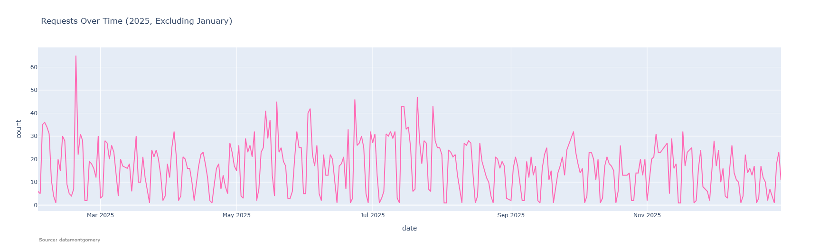

Slide 17
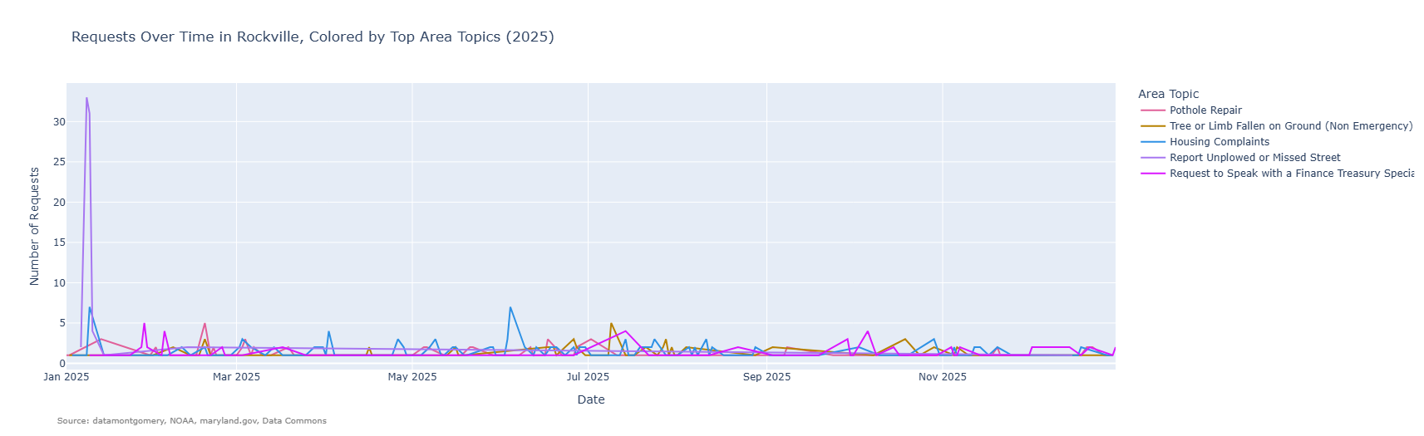
Brookeville and Burtonsville has smaller population = less requests
Peak of unplowed/missed street during January 2025 and peaks of housing complaints.
Eastern Silver Spring had the highest peak for unplowed/missed street with a count of 75
Rockville had small peaks of street drainage and pothole repair requests
Colesville had small peaks of fallen trees/trees blocking the road

Slide 18
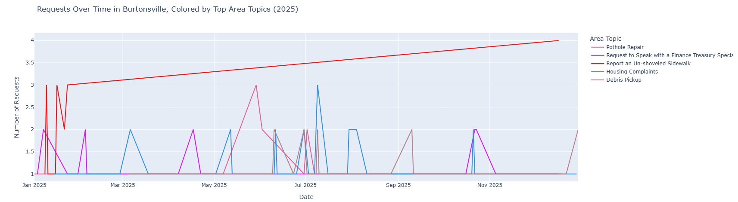
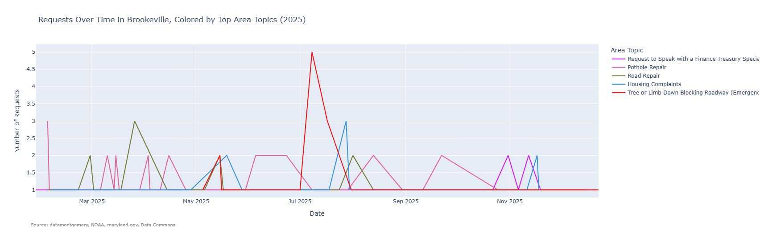

Slide 19
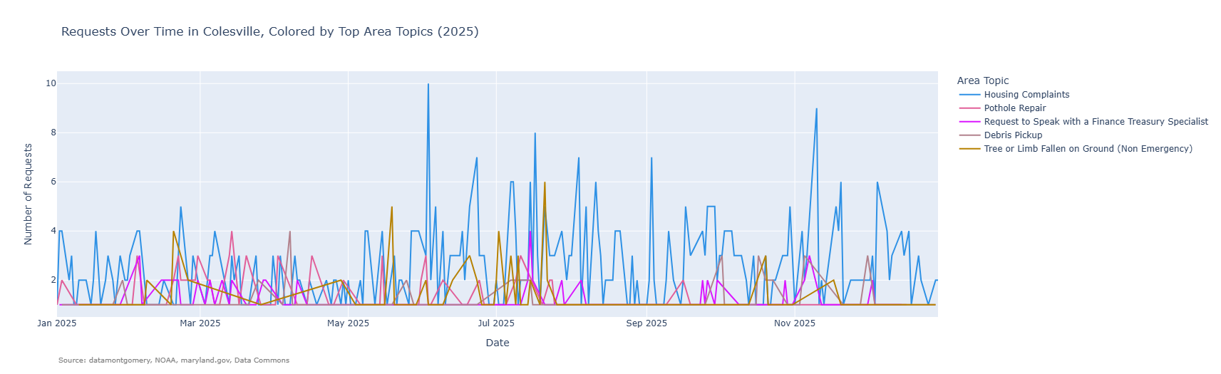
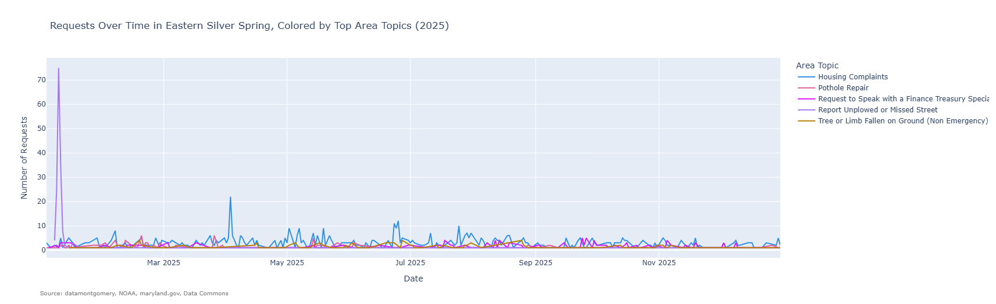

Slide 20
Takeaways
Weather impact is significant
- Service requests spike during colder temperatures and winter months
- Snow-related issues
Geographic differences
- Rockville has the highest request rate per capita and quickest response time
Service patterns
- Highway Services dominate request types
- Request volume peak mid-week and drop on weekends
Model insights
- Regression model had low predictive power for variance in response time
- SLA days only significant indicator
- Classification model had high accuracy (97%), but affected by class imbalance
- Response time and SLA days are strongest predictors of SLA outcomes

Slide 21

Reflection
Challenges
Missing or incomplete data (mainly income datasets)
Class imbalance in classification model
Weak predictive power in regression model
What was rewarding
Successfully integrating datasets
Discovering meaningful trends
What I would change
Find a dataset about work procedures for
Use resampling techniques to address class imbalance
Use more advanced models for better prediction accuracy

Slide 22
Next Steps
Expand dataset to include:
More ZIP codes and longer time range
Additional variables
Use findings to:
Improve resource allocation during peak seasons
Prepare for weather-related demand spikes
Tailor to the unique needs and compliance patterns of each city
Recommendations!

Slide 23
Github Account:
LNGHAN
Link:
https://github.com/lnghan/MC311-Analysis

Slide 24
Thank you to…
Professor Alraee
Professor Perine
Professor Park
Montgomery County Government
DataMontgomery team
DATA205 Classmates
Data Science Early College Cohort!!

