Slide 1

Internship Final Report
Real-time Chat Application
Presenter: Le Nguyen Hoai An
Mentor: Huynh Quoc Thang

Slide 2
Contents
1
2
3
4
5
Key deliverables
Results achieved
Requirement (scope) of project
Technology Stack and Demo
Lessons learnt and Best practices

Slide 3
1. Requirements (scope) of project
Project Scope: Real-time Chat Application
Requirements: Create a chat application with:
User Authentication and Authorization for register/ login.
User profile editing with change avatar and description.
Real-time chat using text, image, file.
Friend request .
Notification using Socket.IO.

Slide 4
2. Key deliverables
Back-end:
Create a RESTful API using ExpressJS and TypeScript.
Utilize TypeORM for interacting with a MySQL database.
Implement authentication and authorization functionalities using JWT.
Integrate Winston for comprehensive logging and monitoring.
Handle real-time chat-box, friend-request, user Profile updates with Socket.IO and store files using AWS S3.

Slide 5
2. Key deliverables
Front-end:
Develop a frontend application using Next.js for server-side rendering and enhanced performance.
Style the application with TailwindCSS to ensure a responsive and modern user interface.

Slide 6
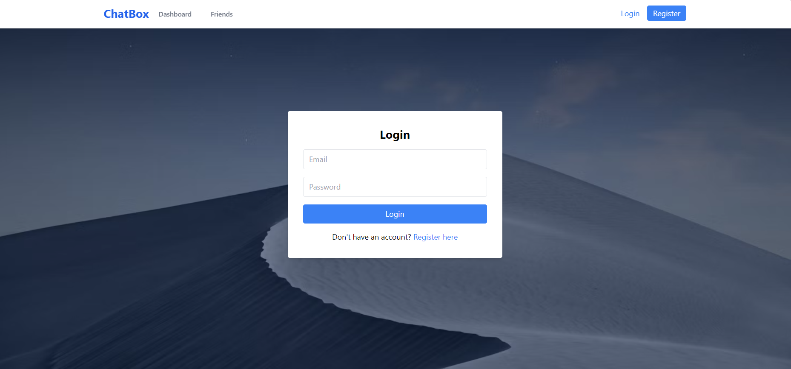
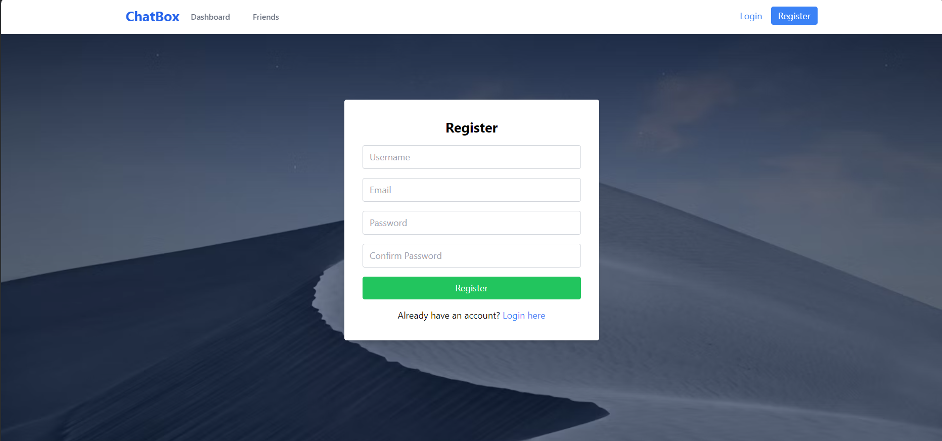
3. Results achieved
Register and Login page

Slide 7
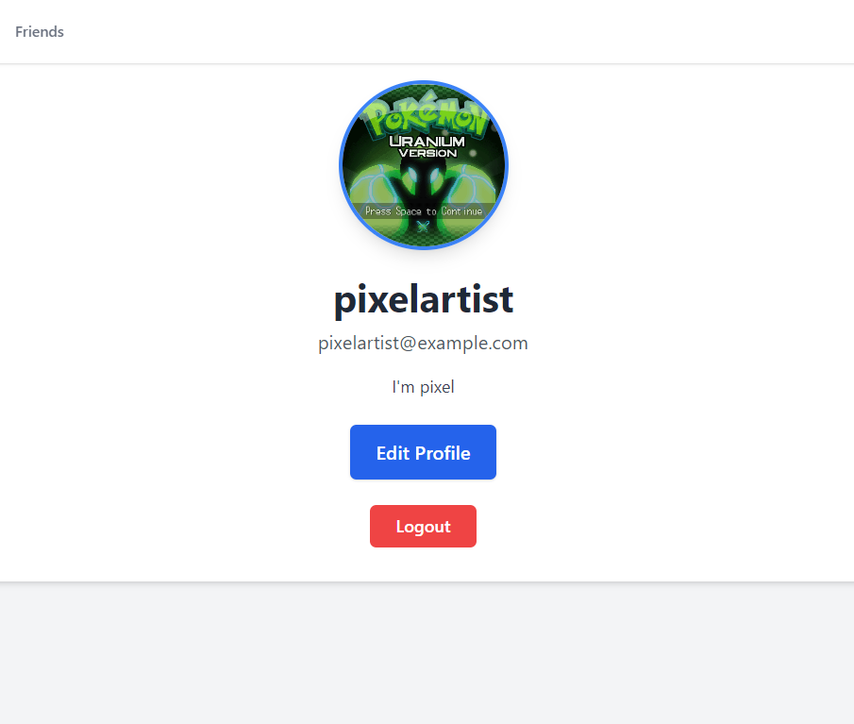
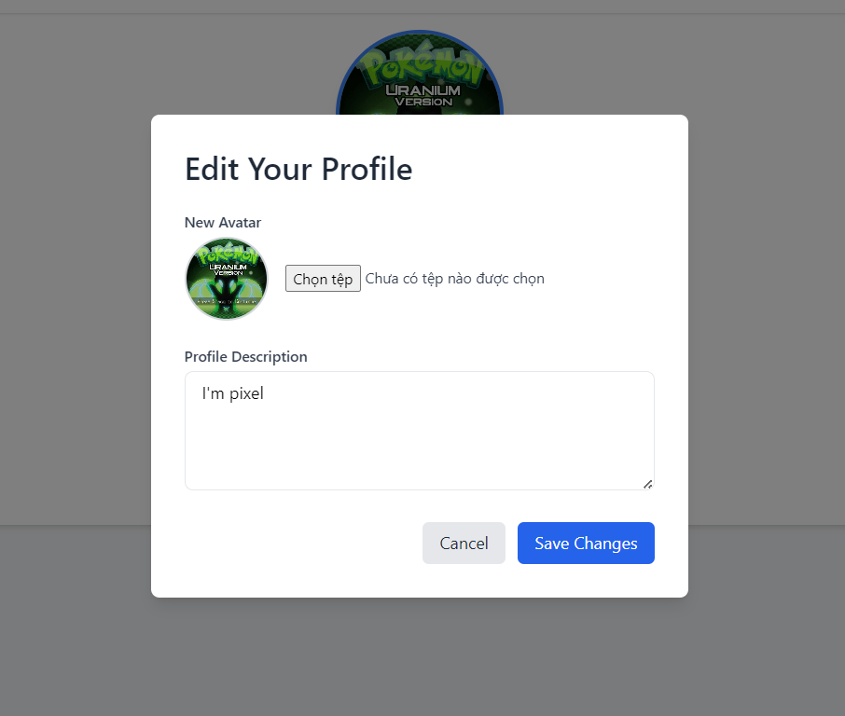
3. Results achieved
User Profile and Edit Profile page

Slide 8
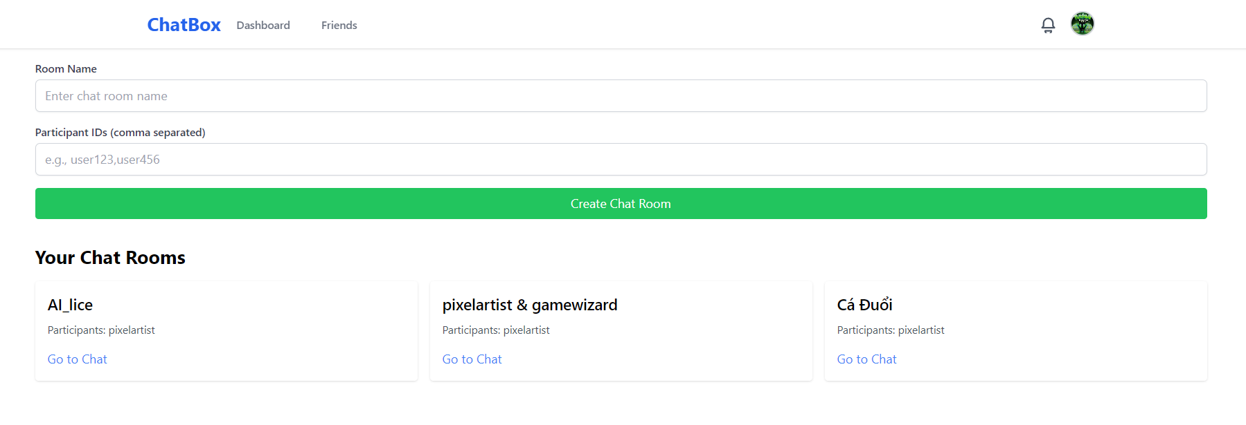
3. Results achieved
Dashboard page

Slide 9
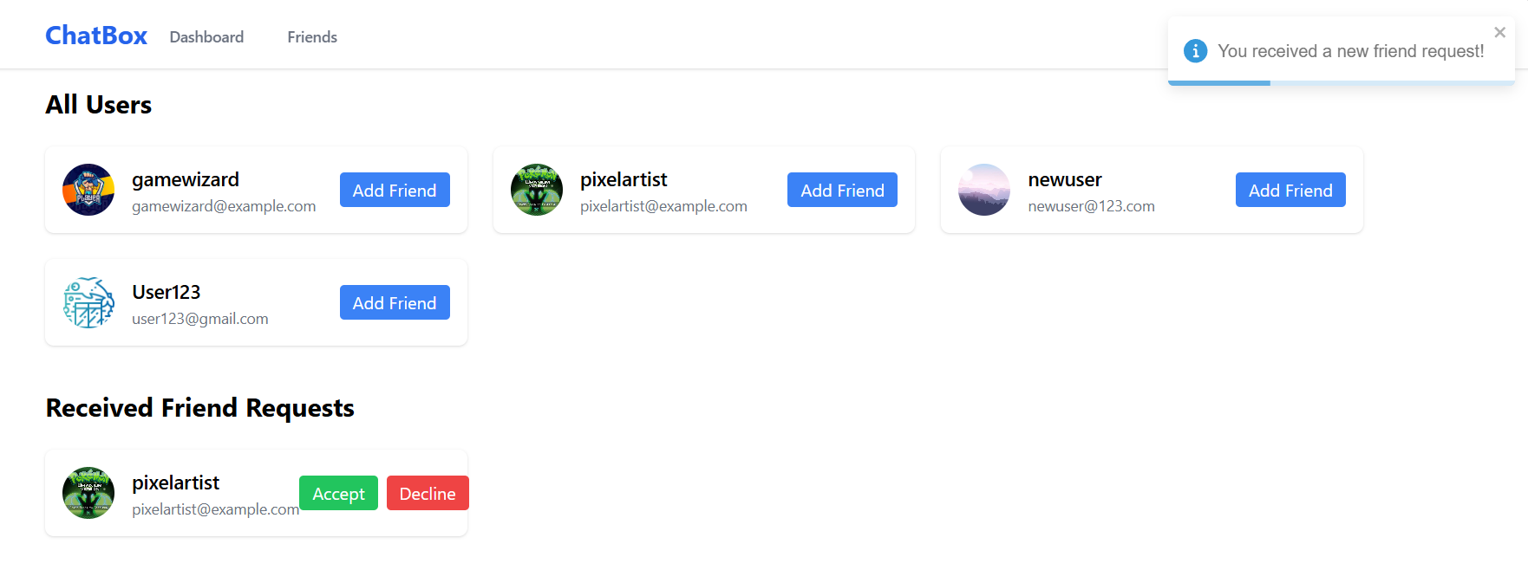
3. Results achieved
Friend Section page

Slide 10
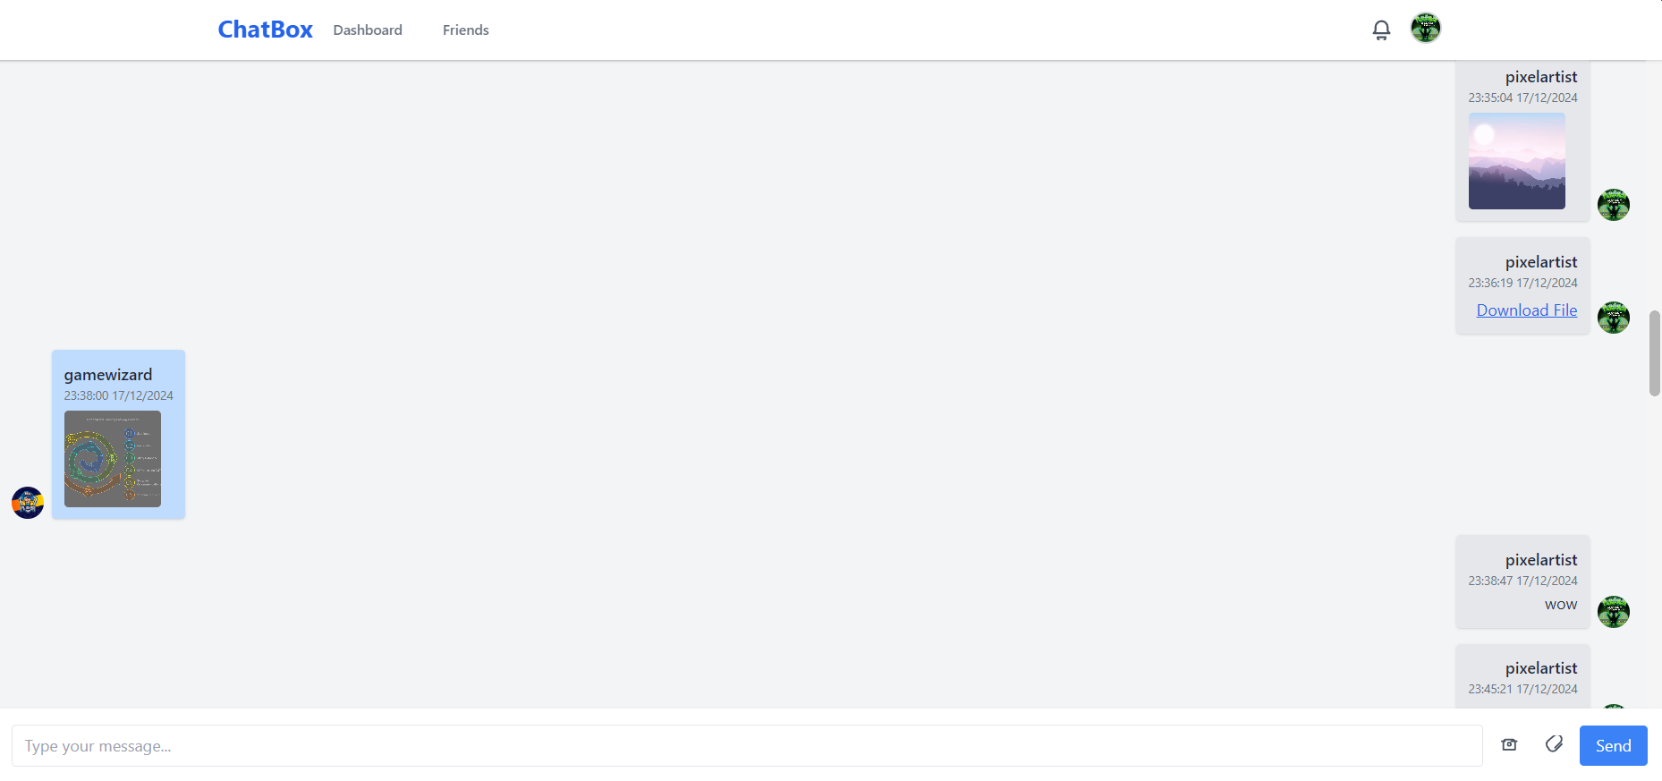
3. Results achieved
Chat room page

Slide 11
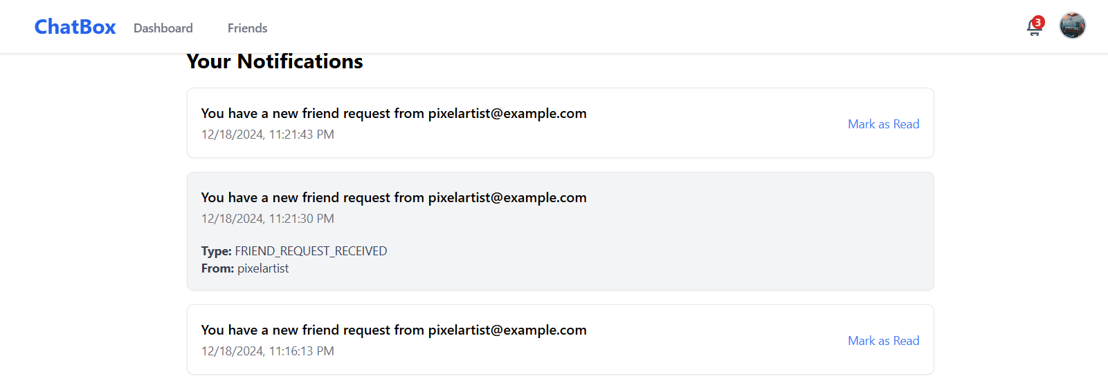
3. Results achieved
Notification Collection page

Slide 12
4. Technology Stack - Overall
TypeScript is a superset of JavaScript that adds static typing to the language. It helps catch errors during development and supports modern JavaScript features.
Why using TypeScript:
Static Typing
Type Checking
Early Error Detection
Improved Code Maintainability

Slide 13
4. Technology Stack - Overall
Socket.IO is a JavaScript library for real-time, bi-directional communication between clients and servers. Often used for chat applications, real-time notifications and live collaboration tools.
Why using Socket.IO:
Real-Time Communication
Automatic Reconnection
Event-Driven Architecture
Cross-Browser Compatibility

Slide 14
4. Technology Stack - Overall
AWS (Amazon Web Services) is a comprehensive cloud computing platform. Highly scalable, reliable and secure, making it suitable for a wide range of applications.
Why using AWS:
Scalability to handle any amount of data
High durability and availability
Have free trial with over a year

Slide 15
4. Technology Stack - Overall
MySQL is an open-source relational database management system. Supports structured data with tables, rows and columns with advanced features.
Why using MySQL:
User-friendly syntax and tools
Compatible with multiple operating systems
Includes features like stored procedures, triggers, views, . . .

Slide 16
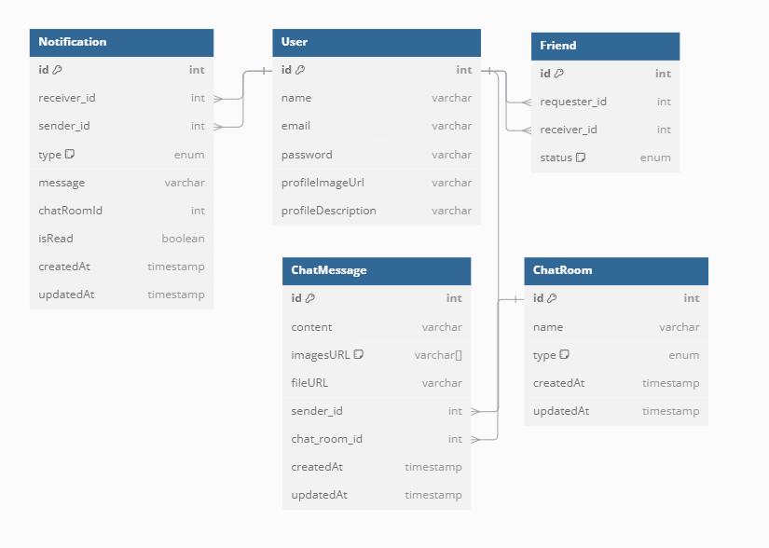
4. Technology Stack - Database

Slide 17
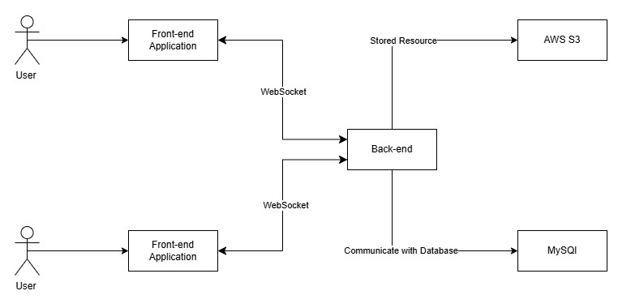
4. Technology Stack - Architecture Design

Slide 18

4. Technology Stack - Demo

Slide 19
5. Lessons learnt/best practices during internship
Best Practices:
Learn to research and use documents
Learn a new language
Improve presentation skills
Know how to write professional emails
Learn about TMA's agile process and workflow
Improve programming skills

Slide 20
5. Lessons learnt/best practices during internship
Lessons Learnt:
Should learn more about database integration.
Should learn source code management tools and practices.
Should improve English skill.
Should learn to optimize coding efficiency and quality.

Slide 21

Please let me know if you have any further question at lnhan-batch45@sdc.edu.vn (Le Nguyen Hoai An)

