Slide 1
Hashtags as a Means for Political Action
Exploring the Impact of Location-based Hashtag Activism on Place-Specific Political Processes Using Geolocated Social Media Posts Data
Leonardo Nicoletti

Slide 2
Problem introduction
# Hashtag Activism today → crucial strategy for activists to influence social change
Lots of research in this field
Importance for the organization and effectiveness of social movements
Importance for influencing political processes
Last summer: #justiceforgeorgefloyd

Slide 3
Knowledge Gap
Lack of research regarding the geographical characteristics of social media movements
Unresolved questions:
is twitter activity in a specific area more likely to influence political processes within that same area?
can the location from where people tweet determine the location from where change happens?
→ the relationship between location based hashtag activism and location based political processes (e.g. voter behaviour, policy adoption)

Slide 4
Research Question
How can location-based hashtag activism influence place-specific political processes in the United States?

Slide 5
Political processes
How can location-based hashtag activism influence place-specific political processes in the United States?
Hashtag Activism

Slide 6
Political processes
How can location-based hashtag activism influence place-specific political processes in the United States?
Hashtag Activism
Key Actors

Slide 7
Political processes
SQ1. Who are the key actors involved in location-based hashtag activism for driving political processes?
How can location-based hashtag activism influence place-specific political processes in the United States?
Hashtag Activism
Key Actors

Slide 8
Political processes
SQ1. Who are the key actors involved in location-based hashtag activism for driving political processes?
How can location-based hashtag activism influence place-specific political processes in the United States?
SQ2. Where does location-based hashtag activism translate into physical protest activity?
Physical protest
Hashtag Activism
Key Actors

Slide 9
Political processes
SQ1. Who are the key actors involved in location-based hashtag activism for driving political processes?
How can location-based hashtag activism influence place-specific political processes in the United States?
SQ2. Where does location-based hashtag activism translate into physical protest activity?
Policy adoption
Voter behaviour
Physical protest
Hashtag Activism
SQ3. Where does location-based hashtag activism influence voter behaviour and/or policy adoption?
Key Actors

Slide 10
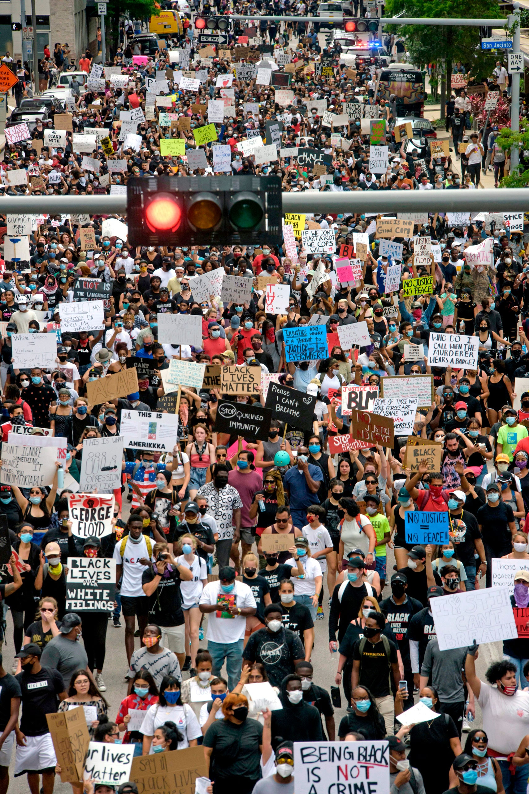
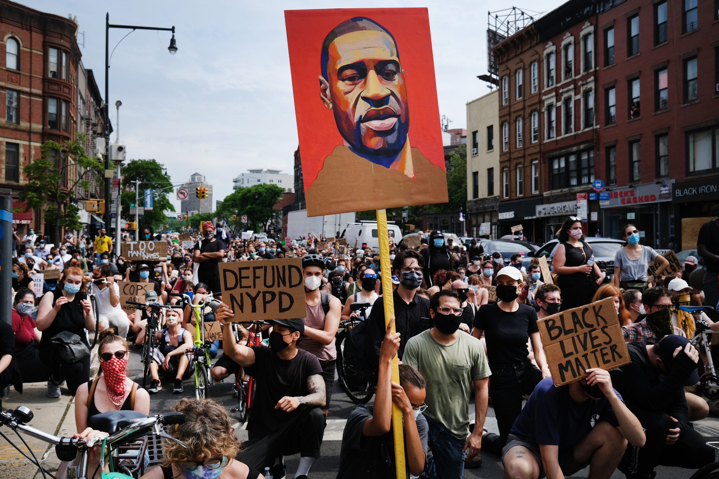
Methods
Case study of #JusticeForGeorgeFloyd

Slide 11
Methods
Case study of #JusticeForGeorgeFloyd
4 data-sets
Geo-located Twitter data from Twitter API
geo-located protest data from ACLED
data on legislatives responses to policing from NCSL
data on 2016/2020 county/precinct level election results

Slide 12
Methods
Case study of #JusticeForGeorgeFloyd
4 data-sets
Geo-located Twitter data from Twitter API
geo-located protest data from ACLED
data on legislatives responses to policing from NCSL
data on 2016/2020 county/precinct level election results
Data Science approach
Web scraping
Geospatial data analysis
Network Analysis
ML (classification, regression, clustering)

Slide 13
Methods
Case study of #JusticeForGeorgeFloyd
4 data-sets
Geo-located Twitter data from Twitter API
geo-located protest data from ACLED
data on legislatives responses to policing from NCSL
data on 2016/2020 county/precinct level election results
Data Science approach
Web scraping
Geospatial data analysis
Network Analysis
ML (classification, regression, clustering)
Iterative process

Slide 14
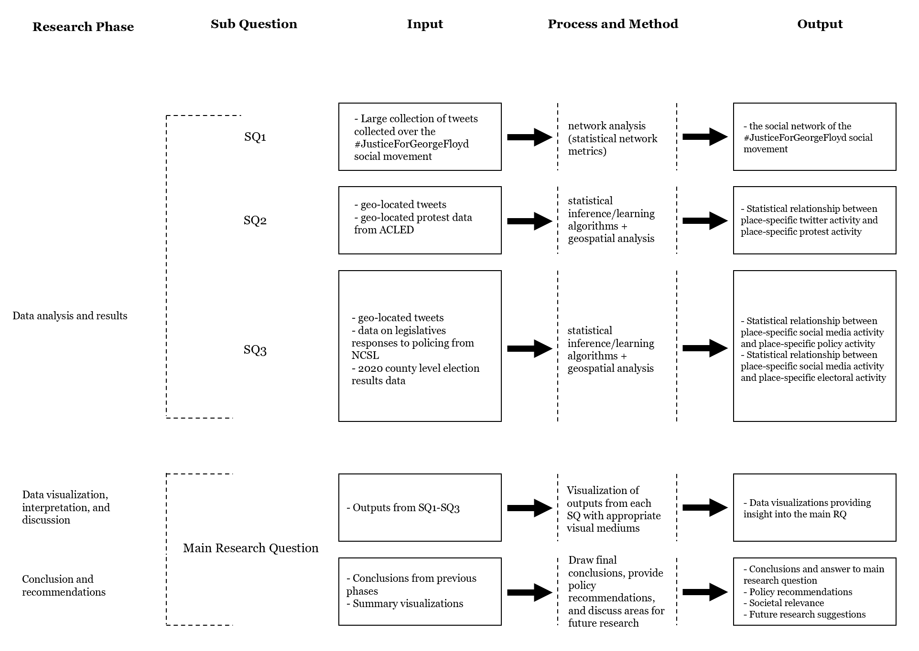

Slide 15
