Slide 1
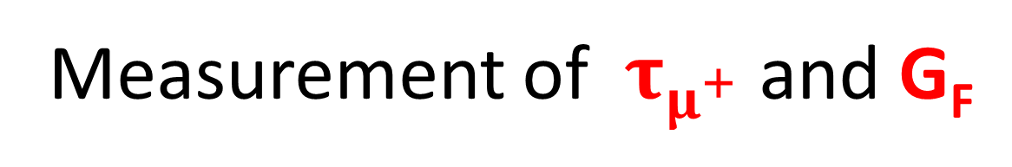
MuLan
Measurement of${ τ}_{μ^{+}}$ and G_{F}

Slide 2
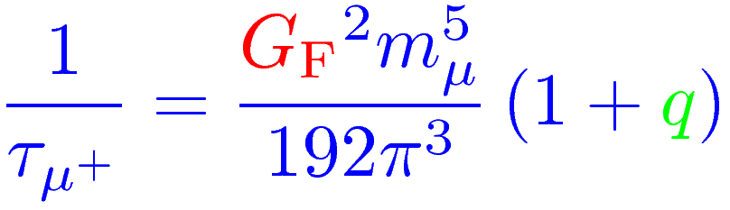
Motivation
Test of SM: Weak interaction determined by G_{F}
Muon lifetime:
Precision of q not limited by theory anymore
Test of equivalence of lifetimes of free muon and muonium

Slide 3

Basics
Free muon decay:
Muons in matter:
positive: either decays “freely” or forms muonium (prediction: same τ )
negative: form muonic atom, eventually gets either captured or decays (τ effective shorter)
Muon decay violates parity
Spin aligned anti-parallel to momentum

Slide 4
Technique
Go to fancy accelerator facility
Produce pions with proton beam
Let pions decay into muons
Send surface muons towards target
Collect μ⁺ in magnetized target
Count decay e⁺ with ~4π detector
Extract τ from decay rate
???
Profit

Slide 5
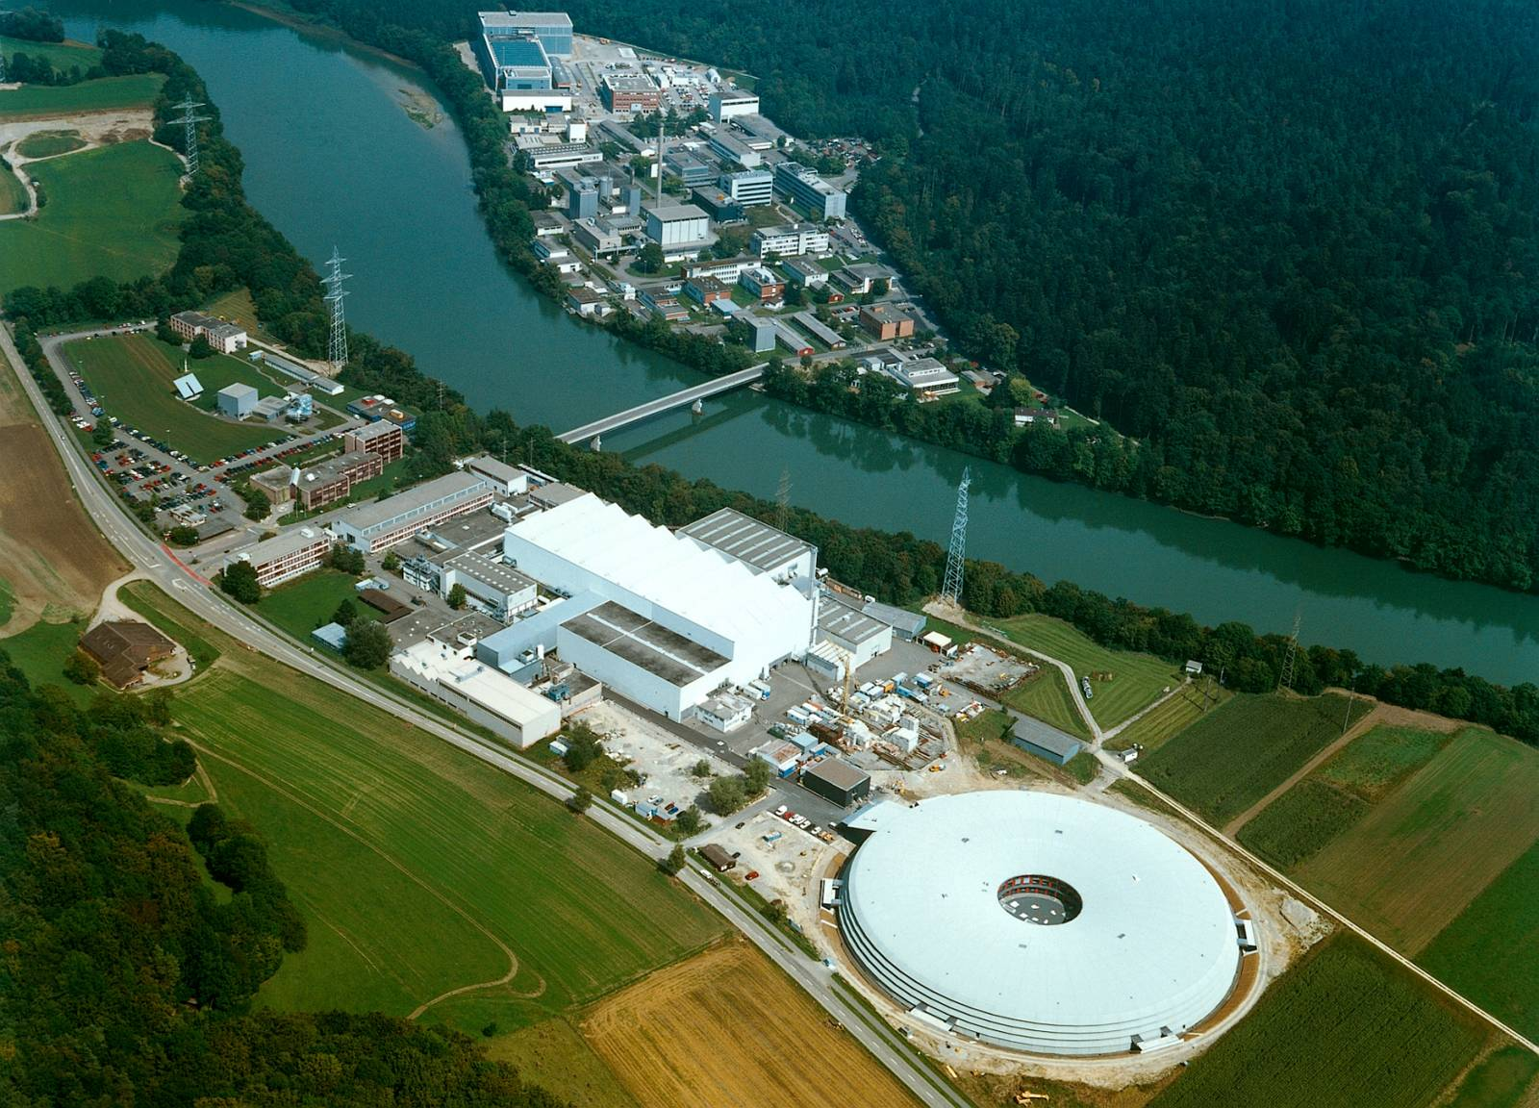
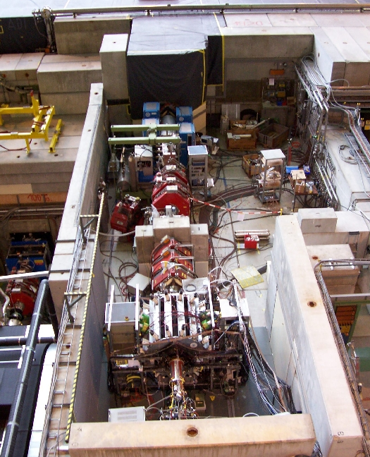
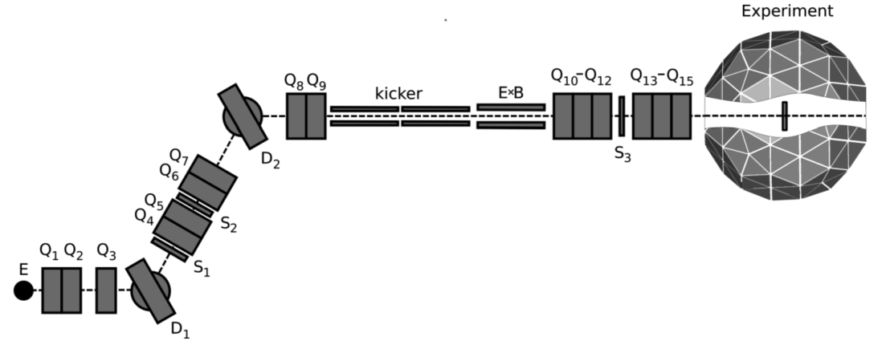
Beamline
Facility at Paul Scherrer Institute, Villingen
590 MeV proton cyclotron
1.4-1.8 mA beam
Rotation 40-60mm long graphite target
Produces surface muons
Pariy violation! ~100% longitudinally polarized
Muons guided towards experiment

Slide 6
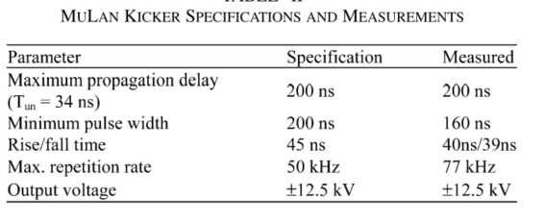
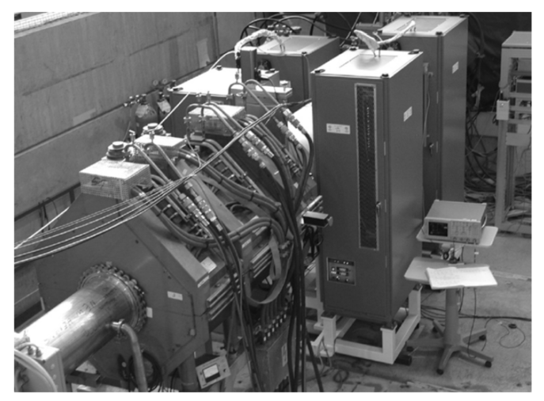
Kicker
Super fast E-field
Displaces beam vertically by 46mm
Two pairs of 75x20 aluminum plates
Operated by 17 high-power, fast transition MOSFETs
Built by TRIUMF

Slide 7
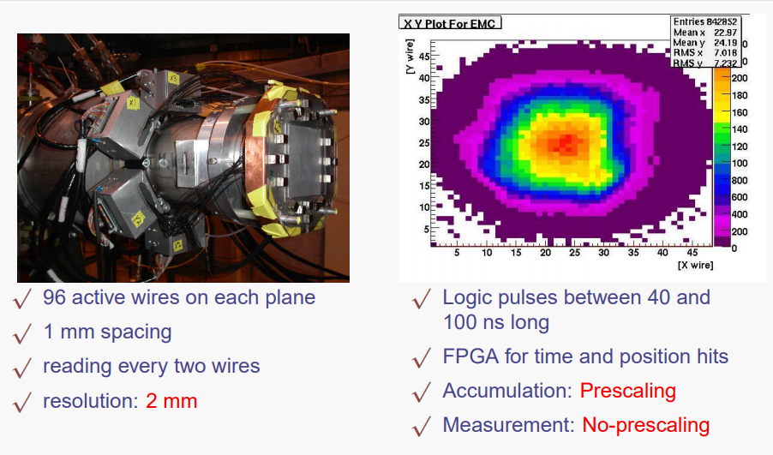
Beam monitor (Entrance Muon Counter, EMC)
Planar, high-voltage, multiwire
Measurement of x-y beam profile
2 perpendicular anode planes between 3 HV-cathode planes

Slide 8
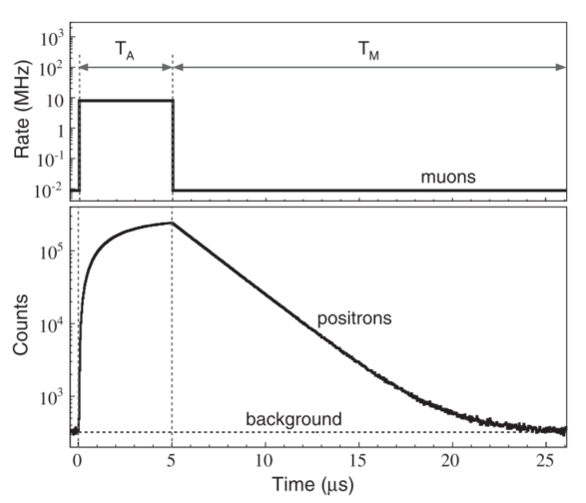
Beam Characteristics
Beam operated @ 28.8 MeV/c
Flux: ~8 MHz
Spot on target: ~21x10mm²
40 stopped muons per accumulation period, 15 positrons measured
T_{A} optimized (5 μs)
T_{M} is roughly 10 x τ_{μ}

Slide 9
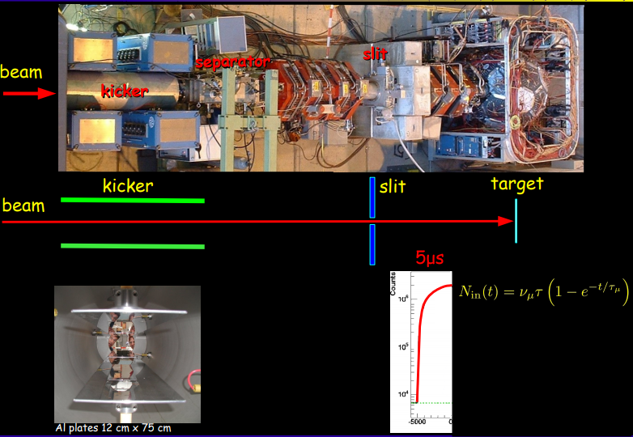

Slide 10
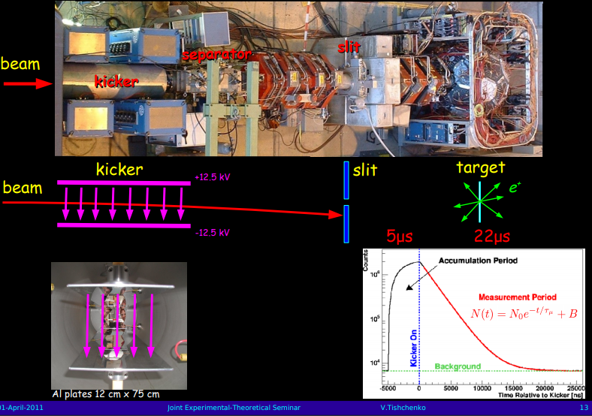

Slide 11
Targets
Target mounted on hinge to swing in beam
Two targets and B-fields for maximal dephasing of stopped muons
Arnokrome-III (AK-3) aka “Fridge Magnet”
Used in R-06 run
Ferromagentic alloy, 30% chrome, 10% copper, 60% iron
200mm in diameter, 0.5mm thick
Intrinsic magnetization oriented perpendicular to muon polarization
Results in 50 MHz precession => depolarization!

Slide 12
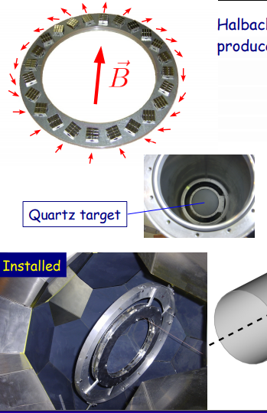
Targets
Target mounted on hinge to swing in beam
Two targets and B-fields for maximal dephasing of stopped muons
Quartz (SiO₂)
Used in R-07 run
Largest diameter single crystal commercially available:
130mm in diameter, 20mm thick
External Halbach array produces 130 Gauss B-field
Stopped muons create muonium (90%)
Test for lifetime dependences!

Slide 13
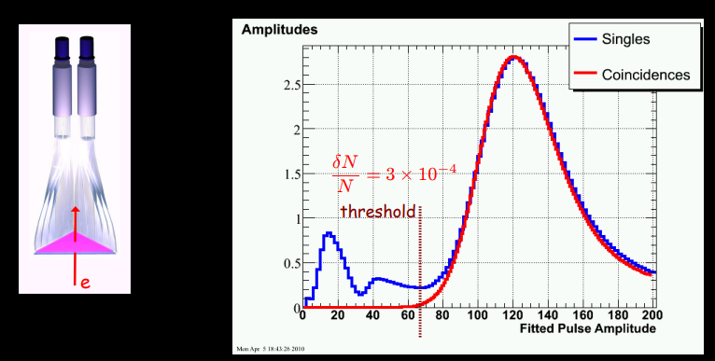
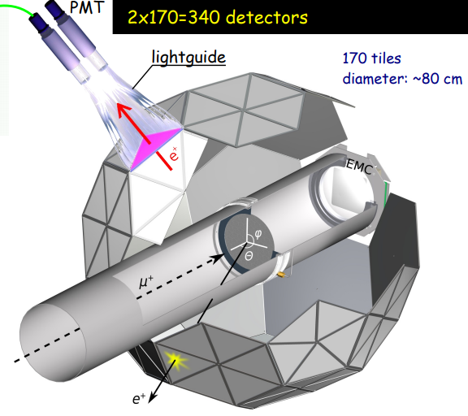
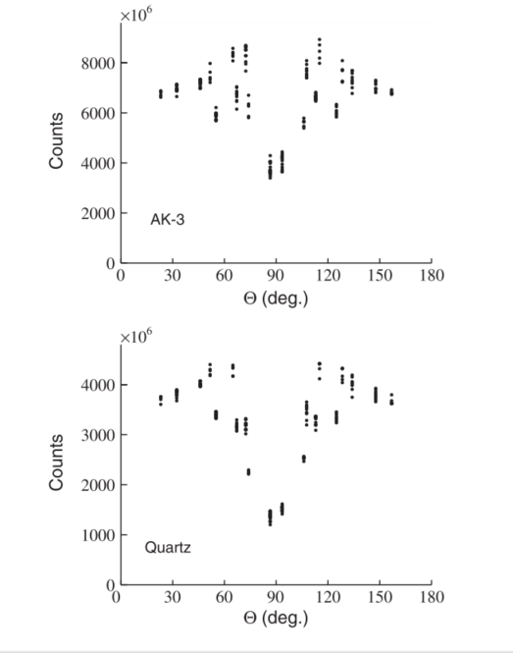
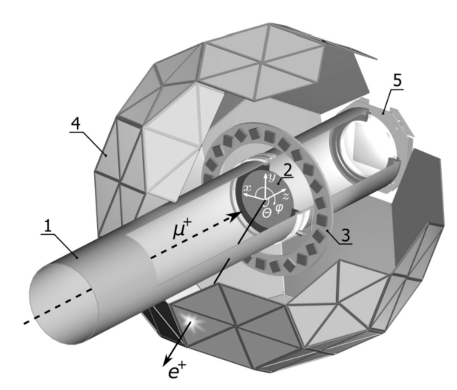
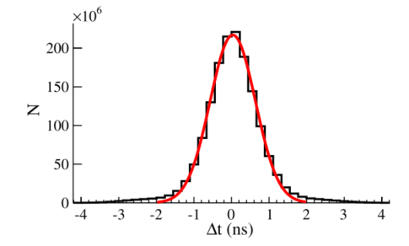
Positron detector
Extended beamline with target sits in center of 4π scintillator arrangement
170 triangle shaped BC-404 plastic scintillator pairs form football with 70% 4π coverage, 40cm inner radius
Tiles 3mm thick, 0.7 ns rise time, 1.8 s fall time
Light guide connects tiles with PMTs
Scintillator stacks suppresses background

Slide 14
Additional Hardware
Laser connected to 24 tiles for time stability monitoring
Waveform digitizer for sampling the raw PTM signals
Clock (crystal oscillator) for long-term stable timing
Precise clock frequency blinded!
Collaboration knew clock rate with 0.2 MHz uncertainty
Etc…

Slide 15
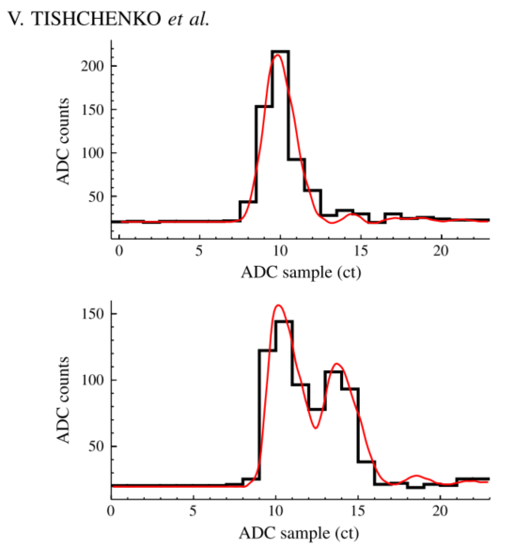
Pileup reconstruction
Oh no! Same detector is hit twice at “the same time”
Leads to pileup of signals
Introduction of artificial deadtime (ADT) to define minimum resolving time for neighboring signals
Reconstruction of lost pulses through “shadow-windows”
Add lost hit if a hit in following fill at the same time is detected
A difficult fit

Slide 16
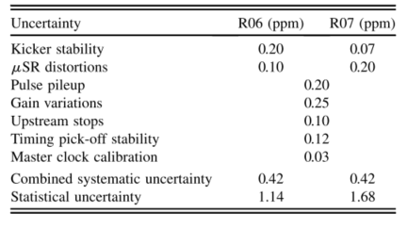
Systematics
Artificial deadtime correction
Below-Threshold pulses
Time pick-off stability
Gain variations
Spin rotation
Upstream muon stops
Beam stability
Clock stability

Slide 17
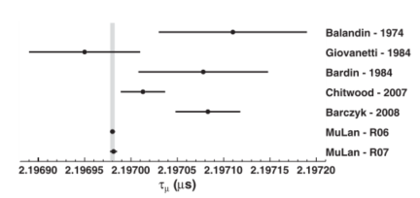
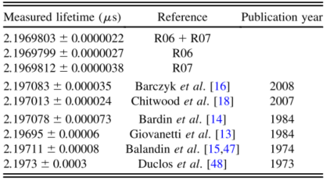
Results

