Slide 1


ECE6950 Research Study
AI-Based Chemical Vapor Detection Platform For Monitoring Busy Spaces
Kyle G Gayliyev
Raven Reitstetter
Department of Electrical and Computer Engineering – University of Utah
Salt Lake City, UT, USA
Fall 2024

Slide 2
Purpose : Synergize Air Quality Sensors to Detect Low-level of Chemicals of Interest.
Features:
Low cost
Reliable
Easy Integration With Existing Technology (AirU)
Detection of low-level chemicals of interest
Empowers informed decision-making
Contributes to a healthier and safer future.
https://github.com/lnis-uofu/ChemAirU

Slide 3
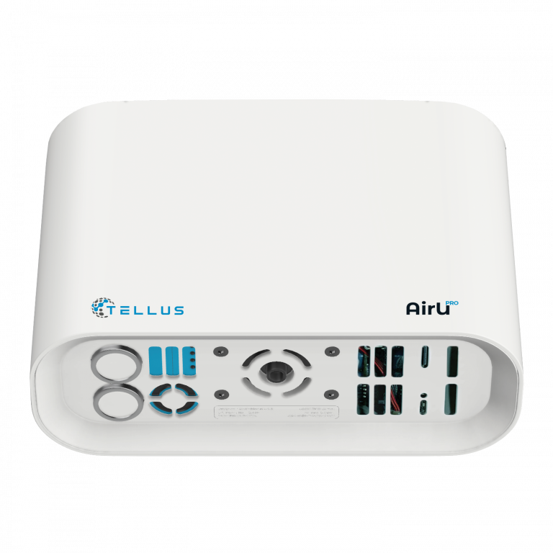
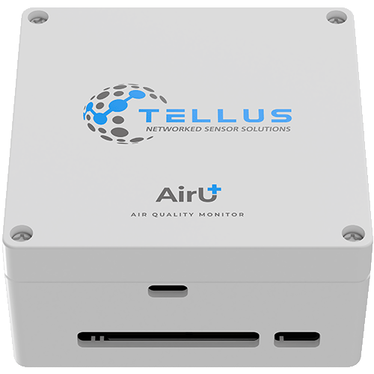
Utilizing AirU, We’re developing ChemAirU
Expanding AirU:
AirU | ChemAirU
CO, H₂S, CH₂O | Acid/base (H₂S, HCl, HCN, SO₂, NH₃)
PM_{2.5}, VOCs, SO₂ | Reductants (H₂, CO)
NO₂ and O₃ | Oxidants (O₃, H₂O₂ Cl₂)
 | Halo Organics (Cl₂, VOCs, C₂H₄O)

Slide 4
Also, detection and identification capabilities of more than 25 compounds at the ppb level including but not limited to:
5-Ethylidine-2-norbornene, 1,6-Dichlorohexane, Perfluor (methylcyclohexane), Dichlorvos, Perfluoro-1,3-Disopropyl fluorophosphate, Bromonitromethane.

Slide 5
Our Proposal :
Enhance the capabilities of the AirUPro:
Screen a large panel of toxic gases
High selectivity/sensitivity at ppb levels
Continuously detecting toxic gases in ppb level
A machine-learning intelligence
Real-time data report through cellular and/or WiFi.

Slide 6
Work we will do:
Work Package 1: ChemAirU Pilot Deployment
ChemAirU Hardware
Cloud-based infrastructure and API delivery
Work Package 2: Chemical Monitoring Testing, Data Acquisition and Validation
Lab Sensor Calibration, Validation and Data Collection
Baseline data collection in busy spaces
Verification of sensor platform and AI-model Identification capability

Slide 7


Thank you!
Questions?
Laboratory for NanoIntegrated Systems (LNIS)
Department of Electrical and Computer Engineering
MEB building – University of Utah – Salt Lake City – UT – USA

