Slide 1


ECE6950 Research Study
AI-Based Chemical Vapor Detection Platform For Monitoring Busy Spaces
Kyle G Gayliyev
Raven Reitstetter
Department of Electrical and Computer Engineering – University of Utah
Salt Lake City, UT, USA
Fall 2024

Slide 2
Purpose : Synergize Air Quality Sensors to Detect Low-level of Chemicals of Interest.
Features:
Low cost
Reliable
Easy Integration With Existing Technology (AirU)
Detection of low-level chemicals of interest
Empowers informed decision-making
Contributes to a healthier and safer future.
https://github.com/lnis-uofu/ChemAirU

Slide 3
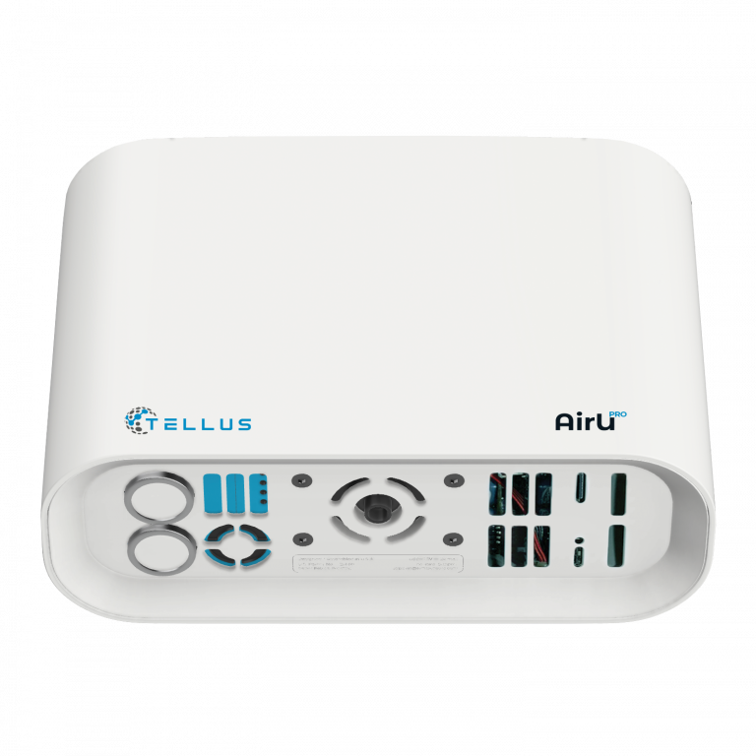
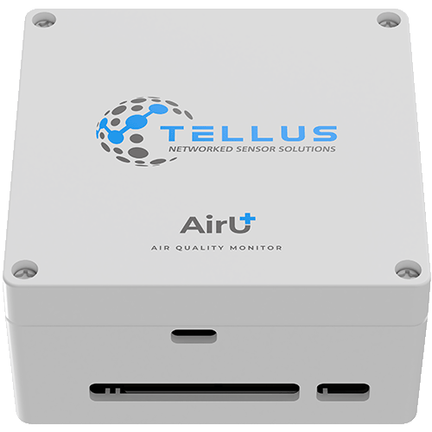
Utilizing AirU, We’re developing ChemAirU
Expanding AirU:
AirU | ChemAirU
CO, H₂S, CH₂O | Acid/base (H₂S, HCl, HCN, SO₂, NH₃)
PM_{2.5}, VOCs, SO₂ | Reductants (H₂, CO)
NO₂ and O₃ | Oxidants (O₃, H₂O₂ Cl₂)
 | Halo Organics (Cl₂, VOCs, C₂H₄O)

Slide 4
Also, detection and identification capabilities of more than 25 compounds at the ppb level including but not limited to:
5-Ethylidine-2-norbornene, 1,6-Dichlorohexane, Perfluor (methylcyclohexane), Dichlorvos, Perfluoro-1,3-Disopropyl fluorophosphate, Bromonitromethane.

Slide 5
Our Proposal :
Enhance the capabilities of the AirUPro:
Screen a large panel of toxic gases
High selectivity/sensitivity at ppb levels
Continuously detecting toxic gases in ppb level
A machine-learning intelligence
Real-time data report through cellular and/or WiFi.

Slide 6
Work we will do:
Work Package 1: ChemAirU Pilot Deployment
ChemAirU Hardware
Cloud-based infrastructure and API delivery
Work Package 2: Chemical Monitoring Testing, Data Acquisition and Validation
Lab Sensor Calibration, Validation and Data Collection
Baseline data collection in busy spaces
Verification of sensor platform and AI-model Identification capability

Slide 7
My Contribution
- Lab Experiment Data Plots Coding on MATLAB.
SNR Analysis & Plots Coding on MATLAB.
AI Code Draft
Features:
Capability of “zooming –in” on a specific data range for analysis.
Visual Graph Comparison Side by Side

Slide 8
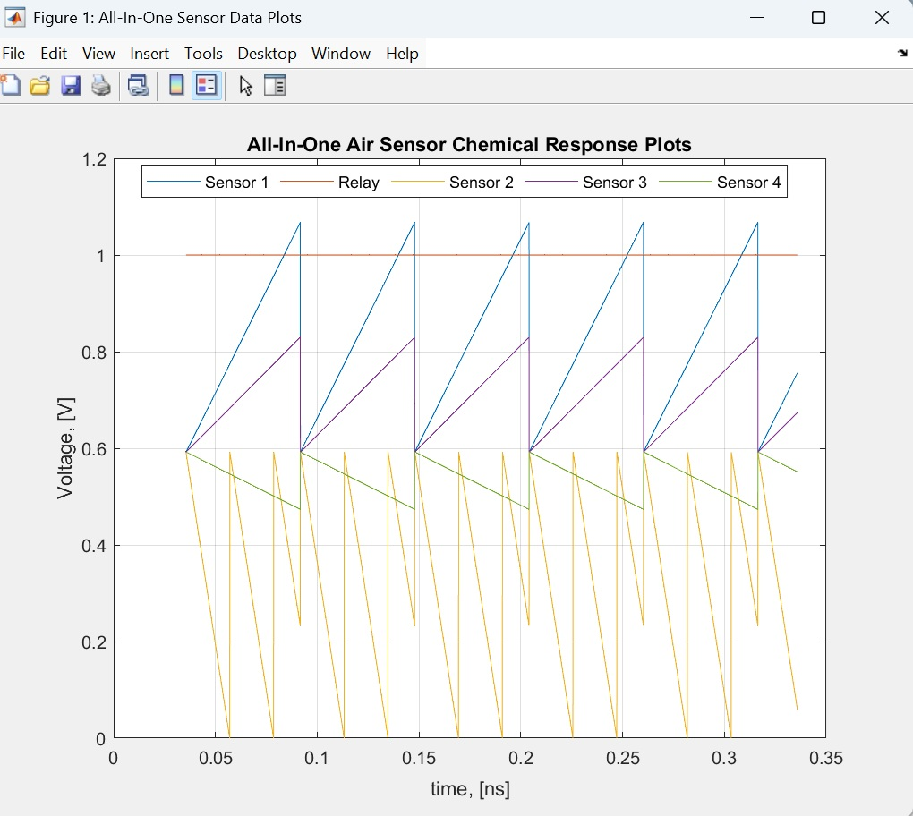
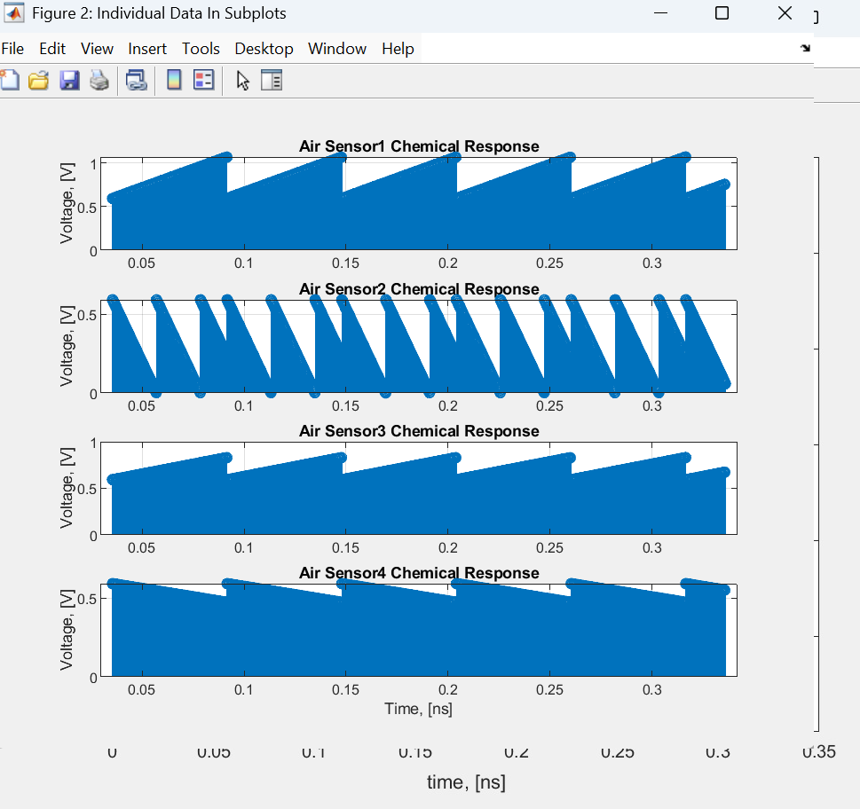
Lab Experiment Data Plots*
The MATLAB code is available on our lnis GitHub repo ChemAirU.
Fig 2. Air Sensors’ Response Plots In Comparison.
Fig 1. Air Sensor Chemical Response Plots: All-In-One
* Plots are generated using sample data. The original data plots will be created once the final lab experiment data is ready to use by the team.

Slide 9
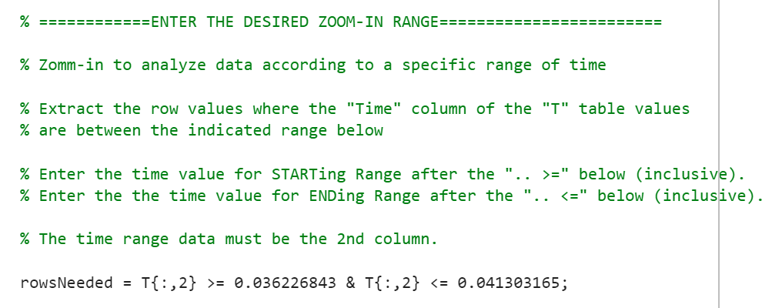
How “Zoom-In” Works
We enter the specific data range to zoom in on MATLAB:

Slide 10
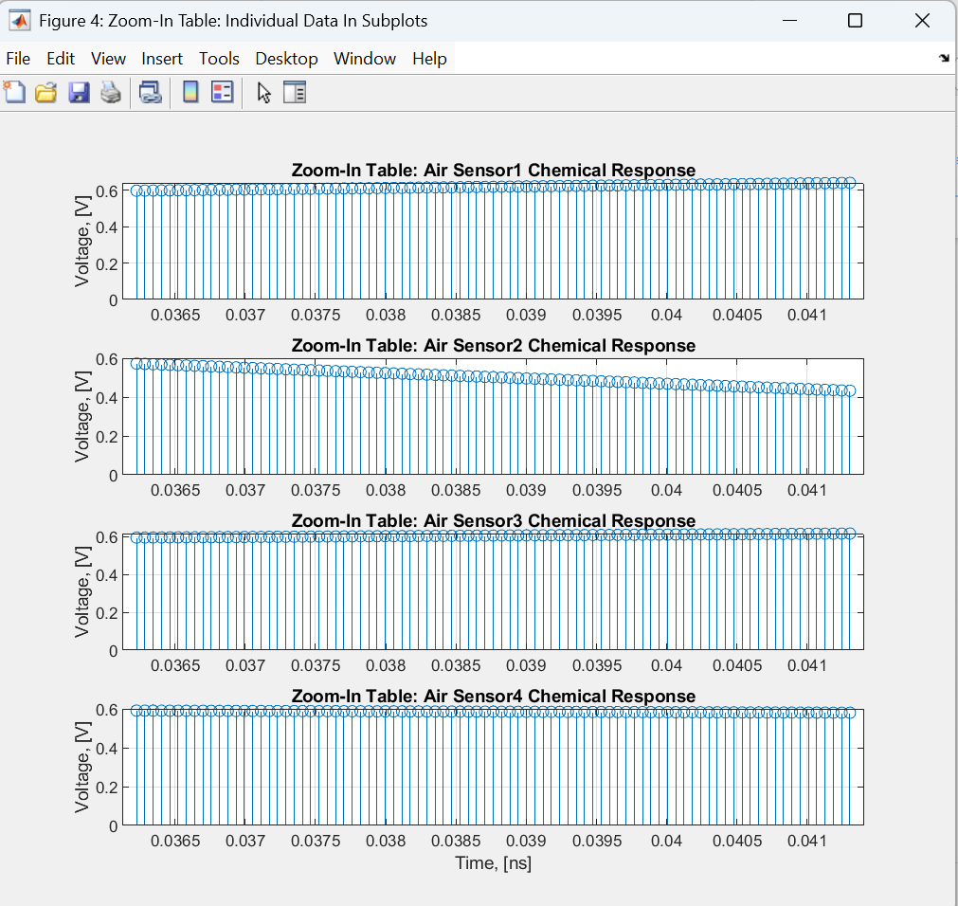
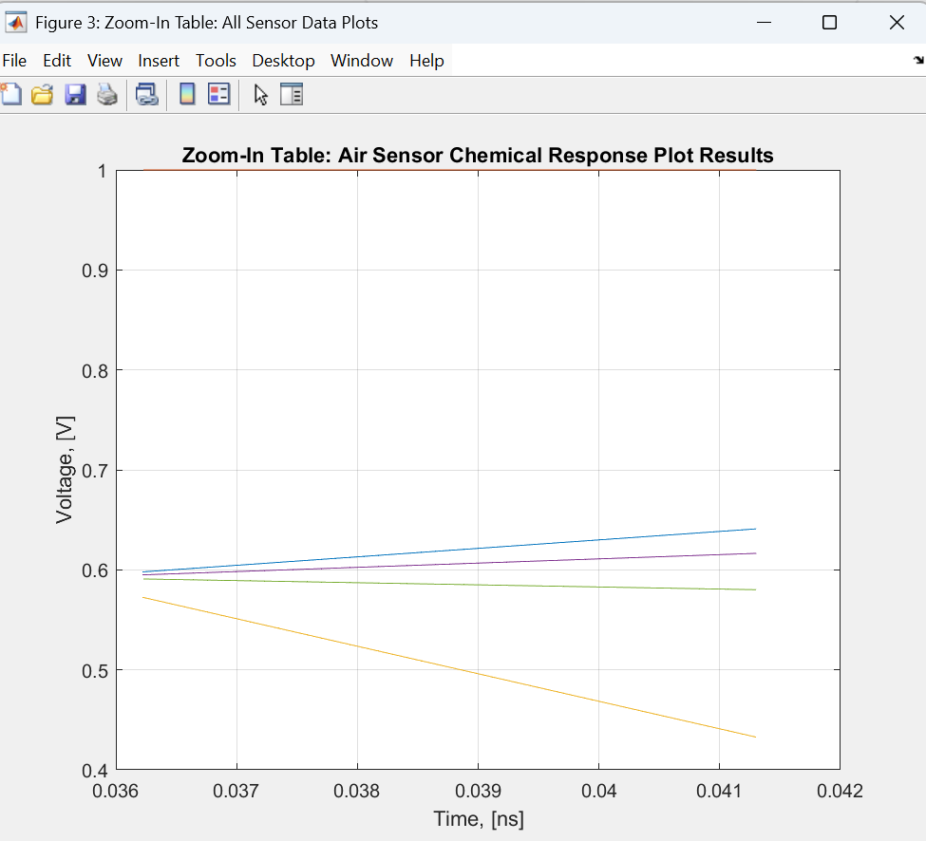
“Zoom-In” Data Plots*
The MATLAB code is available on our lnis GitHub repo ChemAirU.
Fig 4. Air Sensors’ Response Plots In Comparison.
Fig 3. Air Sensor Chemical Response Plots: All-In-One
* Plots are generated using sample data. The original data plots will be created once the final lab experiment data is ready to use by the team.

Slide 11
SNR Analysis*
The MATLAB code is available on our lnis GitHub repo ChemAirU.
Utilized “smoothdata” built-in function
To determine the noise, extract the smoothed data from the original:
Noise = original data – smoothed data.
Then,
SNR = Original data/Noise
* Plots are generated using sample data. The original data plots will be created once the final lab experiment data is ready to use by the team.

Slide 12
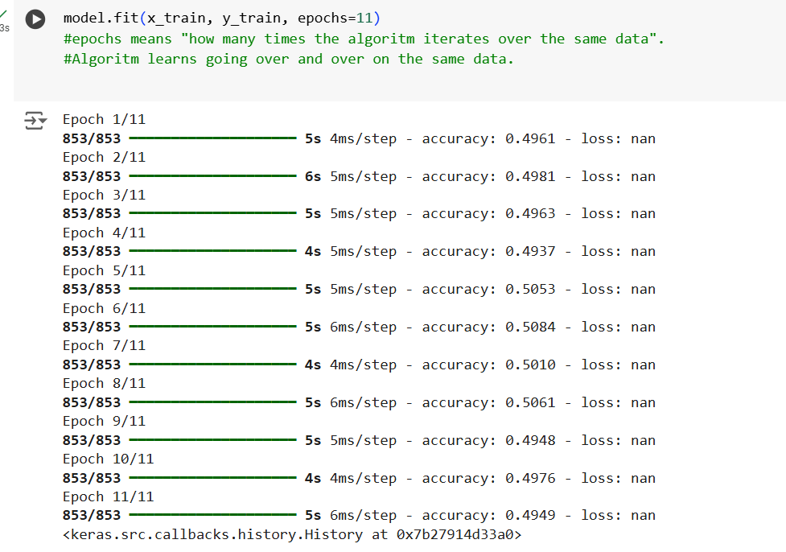
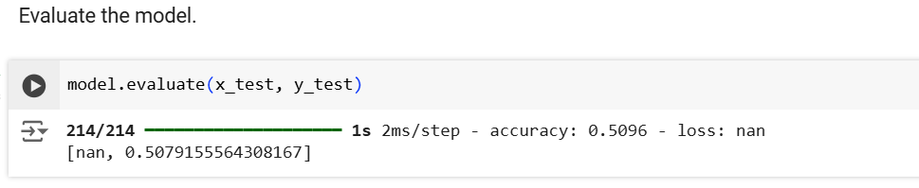
AI Draft Code
The code is available on our lnis GitHub repo ChemAirU.
Coded in Python utilizing Google Collab.
Trained the code with our lab data*
In the final step, we fit our data and evaluate the model. Since we replicated
data for test, the accuracy shows about 0.51 as shown below.
* Plots are generated using sample data. The original data plots will be created once the final lab experiment data is ready to use by the team.

Slide 13


Thank you!
Questions?
Laboratory for NanoIntegrated Systems (LNIS)
Department of Electrical and Computer Engineering
MEB building – University of Utah – Salt Lake City – UT – USA

