Slide 1
Search
Introduction to
Artificial Intelligence

Slide 2
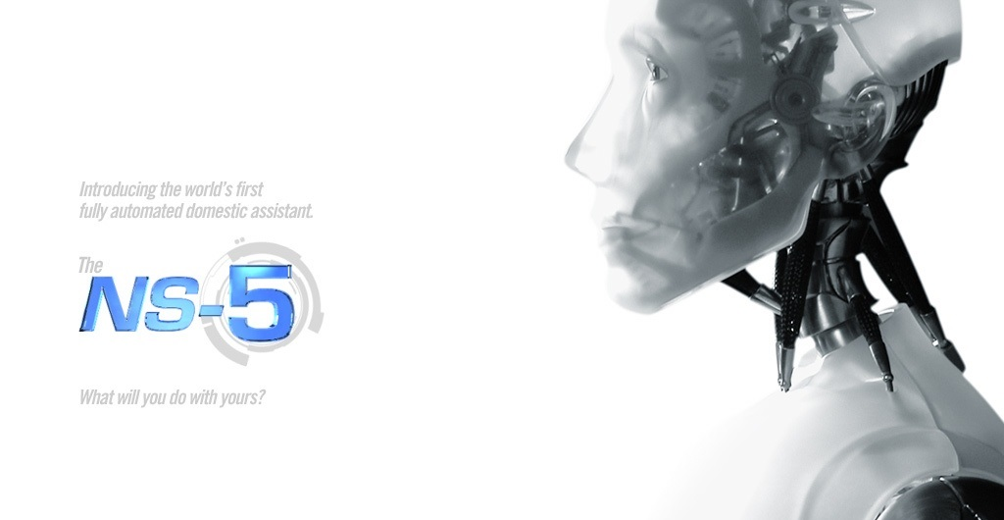
What’s AI?
Artificial intelligence (AI) is the human-like intelligence exhibited by machines or software - wikipedia

Slide 3
Examples
8-queens problem 8皇后問題
Sudoku 數獨
8-puzzle
Global Positioning System(GPS)
Artificial Intelligence in Games

Slide 4
8 Queens Puzzle
將8位皇后按照規則在棋盤上排好
任2位皇后不得同一條線上 (直、橫、斜)
如圖所示 ->

Slide 5
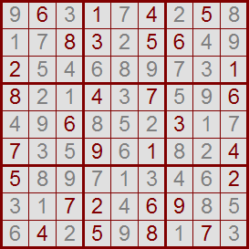
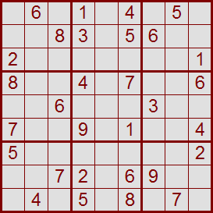
SuDoKu
將空格排上數字
任一小方格 直行 橫列都必須由1~9數字組成

Slide 6
8-puzzle
將數字順序依12345678_排好
6
6
6
6
6
1
2
2
2
2
2
2
7
7
7
7
7
3
4
4
4
8
8
8
8
8
5
1
1
1
1
1
6
4
7
3
3
3
3
3
8
5
5
5
5

Slide 7
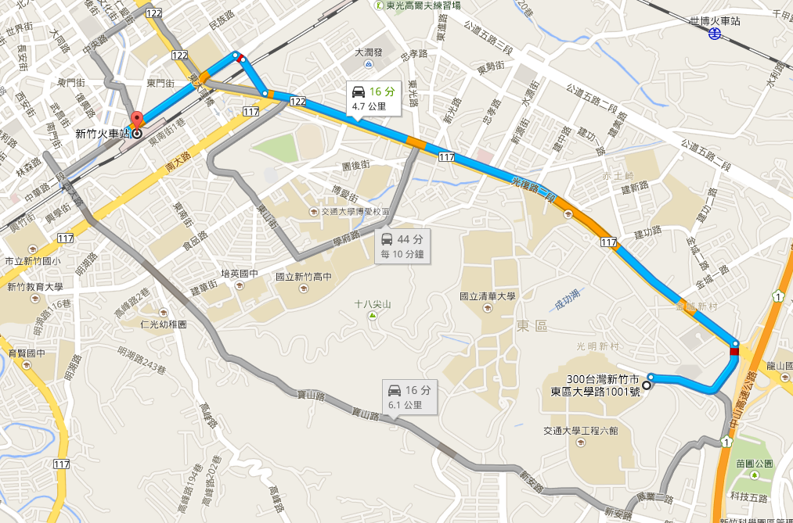
Global Positioning System(GPS)

Slide 8
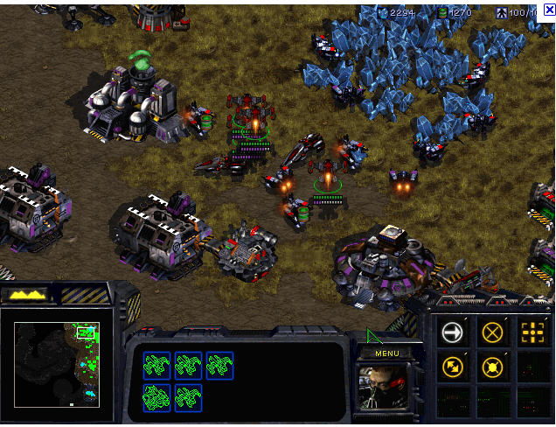
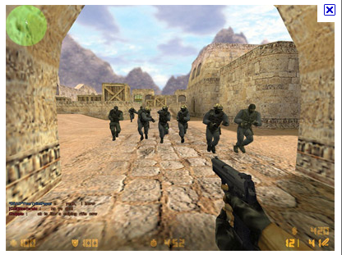
A.I. in games
Blizzard Starcraft I
Counter-strike
And more … <vid>

Slide 9
Concept
Solutions are oftentimes simulating how humans solve the problems and expressed in a systematic way.
Problem-based thinking

Slide 10

Simple Demo: Maze

Slide 11
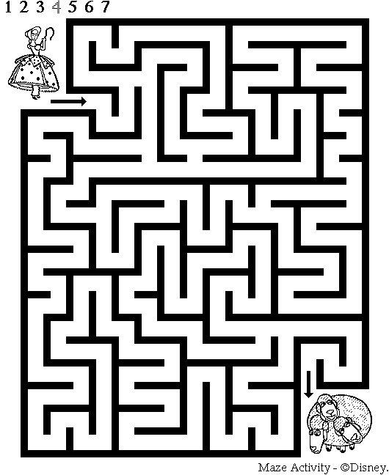
Simple Demo: Maze

Slide 12
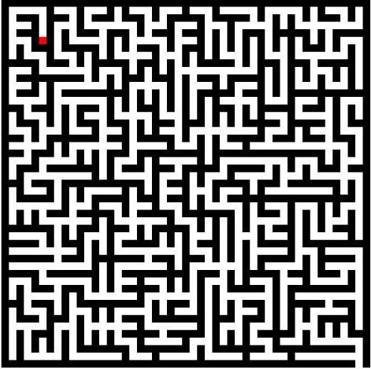
Simple Demo: Maze

Slide 13
Simple Demo: Maze Path Finding

Slide 14
Observe – How I would interpret
Divide and Conquer
Implementation
Recursive / DFS

Slide 15


Minor problems: Think again
Suppose you adopt a strategy as follows:
- You continue walking in the same direction until you come upon an intersection or a dead end
- Your direction Priority: Right > Down > Left > Up
What’s the problem ?
Walking back
Cycle

Slide 16
How do you solve it ?
Ideas ?
Walking back
Cycle
* Mark visited areas

Slide 17
Another example: Logical Quiz
A 說B 在說謊
B 說 C 在說謊
C 說 A、B 都在說謊
請問到底誰在說謊？
I think now you have a great sense of what to learn next : )

Slide 18
What to Learn
- 如何表示一個問題
。state 狀態
。cost 成本
- 基本的Search演算法、優缺點比較
- 進階演算法

Slide 19
Beginning of a search
觀察問題性質，選定適當演算法
Initial State及Goal State
每個點的狀態內容
如何Search (如何編寫程式步驟)
針對問題深入思考，做最佳化處理

Slide 20
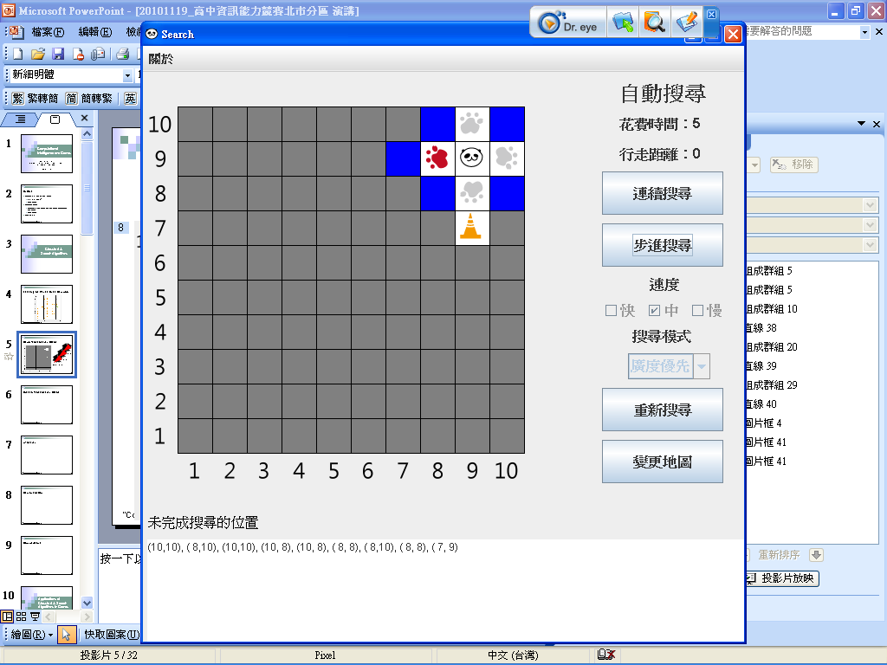
The General Framework
New States
Generate the neighboring states
Next State
If the next state is retrieved in the FIFO order, it’s a BFS.
If the next state is retrieved in the LIFO order, it’s a DFS.

Slide 21
The General Framework
If we have problem-relevant information, we can retrieve the next state in other possible ways.
  the state with the smallest paid cost
  the state with the smallest estimated cost-to-goal
  the state with the smallest sum of both
  etc.

Slide 22
Search Template
設定初始狀態 s₀
標示初始狀態 s₀已拜訪
While (1) {
  If 鄰狀態為空 return failure
  If 如果找到解 return s
  For each s’ in N(s)
  if s’未被拜訪 then
  s’成本 = s成本+cost(拜訪成本)
  標示s’已被拜訪
  搜索(s’)
}

Slide 23
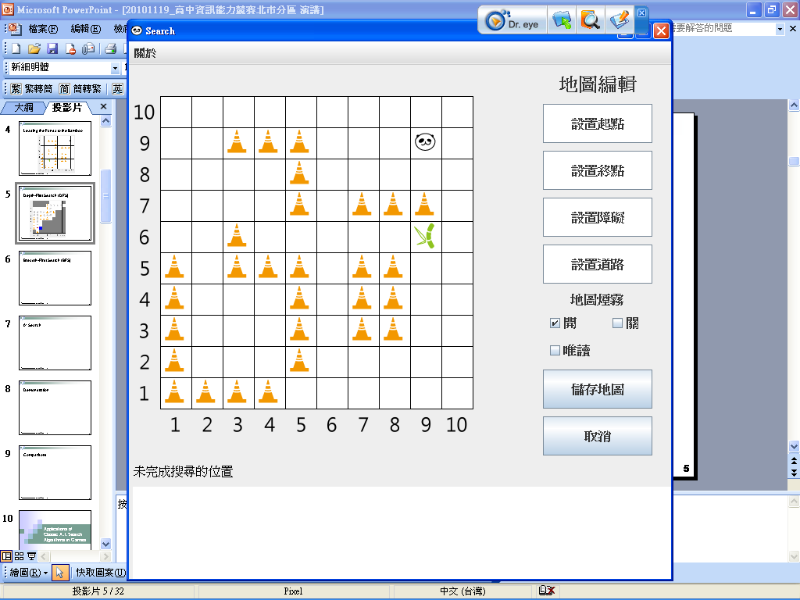
Leading the Panda to the Bamboo

Slide 24
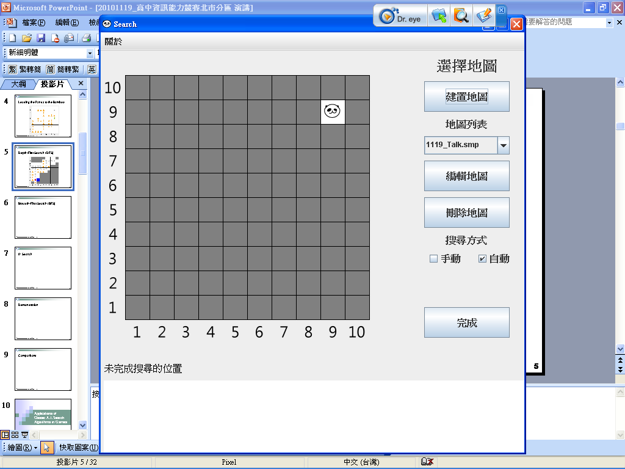
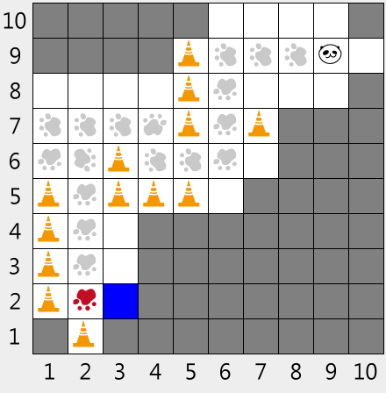
Grid Example: DFS
N
W
E
S
W
S
E
N
W
S
E
N
W
S
E
N
此教學軟體由國科會資訊科學主題式應用與技術探索計畫-認識資訊科學體驗學習計畫團隊開發

Slide 25
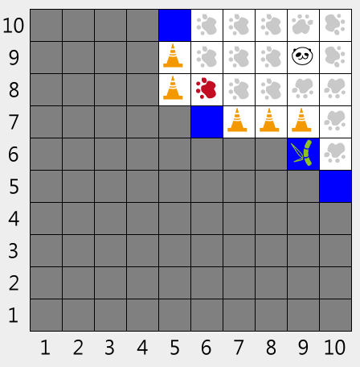
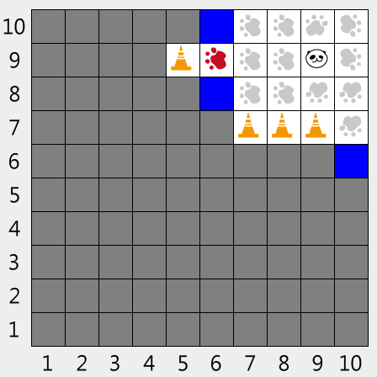
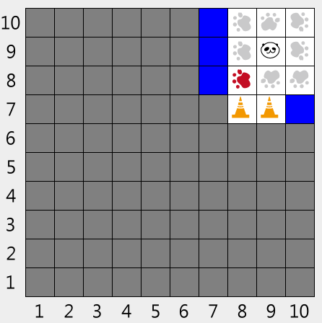
Grid Example: BFS
W
S
E
N
此教學軟體由國科會資訊科學主題式應用與技術探索計畫-認識資訊科學體驗學習計畫團隊開發

Slide 26
Implementation
DFS
Recursive Functions
Stack
BFS
Queue

Slide 27
Analysis: How do you judge?
  有哪些因素使得一個搜索方式比另一個更好?
  Completeness: 找得到解?
  Time complexity: 需要多少時間?
  Space complexity: 記憶體用量?
  Optimality: 找得到最佳解?
  * 編程複雜度

Slide 28
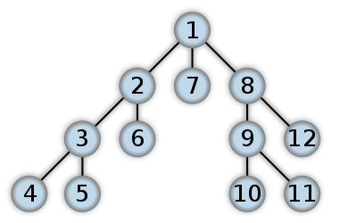
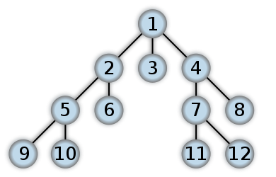
Analysis: DFS & BFS Tree
DFS
BFS

Slide 29
DFS vs. BFS
Completeness?
Time complexity?
Space complexity?
Optimality?

Slide 30
DFS
Completeness?
  Yes
Time complexity?
  O(|S |), ＊剪枝
Space complexity?
  O(d), d為搜索中最大到達深度
Optimality?
  No ☹

Slide 31
BFS
Completeness?
  Yes
Time complexity?
  O(b^{d})
Space complexity?
  O(b^{d}) ☹
Optimality?
  Yes

Slide 32
Practice
8-Queens Chess Problem
SuDoKu
UVa 989 Su DoKu
喵喵捉老鼠 - 2008 NPSC 國中組決賽
Exponentiation by squaring - UVa 374 Big Mod.

Slide 33
Advanced Algorithms
基於DFS BFS發展出的演算法
Iterative Deepening (DFS_ID)
Bidirectional BFS (Bi-BFS)
A* Search
IDA* Search

Slide 34
Iterative Deepening
限制深度 逐步增加，可用來模擬BFS
Completeness?
  Yes ☺
Time complexity?
  O(b^{d}), 甚至不必判斷重點! ☺
Space complexity?
  O(d) ☺
Optimality?
  Yes ☺

Slide 35
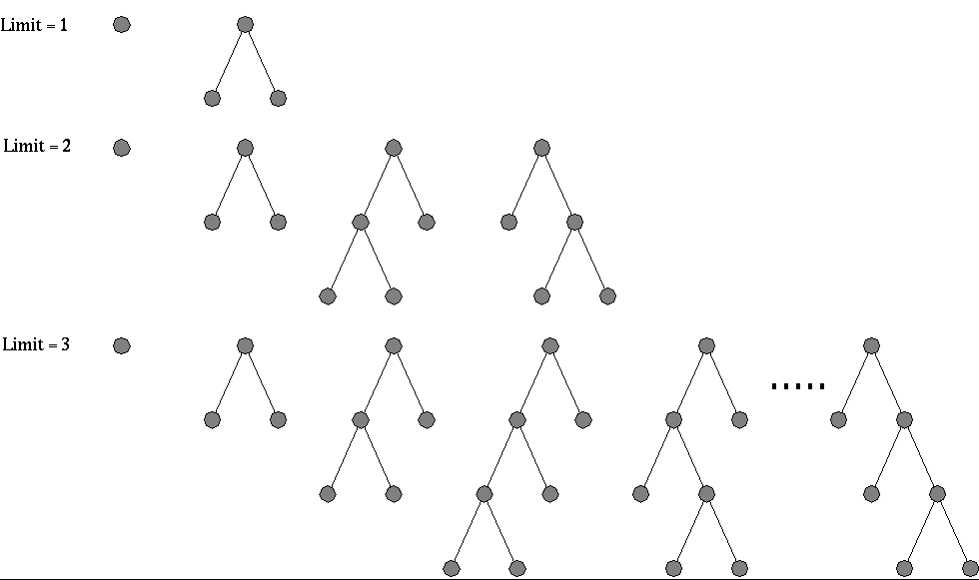
Search Tree: DFS_ID

Slide 36
Bidirectional Search(Bi-BFS)
雙向 BFS – 從狀態起點及終點同時BFS
這樣有什麼幫助?
  b^{d} vs 2b^{l/2d}
為何此演算法難以實做?

Slide 37
Search Tree: Bi-BFS
1
3
4
8
9
10
11
12
13
…
5
6
7
2

Slide 38
Concept
Sometimes the details of algorithms don’t matter,
What matters is what you can learn from them.
What can you learn from Bi-BFS?

Slide 39
Heuristic Search
Things have just started to get interesting

Slide 40
A* Search
最廣泛被使用在遊戲A.I. 的演算法
<vid>
<PPT>

Slide 41
Why ? Concepts of A*
上述Search沒有利用的條件
－＞狀態本身的訊息
什麼樣的訊息?

Slide 42
h function 估價函數
如何評估一個狀態?
Admissible ?
A* is a Best First Search

Slide 43
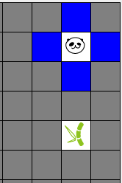
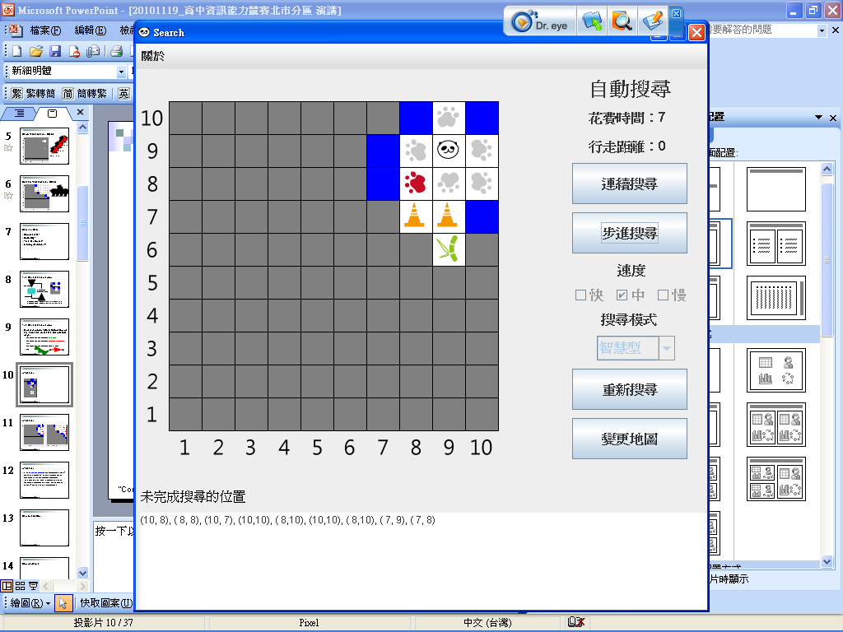
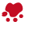
Grid Example: A*
1+4
2+5
2+5
1+4
1+4
2+5
1+2
3+4
3+2

Slide 44
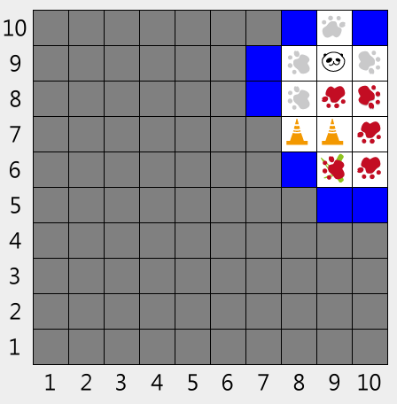
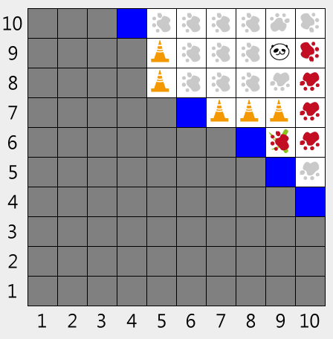
Comparison: BFS & A*
A* 與BFS乍看十分相似，不過其實有些差異
A*
BFS

Slide 45
A* Pseudocode
function A*(start,goal)
closedset := the empty set // The set of nodes already evaluated.
openset := {start} // The set of tentative nodes to be evaluated, initially containing the start node
g_score[start] := 0 // Cost from start along best known path.
// Estimated total cost from start to goal through y.
f_score[start] := g_score[start] + heuristic_cost_estimate(start, goal)
while openset is not empty
current := the node in openset having the lowest f_score[] value
if current = goal
return found
remove current from openset
add current to closedset
for each neighbor in neighbor_nodes(current)
if neighbor in closedset
continue
tentative_g_score := g_score[current] + dist_between(current,neighbor)
if neighbor not in openset or tentative_g_score < g_score[neighbor]
g_score[neighbor] := tentative_g_score
f_score[neighbor] := g_score[neighbor] + heuristic_cost_estimate(neighbor, goal)
if neighbor not in openset
add neighbor to openset
return failure
Adapted from http://en.wikipedia.org/wiki/A*_search_algorithm

Slide 46
A* Search
The Dijkstra’s algorithm, a well-known single-source-shortest-path algorithm, can be viewed as the A* search with zero cost-to-goal

Slide 47
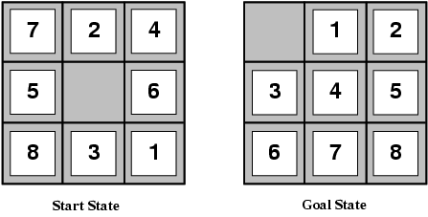
Classic Example: Puzzle Games
8-Puzzle
You have a board with 3x3=9 tiles
Starting from a random board, you want to move the tiles to attain a specific state

Slide 48
Solving Puzzle Games
8-puzzle
Two common estimation functions of cost-to-goal
- h1: the number of misplaced tiles (8)
- h2: Manhattan distance (18)
Both are admissible.
18
[3]
[1]
[2]
[2]
[3]
[2]
[2]
[3]

Slide 49
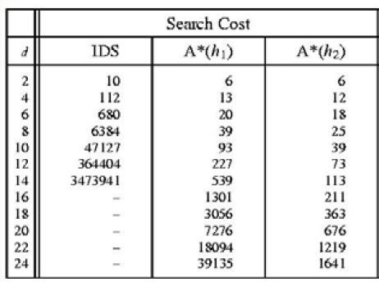
Solving Puzzle Games

Slide 50
A* Analysis - Advantages
A* is complete, optimal, and optimally efficient.
For the completeness, it requires that there is only finitely many nodes with cost no greater than the optimal cost.
For the optimality, it requires that we do not over-estimate the cost-to-goal.
No optimal algorithm can guarantee to expand fewer nodes than A*.

Slide 51
A* Analysis - Drawbacks
為何A*在競賽中實用度不高?
如何改進此缺點?

Slide 52
Improve: IDA* Search
A* 的缺點在於Memory Usage
Improve!
IDA* - A smarter and easier way to realize the concept of heuristic cost function
Much less memory Usage, Still fast
編程簡單 => 適合競賽

Slide 53
Solving 8-Puzzle Using IDA*
UVa 10181 _ 15-Puzzle Problem
TIOJ 1198 _ 8-Puzzle (O_Q)
TIOJ 1573 _ 15-Puzzle (O_Q)

Slide 54
Before you start…
2 Key things to note:
Recall in the Maze example – be careful not to walk back. (Diff. in IDA* and A*)
Puzzle Solvability

Slide 55
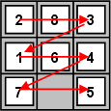
8, 15-Puzzle Solvability
Parity: For each of the tiles, count how many preceding numbers that are greater than itself, then sum up and see whether the result is even or odd.
For 15 Puzzles, you need to add the row number where the empty tile is located at, to the parity calculation.
Order of counting:
From Left to right, top to bottom

Slide 56
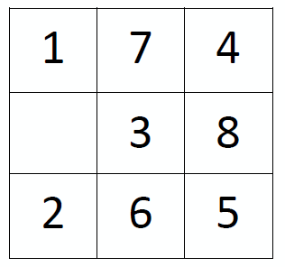
Examples
Parity of 8-Puzzles
0
0
1
0 + 0 + 1 + 2 + 0 + 4 + 2 + 3 = 12
2
0
4
2
3
Even Parity

Slide 57
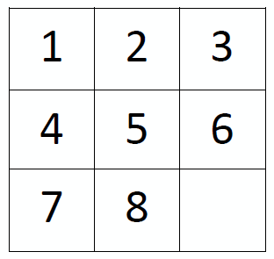
Judging Solvability by Parity
If Parity(Initial State) = Parity(Goal State)
Then the puzzle is solvable
12
Even Parity
0
Even Parity
Initial State
Goal State
Therefore, the puzzle is solvable

Slide 58
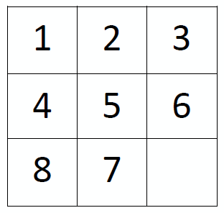
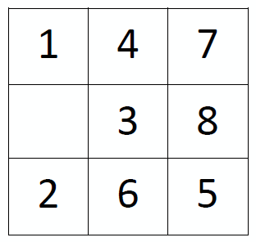
Unsolvable Puzzles
Goal State with Even Parity
1
Odd Parity
0+0+0+2+0+4+2+3=11
Odd Parity
However, if you set either one as the Initial State, the other as the Goal State,
this is solvable
Why is this method correct?

Slide 59
Inside my brain - Ideas
Elevators – What if elevator controllers have more information available?
Exact number of waiting passengers on each floor ?
Type of departments on each floor ?
Gestures, Posture, Moods?
Goal: Least amount of total waiting time? Max Productivity? Max satisfaction for specific customers?

Slide 60
Your Imagination is the limit
These are just my ideas
What is yours ?

Slide 61
fin~
Thank you for your listening

