Slide 1

5 ways…
Title Success –Organic Traffic
Lilliana Nisihira
Ad Operations Analyst
Notes:
The Cheat Sheet is the ultimate, high-quality set of time-saving cheats/guides to everything for the modern “Man” to get the most out of life. I really liked this mantra because this is how I like to live my life and the way the company is run. We’re constantly trying to find the best, most efficient way to do anything so we can have time to do what we want.

Slide 2
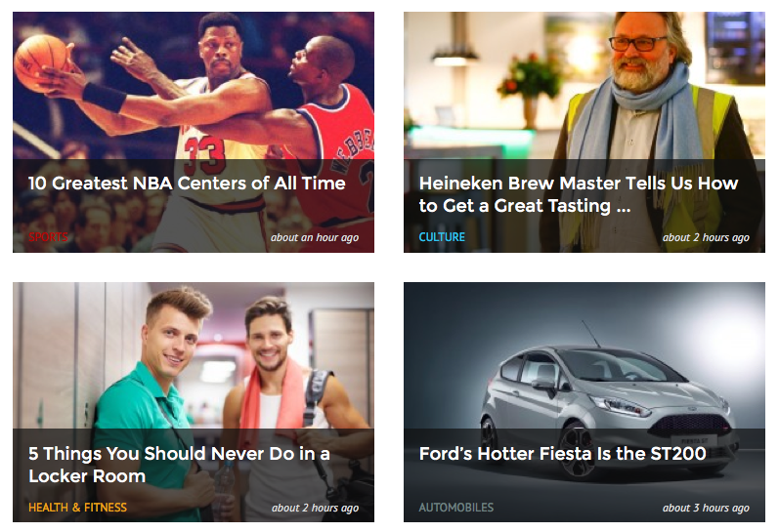
Notes:
Here is a sample of what are gallery looks like.
As you can see the titles are sometimes word-y
The sections are seen in the bottom left
Some have numbers some don’t

Slide 3
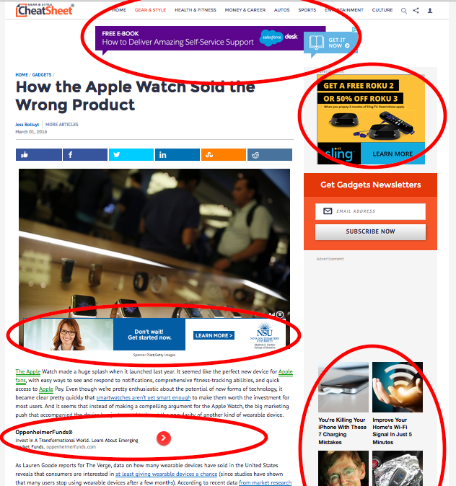
Notes:
Here is how we make money by charging per 1,000 views of each ad
We measure success by pageviews
Each pageview should theoretically give us 12x the amount of impressions.
My big goal this quarter is to increase RPM (rev per 1,000 pages) by 5%

Slide 4
Data Google Analytics + Internal Server
3,000 Titles
Pageviews
Author
Publish Date & Time
Section
Class (0,1)

Slide 5
Plan
Naïve Bayes
PCA
Continue on to other traffic sources
More Features (Potential Revenue)

