Slide 1

LENDING CLUB LOAN ANALYSIS

Slide 2
LENDING CLUB ANALYSIS OVERVIEW
Identifying the Business Problem
Data Description
Data Preparation & Processing
Data Mining
Models
Logistic Regression
Decision Tree
Random Forest
Support Vector Machine
K-Nearest Neighbor
Bagging and Boosting
Multilayer Perceptron
Summary of Findings
Conclusion
Recommendations

Slide 3
IDENTIFYING THE BUSINESS PROBLEM
Lending Club is a Peer-to-Peer lending company that utilizes a group of private investors to fund loan requests.
Lending Club’s model for risk assessment categorizes borrowers by assigning them a grade and a subgrade based on their credit history.
Investors are presented with a list of borrowers, along with their assigned risk assessment grades, and they have the opportunity to choose which borrowers they will fund, and the percentage of funding that they will cover.
Our business problem is that assessment of these borrowers presented by Lending Club in order to make a smart business decision, by identifying borrowers that would likely default on their loans.
Borrower
Lending Club
Investors
Notes:
Lending Club is an online peer to peer credit marketplace which matches borrowers and investors. For evaluating the credit-worthiness of their borrowers, Lending Club primarily relies on a grade and sub-grade it assigns them based on their credit-history. This rating information is then made available to investors who fund the loan requests, so that the investors can decide which loan request and how much of that loan request they will fund. In addition to the grade information, Lending Club provides historical loan performance data to investors for more comprehensive analysis. Our business problem is to find a model that will utilize the historic loan data to help better identify borrowers that are likely to default Such a model would allow investors to avoid loan defaults thus limiting the risk of their investments.

Slide 4
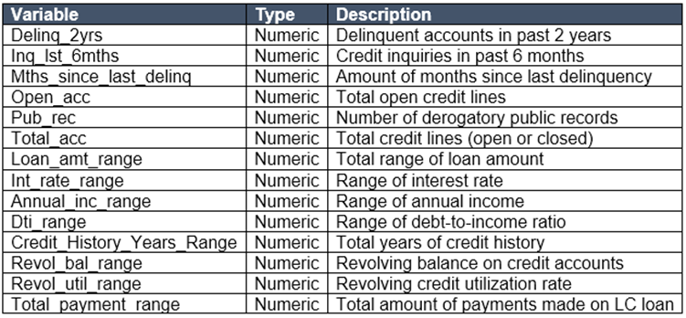
DATA DESCRIPTION
Lending Club provided us with 4 years of historical data (2007-2011). This dataset contained information pertaining to the borrower’s past credit history and Lending Club loan information. The total dataset consisted of over 42542
records, which was sufficient to conduct analysis.
Variables present within the dataset provided an ample
amount of information which could use to identify relationships and gauge their effect upon the success or
failure of a borrower fulfilling the terms of their loan
agreement.
Required only the variables that had a direct or indirect response to a borrower’s potential to default. To achieve this, prepared the data by choosing select variables that would best fit this criteria.
Notes:
Lending Club provides multiple years of good quality historical loan data. I had accessed over 42542 loan records compiled over a period of 4 years from 2007 through 2011. Each record represented an individual loan. These records were comprised of over 100 variables. Included in the data set was a variable that stored information as to whether that particular loan record had gone into default or had stayed current through its repayment term. We could clearly see that this variable would be our dependent variable and that we would evaluate the other relevant variables to see what influence they had over it. Thus began next step of evaluating the data set and cleaning and preparing it for our data mining exercise.

Slide 5
DATA PREPARATION & PROCESSING
Prior to data mining model analysis, the data was reviewed, cleaned and prepared as follows:
Removed columns that obviously had no relation to the analysis in question (E.g. Applicant ID, Employee Title etc.)
Removed columns that had bad quality data (i.e. missing values in observations, unintelligible values etc.)
Removed columns that had identical relationships to the analysis in question (E.g. funded_amnt and funded_amnt_inv as they are always the same as loan_amt)
Converted continuous variables to range of values to enhance interpretation of results (E.g. loan_amt, int_rate, Annual_income, credit_history_years, revol_util, total_pymnt etc.)
Borrowed an idea from the Stanford project report - they reported using the zip_code to join census data "Median House- hold Income and Mean Household Income [2006-2010]“ achieved good results. Instead of joining census data to our loan data ,used the parameter zip_code to achieve better results.
Notes:
Though the data was of good quality, we found that we had to perform some clean-up activity. We discarded variables that were redundant or obviously did not exert any influence on the dependent variable (For example: Employee ID, Borrower job title, and the credit history URL). We then removed observations that were missing data in key variables. This, however, was very small percentage of the population. Once we had trimmed the variables and record set, we converted certain continuous variables into ranges of values that would allow for a better interpretation of the results. Finally, we converted the variable called loan status into a binary variable called “default” for use as our dependent variable.

Slide 6
DATA MINING
LOGISTIC REGRESSION
k-NEAREST NEIGHBOR
MULTILAYER PERCEPTRON
RANDOM FOREST
SUPPORT VECTOR MACHINE
BAGGING & BOOSTING
DECISION TREE
Selected seven data models to determine which returned the best predictive capability. Utilized
multiple assessment parameters to determine the most successful model to include. The models are evaluated based on following performance measurements
Confusion Matrix (Accuracy, Sensitivity and Specificity)
Receiver Operating Characteristic (ROC)
Best metric to evaluate the model is Recall prediction of algorithm to predict whether or not a customer is going to repay the loan.

Slide 7
MODELS
Hyper Parameter tuning and Advanced Algorithms
Implemented following models using Randomized and Grid Search cross-validation techniques to choose the hyper parameters.
Random Forest
Had a feature ‘int_rate’ which has an importance of more then 30%.Random Forests select a subset of features in each of its decision trees there by reducing bias of the model.
Support Vector Machine
Chose to build SVM classifier, because once a hyperplane is found, most of the data other than support vectors become redundant. This means that small changes to data cannot greatly affect the hyperplane and hence SVM.
K-Nearest Neighbor
In K-NN classification, an object is classified by a majority of votes by its neighbors with the object being assigned to the class most common among its k nearest neighbors.

Slide 8
MODELS
Logistic Regression
With logistic regression, outputs have a nice probabilistic interpretation, and the algorithm can be regularized to avoid overfitting. Hence chose to build logistic regression classifier.
Multilayer perceptron
MLP utilizes backpropagation for training. Its multiple layers and non linear activation function helps us distinguish data that is non linearly separable.
Decision Tree
It often mimics human level thinking so it is simple to understand the data and make some good predictions.
Bagging-building multiple models(typically of same type) from different sub-samples of training dataset.
Boosting(Ada Boost)-building multiple models (typically of same type) each of which learns to fix the prediction errors of a prior model in the chain.

Slide 9
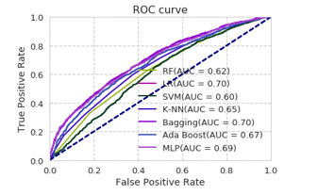
MODEL COMPARISON
Receiver Operating Characteristics (ROC)
Measure | Logistic Regression | Decision Tree | Random Forest | SVM | Bagging | Boosting | K-NN | MLP
AUC | .70 | .77 | .62 | .60 | .70 | .67 | .65 | .69
Confusion Matrix
Parameter | Logistic Regression | Decision Tree | Random Forest | SVM | Bagging | Boosting | K-NN | MLP
Accuracy | .86 | .77 | .85 | .86 | .99 | .99 | .87 | .86
Sensitivity | .87 | .77 | .85 | .87 | .99 | .99 | .87 | .86
Specificity | ..85 | .78 | .80 | .88 | .87 | .87 | .87 | ..83

Slide 10
CONCLUSION
As can be seen from the comparison results, the Boosting and Bagging algorithm outperformed than the other models in terms of recall.
K-NN ,SVM and Logistic regression results were similar with recall of 87% .
Decision Tree resulted in the lowest performance of 77%.
Other notable findings through analysis was that the independent variables relating to the total amount of payments that a borrower had made and the amount of the loan had the strongest relationship with the response variable.

Slide 11
Recommendations
Loans with term of 36 months tended to be defaulted a lot more than loans with term of 60 months. Choose loans with 60 month terms.
Applicants who has taken the Loan for 'small business' has the highest probability of charge off of 24%. So bank should take extra caution like take some asset or guarantee while approving the loan for purpose of 'small business’
Certain sub-grades were almost certain to default compared to other sub-grades. Selecting loans of subgrade F5 and higher will result in a higher chance of repayment.
Applicants who are self employed & less than 1 year of experience are more probable of charged off.
As the interest rate increases the probability that person will default increased with highest of 20% at 15% & above bracket of interest rate
As the annual income decreases the probability that person will default increased with highest of 16% at (0 to 25000) salary bracket.

Slide 12
Thank You!
Notes:
This concludes our presentation. Thank you for taking the time to view it. We hope that you found the story that we unlocked from the Lending Club loan data to be informative and useful.

