Slide 1
CRIO-EPICS Integration
SOL

Slide 2
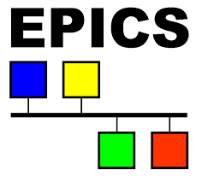
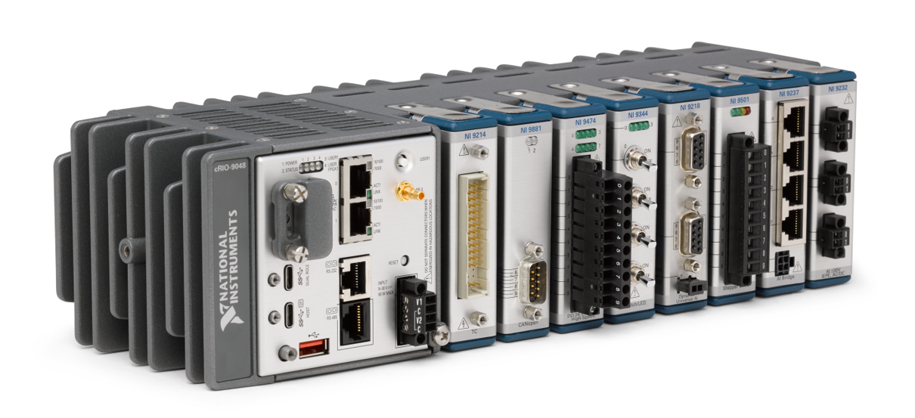
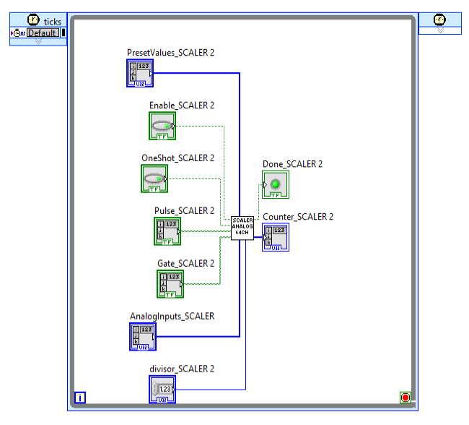
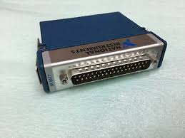
FPGA/Labview RT VIs
Peripherals

Slide 3
cfg.ini
EPICS IOC
NHE device support
Software
NHE library
NI FPGA lib.
LabviewRT VI
Hardware
FPGA VI
C-series module Peripherals

Slide 4


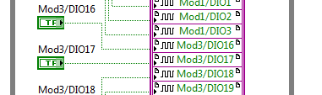

1.1 FPGA variables (1/3)
Add to your FPGA design the following patterns for all the variables (AI, AO, BI, BO) that will be exported on EPICS
Binary input : Convert to 64-bit U64
Analog input : Convert to float
^{Binary output : as is}
^{Analog output : Convert to FXP}

Slide 5
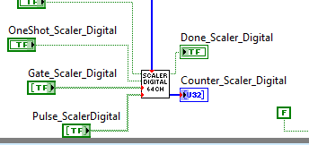
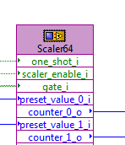
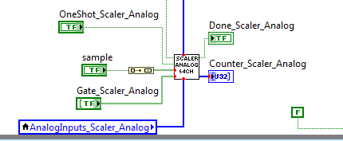
1.1 FPGA variables (2/3)
To implement scaler, use the following IP
^{Scaler digital}
^{Scaler : IP in VHDL}
^{Scaler Analog}
^{Validated with testbench}
If not all 64 counters are used, the logic can simply be optimized by reducing the size of the fixed input arrays.
FPGA utilization can be reduced by approximately 15% if this optimization is applied

Slide 6
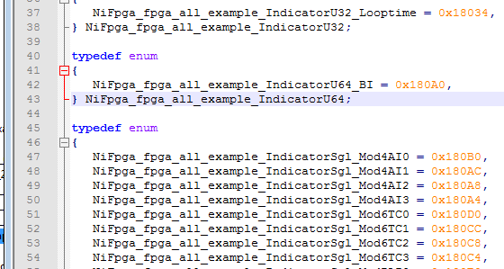
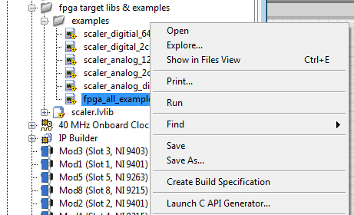
1.1 FPGA variables (3/3)
Generate bitstream and C API files
Generates header file with addresses
The address of each variable must be noted for the cfg.ini file.

Slide 7
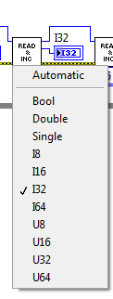
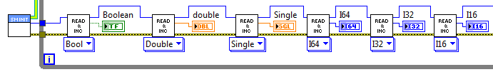
1.2 LabviewRT variables
Four Vis were developed to synchronize variable exchange with EPICs
IOC Shared memory initialize.vi
  Initializes shared memory. All input can be left as default
IOC Shared memory de-initialize.vi
  de-initializes shared memory.
SM read and increment.vi (polymorphic VI)
  Reads the variable (from EPICS) when setting the polymorphic VI
SM write and increment.vi (polymorphic VI)
  Writes the variable (to EPICS) when setting the polymorphic VI
All VI MUST be chained with <ptr in> and <ptr out>.
The index of the variable must be noted for the cfg.ini file.

Slide 8
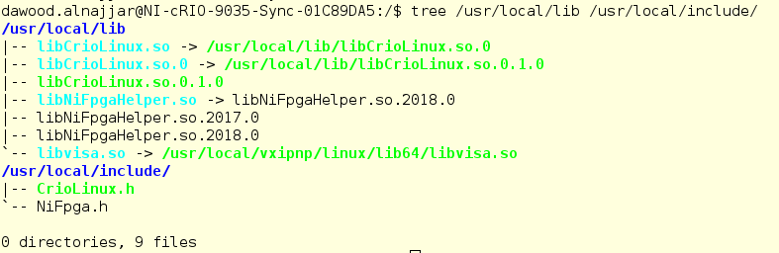
2 & 3 libCrioLinux.so and EPICS device support
NO alteration or re-compile is required!
Device support library path needs to be indicated explicitely in the IOC

Slide 9
4.1 EPICS IOC (1/8)
As long as the associated DB files are used, the IOC does not need to be compiled either!

Slide 10
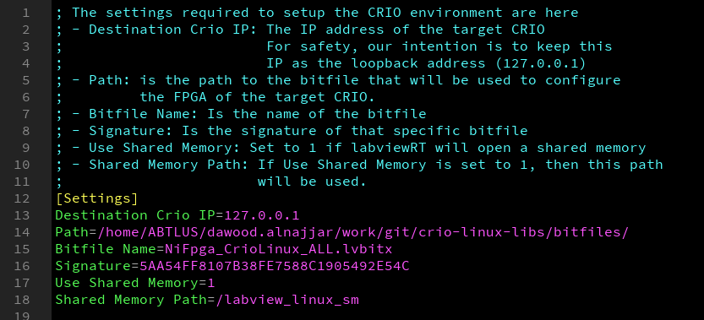
4.2 EPICS IOC – CFG.INI (2/8)
If changed, must be changed in labview RT VI too!
Disabling shared memory disables all labview RT variable processing.

Slide 11

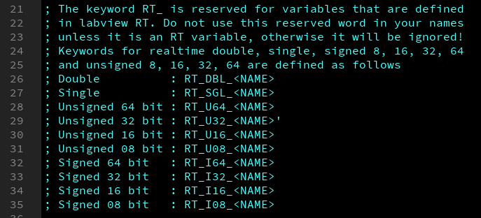
4.2 EPICS IOC – CFG.INI (3/8)
2 types of variables: labview RT variables, and FPGA variables
The library distinguishes the type and its size through its name

Slide 12
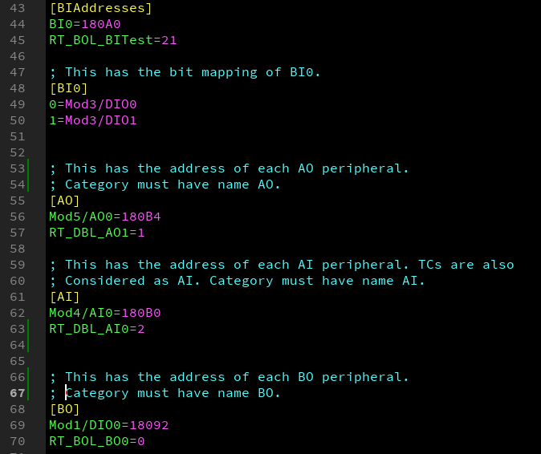
4.2 EPICS IOC – CFG.INI (4/8)
[BIAddresses]
  Address/index of BI
[BI0]: index -name relation of each bit in the 64 bits (FPGA)
[AO]: Address/index of each available output analog variable
[AI]: Address/index of each available input analog variable
[BO]: Address/index of each available output digital variable

Slide 13
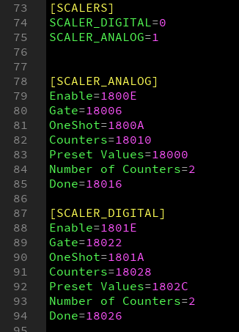
4.2 EPICS IOC – CFG.INI (5/8)

Slide 14


4.2 EPICS IOC – Settings (6/8)
Introduce path of deviceSupportCrio to IOC
$(TOP)/configure/RELEASE
Introduce deviceSupportCrio library name to IOC
$(TOP)/CRIOApp/src/Makefile

Slide 15
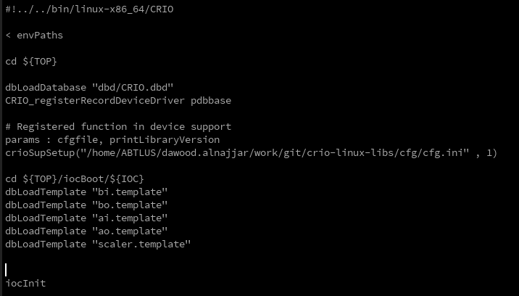
4.2 EPICS IOC – st.cmd (7/8)
Once single modification : provide cfg.ini file name to crioSupSetup.

Slide 16
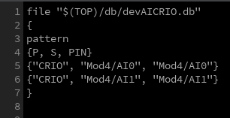
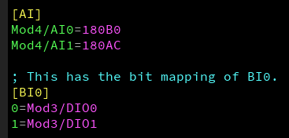
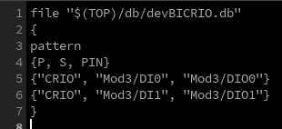
4.2 EPICS IOC – templates (8/8)
ai.template
This name must correspond to the name in the cfg.ini file
bi.template

Slide 17
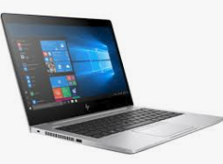
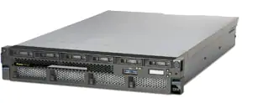
IOC compilation needed?
We now have a docker compilation environment* that compiles using a processor of another host and using the CRIO SSD
^{Map NFS}
^{Map SSD using SSH}
^{Docker on Host}
^{Map NFS}
^{NFS server (EPICS)}
*https://gitlab.cnpem.br/SOL/Docker/dev-crio.git

Slide 18
Softwares used
EPICS 3.14
Synapps 5.8 (Scaler)
Labview 2017
2017 linuxRT firmware

Slide 19
Softwares used
EPICS 3.15
Synapps 5.8 (Scaler)
Labview 2018
2018.5 linuxRT firmware

Slide 20
Exception handling
  Errors in the cfg.ini file, templates, or any inconsistency found appear on the EPICS IOC command prompt
    e.g. Error on read - [LibCrioLinux] Property [RT_DBL_AI0]: Query returned null.
  Since exceptions are redirected to epics terminal, the IOC does not stop functioning, so check your messages!
Start beta testing

Slide 21
Known limitations
Binary inputs are limited to 64 bits
Analog inputs are converted to single precision (23 bits of precision). Moving data from modules that have precision of 24 bits will lossy
Moving U64, I64 (64-bits) also is lossy since these variables are converted to double, and double is 52 bits precision
FXP not implmented (yet)

