Slide 1
CRIO-EPICS Integration
SOL

Slide 2
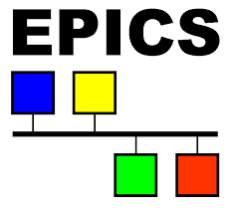
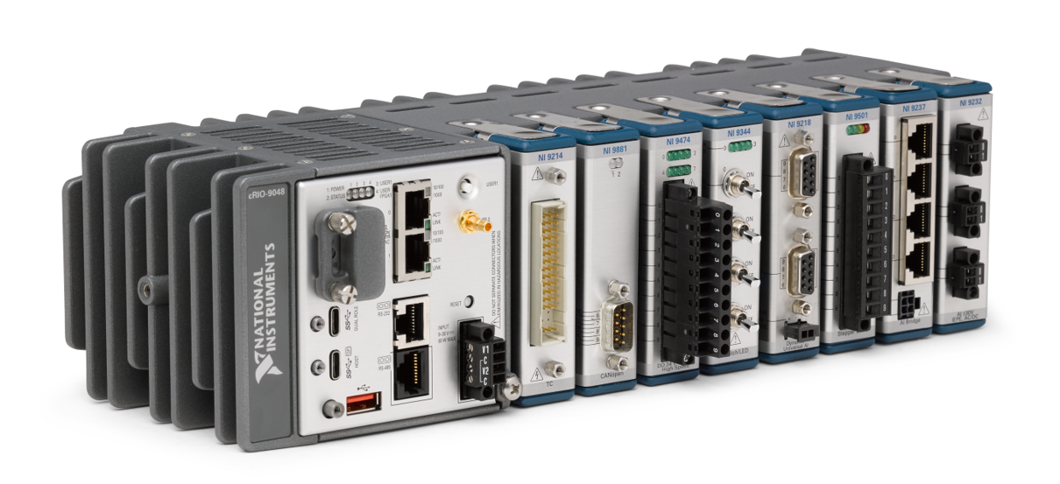
Background
Input and output binary and analog data, fast trigger counting,
fine control using EPICS
FPGA
LabviewRT
Users

Slide 3
CRIO-EPICS solution architecture
(1)
Labview realtime
And FPGA
variables
(2)
LibCrioLinux.so
CrioLinux.h
NiFpgaHelper.so
(3)
EPICs device
Support
CrioDevSup.a/so
(4)
EPICS IOC
(1) LabviewRT : Developed extensions to open a shared memory and write/read from/to it
FPGA : Use C API generator to generate addresses associated with variables
(2) LibCrioLinux.so : abstraction layer to reads and writes to shared memory and
FPGA addresses of the variables using a reference “name”
NiFpgaHelp.so : Contains all NI specific quirks
(3) Device support : EPICS library that contains 5 types of records : BI, BO, AI, AO, Scaler,
And contains functions to initialize CRIO from IOC
(4) EPICS IOC : Very simple IOC (no custom code) that has access to all device
support types
https://gitlab.cnpem.br/SOL/Projetos/nheengatu/blob/master/README.md

Slide 4
CRIO-EPICS solution architecture
(1)
FPGA and
Labview realtime
variables
(2)
LibCrioLinux.so
CrioLinux.h
(3)
EPICs device
Support
CrioDevSup.a/so
(4)
EPICS IOC
cfg.ini
template
Parts in red : needs user intervention
(1) LabviewRT : Developed extensions to open a shared memory and write/read from/to it
FPGA : Use C API generator to generate addresses associated with variables
(2) LibCrioLinux.so : abstraction layer to reads and writes to shared memory and
FPGA addresses of the variables using a reference “name”
NiFpgaHelp.so : Contains all NI specific quirks
(3) Device support : EPICS library that contains 5 types of records : BI, BO, AI, AO, Scaler,
And contains functions to initialize CRIO from IOC
(4) EPICS IOC : Very simple IOC (no custom code) that has access to all device
support types

Slide 5


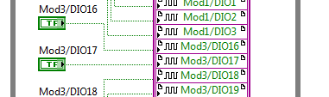

1.1 FPGA variables (1/3)
Add to your FPGA design the following patterns for all the variables (AI, AO, BI, BO) that will be exported on EPICS
Binary input : Convert to 64-bit U64
Analog input : Convert to float
^{Binary output : as is}
^{Analog output : Convert to FXP}

Slide 6
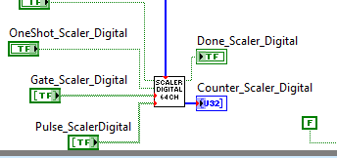
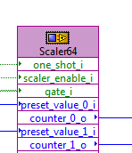
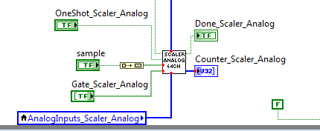
1.1 FPGA variables (2/3)
To implement scaler, use the following IP
^{Scaler digital}
^{Scaler : IP in VHDL}
^{Scaler Analog}
^{Validated with testbench}
If not all 64 counters are used, the logic can simply be optimized by reducing the size of the fixed input arrays.
FPGA utilization can be reduced by approximately 15% if this optimization is applied

Slide 7
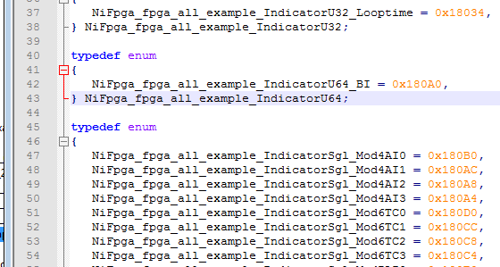
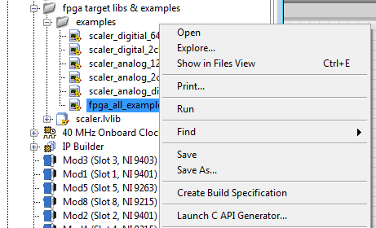
1.1 FPGA variables (3/3)
Generate bitstream and C API files
Generates header file with addresses
The address of each variable must be noted for the cfg.ini file.

Slide 8
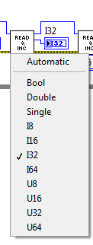
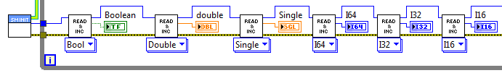
1.2 LabviewRT variables
Four Vis were developed to synchronize variable exchange with EPICs
IOC Shared memory initialize.vi
  Initializes shared memory. All input can be left as default
IOC Shared memory de-initialize.vi
  de-initializes shared memory.
SM read and increment.vi (polymorphic VI)
  Reads the variable (from EPICS) when setting the polymorphic VI
SM write and increment.vi (polymorphic VI)
  Writes the variable (to EPICS) when setting the polymorphic VI
All VI MUST be chained with <ptr in> and <ptr out>.
The index of the variable must be noted for the cfg.ini file.

Slide 9
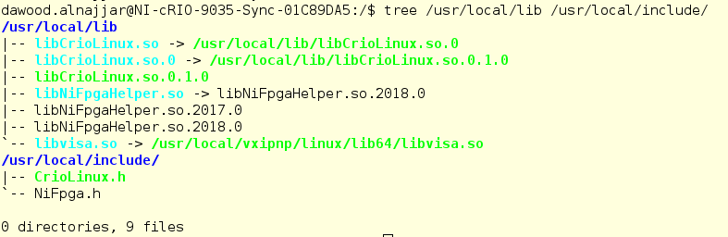
2 & 3 libCrioLinux.so and EPICS device support
NO alteration or re-compile is required!
Device support library path needs to be indicated explicitely in the IOC

Slide 10
4.1 EPICS IOC (1/8)
As long as the associated DB files are used, the IOC does not need to be compiled either!

Slide 11
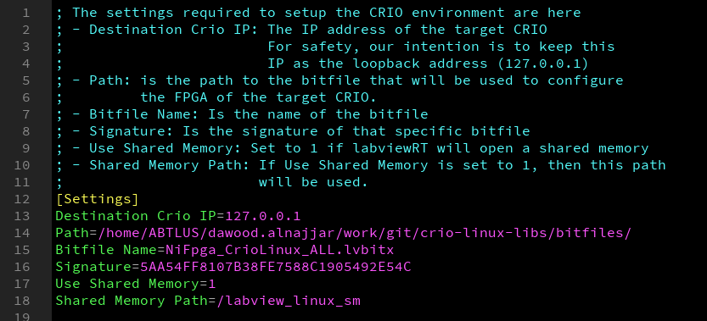
4.2 EPICS IOC – CFG.INI (2/8)
If changed, must be changed in labview RT VI too!
Disabling shared memory disables all labview RT variable processing.

Slide 12

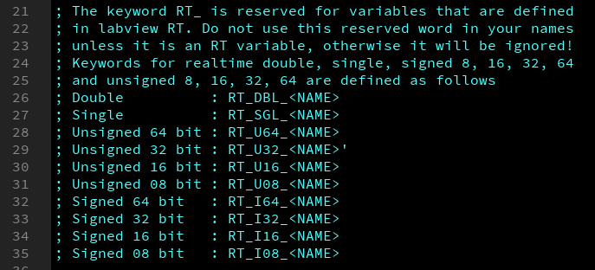
4.2 EPICS IOC – CFG.INI (3/8)
2 types of variables: labview RT variables, and FPGA variables
The library distinguishes the type and its size through its name

Slide 13
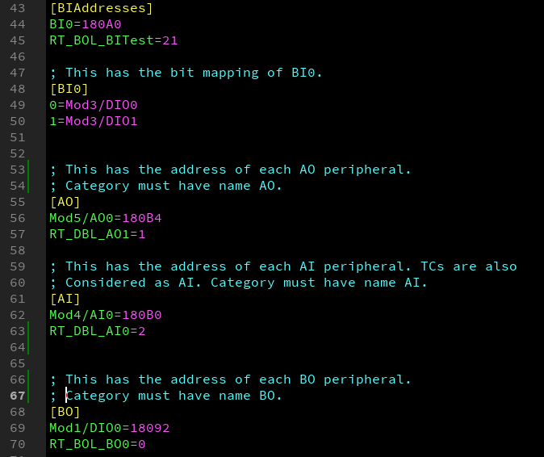
4.2 EPICS IOC – CFG.INI (4/8)
[BIAddresses]
  Address/index of BI
[BI0]: index -name relation of each bit in the 64 bits (FPGA)
[AO]: Address/index of each available output analog variable
[AI]: Address/index of each available input analog variable
[BO]: Address/index of each available output digital variable

Slide 14
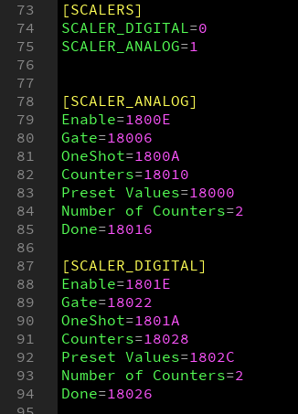
4.2 EPICS IOC – CFG.INI (5/8)

Slide 15


4.2 EPICS IOC – Settings (6/8)
Introduce path of deviceSupportCrio to IOC
$(TOP)/configure/RELEASE
Introduce deviceSupportCrio library name to IOC
$(TOP)/CRIOApp/src/Makefile

Slide 16
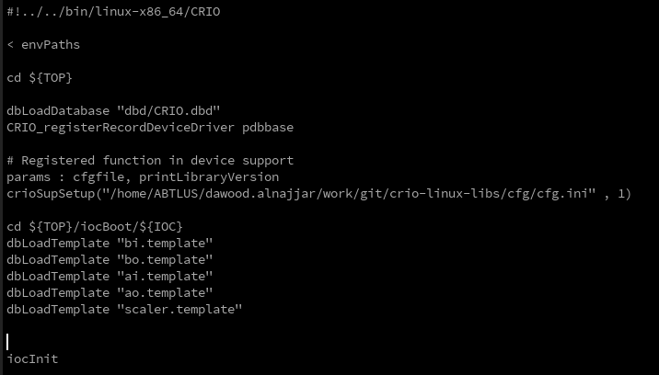
4.2 EPICS IOC – st.cmd (7/8)
Once single modification : provide cfg.ini file name to crioSupSetup.

Slide 17
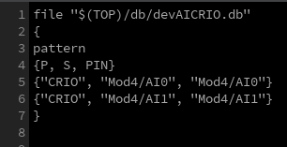
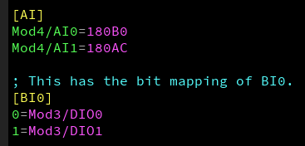
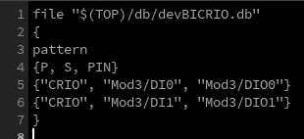
4.2 EPICS IOC – templates (8/8)
ai.template
This name must correspond to the name in the cfg.ini file
bi.template

Slide 18
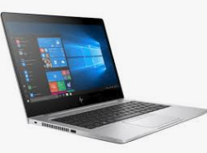
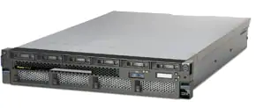
IOC compilation needed?
We now have a docker compilation environment* that compiles using a processor of another host and using the CRIO SSD
^{Map NFS}
^{Map SSD using SSH}
^{Docker on Host}
^{Map NFS}
^{NFS server (EPICS)}
*https://gitlab.cnpem.br/SOL/Docker/dev-crio.git

Slide 19
Softwares used
EPICS 3.14
Synapps 5.8 (Scaler)
Labview 2017
2017 linuxRT firmware

Slide 20
Softwares used
EPICS 3.15
Synapps 5.8 (Scaler)
Labview 2018
2018.5 linuxRT firmware

Slide 21
Exception handling
  Errors in the cfg.ini file, templates, or any inconsistency found appear on the EPICS IOC command prompt
    e.g. Error on read - [LibCrioLinux] Property [RT_DBL_AI0]: Query returned null.
  Since exceptions are redirected to epics terminal, the IOC does not stop functioning, so check your messages!
Start beta testing

Slide 22
Known limitations
Binary inputs are limited to 64 bits
Analog inputs are converted to single precision (23 bits of precision). Moving data from modules that have precision of 24 bits will lossy
Moving U64, I64 (64-bits) also is lossy since these variables are converted to double, and double is 52 bits precision
FXP not implmented (yet)

