Slide 1
From single project RCPSP to multi-project multi-mode RCPSP

Slide 2
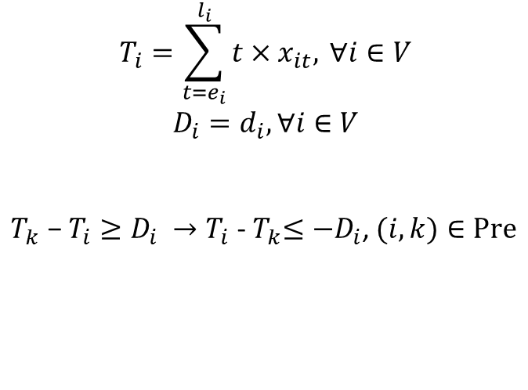


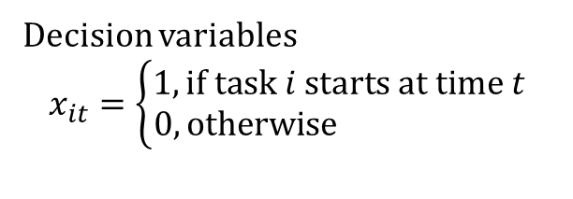
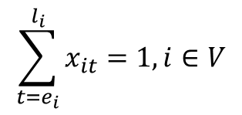
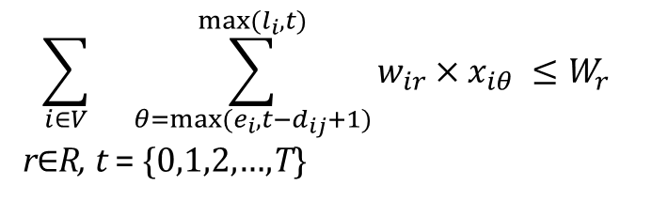
Single project RCPSP
${Obj:\min{T}}_{I}$, I is the dummy end task
$$\sum_{i∈V}{}\sum_{θ={max⁡(e}_{i},t−d_{ij}+1)}^{max⁡(l_{i},t)}{{w_{ir}×x}_{iθ} ≤W_{r}}$$
r$∈$R, t = {0,1,2,…,T}
s.t.
$$T_{i}=\sum_{t=e_{i}}^{l_{i}}{t{×x}_{it}, }∀i∈V$$
$$D_{i}=d_{i},∀i∈V$$
${T_{k}\text{ −}{ T}_{i}≥D_{i} →T}_{i}$ -${ T}_{k}≤−D_{i}$, $(i,k)∈Pre$
$$\sum_{t=e_{i}}^{l_{i}}{x_{it}=1,i∈V}$$
$x_{it}=${0,1}, $i∈V$, t=${e_{i},…,l}_{i}$
Decision variables
$$x_{it}=\left\{\begin{aligned}1, if task i starts at time t \\ 0, otherwise \end{aligned}\right.$$
Based on
Karamlou and Bocchini. (2016). From component damage to system-level probabilistic restoration functions for damaged bridges.

Slide 3
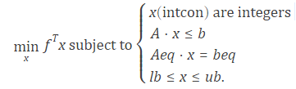
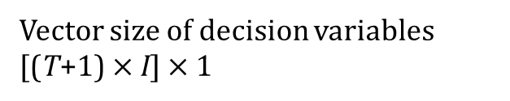
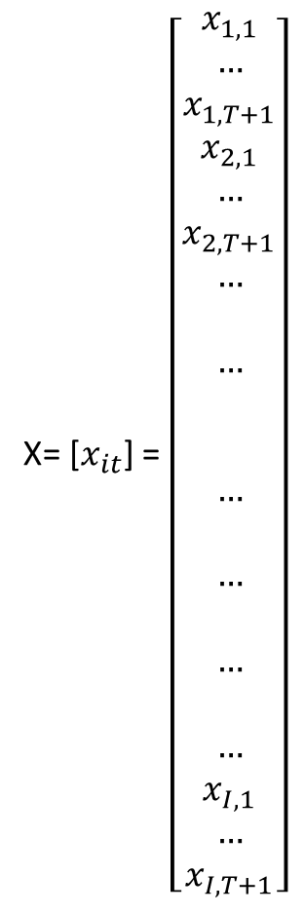
Mixed-integer linear programming solver
[X, fval, exitflag] = intlinprog (f, intcon, A, b, Aeq, beq, lb, ub);
f, x, intcon, b, beq, lb, and ub are vectors, and A and Aeq are matrices.
X= [$x_{it}$] = $\left[\begin{aligned}x_{1,1} \\ … \\ x_{1,T+1} \\ x_{2,1} \\ … \\ x_{2,T+1} \\ … \\ \\ … \\ \\ \\ … \\ \\ … \\ \\ … \\ \\ … \\ x_{I,1} \\ … \\ x_{I,T+1}\end{aligned}\right]$
Vector size of decision variables
[(T+1) $×$I] $×$1

Slide 4
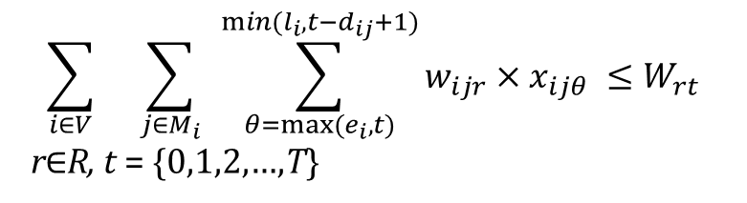

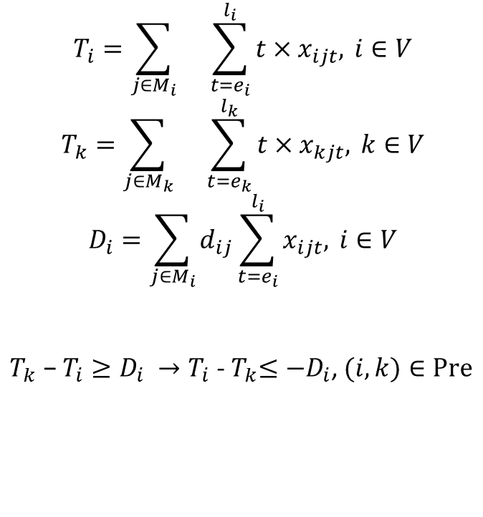
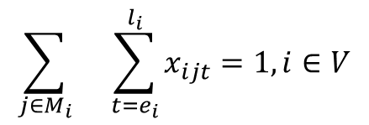

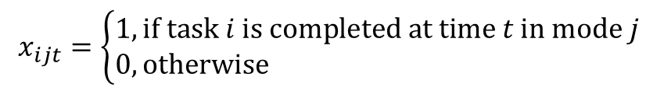
multi-mode RCPSP
$${Obj:\min{T}}_{I}$$
$$Renewable resource constraint$$
s.t.
$$T_{i}=\sum_{j∈M_{i}}{}\sum_{t=e_{i}}^{l_{i}}{t{×x}_{ijt}, }i∈V$$
$$T_{k}=\sum_{j∈M_{k}}{}\sum_{t=e_{k}}^{l_{k}}{t{×x}_{kjt}, }k∈V$$
$$D_{i}=\sum_{j∈M_{i}}{d_{ij}}\sum_{t=e_{i}}^{l_{i}}{x_{ijt}, }i∈V$$
${T_{k}\text{ −}{ T}_{i}≥D_{i} →T}_{i}$ -${ T}_{k}≤−D_{i}$, $(i,k)∈Pre$
$$\sum_{i∈V}{}\sum_{j∈M_{i}}{ }\sum_{θ={max⁡(e}_{i},t)}^{min⁡(l_{i},t−d_{ij}+1)}{{w_{ijr}×x}_{ijθ} ≤W_{rt}}$$
r$∈$R, t = {0,1,2,…,T}
$$\sum_{j∈M_{i}}{}\sum_{t=e_{i}}^{l_{i}}{x_{ijt}=1,i∈V}$$
Precedence constraint
$x_{ijt}=${0,1}, $i∈V$, $j∈M_{i}$, t=${e_{i},…,l}_{i}$
$$x_{ijt}=\left\{\begin{aligned}1, if task i is completed at time t in mode j \\ 0, otherwise \end{aligned}\right.$$

Slide 5
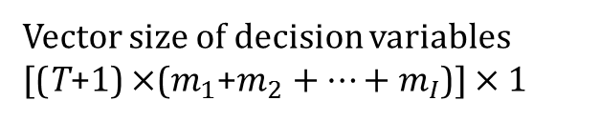
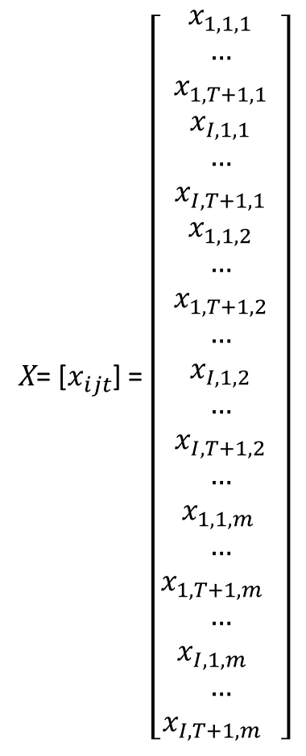
Mixed-integer linear programming solver
[X, fval, exitflag] = intlinprog (f, intcon, A, b, Aeq, beq, lb, ub);
f, x, intcon, b, beq, lb, and ub are vectors, and A and Aeq are matrices.
X= [$x_{ijt}$] = $\left[\begin{aligned}x_{1,1,1} \\ … \\ x_{1,T+1,1} \\ x_{I,1,1} \\ … \\ x_{I,T+1,1} \\ x_{1,1,2} \\ … \\ x_{1,T+1,2} \\ … \\ x_{I,1,2} \\ … \\ x_{I,T+1,2} \\ … \\ x_{1,1,m } \\ … \\ x_{1,{T+1,m}_{}} \\ … \\ x_{I,1,m_{}} \\ … \\ x_{I,{T+1,m}_{}}\end{aligned}\right]$
Vector size of decision variables
[(T+1) $×$($m_{1}$+$m_{2}+…+m_{I}$)] $×$1

Slide 6
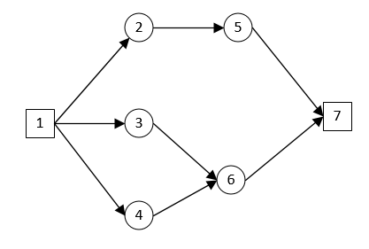
task # | 1st Mode |  | 2nd Mode
 | duration | Resource usage | duration | Resource usage
1 | 0 | 0 | 0 | 0
2 | 4 | 2 | 6 | 1
3 | 2 | 1 | 2 | 1
4 | 3 | 3 | 5 | 1
5 | 2 | 1 | 2 | 1
6 | 2 | 2 | 4 | 1
7 | 0 | 0 | 0 | 0
Renewable resource available per period = 6
0.006412 seconds
Renewable resource available per period = 4
0.012903 seconds

Slide 7
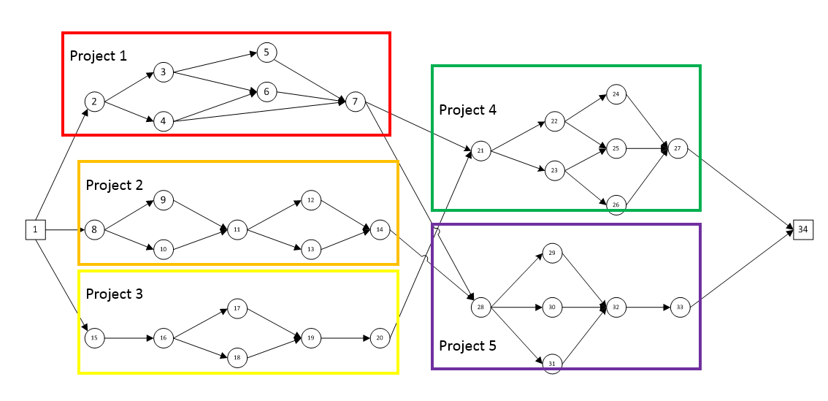
task # | 1st Mode |  | 2nd Mode
 | Duration | Resource | Duration | Resource
1 | 0 | 0 | 0 | 0
2 | 0 | 0 | 0 | 0
3 | 3 | 3 | 2 | 1
4 | 5 | 2 | 4 | 2
5 | 6 | 3 | 1 | 2
6 | 2 | 4 | 3 | 1
7 | 0 | 0 | 0 | 0
8 | 0 | 0 | 0 | 0
9 | 1 | 5 | 3 | 3
10 | 5 | 3 | 2 | 3
11 | 5 | 2 | 1 | 3
12 | 3 | 1 | 1 | 1
13 | 2 | 3 | 2 | 1
14 | 0 | 0 | 0 | 0
15 | 0 | 0 | 0 | 0
16 | 2 | 2 | 2 | 2
17 | 6 | 3 | 2 | 2
18 | 3 | 3 | 2 | 1
19 | 3 | 3 | 3 | 2
20 | 0 | 0 | 0 | 0
21 | 0 | 0 | 0 | 0
22 | 2 | 2 | 1 | 2
23 | 4 | 2 | 3 | 2
24 | 4 | 3 | 1 | 2
25 | 2 | 3 | 1 | 1
26 | 3 | 3 | 2 | 1
27 | 0 | 0 | 0 | 0
28 | 0 | 0 | 0 | 0
29 | 1 | 2 | 2 | 1
30 | 2 | 2 | 3 | 2
31 | 6 | 1 | 1 | 3
32 | 3 | 3 | 2 | 1
33 | 0 | 0 | 0 | 0
34 | 0 | 0 | 0 | 0
Project 1
Renewable resource available per period = 6
3.102517 seconds
Project 2
Project 3
Project 4
Project 5

Slide 8
task # | 1st mode |  | 2nd mode
 | Duration | Resource | Duration | Resource
1 | 0 | 0 | 0 | 0
2 | 0 | 0 | 0 | 0
3 | 3 | 3 | 2 | 1
4 | 5 | 2 | 4 | 2
5 | 6 | 3 | 1 | 2
6 | 2 | 4 | 3 | 1
7 | 0 | 0 | 0 | 0
8 | 0 | 0 | 0 | 0
9 | 1 | 5 | 3 | 3
10 | 5 | 3 | 2 | 3
11 | 5 | 2 | 1 | 3
12 | 3 | 1 | 1 | 1
13 | 2 | 3 | 2 | 1
14 | 0 | 0 | 0 | 0
15 | 0 | 0 | 0 | 0
16 | 2 | 2 | 2 | 2
17 | 6 | 3 | 2 | 2
18 | 3 | 3 | 2 | 1
19 | 3 | 3 | 3 | 2
20 | 0 | 0 | 0 | 0
21 | 0 | 0 | 0 | 0
22 | 2 | 2 | 1 | 2
23 | 4 | 2 | 3 | 2
24 | 4 | 3 | 1 | 2
25 | 2 | 3 | 1 | 1
26 | 3 | 3 | 2 | 1
27 | 0 | 0 | 0 | 0
28 | 0 | 0 | 0 | 0
29 | 1 | 2 | 2 | 1
30 | 2 | 2 | 3 | 2
31 | 6 | 1 | 1 | 3
32 | 3 | 3 | 2 | 1
33 | 0 | 0 | 0 | 0
34 | 0 | 0 | 0 | 0
Project 1
Renewable resource available per period = 8
1.137673 seconds
Project 2
Project 3
Project 4
Project 5

