Slide 1

Components of any Computer System
Control – logic that controls fetching/execution of instructions
Memory – area where instructions/data are stored
Input/Output – external interaction with computer
Address bus
C
o
n
t
r
o
l
Memory
Data bus
Input/Output
devices

Slide 2
Processor Architecture Components
Registers : used for storing data values and addresses
Execution units: perform computations (arithmetic, logic) on data
  ALU: Arithmetic Logic Unit
Control: logic for fetching, executing instructions
Memory: stores instruction and data
Input/Output: external interface with computer system

Slide 3
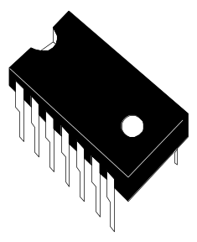
Processor Integration
Early computers had many separate chips for the different portions of a computer system
Registers
ALU
Control
Memory

Slide 4
Microprocessors
First microprocessors placed control, registers, arithmetic logic unit in one integrated circuit (one chip).
Data Bus
CPU
(ALU +
Reg +
control)
Address Bus
Memory
I/O
Devices
Control Bus
CPU – Central Processing Unit

Slide 5
Modern μProcessors
Modern microprocessors (general purpose μProcessors) also integrate memory onchip for faster access. External memory and I/O components still required. Memory integrated on the microprocessor is called cache memory.
Data Bus
CPU
Address Bus
Registers,
ALU,
Fetch,
Exe Logic,
Bus logic,
Cache Memory
Memory
I/O
Devices
Control Bus

Slide 6


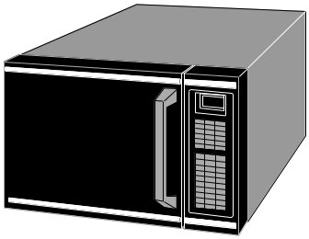
Microcontrollers
Microcontrollers integrate all of the components (control, memory, I/O) of a computer system into one integrated circuit. Microcontrollers are intended to be single chip solutions for systems requiring low to moderate processing power.
Microcontroller

Slide 7
Intel x86 Processors
In this course will study the Intel x86 general purpose microprocessor family
  Instruction set architecture
  Assembly language programming
  Hardware features of different x86 implementations
  Other features of microprocessor systems

Slide 8
ISA vs Implementation
Instruction Set Architecture (ISA) : the definition of the registers and instructions that define the programmer’s view of a processor
Can have different implementations of the same ISA
  Intel and AMD processors both execute the x86 ISA, but internally are very different!!
  Intel has several different implementations of the x86 ISA!
New versions of an ISA extend the previous version by adding instructions, registers – but never invalidate the old ISA

Slide 9
Intel x86 Microprocessors
8086 - 20 bit Addr. Bus - 1MB of Memory
80286 - 24 Addr. Bus - Added Protection Mode
80386 - 32 bit regs/busses - Virtual 86 Mode
80486 - RISC Core - L1 Cache - FPU
Pentium - Superscalar - Dual Pipeline - Split L1 Cache
Pentium Pro - L2 Cache - Branch Pred. - Speculative Exec.
Pentium MMX - 57 Instructions - Integrated DSP (MMX)
Pentium II - 100 MHz Bus - L2 Cache - MMX
Celeron - 66 MHz Bus - True L2 Cache Integration
Pentium III - 100 MHz Bus - 70 Internet Streaming SIMD Ext.

Slide 10
8086/8088 Register File
7
0
7
0
Accumulator
AH
BH
CH
DH
AL
BL
CL
DL
AX
BX
CX
DX
Base
Counter
Data
15
0
Code Segment
CS
DS
SS
ES
Data Segment
Stack Segment
Extra Segment
15
0
Instruction Pointer
IP
SP
BP
SI
DI
}
Stack Pointer
}
Base Pointer
Source Index
}
Destination Index

Slide 11
8086/8088 Register File (cont)
Flags Register
15
0
x
x
x
x
OF
DF
IF
TF
SF
ZF
x
AF
x
PF
x
CF
Status and Control Bits Maintained in Flags Register
  Generally Set and Tested Individually
  9 1-bit flags in 8086; 7 are unused

Slide 12
Status Flags
Indicate Current Processor Status
CF Carry Flag Arithmetic Carry/Borrow
OF Overflow Flag Arithmetic Overflow
ZF Zero Flag Zero Result; Equal Compare
SF Sign Flag Negative Result; Non-Equal Compare
PF Parity Flag Even Number of “1” bits
AF Auxiliary Carry Used with BCD Arithmetic

Slide 13
Control Flags
Influence the 8086 During Execution Phase
DF Direction Flag Auto-Increment/Decrement
  used for “string operations”
IF Interrupt Flag Enables Interrupts
  allows “fetch-execute” to be interrupted
TF Trap Flag Allows Single-Step
  for debugging; causes interrupt after each op

Slide 14
8086/8088 Register File (cont)
Instruction Pointer Register
15
0
IP Contains Address of NEXT Instruction to be Fetched
  Automatically Incremented
  Programmer can control with jump and branch

Slide 15
AX, BX, CX, DX
General Purpose Registers
7
0
7
0
Accumulator
AH
BH
CH
DH
AL
BL
CL
DL
AX
BX
CX
DX
Base
Counter
Data
Can Be Used Separately as 1-byte Registers
        AX = AH:AL
Temporary Storage to Avoid Memory Access
  Faster Execution
  Avoids Memory Access
Some Special uses for Certain Instructions

Slide 16
AX, BX, CX, DX - Some Specialized Uses
7
0
7
0
Accumulator
AH
BH
CH
DH
AL
BL
CL
DL
AX
BX
CX
DX
Base
Counter
Data
AX, Accumulator
  Main Register for Performing Arithmetic
  mult/div must use AH, AL
  “accumulator” Means Register with Simple ALU
BX, Base
  Point to Translation Table in Memory
  Holds Memory Offsets; Function Calls
CX, Counter
  Index Counter for Loop Control
DX, Data
  After Integer Division Execution - Holds Remainder

Slide 17
CS, DS, ES, SS - Segment Registers
Contains “Base Value” for Memory Address
CS, Code Segment
  Used to “point” to Instructions
  Determines a Memory Address (along with IP)
  Segmented Address written as CS:IP
DS, Data Segment
  Used to “point” to Data
  Determines Memory Address (along with other registers)
  ES, Extra Segment allows 2 Data Address Registers
SS, Stack Segment
  Used to “point” to Data in Stack Structure (LIFO)
  Used with SP or BP
  SS:SP or SS:BP are valid Segmented Addresses

Slide 18
IP, SP, BP, SI, DI - Offset Registers
Contains “Index Value” for Memory Address
IP, Instruction Pointer
  Used to “point” to Instructions
  Determines a Memory Address (along with CS)
  Segmented Address written as CS:IP
SI, Source Index; DI, Destination Index
  Used to “point” to Data
  Determines Memory Address (along with other registers)
  DS, ES commonly used
SP, Stack Pointer; BP, Base Pointer
  Used to “point” to Data in Stack Structure (LIFO)
  Used with SS
  SS:SP or SS:BP are valid Segmented Addresses
These can also be used as General Registers !!!!!!

Slide 19
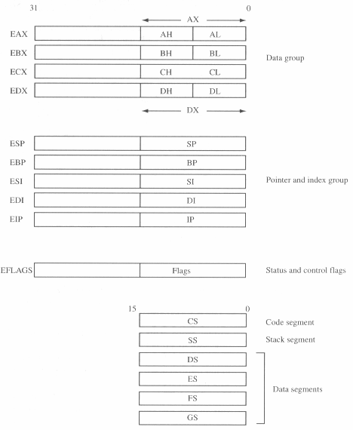
80386 Register Set
Note how registers were extended from 16 bits to 32 bits in width.
Register EAX refers to the entire 32-bit register.

