Slide 1

Financial Sales Dashboard | Power BI
Data Analyst Internship Project Review | Interactive Power BI Analysis

Slide 2




Project Scope & Architecture
Data Volume
Geography
Dataset Size
Locations
Analyzed a core dataset comprising 200 distinct financial transactions, allowing for a focused and deep-dive exploratory data analysis.
Sales data spans across 5 major Indian metropolitan hubs: Delhi, Kolkata, Chennai, Mumbai, and Bangalore.
Tooling
Objective
Platform
Goal
Developed utilizing Power BI, specifically leveraging its capabilities for interactive visual storytelling and complex DAX modeling.
To transform raw transactional records into actionable, operational intelligence for the executive management team.

Slide 3

Dashboard Design & UI
5 Interactive Pages: Comprehensive coverage including Overall Overview, Product Analysis, Regional Performance, Payment Channels, and Customer Demographics.
Dark Mode Aesthetic: Designed with a professional dark theme to reduce eye strain, match modern analytics software, and increase contrast for key metrics.
Seamless Navigation: Integrated custom navigation menus for frictionless movement between different analytical views.
Dynamic Filtering: Implemented comprehensive dropdown slicers allowing users to instantly slice data by region, date, and product type.

Slide 4

Key Performance Indicators
Operational Metrics
The dashboard continuously tracks these 4 primary KPIs prominently on the Overview page to assess business health at a glance.
2.8M
200 Total Transactions Analyzed
TOTAL SALES (INR)
3.05 / 5.0 Average Customer Feedback
31.5% Overall Transaction Success Rate

Slide 5
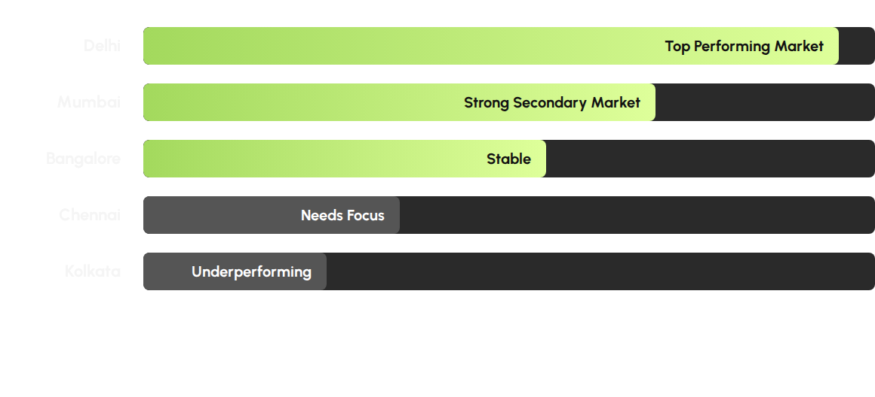
Regional Performance
* Data indicates Delhi is the clear front-runner in sales volume, presenting a model that could be replicated in lagging markets like Kolkata and Chennai.

Slide 6
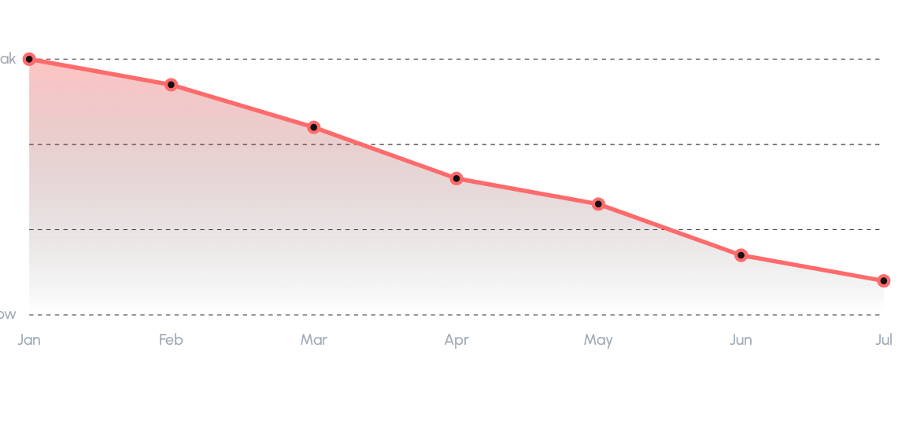
Sales Trend (Jan - Jul)
Critical Observation: Sales hit their absolute peak in January but have demonstrated a persistent, month-over-month decline through July. This is a significant red flag requiring immediate business intervention.

Slide 7

Customer & Payment Insights
Demographics
Age group analysis reveals a highly concentrated demographic driving the majority of revenue.
41 to 50 Years
This demographic constitutes the biggest spenders. Marketing efforts should be heavily weighted towards this high-purchasing-power segment.
Payment Channels
Transaction data shows a completely balanced split between dominant payment ecosystems.
UPI | Credit Card
Both methods are equally popular. Business must ensure payment infrastructure for both channels is highly optimized.

Slide 8

Critical Red Flag
Dashboard analytics have uncovered a severe operational bottleneck:
Only 31.5%
of all initiated transactions are successfully completed.
This exceptionally low success rate represents massive revenue leakage. It is strongly recommended to immediately investigate potential payment gateway failures, UI friction points, or server timeouts causing drop-offs.

Slide 9

Key Recommendations
Replicate Success: Study Delhi's operational strategy and replicate these practices in underperforming markets like Kolkata and Chennai.
Investigate Drop-offs: A 31.5% success rate is critical. Immediately investigate payment gateway failures and transaction bottlenecks.
Reverse the Trend: Address the continuous sales decline since January with aggressive promotional campaigns to stimulate growth.
Targeted Marketing: The 41-50 age group are the biggest spenders; heavily focus marketing budgets on this demographic.
Optimize Payments: Since UPI and Credit Cards are equally popular, maintain infrastructure optimization for both ecosystems.

Slide 10



Challenges & Learnings
Mastering DAX
Analytical Mindset
Technical Skill
Visual Selection
Calculating the Success Rate % was challenging, but it taught me the immense analytical power of calculated measures in Power BI.
Deciding which visuals best answered specific business questions taught me to think strategically like a data analyst.
Enterprise UI
Real-World Data
Dashboard Navigation
Business Acumen
Building a 5-page navigation structure was complex, revealing how professional, enterprise-grade dashboards are architected.
Working with authentic financial datasets taught me how to extract meaningful, actionable business insights from raw numbers.

Slide 11


Thank You

