Slide 1
Decomposition Method
Zhaopeng Qu
Fall 2017

Slide 2
Brown at el(1980)
Take the industry/occupational wage differentials into the Oaxaca-Blinder method.
The average wage of male/female is a summation of product of probability which male/female enters a industry and average wage of the industry.
The average gap

Slide 3
Brown at el(1980)
The first term
here is the female’s probability of working in some industries if they were treated as males.
In a Multinomial Logit equation,

Slide 4
Brown at el(1980)
the second term
X is the average characteristics of males or females in industry j.

Slide 5
Brown at el(1980)
Total gap can be decomposed into four parts
The first term- “can be explained within industry”
The second term- “can NOT be explained within industry”
The third one- “can be explained across industry”
The last one- “can NOT be explained across industry”

Slide 6
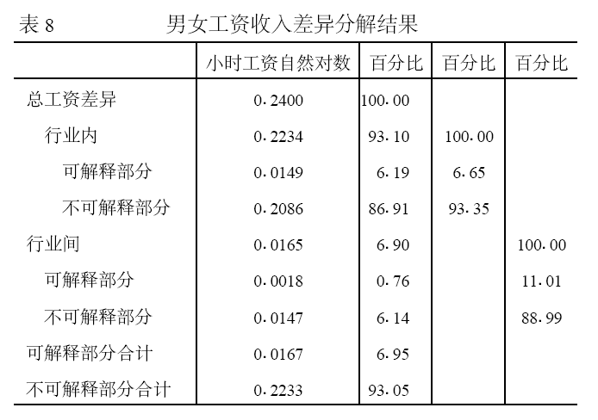
王美艳(2005)

Slide 7
Decomposition of Gaps in the Distribution

Slide 8
Decomposition in the distribution
Katz and Autor(1999)-KA
Juhn, Murphy and Pierce(1993)-JMP
DiNardo, Fortin and Lemieux(1996)-DFL
Machado and Mata(2005)-MM

Slide 9
Katz and Autor(1999)
A simple wage equation
is the vector of estimated(OLS) returns to observable characteristics in t, and is the log wage residual.
Then we can get

Slide 10
Katz and Autor(1999)
Between two periods or two groups
So the change of the variance can be decomposition into the change in between-group inequality(change in the predicted values) and the change in within group inequality(change in the residual variance).

Slide 11
Katz and Autor(1999)
A lot of wage inequality studies use the framework.
But the variance is not a good measure of distribution.

Slide 12
JMP Decomposition
Juhn, Murphy and Pierce(1993)
Wage Inequality and the Rise in Returns to Skill”, Journal of Political Economy, 101(3), pp.410-442.

Slide 13
Juhn, Murphy and Pierce(1993)
Set out to summarize the rising dispersion of earnings in the U.S. during 1970s & 1980s.
Invert a tool to describing the components of wage density changes that could attributed to
measured prices,
measured quantities
residuals(unmeasured prices and quantities)

Slide 14
Juhn, Murphy and Pierce(1993)
A simple wage equation
The residual distribution
is the inverse distribution of wage residual.
is percentile rank in the distribution of residuals.
t also can be male and female.

Slide 15
Juhn, Murphy and Pierce(1993)
The wage distribution
Here is the average returns to the observables over time
is the average cumulative distribution of residual.

Slide 16
Juhn, Murphy and Pierce(1993)
We can construct three counterfactual distribution
Varying only the distribution of X
Varying both observable quantities and prices
Varying quantities, prices and unobservables

Slide 17
Juhn, Murphy and Pierce(1993)
Using the accounting scheme, JMP propose the following decomposition.
The first term is attributed to changes in observable quantities.
The second term is attributed to changes in observable prices.
The third term is attributed to changes in residual inequality

Slide 18
Juhn, Murphy and Pierce(1993)
JMP perform their estimation in three steps:
To obtain the effect of quantities, JMP predict wages for all workers in the sample using the average coefficient vector , and computing a residual for each worker and applying the average residual distribution over full sample.
To obtain the marginal effect of quantities, they repeat this procedure using the coefficient vector
Finally, the third component is simply calculated as the difference between the actual wage distribution and the counterfactual in the second step.

Slide 19
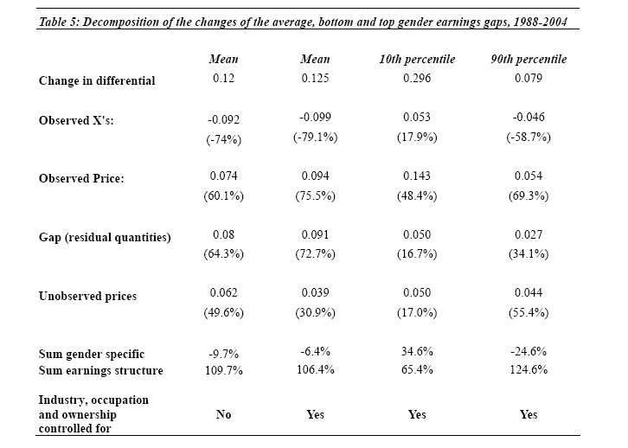
Zhang, Han, Liu and Zhao(2007)

Slide 20
Shortcomings of JMP
OLS wage regression is at the heart of the JMP and the results do not extend naturally to wage quantiles.
Still suffers the sequence problem of decomposition.

Slide 21
DFL Decomposition
DiNardo, Fortin and Lemieux(1996)
“Labor Market Institutions and the Distribution of Wages, 1973-1992: A Semiparametric Approach”, Econometrica, Vol. 64, No. 5, pp. 1001-1044.

Slide 22
Contribution
They reconsidered the effect of the Labor market institution, such as minimum wage or unionization on the wage inequality.
They constructed a semi-parametric estimation of the distribution to work on the entire distribution of wages.

Slide 23
Kernel Density Estimation
Kernel Density Estimation is an empirical analog to a probability density function. It can be seen as an Smoothing histogram.
The kernel density estimate of a density f based on a random sample Wi of size n, with weights ( ) is calculated as follows
is the kernel density function, (normally a Gaussian distribution) and h is the bandwidth which determined the degree of ‘smoothing’.

Slide 24
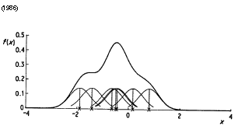
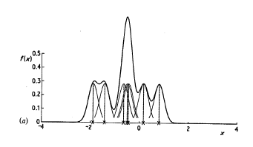
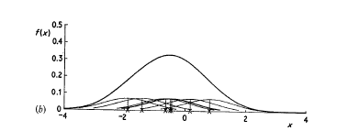
Kernel Density Estimation
bandwidth=0.4
bandwidth=0.2
bandwidth=0.8

Slide 25
Review of Basic Probability Theory
Random variables(X, Y) with their joint p.d.f. f(x,y) and joint c.d.f. F(X,Y)
X’ s marginal p.d. f.
Y’s marginal p.d. f.
Conditional on X, Y’s p.d. f

Slide 26
Wage Distribution
Each wage observation in a given distribution as a vector of (w, z, g) where z is a vector of individual attributes and g is a gender subscript, which is m=male or f=female.

Slide 27
Wage Distribution
Because
So joint distribution can be rewrite as follows
The counterfactual distribution will be constructed by changing the marginal distributions to those which prevailed another time period.

Slide 28
Actual Wage Distribution
Wage Density for male
Wage Density for female

Slide 29
Counterfactual Wage Distribution
Wage Density for women with the distribution of attributes for men equals to
the counterfactuals what would be pay for women if they have the same attributes as men have

Slide 30
Reweighting
This is simply the ratio of probability mass at each point z for male relative to female. Hence it just reweights the female wage density.
Notice that we are not specifying the function that maps z into w, so this reweighting is nonparametric.

Slide 31
Estimation to
But how to get the ?
It could be a high dimensional object to estimate because Z includes k variables such as (age, gender, education, experience)
Remind Bayes’ Rule

Slide 32
Estimation to
So we can obtain
Then

Slide 33
Estimation to
In practice, we pool data from both genders of the sample,male and female.
Then is just the estimation to a probit model which describes the probability of an observation is from male given z.
is equal to the proposition of observations for male over the whole samples.
So we can get directly.

Slide 34
Weighted Kernel Density
Then we put into our Kernel density estimation to sample for male, thus
The counterfactual distribution here which is the density that would have prevailed if individual attributes had remained at their 1979 level and workers had been paid according to the wage rate observed in 1988.

Slide 35
The Distribution Effect on Wage
Then the distribution effect on wage due to the change of attributes is
The effect due to the change of wage

Slide 36
Underlying assumption
this reweighting transformation using the probit model is parametric (the probit model assumes a functional form). The entire DFL method is therefore called semi-parametric because of the parametric reweighting approach.
The underlying assumption: Not a general equilibrium analysis

Slide 37
MM and AKK decomposition
Machado and Mata(2005)“Counterfactual Decomposition of Changes in Wage Distributions using Quantile Regression”, Journal of Applied Econometrics, vol. 20(4), pp 445-465.
Autor, Kearney and Katz(2008)
RES and NBER working paper

Slide 38
Machado and Mata(2005)
Quantile Regression
Then we can get a predict distribution but we can not use it directly to make the counterfactual fact because it is a conditional distribution.
Following the MM method, we can get the unconditional quantile distribution

Slide 39
Machado and Mata(2005)
If U is a uniform distribution on [0,1], then
satisfies distribution of F.
So if come from a U[0,1],we can get l quantiles from regressions. Then I quantiles can be looked as a random sample drawn from a distribution conditional on X.

Slide 40
Machado and Mata(2005)
How to get the unconditional distribution based on estimated coefficients
Generate a random sample of size m from a U[0,1] :
In the female sample, make m quantile regressions on every to yield m estimates of the QR coefficients vectors
Generate a random sample of size m with replacement from male sample:
Combine b) and c) to get the new sample with size m

Slide 41
Machado and Mata(2005)
How to get the unconditional distribution based on the distribution of attributes such as education?
Get a unconditional distribution of female wage
Calculate a share of certain group in the whole male sample
Draw a sample of size with replacement from the certain group sample in
Repeat the procedures to other groups and combine them to get the whole sample, thus the unconditional distribution of female wage if female had the same education as the male.

Slide 42
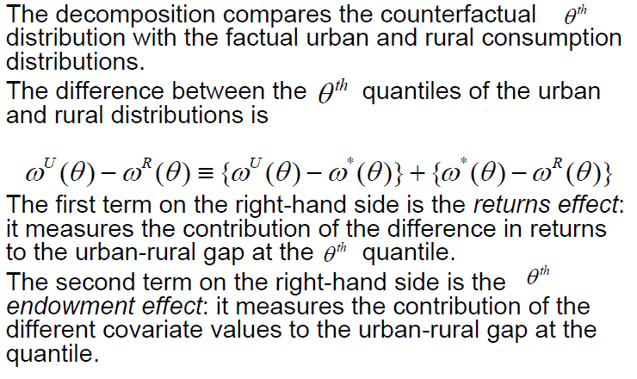
Machado and Mata(2005)

Slide 43
Machado and Mata(2005)
Pitfalls
Very heavily computational process

Slide 44
Some latest extensions
Melly(2006) and Albrecht et al(2007)
Prove this procedure yields a consistent and asymptotically normal estimates of the quantiles of the counterfactual distribution.
Extend the MM method to account the self-selection.

Slide 45
Some latest extensions
Firpo, Fortin and Lemieux(2007,2009) “FFL”
Advantage
More easy to implement
A unified scheme to understand quantile regression decomposition
A more robust decomposition distributional changes into those attributable to single factors.

Slide 46
Firpo, Fortin and Lemieux(2007,2009) “FFL”
The challenge that FFL address is that of aggregating quantile effects.
A lovely feature of OLS regressions is that the conditional expectation function (CEF) is linear.

Slide 47
Some Pitfalls
Intrinsically a partial equilibrium approach to analyze a general equilibrium question.
May not deepen our understanding of the mechanisms underlying the relationship between outcomes and factors.
How is extent to trust the “causal explanation” in the decomposition?

Slide 48
Two directions of Extension
In Summary
Adding more factors into the decomposition make the it from gaps into multi-dimensions.
Doing the more consistence estimations to make the counterfactual distribution more convinced.

