Slide 1

BUEC 311
Business Economics, Organizations and Management
Winter 2019
General Equilibrium and Economic Welfare
Diego B. P. Gomes

Slide 2
Where are we?
The Nature of Firms
✓
Production
Ch. 6
Ideal Market Structure!
More Realistic Markets!
Competitive Markets
Market Power
✓
✓
Costs
Ch. 7
Perfect Competition
Ch. 8
Monopoly & Monopsony
Ch. 11
✓
Properties of Competition
Ch. 9
Pricing & Advertising
Ch. 12
Consumer Behavior
✓
Consumer’s Choice
Ch. 3
Game Theory
Ch. 13
General Equilibrium
Ch. 10
Oligopoly
Ch. 14
Choice under Uncertainty
Ch. 16
Factor Markets
Ch. 15
Labor market
Capital market
Exhaustible resources

Slide 3

General Equilibrium
The study of how equilibrium is determined in all markets simultaneously!
Important for markets that are closely related!
Example
1. Discovery of oil in a small country
Note
Up to this point, we were doing partial equilibrium analysis:
2. Citizens’ income is raised
Analyzing one market in isolation
Prices of other goods were fixed
Quantity of other goods were fixed
3. Higher income affects all markets simultaneously
Spillover effects

Slide 4





Competitive Equilibrium in Two Interrelated Markets
Two markets producing two different goods:
Market 1
Market 2
Related to Market 2
Related to Market 1
Market Demand
$$Q_{1}=D_{1}(p_{1},p_{2})$$
$$Q_{2}=D_{2}(p_{1},p_{2})$$
Market Supply
$$Q_{1}=S_{1}(p_{1})$$
$$Q_{2}=S_{2}(p_{2})$$
To find the equilibrium, we need to solve these four equations in four unknowns simultaneously!
($Q_{1},Q_{2},p_{1},p_{2}$)

Slide 5




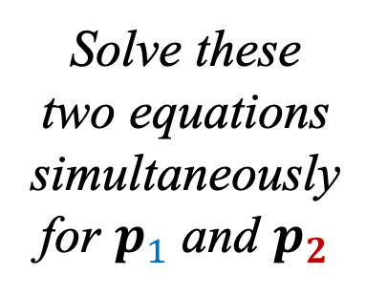
Example
Consider the following linear supply and demand functions:
Demand of Market 1
$$Q_{1}=a_{1}−b_{1}p_{1}+c_{1}p_{2}$$
$$Q_{1}=d_{1}+e_{1}p_{1}$$
Supply of Market 1
Supply of Market 2
Demand of Market 2
$$Q_{2}=a_{2}−b_{2}p_{2}+c_{2}p_{1}$$
$$Q_{2}=d_{2}+e_{2}p_{2}$$
What is the competitive equilibrium?
Equate supply and demand of market 1
$$a_{1}−b_{1}p_{1}+c_{1}p_{2}=d_{1}+e_{1}p_{1}$$
Solve these two equations simultaneously for $p_{1}$ and $p_{2}$
Equate supply and demand of market 2
$$a_{2}−b_{2}p_{2}+c_{2}p_{1}=d_{2}+e_{2}p_{2}$$

Slide 6
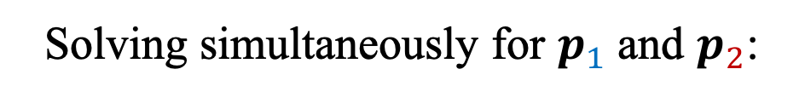
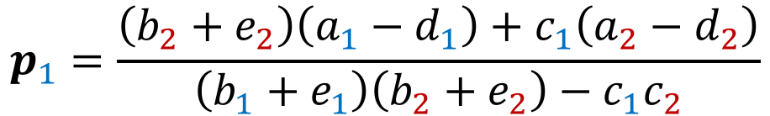
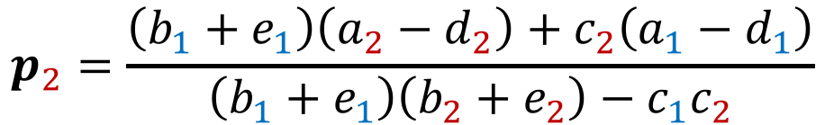


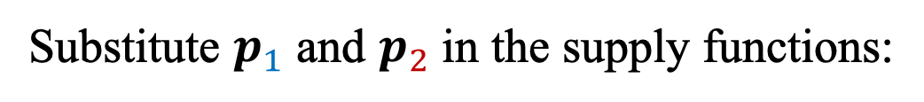
Example (cont.)
Solving simultaneously for $p_{1}$ and $p_{2}$:
$$p_{1}=\frac{\left(b_{2}+e_{2}\right)\left(a_{1}−d_{1}\right)+c_{1}\left(a_{2}−d_{2}\right)}{\left(b_{1}+e_{1}\right)\left(b_{2}+e_{2}\right)−c_{1}c_{2}}$$
$$p_{2}=\frac{\left(b_{1}+e_{1}\right)\left(a_{2}−d_{2}\right)+c_{2}\left(a_{1}−d_{1}\right)}{\left(b_{1}+e_{1}\right)\left(b_{2}+e_{2}\right)−c_{1}c_{2}}$$
Substitute $p_{1}$ and $p_{2}$ in the supply functions:
$$Q_{1}=d_{1}+e_{1}p_{1}=…$$
Do the algebra to find the final expression for quantities!
$$Q_{2}=d_{2}+e_{2}p_{2}=…$$

Slide 7










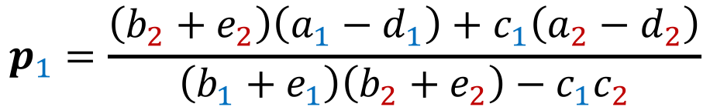

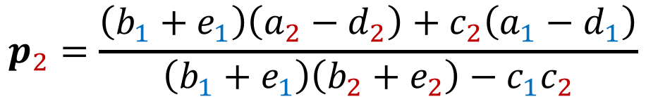
Example (cont.)
$$a_{1}=a_{2}=10$$
$$c_{1}=c_{2}=1$$
$$e_{1}=e_{2}=1$$
$$b_{1}=b_{2}=2$$
$$d_{1}=d_{2}=2$$
2
1
10
2
1
10
2
$$p_{1}=\frac{\left(b_{2}+e_{2}\right)\left(a_{1}−d_{1}\right)+c_{1}\left(a_{2}−d_{2}\right)}{\left(b_{1}+e_{1}\right)\left(b_{2}+e_{2}\right)−c_{1}c_{2}}$$
$$=4$$
2
1
2
1
1
1
2
1
10
2
1
10
2
$$p_{2}=\frac{\left(b_{1}+e_{1}\right)\left(a_{2}−d_{2}\right)+c_{2}\left(a_{1}−d_{1}\right)}{\left(b_{1}+e_{1}\right)\left(b_{2}+e_{2}\right)−c_{1}c_{2}}$$
$$=4$$
2
1
2
1
1
1
2
1
4
2
1
4
$$Q_{1}=d_{1}+e_{1}p_{1}$$
$$=6$$
$$Q_{2}=d_{2}+e_{2}p_{2}$$
$$=6$$

Slide 8
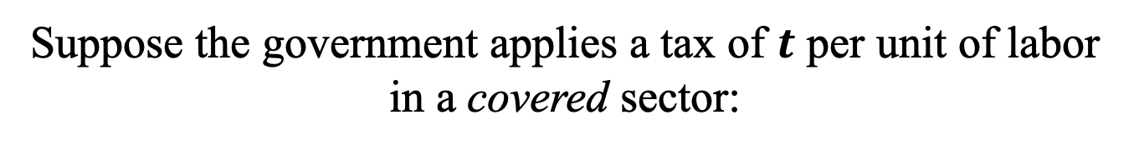




Application
Suppose the government applies a tax of $t$ per unit of labor in a covered sector:
What is the effect on wages, total employment, and employment in the covered and uncovered sectors?
1. After tax, labor becomes more expensive in the covered sector
(a)
C
o
vered Sector
(b) Uncovered Sector
(c)
Total Labor Market
Labor$↓$ ($L_{c}^{2}<L_{c}^{1}$)
Labor $↑$ ($L_{u}^{2}>L_{u}^{1}$)
Wages $↓$ ($w_{2}<w_{1}$)
Wage per hour
Wage per hour
Wage per hour
Labor $↓$ ($L_{2}<L_{1}$)
,
,
,
w
w
w
t
t
S
2. Demand for labor in the covered sector falls
w
w
w
e
1
1
1
1
w
w
w
2
2
2
e
2
3. Total labor market demand also falls
c
c
u
2
1
D
D
D
D
D
2
1
2
1
1
2
L
L
L
L
L
L
c
c
u
u
2
1
L
,
Annual hours
L
,
Annual hours
L
c
u
,
Annual hours

Slide 9
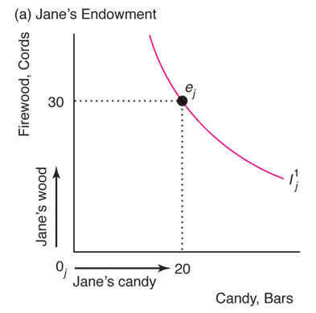
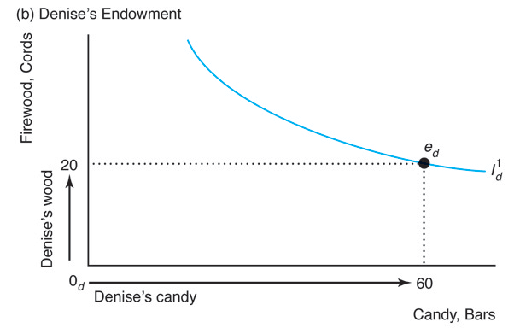
Trading Between Two People
Two consumers with different endowments of two goods:
 | Jane | Denise
Firewood | 30 | 20
Candy Bar | 20 | 60
Note
If they don’t trade, they can each only consume their initial endowments!
Before trade
Before trade

Slide 10
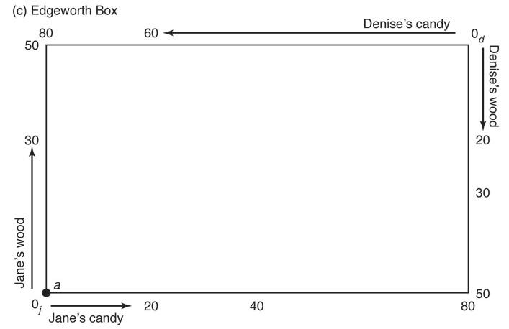
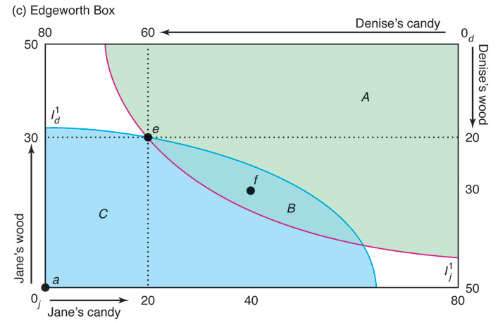
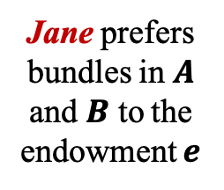
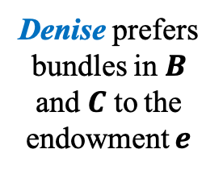
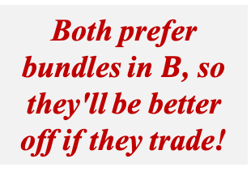
Should the consumers trade goods?
To answer this question, we must use the Edgeworth box!
Denise gives 20 candies
Jane prefers bundles in $A$ and $B$ to the endowment $e$
Jane gives 10 cords of wood
Denise prefers bundles in $B$ and $C$ to the endowment $e$
Denise gets 10 cords of wood
Both prefer bundles in $B$, so they'll be better off if they trade!
Jane gets 20 candies

Slide 11
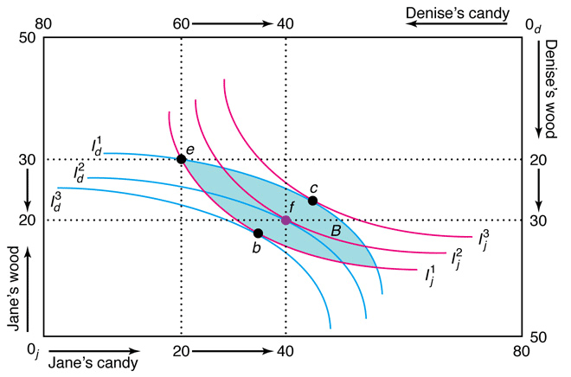
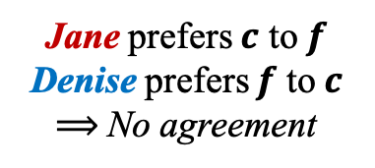
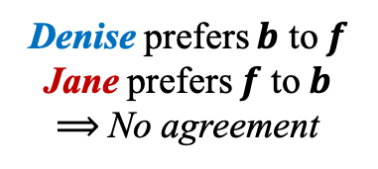
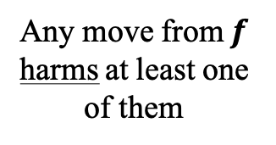
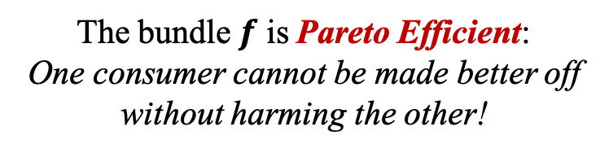
Should the consumers trade goods again?
Jane prefers $c$ to $f$
Denise prefers $f$ to $c$
$⟹$ No agreement
Jane prefers bundles in this direction
Denise prefers $b$ to $f$
Jane prefers $f$ to $b$
$⟹$ No agreement
Denise prefers bundles in the opposite direction
Any move from $f$ harms at least one of them
They will not trade goods!
The bundle $f$ is Pareto Efficient:
One consumer cannot be made better off without harming the other!

Slide 12
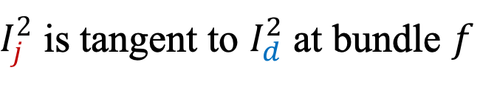


Trading Rules
Two consumers should stop trading when…
Trading Rule 1: …no mutually beneficial trades are possible
Trading Rule 2: …they reach a Pareto-efficient allocation
Trading Rule 3: …the indifference curves are tangent
Trading Rule 4: …the consumers’ $MRS$ are equal
$I_{j}^{2}$ is tangent to $I_{d}^{2}$ at bundle $f$
$$slope of I_{j}^{2}=slope of I_{d}^{2}$$
$${MRS}_{j}={MRS}_{d}$$

Slide 13
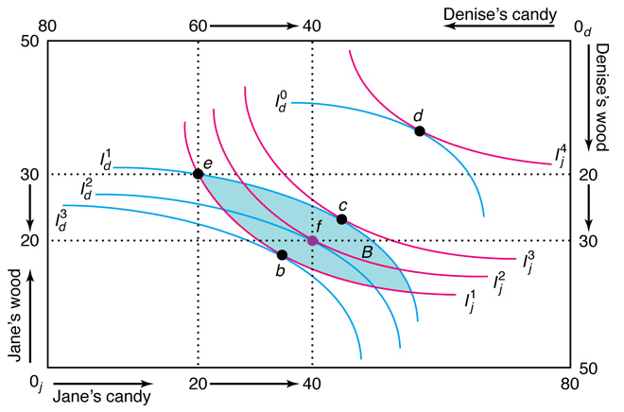
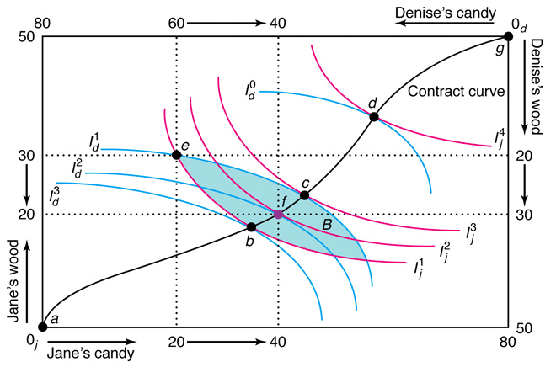
Contract Curve
The set of all Pareto-efficient bundles!

Slide 14
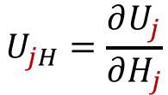
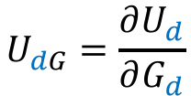
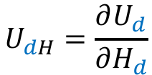









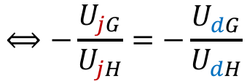
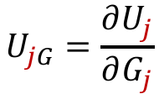
Example
Consider two consumers ($j$ and $d$) and two goods ($G$ and $H$):
$$U_{j}={\left(G_{j}\right)}^{a}{\left(H_{j}\right)}^{b}$$
$$G_{j}+G_{d}=100$$
$$U_{d}={\left(G_{d}\right)}^{a}{\left(H_{d}\right)}^{b}$$
$$H_{j}+H_{d}=50$$
What is the contract curve?
$$⟺−\frac{U_{jG}}{U_{jH}}=−\frac{U_{dG}}{U_{dH}}$$
$${MRS}_{j}={MRS}_{d}$$
$$U_{jG}=\frac{∂U_{j}}{∂G_{j}}$$
$$=a{\left(G_{j}\right)}^{a−1}{\left(H_{j}\right)}^{b}$$
$$U_{dG}=\frac{∂U_{d}}{∂G_{d}}$$
$$=a{\left(G_{d}\right)}^{a−1}{\left(H_{d}\right)}^{b}$$
$$U_{jH}=\frac{∂U_{j}}{∂H_{j}}$$
$$=b{\left(G_{j}\right)}^{a}{\left(H_{j}\right)}^{b−1}$$
$$U_{dH}=\frac{∂U_{d}}{∂H_{d}}$$
$$=b{\left(G_{d}\right)}^{a}{\left(H_{d}\right)}^{b−1}$$

Slide 15
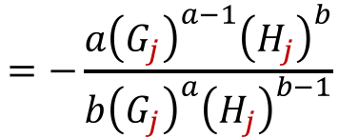
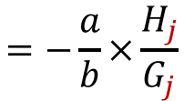
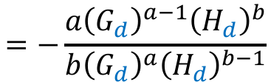
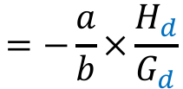
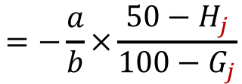
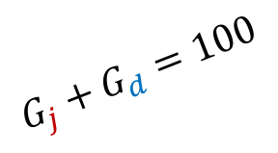
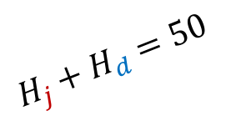
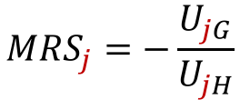
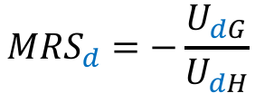

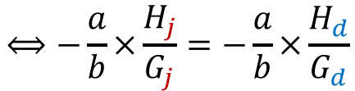
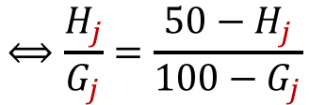


Example (cont.)
Replacing the marginal utilities into the $MRS$ condition:
$${MRS}_{j}=−\frac{U_{jG}}{U_{jH}}$$
$$=−\frac{a{\left(G_{j}\right)}^{a−1}{\left(H_{j}\right)}^{b}}{b{\left(G_{j}\right)}^{a}{\left(H_{j}\right)}^{b−1}}$$
$$=−\frac{a}{b}×\frac{H_{j}}{G_{j}}$$
$${MRS}_{d}=−\frac{U_{dG}}{U_{dH}}$$
$$=−\frac{a{\left(G_{d}\right)}^{a−1}{\left(H_{d}\right)}^{b}}{b{\left(G_{d}\right)}^{a}{\left(H_{d}\right)}^{b−1}}$$
$$=−\frac{a}{b}×\frac{H_{d}}{G_{d}}$$
$$G_{j}+G_{d}=100$$
$$H_{j}+H_{d}=50$$
$$⟺−\frac{a}{b}×\frac{H_{j}}{G_{j}}=−\frac{a}{b}×\frac{H_{d}}{G_{d}}$$
$$=−\frac{a}{b}×\frac{50−H_{j}}{100−G_{j}}$$
$${MRS}_{j}={MRS}_{d}$$
$$⟺\frac{H_{j}}{G_{j}}=\frac{50−H_{j}}{100−G_{j}}$$
$$⟺100H_{j}−H_{j}G_{j}=50G_{j}−H_{j}G_{j}$$
$$⟺G_{j}=2H_{j}$$

Slide 16






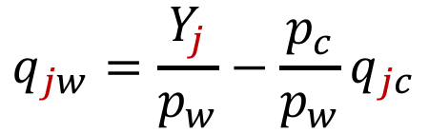
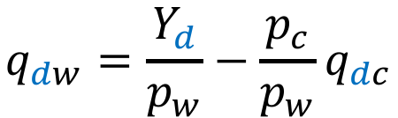
Competitive Exchange
Consumers are price takers and must consider prices when trading!
Jane’s budget constraint
Jane
$$p_{c}q_{jc}+p_{w}q_{jw}$$
$$=p_{c}e_{jc}+p_{w}e_{jw}$$
$$≡Y_{j}$$
Jane’s expenditure
Jane’s endowment
Denise’s budget constraint
Denise
$$p_{c}q_{dc}+p_{w}q_{dw}$$
$$=p_{c}e_{dc}+p_{w}e_{dw}$$
$$≡Y_{d}$$
Denise’s expenditure
Denise’s endowment
$$q_{jw}=\frac{Y_{j}}{p_{w}}−\frac{p_{c}}{p_{w}}q_{jc}$$
$$q_{dw}=\frac{Y_{d}}{p_{w}}−\frac{p_{c}}{p_{w}}q_{dc}$$

Slide 17
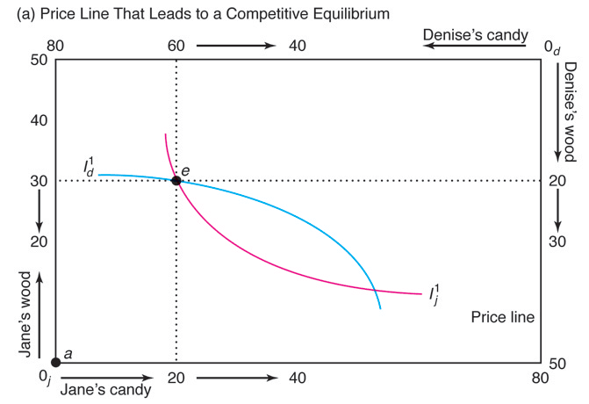
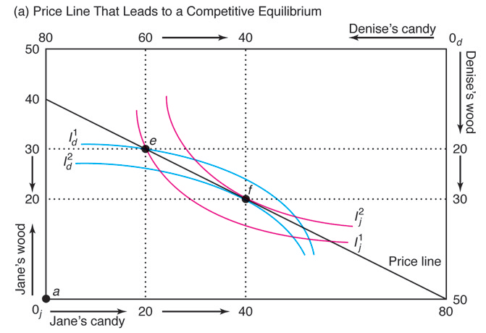

















Prices that Leads to Competitive Equilibrium
$p_{c}=1$ & $p_{w}=2$
$$Y_{j}=p_{c}e_{jc}+p_{w}e_{jw}=80$$
$$q_{jw}=40−\frac{1}{2}q_{jc}$$
Budget constraints
$e_{jc}=20$ & $e_{jw}=30$
$$Y_{d}=p_{c}e_{dc}+p_{w}e_{dw}=100$$
$$q_{dw}=50−\frac{1}{2}q_{dc}$$
$e_{dc}=60$ & $e_{dw}=20$
$$e_{dc}$$
D sells to J
100
$$q_{jc}=0⟹q_{jw}=40$$
Competitive Equilibrium
$$q_{jw}=0⟹q_{jc}=80$$
$$e_{jw}$$
$$e_{dw}$$
$$q_{jc}=20⟹q_{jw}=30$$
J sells to D
D buys from J
$$q_{dc}=0⟹q_{dw}=50$$
$$q_{dw}=0⟹q_{dc}=100$$
Price Line
$$q_{dc}=60⟹q_{dw}=20$$
$$e_{jc}$$
J buys from D

Slide 18
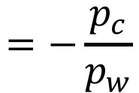
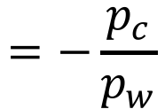



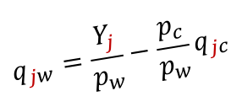

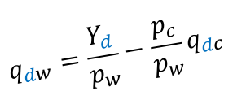
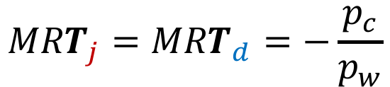
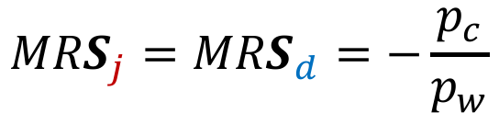
The Efficiency of Competition
In the competitive equilibrium:
Jane’s utility maximization
Denise’s utility maximization
$${MRS}_{j}={MRT}_{j}$$
$${MRS}_{d}={MRT}_{d}$$
Slope of indifference curve
Slope of budget line
Slope of indifference curve
Slope of budget line
$$q_{jw}=\frac{Y_{j}}{p_{w}}−\frac{p_{c}}{p_{w}}q_{jc}$$
$${MRT}_{j}={MRT}_{d}=−\frac{p_{c}}{p_{w}}$$
$${MRT}_{j}=\frac{dq_{jw}}{dq_{jc}}$$
$$=−\frac{p_{c}}{p_{w}}$$
Pareto efficient
$${MRS}_{j}={MRS}_{d}=−\frac{p_{c}}{p_{w}}$$
$$q_{dw}=\frac{Y_{d}}{p_{w}}−\frac{p_{c}}{p_{w}}q_{dc}$$
$${MRT}_{d}=\frac{dq_{dw}}{dq_{dc}}$$
First Theorem of Welfare Economics
$$=−\frac{p_{c}}{p_{w}}$$
Any competitive equilibrium is Pareto efficient!

Slide 19
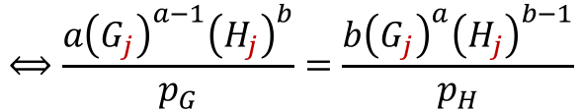





Example
Consider two consumers ($j$ and $d$) and two goods ($G$ and $H$):
$$U_{j}={\left(G_{j}\right)}^{a}{\left(H_{j}\right)}^{b}$$
$$G_{j}+G_{d}=100$$
$$U_{d}={\left(G_{d}\right)}^{a}{\left(H_{d}\right)}^{b}$$
$$H_{j}+H_{d}=50$$
What is competitive equilibrium price ratio $p_{G}/p_{H}$?
Jane’s utility maximization
$$\frac{U_{jG}}{p_{G}}=\frac{U_{jH}}{p_{H}}$$
$$⟺\frac{a{\left(G_{j}\right)}^{a−1}{\left(H_{j}\right)}^{b}}{p_{G}}=\frac{b{\left(G_{j}\right)}^{a}{\left(H_{j}\right)}^{b−1}}{p_{H}}$$
$$⟺G_{j}=\frac{{ap}_{H}}{{bp}_{G}}H_{j}$$
Denise’s utility maximization
$$\frac{U_{dG}}{p_{G}}=\frac{U_{dH}}{p_{H}}$$
$$⟺\frac{a{\left(G_{d}\right)}^{a−1}{\left(H_{d}\right)}^{b}}{p_{G}}=\frac{b{\left(G_{d}\right)}^{a}{\left(H_{d}\right)}^{b−1}}{p_{H}}$$
$$⟺G_{d}=\frac{{ap}_{H}}{{bp}_{G}}H_{d}$$

Slide 20












Example (cont.)
Combining the utility maximization condition with the budget constraints:
$$Y_{j}=p_{G}G_{j}+p_{H}H_{j}$$
$$=p_{G}\frac{{ap}_{H}}{{bp}_{G}}H_{j}+p_{H}H_{j}$$
$$=\frac{a+b}{b}{p_{H}H}_{j}$$
$$⟺H_{j}=\frac{bY_{j}}{(a+b)p_{H}}$$
$$Y_{d}=p_{G}G_{d}+p_{H}H_{d}$$
$$=p_{G}\frac{{ap}_{H}}{{bp}_{G}}H_{d}+p_{H}H_{d}$$
$$=\frac{a+b}{b}{p_{H}H}_{d}$$
$$⟺H_{d}=\frac{bY_{d}}{(a+b)p_{H}}$$
Using the total amount of good $H$:
Need to compute the sum of incomes
$$=\frac{bY_{j}}{(a+b)p_{H}}+\frac{bY_{d}}{(a+b)p_{H}}$$
$$=\frac{b(Y_{j}+Y_{d})}{\left(a+b\right)p_{H}}$$
$$50=H_{j}+H_{d}$$

Slide 21





Example (cont.)
Calculating the sum of incomes:
$$Y_{j}+Y_{d}=(p_{G}G_{j}+p_{H}H_{j})+(p_{G}G_{d}+p_{H}H_{d})$$
$$G_{j}+G_{d}=100$$
$$=p_{G}G_{j}+p_{H}H_{j}+p_{G}(100−G_{j})+p_{H}(50−H_{j})$$
$$H_{j}+H_{d}=50$$
$$⟺Y_{j}+Y_{d}=100p_{G}+50p_{H}$$
Therefore:
$$50=\frac{b(Y_{j}+Y_{d})}{\left(a+b\right)p_{H}}$$
$$=\frac{b(100p_{G}+50p_{H})}{\left(a+b\right)p_{H}}$$
$$=\frac{100b}{\left(a+b\right)}×\frac{p_{G}}{p_{H}}+\frac{50b}{a+b}$$
$$⟺\frac{p_{G}}{p_{H}}=\frac{a}{2b}$$

Slide 22






Production and Trading
Our discussion of trade has been entirely about consumption.
But what about production?
Time spent on the production of each good
Candy Bar
Firewood
Fraction $t$ of the day
Fraction $1−t$ of the day
Inputs
Jane
$$f_{jC}\left(t\right)=3t$$
$$f_{jW}\left(t\right)=6(1−t)$$
Jane’s production function of candy
Jane’s production function of wood
Denise
$$f_{dC}\left(t\right)=6t$$
$$f_{dW}\left(t\right)=3(1−t)$$
Denise’s production function of candy
Denise’s production function of wood

Slide 23



Comparative Advantage
The ability to produce a good at a lower opportunity cost!
Candy Bar
Firewood
For all values of input $t∈[0,1]$
For all values of input $t∈[0,1]$
$$f_{dC}\left(t\right)=6t>3t=f_{jC}\left(t\right)$$
$$f_{jW}\left(t\right)=6\left(1−t\right)>3\left(1−t\right)=f_{dW}\left(t\right)$$
Denise produces any given level of candy with less input
Jane produces any given level of candy with less input
Denise has comparative advantage to produce candy
Jane has comparative advantage to produce firewood

Slide 24




















Benefits of Trade
Assume that Jane and Denise like to consume candy and wood in equal proportions:
Without Trade:
Jane and Denise will produce and consume 2 units of each good!
$$f_{jC}\left(2/3\right)=2$$
$$f_{jC}\left(t\right)=f_{jW}\left(t\right)$$
$$⟺3t=6(1−t)$$
$$⟺t=2/3$$
$$f_{jW}\left(2/3\right)=2$$
$$f_{dC}\left(1/3\right)=2$$
$$f_{dC}\left(t\right)=f_{dW}\left(t\right)$$
$$⟺6t=3(1−t)$$
$$⟺t=1/3$$
With Trade:
Jane and Denise consume more of each good!
$$f_{dW}\left(1/3\right)=2$$
Trade
Only firewood
$$f_{jC}\left(0\right)=0$$
J $\underset{⇐}{3 of C}$ D
J consumes 3 of C
Jane has a comparative advantage for firewood
$$t=0$$
J $\underset{⇒}{3 of W}$ D
$$f_{jW}\left(0\right)=6$$
J consumes 3 of W
Only candy bar
Denise has a comparative advantage for candy
$$f_{dC}\left(1\right)=6$$
D $\underset{⇒}{3 of C}$ J
D consumes 3 of C
$$t=1$$
$$f_{dW}\left(1\right)=0$$
D $\underset{⇐}{3 of W}$ J
D consumes 3 of W

Slide 25






















Production Possibility Frontier
Maximum combination of two outputs that can be produced from a given amount of input!
Only firewood
$$t=0$$
$$f_{jC}\left(0\right)=0$$
$$f_{dC}\left(0\right)=0$$
$$f_{C}\left(0\right)=0$$
Jane has a comparative advantage for firewood
Only candy bar
$$f_{jW}\left(0\right)=6$$
$$f_{dW}\left(0\right)=3$$
$$f_{W}\left(0\right)=9$$
$$t=1$$
$$f_{jC}\left(1\right)=3$$
$$f_{dC}\left(1\right)=6$$
$$f_{C}\left(1\right)=9$$
Denise has a comparative advantage for candy
$$f_{jW}\left(1\right)=0$$
$$f_{dW}\left(1\right)=0$$
$$f_{W}\left(1\right)=0$$
Production Functions
Jane
Denise
Joint Production
W
W
W
Use ${PPF}_{d}$ for the first 6 units of candy
$$f_{jC}\left(t\right)=3t$$
9
Kink
$$f_{jW}\left(t\right)=6(1−t)$$
6
6
Use ${PPF}_{j}$ for the first 6 units of firewood
$$f_{dC}\left(t\right)=6t$$
$${PPF}_{j}$$
3
$${PPF}_{d}$$
$$f_{dW}\left(t\right)=3(1−t)$$
C
C
C
3
6
6
9

Slide 26
PPF in a Competitive Market
There is a large number of producers in competitive markets!
Competitive Market
2 Different Producers
3 Different Producers
Large Number of Different Producers
W
W
PPF becomes a smooth curve
W
PPF has 1 kink
PPF has 2 kinks
Kink
Kink
Kink
C
C
C

Slide 27









Competitive Equilibrium with Production
Slope of budget line
At the competitive equilibrium:
Slope of $I_{j}$
Slope of $I_{d}$
$$=−\frac{{MC}_{c}}{{MC}_{w}}$$
$$=−\frac{p_{c}}{p_{w}}$$
Producers choose output such that $p=MC$
$${MRS}_{j}={MRS}_{d}$$
$$=MRT$$
The size of the Edgeworth box is determined by the PPF
Suppose this is the efficient production
Maximum amount of wood that can be consumed
Maximum amount of candy that can be consumed

Slide 28




Efficiency and Equity
How well various people in a society live depends on:
Efficiency
The size of the pie
Equity
How the pie is divided
Efficiency concept
Equally weights consumers and producers
Pareto Principle
Society prefers reallocation of resources that make someone better off while harming no one else
Welfare Measure
$$W=CS+PS$$
e.g. consumers improve ($CS↑$), producers not harmed ($PS=$)
Pareto-superior allocation
Allocation that increases $W$
e.g. $CS↑ >PS↓ ⟹W↑$ but producers are harmed
The converse is not necessarily true

Slide 29

Graphical Analysis
Let’s go back to the pure exchange economy in which Jane and Denise trade wood and candy:
Denise’s Utility
Utility Possibility Frontier ($UPF$)
The set of utility levels corresponding to the Pareto-efficient allocations along the contract curve
Point a:
Denise has the highest utility
Jane has the lowest utility
a
Corresponds to the end of the contract curve at which Denise has all goods
Point b:
Denise has the lowest utility
Jane has the highest utility
What should be the socially optimal allocation?
Corresponds to the end of the contract curve at which Jane has all goods
Allocations a and b are Pareto-efficient but highly unequal!
b
Jane’s Utility

Slide 30


Social Welfare Function
Combines various consumers’ utilities to provide a collective ranking for allocations!
Utility function for society
$$W(U_{j},U_{d})$$
Isowelfare Curves
Summarize all allocations with the same level of welfare
$$\overline{W}=W(U_{j},U_{d})$$

Slide 31






Social Welfare Maximization
Society maximizes social welfare subject to efficiency!
Denise’s Utility
Allocations in ${\overline{W}}_{1}$ are not efficient
(out of the $UPF$)
Allocations d, e, f are efficient
(in the $UPF$)
${\overline{W}}_{3}$ is farther from the origin than ${\overline{W}}_{2}$, so allocations in ${\overline{W}}_{3}$ are preferable
Therefore, f is the socially optimal allocation!
$$UPF$$
Optimal Allocation!
Highest possible isowelfare curve touches the $UPF$
d
f
e
$${\overline{W}}_{3}$$
$${\overline{W}}_{2}$$
$${\overline{W}}_{1}$$
Jane’s Utility

Slide 32



Special Social Welfare Functions
Utilitarian
Generalized Utilitarian
Rawlsian
Equal weight to all people in society
Different weights assigned, perhaps to hard workers
Maximizes well-being of worst off individual
$$W=U_{j}+U_{d}$$
$$W={α_{j}U}_{j}+α_{d}U_{d}$$
$$W=\min_{}\left\{U_{j},U_{d}\right\}$$
These different social welfare functions yield different distributions of goods

Slide 33
THE END

