Slide 1

BUEC 311
Business Economics, Organizations and Management
Winter 2019
Monopoly and Monopsony
Diego B. P. Gomes

Slide 2
Where are we?
The Nature of Firms
✓
Production
Ch. 6
Ideal Market Structure!
More Realistic Markets!
Competitive Markets
Market Power
✓
✓
Costs
Ch. 7
Perfect Competition
Ch. 8
Monopoly & Monopsony
Ch. 11
✓
Properties of Competition
Ch. 9
Pricing & Advertising
Ch. 12
Consumer Behavior
✓
Consumer’s Choice
Ch. 3
Game Theory
Ch. 13
✓
General Equilibrium
Ch. 10
Oligopoly
Ch. 14
Choice under Uncertainty
Ch. 16
Factor Markets
Ch. 15
Labor market
Capital market
Exhaustible resources

Slide 3

Monopoly
Monopoly is the only seller of a good for which there is no close substitute!
The only seller in the market!
Monopolies have extreme market power
Monopolies can affect output prices
Monopoly output is the market output
Monopoly demand curve is the market demand curve
Monopolies maximize profits (like all firms)
They are not price takers!

Slide 4


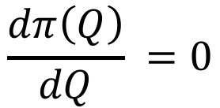
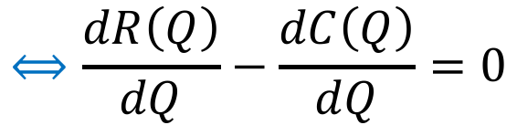

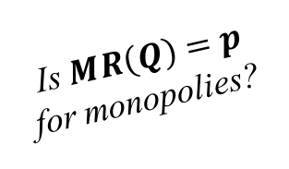
Profit Maximization
Same 2-step procedure as competitive firms: (i) output and (ii) shutdown decisions!
Profit
Revenue
Total Cost
$$π\left(Q\right)=R\left(Q\right)−C(Q)$$
Choose output to maximize profits!
Maximization
$$\max_{Q}{π\left(Q\right)}=R\left(Q\right)−C(Q)$$
Marginal profits equal to zero!
Solution
Is $MR\left(Q\right)=p$ for monopolies?
NO!
$$\frac{dπ\left(Q\right)}{dQ} =0$$
$$⟺\frac{dR\left(Q\right)}{dQ}−\frac{dC\left(Q\right)}{dQ}=0$$
$$⟺MR\left(Q\right)=MC(Q)$$
Marginal
Revenue
Marginal
Cost

Slide 5



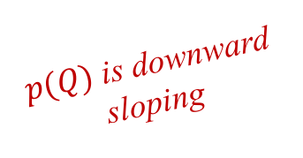
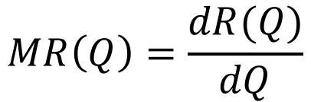



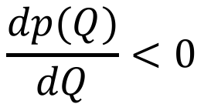
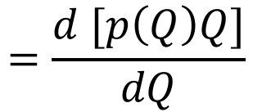
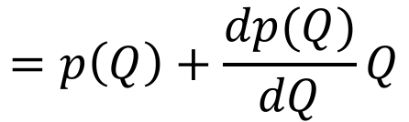
Marginal Revenue & Demand Curves
The monopolist is not a price taker and therefore can affect output prices!
Inverse Demand
The price the monopolist receives from consumers for selling a given quantity
$p(Q)$ is downward sloping
$$p(Q)$$
Demand curve
$$p(Q)$$
$$\frac{dp(Q)}{dQ}<0$$
$$Q$$
A monopoly’s $MR$ lies below its demand curve!
Marginal Revenue
$$MR\left(Q\right)=\frac{dR(Q)}{dQ}$$
$$=\frac{d [p\left(Q\right)Q]}{dQ}$$
$$=p\left(Q\right)+\frac{dp(Q)}{dQ}Q$$
$$<p\left(Q\right)$$
$$<0$$

Slide 6
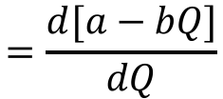












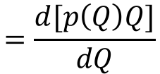
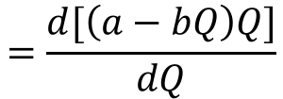

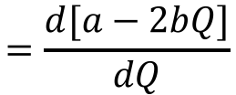

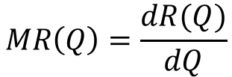
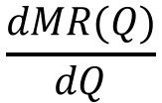
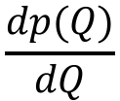
Linear Inverse Demand
$p\left(Q\right)=a−bQ$ $a>0$ $b>0$
Property 1: $MR(Q)$ is linear and downward sloping
$$MR\left(Q\right)=\frac{dR(Q)}{dQ}$$
$$=\frac{d[p\left(Q\right)Q]}{dQ}$$
$$=\frac{d[\left(a−bQ\right)Q]}{dQ}$$
$$=a−2bQ$$
Property 2: $MR(Q)$ has twice the slope of $p\left(Q\right)$
$$\frac{dMR(Q)}{dQ}$$
$$=\frac{d[a−2bQ]}{dQ}$$
$$\frac{dp(Q)}{dQ}$$
$$=\frac{d[a−bQ]}{dQ}$$
$$=−2b$$
$$=−b$$
Property 3: $MR(Q)$ intersects the vertical axis at the same point as $p\left(Q\right)$
$$MR\left(0\right)$$
$$=a−2b×0$$
$$=a$$
$$p\left(0\right)$$
$$=a−b×0$$
$$=a$$
Property 4: $MR(Q)$ intersects the horizontal axis at half the distance as does $p\left(Q\right)$
$$0=MR\left(Q\right)$$
$$=a−2bQ$$
$$⟺Q=a/(2b)$$
$$0=p\left(Q\right)$$
$$=a−bQ$$
$$⟺Q=a/b$$

Slide 7






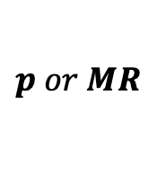






Graphical Analysis
$$p\left(Q\right)=a−bQ$$
$$p or MR$$
$$Q=0⟹p=a$$
$$a$$
$$p=0⟹Q=a/b$$
$$MR\left(Q\right)=a−2bQ$$
$$p(Q)$$
$$Q=0⟹MR=a$$
$$MR=0⟹Q=a/(2b)$$
$$MR(Q)$$
$$Q$$
$$\frac{a}{2b}$$
$$\frac{a}{b}$$

Slide 8















Example
Consider the following inverse demand and cost functions:
$$p\left(Q\right)=24−Q$$
$$C\left(Q\right)=Q^{2}+12$$
Marginal Revenue
$$MR\left(Q\right)=24−2Q$$
Marginal Cost
$$MC\left(Q\right)=2Q$$
Optimal Quantity
$$MR\left(Q\right)=MC(Q)$$
$$⟺24−2Q=2Q$$
$$⟺Q^{∗}=6$$
Optimal Price
$$p\left(Q^{∗}\right)=p(6)$$
$$=24−6=18$$
Optimal Revenue
$$R\left(Q^{∗}\right)=p(Q^{∗})Q^{∗}=p(6)×6$$
$$=18×6=108$$
Optimal Cost
$$C\left(Q^{∗}\right)=C(6)$$
$$=6^{2}+12=48$$
Profit
$$π\left(Q^{∗}\right)=R\left(Q^{∗}\right)−C(Q^{∗})$$
$$=108−48=60$$

Slide 9
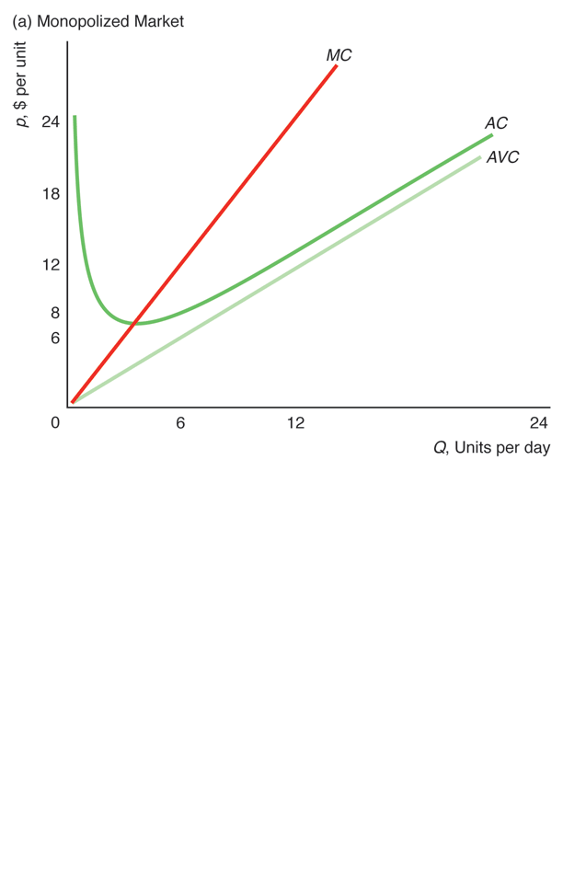
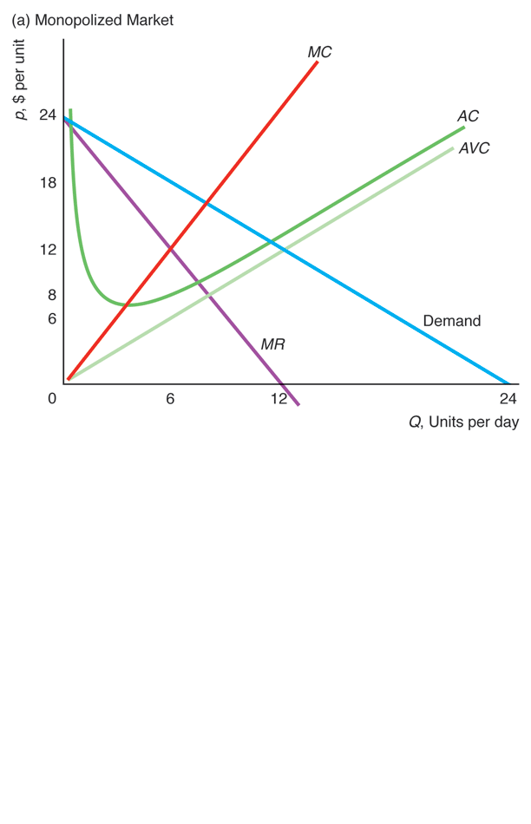
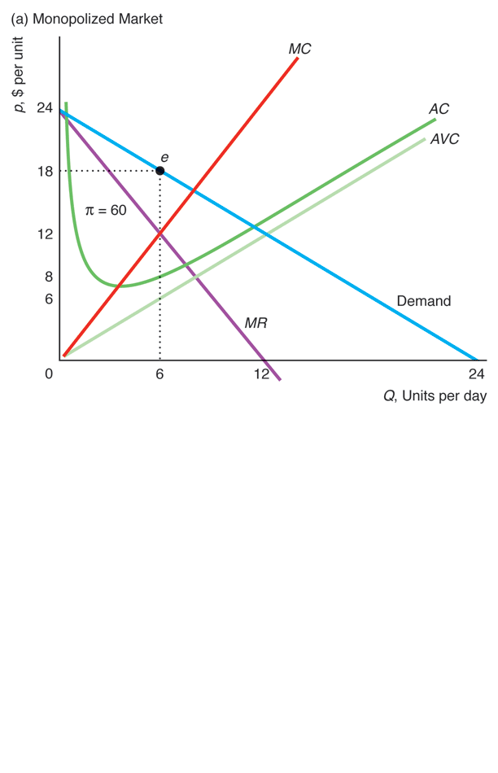
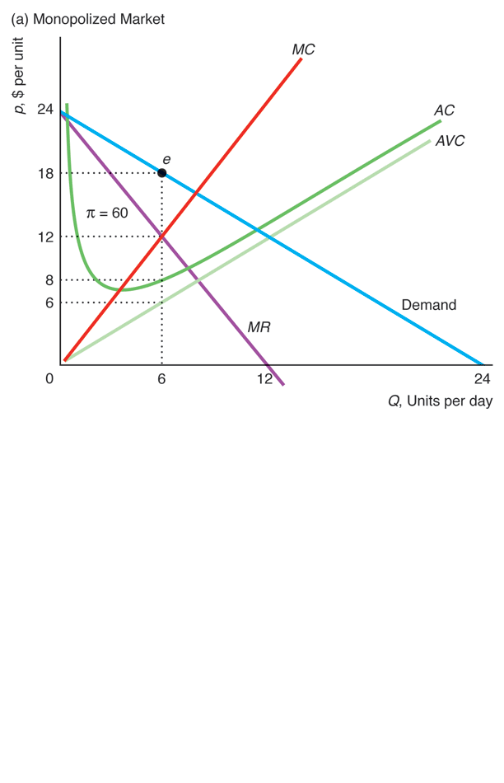
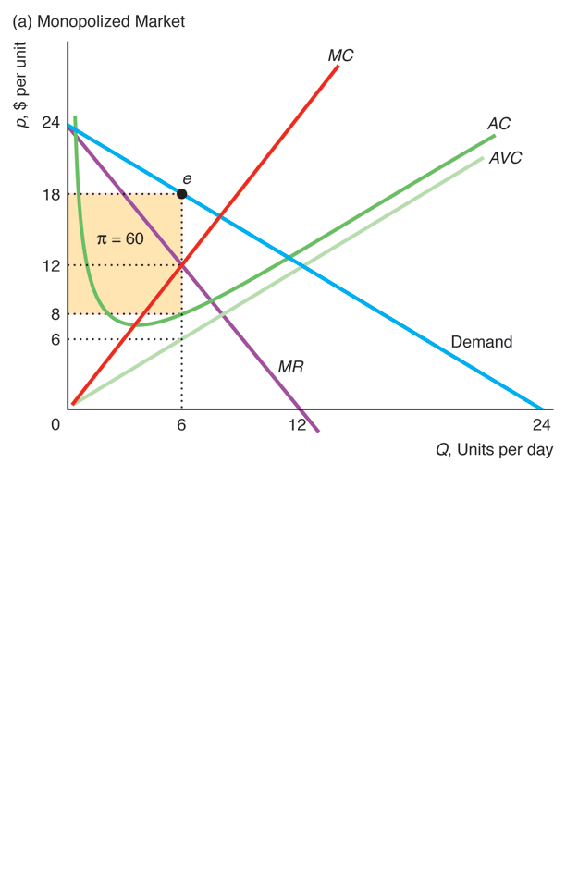
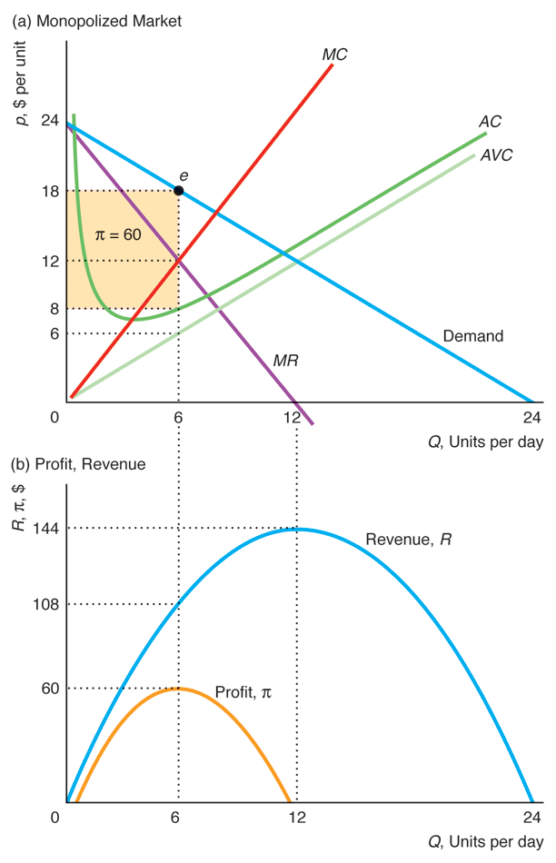








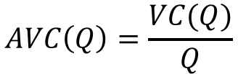
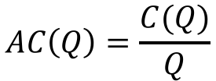
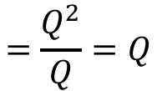
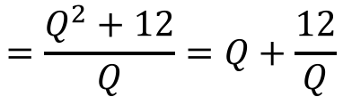





Graphical Analysis
$$C\left(Q\right)=Q^{2}+12$$
Linear
$$MC\left(Q\right)=2Q$$
Linear
$${p(Q}^{∗})$$
$$AVC\left(Q\right)=\frac{VC(Q)}{Q}$$
$$=\frac{Q^{2}}{Q}=Q$$
$${AC(Q}^{∗})$$
U-Shaped
$$AC\left(Q\right)=\frac{C(Q)}{Q}$$
$$=\frac{Q^{2}+12}{Q}=Q+\frac{12}{Q}$$
$$Q^{∗}$$
Linear
$$p\left(Q\right)=24−Q$$
Linear
$$MR\left(Q\right)=24−2Q$$
$${R(Q}^{∗})$$
Inverse
U-Shaped
$$R\left(Q\right)=24Q−Q^{2}$$
$${π(Q}^{∗})$$
Inverse
U-Shaped
$$π\left(Q\right)=−12+24Q−2Q^{2}$$
$$Q^{∗}$$
$$MR=0$$

Slide 10
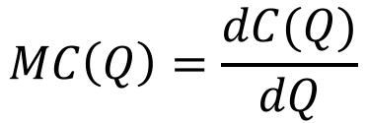
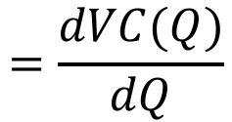



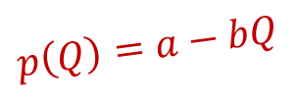
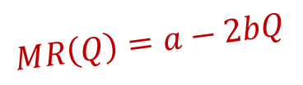







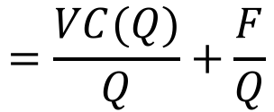
Application
Consider the following about iPad’s production:
$$MC\left(Q\right)=\$220$$
$$F=\$2,000$$
$$p\left(Q\right)=770−11Q$$
What is Apple’s $AC$ function?
$$=\frac{VC(Q)}{Q}+\frac{F}{Q}$$
$$=220+\frac{2000}{Q}$$
$$AC\left(Q\right)=AVC\left(Q\right)+AFC(Q)$$
$$MC\left(Q\right)=\frac{dC(Q)}{dQ}$$
$$=\frac{dVC(Q)}{dQ}$$
$$=220$$
$$⟺VC(Q)=220Q$$
What is Apple’s $MR$ function?
$$p\left(Q\right)=a−bQ$$
$$MR\left(Q\right)=770−22Q$$
$$MR\left(Q\right)=a−2bQ$$

Slide 11



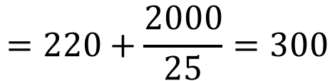









Application (cont.)
What is Apple’s profit maximizing $Q$ and $p$?
Optimal quantity!
$$MR\left(Q\right)=MC(Q)$$
$$⟺770−22Q=220$$
$$⟺Q^{∗}=25$$
$$=770−22Q$$
$$=220$$
$$p\left(Q^{∗}\right)=p(25)$$
$$=770−11×25=495$$
$$=770−11Q$$
What is Apple’s profit from selling iPads?
$$π\left(Q^{∗}\right)=[p\left(Q^{∗}\right)−AC\left(Q^{∗}\right)]Q^{∗}$$
$$=\left[495−300\right]25=4875$$
$$=220+\frac{2000}{25}=300$$
$$AC\left(Q^{∗}\right)=AC(25)$$
$$=220+\frac{2000}{Q}$$

Slide 12
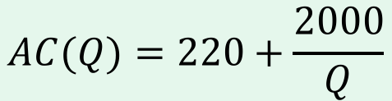






Application (cont.)
$$AC(Q)=220+\frac{2000}{Q}$$
ad
770
, $ per iP
P
$${p(Q}^{∗})$$
495
$$MC(Q)=220$$
= 4.875
$${AC(Q}^{∗})$$
300
A
C
220
MC
$$p\left(Q\right)=770−11Q$$
MR
Demand
0
$$Q^{∗}$$
2
5
3
5
70
Q
, Millions of iPads per year
$$MR\left(Q\right)=770−22Q$$

Slide 13
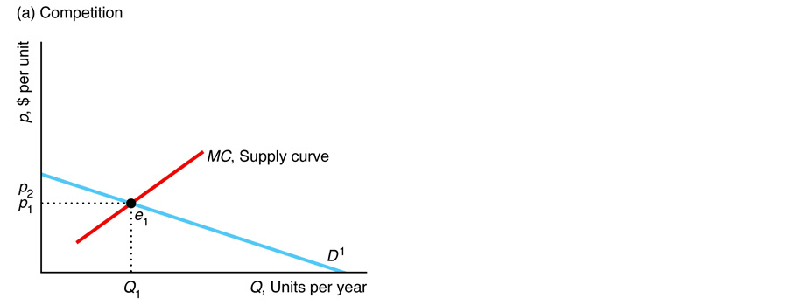
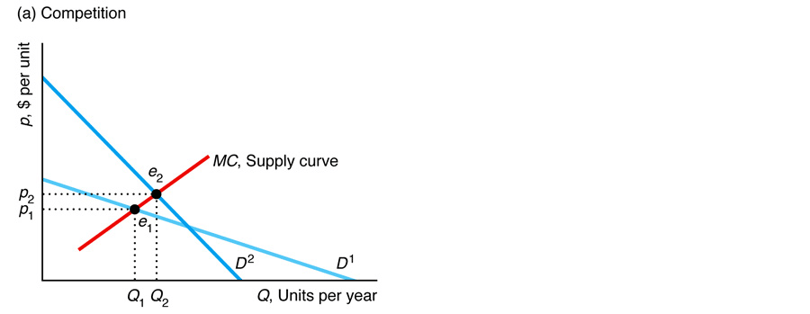
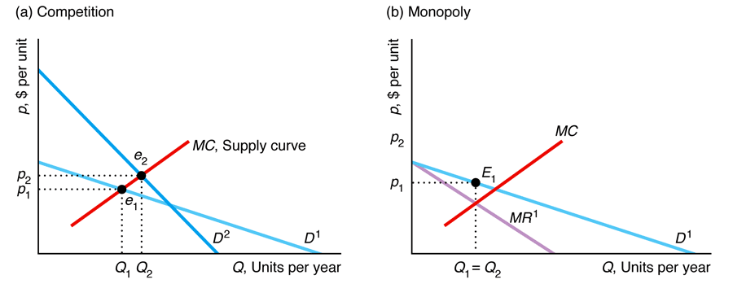
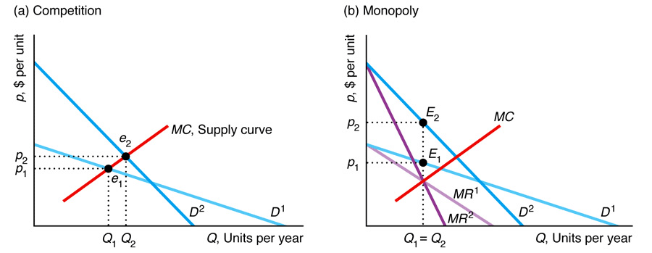






Effects of a Shift of Demand Curve
A shift in demand does not map out a unique relationship between price and quantity in monopolies!
All $Q$ has a single corresponding $p$!
A given $Q$ can correspond to more than one monopoly $p$!
or vice versa
or both change
$$p↑$$
$$p↑$$
= Q₂
$$Q↑$$
$Q$ is the same!

Slide 14
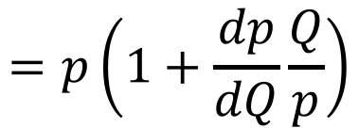
















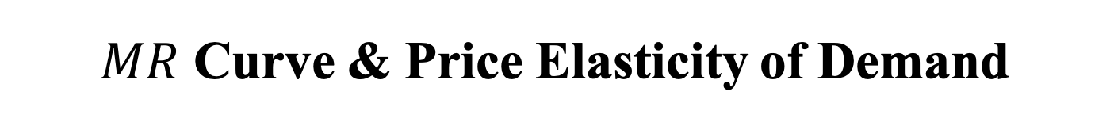
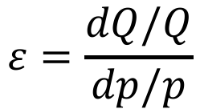
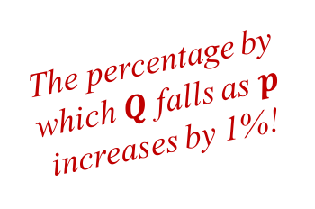
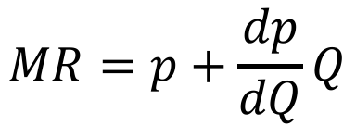
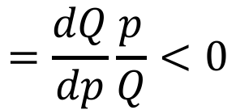
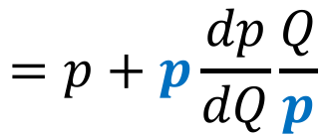
$MR$ Curve & Price Elasticity of Demand
Price Elasticity of Demand
The percentage by which $Q$ falls as $p$ increases by 1%!
$$ε=\frac{dQ/Q}{dp/p}$$
$$=\frac{dQ}{dp}\frac{p}{Q}<0$$
Marginal Revenue
$$MR=p+\frac{dp}{dQ}Q$$
$$=p+p\frac{dp}{dQ}\frac{Q}{p}$$
$$=p\left(1+\frac{dp}{dQ}\frac{Q}{p}\right)$$
$$=p\left(1+\frac{1}{ε}\right)$$
$ε$ is elastic
$$⟺ε<−1$$
$$⟺1/ε>−1$$
$$⟺1+1/ε>0$$
$$⟺MR>0$$
$ε$ is inelastic
$$⟺ε>−1$$
$$⟺1/ε<−1$$
$$⟺1+1/ε<0$$
$$⟺MR<0$$
$ε$ is unitary
$$⟺ε=−1$$
$$⟺1/ε=−1$$
$$⟺1+1/ε=0$$
$$⟺MR=0$$

Slide 15













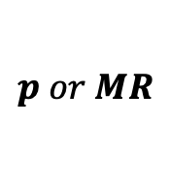




Graphical Analysis
$$p\left(Q\right)=24−Q$$
$$p or MR$$
$$24$$
Demand is elastic
$$MR\left(Q\right)=24−2Q$$
$ε$ is unitary $⟺MR=0$
$$⟺Q=12$$
$$ε=1$$
$$12$$
Demand is inelastic
$ε$ is elastic $⟺MR>0$
$$⟺Q<12$$
$$MR(Q)$$
$$p(Q)$$
$ε$ is inelastic $⟺MR<0$
$$⟺Q>12$$
$$Q$$
$$12$$
$$24$$
$$Q<12$$
$$Q>12$$

Slide 16
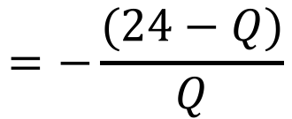
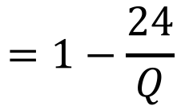


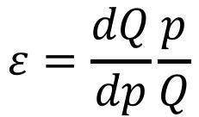





Example
Consider the following inverse demand:
$$p\left(Q\right)=24−Q$$
What is the expression of $ε$?
$$ε=\frac{dQ}{dp}\frac{p}{Q}$$
$$=−\frac{(24−Q)}{Q}$$
$$=1−\frac{24}{Q}$$
$$\frac{dQ}{dp}$$
$$=\frac{d[24−p]}{dp}$$
$$=−1$$
$$p=24−Q$$
$$⟺Q=24−p$$

Slide 17










Market Power & Shape of Demand Curve
Market power is the ability of a firm to charge a $p$ above $MC$!
Profit maximizing condition!
$p/MC$ depends only on the elasticity of demand!
$$=p\left(1+\frac{1}{ε}\right)$$
$$⟺\frac{p}{MC}=\frac{1}{1+1/ε}$$
$$MC=MR$$
Elasticity of Demand ($ε$) | $$p/MC$$ Ratio
-1.01 | 101
-1.1 | 11
-2 | 2
-3 | 1.5
-5 | 1.25
-10 | 1.11
-100 | 1.01
The more elastic the demand curve ($ε↓$), the less a monopoly can raise its $p$ above the $MC$ (and vice versa)!
less elastic $→$
more market power
Formally:
$$\frac{d[p/MC]}{dε}=\frac{1}{{(1+ε)}^{2}}>0$$
$←$ more elastic

Slide 18








Lerner Index
Measures the price markup!
$$\frac{p}{MC}=\frac{1}{1+1/ε}$$
$$LI=\frac{p−MC}{p}$$
$$=1−\frac{MC}{p}$$
$$=1−\left(1+\frac{1}{ε}\right)$$
$$=−\frac{1}{ε}$$
Elasticity of Demand ($ε$) | Lerner Index
-1.01 | 0.99
-1.1 | 0.91
-2 | 0.50
-3 | 0.33
-5 | 0.20
-10 | 0.10
-100 | 0.01
The more elastic the demand curve ($ε↓$), the smaller is the $LI$ (and vice versa)!
less elastic $→$
more market power
Formally:
$$\frac{dLI}{dε}=\frac{1}{ε^{2}}>0$$
$←$ more elastic

Slide 19






Example
Assume that $p=500$ and $MC=220$.
What is the price elasticity of demand?
$$LI=−\frac{1}{ε}$$
$$⟺ε=−\frac{1}{LI}$$
$$=−\frac{1}{0.56}≈−1.78$$
$$LI=\frac{p−MC}{p}$$
$$=\frac{500−220}{500}=0.56$$

Slide 20












Effects of Market Power on Welfare
Consumers:
Lose $B$ because they have to pay a higher price ($p_{m}>p_{c}$)
Lose $C$ because they have to consume fewer output ($Q_{m}<Q_{c}$)
$$A$$
Market Power decreases welfare!
$$B$$
$$C$$
$$D$$
$$E$$
Producers:
Gain $B$ because they sell at a higher price ($p_{m}>p_{c}$)
Lose $E$ because they sell less output ($Q_{m}<Q_{c}$)
$$p(Q)$$
Welfare:
$B$ is a transfer from consumers to producers, so it does not affect welfare
Welfare drops because consumers’ loss of $C$ and producers’ loss of $E$ benefit no one
$$p=MC$$
$$MR=MC$$
Competition, $Q_{c}$
Monopoly, $Q_{m}$
Change
Consumer Surplus, $CS$
$$A+B+C$$
$$A$$
$$−B−C=∆CS$$
Producer Surplus, $PS$
$$D+E$$
$$B+D$$
$$B−E=∆PS$$
Welfare, $W=CS+PS$
$$A+B+C+D+E$$
$$A+B+D$$
$$−C−E=∆W=DWL$$

Slide 21







Specific Taxes and Monopoly
Suppose the government charges a tax $t=8$ per unit of $Q$:
MC
2
(af
t
24
er tax)
, $ per unit
p
A
e
MC
1
(bef
or
e tax)
p
2
= 20
2
t
= 8
$$p↑$$
B
C
e
p
1
= 18
1
D
E
F
8
G
MR
Demand
0
Q
= 4
Q
=
6
1
2
2
4
$$Q↓$$
2
1
Q
, Units per day
Monopoly Before Tax
Monopoly After Tax
Change
Consumer Surplus, $CS$
$$A+B+C$$
$$A$$
$$−B−C=∆CS$$
Producer Surplus, $PS$
$$D+E+G$$
$$B+D$$
$$B−E−G=∆PS$$
Tax Revenues, $T=tQ$
$$0$$
$$G$$
$$G=∆T$$
Welfare, $W=CS+PS+T$
$$A+B+C+D+E+G$$
$$A+B+D+G$$
$$−C−E=∆W$$
Deadweight Loss, $DWL$
$$−F$$
$$−C−E−F$$
$$−C−E=∆DWL$$

Slide 22



Causes of Monopolies
Cost Advantage
1. Essential Facility
2. Superior Technology
3. Natural Monopoly
e.g. Control of scarce resource that is necessary for production
e.g. Better management skills or technical innovation
One firm can produce $Q$ at a lower cost than all others
$$C_{m}\left(Q\right)<C_{1}\left(q_{1}\right)+⋯+C_{n}\left(q_{n}\right)$$
$$Q=q_{1}+q_{2}⋯+q_{n}$$
Government Actions
4. Barriers to Entry
5. Protection from Imitation
Making it hard for firms to obtain a license
Granting a firm the rights to be a monopoly
Auctioning the rights to be a monopoly
e.g. patents or informational secrets

Slide 23








Example
Consider the following cost function of a monopolist:
$$C\left(Q\right)=mQ+F$$
If any entrant would have the same cost, does this market have a natural monopoly?
Suppose that one firm enters the market:
Market Output
Total Cost
$$Q=q_{1}+q_{2}$$
$$TC=C(q_{1})+C(q_{2})$$
$$=(mq_{1}+F)+(mq_{2}+F)$$
$$=m(q_{1}+q_{2})+2F$$
This market has a natural monopoly:
$$C\left(Q\right)<C(q_{1})+C(q_{2})$$
$$=mQ+2F$$
$$>mQ+F=C(Q)$$

Slide 24





Example (cont.)
Assume that $m=10$ and $F=60$:
Natural Monopoly Cost
$$C\left(Q\right)=mQ+F=10Q+60$$
Constant Line
$$MC\left(Q\right)=m=10$$
Constant $MC$ and decreasing $AC$ imply natural monopolies!
Decreasing Curve
$$AC\left(Q\right)=10+\frac{60}{Q}$$

Slide 25
Government Actions that Reduce Market Power
1. Optimal Price Regulation
⇒ Impose a price ceiling equals to the competitive price
⇒ Eliminates the Deadweight Loss
2. Non Optimal Price Regulation
⇒ Impose a price ceiling not equal to the competitive price
⇒ Reduces (but does not eliminate) the Deadweight Loss
3. Increasing Competition
⇒ Allowing/encouraging market entry by new domestic firms
⇒ Ending import bans that kept out international firms

Slide 26








Optimal Price Regulation
Suppose the government sets a price ceiling at $16:
With Price Ceiling:
$$A$$
Regulated demand curve presents a kink at the new equilibrium $e_{o}$
Regulated $MR$ curve presents a discontinuity at the new equilibrium $e_{o}$
$$B$$
$$C$$
Price Ceiling
$$E$$
$$D$$
Optimal price regulation achieves the competitive welfare level!
Monopoly Without Regulation
Monopoly with Optimal Regulation
Change
Consumer Surplus, $CS$
$$A$$
$$A+B+C$$
$$B+C=∆CS$$
Producer Surplus, $PS$
$$B+D$$
$$D+E$$
$$E−B=∆PS$$
Welfare, $W=CS+PS$
$$A+B+D$$
$$A+B+C+D+E$$
$$C+E=∆W$$
Deadweight Loss, $DWL$
$$−C−E$$
$$0$$
No DWL
$$C+E=∆DWL$$

Slide 27
Non Optimal Price Regulation
The government sets a price ceiling below competitive price:
, $ per unit
Market demand
MC
p
A
B
Non optimal price regulation creates a DWL!
p
e
Regulated demand
c
C
D
c
Price Ceiling
p
r
e
m
E
r
MR
MR
Q
Q
Q
Q
, Units per day
Excess Demand
m
c
d
Monopoly with Optimal Regulation
Monopoly with Low Regulated Price
Change
Consumer Surplus, $CS$
$$A+B$$
$$A+C$$
$$C−B=∆CS$$
Producer Surplus, $PS$
$$C+D+E$$
$$E$$
$$−C−D=∆PS$$
Welfare, $W=CS+PS$
$$A+B+C+D+E$$
$$A+C+E$$
$$−B−D=∆W=DWL$$

Slide 28






Price Regulation & Natural Monopoly
Can the government use an optimal price regulation?
NO!
as
g
eet of natural
f
$$p_{m}$$
e_{m}
, $ per thousand cubic
The best the government can do is to set $p=AC$, so the monopolist get zero profits!
p
A
B
Demand
Profits of Monopolist
DWL of Monopoly
Final DWL!
$${AC}_{m}$$
e_{f}
7
.88
A
C
But $p<AC$ at $e_{o}$, so the monopolist is losing money!
To eliminate the DWL, the price ceiling should be at $p=MC$!
5.78
e_{o}
MC
MR
0
$$Q_{m}$$
12.1
23
24.2
Q
,
T
rillion cubic feet of natural gas per year

Slide 29
Monopsony
Monopsony is the only buyer of a good for which there is no close substitute!
The mirror image of monopoly!
The only buyer in the market!
Monopsonies have extreme market power
Monopsonies can affect input prices
Monopsony input is the market input
Monopsony supply curve is the market supply curve
Monopsonies maximize profits (like all firms)
They are not price takers!

Slide 30






Profit Maximization
Choose the amount of input to maximize profits!
Profit
Revenue
Expenditure
$L$ is the labor input!
$$π\left(L\right)=pQ\left(L\right)−E(L)$$
Maximization
$$\max_{L}{π\left(L\right)}=pQ\left(L\right)−E(L)$$
Marginal profits equal to zero!
Solution
$$\frac{dπ\left(L\right)}{dL} =0$$
$$⟺\frac{d[pQ\left(L\right)]}{dL}−\frac{dE\left(L\right)}{dL}=0$$
$$⟺MRPL\left(L\right)=ME(L)$$
Marginal
Revenue Product of Labor
Marginal
Expenditure

Slide 31











Marginal Expenditure & Supply Curves
The monopsonist is not a price taker and therefore can affect input prices!
Inverse Supply
The price the monopsonist pays to consumers for buying a given quantity
$w(L)$ is upward sloping
$$w(L)$$
Supply curve
$$w(L)$$
$$\frac{dw(L)}{dL}>0$$
$$L$$
The monopsony $ME$ lies above its supply curve!
Marginal Expenditure
$$ME\left(L\right)=\frac{dE(L)}{dL}$$
$$=\frac{d [w\left(L\right)L]}{dL}$$
$$=w\left(L\right)+\frac{dw(L)}{dL}L$$
$$>w\left(L\right)$$
$$>0$$

Slide 32







Graphical Analysis
For sellers:
Chapter 8
Analogy
For buyers:
Supply Curve $≈$ $MC$ Curve
Demand Curve $≈$ $MRPL$ Curve
$ME$ curve is above supply curve!
$ME=40>w_{m}=20$!
A monopsony uses its market power by buying at a price below the competitive price!

Slide 33









Welfare Effects of Monopsony
Input Market
Price of input (wage)
Monopsony also decreases welfare!
In the input market, the monopsonist is the consumer!
Units of inputs (Labor)
$$p=MC$$
$$MRPL=ME$$
Competition, $Q_{c}$
Monopsony, $Q_{m}$
Change
Consumer Surplus, $CS$
$$A+B+C$$
$$A+B+D$$
$$D−C=∆CS$$
Producer Surplus, $PS$
$$D+E+F$$
$$F$$
$$−D−E=∆PS$$
Welfare, $W=CS+PS$
$$A+B+C+D+E+F$$
$$A+B+D+F$$
$$−C−E=∆W=DWL$$

Slide 34
Minimum Wage & Monopsony
Government sets a min. wage equal to the competitive wage:
Analogous to optimal price regulation in monopolies!
r
ME
Wage per hour
,
w
Supply
r
w
ME
Minimum wage
Pay more!
r
e
w
e
r
m
m
m
ME
Demand
L
L
L
,
W
o
r
m
r
kers per hour
Hire more workers!

Slide 35
THE END

