Slide 1

BUEC 311
Business Economics, Organizations and Management
Winter 2019
Pricing and Advertising
Diego B. P. Gomes

Slide 2
Where are we?
The Nature of Firms
✓
Production
Ch. 6
Ideal Market Structure!
More Realistic Markets!
Competitive Markets
Market Power
✓
✓
✓
Costs
Ch. 7
Perfect Competition
Ch. 8
Monopoly & Monopsony
Ch. 11
✓
Properties of Competition
Ch. 9
Pricing & Advertising
Ch. 12
Consumer Behavior
✓
Consumer’s Choice
Ch. 3
Game Theory
Ch. 13
✓
General Equilibrium
Ch. 10
Oligopoly
Ch. 14
Choice under Uncertainty
Ch. 16
Factor Markets
Ch. 15
Labor market
Capital market
Exhaustible resources

Slide 3
Motivation
Uniform pricing
Nonuniform pricing
Until this class:
Our assumption has been that firms charge a single price
This class:
Firms often engage in price discrimination based on
Individual characteristics
Sub-group of consumers
Quantity purchased
But this is not necessarily true!
Why price discrimination may be a good strategy?
1. Firms can charge higher prices to customers who are willing to pay more than the uniform price
2. Firms can sell to some people who are not willing to pay as much as the uniform price

Slide 4
Conditions for Price Discrimination
1. A firm must have market power
⇒ Otherwise it cannot charge a price above the competitive price
⇒ e.g. Monopolist, Oligopolist, Monopolistically Competitive, Cartel
2. Identify which consumers are willing to pay more/less
⇒ There must be variation in consumers’ reservation price
⇒ Reservation Price: the maximum amount someone is willing to pay
3. Prevent or limit resale
⇒ From customers who are charged a lower price …
⇒ … to those who are charged a higher price

Slide 5
Types of Price Discrimination
Benchmark!
1. Perfect Price Discrimination
⇒ Each unit is sold at the maximum price each customer is willing to pay
⇒ Prices differ across all consumers
⇒ First-degree price discrimination
2. Nonlinear Price Discrimination
⇒ Prices vary with the quantity purchased
⇒ Customers who buy the same quantity pay the same price
⇒ Second-degree price discrimination
3. Group Price Discrimination
⇒ Prices vary by groups of customers
⇒ Customers in the same group pay the same price
⇒ Third-degree price discrimination
Attention:
. Not all differential pricing is price discrimination
. Not price discrimination if different prices reflect differences in costs
. e.g. Selling books for a higher price in the bookstore than online

Slide 6

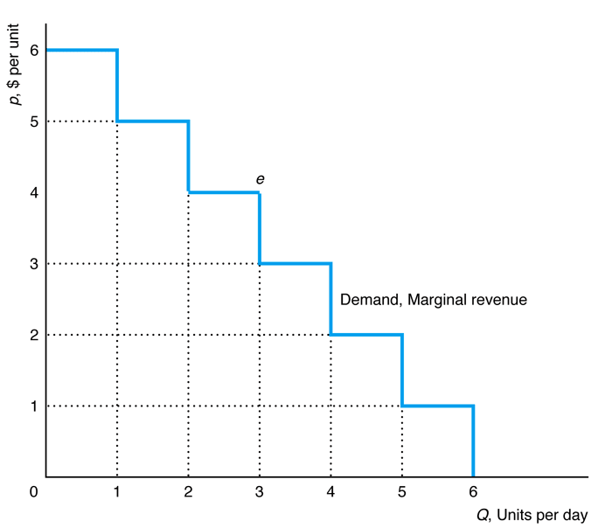








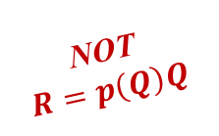






Perfect Price Discrimination
Each unit is sold at each consumer’s reservation price!
Reservation Price:
The maximum amount someone is willing to pay
$$p(Q)$$
Discrete case
Suppose we rank consumers by their willingness to pay:
Highest reservation price
Inverse Demand:
The maximum price consumers are willing to pay for a given quantity
$1st$ unit: $p_{1}=6$
$2nd$ unit: $p_{2}=5$
$3rd$ unit: $p_{3}=4$
$4th$ unit: $p_{4}=3$
$5th$ unit: $p_{5}=2$
Lowest reservation price
$6th$ unit: $p_{6}=1$
NOT
$$R=p\left(Q\right)Q$$
Revenue:
Sum of the prices paid by each unit
$$R=p_{1}+p_{2}+p_{3}+p_{4}+p_{5}+p_{5}$$
$$1st$$
$$2nd$$
$$3rd$$
$$4th$$
$$5th$$
$$6th$$

Slide 7


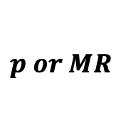
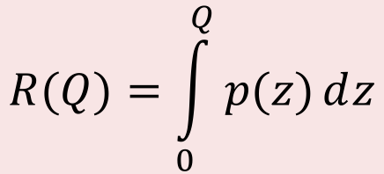
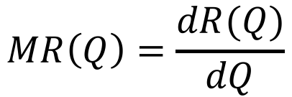
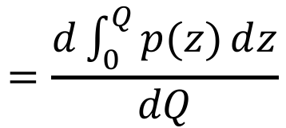

Perfect Price Discrimination: Smooth Demand
Sum of the prices paid by each unit!
Revenue
From calculus:
The sum of infinitely many amounts is the integral!
$$R(Q)=\int_{0}^{Q}{p(z)ⅆz}$$
$$p or MR$$
$$p(Q)$$
$$=MR(Q)$$
Marginal revenue curve is the same as the inverse demand curve!
$$Q$$
Marginal Revenue
$$=\frac{d\int_{0}^{Q}{p(z)ⅆz}}{dQ}$$
$$MR\left(Q\right)=\frac{dR(Q)}{dQ}$$
$$=p(Q)$$

Slide 8


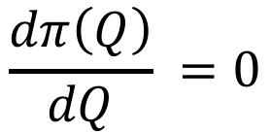



Profit Maximization
Profit
Profit
Revenue
Total Cost
$$π\left(Q\right)=R\left(Q\right)−C(Q)$$
Choose output to maximize profits!
Maximization
$$\max_{Q}{π\left(Q\right)}=R\left(Q\right)−C(Q)$$
Same result of competitive markets!
Marginal profits equal to zero!
Solution
$$\frac{dπ\left(Q\right)}{dQ} =0$$
$$⟺MR(Q)−MC(Q)=0$$
$$⟺p\left(Q\right)=MC(Q)$$
$$=p(Q)$$

Slide 9
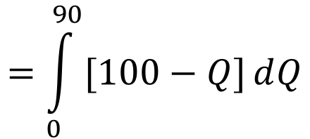

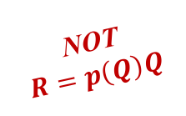






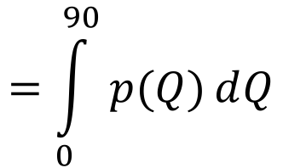
Example
Consider the following $p(Q)$ and $MC(Q)$ functions:
$$p\left(Q\right)=100−Q$$
$$MC\left(Q\right)=10$$
What is the perfect price discrimination output?
Optimal quantity!
$$p\left(Q\right)=MC(Q)$$
$$⟺100−Q=10$$
$$⟺Q^{∗}=90$$
What is the maximum revenue?
NOT
$$R=p\left(Q\right)Q$$
$$=\int_{0}^{90}{p(Q)ⅆQ}$$
$$=\int_{0}^{90}{[100−Q]ⅆQ}$$
$$R\left(Q^{∗}\right)=R(90)$$
$$=4,950$$

Slide 10
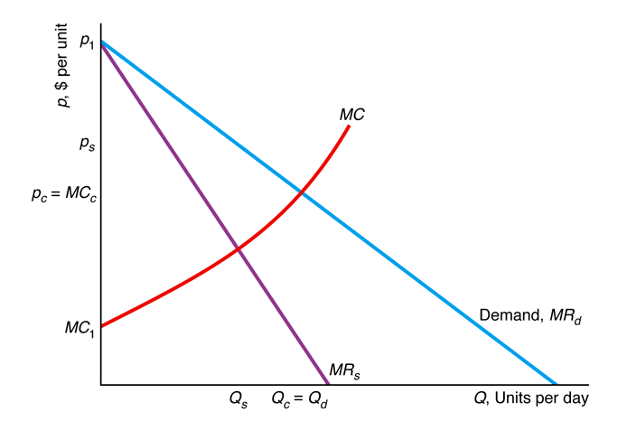
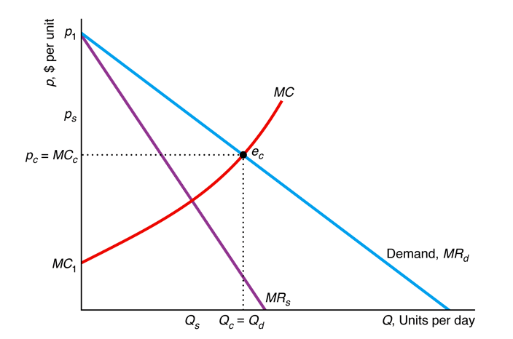


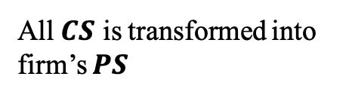





Perfect Price Discrimination & Welfare
Consumer Surplus is …
With Perfect Price Discrimination:
greatest with competition
lower with single-price monopoly
eliminated with perfect price discrimination
Consumers get zero consumer surplus
A
All 𝑪𝑺 is transformed into firm’s $PS$
B
C
E
D
No deadweight loss is generated
, p_{d}
The final allocation maximizes welfare
Monopoly
Perfect Price
Discrimination, $Q_{d}$
Competition, $Q_{c}$
Single Price, $Q_{s}$
Consumer Surplus, $CS$
$$A+B+C$$
$$A$$
$$0$$
Producer Surplus, $PS$
$$D+E$$
$$B+D$$
$$A+B+C+D+E$$
But it’s not Pareto-Improving (consumers get harmed)
Welfare, $W=CS+PS$
$$A+B+C+D+E$$
$$A+B+D$$
$$A+B+C+D+E$$
Deadweight Loss
$$0$$
$$C+E$$
$$0$$

Slide 11


Group Price Discrimination
Firms divide consumers into two or more groups and set a different price for each group!
e.g. senior or student discounts
Total Output
$$Q=Q_{1}+Q_{2}$$
Profit
Revenue Group 1
Revenue Group 2
Profit
Total Cost
$$π\left(Q_{1},Q_{2}\right)=R\left(Q_{1}\right)+R\left(Q_{2}\right)−C(Q)$$
Choose $Q_{1}$ and $Q_{2}$ to maximize profits!
Maximization
$$\max_{Q_{1},Q_{2}}{π\left(Q_{1},Q_{2}\right)}=R\left(Q_{1}\right)+R\left(Q_{2}\right)−C(Q)$$

Slide 12







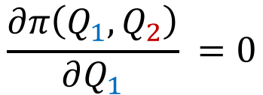
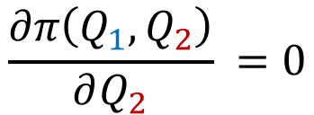
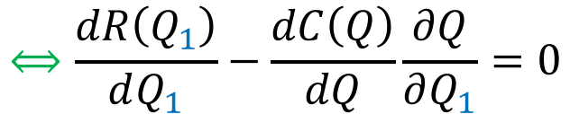

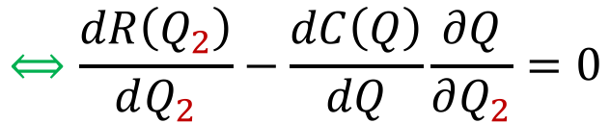


Solution to Profit Maximization
$$Q=Q_{1}+Q_{2}$$
$$\max_{Q_{1},Q_{2}}{π\left(Q_{1},Q_{2}\right)}=R\left(Q_{1}\right)+R\left(Q_{2}\right)−C(Q)$$
Marginal profits of Group 1 equal to zero!
$${MR}_{1}$$
$$MC$$
$$=1$$
$$\frac{∂π\left(Q_{1},Q_{2}\right)}{∂Q_{1}} =0$$
$$⟺\frac{dR\left(Q_{1}\right)}{dQ_{1}}−\frac{dC\left(Q\right)}{dQ}\frac{∂Q}{∂Q_{1}}=0$$
$$⟺{MR}_{1}=MC$$
Marginal profits of Group 2 equal to zero!
$${MR}_{2}$$
$$MC$$
$$=1$$
$$\frac{∂π\left(Q_{1},Q_{2}\right)}{∂Q_{2}} =0$$
$$⟺\frac{dR\left(Q_{2}\right)}{dQ_{2}}−\frac{dC\left(Q\right)}{dQ}\frac{∂Q}{∂Q_{2}}=0$$
$$⟺{MR}_{2}=MC$$
Optimal Condition!
$${MR}_{1}=MC={MR}_{2}$$

Slide 13
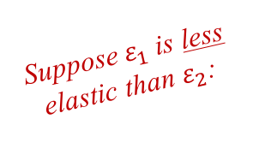
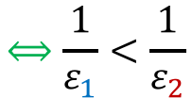
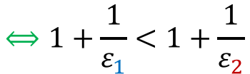
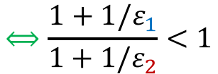



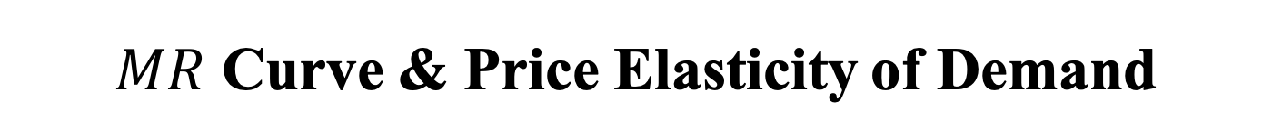
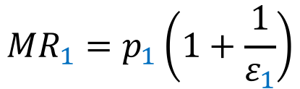
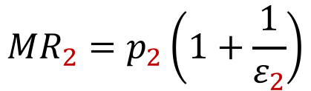

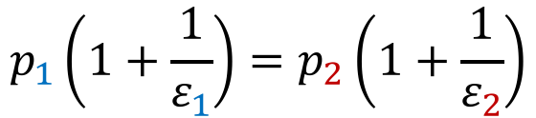
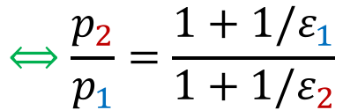

$MR$ Curve & Price Elasticity of Demand
A higher price will be charged in the less elastic market segment!
Marginal revenue of Group 1
Marginal revenue of Group 2
Optimal condition
$${MR}_{1}=p_{1}\left(1+\frac{1}{ε_{1}}\right)$$
$${MR}_{2}=p_{2}\left(1+\frac{1}{ε_{2}}\right)$$
$${MR}_{1}=MC={MR}_{2}$$
Combining the equations above:
$$p_{1}\left(1+\frac{1}{ε_{1}}\right)=p_{2}\left(1+\frac{1}{ε_{2}}\right)$$
$$⟺\frac{p_{2}}{p_{1}}=\frac{1+1/ε_{1}}{1+1/ε_{2}}$$
Suppose $ε_{1}$ is less elastic than $ε_{2}$:
Which price will be higher?
$$⟺\frac{1}{ε_{1}}<\frac{1}{ε_{2}}$$
$$⟺1+\frac{1}{ε_{1}}<1+\frac{1}{ε_{2}}$$
$$⟺\frac{1+1/ε_{1}}{1+1/ε_{2}}<1$$
$$⟺\frac{p_{2}}{p_{1}}<1$$
$$⟺p_{2}<p_{1}$$
$$ε_{1}>ε_{2}$$
$$p_{2}/p_{1}$$

Slide 14


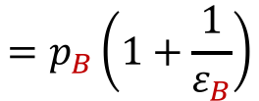
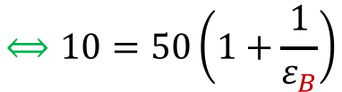

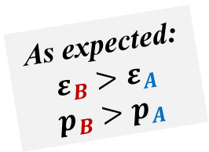







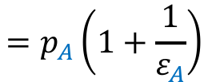
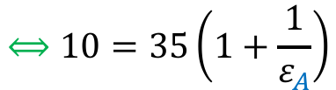







Example
Assume the market is segmented in 2 groups:
$$p_{A}\left(Q_{A}\right)=60−5Q_{A}$$
$$p_{B}\left(Q_{B}\right)=90−20Q_{B}$$
$$MC=10$$
What are the optimal quantities and prices?
$${MR}_{A}=MC$$
$$⟺60−10Q_{A}=10$$
$$⟺Q_{A}^{∗}=5$$
$${MR}_{B}=MC$$
$$⟺90−40Q_{B}=10$$
$$⟺Q_{B}^{∗}=2$$
$$p_{A}\left(Q_{A}^{∗}\right)=p_{A}\left(5\right)$$
$$=60−5×5=35$$
$$p_{B}\left(Q_{B}^{∗}\right)=p_{B}\left(2\right)$$
$$=90−20×2=50$$
What are the elasticities of demand?
As expected:
$$ε_{B}>ε_{A}$$
$$p_{B}>p_{A}$$
$$=p_{A}\left(1+\frac{1}{ε_{A}}\right)$$
$$⟺10=35\left(1+\frac{1}{ε_{A}}\right)$$
$${MC=MR}_{A}$$
$$⟺ε_{A}=−1.4$$
$$=p_{B}\left(1+\frac{1}{ε_{B}}\right)$$
$$⟺10=50\left(1+\frac{1}{ε_{B}}\right)$$
$${MC=MR}_{B}$$
$$⟺ε_{B}=−1.25$$

Slide 15







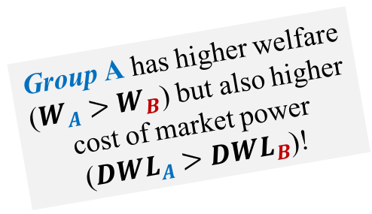











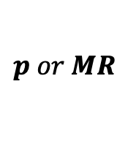




Graphical Analysis
Group A has higher welfare ($W_{A}>W_{B}$) but also higher cost of market power (${DWL}_{A}>{DWL}_{B}$)!
Group A
Group B
$$p or MR$$
$$p or MR$$
$${CS}_{A}=(5×25)/2=62.5$$
$${CS}_{B}=(2×40)/2=40$$
$${PS}_{A}=5×25=125$$
90
$${CS}_{B}$$
$${PS}_{B}=2×40=80$$
$$W_{A}={CS}_{A}+{PS}_{A}=187.5$$
$$W_{B}={CS}_{B}+{PS}_{B}=120$$
$${DWL}_{A}=(5×25)/2=62.5$$
$${DWL}_{B}=(2×40)/2=40$$
60
$$p_{A}(Q_{A})$$
50
$${CS}_{A}$$
$$p_{B}(Q_{B})$$
35
$${PS}_{A}$$
$$MC$$
$${PS}_{B}$$
$${DWL}_{B}$$
$$MC$$
$${DWL}_{A}$$
10
10
$${MR}_{A}$$
$${MR}_{B}$$
$$Q_{A}$$
$$Q_{B}$$
5
6
10
12
2
2.25
4.5
4

Slide 16




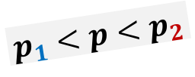








Example
Assume the market is segmented in 2 groups:
$$p_{1}\left(Q_{1}\right)=6−Q_{1}/2$$
$$p_{2}\left(Q_{2}\right)=9−Q_{2}$$
$$MC=1$$
What are the optimal prices with and without price discrimination?
$$Q_{1}=12−2p_{1}$$
$$Q_{2}=9−p_{2}$$
$$p_{1}<p<p_{2}$$
$$Q=Q_{1}+Q_{2}=21−3p$$
(a) Group 1
(b) Group 2
(c) Single-Price Monopoly
p
p
p
Above $p=6$
1
2
9
9
$$p\left(Q\right)=9−Q$$
$$MR\left(Q\right)=9−2Q$$
Below $p=6$
6
6
5
$$p\left(Q\right)=7−Q/3$$
3.5
D
2
4
$$MR\left(Q\right)=7−2Q/3$$
1
D
2
MR
D
1
MR
1
MR
MC
1
MC
1
M
C
Q
Q
Q
5
12
1
4
9
2
3
9
21

Slide 17



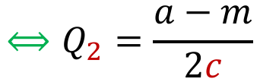

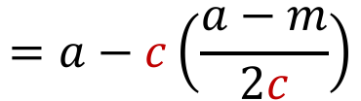

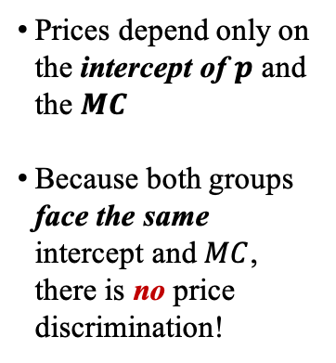





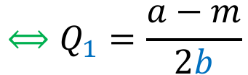

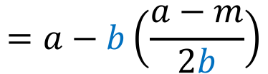
Example
Assume the market is segmented in 2 groups:
$$p_{1}\left(Q_{1}\right)=a−bQ_{1}$$
$$p_{2}\left(Q_{2}\right)=a−cQ_{2}$$
$$MC=m$$
Does the monopolist discriminate prices?
$$⟺Q_{1}=\frac{a−m}{2b}$$
$${MR}_{1}=MC$$
$$⟺a−2bQ_{1}=m$$
$$=a−b\left(\frac{a−m}{2b}\right)$$
$$=\frac{a+m}{2}$$
Prices depend only on the intercept of $p$ and the $MC$
Because both groups face the same intercept and $MC$, there is no price discrimination!
$$p_{1}\left(Q_{1}\right)=a−bQ_{1}$$
$$⟺Q_{2}=\frac{a−m}{2c}$$
$${MR}_{2}=MC$$
$$⟺a−2cQ_{2}=m$$
$$=a−c\left(\frac{a−m}{2c}\right)$$
$$=\frac{a+m}{2}$$
$$p_{2}\left(Q_{2}\right)=a−cQ_{2}$$

Slide 18









Nonlinear Price Discrimination
The monopolist charges one price for the first block of units and a different price for subsequent blocks!
Block Pricing
Total Revenue
price
$$R\left(q,Q\right)=p\left(q\right)q+p\left(Q\right)\left(Q−q\right)$$
$$p(Q)$$
$$=p\left(q\right)q+p\left(Q\right)Q−p\left(Q\right)q$$
$$p(q)$$
$$R(q)$$
$$R(Q)$$
$$p(Q)$$
1st
Block
2nd
Block
$$=R\left(q\right)+R\left(Q\right)−p\left(Q\right)q$$
$$q$$
Total output
output
Cutoff
$$Q$$
Profit
$$π\left(q,Q\right)=R\left(q\right)+R\left(Q\right)−p\left(Q\right)q−C(Q)$$

Slide 19



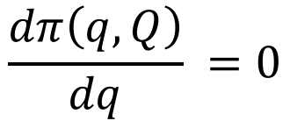

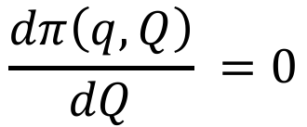


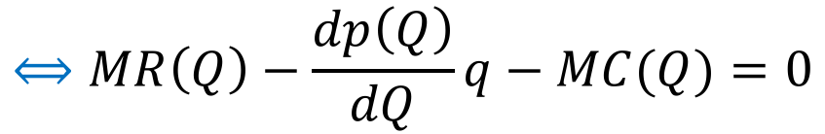
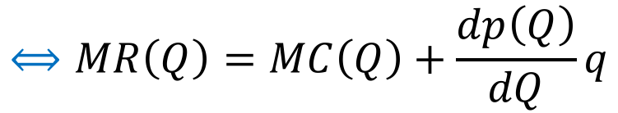
Profit Maximization
Maximization
Choose $q$ and $Q$ to maximize profits!
$$\max_{q,Q}{π\left(q,Q\right)}=R\left(q\right)+R\left(Q\right)−p\left(Q\right)q−C(Q)$$
Solution
$$\frac{dπ\left(q,Q\right)}{dq} =0$$
$$⟺MR\left(q\right)−p(Q) =0$$
$$⟺MR\left(q\right)=p(Q)$$
$$\frac{dπ\left(q,Q\right)}{dQ} =0$$
$$⟺MR\left(Q\right)−\frac{dp\left(Q\right)}{dQ}q−MC(Q)=0$$
$$⟺MR\left(Q\right)=MC\left(Q\right)+\frac{dp\left(Q\right)}{dQ}q$$
$$<0$$
$MR$ not equal to $MC$
$$⟺MR\left(Q\right)<MC\left(Q\right)$$

Slide 20









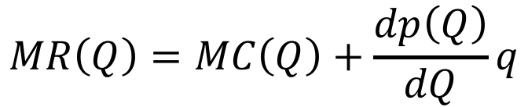


Example
Assume the following inverse demand and cost functions:
$$p\left(Q\right)=90−Q$$
$$C(Q)=30Q$$
What are the optimal prices, output, and cutoff values?
$$MR\left(q\right)=p(Q)$$
$$⟺90−2q=90−Q$$
$$⟺Q=2q$$
$$MR\left(Q\right)=MC\left(Q\right)+\frac{dp\left(Q\right)}{dQ}q$$
$$⟺90−2Q=30−q$$
$$⟺90−4q=30−q$$
$$⟺q=20$$
$$⟹Q=40$$
$$p\left(q\right)=p(20)=70$$
$$p\left(Q\right)=p(40)=50$$

Slide 21
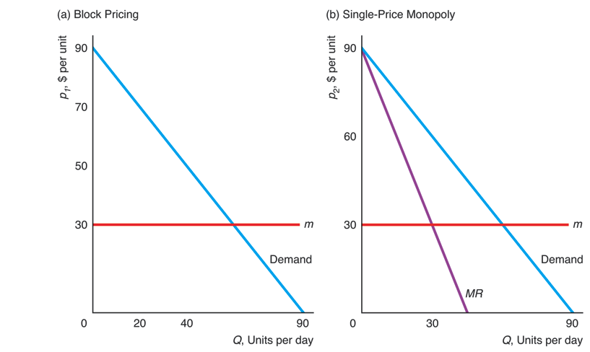





Example (cont.)
In this example!
With Block-Pricing:
A
$$p(q)$$
E
Consumers suffer
Monopolist improves
Society improves
C
$$p(Q)$$
B
F
G
D
$$MC$$
$$MC$$
$$q$$
$$Q$$
Block Pricing
Single Price
Consumer Surplus, $CS$
$$A+C=400$$
$$E=450$$
Producer Surplus, $PS$
$$B=1,200$$
$$F=900$$
Welfare, $W=CS+PS$
$$A+B+C=1,600$$
$$E+F=1,350$$
Deadweight Loss
$$D=200$$
$$G=450$$

Slide 22
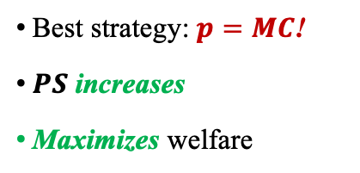

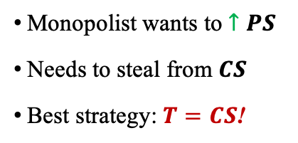



Two-Part Pricing
Assuming Identical Consumers
The firm charges a tariff for the right to purchase (first price) and a per unit price (second price)!
(a)
P
rice Is Abo
v
e Marginal Cost
(b)
P
rice Equals Marginal Cost
Optimal Tariff Strategy:
Optimal Price Strategy:
, $ per unit
, $ per unit
80
Monopolist wants to $↑PS$
Needs to steal from $CS$
Best strategy: $T=CS$!
80
Best strategy: $p=MC$!
$PS$ increases
Maximizes welfare
p
p
D
D
A
=
1,800
A
=
2,450
20
C
=
$50
B
=
600
1
MC
MC
0
1
0
60
70
80
70
80
Q
, Units per day
Q
, Units per day
Without Tariff
With Tariff
Without Tariff
With Tariff
Tariff, $T$
$$0$$
$$A=1,800$$
Tariff, $T$
$$0$$
$$A=2,450$$
Consumer Surplus, $CS$
$$A−T=1,800$$
$$A−T=0$$
Consumer Surplus, $CS$
$$A−T=2,450$$
$$A−T=0$$
Producer Surplus, $PS$
$$B+T=600$$
$$B+T=2,400$$
Producer Surplus, $PS$
$$0−T=0$$
$$0+T=2,450$$
Welfare, $W=CS+PS$
$$A+B=2,400$$
$$A+B=2,400$$
Welfare, $W=CS+PS$
$$A=2,450$$
$$A=2,450$$
Deadweight Loss
$$C=50$$
$$C=50$$
Deadweight Loss
$$0$$
$$0$$

Slide 23
Advertising
Monopoly firms don’t just decide on price and quantity
They are also concerned about advertising their products
Advertising may increase demand for the product
But the cost of advertising may be substantial
Monopolies must make two decisions:
Whether or not to advertise
How much to advertise

Slide 24










Deciding Whether to Advertise
Advertise if cost is less than additional gross profit!
Profit before advertising: $π_{1}$
Profit after advertising: $π_{1}+B$
Advertising shifts demand up!
Additional gross profit: $B$
$$p↑$$
If the cost of advertising is less than $B$, it pays to advertise!
$$Q↑$$

Slide 25










How Much to Advertise
Total Revenue
Inverse demand depends on advertising!
$$R\left(Q,A\right)=p\left(Q,A\right)Q$$
Profit
Production cost
Advertising cost
$$π\left(Q,A\right)=R\left(Q,A\right)−C\left(Q\right)−A$$
Maximization
Choose $Q$ and $A$ to maximize profits!
$$\max_{Q,A}{π\left(Q,A\right)}=R\left(Q,A\right)−C\left(Q\right)−A$$
Solution
$$\frac{∂π(Q,A)}{∂Q}=0$$
$$⟺\frac{∂R\left(Q,A\right)}{∂Q}−\frac{dC\left(Q\right)}{dQ}=0$$
$$⟺MRQ(Q,A)=MC(Q)$$
$$\frac{∂π(Q,A)}{∂A}=0$$
$$⟺\frac{∂R\left(Q,A\right)}{∂A}−1=0$$
$$⟺MRA\left(Q,A\right)=1$$

Slide 26



















Example
Assume the following inverse demand and cost functions:
$$p\left(Q,A\right)=800−4Q+0.2A^{0.5}$$
$$C(Q)=2Q$$
What are the optimal output and advertising values?
$$R\left(Q,A\right)=p\left(Q,A\right)Q$$
$$=\left(800−4Q+0.2A^{0.5}\right)Q$$
$$=800Q−4Q^{2}+0.2A^{0.5}Q$$
$$MRQ\left(Q,A\right)=\frac{∂R(Q,A)}{∂Q}$$
$$MRA\left(Q,A\right)=\frac{∂R(Q,A)}{∂A}$$
$$=0.1A^{−0.5}Q$$
$$=800−8Q+0.2A^{0.5}$$
Optimal condition for $Q$
$$MRQ\left(Q,A\right)=MC\left(Q\right)$$
$$⟺800−8Q+0.2A^{0.5}=2$$
$$⟺800−8Q+0.02Q=2$$
$$⟺Q=100$$
Optimal condition for $A$
$$MRA\left(Q,A\right)=1$$
$$⟺0.1A^{−0.5}Q=1$$
$$⟺A^{0.5}=0.1Q$$
$$=10$$
$$⟺A=100$$

Slide 27
THE END

