Slide 1

BUEC 311
Business Economics, Organizations and Management
Winter 2019
Game Theory
Diego B. P. Gomes

Slide 2
Where are we?
The Nature of Firms
✓
Production
Ch. 6
Ideal Market Structure!
More Realistic Markets!
Competitive Markets
Market Power
✓
✓
✓
Costs
Ch. 7
Perfect Competition
Ch. 8
Monopoly & Monopsony
Ch. 11
✓
✓
Properties of Competition
Ch. 9
Pricing & Advertising
Ch. 12
Consumer Behavior
✓
Consumer’s Choice
Ch. 3
Game Theory
Ch. 13
✓
General Equilibrium
Ch. 10
Oligopoly
Ch. 14
Choice under Uncertainty
Ch. 16
Factor Markets
Ch. 15
Labor market
Capital market
Exhaustible resources

Slide 3

Game Theory
Set of tools to analyze strategic decision making!
Strategic Decision Making:
When a player’s optimal strategy depends on the actions of others
Interaction between players in which players use strategies
GAME
PLAYERS
RULES OF THE GAME
PAYOFFS
STRATEGIES
Agents who make the decisions
e.g. firms, consumers, governments
Actions players can make at each move
Timing of players’ moves
Players’ valuation of the outcome of the game
e.g. profits, utilities, welfare
Plan that specifies the actions that a player will make
Based on the information available at each move

Slide 4
Key Assumptions
1. All players are interested in maximizing their payoffs
2. Rules of the game are common knowledge among all players
3. Payoff functions are common knowledge among all players
4. Each player’s payoff depends on actions taken by all players

Slide 5
Static Games
Each player acts simultaneously and only once!
AIRLINE GAME
PLAYERS
RULES OF THE GAME
PAYOFFS
STRATEGIES
United Airlines
American Airlines
Choose number of passengers on the LA-CHI route
2 possible actions: 48K or 64K passengers/quarter
Play once and simultaneously
Profits
Choose one of the 2 actions to maximize profits
Neither airline knows what action its rival will take when it makes its decision!

Slide 6
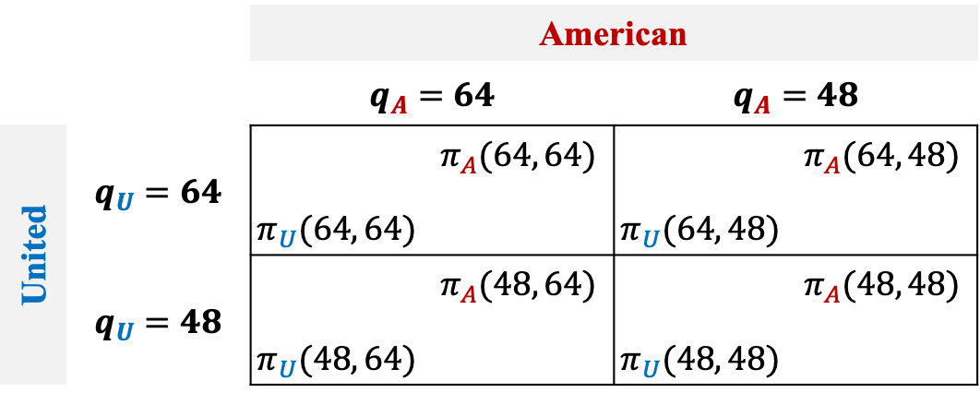


Payoff Matrix
Shows the payoffs for each of the possible combinations of strategies that the players may choose!
Payoffs
Each player’s payoff depends on actions taken by all players
$$π_{U}(q_{U},q_{A})$$
$$π_{A}(q_{U},q_{A})$$
Payoff Matrix
How can we predict the decision of each player?
 |  | American
 |  | $$q_{A}=64$$ |  | $$q_{A}=48$$
United | $$q_{U}=64$$ | $$π_{U}(64, 64)$$ | $$π_{A}(64, 64)$$ | $$π_{U}(64, 48)$$ | $$π_{A}(64, 48)$$
 | $$q_{U}=48$$ | $$π_{U}(48, 64)$$ | $$π_{A}(48, 64)$$ | $$π_{U}(48, 48)$$ | $$π_{A}(48, 48)$$

Slide 7









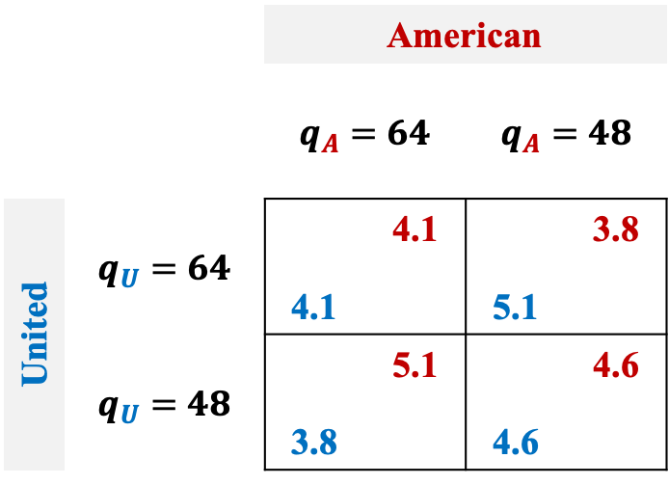






Dominant Strategies
A strategy that produces a higher payoff than any other strategy for every possible combination of its rivals’ strategies!
Assumption:
Rational players will avoid strategies that are dominated by other strategies
Result:
We can predict the outcome of games in which every player has a dominant strategy
$$q_{A}=64$$
$$⟹π_{A}=4.1$$
Both players choose their dominant strategies!
$$q_{U}=64$$
 |  | American
 |  | $$q_{A}=64$$ |  | $$q_{A}=48$$
United | $$q_{U}=64$$ | 4.1 | 4.1 | 5.1 | 3.8
 | $$q_{U}=48$$ | 3.8 | 5.1 | 4.6 | 4.6
$$q_{A}=48$$
$$⟹π_{A}=3.8$$
American
Dominant Strategy
$$q_{A}=64$$
$$⟹π_{A}=5.1$$
$$q_{U}=48$$
$$q_{A}=48$$
$$⟹π_{A}=4.6$$
$$q_{U}=64$$
$$⟹π_{U}=4.1$$
$$q_{A}=64$$
Dominant Strategy
United
$$q_{U}=48$$
$$⟹π_{U}=3.8$$
$$q_{U}=64$$
$$⟹π_{U}=5.1$$
$$q_{A}=48$$
$$q_{U}=48$$
$$⟹π_{U}=4.6$$

Slide 8




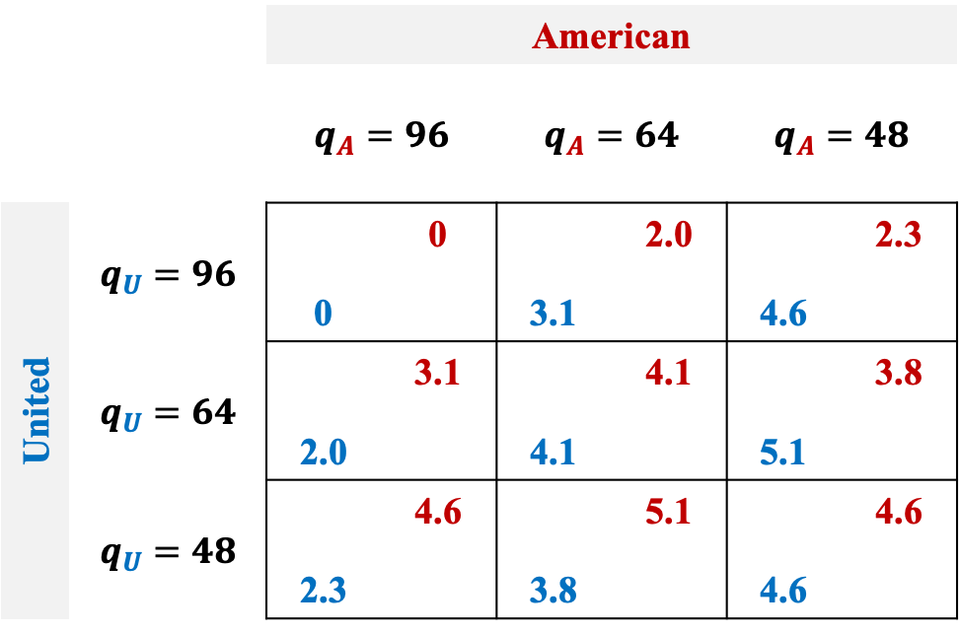







Not every game has dominant strategies!
American
 |  | American
 |  | $$q_{A}=96$$ |  | $$q_{A}=64$$ |  | $$q_{A}=48$$
United | $$q_{U}=96$$ | 0 | 0 | 3.1 | 2.0 | 4.6 | 2.3
 | $$q_{U}=64$$ | 2.0 | 3.1 | 4.1 | 4.1 | 5.1 | 3.8
 | $$q_{U}=48$$ | 2.3 | 4.6 | 3.8 | 5.1 | 4.6 | 4.6
$$q_{U}=48$$
$$⟹q_{A}=64$$
$$q_{U}=64$$
$$⟹q_{A}=64$$
$$q_{U}=96$$
$$⟹q_{A}=48$$
No Dominant Strategy
United
$$q_{A}=48$$
$$⟹q_{U}=64$$
$$q_{A}=64$$
$$⟹q_{U}=64$$
$$q_{A}=96$$
$$⟹q_{U}=48$$
No Dominant Strategy
For these games, we must use a more general approach!

Slide 9

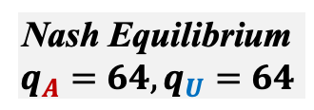





Best Response & Nash Equilibrium
Best Response:
Strategy that maximizes a player’s payoff given its beliefs about its rivals’ strategies
Nash Equilibrium:
Set of strategies such that no player can obtain a higher payoff by choosing a different strategy
American
 |  | American
 |  | $$q_{A}=96$$ |  | $$q_{A}=64$$ |  | $$q_{A}=48$$
United | $$q_{U}=96$$ | 0 | 0 | 3.1 | 2.0 | 4.6 | 2.3
 | $$q_{U}=64$$ | 2.0 | 3.1 | 4.1 | 4.1 | 5.1 | 3.8
 | $$q_{U}=48$$ | 2.3 | 4.6 | 3.8 | 5.1 | 4.6 | 4.6
$$q_{U}=48$$
$$⟹q_{A}=64$$
$$q_{U}=64$$
$$⟹q_{A}=64$$
$$q_{U}=96$$
$$⟹q_{A}=48$$
Best Responses
United
$$q_{A}=48$$
$$⟹q_{U}=64$$
$$q_{A}=64$$
$$⟹q_{U}=64$$
$$q_{A}=96$$
$$⟹q_{U}=48$$
Nash Equilibrium
$$q_{A}=64, q_{U}=64$$
No player wants to change given its rival’s choice!
Best Responses

Slide 10
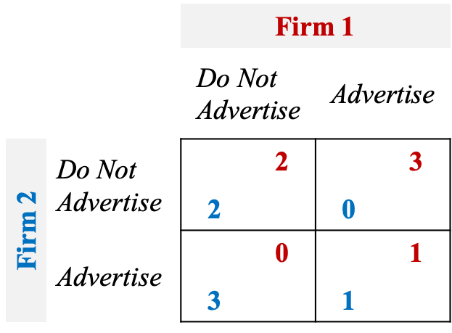

Failure to Maximize Joint Payoffs
Noncooperative firms may not reach the joint profit-maximizing outcome!
It depends on the payoff matrix!
Both firms would be better off by cooperating and not advertising!
 |  | Firm 1
 |  | $$\text{Do} \text{Not} \text{Advertise}$$ |  | $$\text{Advertise}$$
Firm 2 | Do Not Advertise | 2 | 2 | 0 | 3
 | Advertise | 3 | 0 | 1 | 1
No firm can get better off!
 |  | Firm 1
 |  | $$\text{Do} \text{Not} \text{Advertise}$$ |  | $$\text{Advertise}$$
Firm 2 | Do Not Advertise | 2 | 2 | 3 | 4
 | Advertise | 4 | 3 | 5 | 5
Nash Equilibrium
Nash Equilibrium
The sum of profits is not maximized!
The sum of profits is indeed maximized!
Prisoners’ dilemma

Slide 11

Multiple Equilibria
Many games have more than one Nash equilibrium!
 |  | Firm 1
 |  | $$\text{Do} \text{Not} \text{Enter}$$ |  | $$\text{Enter}$$
Firm 2 | Do Not Enter | 0 | 0 | 0 | 1
 | Enter | 1 | 0 | -1 | -1
Nash Equilibrium
Nash Equilibrium
We don’t know which Nash equilibrium will result!

Slide 12




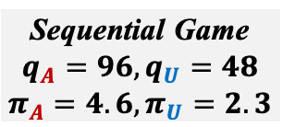
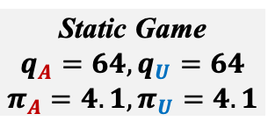










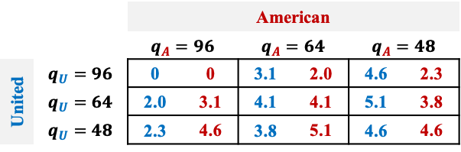




Sequential Games
Stackelberg Game
Players move sequentially, i.e., each player only moves after the other player’s move!
Solve it by backward induction!
 |  | American
 |  | $$q_{A}=96$$ |  | $$q_{A}=64$$ |  | $$q_{A}=48$$
United | $$q_{U}=96$$ | 0 | 0 | 3.1 | 2.0 | 4.6 | 2.3
 | $$q_{U}=64$$ | 2.0 | 3.1 | 4.1 | 4.1 | 5.1 | 3.8
 | $$q_{U}=48$$ | 2.3 | 4.6 | 3.8 | 5.1 | 4.6 | 4.6
Airlines Game Tree
$$(π_{A},π_{U})$$
Follower
$$48$$
$$(4.6, 4.6)$$
2nd to move
United
$$64$$
$$(3.8, 5.1)$$
This Nash equilibrium only works in simultaneous (static) games!
$$48$$
$$96$$
$$(2.3, 4.6)$$
1st to move
Leader
$$48$$
$$(5.1, 3.8)$$
The leader has an advantage!
American
$$64$$
United
$$64$$
$$(4.1, 4.1)$$
$$96$$
$$(2.0, 3.1)$$
Static Game
$$q_{A}=64, q_{U}=64$$
$$π_{A}=4.1, π_{U}=4.1$$
Sequential Game
$$q_{A}=96, q_{U}=48$$
$$π_{A}=4.6, π_{U}=2.3$$
$$96$$
$$48$$
$$(4.6, 2.3)$$
United
$$64$$
Nash Equilibrium
Subgame Perfect Nash Equilibrium
$$(3.1, 2.0)$$
$$96$$
$$(0, 0)$$

Slide 13





Example
Subgame Perfect Nash Equilibrium
Incumbent:
Investment
$$(π_{I},π_{R})$$
Rival:
Do not enter
Do not enter
$$(10, 0)$$
Rival
No investment
Enter
$$(4, 4)$$
Incumbent
Do not enter
$$(8, 0)$$
Investment
Rival
Enter
$$(2, −1)$$

Slide 14

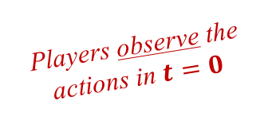
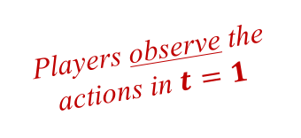
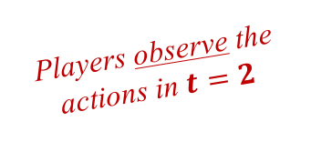
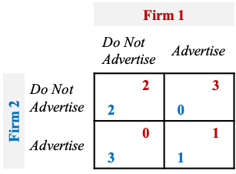






Repeated Games
Much more realistic in term of firms competition!
A static game that is played repeatedly in which each player knows the rival’s previous moves!
The game is repeated endlessly!
$$t=0$$
$$t=1$$
$$t=2$$
$$t=3$$
$$…$$
 |  | Firm 1
 |  | $$\text{Do} \text{Not} \text{Advertise}$$ |  | $$\text{Advertise}$$
Firm 2 | Do Not Advertise | 2 | 2 | 0 | 3
 | Advertise | 3 | 0 | 1 | 1
 |  | Firm 1
 |  | $$\text{Do} \text{Not} \text{Advertise}$$ |  | $$\text{Advertise}$$
Firm 2 | Do Not Advertise | 2 | 2 | 0 | 3
 | Advertise | 3 | 0 | 1 | 1
 |  | Firm 1
 |  | $$\text{Do} \text{Not} \text{Advertise}$$ |  | $$\text{Advertise}$$
Firm 2 | Do Not Advertise | 2 | 2 | 0 | 3
 | Advertise | 3 | 0 | 1 | 1
 |  | Firm 1
 |  | $$\text{Do} \text{Not} \text{Advertise}$$ |  | $$\text{Advertise}$$
Firm 2 | Do Not Advertise | 2 | 2 | 0 | 3
 | Advertise | 3 | 0 | 1 | 1
Beginning of the repeated game
Players observe the actions in $t=0$
Players observe the actions in $t=1$
Players observe the actions in $t=2$
Unlike static games, cooperation is possible in repeated games!

Slide 15

Cooperation Strategy
Collusion agreement!
Both firms would be better off by cooperating!
 |  | Firm 1
 |  | $$\text{Cooperate}$$ |  | $$\text{Do} \text{Not} \text{Cooperate}$$
Firm 2 | Cooperate | 5 | 4 | 0 | 8
 | Do Not Cooperate | 10 | 0 | 1 | 2
Suppose the firms make the following cooperation deal:
1. Both firms always cooperate
2. If a firm breaks the deal once, then the other firm will not cooperate forever
Punishment!
In each static game, the Nash equilibrium is when both do not cooperate!
When will the firms follow the deal and cooperate?

Slide 16











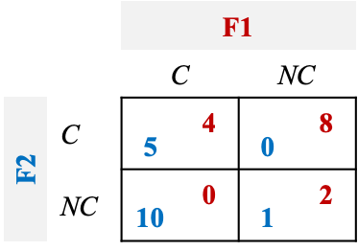





















Present Value of Payoffs
 |  | F1
 |  | $$\text{C}$$ |  | $$\text{NC}$$
F2 | C | 5 | 4 | 0 | 8
 | NC | 10 | 0 | 1 | 2
Both follow the deal
Cooperate!
$$π_{1C}$$
$$=4$$
$$+\frac{4}{(1+r_{1})}$$
$$+\frac{4}{{(1+r_{1})}^{2}}+…$$
$$=4\sum_{t=0}^{∞}{\frac{1}{{\left(1+r_{1}\right)}^{t}}}$$
$$=\frac{4(1+r_{1})}{r_{1}}$$
$$t=0$$
$$t=1$$
$$t=2$$
$$t=…$$
$$=(1+r_{1})/r_{1}$$
$$π_{2C}$$
$$=5$$
$$+\frac{5}{(1+r_{2})}$$
$$+\frac{5}{{(1+r_{2})}^{2}}+…$$
$$=5\sum_{t=0}^{∞}{\frac{1}{{\left(1+r_{2}\right)}^{t}}}$$
$$=\frac{5(1+r_{2})}{r_{2}}$$
Firm 1 breaks the deal
$$=(1+r_{2})/r_{2}$$
$$=1/r_{1}$$
$$π_{1B}$$
$$=8$$
$$+\frac{2}{(1+r_{1})}$$
$$+\frac{2}{{(1+r_{1})}^{2}}+…$$
$$=8+2\sum_{t=1}^{∞}{\frac{1}{{\left(1+r_{1}\right)}^{t}}}$$
$$=8+\frac{2}{r_{1}}$$
Firm 2 breaks the deal
$$=1/r_{2}$$
$$π_{2B}$$
$$=10$$
$$+\frac{1}{(1+r_{2})}$$
$$+\frac{1}{{(1+r_{2})}^{2}}+…$$
$$=10+\sum_{t=1}^{∞}{\frac{1}{{\left(1+r_{2}\right)}^{t}}}$$
$$=10+\frac{1}{r_{2}}$$

Slide 17

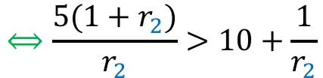


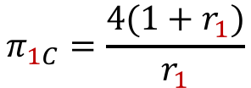
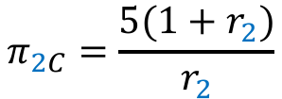
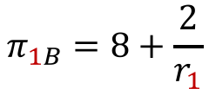
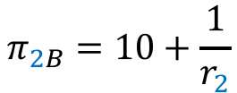


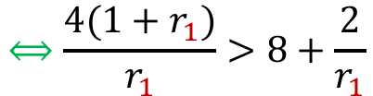

When there is cooperation?
$$π_{1C}=\frac{4(1+r_{1})}{r_{1}}$$
$$π_{1B}=8+\frac{2}{r_{1}}$$
Both Cooperate!
Breaks the Deal!
$$π_{2C}=\frac{5(1+r_{2})}{r_{2}}$$
$$π_{2B}=10+\frac{1}{r_{2}}$$
PV of cooperating is greater than the PV of breaking the deal!
Conditions for Cooperation
$$⟺\frac{4(1+r_{1})}{r_{1}}>8+\frac{2}{r_{1}}$$
$$π_{1C}>π_{1B}$$
$$⟺4(1+r_{1})>8r_{1}+2$$
$$⟺r_{1}<1/2=0.5$$
$$⟺\frac{5(1+r_{2})}{r_{2}}>10+\frac{1}{r_{2}}$$
$$π_{2C}>π_{2B}$$
$$⟺5(1+r_{2})>10r_{2}+1$$
$$⟺r_{2}<4/5=0.8$$
As long as the discount rates are sufficiently small
Prospect of future punishment is sufficiently important
It will pay the firms to stick to the agreement

Slide 18
THE END

