Slide 1

BUEC 311
Business Economics, Organizations and Management
Winter 2019
Factor Markets
Diego B. P. Gomes

Slide 2
Where are we?
The Nature of Firms
✓
Production
Ch. 6
Ideal Market Structure!
More Realistic Markets!
Competitive Markets
Market Power
✓
✓
✓
Costs
Ch. 7
Perfect Competition
Ch. 8
Monopoly & Monopsony
Ch. 11
✓
✓
Properties of Competition
Ch. 9
Pricing & Advertising
Ch. 12
Consumer Behavior
✓
Consumer’s Choice
Ch. 3
Game Theory
Ch. 13
✓
General Equilibrium
Ch. 10
Oligopoly
Ch. 14
Choice under Uncertainty
Ch. 16
Factor Markets
Ch. 15
Labor market
Capital market
Exhaustible resources

Slide 3
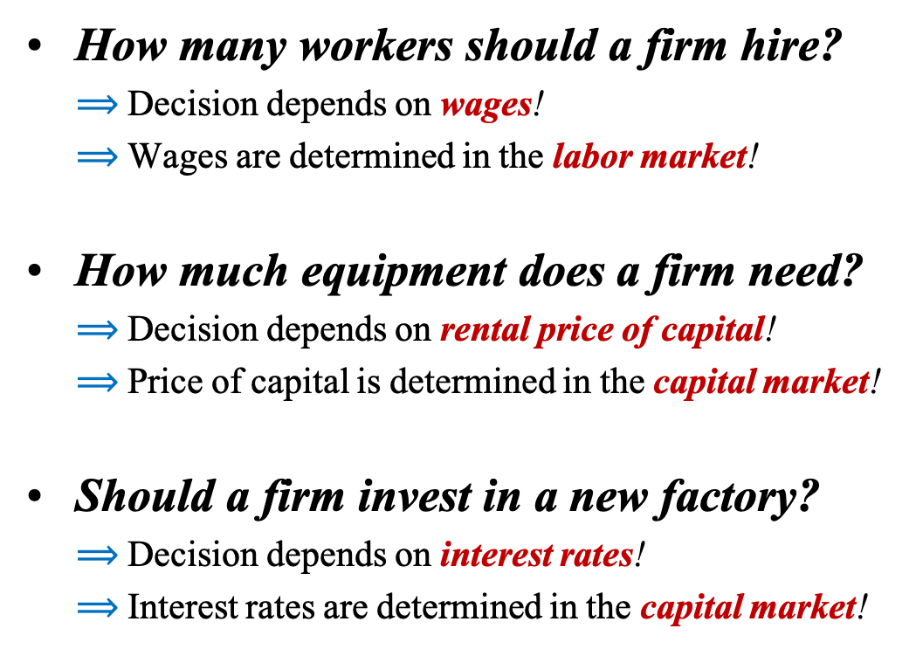
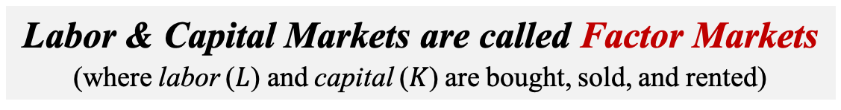
Motivation
How many workers should a firm hire?
$⟹$ Decision depends on wages!
$⟹$ Wages are determined in the labor market!
How much equipment does a firm need?
$⟹$ Decision depends on rental price of capital!
$⟹$ Price of capital is determined in the capital market!
Should a firm invest in a new factory?
$⟹$ Decision depends on interest rates!
$⟹$ Interest rates are determined in the capital market!
Labor & Capital Markets are called Factor Markets
(where labor ($L$) and capital ($K$) are bought, sold, and rented)

Slide 4









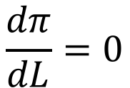
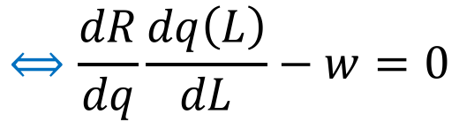

Factor Markets in the Short Run
Output and Cost
Capital is fixed in the short run!
Assuming no market power in factor markets!
$$f\left(L,\overline{K}\right)≡q(L)$$
$$C\left(L\right)=wL+F$$
Profits
$$π=R\left(q\left(L\right)\right)−C(L)$$
$$=R\left(q\left(L\right)\right)−wL−F$$
Firm’s Problem
Choose labor input to maximize profits!
$$\max_{L}{π=R\left(q\left(L\right)\right)−wL−F}$$
Solution
$$MRPL$$
$$\frac{dπ}{dL}=0$$
$$⟺\frac{dR}{dq}\frac{dq\left(L\right)}{dL}−w=0$$
$$⟺MR×MPL(L)=w$$
$$⟺MRPL(L)=w$$
$$MR$$
$$MPL$$

Slide 5
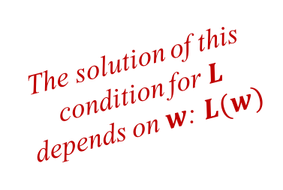

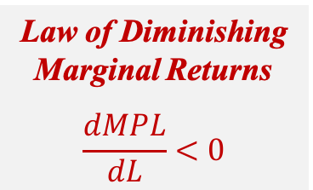







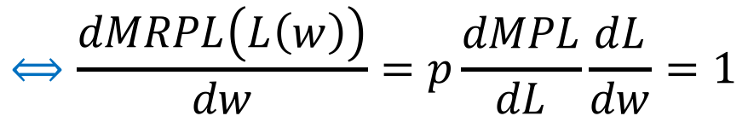
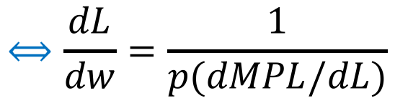
Competitive Firm’s Short-Run Factor Demand
Firms are price takers in competitive markets: $MR=p$
Profit Maximization Condition
$$MRPL(L)=MR×MPL(L)=w$$
$$=pMPL(L)$$
$$=p$$
The solution of this condition for $L$ depends on $w$: $L(w)$
Relationship Between $L$ and $w$
$$MRPL\left(L\left(w\right)\right)=pMPL\left(L\left(w\right)\right)=w$$
Differentiate with respect to $w$
$$⟺\frac{dMRPL\left(L\left(w\right)\right)}{dw}=p\frac{dMPL}{dL}\frac{dL}{dw}=1$$
Law of Diminishing Marginal Returns
$$\frac{dMPL}{dL}<0$$
$$⟺\frac{dL}{dw}=\frac{1}{p(dMPL/dL)}$$
$MRPL$ represents the firm’s demand for labor!
$$<0$$
Chapter 6
$$<0$$

Slide 6

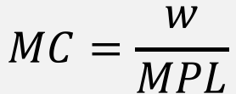
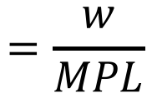

Profit Maximization Choosing Labor or Output
Optimal condition by choosing output
Optimal condition by choosing labor
$$=\frac{w}{MPL}$$
$$p=MC$$
$$⟺w=pMPL$$
$$MC=\frac{w}{MPL}$$
From chapter 7
Both maximization problems are equivalent!

Slide 7




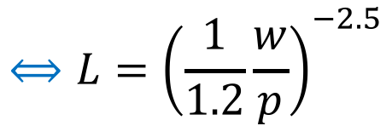






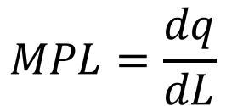
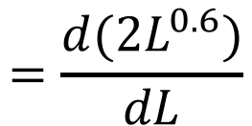

Example
Consider the following competitive market specification:
$$q=L^{0.6}{\overline{K}}^{0.2}$$
$$\overline{K}=32$$
$$p=\$50$$
$$w=\$15/hour$$
How many workers/hour the firm hires?
15
$$⟺L={\left(\frac{1}{1.2}\frac{w}{p}\right)}^{−2.5}$$
$$pMPL=w$$
$$⟺p1.2L^{−0.4}=w$$
$$=32$$
50
$$MPL=\frac{dq}{dL}$$
$$=\frac{d(2L^{0.6})}{dL}$$
$$=1.2L^{−0.4}$$
$$q=L^{0.6}{\overline{K}}^{0.2}$$
$$=L^{0.6}{32}^{0.2}$$
$$=2L^{0.6}$$

Slide 8
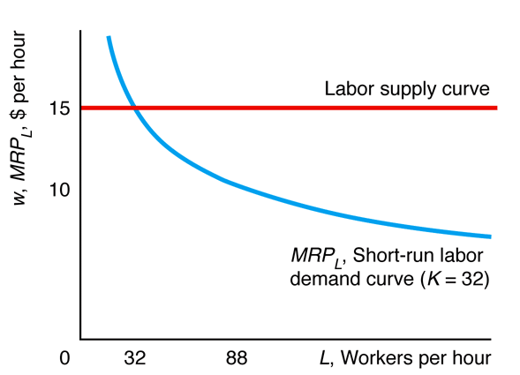


Graphical Analysis
$$MRPL=p1.2L^{−0.4}$$
50
$$L↑$$

Slide 9





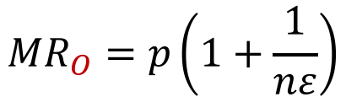
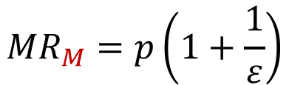




Noncompetitive Firm’s SR Factor Demand
Factor demand curves vary with market power!
Labor Demand
$$MRPL=MR×MPL$$
Chapter 8
Competition
$${MR}_{C}=p$$
$${MRPL}_{C}=pMPL$$
Chapter 14
Oligopoly
$${MR}_{O}=p\left(1+\frac{1}{nε}\right)$$
$${MRPL}_{O}=p\left(1+\frac{1}{nε}\right)MPL$$
Chapter 11
Monopoly
$${MR}_{M}=p\left(1+\frac{1}{ε}\right)$$
$${MRPL}_{M}=p\left(1+\frac{1}{ε}\right)MPL$$
$$ε<0$$
$$⟹{MR}_{M}<{MR}_{O}<{MR}_{C}$$
$$⟹{MRPL}_{M}<{MRPL}_{O}<{MRPL}_{C}$$
For all values of $L$!

Slide 10
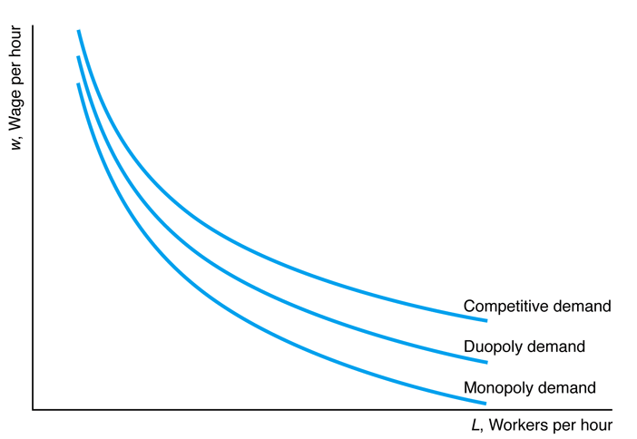












Graphical Analysis
$↑$ Market power implies $↓$ wages!
$$w_{C}$$
$$w_{M}<w_{O}<w_{C}$$
$$w_{O}$$
$$w_{M}$$
$$L^{∗}$$
$↑$ Market power implies $↓$ labor!
$$L_{M}<L_{O}<L_{C}$$
$$w^{∗}$$
$$L_{M}$$
$$L_{O}$$
$$L_{C}$$

Slide 11





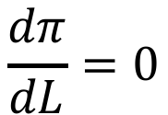
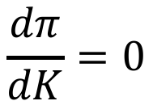
Factor Markets in the Long Run
Capital is variable in the long run!
Assuming no market power in factor markets!
Output and Cost
$$f\left(L,K\right)≡q(L,K)$$
$$C\left(L,K\right)=wL+rK$$
Profits
$$π=R\left(q\left(L,K\right)\right)−C(L,K)$$
$$=R\left(q\left(L,K\right)\right)−wL−rK$$
Choose labor and capital inputs to maximize profits!
Firm’s Problem
$$\max_{L,K}{π=R\left(q\left(L,K\right)\right)−wL−rK }$$
Solution
$$\frac{dπ}{dL}=0$$
$$\frac{dπ}{dK}=0$$

Slide 12


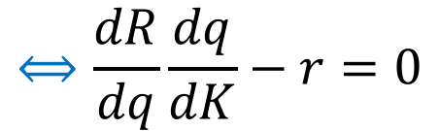




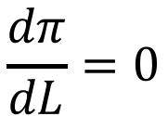
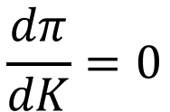

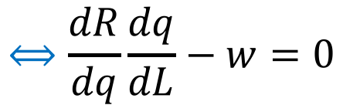
Solution to Firm’s Problem
$$\max_{L,K}{π=R\left(q\left(L,K\right)\right)−wL−rK }$$
$$MRPL$$
$$\frac{dπ}{dL}=0$$
$$⟺\frac{dR}{dq}\frac{dq}{dL}−w=0$$
$$⟺MR×MPL=w$$
$$⟺MRPL=w$$
$$MR$$
$$MPL$$
$$MRPK$$
$$\frac{dπ}{dK}=0$$
$$⟺\frac{dR}{dq}\frac{dq}{dK}−r=0$$
$$⟺MR×MPK=r$$
$$⟺MRPK=r$$
$$MR$$
$$MPK$$

Slide 13







Competitive Firm’s Long-Run Factor Demand
Profit Maximization Condition for $L$
$$MRPL=MR×MPL=w$$
$$=pMPL$$
Firms are price takers in competitive markets: $MR=p$
$$=p$$
Profit Maximization Condition for $K$
$$MRPK=MR×MPK=r$$
$$=pMPK$$
$$=p$$

Slide 14
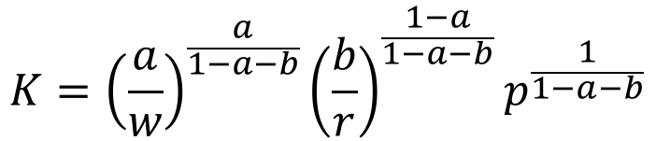
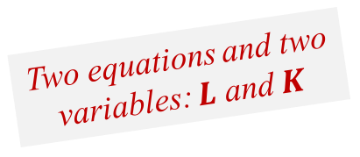







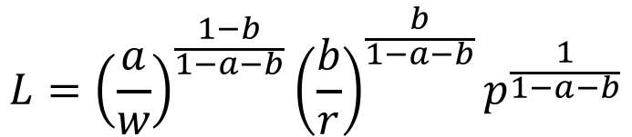
Example
Consider the following competitive market specification:
$$q=L^{a}K^{b}$$
$$prices: p, w, r$$
What are the optimal choices for $L$ and $K$?
$$L={\left(\frac{a}{w}\right)}^{\frac{1−b}{1−a−b}}{\left(\frac{b}{r}\right)}^{\frac{b}{1−a−b}}p^{\frac{1}{1−a−b}}$$
$$pMPL=w$$
$$⟺paL^{a−1}K^{b}=w$$
Two equations and two variables: $L$ and $K$
$$K={\left(\frac{a}{w}\right)}^{\frac{a}{1−a−b}}{\left(\frac{b}{r}\right)}^{\frac{1−a}{1−a−b}}p^{\frac{1}{1−a−b}}$$
$$pMPK=r$$
$$⟺pbL^{a}K^{b−1}=r$$

Slide 15
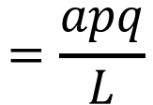







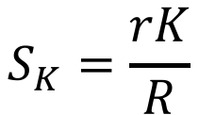
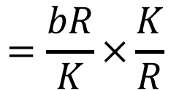

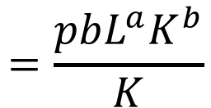

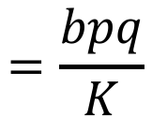

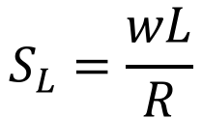
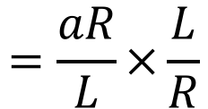

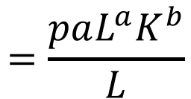

Example (cont.)
What is the share of revenue devoted to labor expenses?
$$S_{L}=\frac{wL}{R}$$
$$=\frac{aR}{L}×\frac{L}{R}$$
$$=a$$
Optimal condition for $L$
$$=q$$
$$=R$$
$$=\frac{paL^{a}K^{b}}{L}$$
$$=\frac{apq}{L}$$
$$=\frac{aR}{L}$$
$$w=paL^{a−1}K^{b}$$
What is the share of revenue devoted to capital expenses?
$$S_{K}=\frac{rK}{R}$$
$$=\frac{bR}{K}×\frac{K}{R}$$
$$=b$$
Optimal condition for $K$
$$=q$$
$$=R$$
$$=\frac{pbL^{a}K^{b}}{K}$$
$$=\frac{bpq}{K}$$
$$=\frac{bR}{K}$$
$$r=pbL^{a}K^{b−1}$$

Slide 16
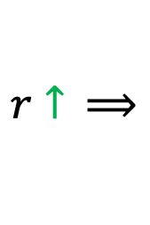







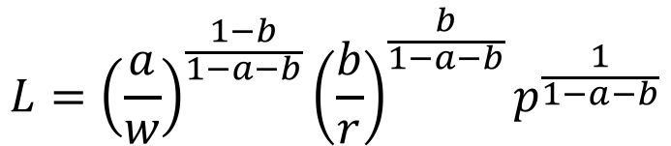
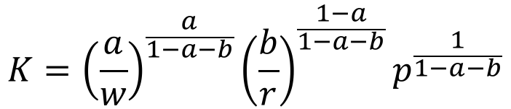
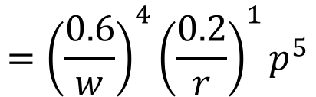
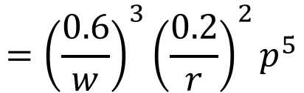
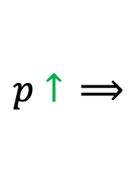
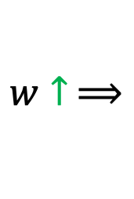
Example (cont.)
Now assume that $a=0.6$ and $b=0.2$.
How the demand for $L$ and $K$ changes with $p$, $w$, $r$?
$$L={\left(\frac{a}{w}\right)}^{\frac{1−b}{1−a−b}}{\left(\frac{b}{r}\right)}^{\frac{b}{1−a−b}}p^{\frac{1}{1−a−b}}$$
$$={\left(\frac{0.6}{w}\right)}^{4}{\left(\frac{0.2}{r}\right)}^{1}p^{5}$$
$$K={\left(\frac{a}{w}\right)}^{\frac{a}{1−a−b}}{\left(\frac{b}{r}\right)}^{\frac{1−a}{1−a−b}}p^{\frac{1}{1−a−b}}$$
$$={\left(\frac{0.6}{w}\right)}^{3}{\left(\frac{0.2}{r}\right)}^{2}p^{5}$$
$$p↑ ⟹$$
$$L↑$$
$$K↑$$
The demand for each factor decreases with respect to factor prices $w$ or $r$, and increases with output price $p$!
$$w↑ ⟹$$
$$L↓$$
$$K↓$$
$$r↑ ⟹$$
$$L↓$$
$$K↓$$

Slide 17
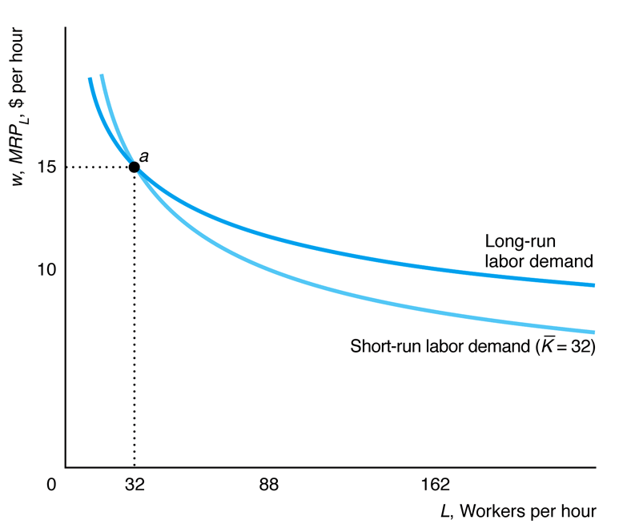
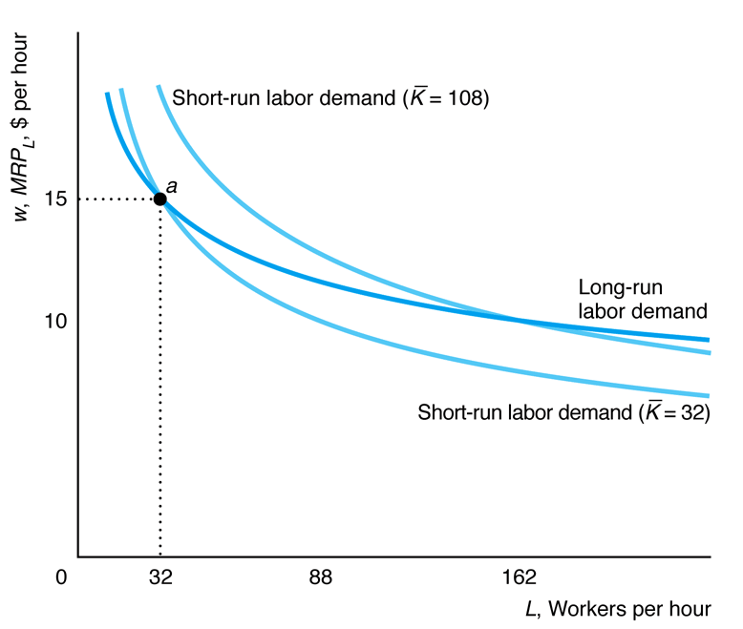

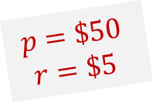

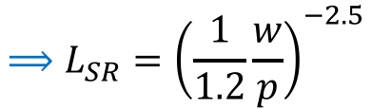
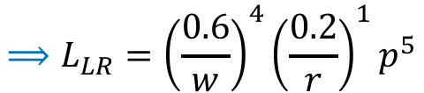




Short-Run vs Long-Run Labor Demand
$$p=\$50$$
$$r=\$5$$
From the two previous examples:
Short-Run:
$$q=L^{0.6}{\overline{K}}^{0.2}$$
$$\overline{K}=32$$
$$⟹L_{SR}={\left(\frac{1}{1.2}\frac{w}{p}\right)}^{−2.5}$$
$$≈{27,885.48w}^{−2.5}$$
Long-Run:
$$q=L^{0.6}K^{0.2}$$
$$⟹L_{LR}={\left(\frac{0.6}{w}\right)}^{4}{\left(\frac{0.2}{r}\right)}^{1}p^{5}$$
$$≈{1,620,000w}^{−4}$$
$L_{LR}$ increases more than $L_{SR}$
Firms can substitute $K$ for $L$ in the LR

Slide 18
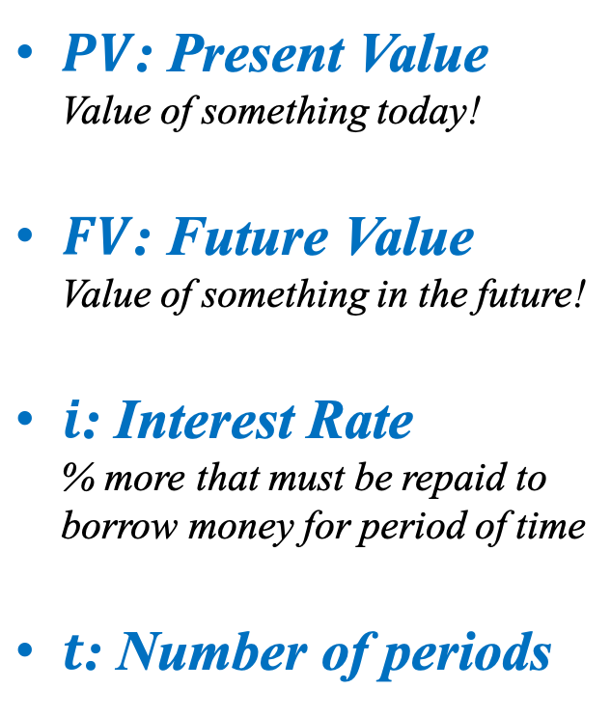

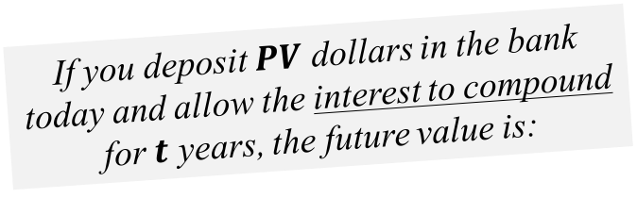


Capital Markets and Investing
People value having a dollar today more than having a dollar in the future!
$PV$: Present Value
Value of something today!
$FV$: Future Value
Value of something in the future!
$i$: Interest Rate
% more that must be repaid to borrow money for period of time
$t$: Number of periods
If you deposit $PV$ dollars in the bank today and allow the interest to compound for $t$ years, the future value is:
$$FV=PV{(1+i)}^{t}$$
Real rate, discounting inflation!
The amount of money that you would have to put in the bank today to get $FV$ in $t$ years at an interest rate of $i$ is:
$$PV=\frac{FV}{{(1+i)}^{t}}$$

Slide 19








Present Value of a Finite Stream of Payments
The present value of the stream of payments is the sum of the present value of each future payment!
Payments of $f$ for $t$ years at an interest rate of $i$:
$$PV=\frac{f}{{(1+i)}^{1}}+\frac{f}{{(1+i)}^{2}}+…+\frac{f}{{(1+i)}^{t}}$$
$$=f\left[\frac{1}{{(1+i)}^{1}}+\frac{1}{{(1+i)}^{2}}+…+\frac{1}{{(1+i)}^{t}}\right]$$
$$⟺PV(1+i)=f\left[\frac{1}{{\left(1+i\right)}^{1}}+\frac{1}{{\left(1+i\right)}^{2}}+…+\frac{1}{{\left(1+i\right)}^{t}}\right](1+i)$$
$$=f\left[1+\frac{1}{{\left(1+i\right)}^{1}}+…+\frac{1}{{\left(1+i\right)}^{t−1}}\right]$$
$$=PV−\frac{f}{{(1+i)}^{t}}$$
$$=f+f\left[\frac{1}{{\left(1+i\right)}^{1}}+\frac{1}{{\left(1+i\right)}^{2}}+…+\frac{1}{{\left(1+i\right)}^{t−1}}\right]$$
$$=f+PV−\frac{f}{{(1+i)}^{t}}$$
$$⟺PV=\frac{f}{i}\left[1−\frac{1}{{\left(1+i\right)}^{t}}\right]$$

Slide 20






Present Value of a Infinite Stream of Payments
Payments of $f$ forever at an interest rate of $i$:
$$PV=\frac{f}{{(1+i)}^{1}}+\frac{f}{{(1+i)}^{2}}+\frac{f}{{(1+i)}^{3}}+…$$
$$=PV$$
$$=\frac{1}{(1+i)}\left[f+\frac{f}{{(1+i)}^{1}}+\frac{f}{{(1+i)}^{2}}+\frac{f}{{(1+i)}^{3}}+…\right]$$
$$=\frac{1}{(1+i)}\left[f+PV\right]$$
$$⟺PV=\frac{f}{i}$$

Slide 21











Example
Consider an interest rate of 5% and a constant payment of $10.
What is the present value when $t=10, 50, 100$?
$$PV=\frac{f}{i}\left[1−\frac{1}{{\left(1+i\right)}^{t}}\right]$$
$$t=10: PV=\frac{10}{0.05}\left[1−\frac{1}{{\left(1+0.05\right)}^{10}}\right]$$
$$≈77.22$$
$$t=50: PV=\frac{10}{0.05}\left[1−\frac{1}{{\left(1+0.05\right)}^{50}}\right]$$
$$≈182.56$$
$PV↑$ when $t↑$!
$$t=100: PV=\frac{10}{0.05}\left[1−\frac{1}{{\left(1+0.05\right)}^{100}}\right]$$
$$≈198.48$$
What is the present value when $t$ runs forever?
$$PV=\frac{f}{i}$$
$$PV=\frac{10}{0.05}=200$$
As $t$ increases, the $PV$ approaches the infinite case!

Slide 22





Future Value of a Finite Stream of Payments
Payments of $f$ for $t$ years at an interest rate of $i$:
$$FV=f+f{(1+i)}^{1}+f{(1+i)}^{2}+…+f{(1+i)}^{t−1}$$
$$=f\left[1+{(1+i)}^{1}+{(1+i)}^{2}+…+{(1+i)}^{t−1}\right]$$
$$⟺FV(1+i)=f\left[1+{(1+i)}^{1}+{(1+i)}^{2}+…+{(1+i)}^{t−1}\right](1+i)$$
$$=f\left[{(1+i)}^{1}+{(1+i)}^{2}+…+{(1+i)}^{t}\right]$$
$$=FV−f$$
$$=f\left[{(1+i)}^{1}+{(1+i)}^{2}+…+{(1+i)}^{t−1}\right]+f{(1+i)}^{t}$$
$$=FV−f+f{(1+i)}^{t}$$
$$⟺FV=\frac{f}{i}\left[{(1+i)}^{t}−1\right]$$

Slide 23








Example
Suppose that you plan to work from age 22 until you retire at 70 and that you can earn 5% on your retirement savings.
Consider these two retirement plans:
Early bird: Save $5,000 a year for the first 15 years and then let savings accumulate interest until retirement.
Late bloomer: After not saving for the first 15 years, you save $5,000 a year for the next 33 years until retirement.
Which plan leads to a bigger retirement amount?
At age 37 (22 + 15)!
$$FV=\frac{f}{i}\left[{(1+i)}^{t}−1\right]$$
$$FV=\frac{5,000}{0.05}\left[{(1+0.05)}^{15}−1\right]$$
$$=\$107,892.82$$
At age 70 (37 + 33)!
$$FV=PV{(1+i)}^{t}$$
$${FV}_{EB}=107,892.82{(1+0.05)}^{33}$$
$$=\$539,808.12$$
Saving early makes a difference!
LB contributes longer but accumulates less!
$${FV}_{LB}=\frac{5,000}{0.05}\left[{(1+0.05)}^{33}−1\right]$$
$$=\$400,318.85$$

Slide 24






Net Present Value
A firm should make an investment only if the net present value is positive!
$$NPV>0$$
$$R=R_{0}+\frac{R_{1}}{{(1+i)}^{1}}+\frac{R_{2}}{{(1+i)}^{2}}+…+\frac{R_{T}}{{(1+i)}^{T}}$$
Present Value of Revenues
Present Value of Costs
$$C=C_{0}+\frac{C_{1}}{{(1+i)}^{1}}+\frac{C_{2}}{{(1+i)}^{2}}+…+\frac{C_{T}}{{(1+i)}^{T}}$$
Net Present Value
$$NPV=R−C$$
$$=R_{0}+\frac{R_{1}}{{(1+i)}^{1}}+\frac{R_{2}}{{(1+i)}^{2}}+…+\frac{R_{T}}{{(1+i)}^{T}}$$
$$−\left[C_{0}+\frac{C_{1}}{{(1+i)}^{1}}+\frac{C_{2}}{{(1+i)}^{2}}+…+\frac{C_{T}}{{(1+i)}^{T}} \right]$$

Slide 25




Net Present Value & Profits
$$NPV=R_{0}+\frac{R_{1}}{{(1+i)}^{1}}+\frac{R_{2}}{{(1+i)}^{2}}+…+\frac{R_{T}}{{(1+i)}^{T}}$$
$$−\left[C_{0}+\frac{C_{1}}{{(1+i)}^{1}}+\frac{C_{2}}{{(1+i)}^{2}}+…+\frac{C_{T}}{{(1+i)}^{T}} \right]$$
$$=\left(R_{0}−C_{0}\right)+\frac{R_{1}−C_{1}}{{(1+i)}^{1}}+\frac{R_{2}−C_{2}}{{(1+i)}^{2}}+…+\frac{R_{T}−C_{T}}{{(1+i)}^{T}}$$
$$=π_{0}+\frac{π_{1}}{{(1+i)}^{1}}+\frac{π_{2}}{{(1+i)}^{2}}+…+\frac{π_{T}}{{(1+i)}^{T}}$$

Slide 26






Example
Consider the following cash flow of an investment:
$12M
$12M
$12M
$12M
$12M
…
0
Time Line
1Y
2Y
3Y
4Y
5Y
…
$450M
Is this investment worth it when the interest rate is 2%?
$$NPV=R−C$$
$$=600−450=150>0$$
The investment is worth it!
$$R=\frac{12}{0.02}$$
$$PV=\frac{f}{i}$$
$$=600$$
Interest rates matter!
However, if the interest rate is 10%, this investment is not worth it!
$$C=450$$

Slide 27






Internal Rate of Return
The discount rate such that the net present value of an investment is zero!
$$NPV=π_{0}+\frac{π_{1}}{{(1+irr)}^{1}}+\frac{π_{2}}{{(1+irr)}^{2}}+…+\frac{π_{T}}{{\left(1+irr\right)}^{T}}=0$$
Steady stream of profit $f$ forever and cost equals $PV$:
$$NPV=−PV+\frac{f}{{(1+irr)}^{1}}+\frac{f}{{(1+irr)}^{2}}+…=0$$
$$⟺PV=\frac{f}{{(1+irr)}^{1}}+\frac{f}{{(1+irr)}^{2}}+…$$
$$⟺PV=\frac{f}{irr}$$
$$⟺irr=\frac{f}{PV}$$
Decision Rule:
Invest only if $irr>i$!
$$PV=\frac{f}{i}$$

Slide 28



Example
Consider the following cash flow of an investment:
$12M
$12M
$12M
$12M
$12M
…
0
Time Line
1Y
2Y
3Y
4Y
5Y
…
$450M
What is the internal rate of return of this investment?
$$irr=\frac{12}{450}$$
This investment is worth it if the investor’s discount rate is smaller than 2.667%!
$$irr=\frac{f}{PV}$$
$$≈2.667\%$$

Slide 29
THE END

