Slide 1

BUEC 311
Business Economics, Organizations and Management
Winter 2019
A Consumer’s Constrained Choice
Diego B. P. Gomes

Slide 2
Where are we?
The Nature of Firms
✓
Production
Ch. 6
Ideal Market Structure!
More Realistic Markets!
Competitive Markets
Market Power
✓
✓
Costs
Ch. 7
Perfect Competition
Ch. 8
Monopoly & Monopsony
Ch. 11
✓
Properties of Competition
Ch. 9
Pricing & Advertising
Ch. 12
Consumer Behavior
Consumer’s Choice
Ch. 3
Game Theory
Ch. 13
General Equilibrium
Ch. 10
Oligopoly
Ch. 14
Choice under Uncertainty
Ch. 16
Factor Markets
Ch. 15
Labor market
Capital market
Exhaustible resources

Slide 3
Model of Consumer Behavior
Premises of the Model:
1. | Preferences | Individual preferences determine the amount of pleasure people derive from the goods and services they consume.
2. | Budget Constraints | Consumers face budget constraints, or limits, on their choices.
3. | Well-being Maximization | Consumers maximize their well-being from consumption subject to the budget constraints they face.

Slide 4


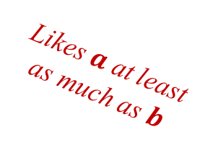

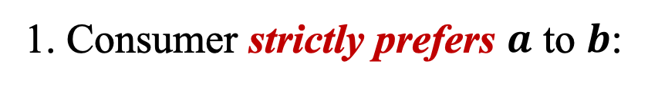
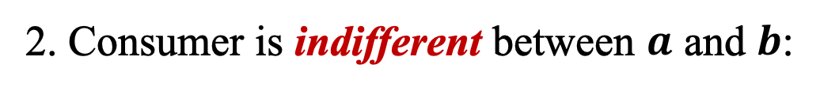
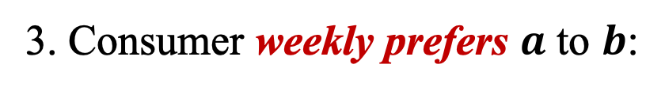



Preferences
Consumers have a set of preferences that they use to guide them in choosing between goods!
We summarize a consumer’s ranking using a preference relation $≿$
e.g. Two bundles: $a$ and $b$
1. Consumer strictly prefers $a$ to $b$:
$$a≻b$$
2. Consumer is indifferent between $a$ and $b$:
$$a \sim b$$
3. Consumer weekly prefers $a$ to $b$:
Likes $a$ at least as much as $b$
$$a≿b$$

Slide 5
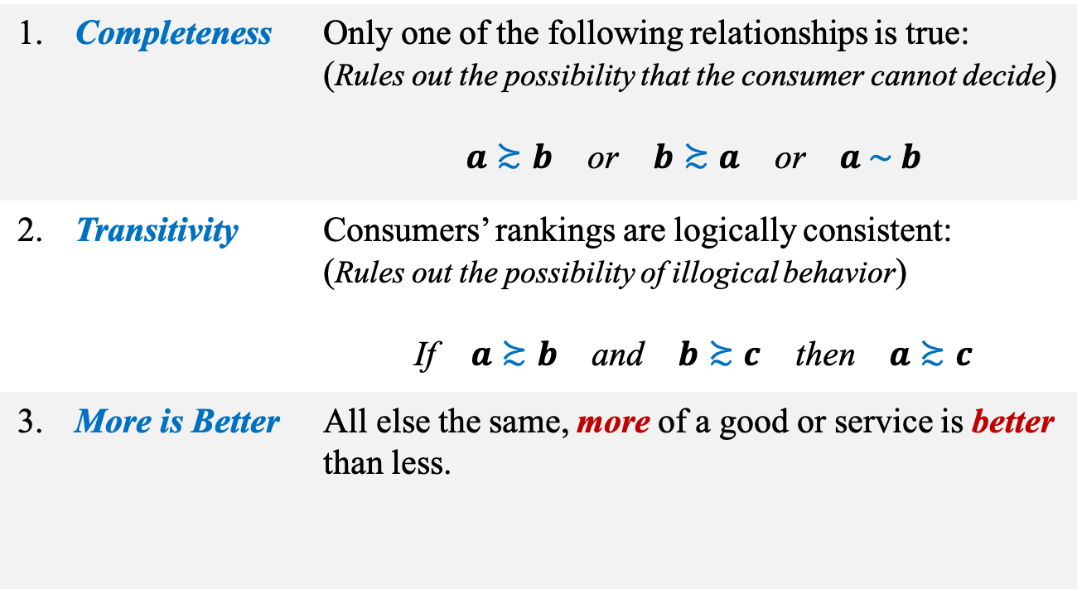
Properties of Preferences
1. | Completeness | Only one of the following relationships is true: (Rules out the possibility that the consumer cannot decide) $a≿b$ or $b≿a$ or $a \sim b$
2. | Transitivity | Consumers’ rankings are logically consistent: (Rules out the possibility of illogical behavior) If $a≿b$ and $b≿c$ then $a≿c$
3. | More is Better | All else the same, more of a good or service is better than less.

Slide 6
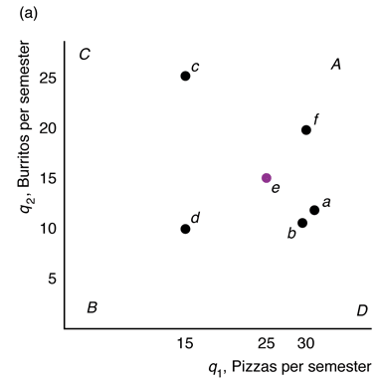
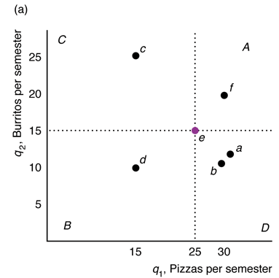
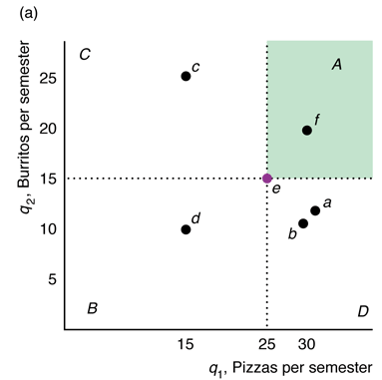
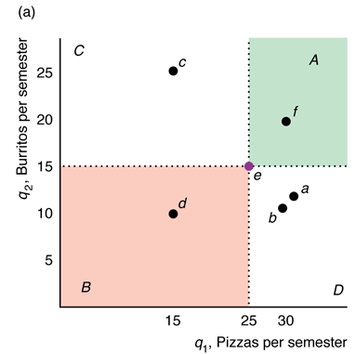



Preference Maps
Graphical interpretation of consumer preferences over two goods!
"More is better" property!
All bundles in the green area are preferable to bundle $e$!
e.g. $f≻e$
Question:
How to compare bundle $e$ with bundles in the grey areas?
"More is better" property!
Bundle $e$ is preferable to all bundles in the red area!
e.g. $e≻d$
Answer:
Need to learn about indifference curves

Slide 7
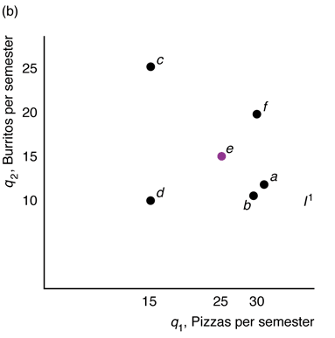

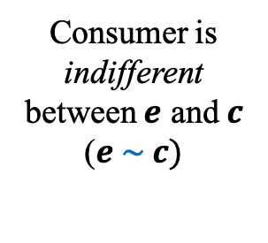
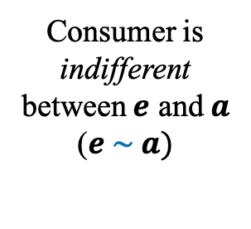
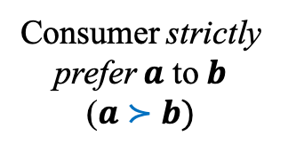
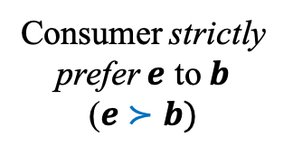
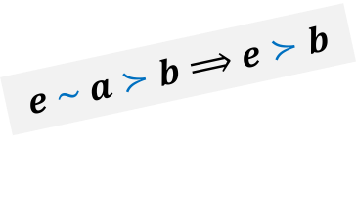
Indifference Curves
The set of all bundles that a consumer views as being equally desirable!
Same indifference curve
"More is better" property!
Consumer is indifferent between $e$ and $c$
($e \sim c)$
Consumer strictly prefer $a$ to $b$
($a≻b)$
Indifference Curve
Same indifference curve
Transitivity property!
Consumer is indifferent between $e$ and $a$ ($e \sim a)$
Consumer strictly prefer $e$ to $b$
($e≻b)$
$$e \sim a≻b⟹e≻b$$

Slide 8
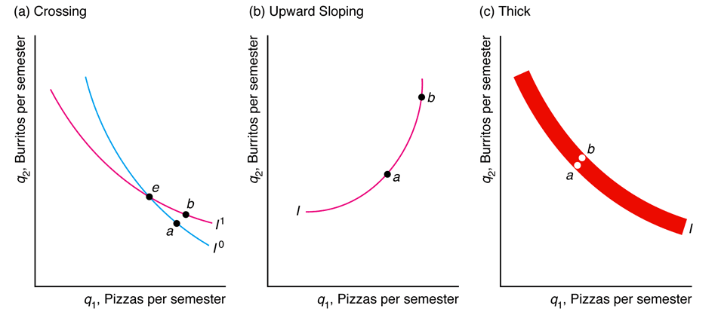
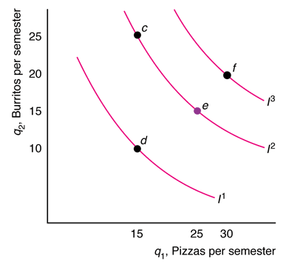
Properties of Indifference Curves
✘
1. Indifference curves farther from the origin are preferred
2. Indifference curves cannot cross
3. Indifference curves slope downward
✘
✘
4. Indifference curves cannot be thick
5. Every bundle must lies on an indifference curve

Slide 9






Utility
Set of numerical values that reflect the relative rankings of various bundles of goods!
Utility Function
Relationship between utility measures and every possible bundle of goods
Preferences
Utility
$$a≻b$$
$$U\left(a\right)>U(b)$$
$$a \sim b$$
$$U\left(a\right)=U(b)$$
$$a≿b$$
$$U\left(a\right)≥U(b)$$

Slide 10


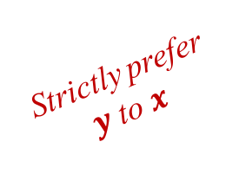

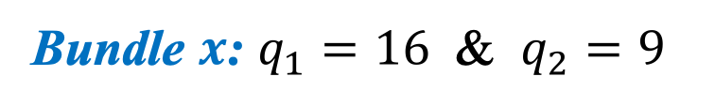
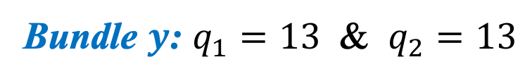





Example
Consider the following utility function:
$$U\left(q_{1},q_{2}\right)=\sqrt{q_{1}q_{2}}$$
Consider the following two bundles of goods:
Bundle $x$: $q_{1}=16$ & $q_{2}=9$
Bundle $y$: $q_{1}=13$ & $q_{2}=13$
Which bundle is preferable?
$$U\left(x\right)=U\left(16, 9\right)$$
$$=\sqrt{16×9}=12$$
$$U\left(y\right)>U\left(x\right)$$
$$⇓$$
Strictly prefer $y$ to $x$
$$U\left(y\right)=U\left(13, 13\right)$$
$$=\sqrt{13×13}=13$$
$$y≻x$$

Slide 11
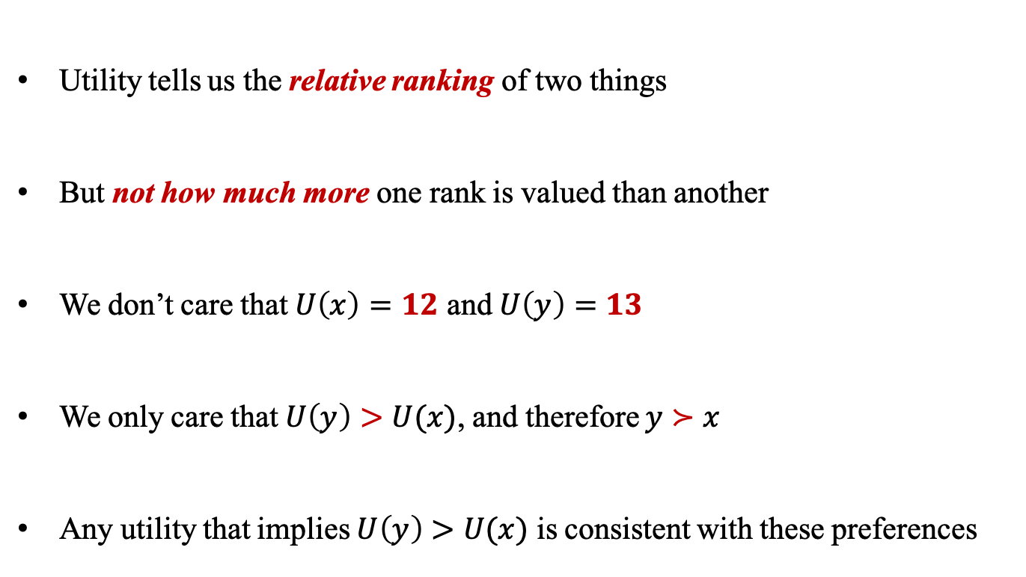


Ordinal Utility
Utility is an ordinal measure rather than a cardinal one!
Utility tells us the relative ranking of two things
But not how much more one rank is valued than another
We don’t care that $U\left(x\right)=12$ and $U\left(y\right)=13$
We only care that $U\left(y\right)>U(x)$, and therefore $y≻x$
Any utility that implies $U\left(y\right)>U(x)$ is consistent with these preferences
Do you prefer bundle $y$ than bundle $x$?
NOT: How much more do you prefer bundle $y$ than bundle $x$?

Slide 12




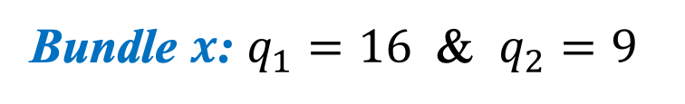




Example
Consider the following utility functions:
$$U^{1}\left(q_{1},q_{2}\right)=\sqrt{q_{1}q_{2}}$$
$$U^{2}\left(q_{1},q_{2}\right)=q_{1}^{1/3}q_{2}^{1/3}$$
Bundle $x$: $q_{1}=16$ & $q_{2}=9$
Bundle $y$: $q_{1}=13$ & $q_{2}=13$
How each utility function ranks the bundles?
$$U^{1}\left(x\right)=12$$
$$U^{2}\left(x\right)=U^{2}\left(16, 9\right)={16}^{1/3}9^{1/3}≈3.5$$
$$U^{1}\left(y\right)=13$$
$$U^{2}\left(y\right)=U^{2}\left(13, 13\right)={13}^{1/3}{13}^{1/3}≈5.5$$
Same ranking
$$U^{1}\left(y\right)>U^{1}\left(x\right)$$
$$U^{2}\left(y\right)>U^{2}\left(x\right)$$
Both utility functions represent the same preference relation!
$$y≻x$$
$$y≻x$$

Slide 13





Utility and Indifference Curves
An indifference curve consists of all bundles that correspond to the same utility level!
$$\overline{U}=U\left(q_{1},q_{2}\right)$$
Same Indifference Curve $\overline{U}$
Indifference Curve
$$c \sim e \sim a$$
$$U\left(c\right)=U\left(e\right)=U\left(a\right)=\overline{U}$$
$$\overline{U}$$

Slide 14
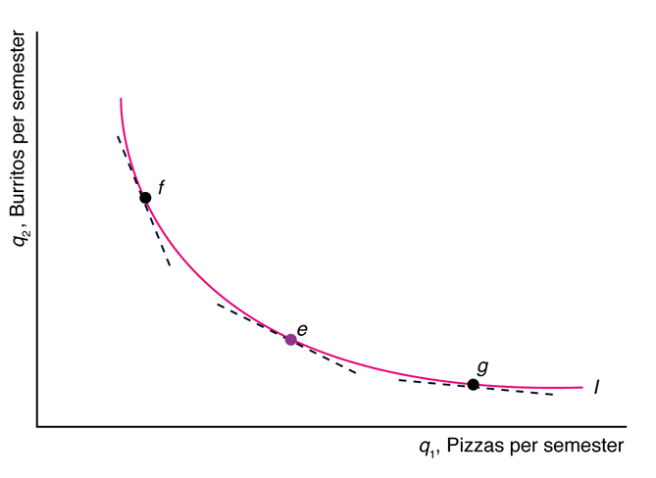
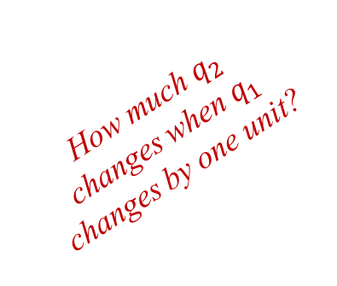
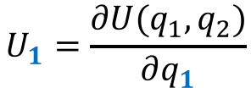
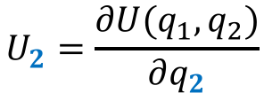
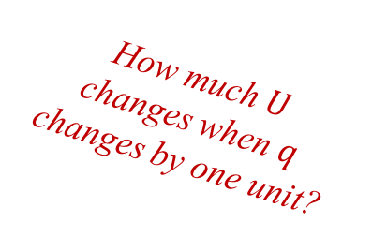
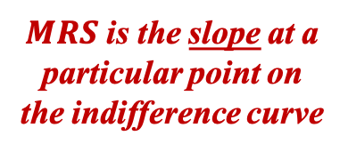



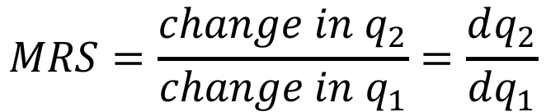

Marginal Rate of Substitution
The maximum amount of one good that a consumer will trade to obtain one more unit of another good!
How much $q_{2}$ changes when $q_{1}$ changes by one unit?
2nd Formula!
$$MRS=\frac{change in q_{2}}{change in q_{1}}=\frac{dq_{2}}{dq_{1}}$$
$$=−\frac{U_{1}}{U_{2}}$$
Marginal Utilities
How much $U$ changes when $q$ changes by one unit?
$MRS$ is the slope at a particular point on the indifference curve
$$U_{1}=\frac{∂U(q_{1},q_{2})}{∂q_{1}}$$
$${MRS}_{f}$$
$${MRS}_{e}$$
$$U_{2}=\frac{∂U(q_{1},q_{2})}{∂q_{2}}$$
$${MRS}_{g}$$

Slide 15

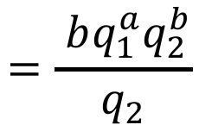
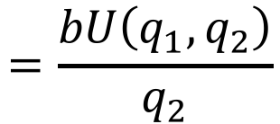

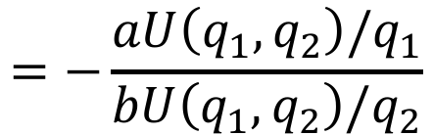


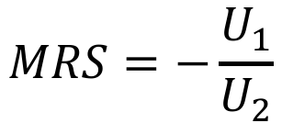
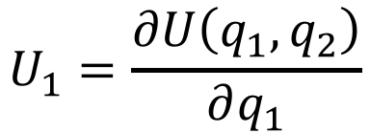
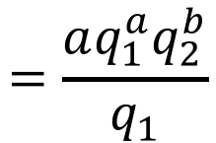
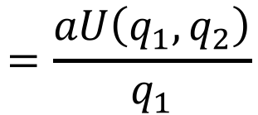


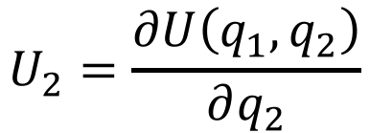
Example
Consider the following Cobb-Douglas utility function:
$$U\left(q_{1},q_{2}\right)=q_{1}^{a}q_{2}^{b}$$
What is the MRS?
$$MRS=−\frac{U_{1}}{U_{2}}$$
$$=−\frac{aU\left(q_{1},q_{2}\right)/q_{1}}{bU\left(q_{1},q_{2}\right)/q_{2}}$$
$$=−\frac{a}{b}×\frac{q_{2}}{q_{1}}$$
$$U(q_{1},q_{2})$$
$$U_{1}=\frac{∂U\left(q_{1},q_{2}\right)}{∂q_{1}}$$
$$=\frac{aq_{1}^{a}q_{2}^{b}}{q_{1}}$$
$$=\frac{aU\left(q_{1},q_{2}\right)}{q_{1}}$$
$$=aq_{1}^{a−1}q_{2}^{b}$$
$$U(q_{1},q_{2})$$
$$U_{2}=\frac{∂U\left(q_{1},q_{2}\right)}{∂q_{2}}$$
$$=\frac{ bq_{1}^{a}q_{2}^{b}}{q_{2}}$$
$$=\frac{bU\left(q_{1},q_{2}\right)}{q_{2}}$$
$$=bq_{1}^{a}q_{2}^{b−1}$$

Slide 16


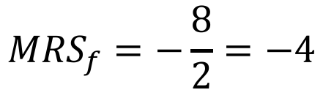
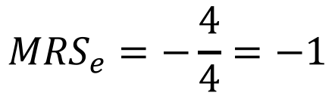
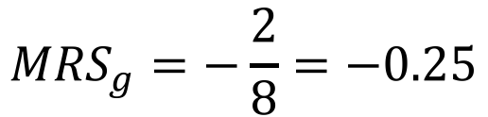
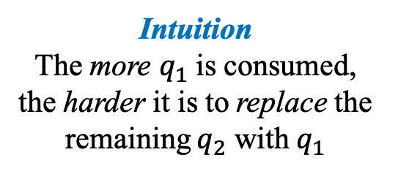

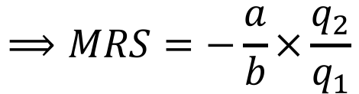

Diminishing MRS
Indifference curve of Cobb-Douglas with $a=b=0.5$:
$$⟹MRS=−\frac{a}{b}×\frac{q_{2}}{q_{1}}$$
$$=−\frac{q_{2}}{q_{1}}$$
$$\overline{U}=4=q_{1}^{0.5}q_{2}^{0.5}$$
Intuition
The more $q_{1}$ is consumed, the harder it is to replace the remaining $q_{2}$ with $q_{1}$
Previous example!
$$a=b$$
$${MRS}_{f}=−\frac{8}{2}=−4$$
8
The MRS gets closer to zero!
$${MRS}_{e}=−\frac{4}{4}=−1$$
4
2
$$\overline{U}=4$$
$${MRS}_{g}=−\frac{2}{8}=−0.25$$
2
4
8

Slide 17
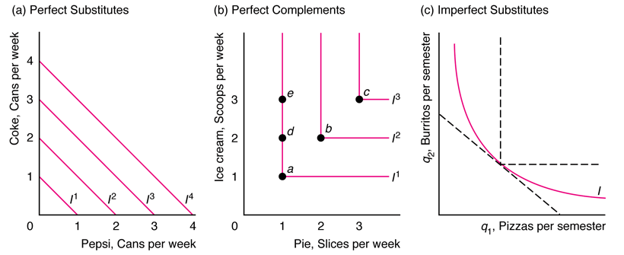
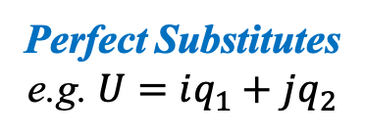
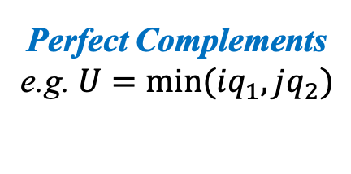
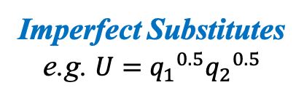
Shape of Indifference Curves
The curvature of an indifference curve shows how readily a consumer can trade one good for another!
Typical case
Perfect Substitutes
e.g. $U=iq_{1}+jq_{2}$
Perfect Complements
e.g. $U=min⁡(iq_{1},jq_{2})$
Imperfect Substitutes
e.g. $U={q_{1}}^{0.5}{q_{2}}^{0.5}$
Consumer is indifferent between goods!
Goods are consumed in fixed proportions!
Between both extremes!

Slide 18
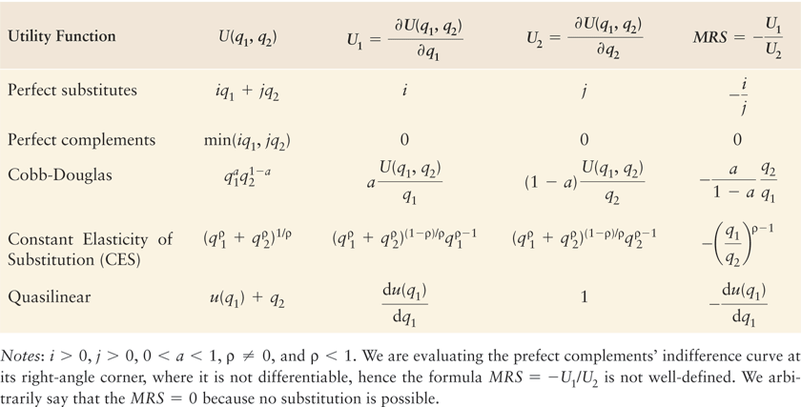
MRS for Five Utility Functions

Slide 19






Budget Constraint
Bundles of goods that can be bought if a consumer’s entire budget is spent!
Cannot spend more than the budget!
$$p_{1}q_{1}+p_{2}q_{2}=Y$$
No save and borrow!
$Y$: Income (budget)
$p_{1}q_{1}$: Amount spent on good 1
$p_{1}$: Price of good 1
$p_{2}q_{2}$: Amount spent on good 2
$p_{2}$: Price of good 2

Slide 20







Graphical Analysis
$$q_{1}=0⟹q_{2}=\frac{Y}{p_{2}}$$
$$⟹q_{2}=\frac{Y}{p_{2}}−\frac{p_{1}}{p_{2}}q_{1}$$
$$p_{1}q_{1}+p_{2}q_{2}=Y$$
$$q_{2}=0⟹q_{1}=\frac{Y}{p_{1}}$$
On the Line:
Budget constraint with equality
$$p_{1}q_{1}+p_{2}q_{2}=Y$$
Interior:
Budget constraint with inequality
$$p_{1}q_{1}+p_{2}q_{2}<Y$$

Slide 21





Marginal Rate of Transformation
Trade-off imposed by the market on how the consumer is able to trade one good for the other!
Slope of the budget constraint!
$$MRT=\frac{dq_{2}}{dq_{1}}$$
$$=\frac{d\left[Y/p_{2}−(p_{1}/p_{2})q_{1}\right]}{dq_{1}}$$
$$=−\frac{p_{1}}{p_{2}}$$
Recall the budget constraint:
$$q_{2}=\frac{Y}{p_{2}}−\frac{p_{1}}{p_{2}}q_{1}$$
Notice:
$MRS$: Trade-off the consumer wants to do
$MRT$: trade-off the consumer is able to do

Slide 22

Constrained Consumer Choice
Combining the indifference curve and budget constraint, a consumer finds the optimal bundle of goods that is affordable!
Interior Solution:
An optimal bundle that has positive quantities of all goods
Corner Solution:
An optimal bundle where one of the goods is not consumed
Indifference curves do not hit the axes!
Indifference curves hit the axes!

Slide 23


Graphical Analysis of Interior Solution
What is the optimal bundle?
Bundles $f$ and $g$ are not affordable (out of the budget constraint)
Bundles $a$, $c$, $d$, $e$ are affordable (in the budget constraint)
$I^{2}$ is farther from the origin than $I^{1}$, so bundles in $I^{2}$ are preferable
Therefore, $e$ is the optimal bundle!
Optimal Bundle!

Slide 24






Interior Solution Rules
1. Highest Indifference Curve: Pick the bundle where the highest indifference curve touches the budget line.
or
2. Tangency: Pick the bundle where the indifference curve is tangent to the budget line.
or
3. Same Slope: Pick the bundle where the $MRS=MRT$.
$$slope IC=slope BL$$
$$MRS=MRT$$
$$\frac{U_{1}}{p_{1}}=\frac{U_{2}}{p_{2}}$$
$$−\frac{U_{1}}{U_{2}}=−\frac{p_{1}}{p_{2}}$$

Slide 25





Interior Solution Using Calculus
Consumers maximize their utility subject to their budget constraint!
Lagrangian Multiplier
Step 1: Write the Lagrangian
$$ℒ=U(q_{1},q_{2})+λ(Y−p_{1}q_{1}−p_{2}q_{2})$$
Utility Function
Budget Constraint
Step 2: Maximization Problem
$$\max_{q_{1},q_{2},λ}{ℒ}=U(q_{1},q_{2})+λ(Y−p_{1}q_{1}−p_{2}q_{2})$$
Step 3: First-Order Conditions
$$\frac{∂ℒ}{∂q_{1}}=0$$
$$\frac{∂ℒ}{∂q_{2}}=0$$
$$\frac{∂ℒ}{∂λ}=0$$

Slide 26













Solution of Utility Maximization
Calculating the First-Order Conditions:
$$ℒ=U(q_{1},q_{2})+λ(Y−p_{1}q_{1}−p_{2}q_{2})$$
Same Slope Rule!
$$\frac{∂ℒ}{∂q_{1}}=0$$
$$⟹\frac{∂U(q_{1},q_{2})}{∂q_{1}}−λp_{1}=0$$
$$⟹λ=\frac{U_{1}}{p_{1}}$$
$$\frac{U_{1}}{p_{1}}=\frac{U_{2}}{p_{2}}$$
$$U_{1}$$
$$\frac{∂ℒ}{∂q_{2}}=0$$
$$⟹\frac{∂U(q_{1},q_{2})}{∂q_{2}}−λp_{2}=0$$
$$⟹λ=\frac{U_{2}}{p_{2}}$$
$$U_{2}$$
Budget Constraint!
$$\frac{∂ℒ}{∂λ}=0$$
$$⟹Y−p_{1}q_{1}−p_{2}q_{2}=0$$
$$⟹Y=p_{1}q_{1}+p_{2}q_{2}$$

Slide 27



















Example
Consider the following Cobb-Douglas utility function:
$$U\left(q_{1},q_{2}\right)=q_{1}^{a}q_{2}^{b}$$
What is the optimal bundle of goods?
$$Y=p_{1}q_{1}+p_{2}q_{2}$$
$$=p_{1}\frac{ap_{2}}{bp_{1}}q_{2}+p_{2}q_{2}$$
$$=\frac{a+b}{b}p_{2}q_{2}$$
$$⟹q_{2}=\left(\frac{b}{a+b}\right)\frac{Y}{p_{2}}$$
$$\frac{U_{1}}{p_{1}}=\frac{U_{2}}{p_{2}}$$
$$⟹\frac{aU\left(q_{1},q_{2}\right)/q_{1}}{p_{1}}=\frac{bU\left(q_{1},q_{2}\right)/q_{2}}{p_{2}}$$
$$⟹\frac{a }{p_{1}q_{1}}=\frac{b }{p_{2}q_{2}}$$
$$⟹q_{1}=\frac{ap_{2}}{bp_{1}}q_{2}$$
$$U(q_{1},q_{2})$$
$$U_{1}=\frac{∂U\left(q_{1},q_{2}\right)}{∂q_{1}}$$
$$=\frac{aq_{1}^{a}q_{2}^{b}}{q_{1}}$$
$$=\frac{aU\left(q_{1},q_{2}\right)}{q_{1}}$$
$$=aq_{1}^{a−1}q_{2}^{b}$$
$$q_{1}=\left(\frac{a}{a+b}\right)\frac{Y}{p_{1}}$$
$$U(q_{1},q_{2})$$
$$U_{2}=\frac{∂U\left(q_{1},q_{2}\right)}{∂q_{2}}$$
$$=\frac{bq_{1}^{a}q_{2}^{b}}{q_{2}}$$
$$=\frac{bU\left(q_{1},q_{2}\right)}{q_{2}}$$
$$=bq_{1}^{a}q_{2}^{b−1}$$

Slide 28













Application
Consider the following specification:
Cobb-Douglas
$$U\left(q_{1},q_{2}\right)=q_{1}^{a}q_{2}^{b}$$
$$a=0.4$$
$$b=0.6$$
What is the share of income devoted to each good?
$$s_{1}=\frac{p_{1}q_{1}}{Y}$$
$$=\frac{p_{1}}{Y}\left(\frac{a}{a+b}\right)\frac{Y}{p_{1}}$$
$$=\frac{a}{a+b}$$
$$=\frac{0.4}{0.4+0.6}=0.4$$
$$s_{2}=\frac{p_{2}q_{2}}{Y}$$
$$=\frac{p_{2}}{Y}\left(\frac{b}{a+b}\right)\frac{Y}{p_{2}}$$
$$=\frac{b}{a+b}$$
$$=\frac{0.6}{0.4+0.6}=0.6$$
From the previous example:
$$q_{1}=\left(\frac{a}{a+b}\right)\frac{Y}{p_{1}}$$
$$q_{2}=\left(\frac{b}{a+b}\right)\frac{Y}{p_{2}}$$

Slide 29













Graphical Analysis of Corner Solution
Perfect Substitutes Utility Function
Slope of indifference curves
$$U\left(q_{1},q_{2}\right)=q_{1}+q_{2}$$
$$p_{1}<p_{2}$$
$$MRS=−\frac{U_{1}}{U_{2}}$$
$$=−\frac{1}{1}=−1$$
Lesson:
If $MRS≠MRT$, then the optimal bundle is a corner solution
Slope of budget line
$$q_{1}>0$$
$$q_{2}=0$$
$$MRT=−\frac{p_{1}}{p_{2}}$$
$$>−1=MRS$$
Optimal Bundle!
1. Cannot apply the Same Slope Rule!
$$MRS≠MRT$$
2. Budget line is flatter than indifference curve
$$MRS<MRT<0$$

Slide 30







Expenditure Minimization
An equivalent problem to maximize utility is to minimize expenditure for a given level of utility!
Bundle $a$ is not acceptable (out of the indifference curve)
Bundles $b$, $c$, $d$, $e$ are acceptable (in the indifference curve)
$E_{2}$ is closer to the origin than$E_{3}$, so bundles in $E_{2}$ are cheaper
Therefore, $b$ is the optimal bundle!
Optimal Bundle!
c
a
b
d
$$(\overline{U})$$

Slide 31



Using Calculus to Minimize Expenditure
Consumers minimize their expenditure subject to a utility level!
Lagrangian Multiplier
Step 1: Write the Lagrangian
$$ℒ=p_{1}q_{1}+p_{2}q_{2}+λ(\overline{U}−U(q_{1},q_{2}))$$
Total Expenditure
Utility Constraint
Step 2: Minimization Problem
$$\min_{q_{1},q_{2},λ}{ℒ}=p_{1}q_{1}+p_{2}q_{2}+λ(\overline{U}−U(q_{1},q_{2}))$$
Step 3: First-Order Conditions
$$\frac{∂ℒ}{∂q_{1}}=0$$
$$\frac{∂ℒ}{∂q_{2}}=0$$
$$\frac{∂ℒ}{∂λ}=0$$

Slide 32







Solution of Expenditure Minimization
Calculating the First-Order Conditions:
$$ℒ=p_{1}q_{1}+p_{2}q_{2}+λ(\overline{U}−U(q_{1},q_{2}))$$
Same Slope Rule!
$$\frac{∂ℒ}{∂q_{1}}=0$$
$$⟹p_{1}−λ\frac{∂U(q_{1},q_{2})}{∂q_{1}}=0$$
$$⟹λ=\frac{p_{1}}{U_{1}}$$
$$\frac{U_{1}}{p_{1}}=\frac{U_{2}}{p_{2}}$$
$$U_{1}$$
$$\frac{∂ℒ}{∂q_{2}}=0$$
$$⟹p_{2}−λ\frac{∂U(q_{1},q_{2})}{∂q_{2}}=0$$
$$⟹λ=\frac{p_{2}}{U_{2}}$$
Same result of utility maximization
$$U_{2}$$
Indifference Curve!
$$\frac{∂ℒ}{∂λ}=0$$
$$⟹\overline{U}−U(q_{1},q_{2})=0$$
$$⟹\overline{U}=U(q_{1},q_{2})$$

Slide 33








Dual Problems
Utility Maximization
Expenditure Minimization
$$ℒ=U(q_{1},q_{2})+λ(Y−p_{1}q_{1}−p_{2}q_{2})$$
$$ℒ=p_{1}q_{1}+p_{2}q_{2}+λ(\overline{U}−U(q_{1},q_{2}))$$
Utility Function
Budget Constraint
Total Expenditure
Utility Constraint
$$\max_{q_{1},q_{2},λ}{ℒ}=U(q_{1},q_{2})+λ(Y−p_{1}q_{1}−p_{2}q_{2})$$
$$\min_{q_{1},q_{2},λ}{ℒ}=p_{1}q_{1}+p_{2}q_{2}+λ(\overline{U}−U(q_{1},q_{2}))$$
$$\frac{U_{1}}{p_{1}}=\frac{U_{2}}{p_{2}}$$
Same result!
$$\frac{U_{1}}{p_{1}}=\frac{U_{2}}{p_{2}}$$
Budget Constraint!
Indifference Curve!
$$Y=p_{1}q_{1}+p_{2}q_{2}$$
$$\overline{U}=U(q_{1},q_{2})$$

Slide 34
THE END

