Slide 1

BUEC 311
Business Economics, Organizations and Management
Winter 2019
Firms and Production
Diego B. P. Gomes

Slide 2
Motivation
What is the purpose of a firm?
Make money?
Produce goods and services?
Do we really need a firm to achieve these goals?

Slide 3










Suppose you want to make money by doing landscaping services…
1. Wake up every day
10. Put the rest of the money in the pocket
2. Rent a U-Haul truck
9. Pay for the rented equipment
3. Rent lawn mowers, trimmers, rakes, etc
8. Pay the workers
4. Start yelling: Who wants to cut lawns today?
7. Collect the money
5. Negotiate the compensation with workers
6. Ring doorbells to get customers

Slide 4
What are the characteristics of this workflow?
! No firm
✔ Money in the pocket
✔ Service provided
☠️ Too many transactions everyday
☠️ Too many risks everyday

Slide 5
What could be done?
Purchase vehicles
Purchase equipment
Hire permanent employees
Contracting with customers
Set rules and schedules
✘
Organize production!

Slide 6

Returning to the Motivational Question
What is the purpose of a firm?
Make money?
Produce goods and services?
Remember: Firms are also called Organizations
Organize the production process!
. Reduce transaction costs
. Reduce risks
. Increase efficiency

Slide 7


Definition of a Firm
A firm is an organization that converts inputs into outputs!
The Firm
Inputs
Outputs
Labor
Capital
Materials
Goods
Services
Production
Process

Slide 8


Examples
Goods
production
Inputs
Steel Plant
Outputs
Workers
Machinery
Iron ore
Steel structures
Steel pieces
Services
production
Inputs
Restaurant
Outputs
Cooker
Stove
Raw food
Lunch service
Dinner service

Slide 9
Types of Firms
Share of U.S. Gross
Domestic Product (GDP)
Private for-profit
(e.g. Google, Apple, Walmart, Starbucks, etc.)
The focus of this course from now on!
Private nonprofit
(e.g. Greenpeace, Red Cross, Salvation Army, etc.)
Public
(e.g. court system, armed forces, public schools, etc.)
Source: 2012 U.S Statistical Abstract

Slide 10
Ownership of For-Profit Firms
Legal structure determines who is liable for the firm’s debts!
Legal Structure | Owned by | Owners Liable?
Sole Proprietorships | One individual | Yes
General Partnerships | Two or more people | Yes
Corporations Incorporated (Inc.) Limited (Ltd) | Shareholders in proportion to # of shares | No Owners have limited liability

Slide 11
More on Limited Liability
1. What does limited liability mean?
Personal assets of owners cannot be used to pay firm’s debt!
Even if the firm goes into bankruptcy
2. How much money shareholders can lose?
The amount they pay for their stocks.
Which typically becomes worthless in case of bankruptcy
3. What is the purpose of limiting liability?
To allow firms to raise funds and grow beyond what was possible by only using owners personal assets.

Slide 12
Does limiting liability really allow corporations to grow larger?
Share of Firms by Legal Structure in the U.S. (2012)
Share of Sales Revenues
Share of Net Income
Although there are fewer corporations, they account for the largest share of the economy!

Slide 13
Management of Firms
Size of Firm | Who Manages? | Decision Makers
Small Sole Proprietorships Small Partnerships | The owner(s) | Only the owner(s)
Large Corporations Large Partnerships | Owners hire a management team | Owners, managers, and supervisors

Slide 14





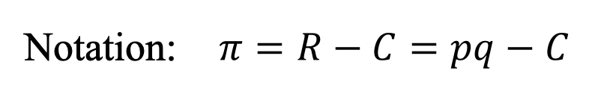
What owners want?
Owners want to maximize the firm’s profits!
$$(π)$$
$$(R)$$
$$(C)$$
Profit = Revenues - Costs
Earnings from selling goods and services
Expenses to produce goods and services
$$(p)$$
$$(q)$$
Revenues = Price X Quantity
In the case of a single good or service
Notation: $π=R−C=pq−C$

Slide 15
What must be done to maximize profits?
A firm’s production must be as efficient as possible!
Efficient Production
No efficient production
Given the current level of
knowledge and technology, …
Definition 1
… cannot produce the same level of output with fewer inputs.
Necessary condition
Definition 2
… cannot produce more output with the same level of inputs.
No profit maximization

Slide 16
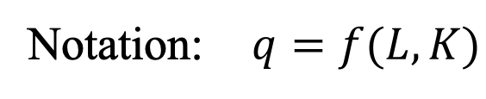



How do we represent efficient production?
We use the concept of a production function!
Production Function
Notation: $q=f(L,K)$
$$(q)$$
$$(L)$$
$$(K)$$
(
)
Maximum quantity of output that can be produced
f
Units of labor
(e.g. hours of work provided by workers)
Maximum quantity of output that can be produced
Units of labor
(e.g. hours of work provided by workers)
Units of capital
(e.g. land, buildings, equipment, vehicles, etc.)
=
Units of capital
(e.g. land, buildings, equipment, vehicles, etc.)
,
Output
2 Inputs
The maximum quantity implies efficient production!

Slide 17
Time and Variability of Inputs
A firm can more easily adjust its inputs in the long run than in the short run!
Time Horizon | Definition | Fixed Inputs? | Variable Inputs?
Short Run Not enough time to adjust some inputs | At least one input cannot be varied | Yes | Yes
Long Run Long enough period that all inputs can be varied | All inputs can be adjusted | No | Yes

Slide 18
What is the time span of a short and long run?
It depends on the inputs a firm uses!
Labor | Unskilled workers | Days (short run) | Variable input 2-week planning
 | Skilled workers | Months (long run) | Fixed input 2-week planning
Capital | Rent a truck | Days (short run) | Variable input 6-month planning
 | Personal computers | Days (short run) | Variable input 6-month planning
 | Buildings/Plants | Years (long run) | Fixed input 6-month planning

Slide 19

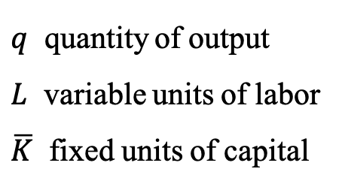
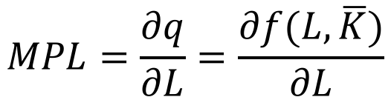
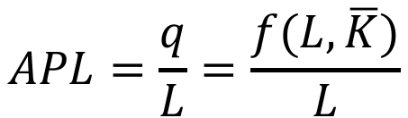
Short-Run Production
At least one input cannot be varied!
Assumptions
1. Labor is a variable input
2. Capital is a fixed input
Marginal Product of Labor
Change in output resulting from using an extra unit of labor, holding capital constant.
$$MPL=\frac{∂q}{∂L}=\frac{∂f(L,\overline{K})}{∂L}$$
Production Function
Average Product of Labor
Output can increase only by increasing the amount of labor
$$q=f(L,\overline{K})$$
Ratio of output to the total units of labor used to produce the output.
$q$ quantity of output
$L$ variable units of labor
$\overline{K}$ fixed units of capital
$$APL=\frac{q}{L}=\frac{f(L,\overline{K})}{L}$$

Slide 20


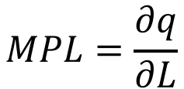
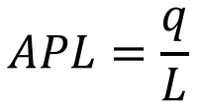
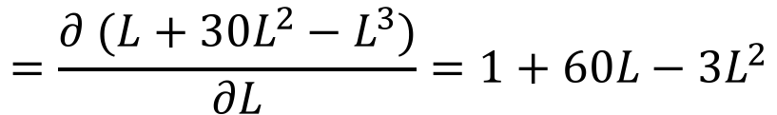
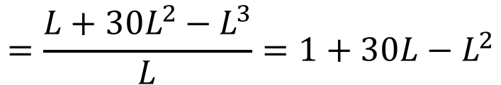

Example
A computer assembly firm’s production function:
$$q=f\left(L,\overline{K}\right)=0.1L\overline{K}+3L^{2}\overline{K}−0.1L^{3}\overline{K}$$
Production Function ($\overline{K}=10$)?
$$q=f(L,10)$$
$$=L+30L^{2}−L^{3}$$
Marginal Product of Labor?
$$MPL=\frac{∂q}{∂L}$$
$$=\frac{∂ (L+30L^{2}−L^{3})}{∂L}=1+60L−3L^{2}$$
Average Product of Labor?
$$APL=\frac{q}{L}$$
$$=\frac{L+30L^{2}−L^{3}}{L}=1+30L−L^{2}$$

Slide 21
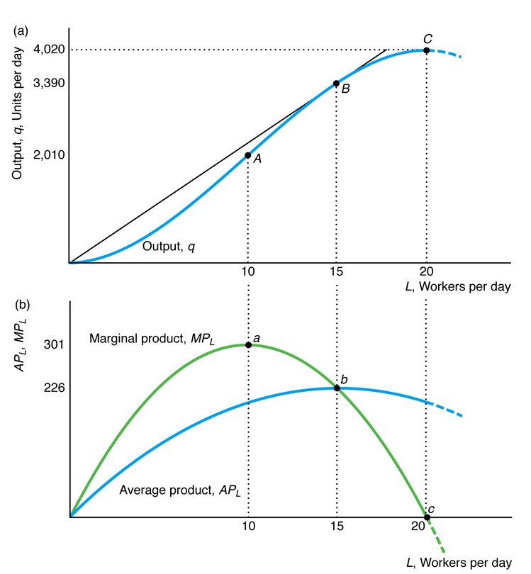

Graphical Analysis
Maximum output
Output starts to decrease as input increases!
Inefficient production zone!
$$MPL=0$$
From calculus:
The maximum of a function is where its derivative equals zero!

Slide 22
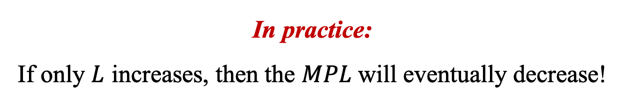

Law of Diminishing Marginal Returns
If a firm keeps increasing an input, holding all other inputs and technology constant, the corresponding increases in output will eventually becomes smaller.
(Empirical regularity more than a law)
In practice:
If only $L$ increases, then the $MPL$ will eventually decrease!
When the MPL decreases?
For values of $L$ where $\frac{∂MPL}{∂L}<0$!

Slide 23
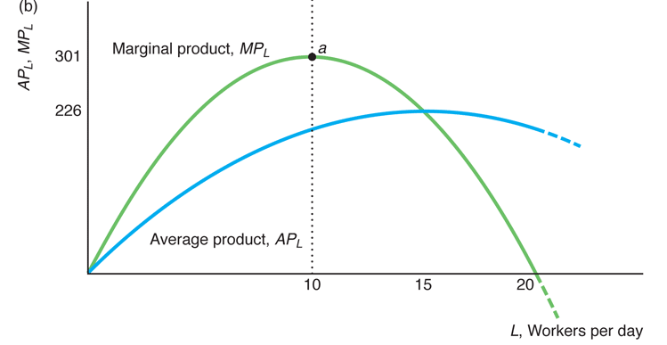

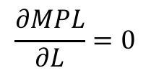




Graphical Analysis
From calculus:
The maximum of a function is where its derivative equals zero!
Maximum $MPL$
$$\frac{∂MPL}{∂L}=0$$
Diminishing Marginal
Returns Zone
$$\frac{∂MPL}{∂L}>0$$
$$\frac{∂MPL}{∂L}<0$$
Each additional worker increases the $MPL$
Each additional worker reduces the $MPL$

Slide 24

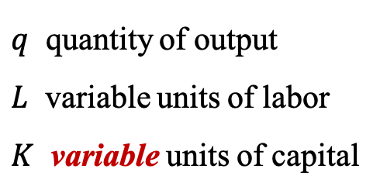




Long-Run Production
All inputs are variable!
Assumptions
1. Labor is a variable input
2. Capital is a variable input
The firm can produce in various ways:
e.g. a lumberyard can produce 200 planks/hour with…
Production Function
Labor | Capital
10 workers | handsaws
4 workers | handheld power saws
2 workers | bench power saws
The firm can substitute one input for another!
$$+L$$
$$−K$$
$$q=f(L,K)$$
$q$ quantity of output
$L$ variable units of labor
$K$ variable units of capital
$$−L$$
$$+K$$

Slide 25
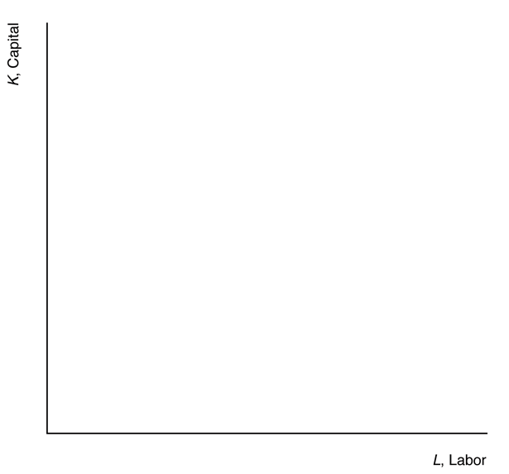
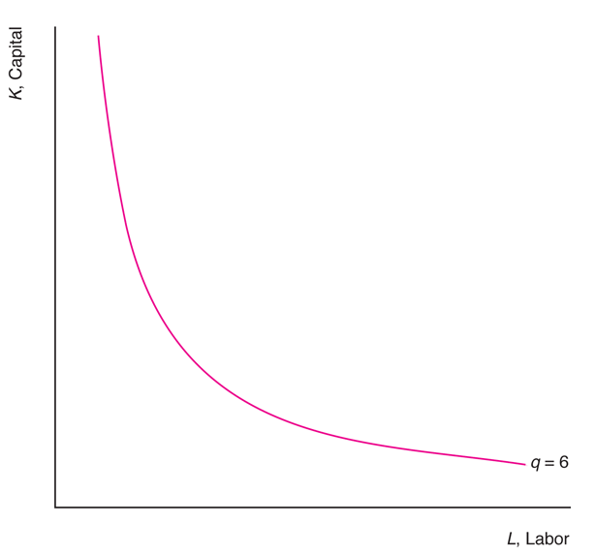
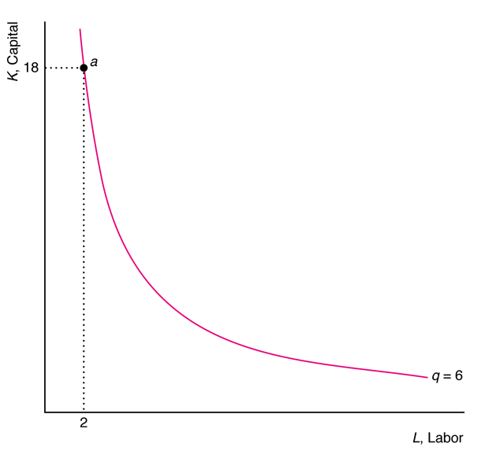
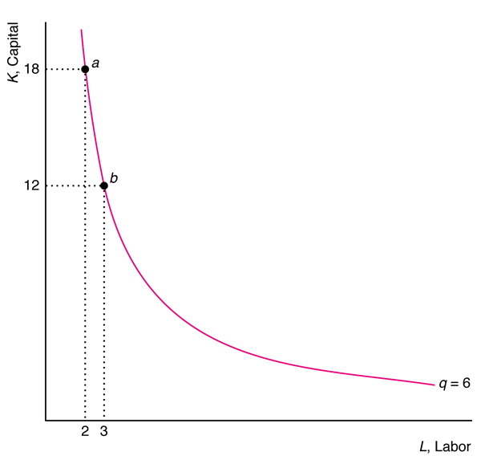
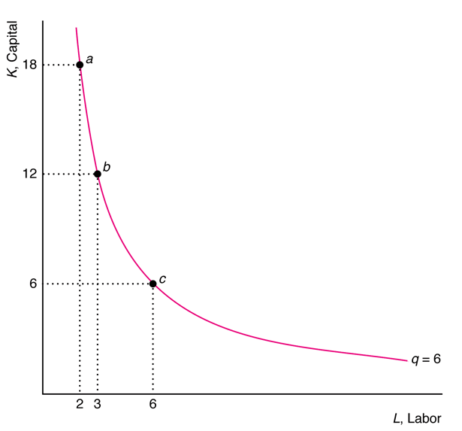
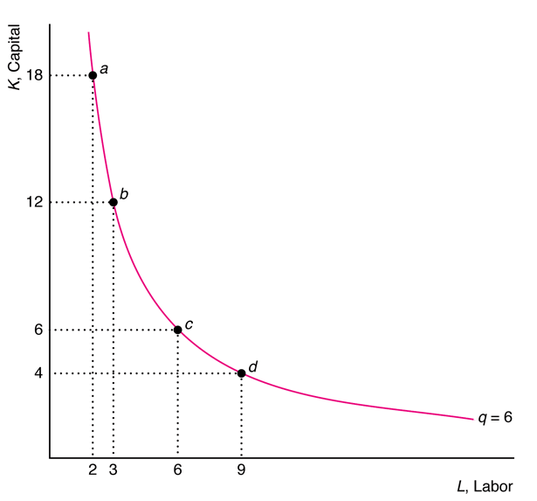
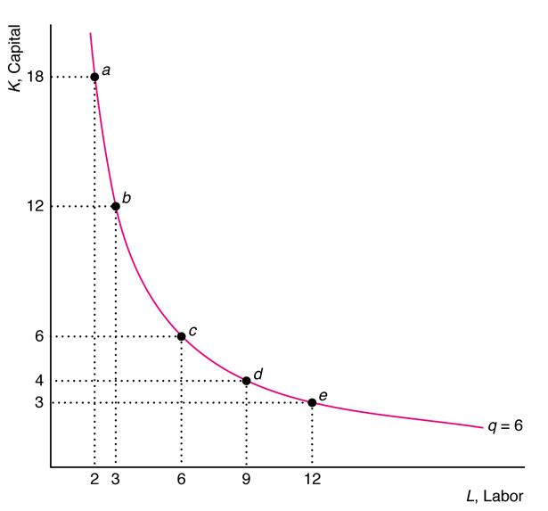
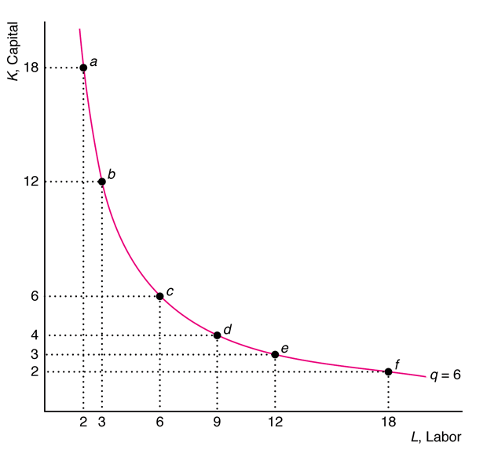
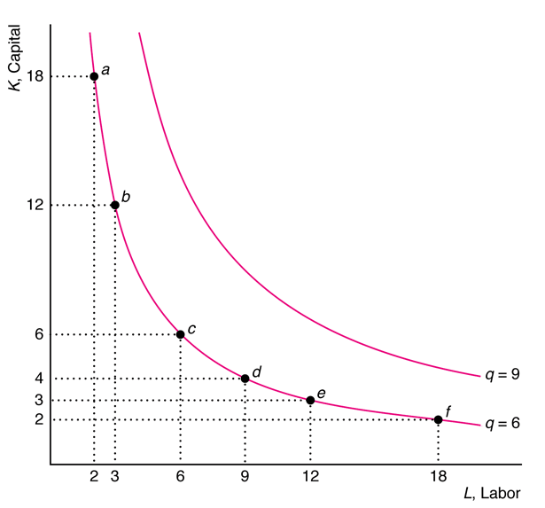
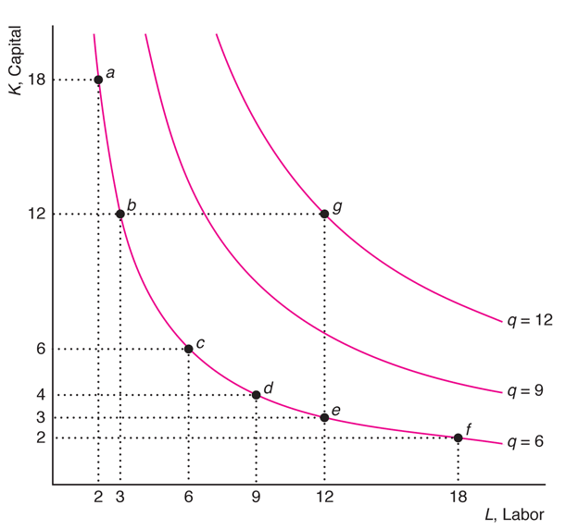




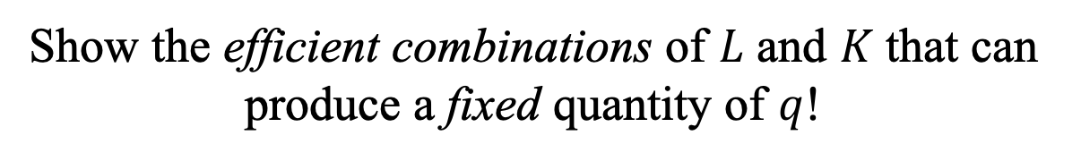

Isoquants
Show the efficient combinations of $L$ and $K$ that can produce a fixed quantity of $q$!
Output is fixed (notice the bar)
Example: Cobb-Douglas production function
$$\overline{q}=f(L,K)$$
$$=L^{0.5}K^{0.5}$$
$$L^{0.5}K^{0.5}=12$$
$$L^{0.5}K^{0.5}=9$$
$$L^{0.5}K^{0.5}=6$$

Slide 26
Properties of Isoquants (1)
The farther an isoquant is from the origin, the greater the level of output!
The more inputs a firm uses, the more output it gets!
(if it produces efficiently)
origin

Slide 27


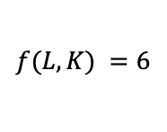
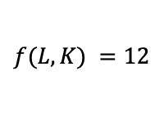
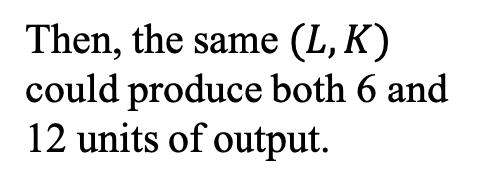
Properties of Isoquants (2)
Isoquants do not cross!
Suppose they could cross…
$$K$$
Then, the same $(L,K)$ could produce both 6 and 12 units of output.
But this violates efficiency!
$$f(L,K) =12$$
$$f(L,K) =6$$
$$L$$

Slide 28
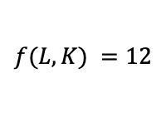
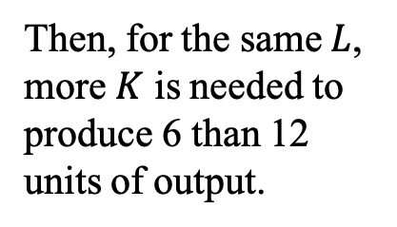
Properties of Isoquants (3)
All isoquants slope downwards!
Suppose one of them slope upwards…
$$K$$
$$f(L,K) =12$$
Again the crossing issue.
But this violates efficiency!
Then, for the same $L$, more $K$ is needed to produce 6 than 12 units of output.
$$f(L,K) =6$$
$$L$$

Slide 29
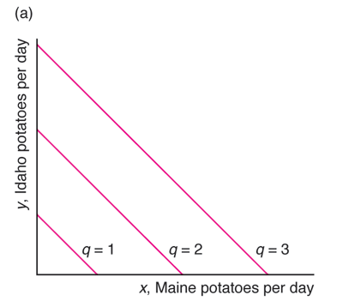
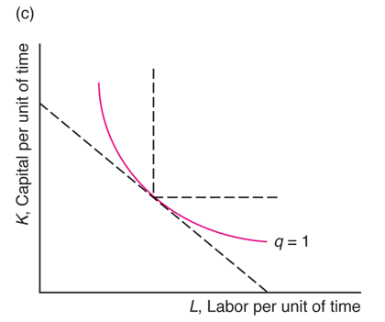
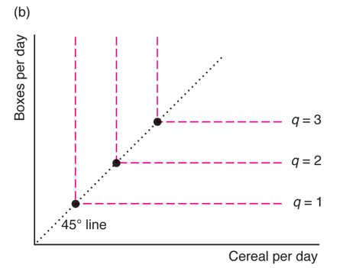
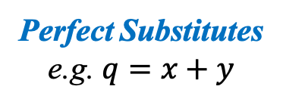
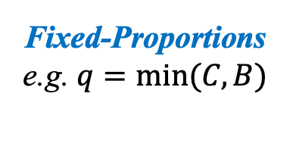
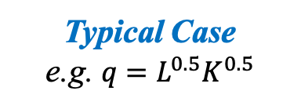
Shape of Isoquants
The curvature of an isoquant shows how readily a firm can substitute one input for another!
Perfect Substitutes
e.g. $q=x+y$
Fixed-Proportions
e.g. $q=min⁡(C,B)$
Typical Case
e.g. $q=L^{0.5}K^{0.5}$
Isoquant is a straight line!
Inputs cannot be substituted!
Between both extremes!
The dots are the only efficient bundles!

Slide 30
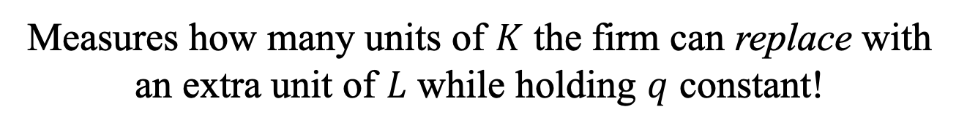
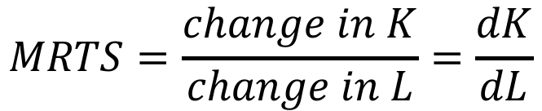



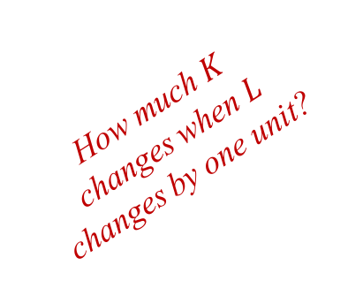
Marginal Rate of Technical Substitution
Measures how many units of $K$ the firm can replace with an extra unit of $L$ while holding $q$ constant!
How much $K$ changes when $L$ changes by one unit?
2nd Formula!
$$MRTS=\frac{change in K}{change in L}=\frac{dK}{dL}$$
$$=−\frac{MPL}{MPK}$$
Marginal Product of Labor
$$MPL=\frac{∂q}{∂L}=\frac{∂f(L,K)}{∂L}$$
Marginal Product of Capital
$$MPK=\frac{∂q}{∂K}=\frac{∂f(L,K)}{∂K}$$

Slide 31

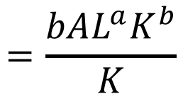
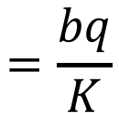
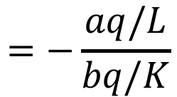
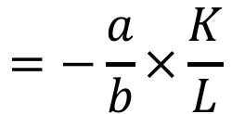
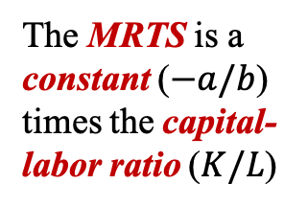

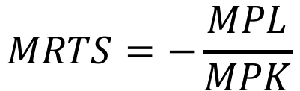
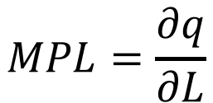
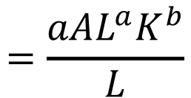




Example
Consider the general Cobb-Douglas production function:
$$q=AL^{a}K^{b}$$
What is the MRTS?
The MRTS is a constant ($−a/b$) times the capital-labor ratio ($K/L$)
$$MRTS=−\frac{MPL}{MPK}$$
$$=−\frac{aq/L}{bq/K}$$
$$=−\frac{a}{b}×\frac{K}{L}$$
$$=q$$
$$MPL=\frac{∂q}{∂L}$$
$$=\frac{aAL^{a}K^{b}}{L}$$
$$=\frac{aq}{L}$$
$$=aAL^{a−1}K^{b}$$
$$=q$$
$$MPK=\frac{∂q}{∂K}$$
$$=\frac{bAL^{a}K^{b}}{K}$$
$$=\frac{bq}{K}$$
$$=bAL^{a}K^{b−1}$$

Slide 32










Diminishing MRTS
Isoquant of Cobb-Douglas with $A=1$ and $a=b=0.5$:
$$⟹MRTS=−\frac{a}{b}×\frac{K}{L}$$
$$=−\frac{K}{L}$$
$$\overline{q}=6=L^{0.5}K^{0.5}$$
Previous example!
$$a=b$$
The MRTS gets closer to zero!
Intuition
The more $L$ the firm has, the harder it is to replace the remaining $K$ with labor

Slide 33






Elasticity of Substitution
Measures the ease with which a firm can substitute $K$ for $L$!
How much $K/L$ changes when MRTS changes?
Greek letter sigma!
$$=\frac{ \frac{d(K/L)}{K/L} }{\frac{dMRTS}{MRTS}}$$
$$σ=\frac{\% change in K/L}{\% change in MRTS}$$
$$=\frac{d(K/L)}{dMRTS}×\frac{MRTS}{K/L}$$
Industries less dependent on $K$
Interpretation
A higher $σ$ means it is easier to substitute $K$ for $L$!
Source: Chirinko and Mallick (2014)

Slide 34













Example
Consider the following production function:
$$q={(L^{ρ}+K^{ρ})}^{\frac{1}{ρ}}$$
Greek letter rho!
What about this term?
What is the Elasticity of Substitution?
$$σ=\frac{d(K/L)}{dMRTS}×\frac{MRTS}{K/L}$$
We just found this term!
$$=−\frac{{(L^{ρ}+K^{ρ})}^{\frac{1}{ρ} −1}L^{ρ−1}}{{(L^{ρ}+K^{ρ})}^{\frac{1}{ρ} −1}K^{ρ−1}}$$
$$MRTS=−\frac{MPL}{MPK}$$
$$=−\frac{L^{ρ−1}}{K^{ρ−1}}$$
$$=−{\left(\frac{L}{K}\right)}^{ρ−1}$$
$$=−{\left(\frac{K}{L}\right)}^{1−ρ}$$
$$MPL=\frac{∂q}{∂L}$$
$$={\frac{1}{ρ}(L^{ρ}+K^{ρ})}^{\frac{1}{ρ} −1}{ρL}^{ρ−1}$$
$$={(L^{ρ}+K^{ρ})}^{\frac{1}{ρ} −1}L^{ρ−1}$$
$$MPK=\frac{∂q}{∂K}$$
$$={\frac{1}{ρ}(L^{ρ}+K^{ρ})}^{\frac{1}{ρ} −1}{ρK}^{ρ−1}$$
$$={(L^{ρ}+K^{ρ})}^{\frac{1}{ρ} −1}K^{ρ−1}$$

Slide 35








Example (cont.)
Notice that we can express $K/L$ as a function of the $MRTS$:
$$⟺\frac{d(K/L)}{dMRTS}=\frac{{−(−MRTS)}^{\frac{ρ}{1−ρ}}}{1−ρ}$$
$$MRTS=−{\left(\frac{K}{L}\right)}^{1−ρ}$$
$$⟺ \frac{K}{L}={(−MRTS)}^{\frac{1}{1−ρ}}$$
Substituting the $MRTS$ expression…
$$\frac{d(K/L)}{dMRTS}=\frac{−{\left[{\left(K/L\right)}^{1−ρ}\right]}^{\frac{ρ}{1−ρ}}}{1−ρ}$$
$$=\frac{−{\left(K/L\right)}^{ρ}}{1−ρ}$$
Constant term!
$$σ=\frac{d(K/L)}{dMRTS}×\frac{MRTS}{K/L}=\frac{−{\left(K/L\right)}^{ρ}}{1−ρ}×\frac{−{\left(K/L\right)}^{1−ρ}}{K/L}$$
$$=\frac{1}{1−ρ}$$
$q={(L^{ρ}+K^{ρ})}^{\frac{1}{ρ}}$ is the Constant Elasticity of Substitution Production Function!

Slide 36

Returns to Scale
Measures how much output changes when all inputs change proportionately!
 | e.g. Doubling all inputs…
Constant Returns to Scale | $$f\left(2L,2K\right)=2f\left(L,K\right)$$ …exactly doubles the output!
Increasing Returns to Scale | $$f\left(2L,2K\right)>2f\left(L,K\right)$$ …more than doubles the output!
Decreasing Returns to Scale | $$f\left(2L,2K\right)<2f\left(L,K\right)$$ …less than doubles the output!

Slide 37















Example
Consider the Cobb-Douglas production function:
$$q=AL^{a}K^{b}$$
What happens when all inputs double?
$$Q=A{(2L)}^{a}{(2K)}^{b}$$
$$=2^{a+b}AL^{a}K^{b}$$
$$=2^{a+b}q$$
$$=2^{γ }q$$
Define:
$$γ=a+b$$
Greek letter gamma!
How to find the returns to scale?
$$=q$$
$$γ<1$$
$$⟹Q=2^{γ }q<2q$$
Decreasing Returns
If all inputs double, output increases by $2^{γ }$
$$γ=1$$
$$⟹Q=2^{γ }q=2q$$
Constant Returns
$γ$ is a measure of returns to scale!
(scale elasticity)
$$γ>1$$
$$⟹Q=2^{γ }q>2q$$
Increasing Returns

Slide 38



Application
Estimates of Cobb-Douglas production functions and returns to scale in various industries
Returns to scale measure!
$$γ<1$$
$$γ=1$$
$$γ>1$$

Slide 39



Application (cont.)
Japanese beer firm: $γ=1.0$
(constant returns to scale)
500
400
, Units of capital per year
300
K
200
Doubles $K$
q
= 200
Doubles production!
1
0
0
q
=
100
0
1
00
200
300
400
500
Doubles $L$
L
, Units of labor per year

Slide 40



Application (cont.)
U.S. tobacco firm: $γ=0.51$
(decreasing returns to scale)
500
400
q
= 200
, Units of capital per year
300
K
200
q
=
1
4
2
Doubles $K$
Less than Doubles!
1
0
0
q
=
1
0
0
0
1
00
200
300
400
500
Doubles $L$
L
, Units of labor per year

Slide 41

Application (cont.)
Bangladesh metal firm: $γ=1.26$
(increasing returns to scale)
500
400
, Units of capital per year
300
K
200
Doubles $K$
q
= 239
More than Doubles!
1
0
0
q
= 200
q
=
1
0
0
0
1
00
200
300
400
500
Doubles $L$
L
, Units of labor per year

Slide 42









Varying Returns to Scale
The same production function may present all types of returns to scale depending on the size of output!
Increasing returns to scale for small amounts of output
Constant returns to scale for moderate amounts of output
Decreasing returns to scale for large amounts of output

Slide 43
Productivity and Technical Change
Even if all firms produce efficiently, they may not be equally productive!
Factors than influence productivity:
Management skill/organization
Technical innovation
Union-mandated work rules
Work place discrimination
Government regulations
Institutional restrictions
Degree of competition
Create differences in relative productivity between firms!

Slide 44
Main Drivers of Productivity
Innovations
Technical Progress
Organizational Change
Increase Productivity
More output per input
Same output with less input
Neutral
same ratio of inputs
Non-neutral
change the ratio of inputs
Labor
saving
Capital
saving

Slide 45


Real World Application
Labor Productivity Measure
$$APL=\frac{q}{L}$$
Output per hour of labor in the USA
Labor productivity rises in recessions and falls in expansions!
Why?
Recessions
Recessions

Slide 46



Real World Application (cont.)
The data shows that:
Recessions:
$$L↓ \& APL↑$$
Expansions:
$$L↑ \& APL↓$$
How can we explain this fact using the tools we learned?
Hypothesis:
$$\frac{dAPL}{dL}<0$$

Slide 47




Real World Application (cont.)
Consider the Cobb-Douglas production function:
$a$: output elasticities of labor
$b$: output elasticities of capital
$$q=AL^{a}K^{b}$$
Average Product of Labor:
$$APL=\frac{q}{L}=\frac{AL^{a}K^{b}}{L}=AL^{a−1}K^{b}$$
$$\frac{dAPL}{dL}=\frac{d(AL^{a−1}K^{b})}{dL}=(a−1)AL^{a−2}K^{b}$$
Always positive!
If $a<1$ then $\frac{dAPL}{dL}<0$

Slide 48

Real World Application (cont.)
Estimates of Cobb-Douglas production functions and returns to scale in various industries
The estimates provide evidence that $a<1$!

Slide 49
THE END

