Slide 1

BUEC 311
Business Economics, Organizations and Management
Winter 2019
Costs
Diego B. P. Gomes

Slide 2
Where are we?
The Nature of Firms
✓
Production
Ch. 6
Ideal Market Structure!
More Realistic Markets!
Competitive Markets
Market Power
Costs
Ch. 7
Perfect Competition
Ch. 8
Monopoly & Monopsony
Ch. 11
Properties of Competition
Ch. 9
Pricing & Advertising
Ch. 12
Consumer Behavior
Consumer’s Choice
Ch. 3
Game Theory
Ch. 13
General Equilibrium
Ch. 10
Oligopoly
Ch. 14
Choice under Uncertainty
Ch. 16
Factor Markets
Ch. 15
Labor market
Capital market
Exhaustible resources

Slide 3

How does a firm determine how to produce a certain amount of output efficiently?
Available Production Processes
Technologically Efficient Production Processes
Economically Efficient Production Process
Many technical and organizational arrangements
Produce the desired level of output with the least inputs
Minimize the cost of producing a specified amount of output
Previous lectures!
Current lecture!
Chosen Production Process!

Slide 4
Measuring Costs
Type | Definition | Considered in Production Decisions?
Explicit Costs | Direct payments for inputs (e.g. labor, capital, energy, and materials) | YES
Opportunity Costs | Value of the best alternative use of inputs (Reflect a forgone opportunity) | YES
Sunk Costs | Past expenditure that cannot be recovered | NO

Slide 5

Example
Owns and manages a firm
Different opportunity
Also earns uncertain profits at the end of the year
Pays himself a monthly salary of
$1,000
Could work for another firm and earn
$11,000
Explicit cost of the firm (labor cost)
Opportunity cost of the owner
(forgone benefit)

Slide 6

Example (cont.)
Firm buys a machine for
$25,000
Can resell it for the same price
Cannot resell it
Can resell it for
$10,000
Opportunity cost: $25,000
Sunk cost: zero
Opportunity cost: zero
Sunk cost: $25,000
Opportunity cost: $10,000
Sunk cost: $15,000

Slide 7

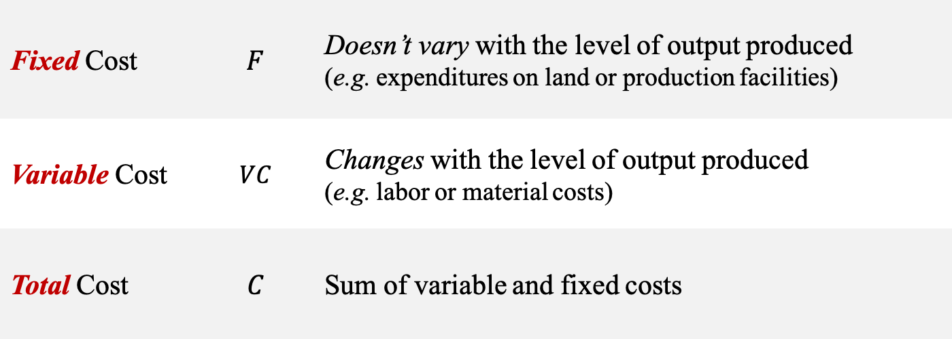

Short-Run Costs
Short run is when at least one input cannot be varied!
(Labor is variable & Capital is fixed)
Fixed Cost | $$F$$ | Doesn’t vary with the level of output produced (e.g. expenditures on land or production facilities)
Variable Cost | $$VC$$ | Changes with the level of output produced (e.g. labor or material costs)
Total Cost | $$C$$ | Sum of variable and fixed costs
$$C=VC+F$$

Slide 8
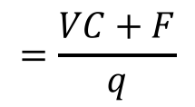
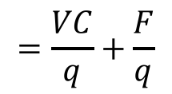
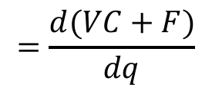
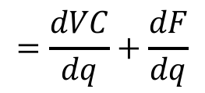





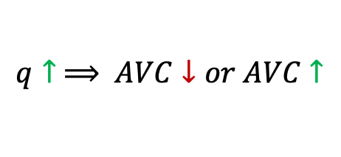

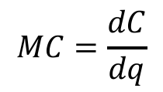
Cost Metrics
Help firms to decide on how much to produce!
Average Fixed Cost
Fixed cost divided by units of output produced
$$AFC=\frac{F}{q}$$
$$q↑ ⟹ AFC↓$$
Average Variable Cost
Variable cost divided by units of output produced
$$AVC=\frac{VC}{q}$$
$$q↑ ⟹ AVC↓or AVC↑$$
Average Total Cost
Total cost divided by units of output produced
$$AC=\frac{C}{q}$$
$$=\frac{VC+F}{q}$$
$$=\frac{VC}{q}+\frac{F}{q}$$
$$=AVC+AFC$$
= zero
Marginal Cost
Change in cost caused by the production of one more unit of output
$$MC=\frac{dC}{dq}$$
$$=\frac{d(VC+F)}{dq}$$
$$=\frac{dVC}{dq}+\frac{dF}{dq}$$
$$=\frac{dVC}{dq}$$

Slide 9









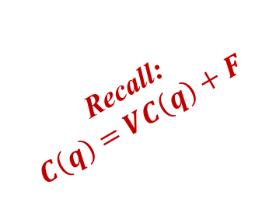





Example
A manufacturing plant has a short-run cost function of:
Recall:
$$C\left(q\right)=VC\left(q\right)+F$$
$$C\left(q\right)=100q−4q^{2}+0.2q^{3}+450$$
Depends on $q$
No $q$
Variable Cost?
$$VC\left(q\right)=100q−4q^{2}+0.2q^{3}$$
Fixed Cost?
$$F=450$$
Average Variable Cost?
$$AVC=\frac{VC(q)}{q}$$
$$=\frac{100q−4q^{2}+0.2q^{3}}{q}$$
$$=100−4q+0.2q^{2}$$
Average Fixed Cost?
$$AFC=\frac{F}{q}$$
$$=\frac{450}{q}$$
Average Total Cost?
$$=100−4q+0.2q^{2}+\frac{450}{q}$$
$$AC=AVC+AFC$$
Marginal Cost?
$$MC=\frac{dVC(q)}{dq}$$
$$=\frac{d(100q−4q^{2}+0.2q^{3})}{dq}$$
$$=100−8q+0.6q^{2}$$

Slide 10
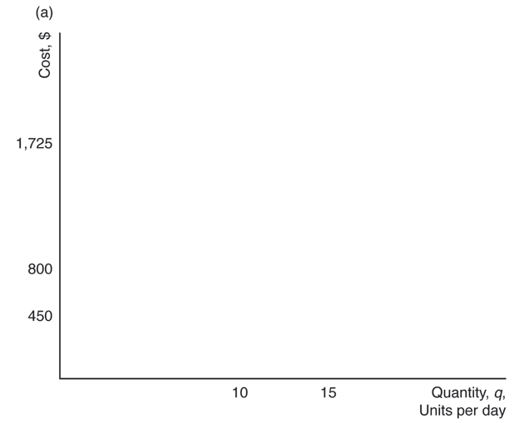
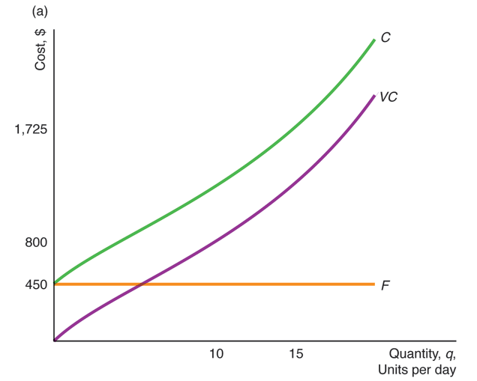

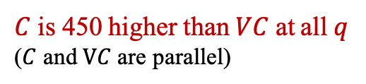


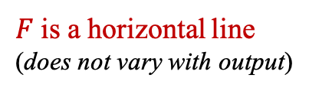


Short-Run Cost Curves
$$C\left(q\right)=VC\left(q\right)+F=100q−4q^{2}+0.2q^{3}+450$$
$$VC(q)$$
$$F$$
$C$ is 450 higher than $VC$ at all $q$
($C$ and $VC$ are parallel)
450
$VC↑$ when $q↑$
450
450
$C=F$ if $q=0$
$F$ is a horizontal line
(does not vary with output)
$VC=0$ if $q=0$

Slide 11
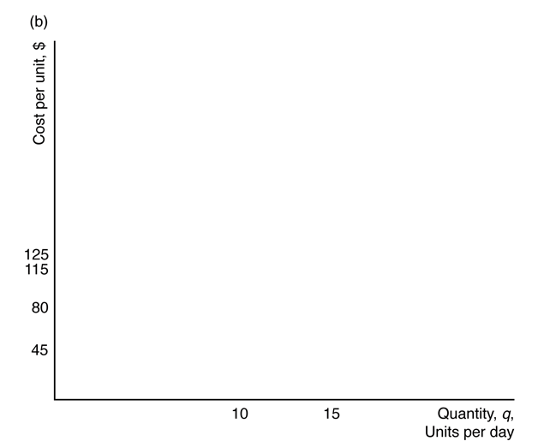
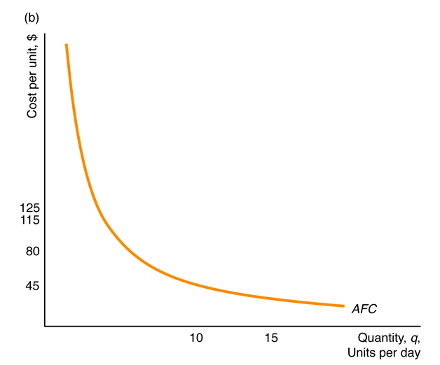
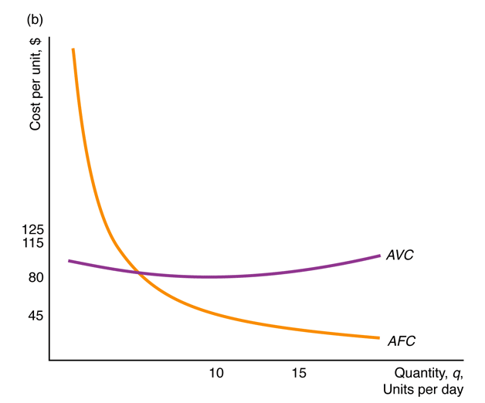
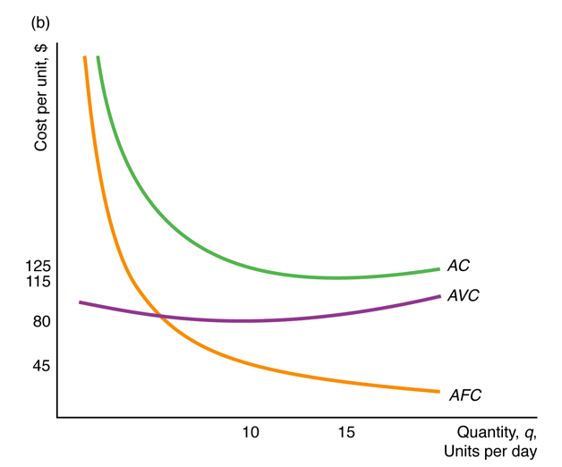
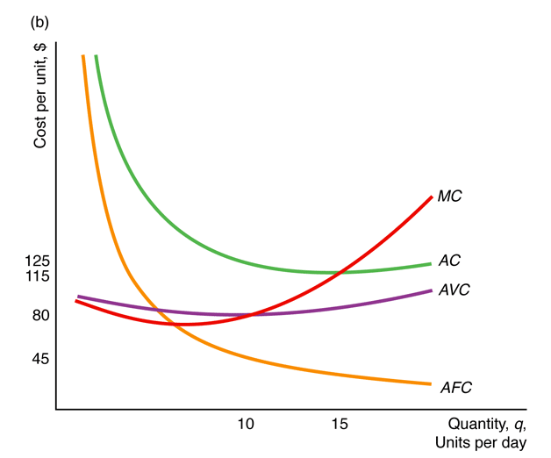
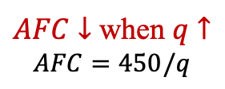
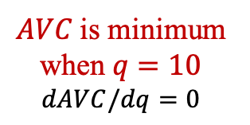
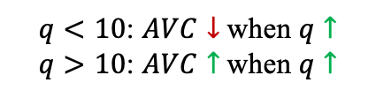

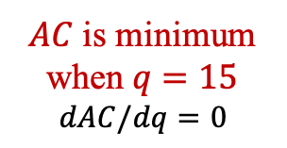
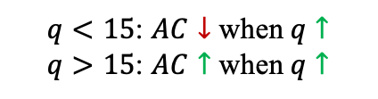

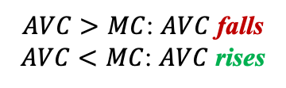
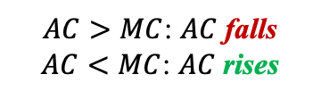



Short-Run Cost Metrics Curves
$AVC>MC$: $AVC$ falls
$AVC<MC$: $AVC$ rises
$MC$ cuts $AVC$ and $AC$ at their minimums
vertical sum of $AVC$ and $AFC$
$AC>MC$: $AC$ falls
$AC<MC$: $AC$ rises
$$MC=100−8q+0.6q^{2}$$
$$AC=AVC+AFC$$
$$AVC=100−4q+0.2q^{2}$$
$AFC↓$ when $q↑$
$$AFC=450/q$$
$AVC$ is minimum when $q=10$
$$dAVC/dq=0$$
$AC$ is minimum when $q=15$
$$dAC/dq=0$$
$q<10$: $AVC↓$ when $q↑$
$q>10$: $AVC↑$ when $q↑$
$q<15$: $AC↓$ when $q↑$
$q>15$: $AC↑$ when $q↑$

Slide 12








Production Functions and the Shape of Cost Curves
The production function determines the shape of a firm’s cost curves!
Total Cost Function
Variable Cost Function
fixed
fixed
$$C(q)$$
$$=C(f(L,\overline{K}))$$
$$=C(L)$$
$$VC(q)$$
$$=VC(f(L,\overline{K}))$$
$$=VC(L)$$
$C$ and $VC$ depends only on $L$!
$$q=f(L,\overline{K})$$
Short-Run Production Function

Slide 13

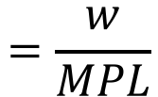
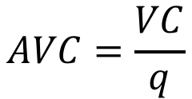
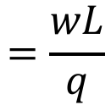
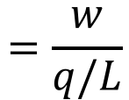


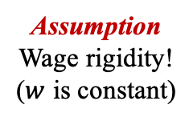
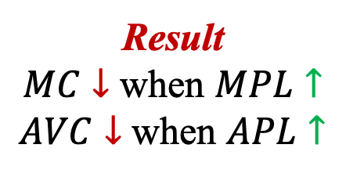

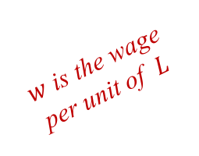
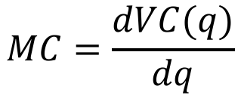
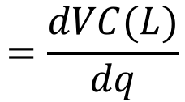
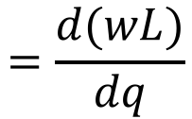
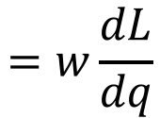
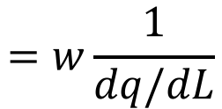
Shape of the Marginal and Average Cost Curves
The only variable cost in the short run is labor cost!
Variable Cost Function
$w$ is the wage per unit of $L$
Assumption
Wage rigidity!
($w$ is constant)
$$VC\left(L\right)=wL$$
Wage times the extra labor required to produce one extra unit of output
Marginal Cost
$$MC=\frac{dVC(q)}{dq}$$
$$=\frac{dVC(L)}{dq}$$
$$=\frac{d(wL)}{dq}$$
$$=w\frac{dL}{dq}$$
$$=w\frac{1}{dq/dL}$$
$$=\frac{w}{MPL}$$
Average Variable Cost
$$=MPL$$
Result
$MC↓$ when $MPL↑$
$AVC↓$ when $APL↑$
$$AVC=\frac{VC}{q}$$
$$=\frac{wL}{q}$$
$$=\frac{w}{q/L}$$
$$=\frac{w}{APL}$$
$$=APL$$

Slide 14













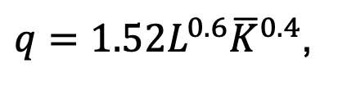
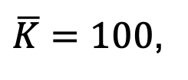




Example
Consider the following information for a Japanese beer producer:
$q=1.52L^{0.6}{\overline{K}}^{0.4}$,
$\overline{K}=100$,
$$w=24$$
Production Function?
$$q=1.52L^{0.6}{100}^{0.4}$$
$$≈9.59L^{0.6}$$
$$APL=\frac{q}{L}$$
$$=\frac{9.59L^{0.6} }{L}$$
Average Product of Labor?
$$=9.59L^{−0.4}$$
Marginal Product of Labor?
$$MPL=\frac{dq}{dL}$$
$$=\frac{d(9.59L^{0.6})}{dL}$$
$$=5.75L^{−0.4}$$
Average Variable Cost?
$$AVC=\frac{w}{APL}$$
$$=\frac{24}{9.59L^{−0.4} }$$
$$=\frac{24}{9.59}L^{0.4}$$
$$≈2.50L^{0.4}$$
Marginal Cost?
$$MC=\frac{w}{MPL}$$
$$=\frac{24}{5.75L^{−0.4} }$$
$$=\frac{24}{5.75 }L^{0.4}$$
$$≈{4.17L}^{0.4}$$

Slide 15






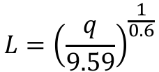




Example (cont.)
Now find $AVC$ and $MC$ in terms of the output $q$:
Average Variable Cost?
$$AVC=2.50L^{0.4}$$
$$=2.50{({0.023q}^{1.67} )}^{0.4}$$
$$≈0.55q^{0.67}$$
Marginal Cost?
$$MC={4.17L}^{0.4}$$
$$={4.17({0.023q}^{1.67} )}^{0.4}$$
$$≈0.92q^{0.67}$$
$$L={\left(\frac{q}{9.59}\right)}^{\frac{1}{0.6}}$$
$$≈{\left(\frac{1}{9.59}\right)}^{1.67}{∙q}^{1.67}$$
$L$ as a function of $q$?
$$≈{0.023q}^{1.67}$$
invert the production function
Production Function:
$$q=9.59L^{0.6}$$

Slide 16
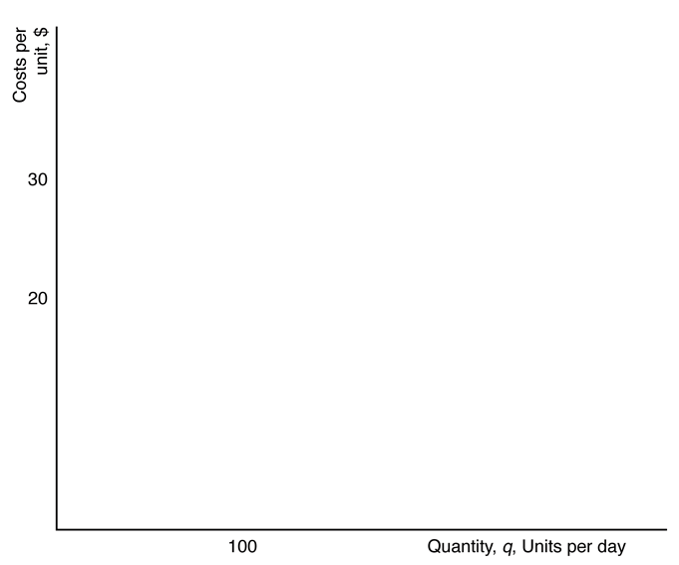
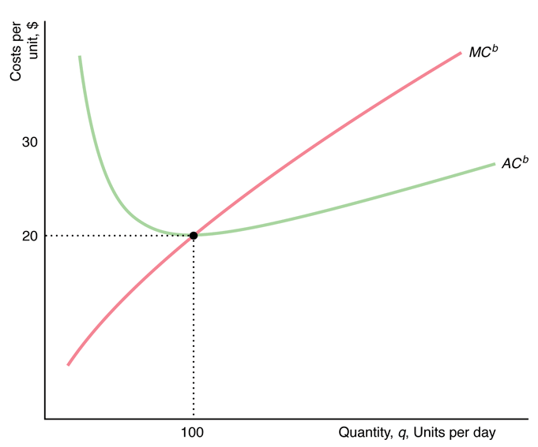
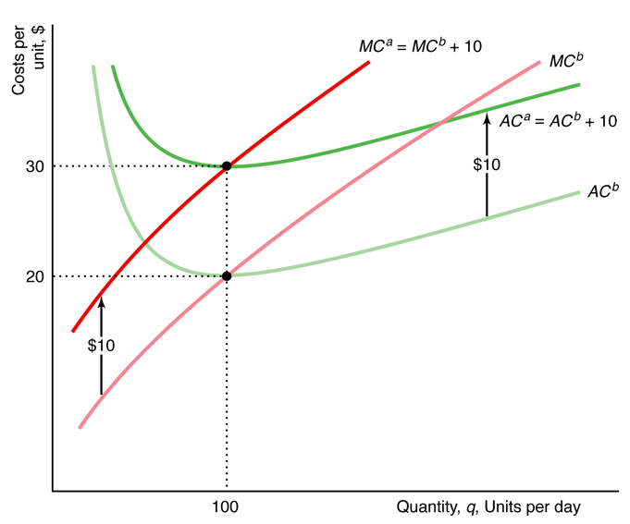








Example (cont.)
Suppose the government applies a tax of $10 per unit of output:
Before Taxes:
$${MC}^{B}=0.92q^{0.67}$$
$${AVC}^{B}=0.55q^{0.67}$$
Assume some fixed cost
$${AC}^{B}={AVC}^{B}+AFC$$
After Taxes:
$${MC}^{A}={MC}^{B}+\$10$$
$${AVC}^{A}={AVC}^{B}+\$10$$
$${AC}^{A}={AVC}^{A}+AFC$$
$={AVC}^{B}+\$10+AFC$
$={AC}^{B}+\$10$

Slide 17
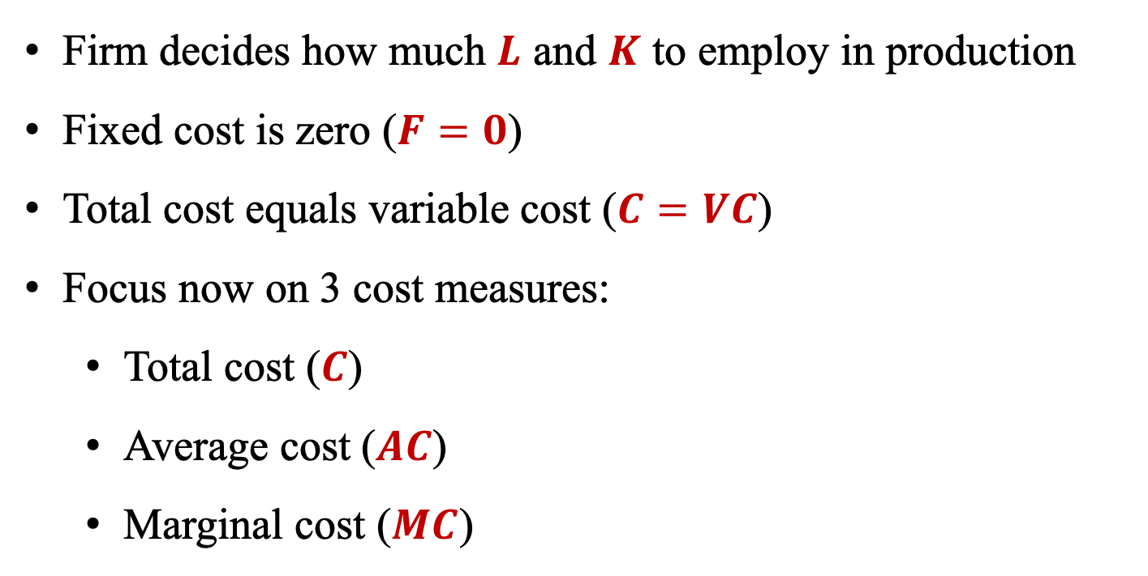
Long-Run Costs
Long run is when all inputs can be varied!
(Labor and Capital are variable)
Firm decides how much $L$ and $K$ to employ in production
Fixed cost is zero ($F=0$)
Total cost equals variable cost ($C=VC$)
Focus now on 3 cost measures:
Total cost ($C$)
Average cost ($AC$)
Marginal cost ($MC$)

Slide 18
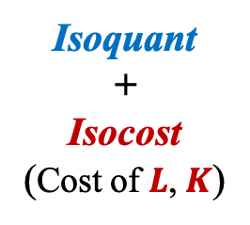
Long-Run Costs & Input Choice
Recall the Production Workflow
Technologically Efficient
Economically
Efficient
Available
Isoquant
Isoquant
+
Isocost
(Cost of $L$, $K$)

Slide 19







Isocost Lines
Show the efficient combinations of $L$ and $K$ that require the same total cost!
Total Cost
Notice the bar!
Isocost
Isocost for Graphs
$$C=wL+rK$$
$w$: wage rate per unit of $L$
$r$: rental rate per unit of $K$
$$\overline{C}=wL+rK$$
$$K=\frac{\overline{C}}{r}−\frac{w}{r}L$$
Cost is fixed at a level $\overline{C}$
$K$ in the vertical axis
$L$ in the horizontal axis
If the firm owns $K$, $r$ is the implicit rental rate!

Slide 20














Graphical Analysis
$$L=0⟹K=\frac{\overline{C}}{r}$$
$$K=\frac{\overline{C}}{r}−\frac{w}{r}L$$
$$K$$
$$K=0⟹L=\frac{\overline{C}}{w}$$
$$\frac{3,000}{r}$$
$$\frac{2,000}{r}$$
$$\overline{C}=\$3,000$$
$$\overline{C}=\$2,000$$
$$\frac{1,000}{r}$$
$$\overline{C}=\$1,000$$
$$L$$
$$\frac{1,000}{w}$$
$$\frac{2,000}{w}$$
$$\frac{3,000}{w}$$

Slide 21










Properties of Isocosts
$$K=\frac{\overline{C}}{r}−\frac{w}{r}L$$
1. The firm’s costs $\overline{C}$ and input prices $w$ and $r$ determine where the isocost line hits the axes.
2. Isocosts farther from the origin have higher costs than those closer to the origin.
3. The slope of each isocost is the same and is given by the relative prices of the inputs
$$K$$
$$\frac{3,000}{r}$$
Higher costs!
$$\frac{2,000}{r}$$
$$\overline{C}=\$3,000$$
MRTS
$$\frac{dK}{dL}=−\frac{w}{r}$$
$$\overline{C}=\$2,000$$
$$\frac{1,000}{r}$$
$$\overline{C}=\$1,000$$
$$L$$
$$\frac{1,000}{w}$$
$$\frac{2,000}{w}$$
$$\frac{3,000}{w}$$

Slide 22







Cost Minimization
Combining the isoquant and isocost, a firm determines how to produce a given level of output at the lowest cost!
$$w=\$24$$
$$r=\$8$$
Cheapest mix?
No!
Cheapest!
Cheapest mix?
No!
This cost level cannot afford the production of $q=100!$

Slide 23



Cost Minimization Rules
1. Lowest-isocost: Pick the bundle of inputs where the lowest isocost touches the isoquant.
or
2. Tangency: Pick the bundle of inputs where the isoquant is tangent to the isocost.
or
3. Last-dollar: Pick the bundle of inputs where the last dollar spent on each input gives the same extra output.
$$\frac{dK}{dL}=−\frac{w}{r}$$
$$=MRTS=−\frac{MPL}{MPK}$$
MRTS
$$\frac{MPL}{w}=\frac{MPK}{r}$$

Slide 24





Using Calculus to Minimize Cost
The firm minimizes its cost subject to a production constraint!
Lagrangian Multiplier
Greek letter lambda!
Step 1: Write the Lagrangian
$$ℒ=wL+rK+λ(\overline{q}−f(L,K))$$
Total Cost
Production Constraint
Step 2: Minimization Problem
$$\min_{L,K,λ}{ℒ}=wL+rK+λ(\overline{q}−f(L,K))$$
Step 3: First-Order Conditions
$$\frac{∂ℒ}{∂L}=0$$
$$\frac{∂ℒ}{∂K}=0$$
$$\frac{∂ℒ}{∂λ}=0$$

Slide 25











Solution of Cost Minimization
Calculating the First-Order Conditions:
$$ℒ=wL+rK+λ(\overline{q}−f(L,K))$$
Last-dollar Rule!
$$\frac{∂ℒ}{∂L}=0$$
$$⟺w−λ\frac{∂f\left(L,K\right)}{∂L}=0$$
$$⟺λ=\frac{w}{MPL}$$
$$\frac{MPL}{w}=\frac{MPK}{r}$$
MPL
$$\frac{∂ℒ}{∂K}=0$$
$$⟺r−λ\frac{∂f\left(L,K\right)}{∂K}=0$$
$$⟺λ=\frac{r}{MPK}$$
MPK
$$\frac{∂ℒ}{∂λ}=0$$
Isoquant!
$$⟺\overline{q}−f(L,K)=0$$
$$⟺\overline{q}=f(L,K)$$

Slide 26






















Example
Consider the following setup:
$$f(L,K)={(L^{ρ}+K^{ρ})}^{\frac{1}{ρ}}$$
$$ρ=0.5$$
$$w=r=1$$
$$\overline{q}=4$$
What are the cost minimizing $L$ and $K$?
$$⟹4={(L^{ρ}+K^{ρ})}^{\frac{1}{ρ}}$$
$$⟹4={({2L}^{ρ})}^{\frac{1}{ρ}}$$
$$⟹4={L2}^{\frac{1}{ρ}}$$
$$\overline{q}=f(L,K)$$
$$⟹4={L2}^{2}$$
$$⟹L=1$$
$$⟹\frac{{(L^{ρ}+K^{ρ})}^{\frac{1−ρ}{ρ}}L^{ρ−1} }{{(L^{ρ}+K^{ρ})}^{\frac{1−ρ}{ρ}}K^{ρ−1} }=1$$
$$\frac{MPL}{w}=\frac{MPK}{r}$$
$$⟹\frac{MPL}{MPK}=\frac{w}{r}$$
$$⟹\frac{L^{ρ−1}}{K^{ρ−1}}=1$$
$$⟹L=K$$
$$=\frac{{(L^{ρ}+K^{ρ})}^{\frac{1}{ρ} −1}ρL^{ρ−1}}{ρ}$$
$$MPL=\frac{∂f(L,K)}{∂L}$$
$$={(L^{ρ}+K^{ρ})}^{\frac{1−ρ}{ρ}}L^{ρ−1}$$
$$=\frac{{(L^{ρ}+K^{ρ})}^{\frac{1}{ρ} −1}ρK^{ρ−1}}{ρ}$$
$$MPK=\frac{∂f(L,K)}{∂K}$$
$$={(L^{ρ}+K^{ρ})}^{\frac{1−ρ}{ρ}}K^{ρ−1}$$

Slide 27






Output Maximization
An equivalent problem to minimize costs is to maximize output for a given level of cost!
Highest!
$q=125$ cannot be afforded by $C=2,000$!
Highest output?
No!

Slide 28


Using Calculus to Maximize Output
The firm maximizes its output subject to a cost constraint!
Lagrangian Multiplier
Step 1: Write the Lagrangian
$$ℒ=f\left(L,K\right)+λ(\overline{C}−wL−rK)$$
Output
Cost Constraint
Step 2: Maximization Problem
$$\max_{L,K,λ}{ℒ}=f\left(L,K\right)+λ(\overline{C}−wL−rK)$$
Step 3: First-Order Conditions
$$\frac{∂ℒ}{∂L}=0$$
$$\frac{∂ℒ}{∂K}=0$$
$$\frac{∂ℒ}{∂λ}=0$$

Slide 29







Solution of Output Maximization
Calculating the First-Order Conditions:
$$ℒ=f(L,K)+λ(\overline{C}−wL−rK)$$
Last-dollar Rule!
$$\frac{∂ℒ}{∂L}=0$$
$$⟹\frac{∂f\left(L,K\right)}{∂L}−λw=0$$
$$⟹λ=\frac{MPL}{w}$$
$$\frac{MPL}{w}=\frac{MPK}{r}$$
MPL
$$\frac{∂ℒ}{∂K}=0$$
$$⟹\frac{∂f\left(L,K\right)}{∂K}−λr=0$$
$$⟹λ=\frac{MPK}{r}$$
Same result of cost minimization
MPK
$$\frac{∂ℒ}{∂λ}=0$$
Isocost!
$$⟹\overline{C}−wL−rK=0$$
$$⟹\overline{C}=wL+rK$$

Slide 30








Dual Problems
Cost Minimization
Output Maximization
$$ℒ=wL+rK+λ(\overline{q}−f(L,K))$$
$$ℒ=f\left(L,K\right)+λ(\overline{C}−wL−rK)$$
Total Cost
Production Constraint
Output
Cost Constraint
$$\min_{L,K,λ}{ℒ}=wL+rK+λ(\overline{q}−f(L,K))$$
$$\max_{L,K,λ}{ℒ}=f\left(L,K\right)+λ(\overline{C}−wL−rK)$$
$$\frac{MPL}{w}=\frac{MPK}{r} or \frac{MPL}{MPK}=\frac{w}{r}$$
Same result!
$$\frac{MPL}{w}=\frac{MPK}{r} or \frac{MPL}{MPK}=\frac{w}{r}$$
Isoquant!
Isocost!
$$\overline{q}=f(L,K)$$
$$\overline{C}=wL+rK$$

Slide 31








Input Price Changes
How should the firm changes its behavior if the cost of one input changes?
Affect cost structure
Isocost changes
But how isocost changes?
Change in input prices
Does not affect technology
Isoquant does not change
Produce the same $q$
Use more $L$
Use less $K$
Total cost $C$ goes down
Slope of isocost:
$$w=\$24$$
$$r=\$8$$
$$\frac{dK}{dL}=−\frac{w}{r}=−3$$
Slope of isocost:
$$w=\$8$$
$$r=\$8$$
$$\frac{dK}{dL}=−\frac{w}{r}=−1$$
New bundle of $L$ and $K$
Isocost becomes flatter!

Slide 32











Expansion Path
The cost-minimizing combination of $L$ and $K$ for each output level!
$$q=100 L=50 K=100$$
$$q=150 L=75 K=150$$
$$q=200 L=100 K=200$$
$$L=q/2$$
$$K=q$$
$$K=2L$$
Expansion Path Equation

Slide 33






Long-Run Cost Function
Shows the relationship between the cost and output!
$24
$$=w\frac{q}{2}+rq$$
$8
$$=q\left(\frac{w}{2}+r\right)$$
$$C=wL+rK$$
$$=20q$$
Example from previous slide
$$L=q/2$$
$$K=q$$

Slide 34



















Example
Consider the following Cobb-Douglas production function:
$$q=AL^{a}K^{b}$$
Optimal Condition?
$$\frac{w}{r}=\frac{MPL}{MPK}$$
$$=\frac{aAL^{a−1}K^{b}}{bAL^{a}K^{b−1}}$$
$$=\frac{a(AL^{a}K^{b})/L}{b(AL^{a}K^{b})/K}$$
$$=\frac{a}{b}\frac{K}{L}$$
Expansion Path?
$$K=\frac{b}{a}\frac{w}{r}L$$
$$⟺rK=\frac{b}{a}wL$$
$$⟺wL=\frac{a}{b}rK$$
Labor vs Cost?
$$C=wL+rK$$
$$=wL+\frac{b}{a}wL$$
$$=\frac{a+b}{a}wL$$
$$⟺L=\frac{a}{a+b}\frac{C}{w}$$
Capital vs Cost?
$$=\frac{a}{b}rK+rK$$
$$=\frac{a+b}{b}rK$$
$$⟺K=\frac{b}{a+b}\frac{C}{r}$$
$$C=wL+rK$$
$$=A{\left(\frac{a}{a+b}\frac{C}{w}\right)}^{a}{\left(\frac{b}{a+b}\frac{C}{r}\right)}^{b}$$
$$⟺C=const × q^{\frac{1}{a+b}}$$
LR Cost Function?
$$q=AL^{a}K^{b}$$
Do the algebra to find the constant!

Slide 35

The Shape of the Long-Run Cost Curves
The shape of the average cost curve indicates if the production results in economies or diseconomies of scale!
Economies of Scale | Average cost falls as output rises $$AC↓if q↑$$ | Doubling $L,K$ more than doubles $q$, so $AC$ falls with higher $q$ Increasing Returns to Scale $⟹$ Economies of Scale
Diseconomies of Scale | Average cost rises as output rises $$AC↑if q↑$$ | Doubling $L,K$ less than doubles $q$, so $AC$ rises with higher $q$ Decreasing Returns to Scale $⟹$ Diseconomies of Scale
No Economies of Scale | Average cost is the same as output rises $$AC=if q↑$$ | Doubling $L,K$ exactly doubles $q$, so $AC$ stays the same with higher $q$ Constant Returns to Scale $⟹$ No Economies of Scale

Slide 36




Long-Run Average Cost Curve
Economies of Scale Zone
Diseconomies of Scale Zone
$$AC$$
$$AC↓if q↑$$
$$AC↑if q↑$$
$$q$$

Slide 37












Long-Run vs Short-Run Average Cost Curves
Because a firm cannot vary $K$ in the SR but it can in the LR, SR average cost is at least as high as the LR one!
Suppose the firm has 3 possible plant sizes:
In the LR, it selects the plant with the lowest $SRAC$ for each possible value of $q$!
The $LRAC$ is the envelope of all $SRAC$
At $q_{1}$, it selects plant 1 in the LR
At $q_{2}$, it selects plant 2 in the LR
To produce $q_{1}$, the firm minimizes it’s $SRAC$ by choosing plant 1
To produce $q_{2}$, the firm minimizes it’s $SRAC$ by choosing plant 2

Slide 38



Example
Suppose the production function has constant returns to scale:
40
Recall:
Constant Returns to Scale
$$⇓$$
No Economies of Scale
$$⇓$$
$LRAC$ is the same as output rises
Costs per unit, $
1
SRAC
30
2
SRAC
20
LRAC
1
0
0
200
600
1,200
To produce 200, the firm minimizes it’s $SRAC$ by choosing plant 1
q
, Beer units per day
To produce 600, the firm minimizes it’s $SRAC$ by choosing plant 2

Slide 39






Application
Suppose the firm has two options of printers:
Laser: $F=\$90$, $VC=\$0.04$ per page
$${SRAC}^{L}=\$90/q+0.04$$
Inkjet: $F=\$30$, $VC=\$0.07$ per page
$${SRAC}^{I}=\$30/q+0.07$$
Notice:
$q<2,000$: ${SRAC}^{I}<{SRAC}^{L}$
$q=2,000$: ${SRAC}^{I}={SRAC}^{L}$
$q>2,000$: ${SRAC}^{I}>{SRAC}^{L}$
SRAC
of laser printer
Cents per page
8.5
SRAC
of inkjet printer
Envelope of all $SRAC$
LRAC
4
0
2,000
q
, Lifetime pages

Slide 40









Short-Run vs Long-Run Expansion Paths
Expanding output is cheaper in LR than in SR because of ability to move away from fixed capital choice!
The cost to produce $q=200$ in the SR is higher than in the LR:
Isocost in LR: $\overline{C}=\$4,000$ (point z)
Isocost in SR: $\overline{C}=\$4,616$ (point y)
LR bundle at $q=200$
To produce $q=200$ in the SR, cannot adjust $K$, only $L$!
Horizontal!
LR bundle at $q=100$

Slide 41

Learning by Doing
The productive skills and knowledge of better ways to produce that firms gain from experience!
As we keep doing the same activity, we get better over time!
Average cost curves move down over time!
1st Year
2nd Year
3rd Year
The average cost of production tends to fall over time!

Slide 42

Cost of Producing Multiple Goods
If a firm produces multiple goods, the cost of one good may depend on the output level of the other!
e.g. Production of beef and hide
Producing together
Producing separately
Throw away unused input
Single cow
Beef
Hide
Beef
Hide
Less expensive to produce together!

Slide 43




Economies of Scope
There are economies of scope if it’s cheaper to produce goods jointly than separately!
$C(q_{1},q_{2})$: cost of producing both goods $q_{1}$ and $q_{2}$
$C(q_{1},0)$: cost of producing good $q_{1}$ by itself
$C(0,q_{2})$: cost of producing good $q_{2}$ by itself
Cost of producing both goods separately
Cost of producing both goods jointly
Degree of Scope Economies
$$SC=\frac{C\left(q_{1},0\right)+C\left(0,q_{2}\right)−C(q_{1},q_{2})}{C(q_{1},q_{2})}$$
There are economies of scope!
$SC>0$ implies it’s cheaper to produce jointly!
$$C\left(q_{1},0\right)+C\left(0,q_{2}\right)>C(q_{1},q_{2})$$

Slide 44
THE END

