Slide 1

BUEC 311
Business Economics, Organizations and Management
Winter 2019
Competitive Firms and Markets
Diego B. P. Gomes

Slide 2
Where are we?
The Nature of Firms
✓
Production
Ch. 6
Ideal Market Structure!
More Realistic Markets!
Competitive Markets
Market Power
✓
Costs
Ch. 7
Perfect Competition
Ch. 8
Monopoly & Monopsony
Ch. 11
Properties of Competition
Ch. 9
Pricing & Advertising
Ch. 12
Consumer Behavior
Consumer’s Choice
Ch. 3
Game Theory
Ch. 13
General Equilibrium
Ch. 10
Oligopoly
Ch. 14
Choice under Uncertainty
Ch. 16
Factor Markets
Ch. 15
Labor market
Capital market
Exhaustible resources

Slide 3

Market Structure
Provides information about how firms operating in the market will behave!
Types of Market Structures
Firms behave differently in each market structure!
Focus of this class!
Latter…
Latter…
Latter…
Latter…
Perfect Competition
Monopolistic Competition
Monopoly
Monopsony
Oligopoly
Market structures depend on:
Number of firms in the market
Ability to differentiate products
Flow of information in the market
Size of transaction costs
Ease to enter and leave the market

Slide 4
Perfect Competition
Buyers and sellers behave as price takers!
Implication:
A firm’s demand curve is horizontal at the market price!
What does price taker mean?
A firm cannot sell at a price greater than the market price
A consumer cannot purchase at a price less than the market price
What drive firms to behave as price takers?

Slide 5
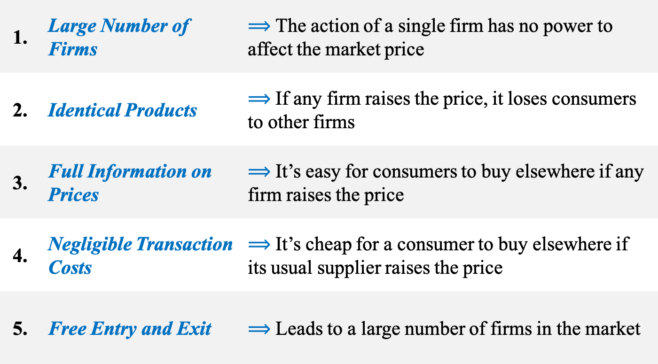
5 Features that Force Firms to be Price Takers
These are the features of a competitive market!
1. | Large Number of Firms | $⟹$ The action of a single firm has no power to affect the market price
2. | Identical Products | $⟹$ If any firm raises the price, it loses consumers to other firms
3. | Full Information on Prices | $⟹$ It’s easy for consumers to buy elsewhere if any firm raises the price
4. | Negligible Transaction Costs | $⟹$ It’s cheap for a consumer to buy elsewhere if its usual supplier raises the price
5. | Free Entry and Exit | $⟹$ Leads to a large number of firms in the market

Slide 6
Example
Chicago Commodity Exchange
Buyers and sellers can trade wheat
Thousands of buyers and sellers
Wheat is quite homogeneous across producers
Prices are posted on the screen for everyone to see
1. Large Number of Firms
2. Identical Products
3. Full Information on Prices
Buy and sell orders are posted electronically
Producers can easily access the marketplace
4. Low Transaction Costs
5. Easy entry and exit

Slide 7
Why Perfect Competition is Important?
Let’s face it: All the requirements for perfect competition are hardly achieved!
So why study it?
More importantly…
Reason #1
Some markets can be reasonably described as competitive
Reason #2
Perfectly competitive markets have many desirable properties
Agriculture
Other commodities
Stock exchanges
Retail and Wholesale
We can compare real-world markets to this ideal market
Society as a whole suffers if the properties of perfect competition fail
We’ll see it throughout the course

Slide 8

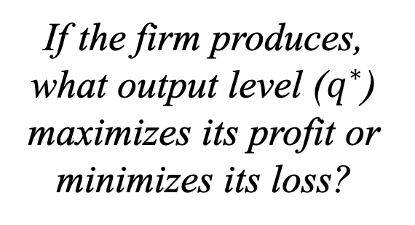
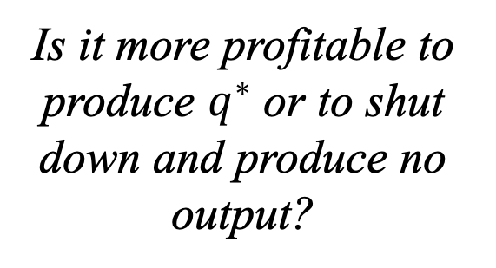
Profit Maximization
Any firm uses a two-step process to maximize profits!
Profit
Revenue
Opportunity Cost
$$π\left(q\right)=R\left(q\right)−C(q)$$
Step 1
Output Decision
Step 2
Shutdown Decision
If the firm produces, what output level ($q^{∗}$) maximizes its profit or minimizes its loss?
Is it more profitable to produce $q^{∗}$ or to shut down and produce no output?

Slide 9

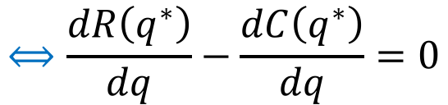

Profit Maximization: Output Rules
A firm sets its output where…
Output Rule 1: …profit is maximized
Output Rule 2: …marginal profit is zero
Output Rule 3: …marginal revenue equals marginal cost
From calculus:
The maximum of a function is where its derivative equals zero!
Marginal Profit
Marginal Revenue
Marginal Cost
$$\frac{dπ\left(q^{∗}\right)}{dq}=0$$
$$⟺\frac{dR\left(q^{∗}\right)}{dq}−\frac{dC\left(q^{∗}\right)}{dq}=0$$
$$⟺MR(q^{∗}) =MC(q^{∗})$$

Slide 10
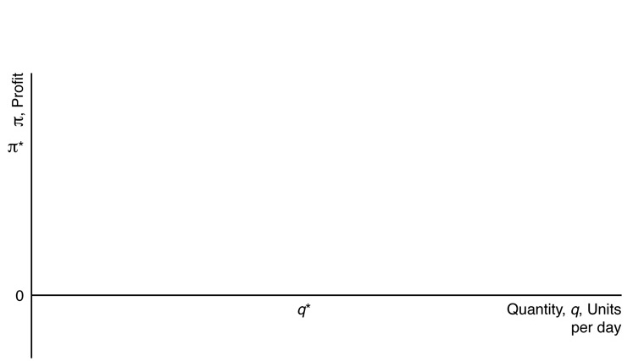
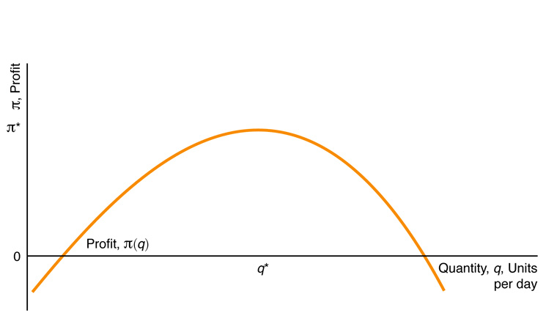
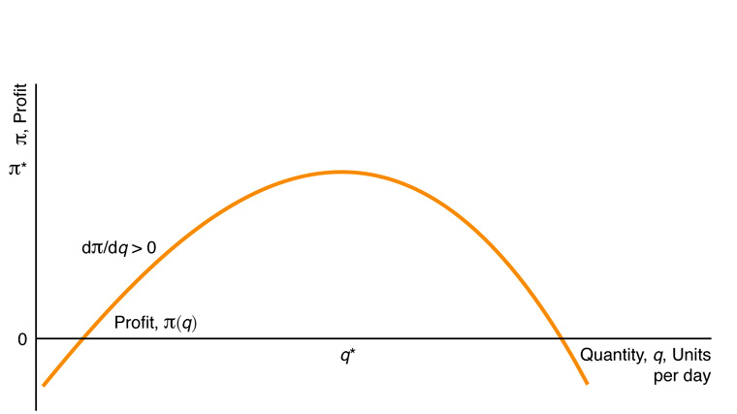
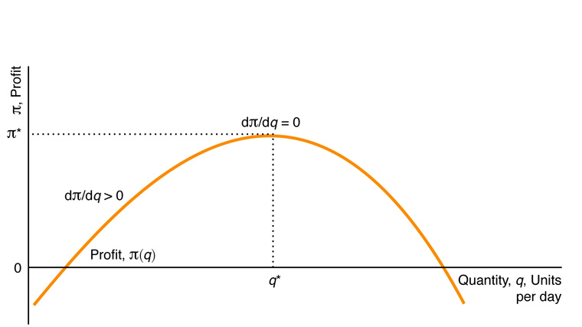
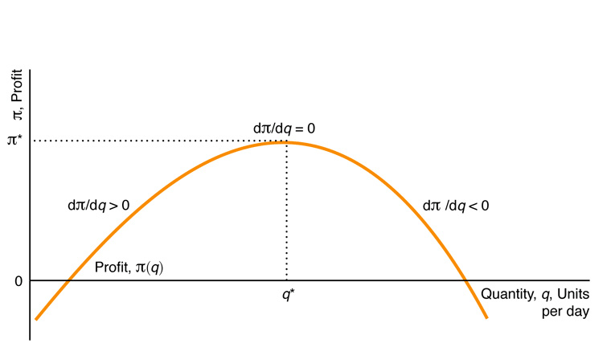


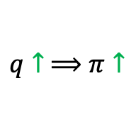
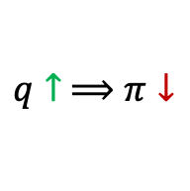
Graphical Intuition
$$q↑ ⟹π↑$$
$$q↑ ⟹π↓$$
Maximum Profit
$$⟸$$
Negative Profit
$$⟹$$
Negative Profit

Slide 11


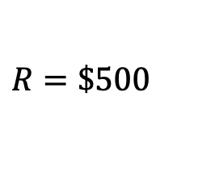



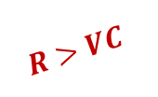
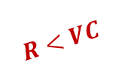
Profit Maximization: Shutdown Rules
A firm shuts down only if…
Shutdown Rule 1: …it can reduce its loss by doing so
Shutdown Rule 2: …its revenue is less than its avoidable cost
Avoidable
Sunk
Example: $VC=\$1,000$, $F=\$3,000$
Best decision!
$$R>VC$$
Operates: $π=−2,000$
$$R=\$2,000$$
Shutdown: $π=−3,000$
$$π=R−VC−F$$
$$R<VC$$
Operates: $π=−3,500$
$$R=\$500$$
Best decision!
Shutdown: $π=−3,000$

Slide 12
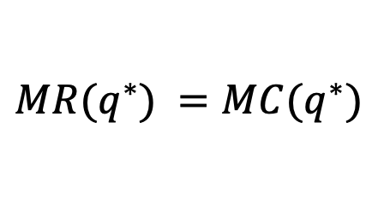

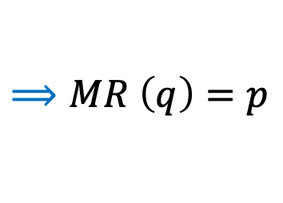



Short-Run Output Decision
Applying the output rules for profit maximization:
Marginal Revenue equals Marginal Cost
$$MR(q^{∗}) =MC(q^{∗})$$
But notice that:
Marginal Revenue equals the market price for every $q$
$$R(q)=pq$$
$$⟹MR \left(q\right)=p$$
The firm produces $q^{∗}$ such that
Marginal Cost equals Market Price
$$MC\left(q^{∗}\right)=p$$

Slide 13
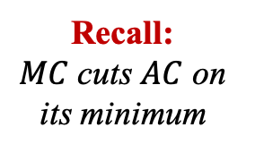


Graphical Analysis
on
1
Optimal Condition
$$MC=p$$
t
0
MC
, $ per
p
A
C
Market
Price
e
8
p
=
MR
6.50
Optimal Output $q^{∗}$
6
0
1
4
0
284
q
, Thousand metric tons of lime per year
Recall:
$MC$ cuts $AC$ on its minimum

Slide 14
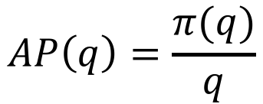
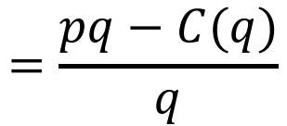



Profit & Average Cost
Consider the average profit of a firm:
Average Cost
Revenue
Cost
$$AP\left(q\right)=\frac{π(q)}{q}$$
$$=\frac{pq−C(q)}{q}$$
$$=p−\frac{C\left(q\right)}{q}$$
$$=p−AC\left(q\right)$$
$$π\left(q\right)=q[p−AC\left(q\right)]$$
Alternative way of defining profits!

Slide 15



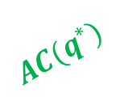

Graphical Representation of Profit
$$π\left(q^{∗}\right)=q^{∗}[p−AC\left(q^{∗}\right)]$$
on
1
t
0
MC
, $ per
Profit is the area of the rectangle
p
$$p$$
A
C
8
e
p
=
MR
$$p−AC(q^{∗})$$
= $426,000
6.50
$$AC(q^{∗})$$
6
0
1
4
0
284
q
, Thousand metric tons of lime per year
Optimal Output $q^{∗}$

Slide 16






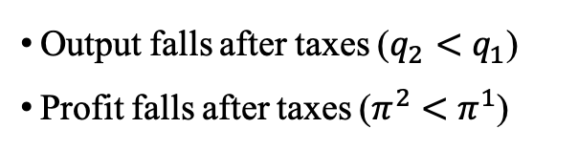
Example: Taxes
Suppose the government applies a tax of $t$ per unit of output:
Before Taxes:
M
C
2
=
M
1
C
+
t
, $ per unit
1
MC
$${MC}^{1}(q)=p$$
p
A
2
1
C
=
A
C
+
t
$$π^{1}\left(q\right)=A+B$$
A
C
1
e
e
After Taxes:
Tax Cost
p
2
1
p
=
MR
A
A
2
C
(
q
)
t
$$C^{2}(q)=C^{1}(q)+tq$$
2
B
A
1
C
(
q
)
$${MC}^{2}(q)={MC}^{1}(q)+t$$
1
$${AC}^{2}(q)={AC}^{1}(q)+t$$
t
$$π^{2}\left(q\right)=A$$
q
q
q
, Units per year
2
1
Conclusion:
Optimal output after taxes
Optimal output before taxes
Output falls after taxes ($q_{2}<q_{1}$)
Profit falls after taxes ($π^{2}<π^{1}$)

Slide 17





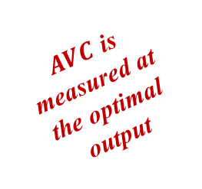
Short-Run Shutdown Decision
Applying the shutdown rules for profit maximization:
Revenue less than Avoidable Cost
After choosing the optimal output
$$R\left(q^{∗}\right)<VC(q^{∗})$$
Average Variable Cost
But notice that:
$$⟺p<\frac{VC(q^{∗})}{q^{∗}}$$
$$R\left(q^{∗}\right)<VC(q^{∗})$$
$$⟺pq^{∗}<VC(q^{∗})$$
The firm shutdowns only if
Market Price is less than Average Variable Cost
$AVC$ is measured at the optimal output
$$p<AVC\left(q^{∗}\right)$$

Slide 18








Short-Run Shutdown Decision: 3 Cases
Shutdown rule
Case 1:
$$p<AVC\left(q^{∗}\right)$$
Shutdown
Opposite of Shutdown rule
Operates
Case 2:
$$AVC\left(q^{∗}\right)≤p<AC(q^{∗})$$
Loss
$$⟹p−AC\left(q^{∗}\right)<0$$
$$⟹π\left(q^{∗}\right)<0$$
$$π\left(q^{∗}\right)=q^{∗}[p−AC\left(q^{∗}\right)]$$
Case 3:
$$AC\left(q^{∗}\right)≤p$$
Profit
Operates
$$⟹p−AC\left(q^{∗}\right)≥0$$
$$⟹π\left(q^{∗}\right)≥0$$

Slide 19
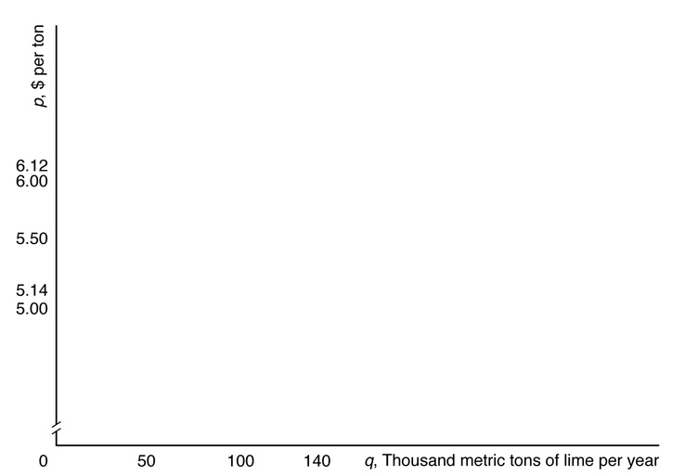
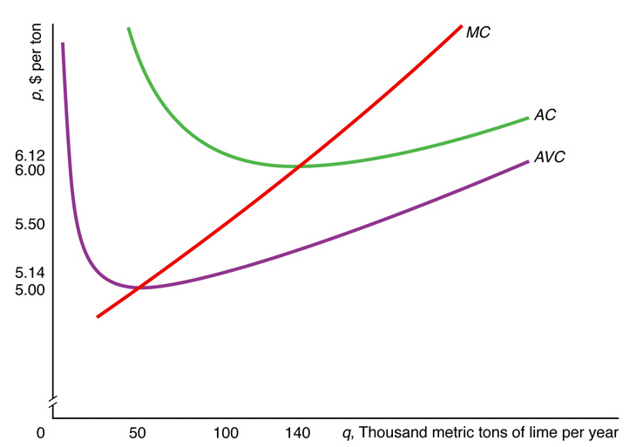
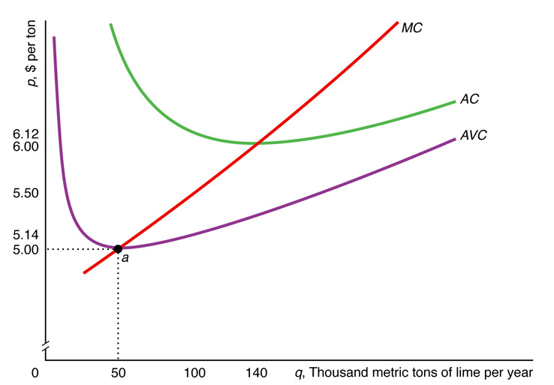
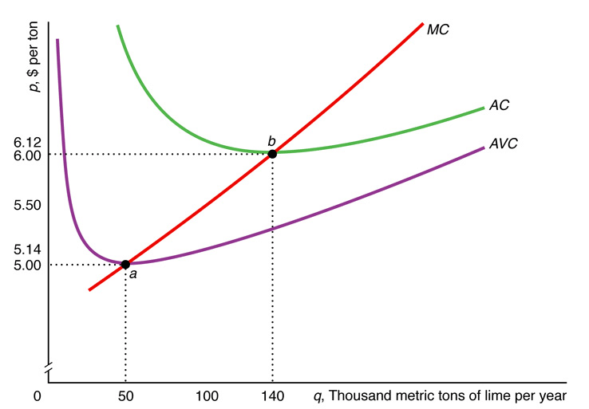
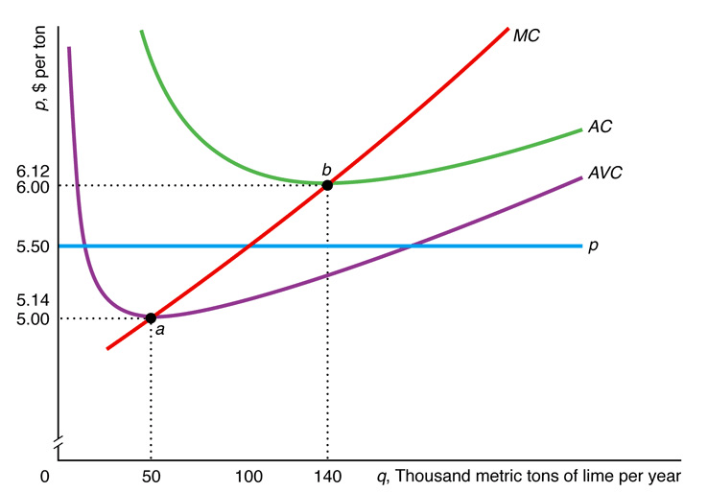
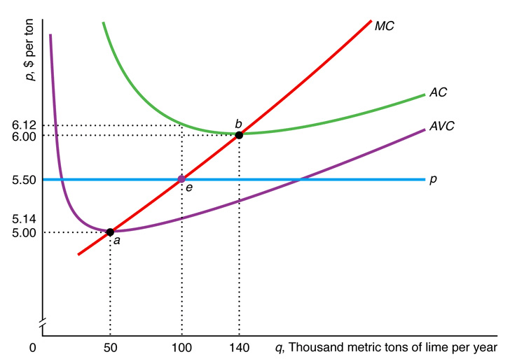
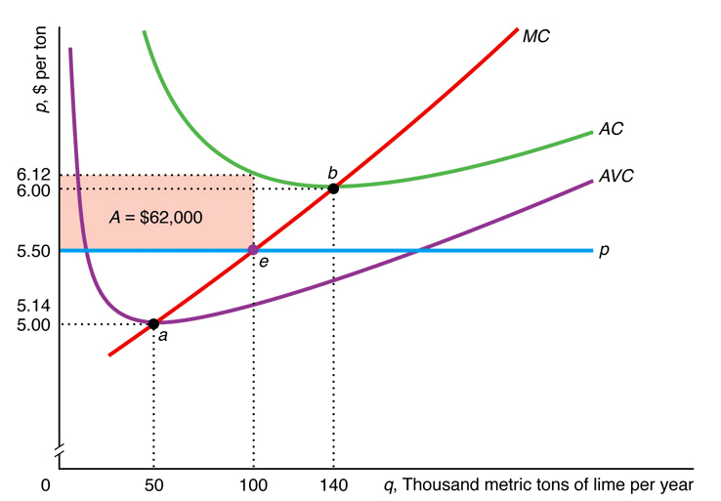

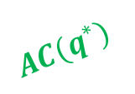
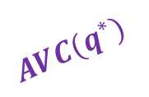


Graphical Analysis
Loss is the area of the rectangle
$$AC(q^{∗})$$
$$p$$
Operates
$$AVC(q^{∗})$$
$$AVC\left(q^{∗}\right)<p<AC(q^{∗})$$
Loss
$$q^{∗}$$

Slide 20
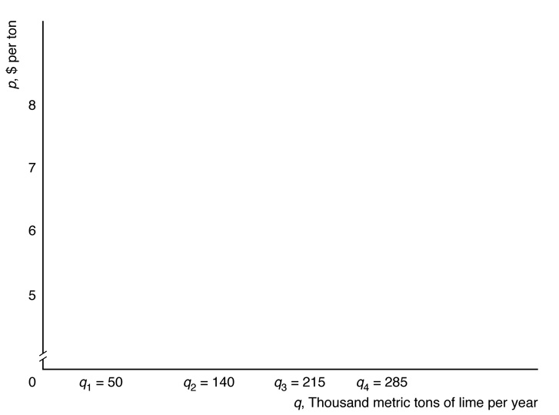
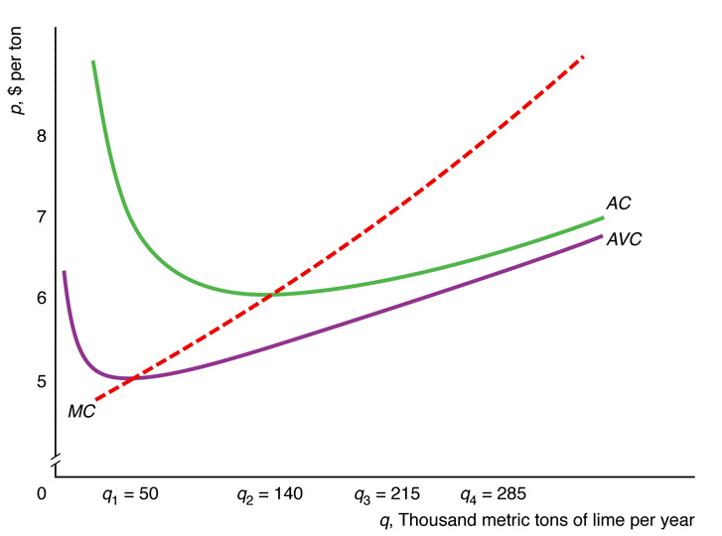
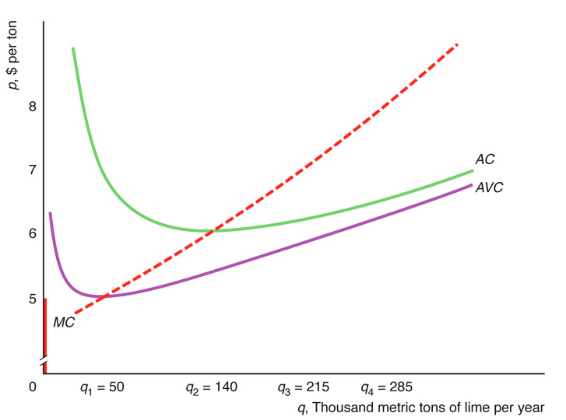
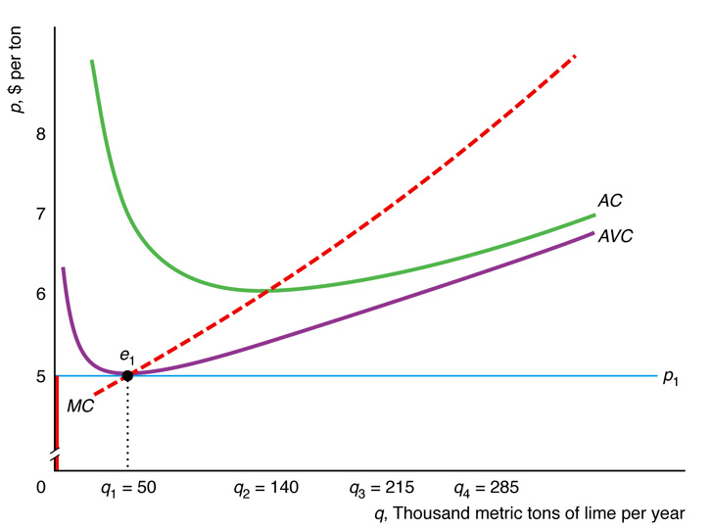
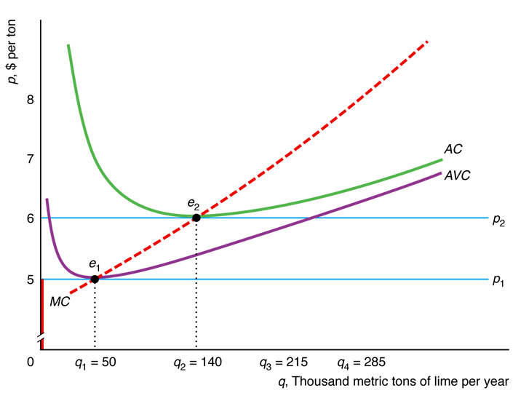
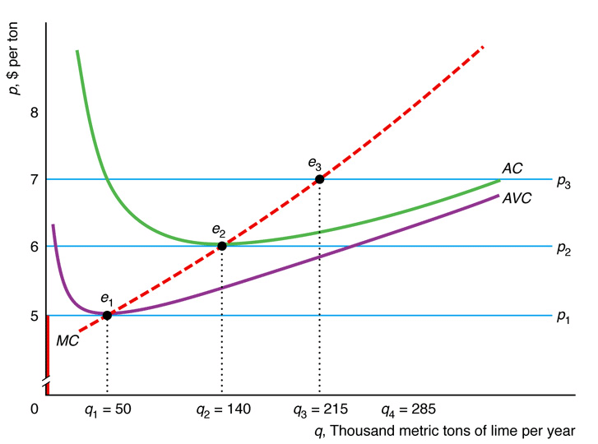
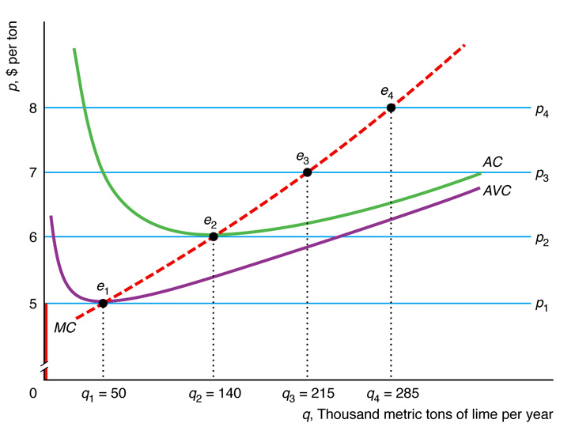
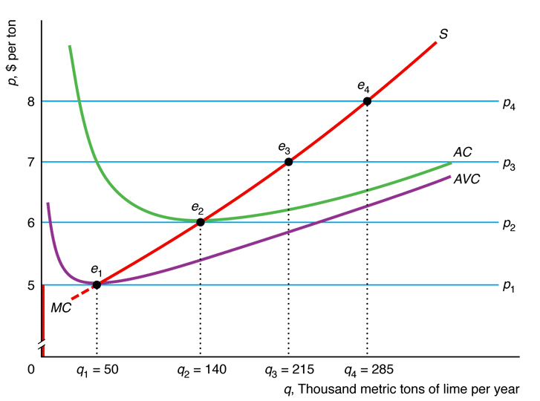

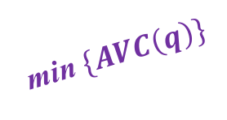

Short-Run Firm Supply Curve
$$p<\min_{q}{\{AVC\left(q\right)\}}$$
Shutdown
No Supply
Supply curve $S$ is the section of $MC$ above the min$\{AVC\}$!
min $\{AVC\left(q\right)\}$
No Supply Zone

Slide 21


Short-Run Market Supply: Identical Firms
Market supply is the sum of the supply of all individual firms in the market!
n is the number of firms
$$Q=q_{1}+q_{2}+q_{3}+⋯+q_{n}$$
Assuming all firms are identical:
They produce the same level of output for each price level
$$q_{1}=q_{2}=q_{3}=⋯=q_{n}=q$$
Market Supply
$$Q=nq$$

Slide 22
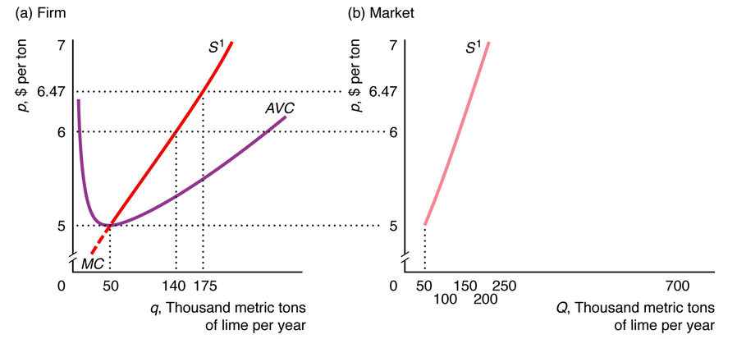
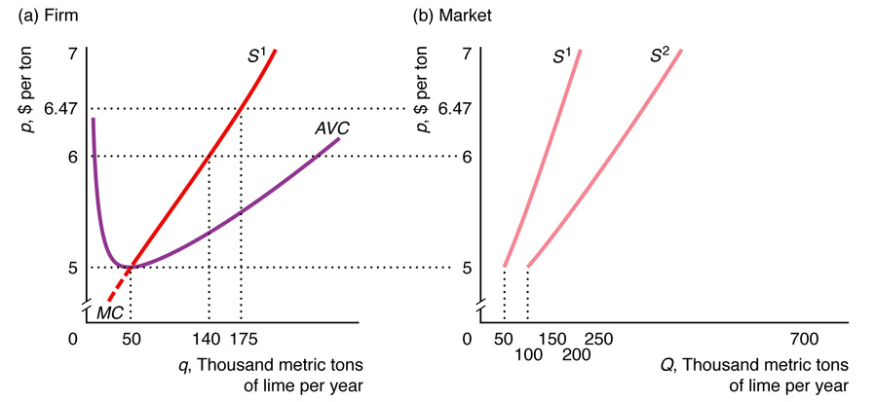
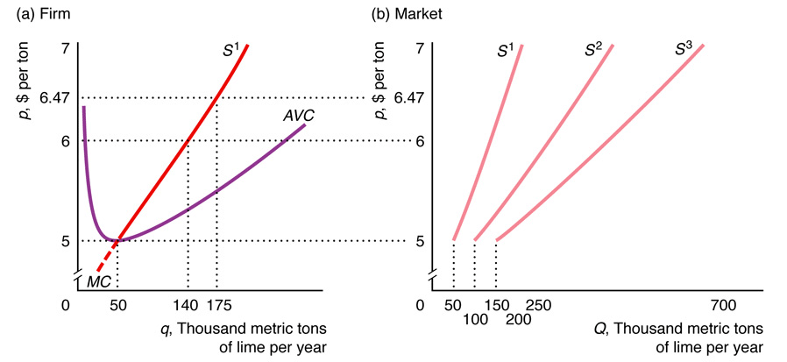
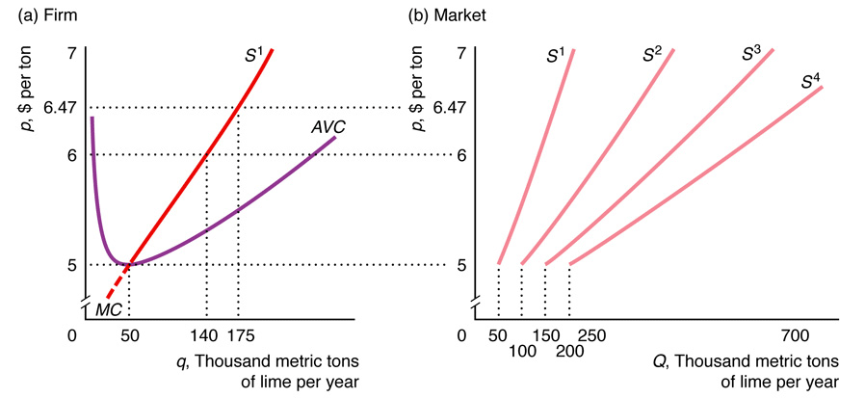
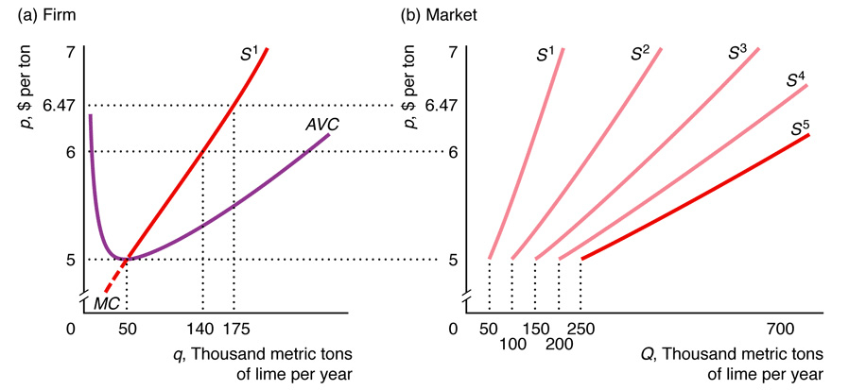
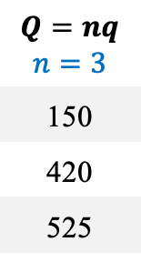






Graphical Analysis
Why the market supply gets flatter when $n$ grows?
No supply
No supply
$$Q=nq$$ $$n=1$$
50
140
175
$$Q=nq$$ $$n=2$$
100
280
350
$$Q=nq$$ $$n=3$$
150
420
525
$$Q=nq$$ $$n=4$$
200
560
700
$$Q=nq$$ $$n=5$$
250
700
875
$$p$$ | $$q$$
5 | 50
6 | 140
6.47 | 175

Slide 23







Why the market supply gets flatter when 𝒏 grows?
We need to look ate the slope of the market supply curve!
$$slope=\frac{dp}{dQ}$$
e.g. Slope when $p$ rises from $6 to $6.47:
$$n=1: slope=\frac{dp}{dQ}=\frac{\$6.47−\$6}{175−140}=\frac{47¢}{35}≈1.34$$
$dp$ is always the same
$$n=3: slope=\frac{dp}{dQ}=\frac{\$6.47−\$6}{525−420}=\frac{47¢}{105}≈0.45$$
$dQ$ grows when $n$ grows
$$n=5: slope=\frac{dp}{dQ}=\frac{\$6.47−\$6}{875−700}=\frac{47¢}{175}≈0.27$$
$slope$ falls when $n$ grows

Slide 24








Short-Run Market Supply: Different Firms
e.g. Firm 2 has higher $AVC$ and $MC$ than firm 1
$$S=S^{1}+S^{2}$$
Both firms in the market and $S$ gets flatter
Both firms operate
Only firm 1 operates
$$S=S^{1}+S^{2}$$
Firm 2 enters the market and $S$ shifts to the right
$$S=S^{1}$$
Only firm 1 in the market
No firm operates

Slide 25
















Short-Run Competitive Equilibrium
By combining the SR market supply and demand curves, we can find the SR competitive equilibrium!
Assuming identical firms:
$$p_{1}$$
$$p_{1}$$
Demand shifts left
($S=D^{1}$)
$${AC(q}_{2})$$
$${AC(q}_{1})$$
$$p_{2}$$
$$p_{2}$$
($S=D^{2}$)
Profit
$$π\left(q_{1}\right)=q_{1}\left[p_{1}−AC\left(q_{1}\right)\right]$$
$$=215\left[7−6.20\right]=172$$
But Operates!
$$p_{2}=AVC(q_{2})$$
$$π\left(q_{2}\right)=q_{2}\left[p_{2}−AC\left(q_{2}\right)\right]$$
$$=50\left[5−6.97\right]=−98.5$$
Loss

Slide 26



Effect of Taxes on Competitive Equilibrium
Suppose the government applies a tax of $t$ per unit of output:
Assuming identical firms:
(a)
F
i
r
m
(b) Mar
k
et
, $ per unit
, $ per unit
1
1
p
S
+
t
S
p
A
VC
+
t
S
+
t
AVC
t
E
S
Equilibrium price increases after taxes ($p_{2}>p_{1}$)
e
t
2
p
2
t
2
p
e
E
1
1
1
t
D
MC
+
t
MC
q
q
q
, Units per year
Q
=
nq
Q
=
nq
2
1
2
2
1
1
Each firm reduces output after taxes ($q_{2}<q_{1}$)
Q
, Units per year
Market supply falls after taxes ($Q_{2}<Q_{1}$)

Slide 27


Competition in the Long Run
Firms use the same short-run output and shutdown rules!
Long-Run Output Decision:
$$MC\left(q^{∗}\right)=p$$
Long-Run Shutdown Decision:
In the long run all costs are variable
$$p<AVC\left(q^{∗}\right)=AC(q^{∗})$$

Slide 28












Long-Run Firm Supply Curve
The LR supply curve is the $MC$ curve above the minimum $AC$ curve!
If $p$ remains the same:
The firm can adjust inputs in the LR to supply more
e.g. Build a larger plant
Short-Run:
$$q^{SR}=50$$
$$π^{SR}=A$$
Long-Run:
Conclusions:
Firm produces more in the LR ($q^{LR}>q^{SR}$)
Frim earns higher profit in the LR ($π^{LR}>π^{SR}$)
$$q^{LR}=110$$
$$π^{LR}=A+B$$

Slide 29

Long-Run Market Supply Curve
As in the SR, the LR market supply curve is the horizontal sum of individual firm supply curves!
3 Assumptions:
Free entry and exit
Identical firms
Constant input prices
LR market supply curve is flat at the minimum $LRAC$!

Slide 30





Graphical Analysis
3 Assumptions: 1. Free entry/exit 2. Identical firms 3. Constant input prices
Because of free entry:
Firms keep entering the market to enjoy profits!
Firms are making profits here!
Suppose LR market supply is here:
Market supply curve becomes flatter…
…until profits are non-negative!
Minimum $LRAC$
No supply
No supply
LR market supply curve is flat at the minimum $LRAC$!
$$Q=nq$$

Slide 31

Scenarios of Non-Flat Long-Run Market Supply
At least one of the previous assumptions are false!
Long-Run Market Supply Curve is upward-sloping in these cases!
1. | Entry is limited | e.g. if government restricts number of firms, if firms need a scarce resource, or if entry is costly.
2. | Firms differ | e.g. if firms with relatively low minimum $LRAC$ are willing to enter market at lower prices than others
3. | Input prices vary with output | e.g. if input prices rise with output (increasing-cost market)

Slide 32

Example: Increasing-Cost Market
Input prices rise with output:
7. Harder to enter the market
(a)
Firm
(b) Market
6. Firms must operate at a higher minimum $AC$
, $ per unit
5. Costs go up
, $ per unit
M
C
2
1
p
M
C
A
2
p
C
1. Demand goes up (shifts right)
S
A
1
C
2. Market price rises
8. Supply curve doesn’t gets totally flat!
e
p
2
2
E
e
2
p
1
1
E
D
1
2
D
1
q
1
q
2
q
, Units per year
Q
=
n
q
Q
=
n
q
Q
, Units per year
1
1
1
2
2
2
3. New firms enter and market output rises
4. Input prices rise!

Slide 33






Long-Run Competitive Equilibrium
Equilibrium occurs at the intersection of LR market demand and LR market supply!
LR and SR competitive equilibrium may differ!
Demand goes up (shifts right)
Flat at the min. $AC$!
Market price rises
Demand shift:
LR quantity changes but price remains the same!

Slide 34
THE END

