Slide 1

BUEC 311
Business Economics, Organizations and Management
Winter 2019
Uncertainty
Diego B. P. Gomes

Slide 2
Where are we?
The Nature of Firms
Production
Ch. 6
Ideal Market Structure!
More Realistic Markets!
Competitive Markets
Market Power
Costs
Ch. 7
Perfect Competition
Ch. 8
Monopoly & Monopsony
Ch. 11
Properties of Competition
Ch. 9
Pricing & Advertising
Ch. 12
Consumer Behavior
Consumer’s Choice
Ch. 3
Game Theory
Ch. 13
General Equilibrium
Ch. 10
Oligopoly
Ch. 14
Choice under Uncertainty
Ch. 16
Factor Markets
Ch. 15
Labor market
Capital market
Exhaustible resources

Slide 3
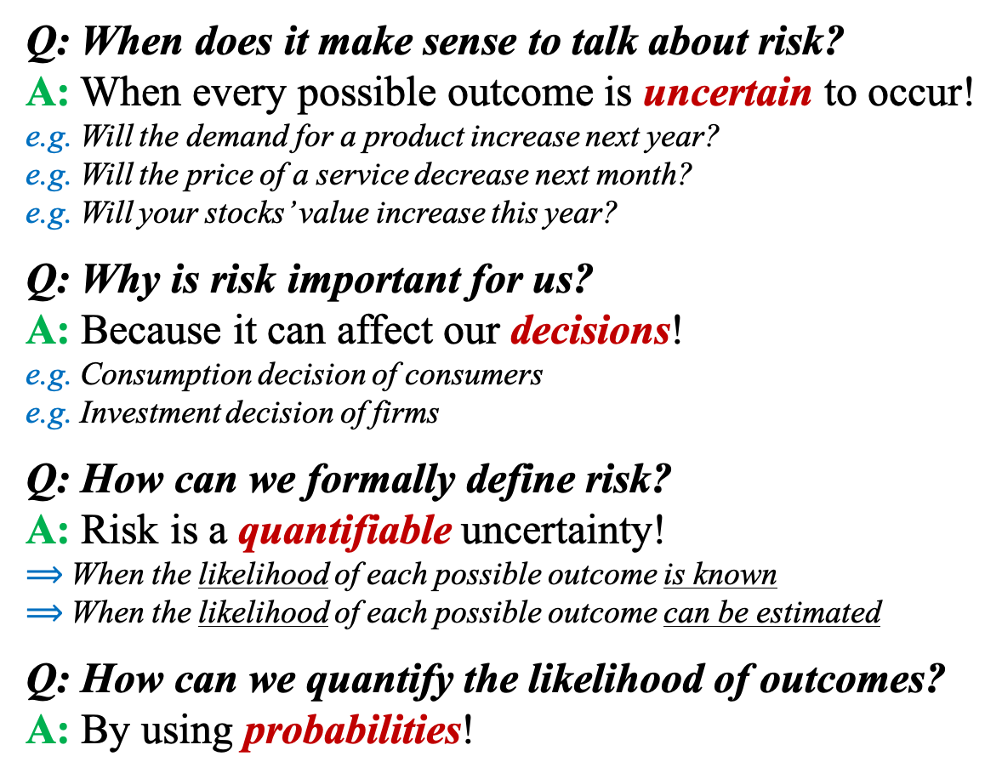
Assessing Risk
Q: When does it make sense to talk about risk?
A: When every possible outcome is uncertain to occur!
e.g. Will the demand for a product increase next year?
e.g. Will the price of a service decrease next month?
e.g. Will your stocks’ value increase this year?
Q: Why is risk important for us?
A: Because it can affect our decisions!
e.g. Consumption decision of consumers
e.g. Investment decision of firms
Q: How can we formally define risk?
A: Risk is a quantifiable uncertainty!
$⟹$ When the likelihood of each possible outcome is known
$⟹$ When the likelihood of each possible outcome can be estimated
Q: How can we quantify the likelihood of outcomes?
A: By using probabilities!

Slide 4

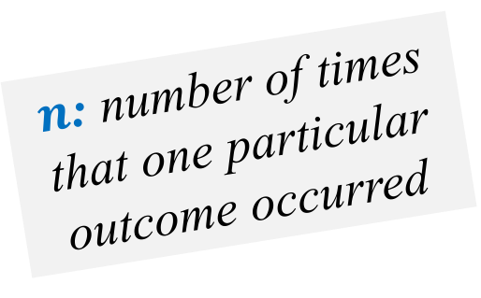
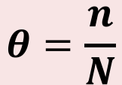
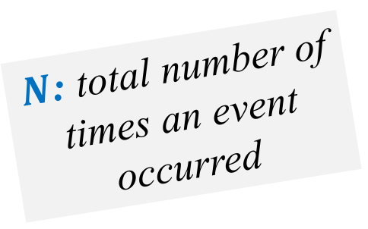
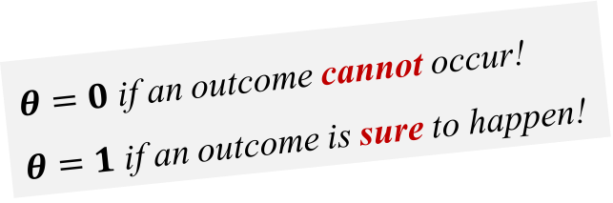
Probability
Is a number between 0 and 1 that indicates the likelihood that a particular outcome will occur!
We can estimate probabilities using frequencies:
Estimated Probability:
$N$: total number of times an event occurred
e.g. Flip a coin
Greek letter theta!
$$θ=\frac{n}{N}$$
$n$: number of times that one particular outcome occurred
$θ=0$ if an outcome cannot occur!
$θ=1$ if an outcome is sure to happen!
e.g. # of Heads

Slide 5
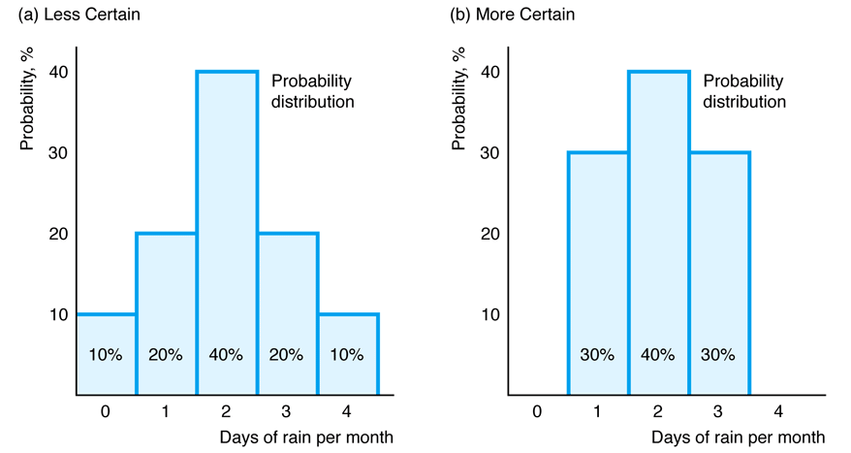












Probability Distribution
Relates the probability of occurrence to each possible outcome!
$$θ_{2}$$
$$θ_{2}$$
$$θ_{1}$$
$$θ_{3}$$
$$θ_{1}$$
$$θ_{3}$$
$$θ_{0}$$
$$θ_{4}$$
$$=100\%$$
$$=100\%$$
$$θ_{0}$$
$$θ_{4}$$
The probabilities must sum to 100%

Slide 6

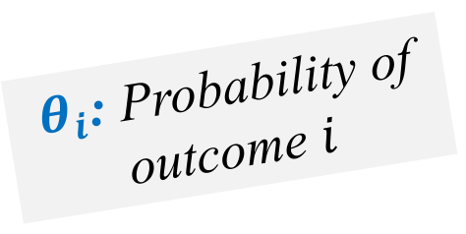
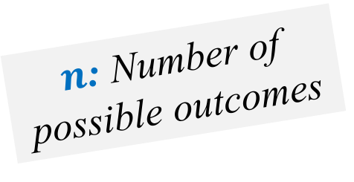
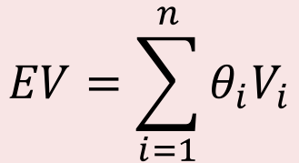
Expected Value
The weighted average of the values of each possible outcome, where the weights are the probabilities!
$V_{i}$: Value of outcome $i$
Expected Value:
$$EV=θ_{1}V_{1}+θ_{2}V_{2}+…+θ_{n}V_{n}$$
$θ_{i}$: Probability of outcome $i$
or
$$EV=\sum_{i=1}^{n}{θ_{i}V_{i}}$$
$n$: Number of possible outcomes

Slide 7






Example
Suppose you are planning an outdoor event:
If it doesn’t rain, you will make $15K in profit
If it does rain, you will make -$5K in profit (loss)
There is a 50% chance of rain
How much would you expect to earn?
$$EV=θ_{R}V_{R}+θ_{NR}V_{NR}$$
$$=0.5×(−5)+0.5×15$$
$$=\$5K$$
$$θ_{R}+θ_{NR}=1$$
$$θ_{R}=0.5$$
$$⟹θ_{NR}=1−θ_{R}=0.5$$

Slide 8
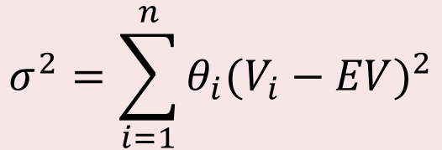
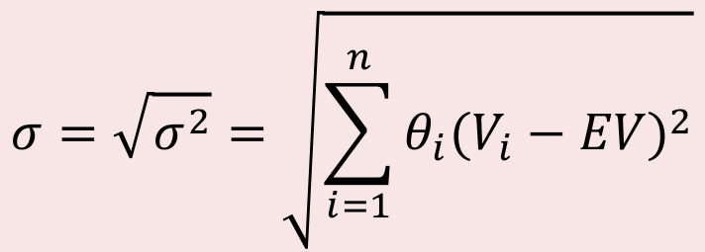
Variance & Standard Deviation
Measures the spread of the probability distribution!
Variance
Variation between the actual value and the expected value!
$$σ^{2}=\sum_{i=1}^{n}{θ_{i}{(V_{i}−EV)}^{2}}$$
Issue with variance:
The unit of measurement is squared!
Is a typical measure of risk in Finance!
Standard Deviation
$$σ=\sqrt{σ^{2}}=\sqrt{\sum_{i=1}^{n}{θ_{i}{(V_{i}−EV)}^{2}}}$$
Fixes the measurement issue!

Slide 9



Example
Suppose you are planning an outdoor event:
If it doesn’t rain, you will make $15K in profit
If it does rain, you will make -$5K in profit (loss)
There is a 50% chance of rain
What is the standard deviation of earnings?
$$EV=5$$
$$σ^{2}=θ_{R}{(V_{R}−EV)}^{2}+θ_{NR}{(V_{NR}−EV)}^{2}$$
$$=0.5{(−5−5)}^{2}+0.5{(15−5)}^{2}$$
$$=100$$
$$σ=\sqrt{σ^{2}}=\sqrt{100}=\$10K$$

Slide 10
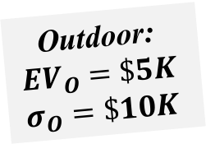







Example
Consider the following two possible arrangements:
 | Outdoor | Indoor
Rain | -$5K | $0K
No Rain | $15K | $10K
$$θ_{R}=50\%$$
Need to compare the SDs!
Which arrangement is riskier from a finance perspective?
$${EV}_{I}=0.5×0+0.5×10$$
$$=\$5K$$
$${EV}_{O}={EV}_{I}$$
Outdoor:
$${EV}_{O}=\$5K$$
$$σ_{O}=\$10K$$
$$σ_{I}^{2}=0.5{(0−5)}^{2}+0.5{(10−5)}^{2}$$
$$=25$$
$$σ_{I}=\sqrt{25}=\$5K$$
Outdoor is riskier!
$$σ_{I}<σ_{O}$$

Slide 11
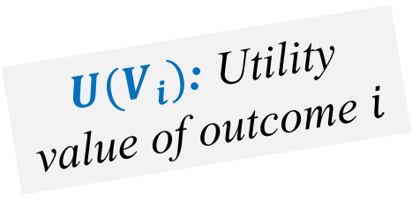
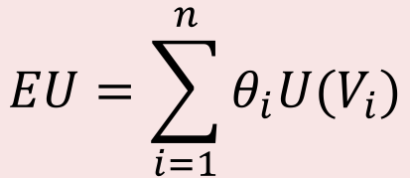
Expected Utility Theory
Expected utility is the probability-weighted average of the utility from each possible outcome!
${U(V}_{i})$: Utility value of outcome $i$
Expected Utility:
$$EU=θ_{1}U(V_{1})+…+θ_{n}U(V_{n})$$
$θ_{i}$: Probability of outcome $i$
or
$$EU=\sum_{i=1}^{n}{θ_{i}{U(V}_{i})}$$
$n$: Number of possible outcomes

Slide 12





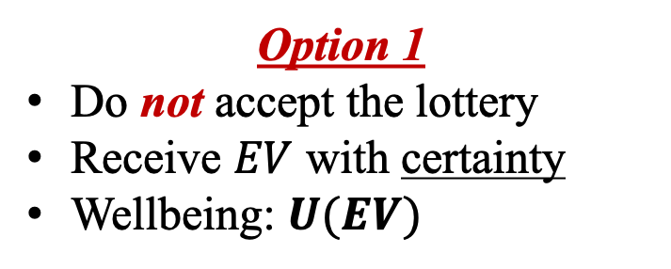
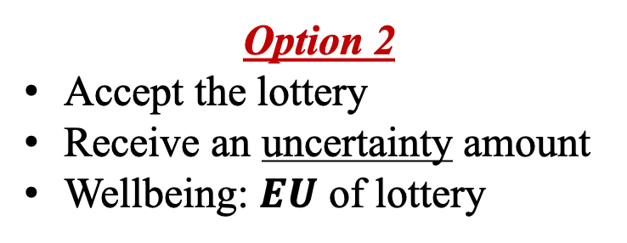




Attitudes Toward Risk
People can be classified according to attitudes toward risk!
Assume there is a lottery with expected value $EV$:
No risk
Risky
Option 1
Do not accept the lottery
Receive $EV$ with certainty
Wellbeing: $U(EV)$
Option 2
Accept the lottery
Receive an uncertainty amount
Wellbeing: $EU$ of lottery
Risk Averse
If $U$ is concave
$$Option1≻Option2$$
$$U\left(EV\right)>EU$$
Risk Neutral
$$Option1 \sim Option2$$
$$U\left(EV\right)=EU$$
If $U$ is linear
Risk Lover
$$Option1≺Option2$$
$$U\left(EV\right)<EU$$
If $U$ is convex

Slide 13
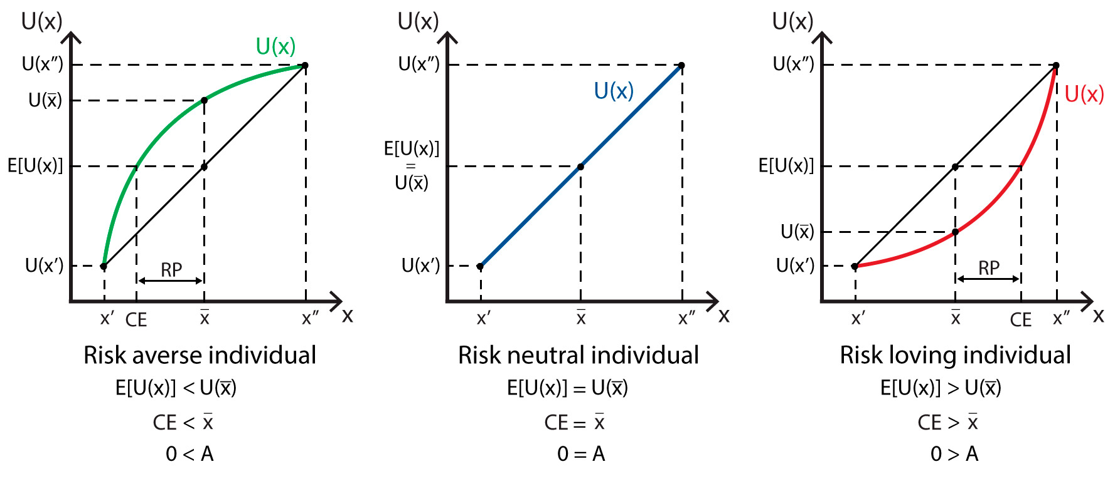

























Graphical Analysis
$U$ is concave
$U$ is linear
$U$ is convex
Risk Averse
Risk Neutral
Risk Lover
$$U$$
$$U$$
$$U$$
$${U(V}_{2})$$
$${U(V}_{2})$$
$${U(V}_{2})$$
$$U(EV)$$
$$EU$$
$$EU$$
$$EU$$
$$U(EV)$$
$$U(EV)$$
$${U(V}_{1})$$
Wealth
$${U(V}_{1})$$
Wealth
$${U(V}_{1})$$
Wealth
$$V_{1}$$
$$EV$$
$$V_{2}$$
$$V_{1}$$
$$EV$$
$$V_{2}$$
$$V_{1}$$
$$EV$$
$$V_{2}$$
$$U\left(EV\right)>EU$$
$$U\left(EV\right)=EU$$
$$U\left(EV\right)<EU$$

Slide 14







Example
Consider the utility $U\left(x\right)=\sqrt{x}$ and the following lottery:
Win $10K with probability of 50%
Win $70K with probability of 50%
What is the risk preference of this individual?
$$EV=0.5×10+0.5×70$$
$$=\$40K$$
$$U\left(EV\right)=\sqrt{40}$$
$$≈\$6.3K$$
Risk Averse
$$U(EV)>EU$$
$$EU=0.5×U(10)+0.5×U(70)$$
$$=0.5×\sqrt{10}+0.5×\sqrt{70}$$
$$≈\$5.8K$$

Slide 15




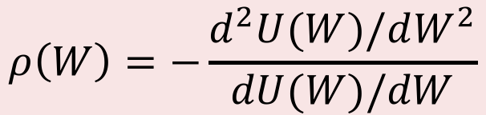
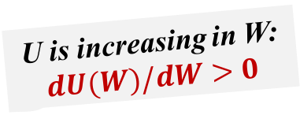

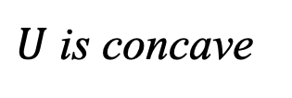
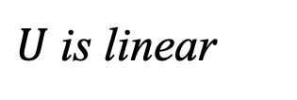
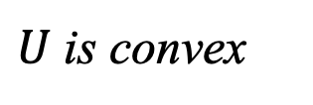

Degree of Risk Aversion
The degree of risk aversion is judged by the shape of the utility function over wealth!
Arrow-Pratt measure of risk aversion:
2nd derivative
U is increasing in W:
$$dU(W)/dW>0$$
$$ρ\left(W\right)=−\frac{d^{2}U(W)/dW^{2}}{dU(W)/dW}$$
1st derivative
Risk Averse
$U$ is concave
$$d^{2}U(W)/dW^{2}<0$$
$$ρ\left(W\right)>0$$
Risk Neutral
$U$ is linear
$$d^{2}U(W)/dW^{2}=0$$
$$ρ\left(W\right)=0$$
Risk Lover
$U$ is convex
$$d^{2}U(W)/dW^{2}>0$$
$$ρ\left(W\right)<0$$

Slide 16
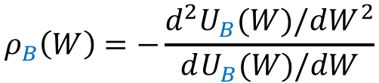
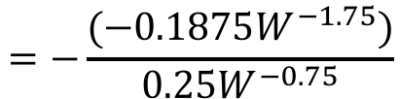






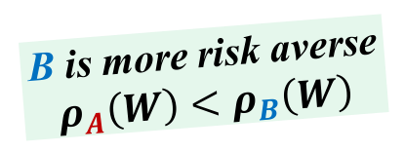


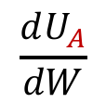
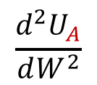
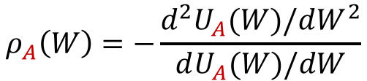
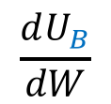
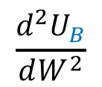
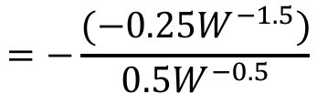
Example
Consider the utility functions of two individuals:
$$U_{A}\left(W\right)=W^{0.5}$$
$$U_{B}\left(W\right)=W^{0.25}$$
Which individual is more risk averse?
$$\frac{dU_{A}}{dW}$$
$$ρ_{A}\left(W\right)=−\frac{d^{2}U_{A}(W)/dW^{2}}{dU_{A}(W)/dW}$$
$$=0.5W^{−0.5}$$
$$\frac{d^{2}U_{A}}{dW^{2}}$$
$$=−\frac{(−0.25W^{−1.5})}{0.5W^{−0.5}}$$
$$=\frac{0.5}{W}$$
$$=−0.25W^{−1.5}$$
B is more risk averse
$$ρ_{A}\left(W\right)<ρ_{B}\left(W\right)$$
$$\frac{dU_{B}}{dW}$$
$$ρ_{B}\left(W\right)=−\frac{d^{2}U_{B}(W)/dW^{2}}{dU_{B}(W)/dW}$$
$$=0.25W^{−0.75}$$
$$\frac{d^{2}U_{B}}{dW^{2}}$$
$$=−\frac{(−0.1875W^{−1.75})}{0.25W^{−0.75}}$$
$$=\frac{0.75}{W}$$
$$=−0.1875W^{−1.75}$$

Slide 17








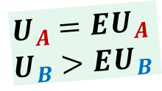
Example (cont.)
Assume they own $100K and consider the following gamble:
Wealth goes to $81K with probability of 50%
Wealth goes to $121K with probability of 50%
Will either person take this gamble?
$$U_{A}={EU}_{A}$$
$$U_{B}>{EU}_{B}$$
Reject the Gamble:
$$U_{A}(100)={100}^{0.5}=10$$
$$U_{B}(100)={100}^{0.25}≈3.1623$$
B, the more risk averse, rejects the gamble!
Accept the Gamble:
$${EU}_{A}=0.5×U_{A}(81)+0.5×U_{A}(121)$$
$$=0.5×{81}^{0.5}+0.5×{121}^{0.5}$$
$$=10$$
$${EU}_{B}=0.5×U_{B}(81)+0.5×U_{B}(121)$$
$$=0.5×{81}^{0.25}+0.5×{121}^{0.25}$$
$$≈3.1583$$

Slide 18
THE END

