Slide 1
The Hidden Cost of Bank Bailouts During the Recent Financial Crisis: How Much Did Taxpayers Pay?
Nae Tanaka
Presented by Pearl Li
September 2, 2015

Slide 2
Outline
Questions
Background
Data
Empirical Analysis
Conclusion

Slide 3
Questions
How can we quantify the amount of moral hazard resulting from bank bailouts during the financial crisis?
How much did taxpayers pay to save failing financial institutions?

Slide 4
Background (1)
May 1984 bailout of Continental Illinois Bank (Conover 1984)
During financial crisis, Bear Stearns, AIG, GM, Chrysler, Fannie Mae, Freddie Mac bailed out
Goal: contain financial contagion from interconnected financial institutions
Only solvent but illiquid financial institutions should have access to lender of last resort lending (Mishkin 2007)
Too big to fail => moral hazard
Notes:
$5.5 billion capital infusion, $8 billion emergency loans to Continental Illinois
Congressman Stewart McKinney popularized phrase “too big to fail” in Congressional hearing

Slide 5
Background (2)
Credit default swap: derivative contract providing insurance against particular company’s default
Spread of a CDS: annual amount paid by buyer to seller
CDS transactions were completed OTC with little regulation and transparency (Brunnermeier 2009)
Assume CDS spread value equals firm’s probability of default

Slide 6
Data
12 U.S.-based too big/complex to fail institutions, including Goldman Sachs, AIG, Lehman Brothers, and Ford Motor Company
Daily trading CDS spread data between October 2004 and December 2009 from Bloomberg
Other firm-specific and macroeconomic variables
5 government intervention events selected from NY Fed Crisis Timeline

Slide 7
Empirical Analysis (1)
Forecast CDS spreads in absence of 5 government intervention events:
March 14, 2008: JP Morgan acquires Bear Stearns with Fed assistance
September 7, 2008: Fannie Mae and Freddie Mac placed in federal conservatorship
September 15, 2008: Lehman Brothers files for bankruptcy
September 29, 2008: Citigroup bails out Wachovia in Fed-brokered deal
October 14, 2008: 9 large banks get capital injection
Value of TBTF = forecasted CDS spreads – observed CDS spreads

Slide 8
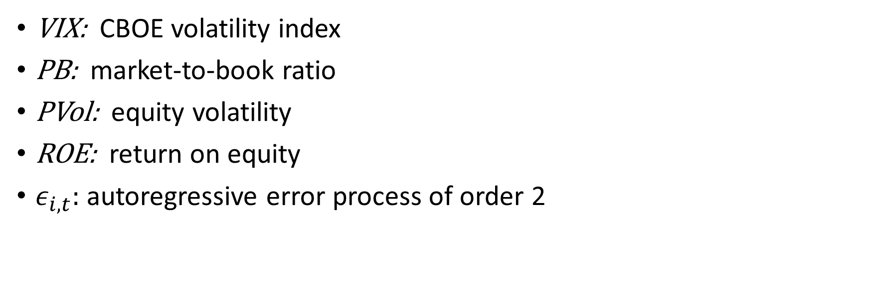
Empirical Analysis (2)
VIX: CBOE volatility index
PB: market-to-book ratio
PVol: equity volatility
ROE: return on equity
$ε_{i, t}:$ autoregressive error process of order 2
Notes:
Increases in volatility: economic conditions deteriorate in high volatility
Decreases in market-to-book: equity markets undervalue company
Decreases in ROE: more profitable companies less likely to default

Slide 9
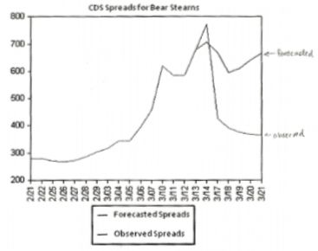
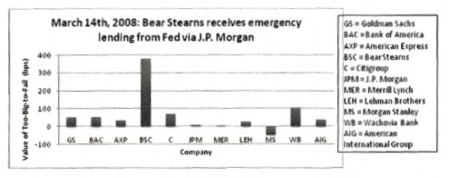
Event 1: Bear Stearns acquisition (3/14/08)
CDS spreads narrowed for 10 of 11 financial institutions after bailout
Bear Stearns had highest value of TBTF (378 bps), signaling increased investor confidence despite no fundamental change in nature of business
Notes:
March 14, 2008: JP Morgan acquires Bear Stearns with Fed assistance

Slide 10
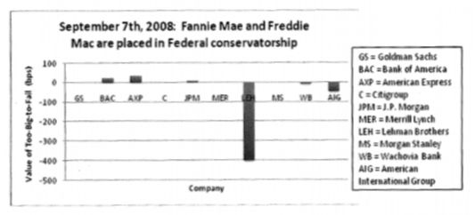
Event 2: Takeover of Fannie & Freddie (9/7/08)
Average decline in TBTF of 39.8 bps
Value of TBTF lowest during Event 2 among five considered
Market considered Fannie and Freddie distinct from private sector
Lehman Brother considered at extreme risk of default despite Bear Stearns bailout
Notes:
September 7, 2008: Fannie Mae and Freddie Mac placed in federal conservatorship

Slide 11
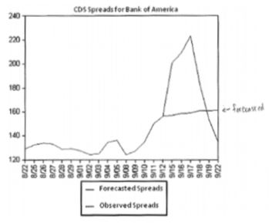
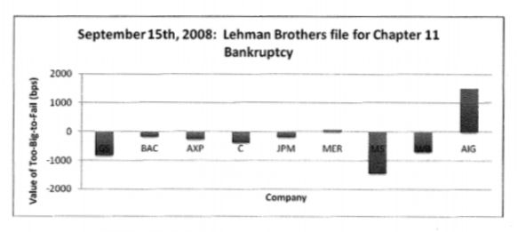
Event 3: Lehman Brothers collapse (9/15/08)
Fed signaled it would allow some institutions to fail
Forecasted CDS spread now below observed spread
Value of TBTF significantly decreased for 7 of 9 institutions
Notes:
September 15, 2008: Lehman Brothers files for bankruptcy

Slide 12
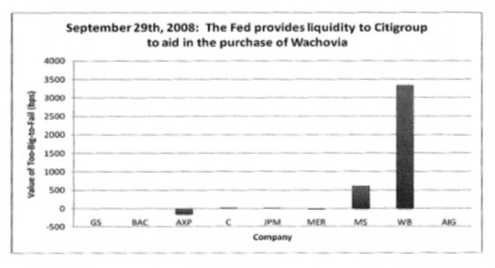
Event 4: Wachovia bailout (9/29/08)
Large spike in Wachovia TBTF value to 3340 bps reflecting bidding war between Citigroup and Wells Fargo
Investors still unsure how government would act after Lehman bankruptcy
Notes:
September 29, 2008: Citigroup bails out Wachovia in Fed-brokered deal

Slide 13
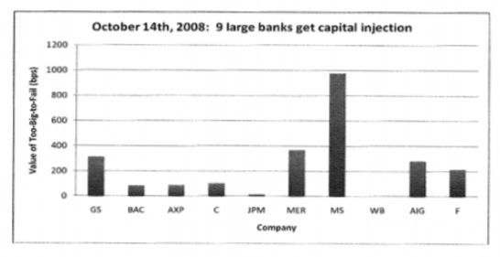
Event 5: Capital injection (10/14/08)
9 large banks forced to take loans from Treasury, subjecting them to restrictions on unnecessary risk
Increase in TBTF value for 8 of 9 companies (except Wachovia, which was previously bailed out)
Market perception of safety net more influential than risk restrictions
Notes:
October 14, 2008: 9 large banks get capital injection

Slide 14
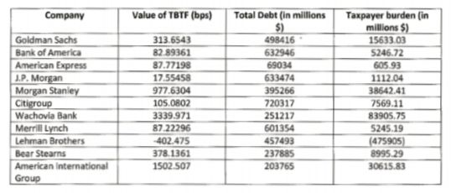
Conclusion
Value of TBTF corresponds to cost for a TBTF institution to have its total debt insured
Obtain taxpayer burden by multiplying TBTF value (bps) by total debt
Taxpayer burden is positive for all institutions except Lehman, which was allowed to fail
Net taxpayer burden -$278 billion

