Slide 1

智享健康
智能姿态与眼部提示助手
AI for everyday wellness
Posture and eye-cue support for students
科技论坛项目展示
新加坡与中国学生合作项目
Tech Forum · Singapore–China student collaboration
智享健康 · 中新学生合作项目
01
Notes:
Content based on original 少字版.pptx and product README.md. Images, when present, reused from the source presentation. Capabilities follow the current README; planned validation is not presented as an achieved result.

Slide 2
目录
01
问题与背景
02
目标与方案
Problem & background
Goals & solution
03
功能与实现
04
成果演示
Features & implementation
Demonstration
05
局限与展望
06
资料来源
Limitations & next steps
Sources
智享健康 · 中新学生合作项目
02
Notes:
Content based on original 少字版.pptx and product README.md. Images, when present, reused from the source presentation. Capabilities follow the current README; planned validation is not presented as an achieved result.

Slide 3
学习中的四个常见困扰
01
02
03
久坐学习
持续看屏幕
书写习惯
长时间保持同一姿势，容易忽略活动与调整。
专注阅读与做题时，眨眼和休息常被忽略。
低头、趴桌与手部姿势变化不容易及时察觉。
Long study sessions can make movement and posture changes easy to forget.
During screen tasks, students may overlook blinking and breaks.
Leaning over a desk and hand-position changes can be hard to notice.
智享健康 · 中新学生合作项目
03
Notes:
Content based on original 少字版.pptx and product README.md. Images, when present, reused from the source presentation. Capabilities follow the current README; planned validation is not presented as an achieved result.

Slide 4
背景数据：学生视力值得关注
51.9%
小学 / Primary
36.7%
初中 / Junior secondary
2022年中国儿童青少年总体近视率
71.4%
Overall myopia prevalence among children
and adolescents in China, 2022
高中 / Senior secondary
81.2%
背景数据不代表本产品的效果。/ These figures do not measure the app’s effectiveness.
智享健康 · 中新学生合作项目
04
Notes:
Source: 国家疾病预防控制局, 2024-03. 2022 surveillance data. https://www.ndcpa.gov.cn/jbkzzx/c100008/common/content/content_1764617954927783936.html

Slide 5
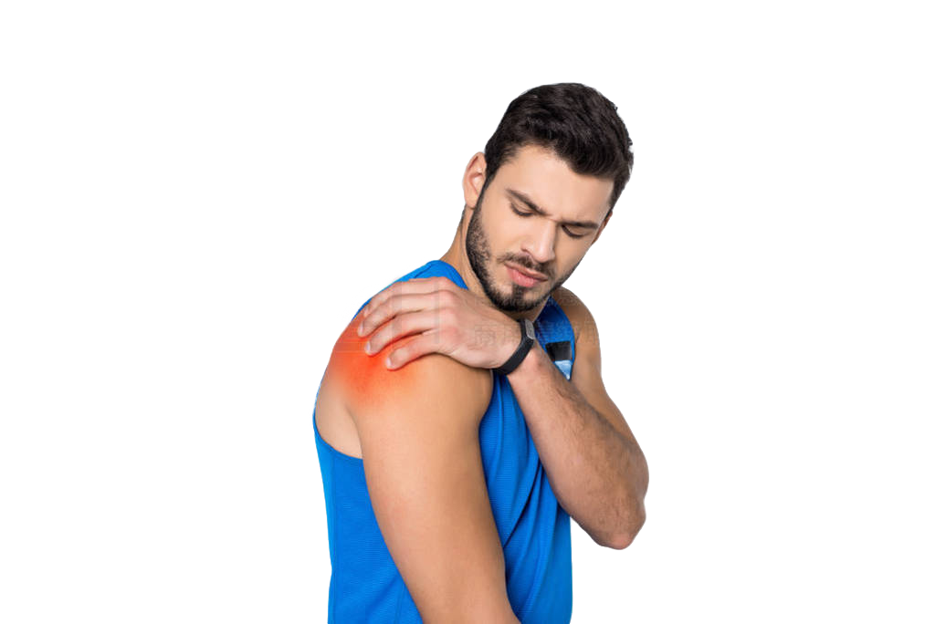
身体发出信号时，我们未必注意到
从颈肩紧绷，到长时间不变换姿势
From neck and shoulder discomfort to staying in one position for too long
项目关注：让可见变化更容易被察觉，并提供小幅调整与休息提示。
Project focus: notice visible changes and prompt small adjustments or breaks.
智享健康 · 中新学生合作项目
05
Notes:
Content based on original 少字版.pptx and product README.md. Images, when present, reused from the source presentation. Capabilities follow the current README; planned validation is not presented as an achieved result.

Slide 6
我们的目标：发现、行动、反馈
01
02
03
发现习惯
鼓励行动
温和反馈
帮助学生察觉姿态、眼部与书写特征的变化。
提醒调整姿势、移开视线和适时活动。
让建议清楚、及时，并由学生控制提醒。
Help students notice posture, eye and writing-feature changes.
Encourage posture adjustments, looking away and movement.
Keep guidance clear and timely, with user-controlled reminders.
智享健康 · 中新学生合作项目
06
Notes:
Content based on original 少字版.pptx and product README.md. Images, when present, reused from the source presentation. Capabilities follow the current README; planned validation is not presented as an achieved result.

Slide 7
双场景设计：屏幕学习与书写
01
02
屏幕学习
书写学习
观察头肩姿态、眨眼与闭眼线索，提示调整或休息。
结合坐姿与个人手部参考，观察书写时的可见变化。
Observe head and shoulder posture, blinking and eye closure, then suggest adjustment or rest.
Combine posture cues with a personal hand reference to observe visible writing changes.
智享健康 · 中新学生合作项目
07
Notes:
Content based on original 少字版.pptx and product README.md. Images, when present, reused from the source presentation. Capabilities follow the current README; planned validation is not presented as an achieved result.

Slide 8
工作流程：从个人参考到提醒
01
02
03
04
摄像头输入
个人参考校准
观察持续变化
显示建议与提醒
Capture visible features
Calibrate a personal reference
Track sustained changes
Show guidance and reminders
姿态参考校准需稳定保持约5秒，移动摄像头后需要重新校准。
Hold a stable posture for about 5 seconds. Recalibrate after moving a camera.
智享健康 · 中新学生合作项目
08
Notes:
Content based on original 少字版.pptx and product README.md. Images, when present, reused from the source presentation. Capabilities follow the current README; planned validation is not presented as an achieved result.

Slide 9

姿态监测：正面与侧面互补
正面观察头部倾斜、转动和肩部变化
The front view observes head tilt, head turn and shoulder changes.
侧面可补充头部前移。髋部可见时，系统才评估躯干倾斜。
A side view adds forward-head cues. Torso lean requires visible hips.
智享健康 · 中新学生合作项目
09
Notes:
Content based on original 少字版.pptx and product README.md. Images, when present, reused from the source presentation. Capabilities follow the current README; planned validation is not presented as an achieved result.

Slide 10

眼部提示：眨眼、移开视线、休息
摄像头观察眼睛开合与近期闭眼模式
The camera tracks eye openness and recent closure patterns.
低眨眼提示眨眼与远眺；较长或频繁闭眼可提示休息。它们是视觉线索，不能诊断眼疲劳。
Low blinking prompts blinking and looking away. Longer or frequent closures may prompt a break. These cues do not diagnose eye strain.
智享健康 · 中新学生合作项目
10
Notes:
Content based on original 少字版.pptx and product README.md. Images, when present, reused from the source presentation. Capabilities follow the current README; planned validation is not presented as an achieved result.

Slide 11

书写监测：建立自己的手部参考
正常书写约12秒，学习个人活动范围
Write normally for about 12 seconds to establish a personal movement reference.
显示手腕、拇指、食指和中指。系统观察相对变化，不认定某一种握笔方式适合所有人。
Keep the wrist, thumb, index and middle fingers visible. The app compares changes against the user’s own reference.
智享健康 · 中新学生合作项目
11
Notes:
Content based on original 少字版.pptx and product README.md. Images, when present, reused from the source presentation. Capabilities follow the current README; planned validation is not presented as an achieved result.

Slide 12
提醒交互：清楚，也可调整
01
02
03
持续变化后提醒
多种反馈方式
学生控制节奏
姿态偏离持续达到设定时长，才触发提醒。
界面提示、本地语音，以及macOS桌面通知。
调节灵敏度、延迟、冷却时间，或设置安静时段。
A posture deviation must persist for the selected delay before a reminder qualifies.
Dashboard guidance, local speech and macOS desktop notifications.
Adjust sensitivity, delay and cooldown, or set quiet hours.
智享健康 · 中新学生合作项目
12
Notes:
Content based on original 少字版.pptx and product README.md. Images, when present, reused from the source presentation. Capabilities follow the current README; planned validation is not presented as an achieved result.

Slide 13
提示示例：从观察到可执行建议
头肩持续偏离参考
放松肩膀，调整坐姿
Sustained head or shoulder deviation
Relax your shoulders and adjust your position.
长时间保持近似姿势
换个姿势，活动一下
Little visible posture movement
Change position and take a movement break.
眼部闭合线索增加
如感到疲倦，可以休息
More eye-closure cues
Consider a break if you feel tired.
智享健康 · 中新学生合作项目
13
Notes:
Content based on original 少字版.pptx and product README.md. Images, when present, reused from the source presentation. Capabilities follow the current README; planned validation is not presented as an achieved result.

Slide 14
仪表盘：从即时提示到学习回顾
01
02
03
实时监测
会话回顾
休息工具
在同一界面查看姿态、眼部与书写提示，并显示追踪可用性。
查看有效监测时间、常见变化、眨眼估算和分钟趋势。
使用专注计时器或两分钟休息，休息后手动恢复。
See posture, eye and writing guidance together, with tracking availability.
Review observed time, recurring changes, estimated blinking and minute trends.
Use a focus timer or a two-minute break, then resume monitoring manually.
智享健康 · 中新学生合作项目
14
Notes:
Content based on original 少字版.pptx and product README.md. Images, when present, reused from the source presentation. Capabilities follow the current README; planned validation is not presented as an achieved result.

Slide 15
隐私与本地处理
01
02
03
画面留在电脑
数值记录可选
暂停即可停止拍摄
本地处理摄像头画面，不上传或保存视频。
会话汇总存储在本机，可关闭保存、导出或清除。
暂停释放摄像头并清除实时测量。
Camera processing stays local. Video is neither uploaded nor saved.
Optional numeric summaries stay on the device and can be disabled, exported or cleared.
Pausing releases the cameras and clears live measurements.
智享健康 · 中新学生合作项目
15
Notes:
Content based on original 少字版.pptx and product README.md. Images, when present, reused from the source presentation. Capabilities follow the current README; planned validation is not presented as an achieved result.

Slide 16
从想法到产品：开发过程
01
02
03
需求与原型
视觉与应用集成
测试与迭代
从学习痛点出发，使用Figma规划布局与交互。
Python、OpenCV与MediaPipe连接视觉处理和本地网页界面。
检查几何计算、校准与提醒时序，持续改进稳定性。
Start with study needs and plan layouts and interactions in Figma.
Python, OpenCV and MediaPipe connect visual processing to a local web dashboard.
Check geometry, calibration and reminder timing, then refine stability.
智享健康 · 中新学生合作项目
16
Notes:
Content based on original 少字版.pptx and product README.md. Images, when present, reused from the source presentation. Capabilities follow the current README; planned validation is not presented as an achieved result.

Slide 17
实现方式：已有视觉模型与个人参考
MediaPipe提供姿态和面部关键点，应用计算相对个人参考的变化。
MediaPipe supplies pose and face landmarks. The app computes changes relative to a personal reference.
可选书写学习功能
经标注的数值记录可训练本地变化检测器，需用不同参与者检验。
Labeled numeric recordings can train a local change detector, evaluated with separate participants.
智享健康 · 中新学生合作项目
17
Notes:
Content based on original 少字版.pptx and product README.md. Images, when present, reused from the source presentation. Capabilities follow the current README; planned validation is not presented as an achieved result.

Slide 18
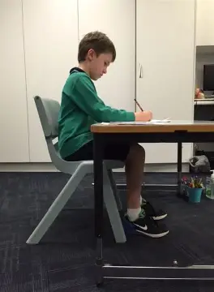
演示一：启动与参考校准
选择摄像头，让面部与双肩清晰可见
Select a camera and keep the face and both shoulders visible.
① 启动会话 ② 跟随构图提示 ③ 稳定保持约5秒
① Start a session ② Follow framing cues ③ Hold still for about 5 seconds
智享健康 · 中新学生合作项目
18
Notes:
Content based on original 少字版.pptx and product README.md. Images, when present, reused from the source presentation. Capabilities follow the current README; planned validation is not presented as an achieved result.

Slide 19
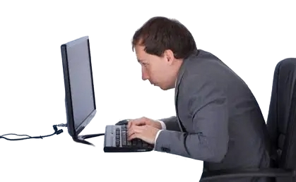
演示二：观察变化与提醒
展示一次持续的头肩姿态变化，再恢复参考姿势
Demonstrate a sustained head or shoulder change, then return toward the reference.
观察实时提示与提醒延迟；遮挡关键部位时，检查“不可用”状态。
Observe live guidance and the reminder delay. Cover a tracked feature to show the unavailable state.
智享健康 · 中新学生合作项目
19
Notes:
Content based on original 少字版.pptx and product README.md. Images, when present, reused from the source presentation. Capabilities follow the current README; planned validation is not presented as an achieved result.

Slide 20
演示三：书写与休息流程
01
02
书写校准
休息与恢复
显示手部，正常书写约12秒，再展示可见的手腕或手指变化。
点击两分钟休息，确认摄像头暂停，再手动恢复会话。
Show the hand, write normally for about 12 seconds, then demonstrate a visible wrist or finger change.
Start a two-minute break, confirm cameras pause, then manually resume.
智享健康 · 中新学生合作项目
20
Notes:
Content based on original 少字版.pptx and product README.md. Images, when present, reused from the source presentation. Capabilities follow the current README; planned validation is not presented as an achieved result.

Slide 21
演示结果应该怎样解读？
界面能否清楚展示状态、变化与用户控制？
Does the interface clearly communicate status, changes and user controls?
演示模式使用合成数据，只验证界面与流程。真实效果仍需学生测试。
Demo mode uses synthetic data to check the interface and workflow. Real-world effectiveness still needs student testing.
智享健康 · 中新学生合作项目
21
Notes:
Content based on original 少字版.pptx and product README.md. Images, when present, reused from the source presentation. Capabilities follow the current README; planned validation is not presented as an achieved result.

Slide 22
当前局限：看得见，也未必测得准
01
02
03
环境与遮挡
范围与估算
验证尚不充分
光线、眼镜、服装与拍摄角度影响关键点追踪。
仅评估可见特征；无法从摄像头测量疼痛、握笔压力或健康状态。
阈值属于工程设定，尚无真实用户准确率与健康改善结论。
Lighting, glasses, clothing and camera angles affect landmark tracking.
Only visible features can be assessed. Cameras cannot measure pain, grip force or health.
Thresholds are engineering settings. Real-user accuracy and health benefits remain unestablished.
智享健康 · 中新学生合作项目
22
Notes:
Content based on original 少字版.pptx and product README.md. Images, when present, reused from the source presentation. Capabilities follow the current README; planned validation is not presented as an achieved result.

Slide 23
下一步：验证、适应与体验
01
02
03
真实场景测试
提升适应性
完善体验
邀请学生多次使用，分别记录正常活动、刻意变化与追踪失败。
使用多样参与者与不同机位，评估误报、漏报和可用覆盖。
根据反馈改善操作指引与提醒节奏，清楚说明结果适用范围。
Collect repeated student sessions covering normal activity, deliberate changes and tracking failures.
Evaluate false alerts, missed changes and coverage across participants and camera positions.
Refine guidance and reminder timing from feedback, and explain what results mean.
智享健康 · 中新学生合作项目
23
Notes:
Content based on original 少字版.pptx and product README.md. Images, when present, reused from the source presentation. Capabilities follow the current README; planned validation is not presented as an achieved result.

Slide 24
资料来源与内容说明
01 项目原始材料
《少字版.pptx》：问题、目标、双场景设计、开发过程与展望。
Original deck: motivation, goals, study scenarios, development and next steps.
02 产品文档
README.md：当前功能、技术实现、隐私、校准与已知局限。
Product documentation: current features, implementation, privacy, calibration and limits.
03 国家疾病预防控制局（2024年发布，2022年监测数据）
儿童青少年近视率统计。图片沿用原始演示稿，原始图片出处未提供。
Myopia surveillance data. Images reused from the original deck; original asset credits were not supplied.
智享健康 · 中新学生合作项目
24
Notes:
Statistics source: https://www.ndcpa.gov.cn/jbkzzx/c100008/common/content/content_1764617954927783936.html
Original unsupported 60% eye strain and 30–60% dry eye figures omitted. Original PyTorch CNN/PyQt claims replaced with documented implementation. Original team name spelling differs across cover and closing slide, so no unverified spelling has been introduced.

Slide 25
谢谢聆听
让技术帮助我们更早注意身体的变化。
Using technology to notice bodily changes sooner.
欢迎提问与建议
Questions and feedback are welcome
智享健康 · 中新学生合作项目
25
Notes:
Content based on original 少字版.pptx and product README.md. Images, when present, reused from the source presentation. Capabilities follow the current README; planned validation is not presented as an achieved result.

