Slide 1




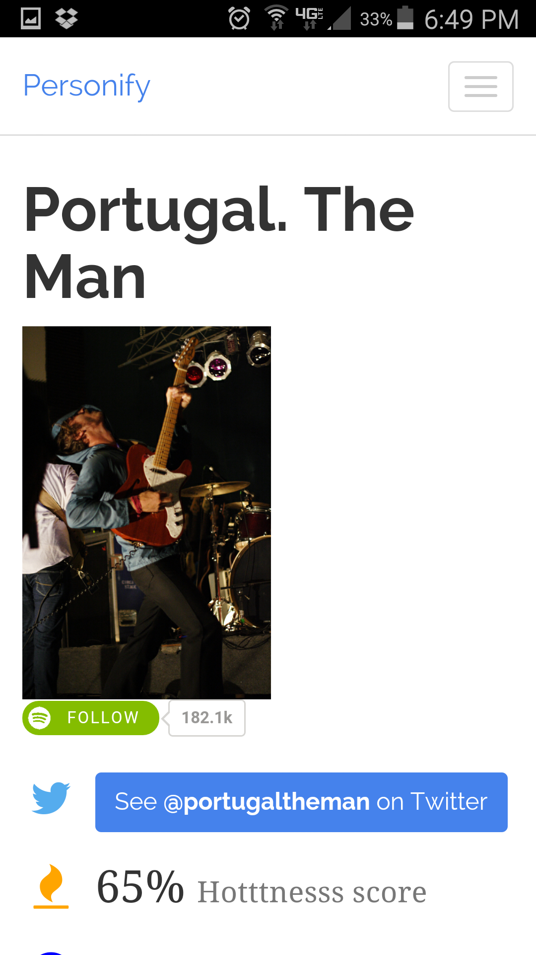
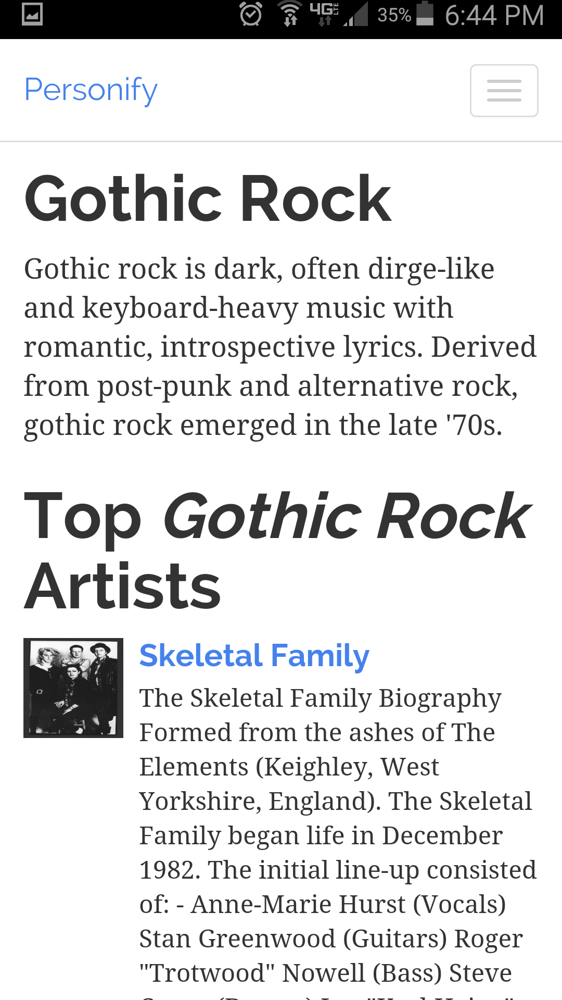


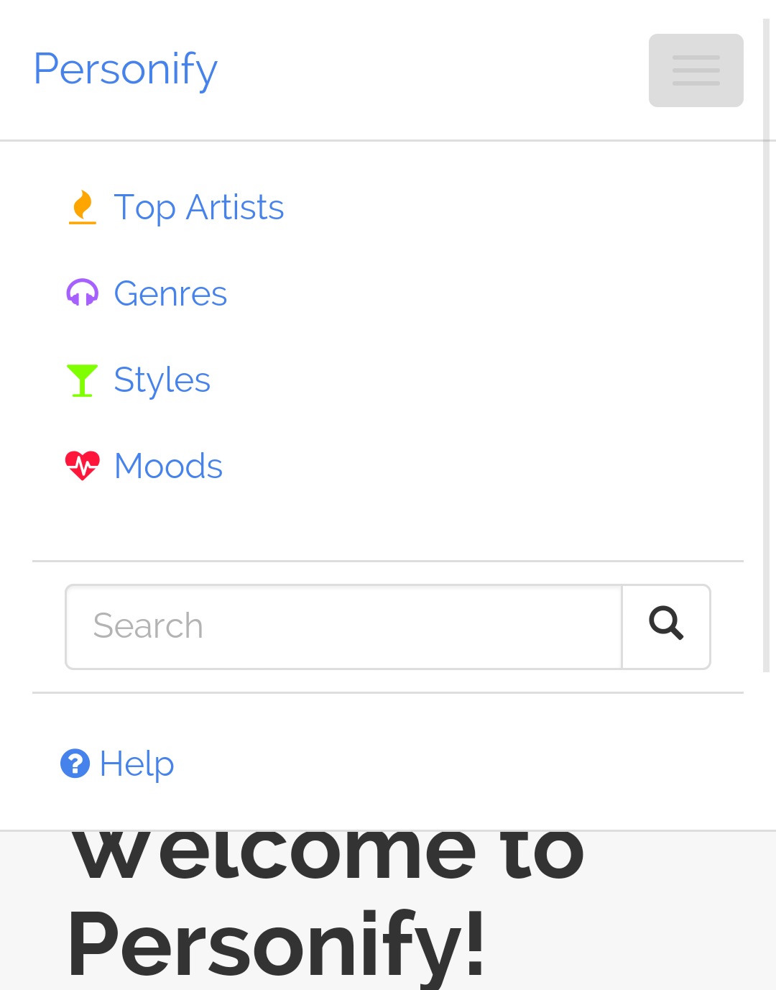
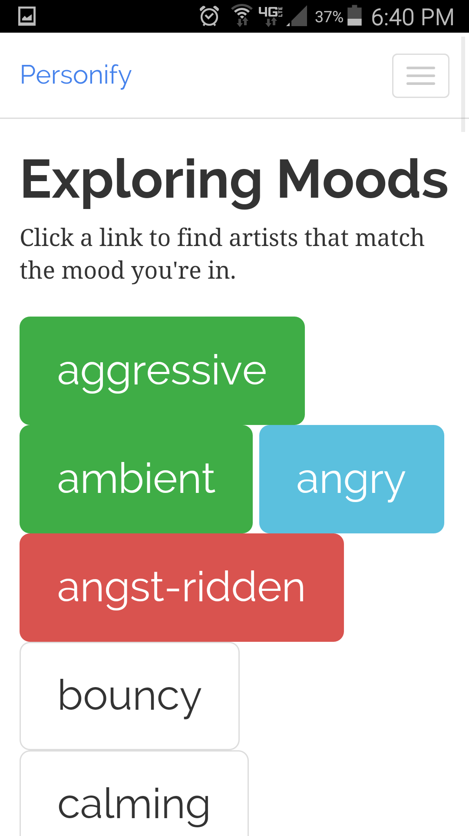

Personify - More than a beat
WEB & MOBILE - United
ARTIST DETAILS
GENRE DETAILS
STYLE & MOOD
Search for and find: Artists, Genres. Discover and learn about new types of music and people.
FEATURES
Artist bios, news, blogs. Shows similar artists.
Can follow artist on Spotify and Twitter.
See a list of music genres and select to see top artists from that genre.
Genre descriptions and details.
Fuzzy search for both artists and genres.
Find artists that match certain music styles or moods.
NAVIGATION VIA DROPDOWN MENU
TRY IT OUT
Toolbar is responsive and adapts to the screen size. Search and navigate around the app in one easy place.
lnunno.github.io/personify
Lucas Nunno
lucasnunno@gmail.com

