Slide 1
New York Times Article Abstract Analysis using Hadoop and NLTK
By: Lucas Nunno (lnunno@cs.unm.edu)

Slide 2
Part 1: Data Acquisition

Slide 3
Data acquisition
Used the python requests module.
Used the offset parameter to load new pages of abstracts and slept 1/8th of a second between each request to abide by the NYT API terms of use.
Loaded JSON response into python dictionary and then exported as a single large JSON file containing all the articles and all metadata. (~40,000)
In a separate script, I export this JSON data to a CSV file with the docIDs, URLs, and abstracts.
This is also where I check for duplicates. I have a set of URLs that the exporter has seen, if this URL is in this set the program prints a warning and does not export it.

Slide 4
Part 2: Preprocessing and tf-idf

Slide 5
Preprocessing
Used the python natural language toolkit (NLTK) module for most of the preprocessing tasks. The algorithm is as follows:
Convert text to lowercase.
Remove punctuation and numbers.
Simple regex substitution:
remove_pattern = re.compile(r'[^a-z\s]')
Remove stopwords.
See: nltk.corpus.stopwords
Stem all the remaining words.
See: http://www.nltk.org/api/nltk.stem.html#module-nltk.stem.porter
Output the cleaned abstract.

Slide 6
tf-idf is broken up into a couple of stages
Term frequency map reduce job.
Document frequency and calculating the total number of documents. Done as a separate map reduce job.

Slide 7
How is this parallelized in Hadoop? – Term frequency
articles.csv
clean_text() on each abstract
Emit: (URL,WORD,COUNT) Separated by tabs. URL is key.
Word counting
Hadoop mapper

Slide 8
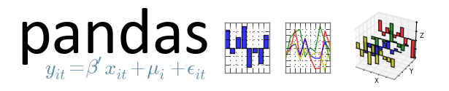
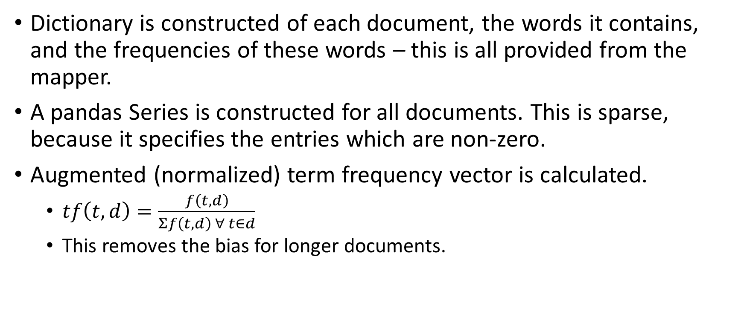
Term frequency
Dictionary is constructed of each document, the words it contains, and the frequencies of these words – this is all provided from the mapper.
A pandas Series is constructed for all documents. This is sparse, because it specifies the entries which are non-zero.
Augmented (normalized) term frequency vector is calculated.
$tf\left(t,d\right)=\frac{f\left(t,d\right)}{Σf\left(t,d\right) ∀ t∈d}$
This removes the bias for longer documents.

Slide 9
How is this parallelized in Hadoop? – Doc frequency
(URL,WORD,COUNT) From previous mapper
Count how many documents each word appears in.
doc_freq.json
Count the total number of words (N)
Hadoop reducer

Slide 10

df and tf-idf
Document frequency vector is calculated in a reducer by counting the number of unique documents that each term appears in.
We then multiply each normalized term frequency vector with the idf vector to calculate each document’s tf-idf vector.
A special implementation detail is that we remove all nonzero entries and only output the information where the tf-idf score is zero. This saves a massive amount of space and time. Every tf-idf vector is very sparse.
From these data structures we can calculate the inverse document frequency (idf) vector.

Slide 11
How is this parallelized in Hadoop?
(URL,WORD,COUNT)
tf-idf vectors
Emitted: (URL, tf-idf vector)
In JSON.
Hadoop mapper
doc_freq.json
No matching reducer. Mapping is all that’s needed. Internally, we just use the Apache IdentityReducer in the Streaming API.

Slide 12
Part 3: Clustering and Visualization
So now that we have the tf-idf vectors, how do we cluster?

Slide 13

Clustering methodology
Apache Spark makes it (relatively) easy to do distributed clustering.
The API for Spark allows for a text file to be stored in a distributed manner.
We use the previously calculated tf-idf vectors and transform them into Apche Spark’s own SparseVectors.
Spark’s MLlib module is then used for distributed K-means clustering.
This uses the SparseVectors that we created and can rapidly separate the vectors into clusters.
The centroids of the K-means model were analyzed to determine the most discriminative terms per cluster.

Slide 14
Why K-means?
Aside from it being the only clustering algorithm available in Spark (which is a good reason), it is one of the most popular clustering algorithms available and used in production in many Big Data applications.
The Mahout K-means algorithm was also considered, but Apache Spark offered an easier set-up and a Python API so it was used.

Slide 15
K-means pros and cons
Can easily tweak the k value.
Can easily tweak the number of iterations and see if this improves the solution.
Implementation is simple and easy to understand.
Will find a local error minimum.
Widely used.
Must pick the appropriate K value.
Have to choose how many iterations to perform.
Will probably not find the optimal solution.
Sensitive to outliers.

Slide 16
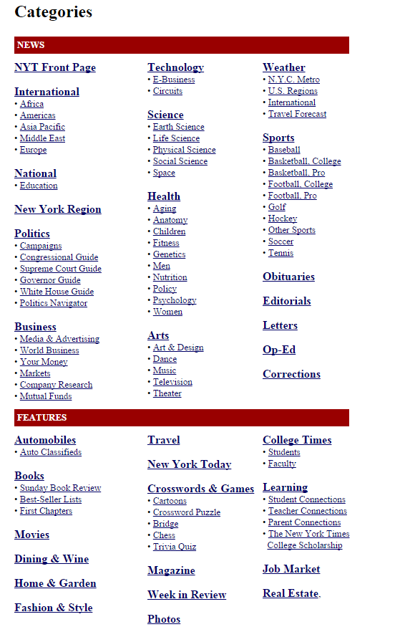
How many clusters?
If you look at the sections in the New York Times (right), there are around 20 primary sections of the paper.
We initially started out at 20 clusters and then quantitatively analyzed how the number of clusters affected the results.

Slide 17
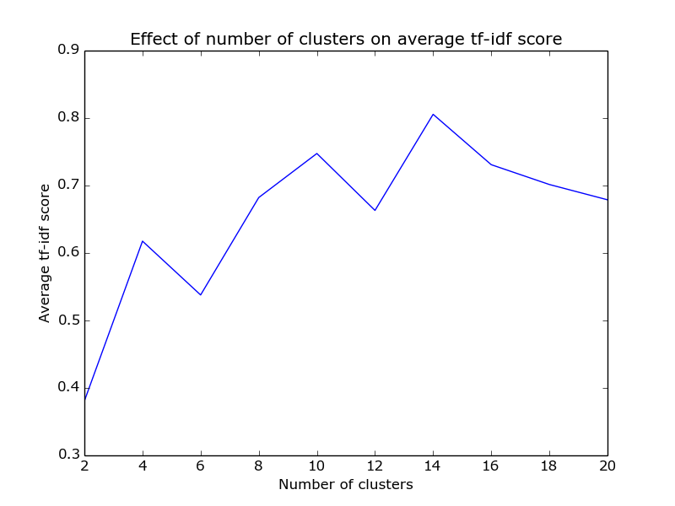
Analysis on number of clusters
Each cluster contains a vector of the 20 highest discriminative terms for that cluster.
Notice how the average is maximized at 14 clusters.
Due to these results, we will be using the 14 clusters found to have the highest average discriminative terms.

Slide 18
Things to consider when clustering
Our sample size is relatively small (~40k) and not all sections may be represented sufficiently.
Sampling methodology.
It is highly dependent on which articles were being produced the most at the time of collection. We did not discriminate on the types of articles found.
This is a combination of the limitations of the New York Times API and the methodology employed in this study.
This may help to explain some of the results. Some clusters seem to be much more informative than others.

Slide 19
Visualization notes
The top terms were selected based on their tf-idf value for that cluster. This was simply row.nlargest(NUM_TERMS) for each DataFrame row.
Some clusters had less than 20 significant terms, the terms with zero tf-idf scores were eliminated, therefore some of the plots show less than 20 terms per cluster.
This is an effect of the clustering algorithm used.

Slide 20
14 Cluster Plots

Slide 21
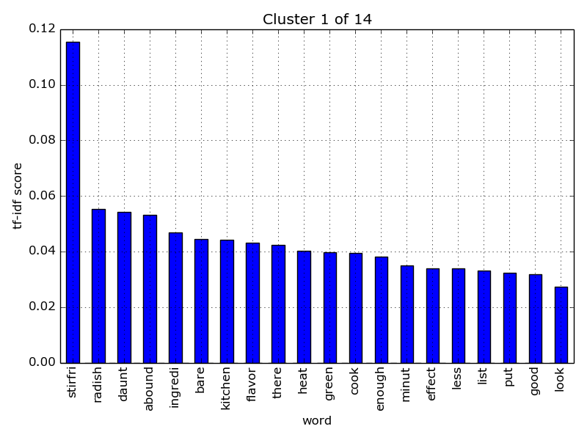
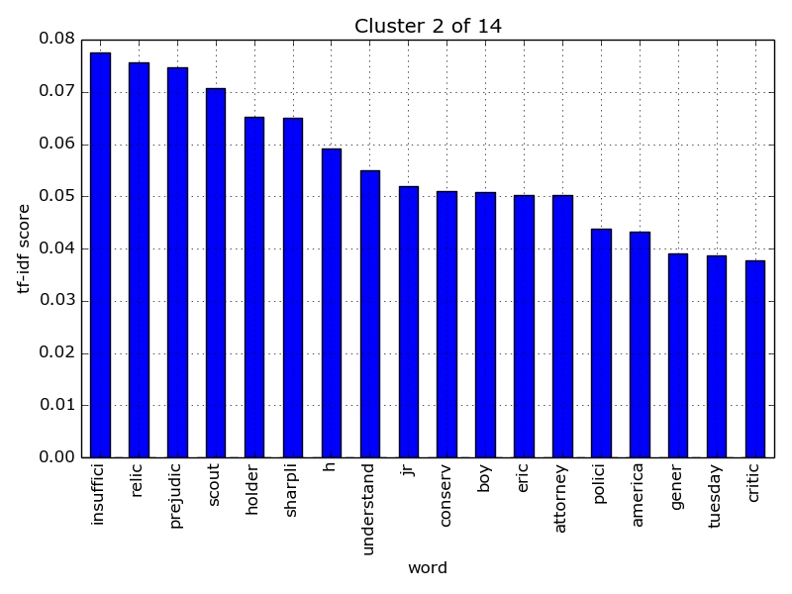
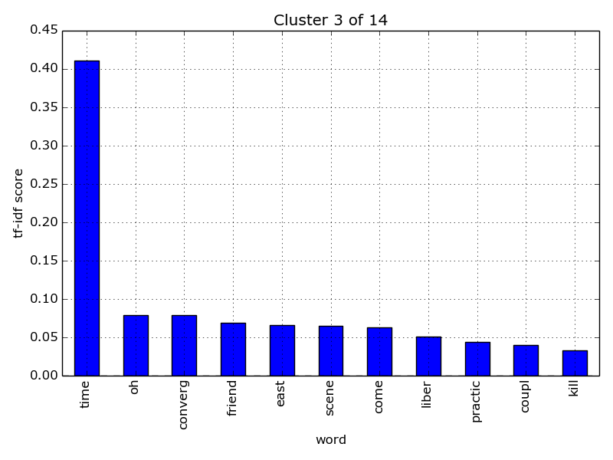
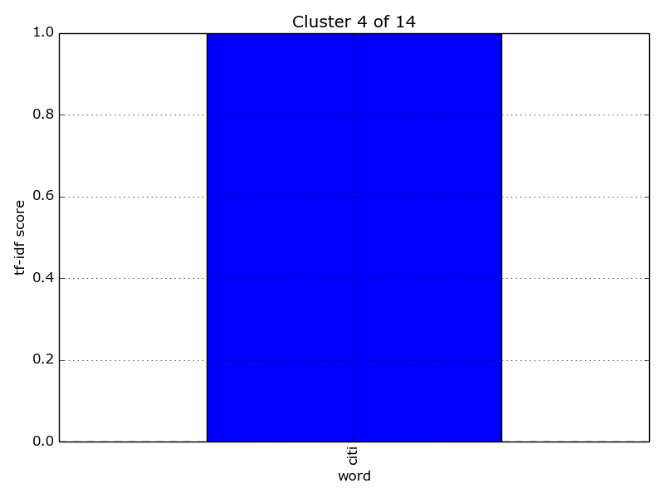
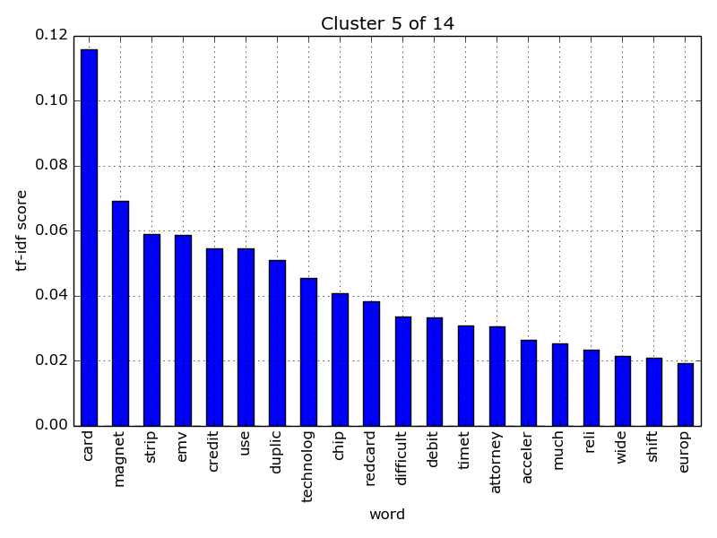
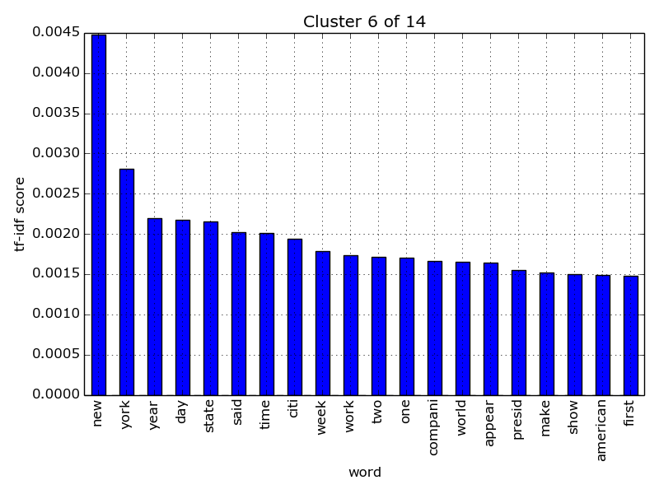

Slide 22
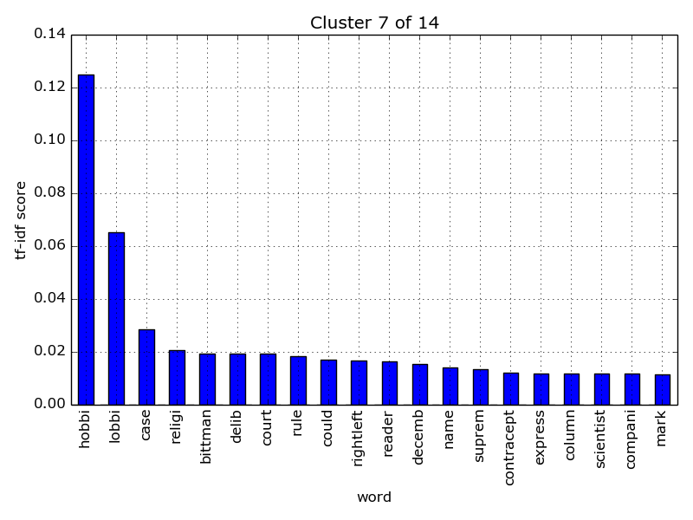
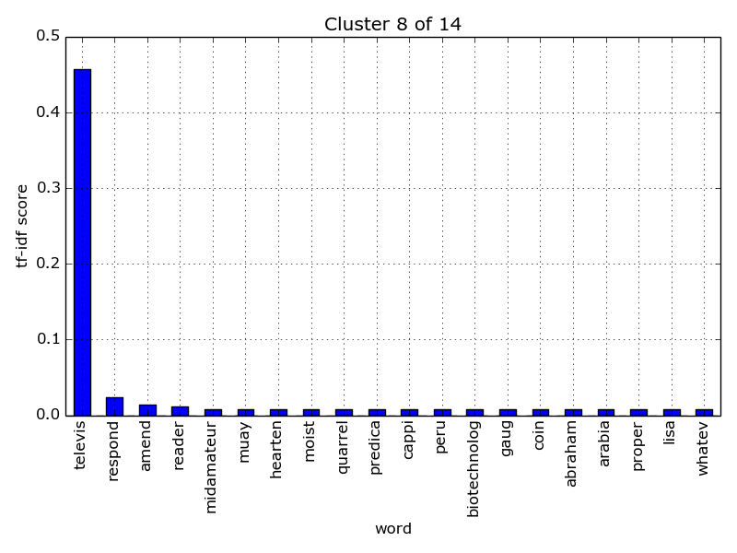
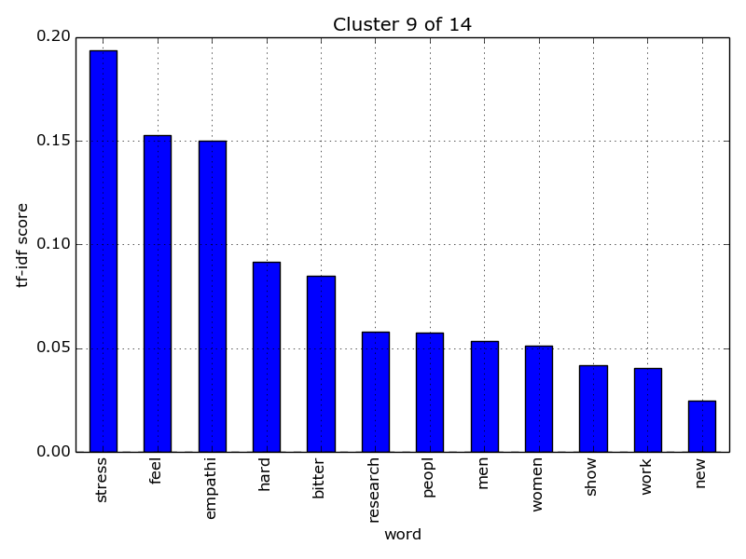
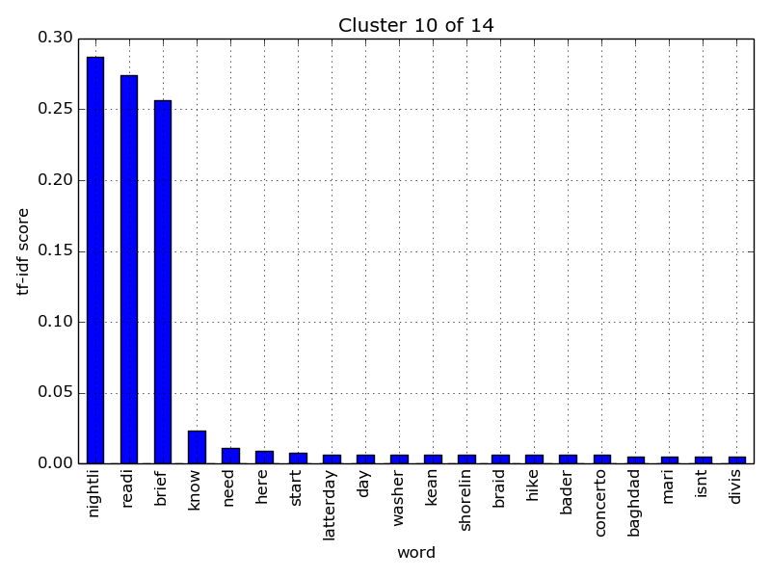
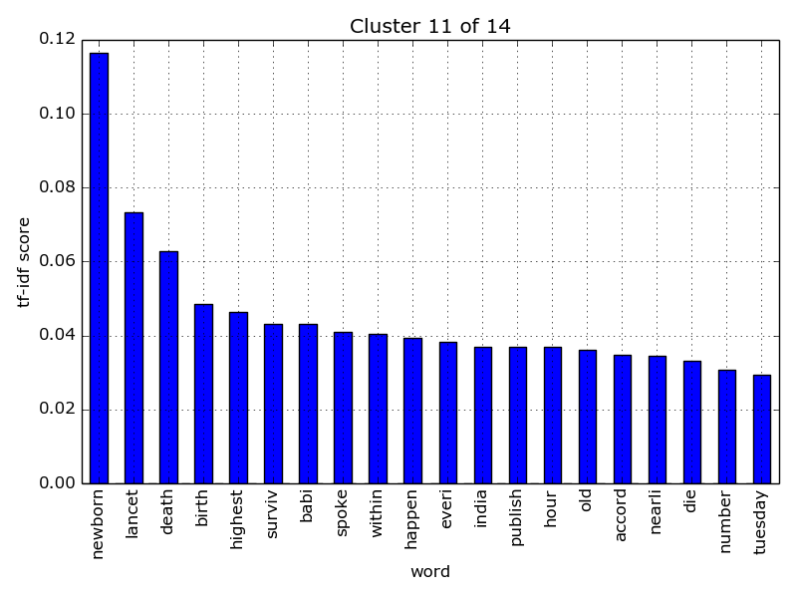
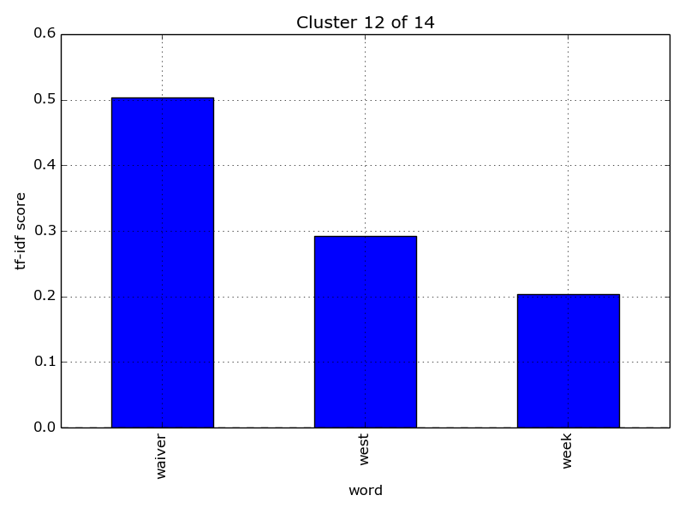

Slide 23
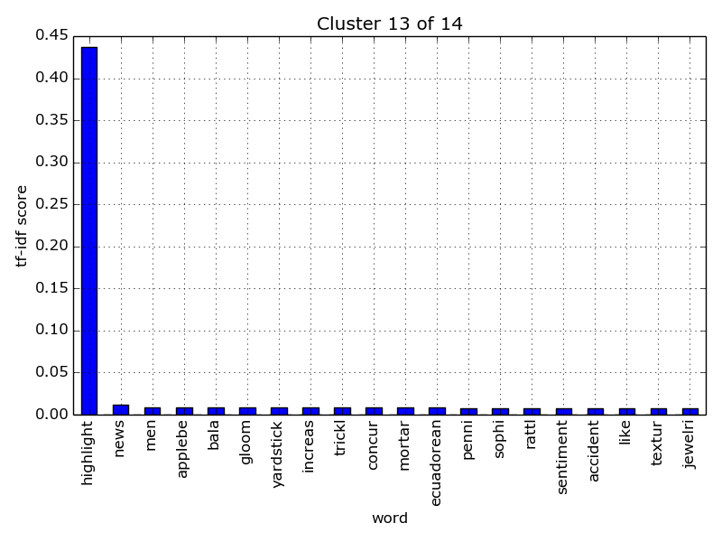
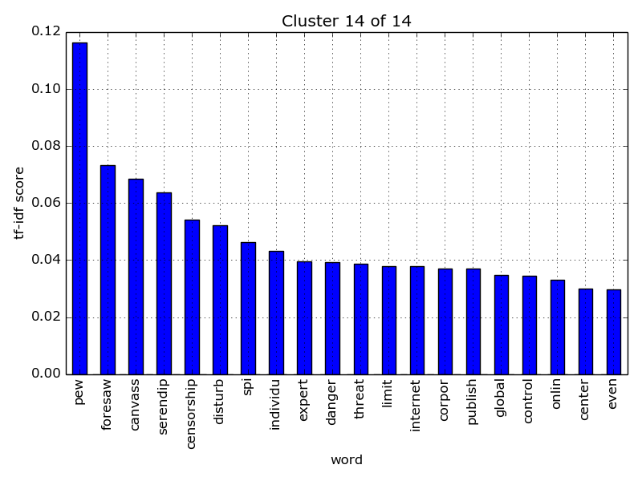

Slide 24
14 Clusters Selected Word Clouds
These were created by hand at http://www.wordle.net/compose using the tf-idf scores as weights. Words with higher weights are larger.
Most interesting included, some left out for brevity.

Slide 25
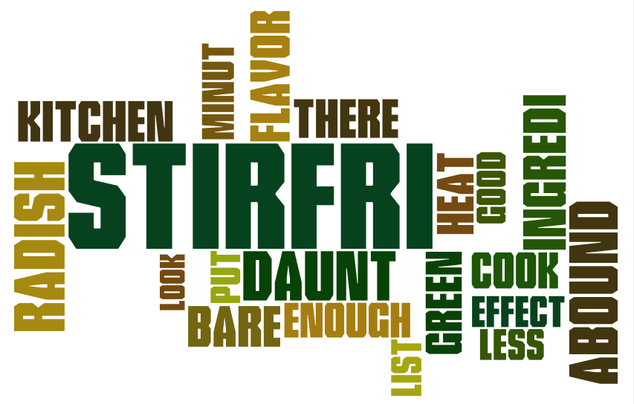
Cooking cluster?

Slide 26
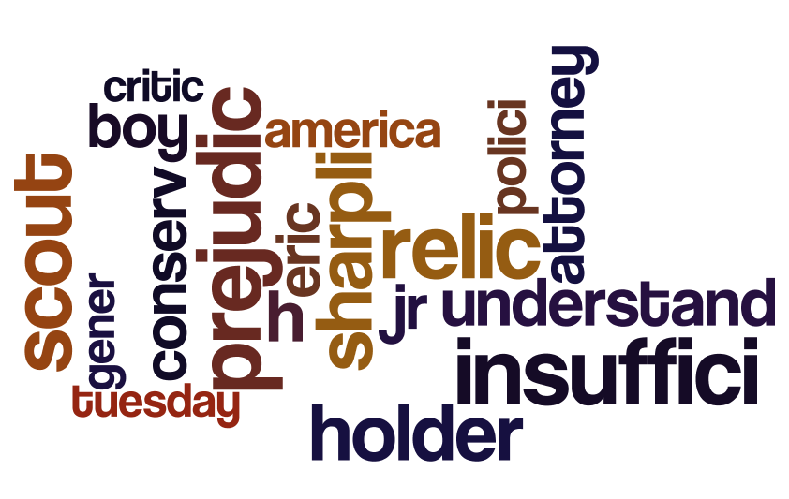

Slide 27
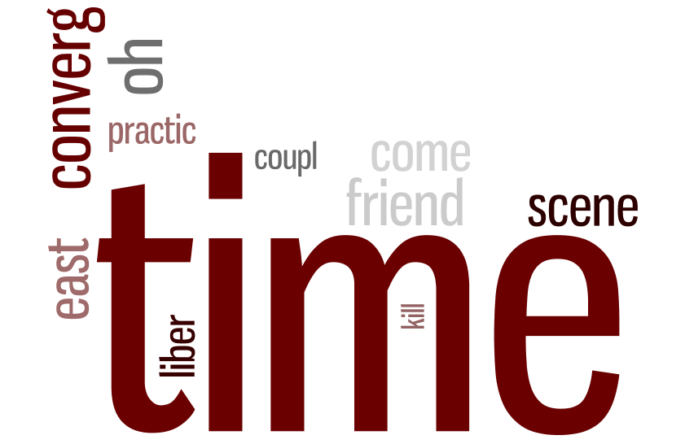

Slide 28
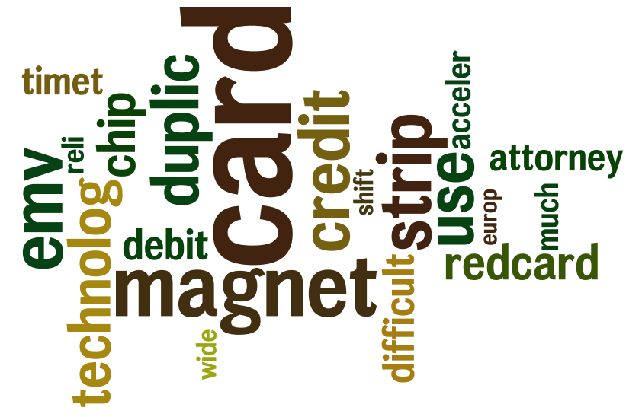

Slide 29
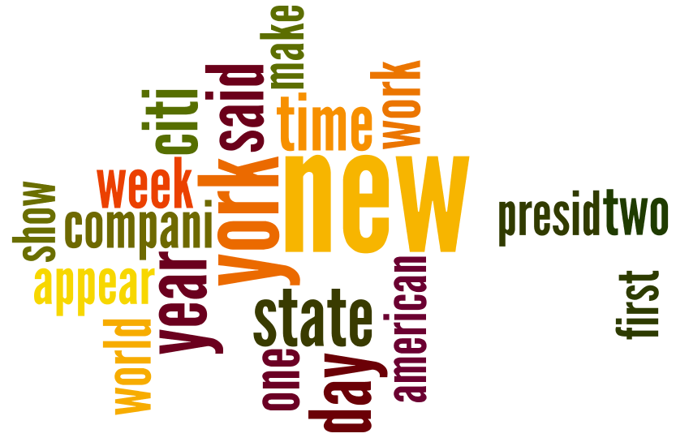
Local news?

Slide 30
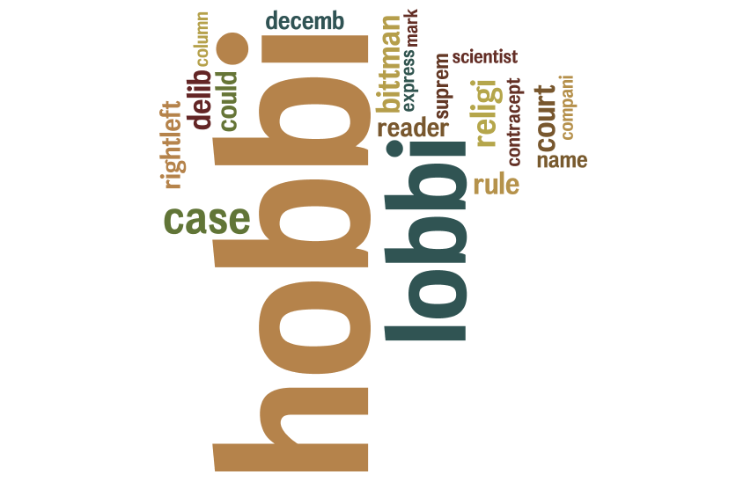

Slide 31


Slide 32
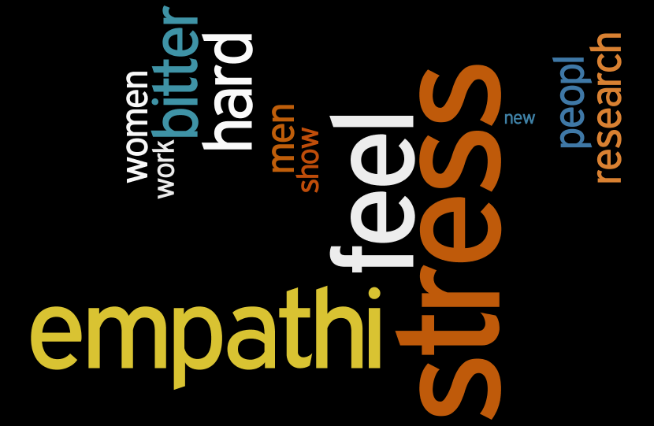
Lifestyle & health cluster?

Slide 33
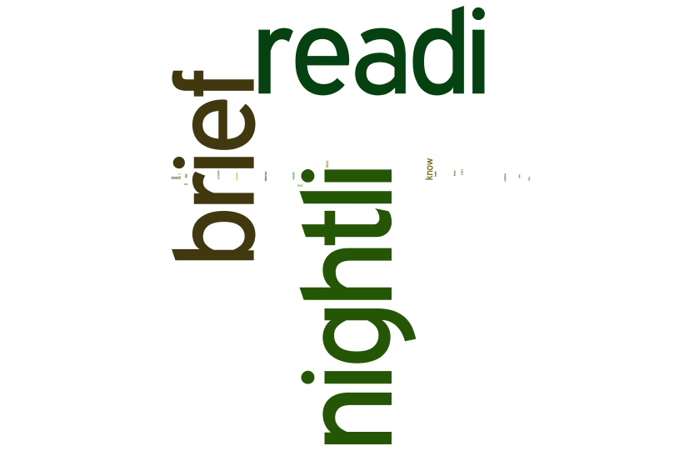

Slide 34
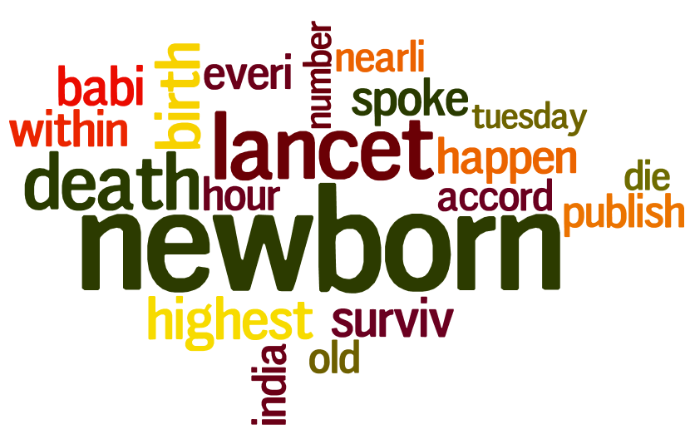

Slide 35
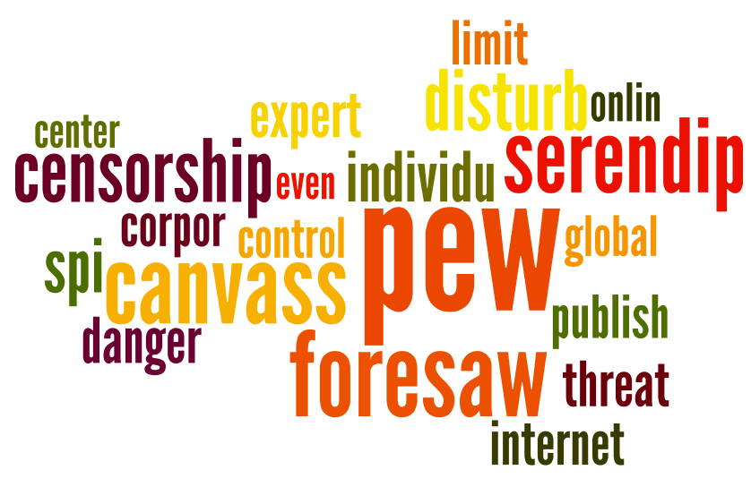

Slide 36

Thank you.
Check out the source on Github: https://github.com/lnunno/big-data-nyt-tf-idf

