Slide 1
What is React?
- React is front end library developed by Facebook. It's used for handling view layer for web and mobile apps. ReactJS allows us to create reusable UI components.
- One might think of it as the “View” in the “Model-View-Controller” pattern.
- Open source, It is used at Facebook in production, and Instagram.com.
- It not only render on the customer, but also render on servers.
Invoked immediately before a component is unmounted from the DOM.
Invoked immediately before a component is unmounted from the DOM.

Slide 2
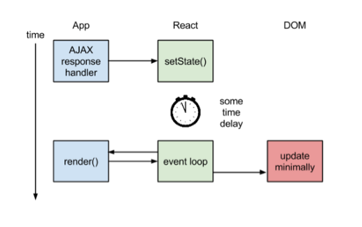
How the Magic Happens
Figure 1: React.js Rendering

Slide 3
Virtual DOM
Another notable feature is the use of a "virtual DOM." React creates an in-memory data structure cache, computes the resulting differences, and then updates the browser's displayed DOM efficiently.
The idea of Virtual DOM is great and isn’t new actually.
Using libraries like React we can boost the performance of our applications and it’s actually very easy to get in.

Slide 4
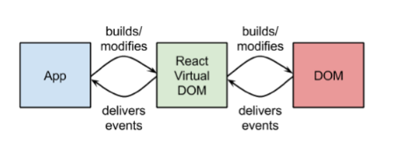
Virtual DOM
Figure 2: Virtual DOM

Slide 5
JSX: JavaScript syntax extension
JSX is a statically-typed, object-oriented programming language designed to run on modern web browsers. Being developed at DeNA.
- Faster: JSX performs optimization while compiling the source code to JavaScript.
- Safer: In contrast to JavaScript, JSX is statically-typed. Many errors will be caught during the compilation process.
- Easier: JSX Javascript-based inheritance, so it is easy to let the programmer can use Javascripts

Slide 6
Props and State
Props and states are both plain JS objects; a change within one of them will trigger a render.
- Props are best explained as “a way of passing data from parent to child.” In essence, props are just a communication channel between components, always moving from top (parent) to bottom (child)

Slide 7


Props and State (Con..)
setProps() and replaceProps()
Figure 4: setProps().
Figure 5: replaceProps().
- With SetProps() it merge any property which it is set.
- With replaceProps() it deletes the previously existing props and replaced by new properties.

Slide 8
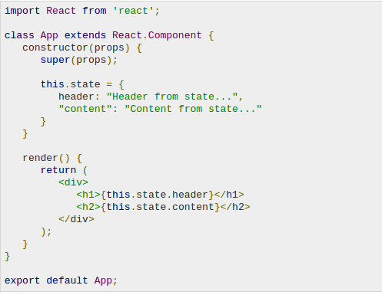
Props and State (Con..)
- State is another concept introduced by React and behaves a little bit differently from props. State is best described as how a component’s data looks at a given point in time.
Figure 6: State

Slide 9
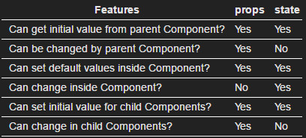
Props and State (Con..)
Figure 7: Different between Props and State.

Slide 10
Props and State (Con..)
Similar:
Props and state are plain JS objects.
Props and state will trigger render the change update.

Slide 11
Simple "Hello World"
var Hello = React.createClass({
render: function () {
return <div>Hello {this.props.name}</div>;
}
});
React.render(<Hello name="World" />, document.body);
Invoked immediately before a component is unmounted from the DOM.
Invoked immediately before a component is unmounted from the DOM.

Slide 12
Component Specifications
render: should be pure, examine this.props and this.state and return a single child element.
getInitialState: Return value is the initial value for state.
getDefaultProps: Sets fallback props values if props aren’t supplied.
propTypes: validate props being passed to your components.
mixins: An array of objects, used to extend the current component’s functionality.
displayName: used in debugging messages.

Slide 13
Components API
SetState: merges nextState with the current state.
replaceState: like setState but deletes any pre-existing state keys that are not in nextState.
forceUpdate: call render() on the component, skipping shouldComponentUpdate().
isMounted: returns true if the component is rendered into the DOM.
setProps: change the properties and trigger re-render.
replaceProps: deletes any pre-existing props instead of merging the two objects.

Slide 14
Component Lifecycle Methods
componentWillMount: executed before rendering, on both server and client side.
componentDidMount: executed after first render only on the client side. This is where integrate with other JavaScript frameworks, set timers using setTimeout or setInterval, or send AJAX requests.
componentWillReceiveProps: invoked when a component is receiving new prop. Use setState() here.
shouldComponentUpdate: invoked before rendering when new props or state are being received.

Slide 15
Component Lifecycle Methods
ComponentWillUpdate: invoked immediately before rendering when new props or state are being received.
componentDidUpdate: invoked immediately after the component's updates are flushed to the DOM. Operate on the DOM here.
componentWillUnmount: Invoked immediately before a component is unmounted from the DOM.

Slide 16
THANK FOR WATCHING

