Slide 2
What is React?
React is front end library developed by Facebook. It's used for handling view layer for web and mobile apps. ReactJS allows us to create reusable UI components.
One might think of it as the “View” in the “Model-View-Controller” pattern.
Open source, It is used at Facebook in production, and Instagram.com.
It not only render on the customer, but also render on servers.

Slide 3
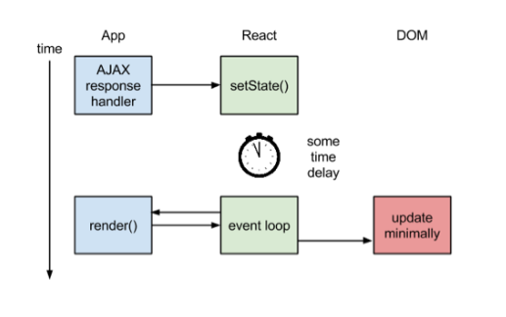
How the Magic Happens
Figure 1: React.js Rendering

Slide 4
Virtual DOM
Another notable feature is the use of a "virtual DOM." React creates an in-memory data structure cache, computes the resulting differences, and then updates the browser's displayed DOM efficiently.
The idea of Virtual DOM is great and isn’t new actually.
Using libraries like React we can boost the performance of our applications and it’s actually very easy to get in.

Slide 5
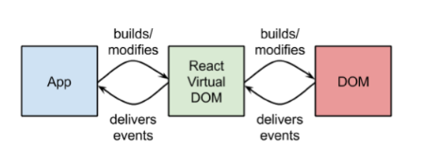
Figure 2: Virtual DOM

Slide 6
JSX: JavaScript syntax extension
JSX is a statically-typed, object-oriented programming language designed to run on modern web browsers. Being developed at DeNA.
Faster: JSX performs optimization while compiling the source code to JavaScript.
Safer: In contrast to JavaScript, JSX is statically-typed. Many errors will be caught during the compilation process.
Easier: JSX Javascript-based inheritance, so it is easy to let the programmer can use Javascripts

Slide 7
Props and State
Props and states are both plain JS objects; a change within one of them will trigger a render. These objects are deterministic.
Props are best explained as “a way of passing data from parent to child.” In essence, props are just a communication channel between components, always moving from top (parent) to bottom (child)

Slide 8
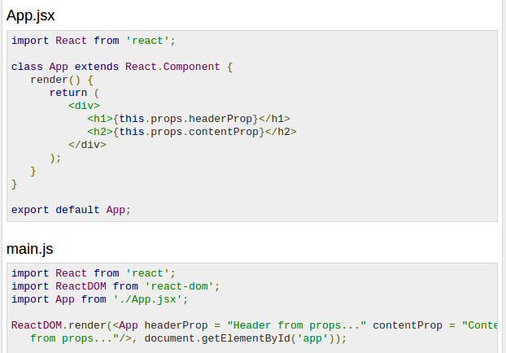
Figure 3: Props.

Slide 9
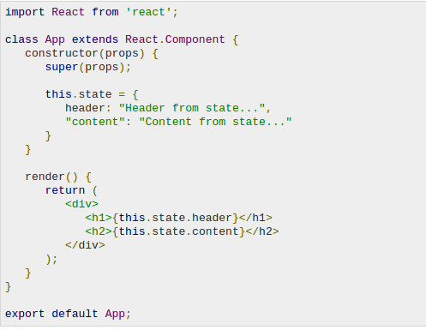
State is another concept introduced by React and behaves a little bit differently from props. State is best described as how a component’s data looks at a given point in time.
Figure 4: State

Slide 10
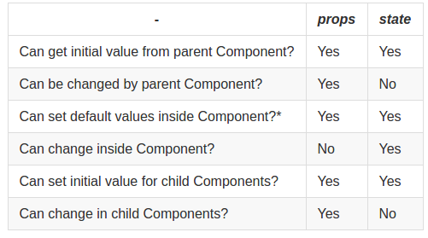
Changing props and state
Figure 5.

