Slide 1


DATA
ANALYSIS

Slide 2


Today's agenda
Project recap
Problem
The Analytics team
Process
Insights
Summary

Slide 3

Social Buzz, a content focused startup due it’s fast growth needs to adapt proper data business practices.
Accenture has begun a three month POC focusing on
these tasks:
An audit of Social Buzz's big data practice
Recommendations for a successful IPO
Analysis to find Social Buzz's top 5 most
popular categories of content
Project Recap

Slide 4


Problem
With over 100,000 posts per day
500 million active users
With this deluge of data, there is necessity to properly analyse it to gain proper insight.
Notes:
t

Slide 5


Andrew Fleming (Chief Technical Architect),
The Analytics team
Marcus Rompton (Senior Principle)
Joshua (Data Analyst)

Slide 6
Process
1
Understanding the data
2
Data cleaning
3
Data modeling
4
Data analysis
5
Insights

Slide 7

Insights
16
1897
January
Unique Categories
Reactions to the highest category, “Animals”
The month with the most posts

Slide 8
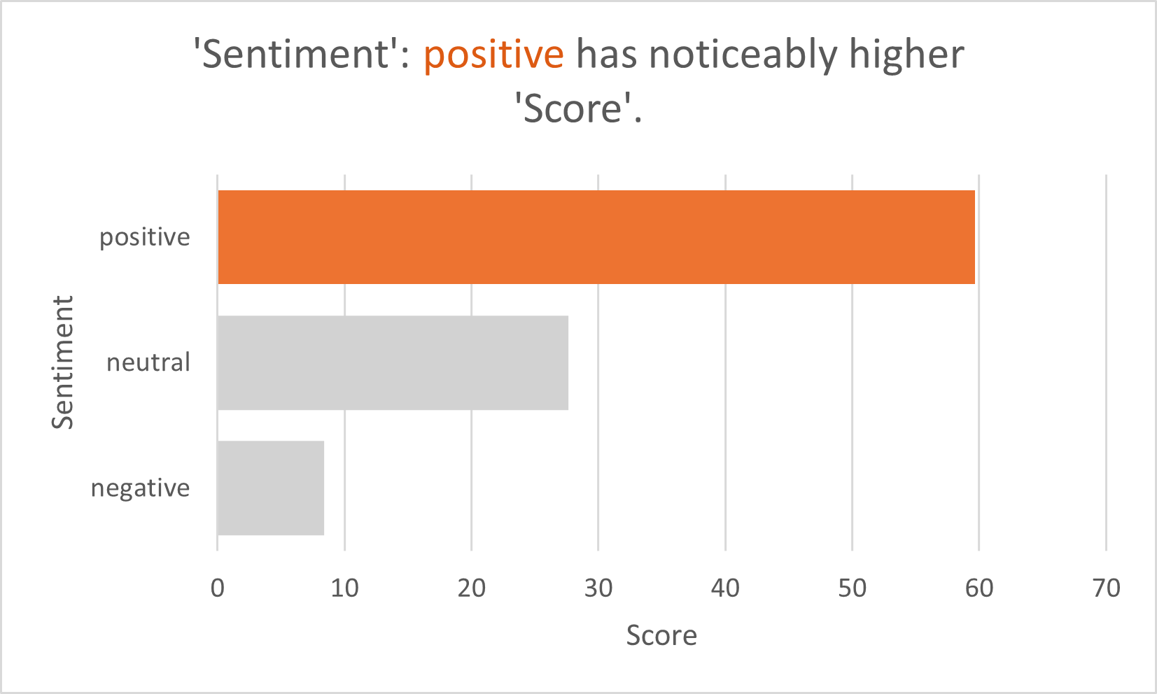

Slide 9
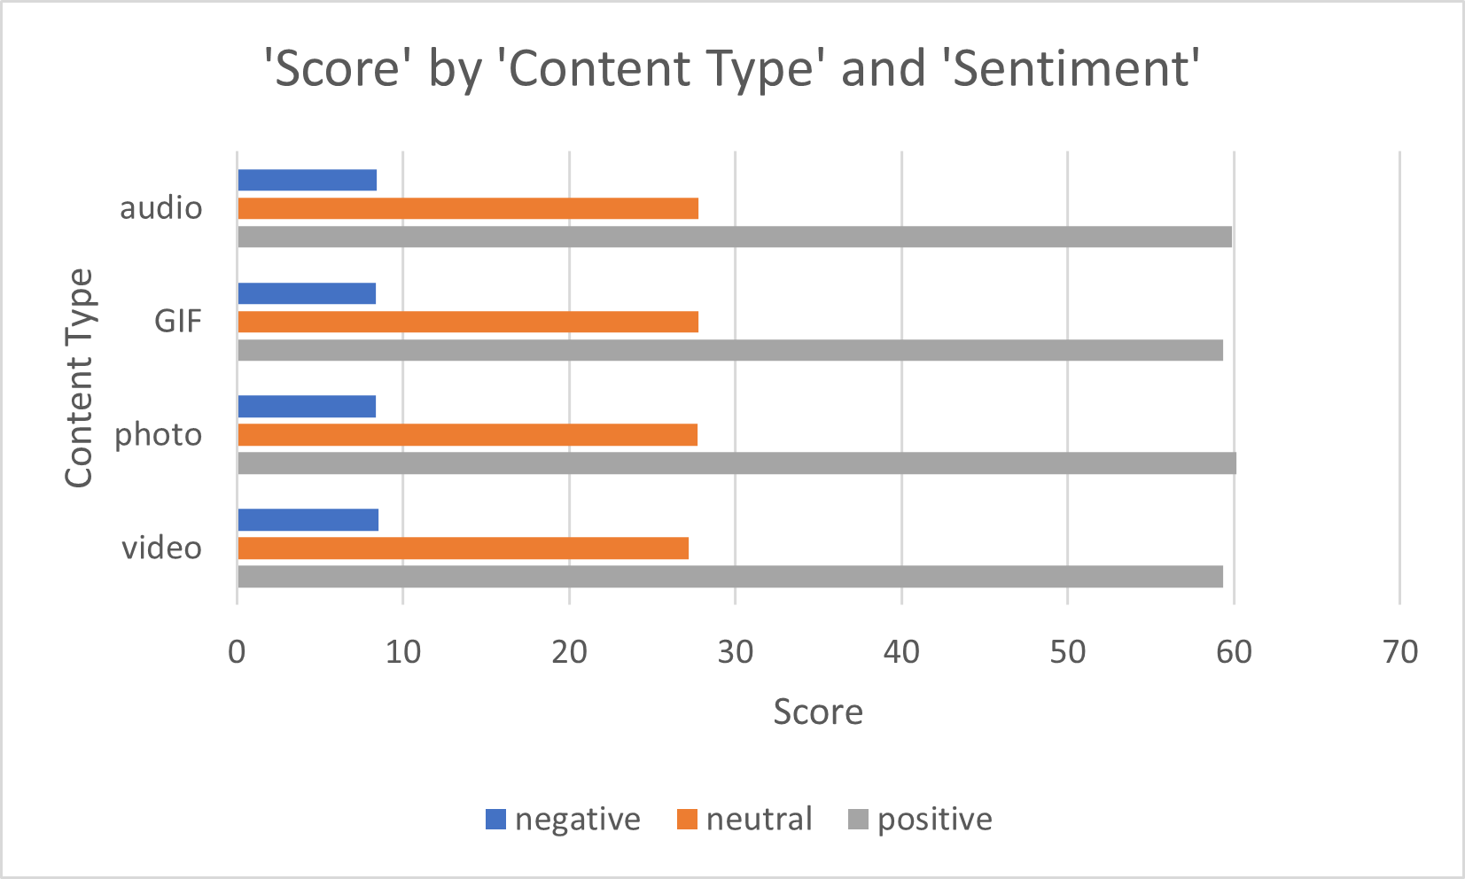

Slide 10
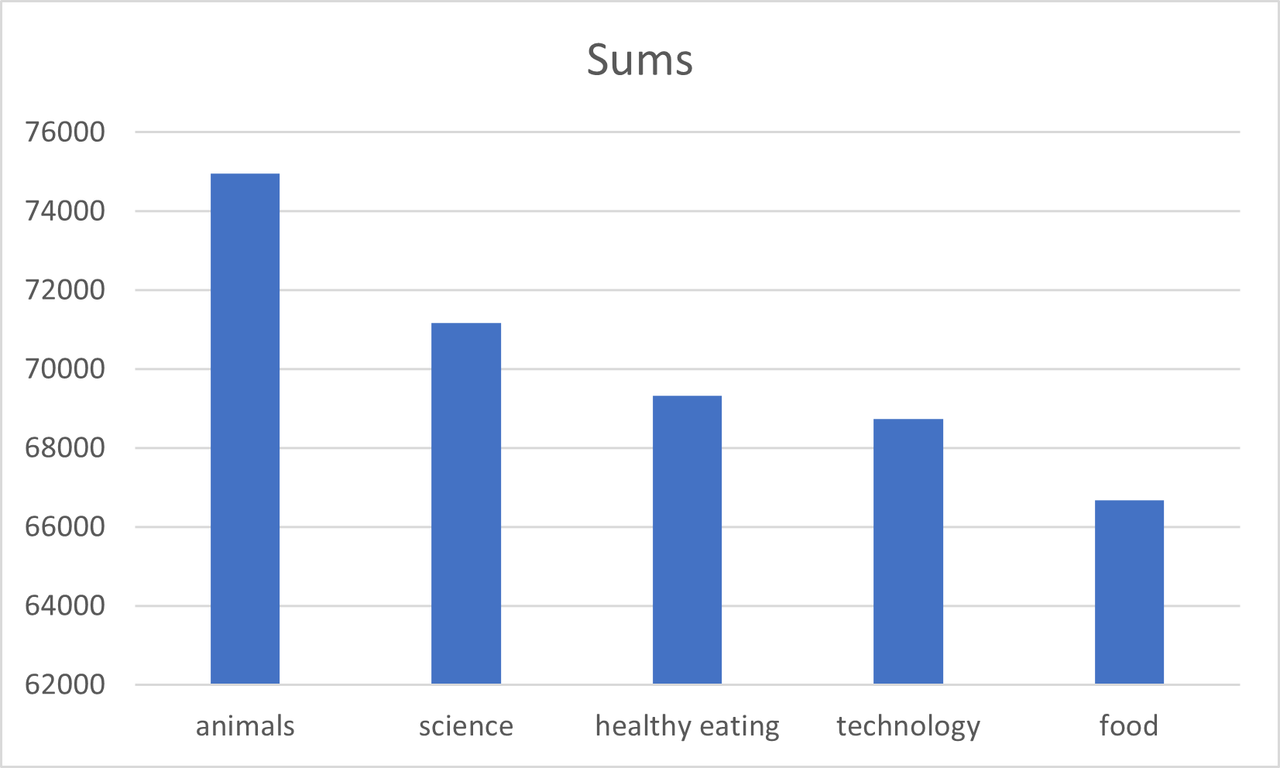

Slide 11

ANALYSIS
Animals and science are the two most popular categories of content, showing that people enjoy “real-life” and “factual” content the most.
The greatest disparity in the score is realized only when they are divided into categories. Based on content type, the scores were equal throughout the data.
INSIGHT
“Food” alongside “healthy eating” were ranked amongst the highest categories. This might indicate an interest with primarily food within your users. You could use this insight to create a campaign and partner with healthy eating brands to boost user engagement
NEXT-STEPS
Although this analysis is insightful, its large scale deployment for real-time understnaing of the business is it’s logical conclusion and we are here to help you with that.
Summary

Slide 12

Thank you!
ANY QUESTIONS?

