Slide 1

UK-France Power Spread Option Pricing
Valuing Transmission Rights via Kirk’s Approximation & Monte Carlo Simulation
Author: Lyndon Odia | October 2025

Slide 2
Objective:
Quantify the fair EUR/MWh value of optional transmission capacity between UK and France using spread option pricing methods (Kirk’s Approximation and Monte Carlo Simulation).
Market Context:
Interconnectors allow traders to arbitrage power spreads between coupled European markets. Valuing transmission rights as options captures the profit potential from volatility, correlation, and capacity costs.
Author: Lyndon Odia | October 2025

Slide 3
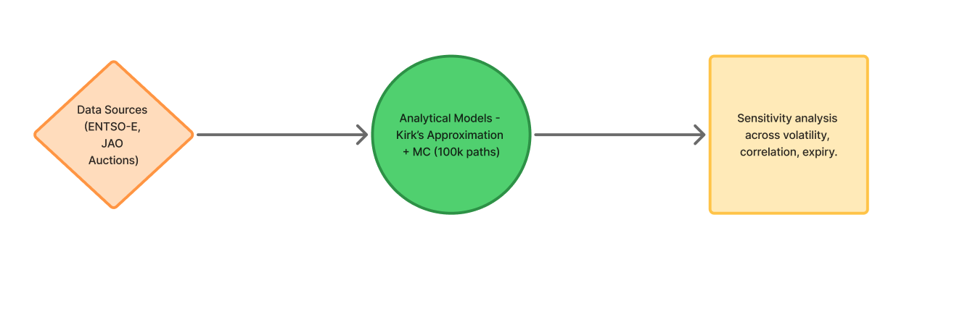
Methodology Overview:
Data from ENTSO-E (France), simulated UK day-ahead prices, and JAO auction capacity costs were used.
Analytical (Kirk’s) and Monte Carlo (100k paths) models were applied with sensitivity sweeps across volatility, correlation and expiry.
Author: Lyndon Odia | October 2025

Slide 4
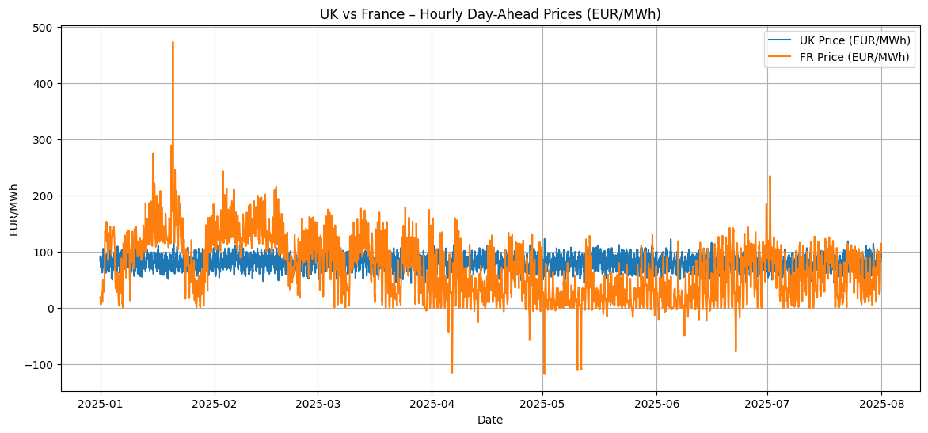
“UK vs FR Hourly Day-Ahead Prices (EUR/MWh)”
Author: Lyndon Odia | October 2025

Slide 5
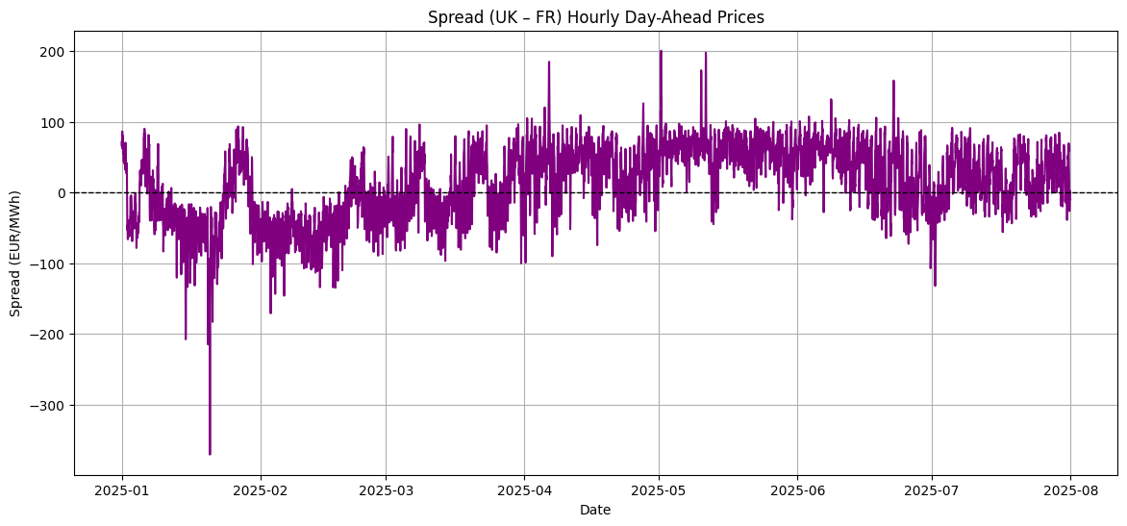
“Spread (UK-FR) Hourly Prices”
Author: Lyndon Odia | October 2025

Slide 6
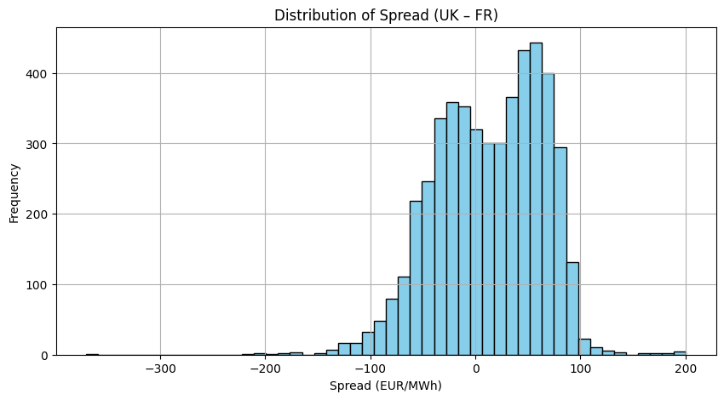
“Distribution of Spread (UK-FR)”
Author: Lyndon Odia | October 2025

Slide 7
Base Inputs (table)
Parameter | Description | Value
S_1 | UK mean price (EUR/MWh) | 81.10-​
S_2 | FR mean price (EUR/MWh) | 68.06
Sigma_1 | UK annualized volatility | 0.198
Sigma_2 | FR annualized volatility | 1.008
rho | Correlation (UK-FR) | 0.142
T | Time to expiry | 1/12 (1 month)
K | Capacity cost (strike) | 0.76 EUR/MWh
FX | GBP – EUR conversion | 1.17
Author: Lyndon Odia | October 2025

Slide 8
Results Summary (table)
Model | Option Value (EUR/MWh) | Interpretation
Kirk’s Approximation | 16.0 | Analytical closed-form estimate
Monte Carlo (100k paths) | 15.99 | Numerical validation
Mean Spread | 13.0 | Average UK-FR spread
Capacity Cost | FR annualized volatility | From JAO GB-FR auctions
Fair Value | = 16 EUR/MWh | Net of cost, for 1-month horizon
Author: Lyndon Odia | October 2025

Slide 9
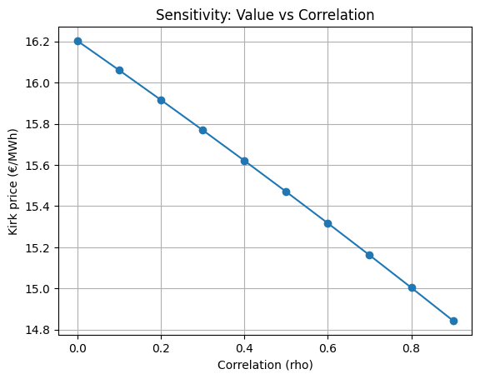
“Sensitivity: Value vs Correlation”
Author: Lyndon Odia | October 2025

Slide 10
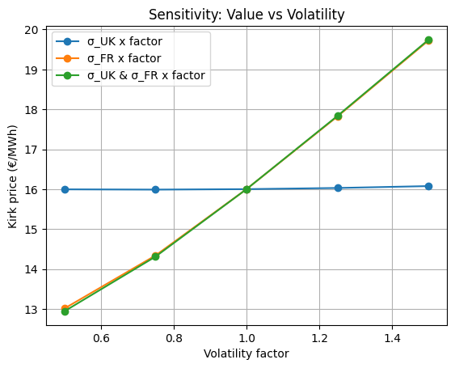
“Sensitivity: Value vs Volatility”
Author: Lyndon Odia | October 2025

Slide 11
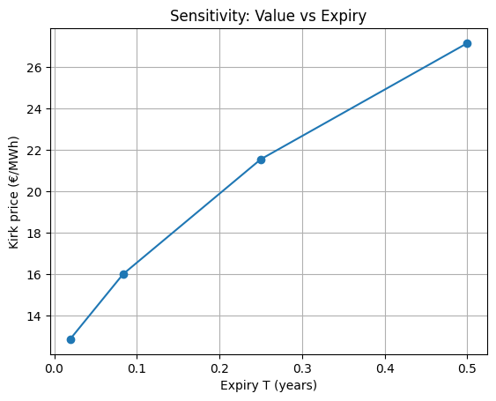
“Sensitivity: Value vs Expiry”
Author: Lyndon Odia | October 2025

Slide 12

Interpretation & Market Implications:
Option value represents right (not obligation) to flow power when profitable.
Positive optionality driven by spread volatility and low correlation.
Capacity cost (0.76 EUR/MWh) = market – clearing price paid at JAO auctions.
1GW for 1 month = EUR 11.5m notional value.
Author: Lyndon Odia | October 2025

Slide 13
Limitations:
We use one set of S_1, S_2, sigma_1, sigma_2, rho from Jan–Jul 2025, which smooths monthly seasonality and regime shifts.
Capacity cost is included as a single average (€0.76/MWh) rather than the actual monthly JAO auction prices.
Kirk/MC are applied with a terminal-only exercise (European-style). Real transmission rights can be exercised daily/hourly.
rho and sigma are fixed; we do not model time-varying or regime-switching dynamics.
Losses, balancing fees, ramp/nomination constraints, curtailment risk, and gate-closure timing are not included.
We price one direction (IF2-GB → FR). The reverse direction (FR → GB) can have a different K, availability, and value.
Pull 5+ years of real UK and France day-ahead prices so we can stress-test across different market regimes, especially 2022.
Next Steps:
1. Monthly Re-estimation:
Compute S_1, S_2, sigma_1, sigma_2, rho from hourly data within each month.
Pull the JAO monthly auction K_m for the same month and direction.
Price a 1-month option each month.
This will capture seasonality, regime shifts, and the true cost of capacity.
Pull 5+ years of real UK and France day-ahead prices so we can stress-test across different market regimes, especially 2022.
2. Two-direction view: Repeat for FR - GB to compare value asymmetry and assess netting/portfolio effects.
3. Time-varying dynamics: Explore GARCH (time varying correlation) or regime-switching volatility to better reflect stress periods.
4. Costs & frictions: Add losses, balancing/imbalance charges and nominations/gate closure constraints.
Author: Lyndon Odia | October 2025

