Slide 1
Food Access in the United States
Lauren O’Donnell

Slide 2
Why food access matters
Limited access can influence:
Nutrition
Transportation costs
Healthcare outcomes
Notes:
This issue is especially important in rural communities, where residents may need to travel much longer distances to reach grocery stores.
Living in West Virginia also made this topic personally interesting to me because many Appalachian communities face geographic and transportation barriers

Slide 3
Research Question
How does geographic location influence food access patterns across the United States?
Notes:
Main Research Question
How does geographic location influence food access patterns across the United States?
Supporting Questions
To answer that, I broke the analysis into a few supporting questions:
What geographic patterns of low food access appear across the United States?
How do food access rates differ across demographic groups?
How do food access patterns differ between rural and urban communities?
How does food access vary across counties in West Virginia and Kentucky?

Slide 4
Data Sources and Tools
USDA Food Access Research Atlas
Excel
Python
Notes:
I used data from the USDA Food Access Research Atlas. Excel helped with initial exploration and validation.
Python was used for:
cleaning data
geographic analysis
and building visualizations.

Slide 5
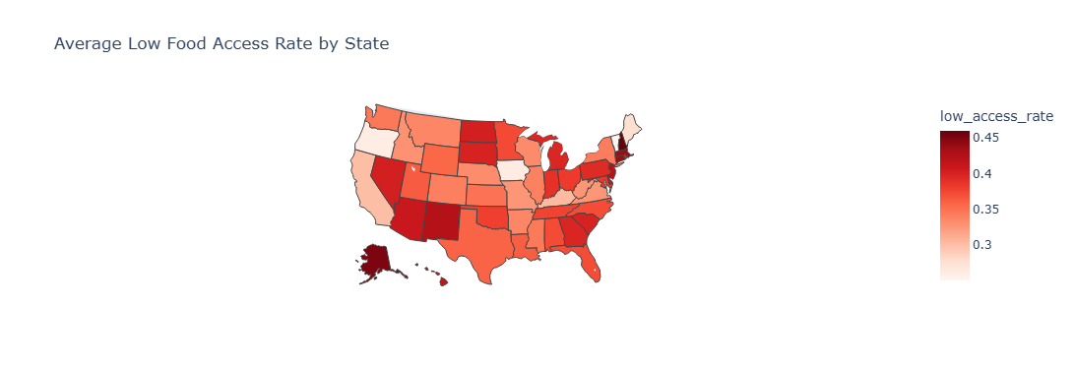
National Geographic Patterns
Notes:
The darker states on this map represent higher average levels of low food access.
One thing that stood out was that food access challenges were not distributed evenly across the country. Certain regions showed much higher concentrations than others.

Slide 6
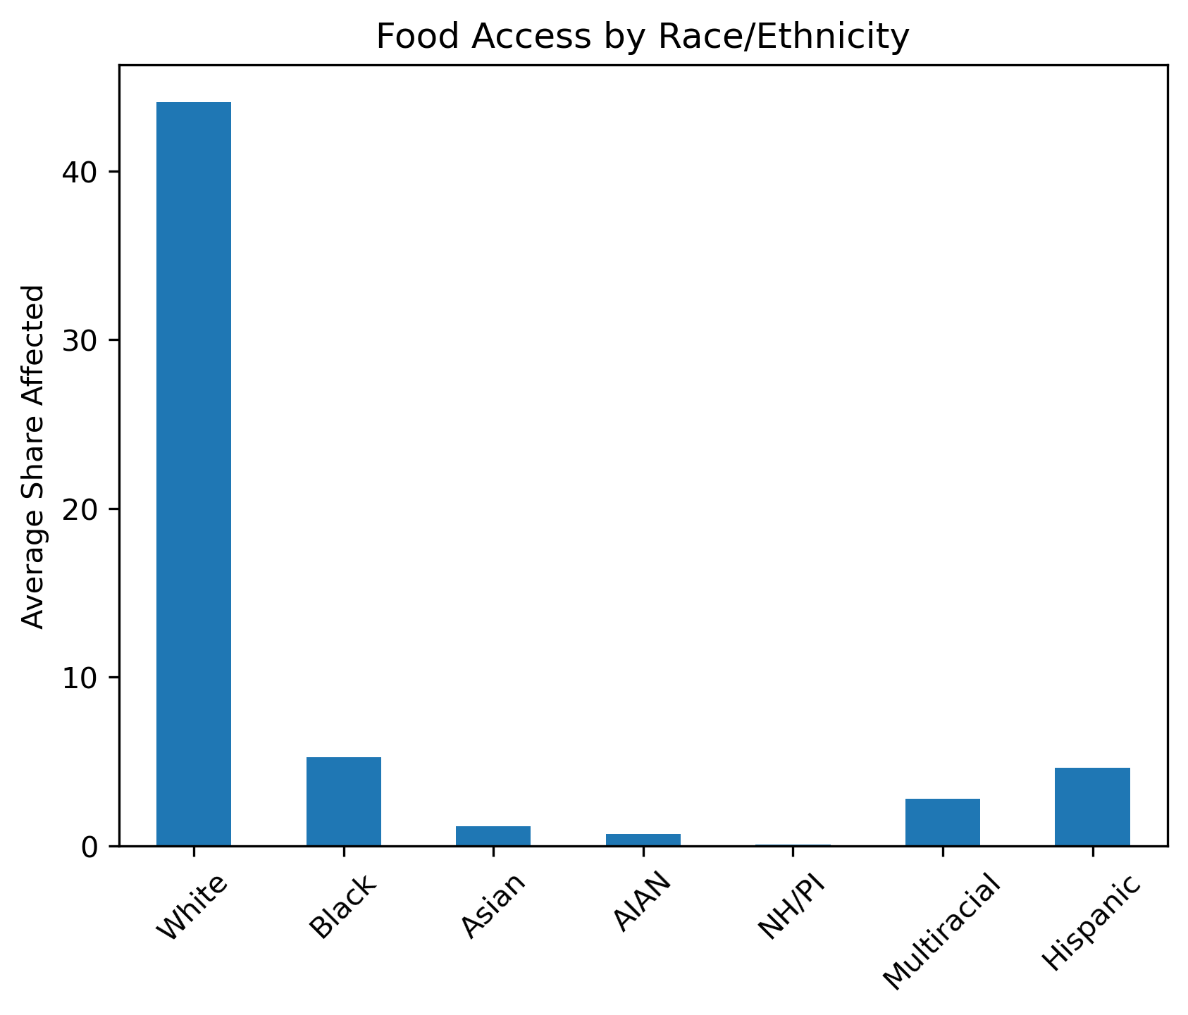
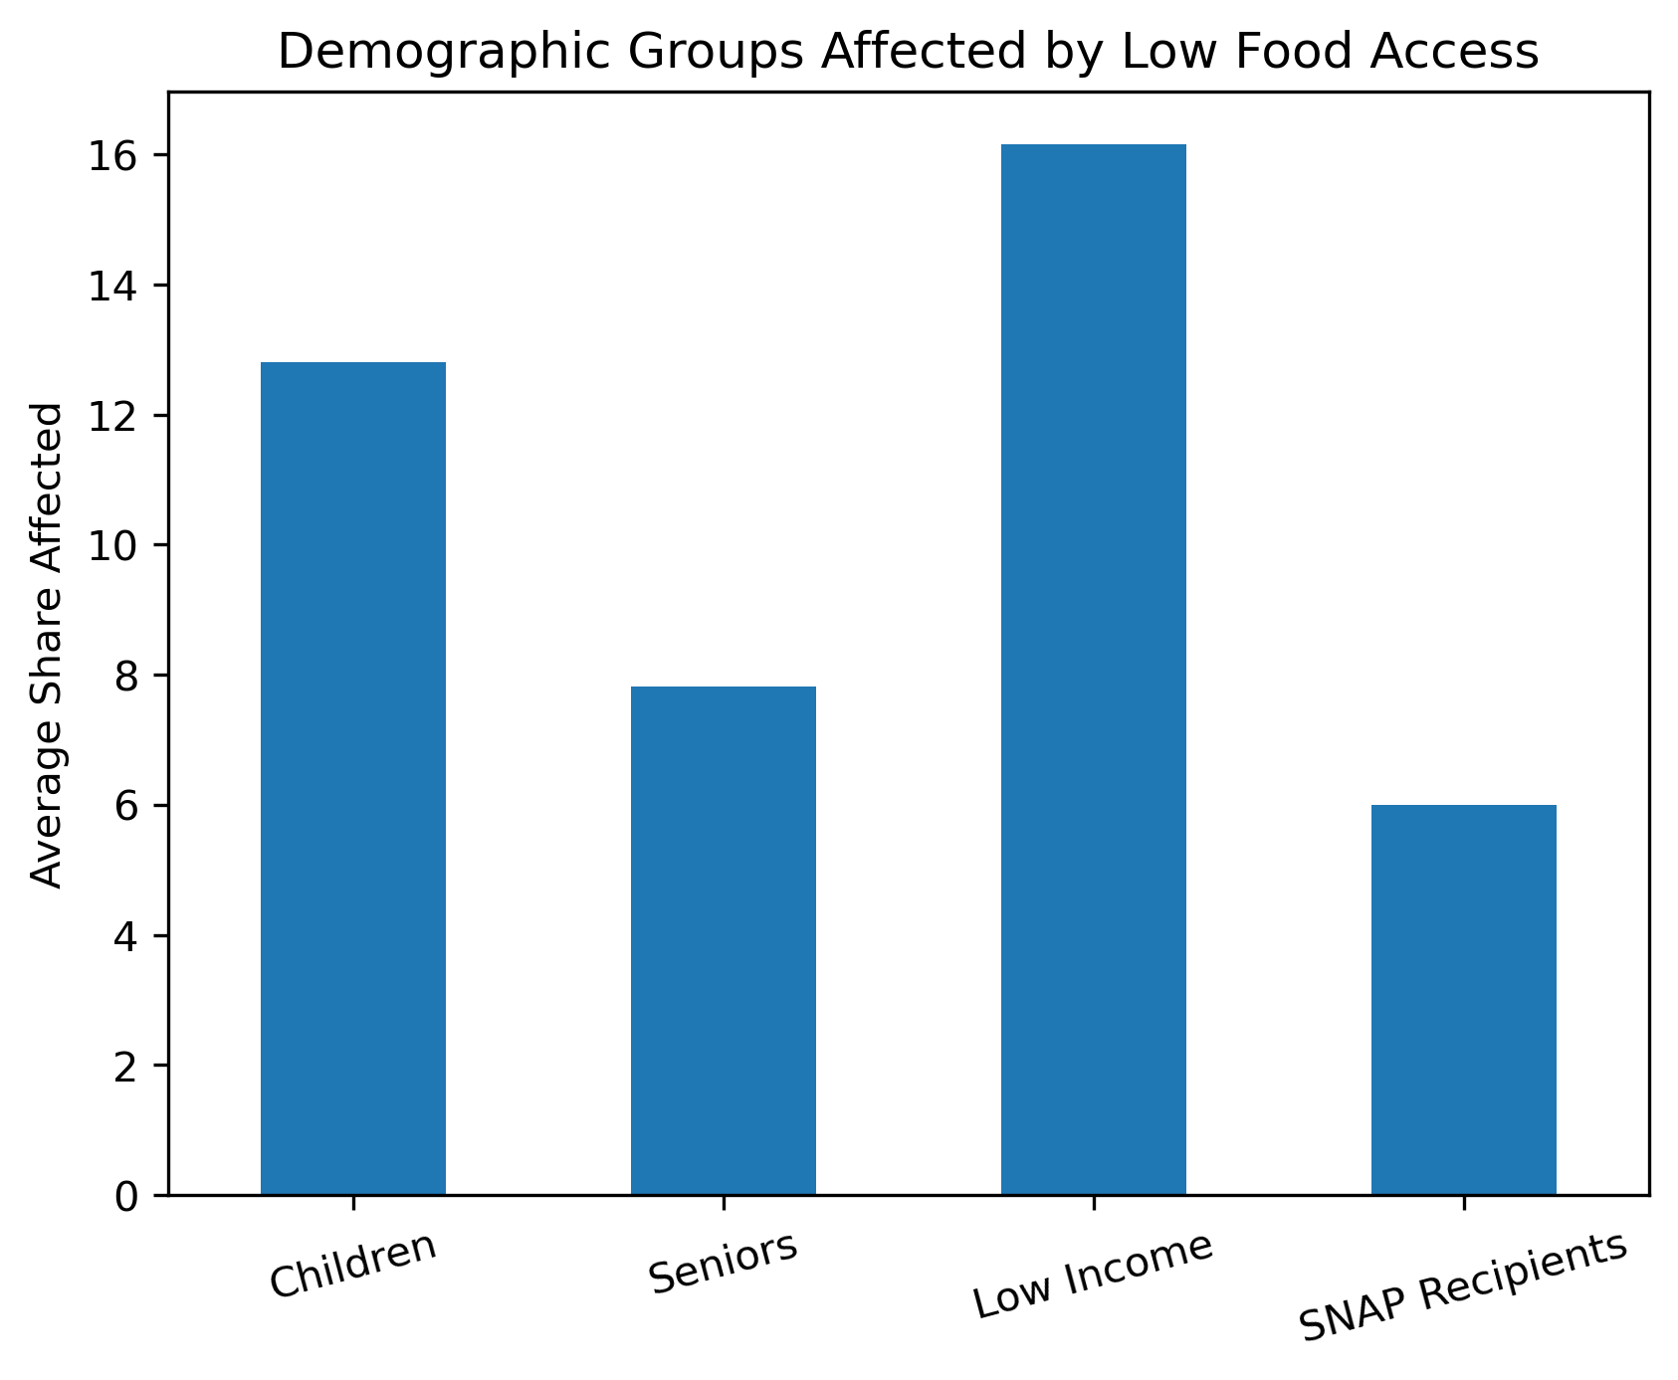
National Demographic Findings
Notes:
I also explored racial demographic distributions to determine if this played a role in low food access, but it did not. I then explored which demographic groups appeared most represented within low-access areas. One major finding was that low-income populations experienced the highest levels of limited food access overall. Food access challenges were most concentrated among low-income communities, highlighting the role economic inequality may play in access to grocery stores.

Slide 7
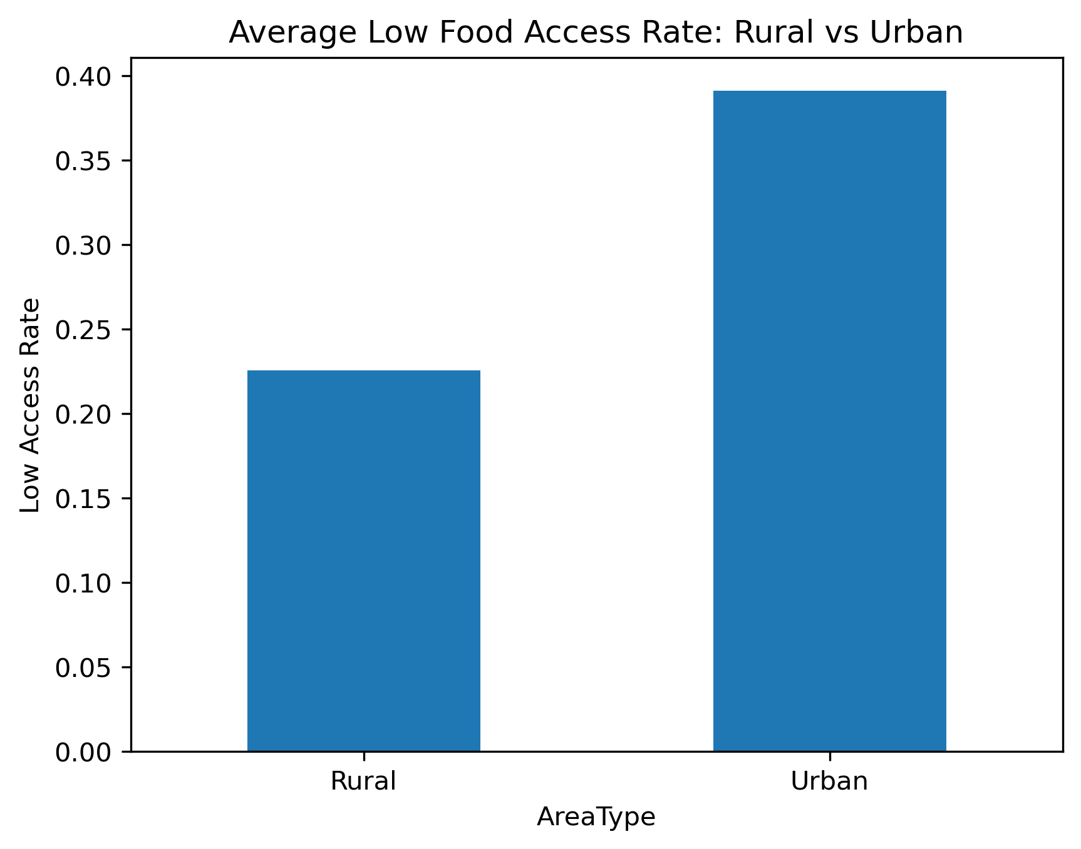
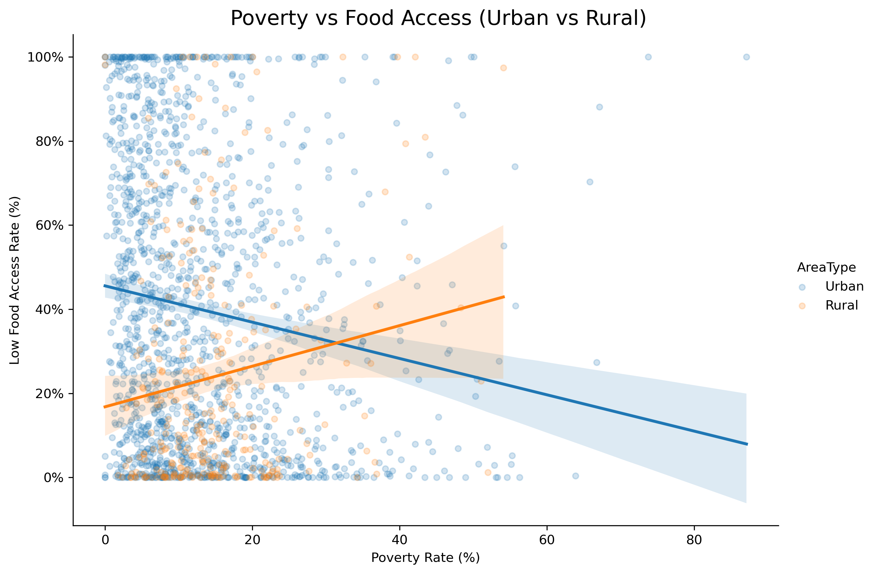
National Rural vs Urban Analysis
Notes:
Next, I compared rural and urban communities. Urban areas represent more densely populated communities, while rural areas represent less populated and more geographically isolated communities. The analysis showed noticeable differences in food access distribution between rural and urban areas. In many rural areas, distance and transportation barriers appeared more significant, while urban areas often showed clustering linked to poverty and population density. These findings led me to focus more closely on Appalachia and specifically West Virginia.

Slide 8
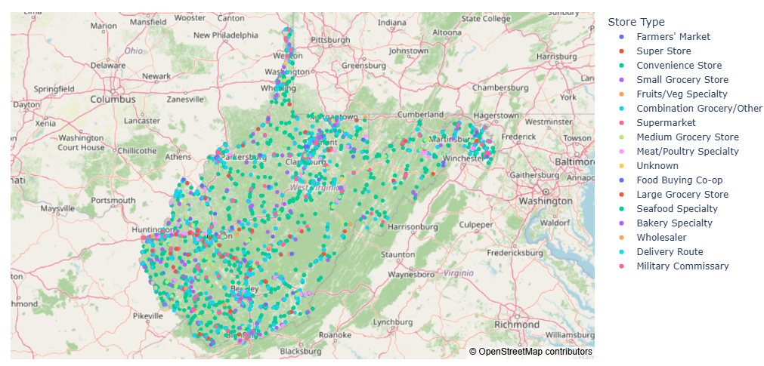
West Virginia County Analysis
Notes:
After identifying broader national patterns, I wanted to examine food access at a more localized level within West Virginia counties. County-level analysis helped show how statewide averages can hide major differences between individual communities. This map revealed that food access disparities were not evenly distributed across West Virginia. Some counties showed substantially higher levels of limited food access than others.

Slide 9
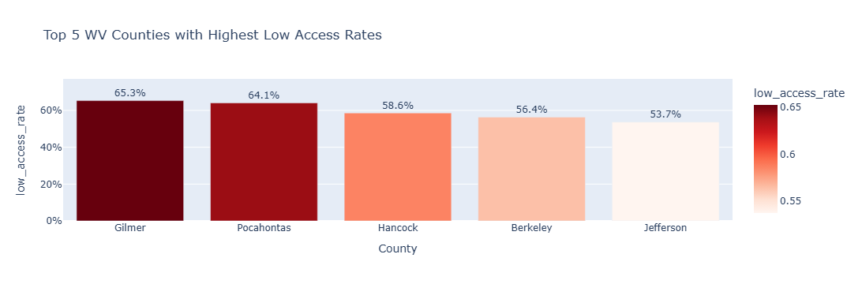
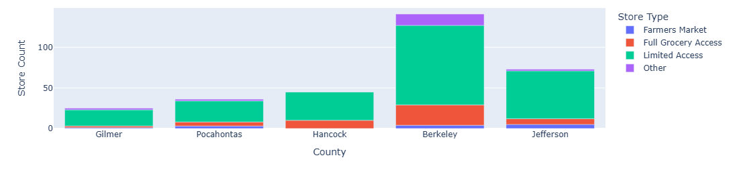
West Virginia County Analysis
Notes:
To explore the data more closely, I focused on the top 5 counties with highest low access rate and the type of stores they offer, as an example of how localized food access conditions can become.

Slide 10
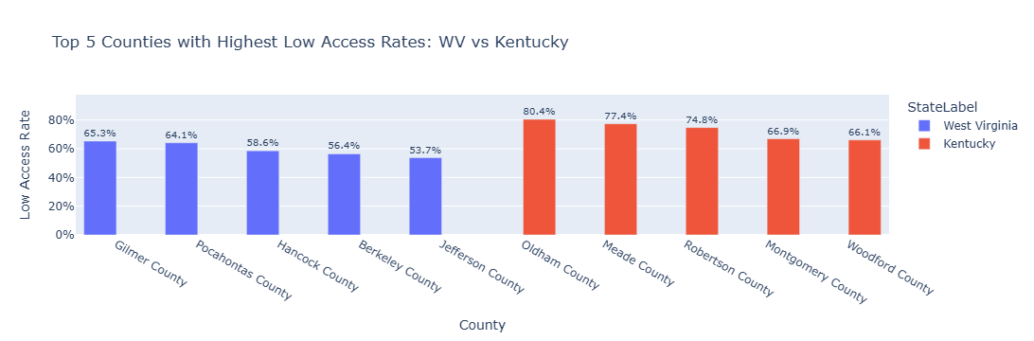
Kentucky vs WV County Comparison
Notes:
After examining West Virginia more closely, I wanted to compare those county-level patterns with Kentucky to determine whether similar trends appeared across neighboring Appalachian regions. While both states showed evidence of localized food access disparities, the geographic distribution patterns were not identical. There are more people living in the state of Kentucky than West Virginia. Since the low access rate is based on population the data does reflect that.

Slide 11
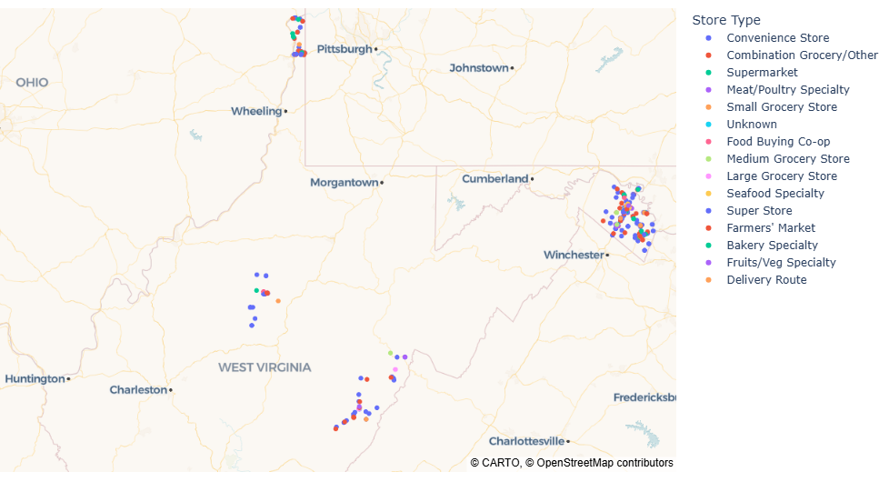
West Virginia Map County Analysis
Notes:
While the previous visual summarized county-level differences, the interactive map allowed me to explore those patterns more dynamically across West Virginia. One important takeaway was that neighboring counties could still show noticeably different patterns, reinforcing how localized these challenges can become. ***Switch to python for map interaction.***

Slide 12
Challenges and Limitations
Tracking data
Multiple notebooks
Large dataset
A lot of visuals
Notes:
Tracking data while making new visuals, accidentally deleting columns I needed, working out of two notebooks and thinking the codes wouldn’t be different
The dataset contained a very large number of demographic and geographic variables, so organizing and cleaning the data became a major part of the project.

Slide 13
Questions?

