Slide 1

QUICK BOOST
Francis, Noortje, Don & Bobby

Slide 2
t
KLEUREN
FONT
Roboto

Slide 3
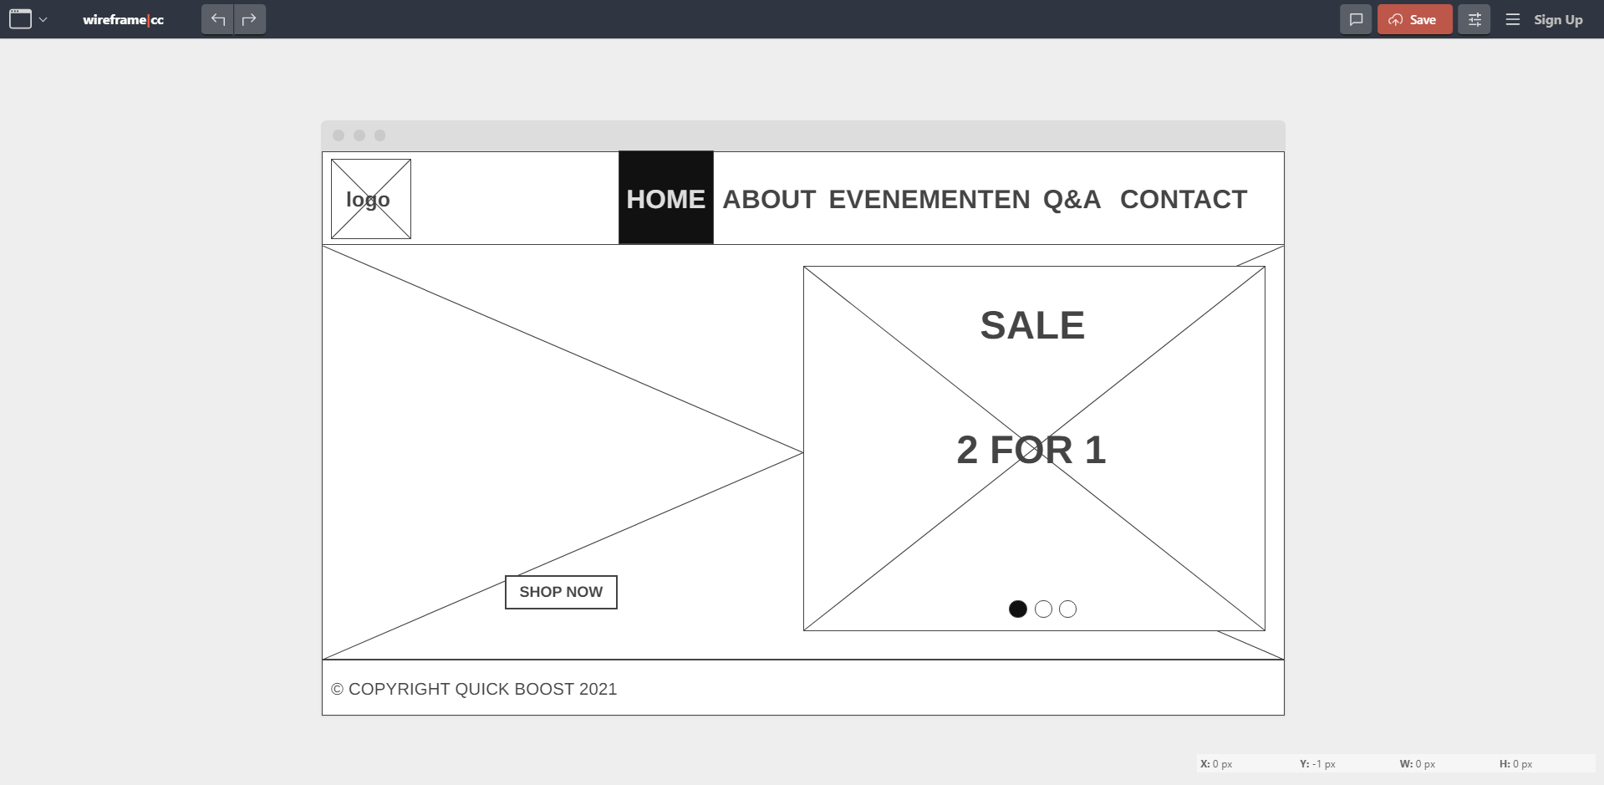
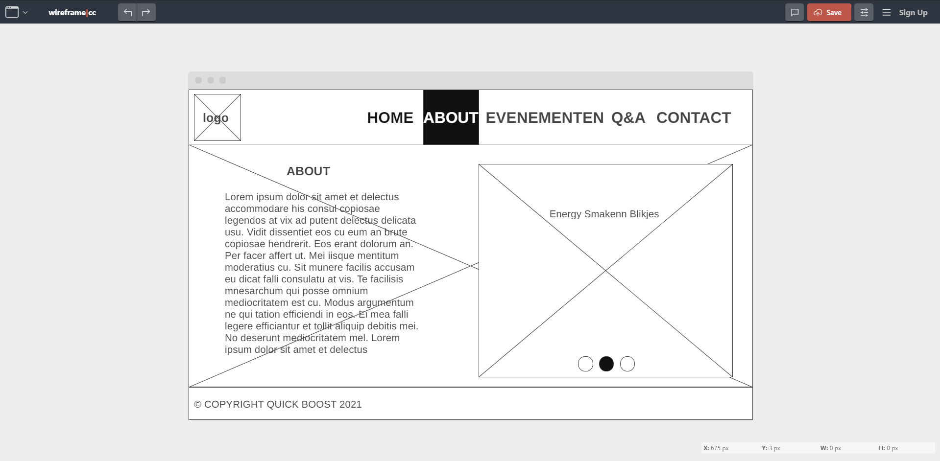
DESKTOP
WIREFRAMES

Slide 4
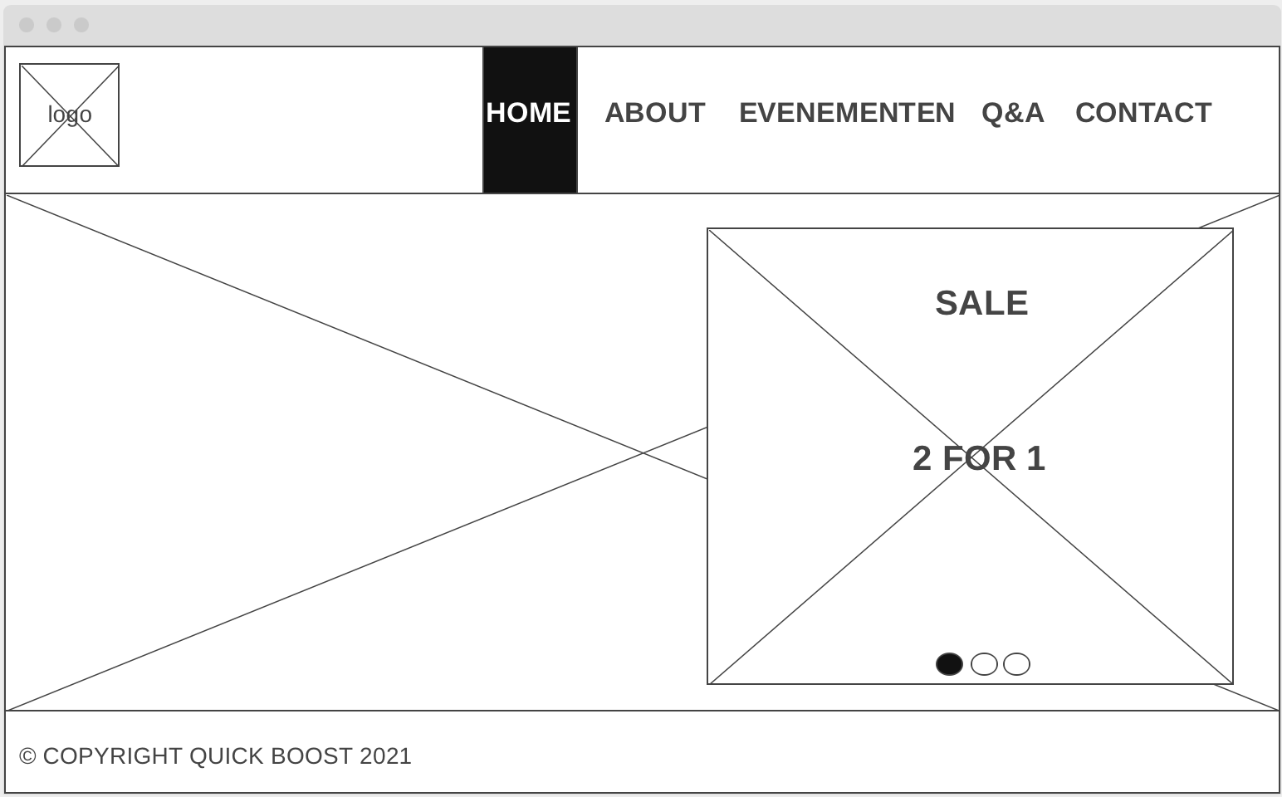
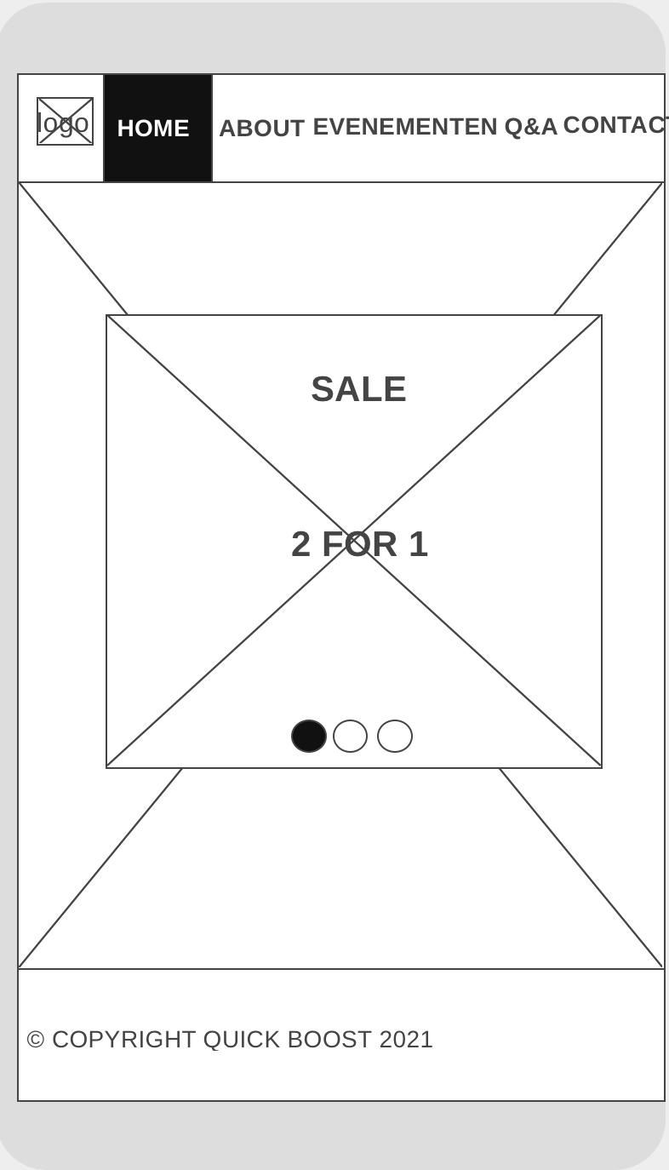
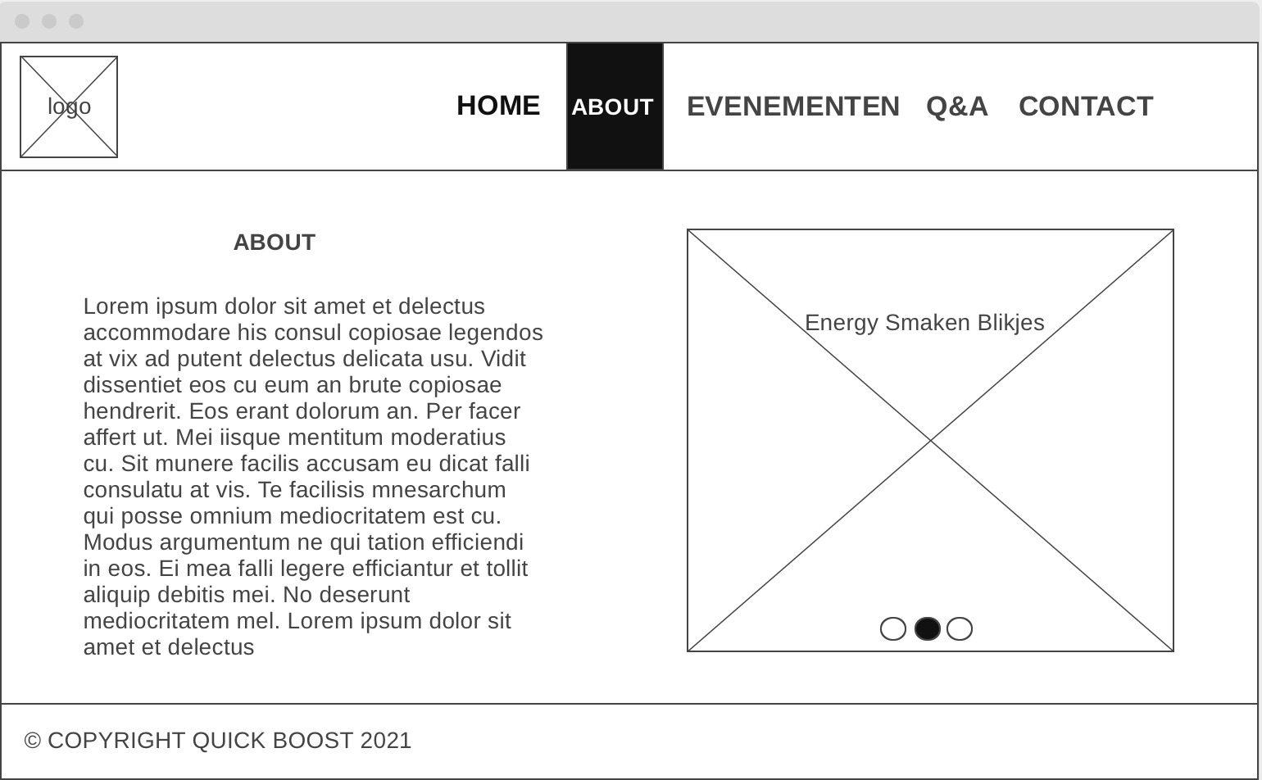
RESPONSIVE
WIREFRAMES

Slide 5
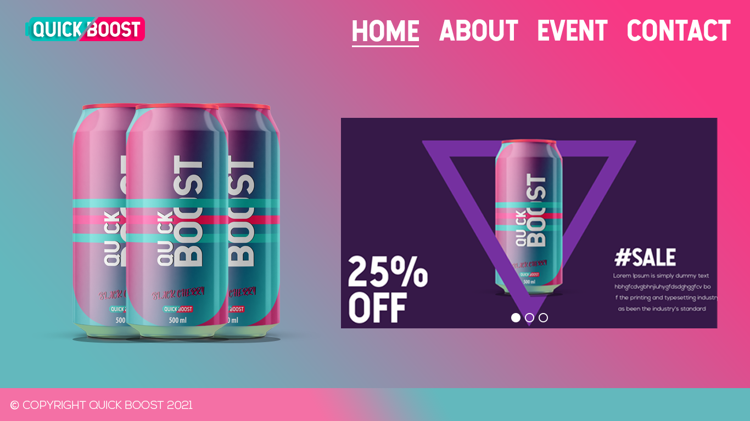
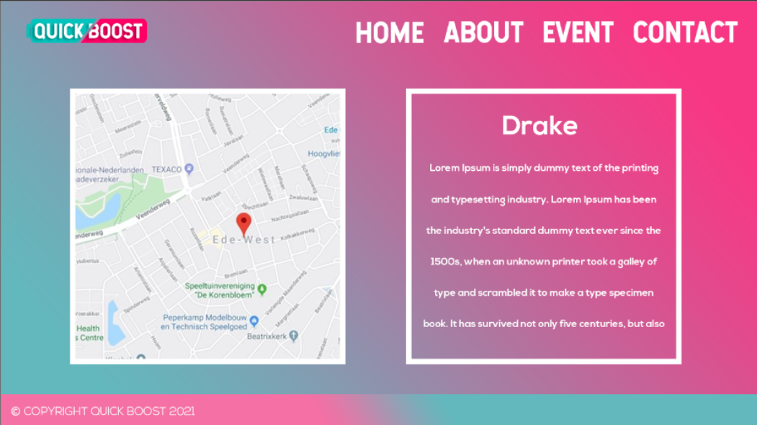
DESKTOP
MOCKUPS

Slide 6
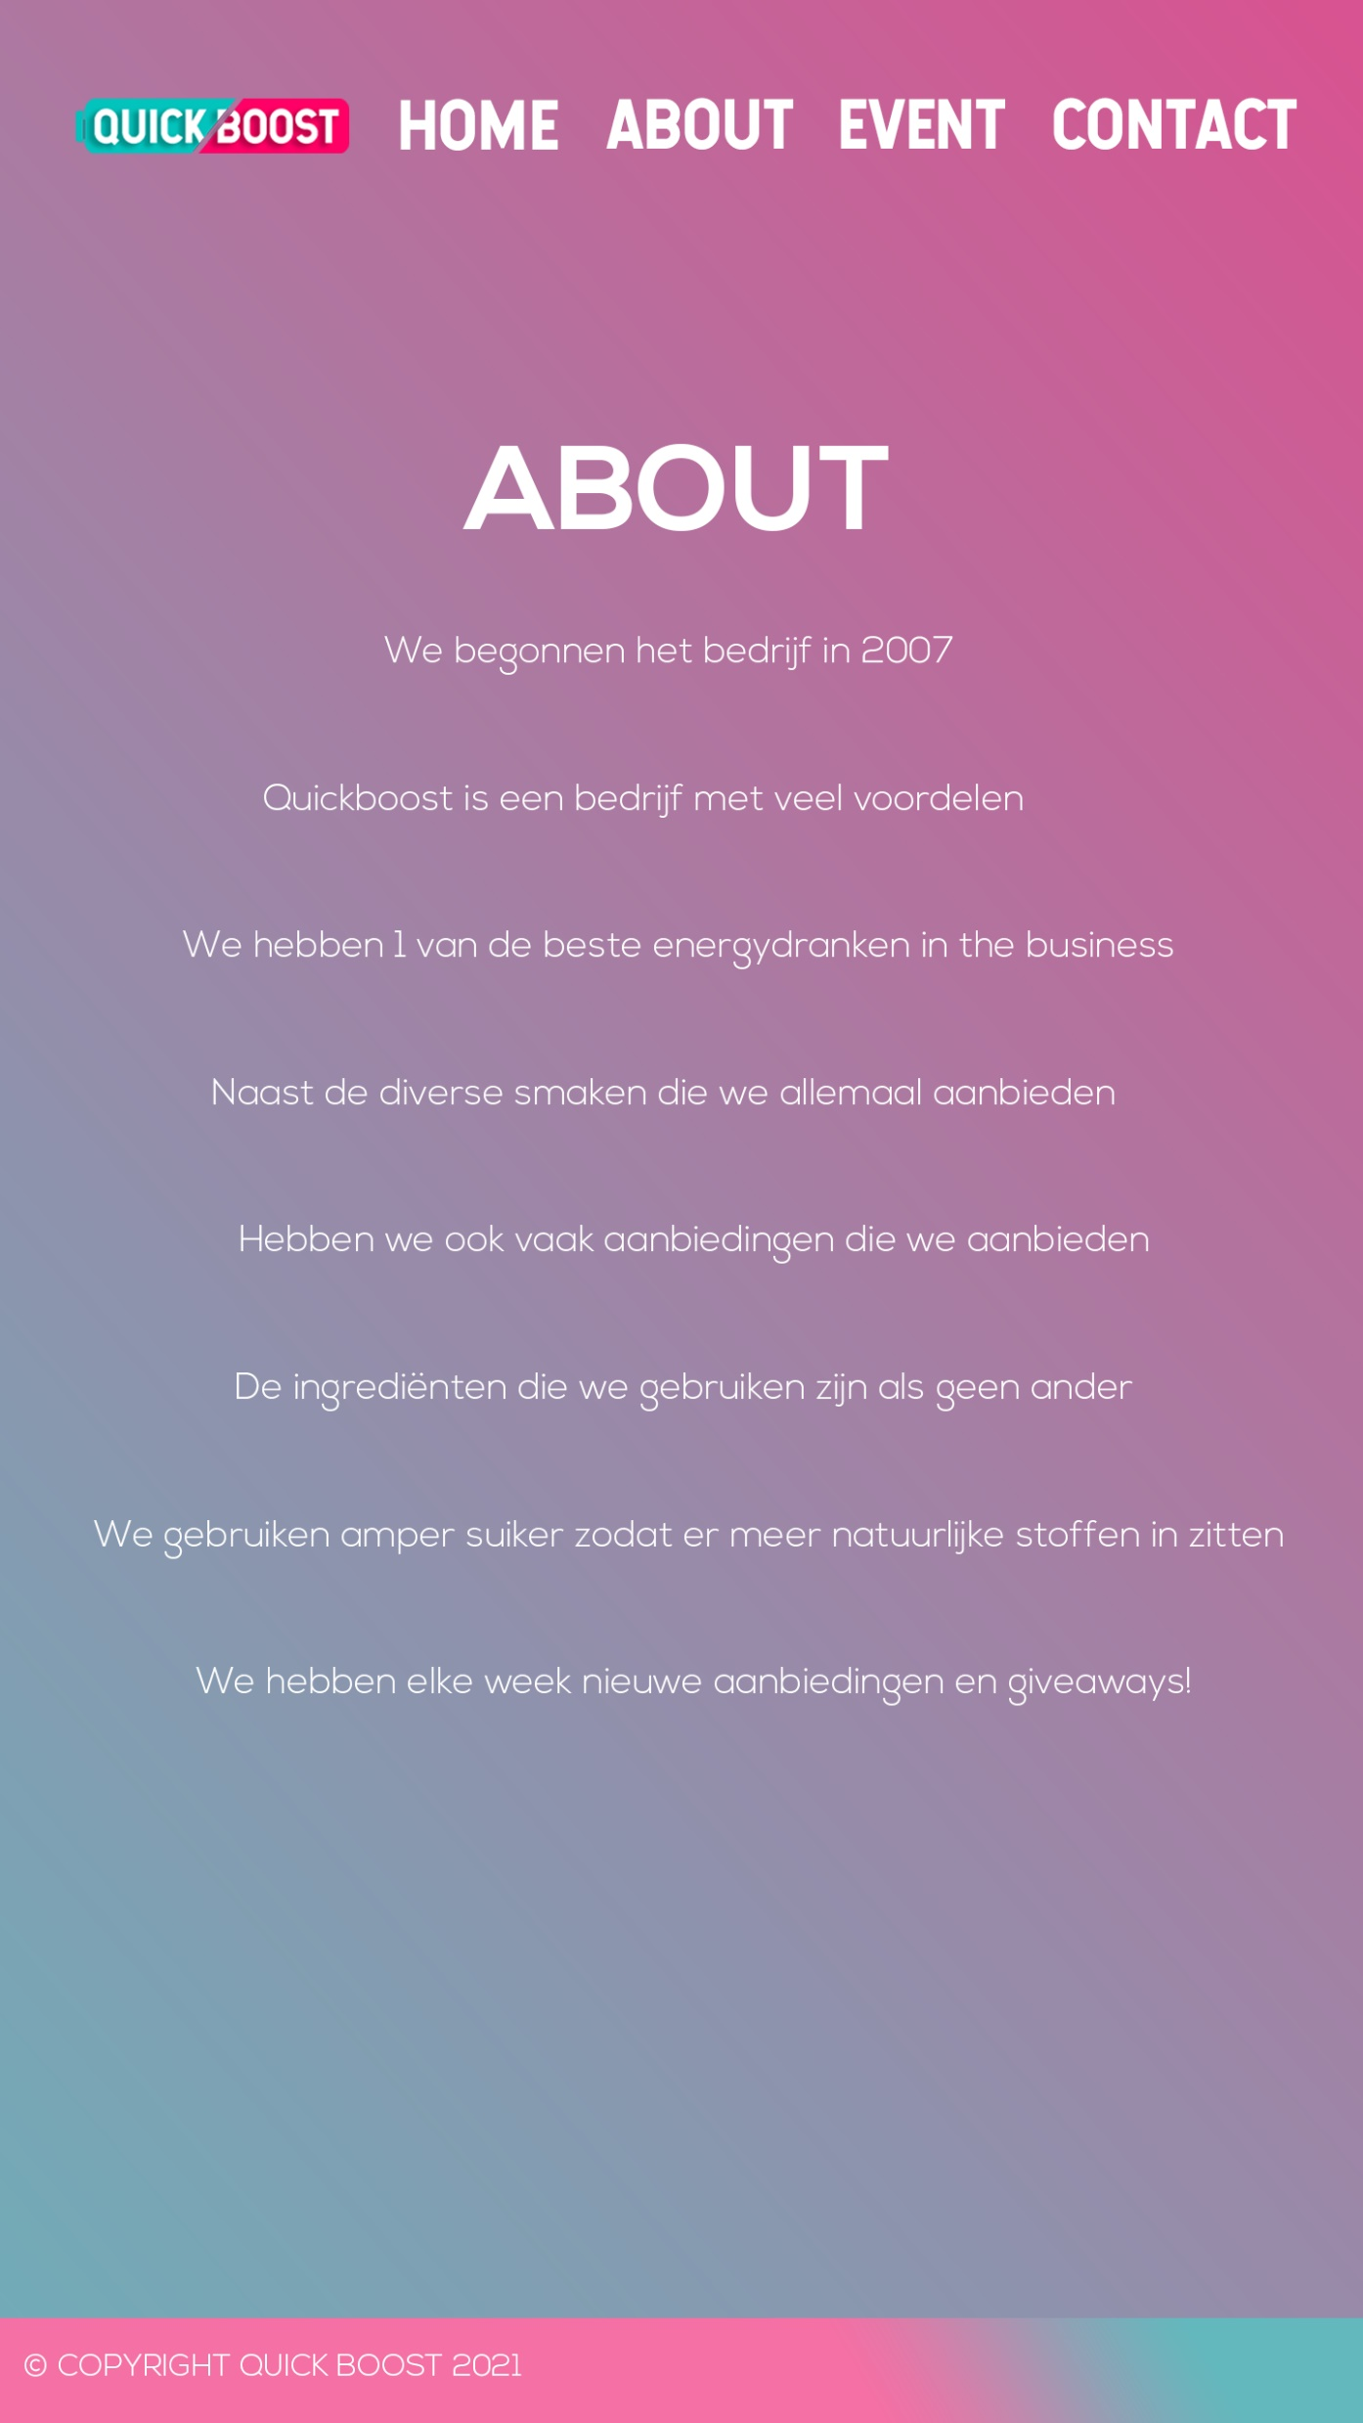
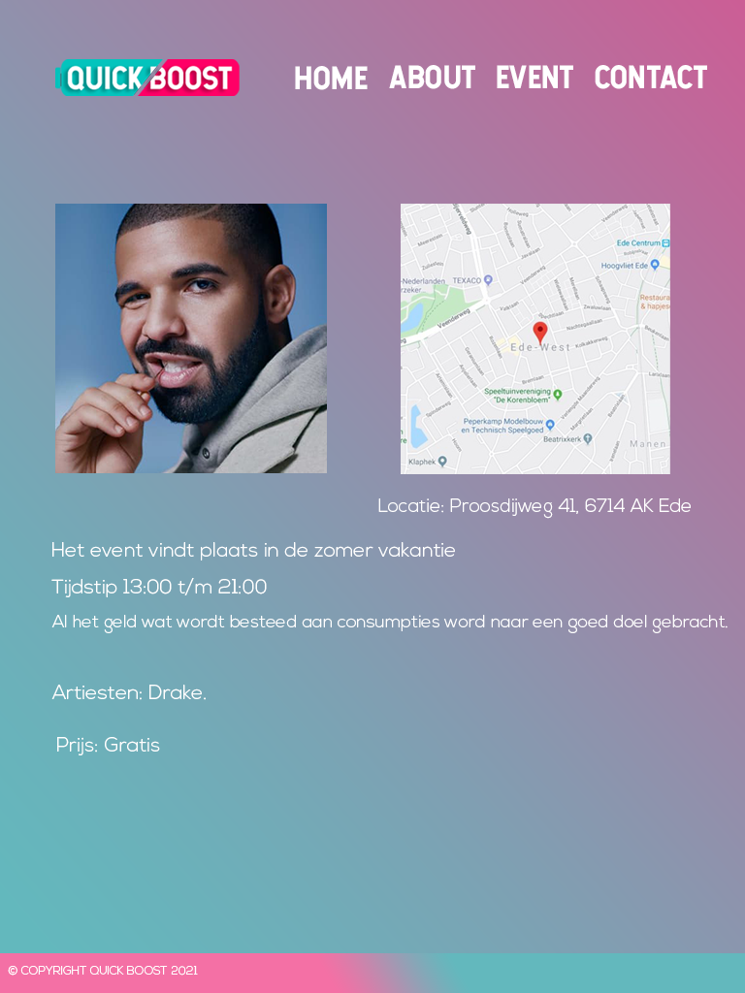
RESPONSIVE
MOCKUPS

Slide 7
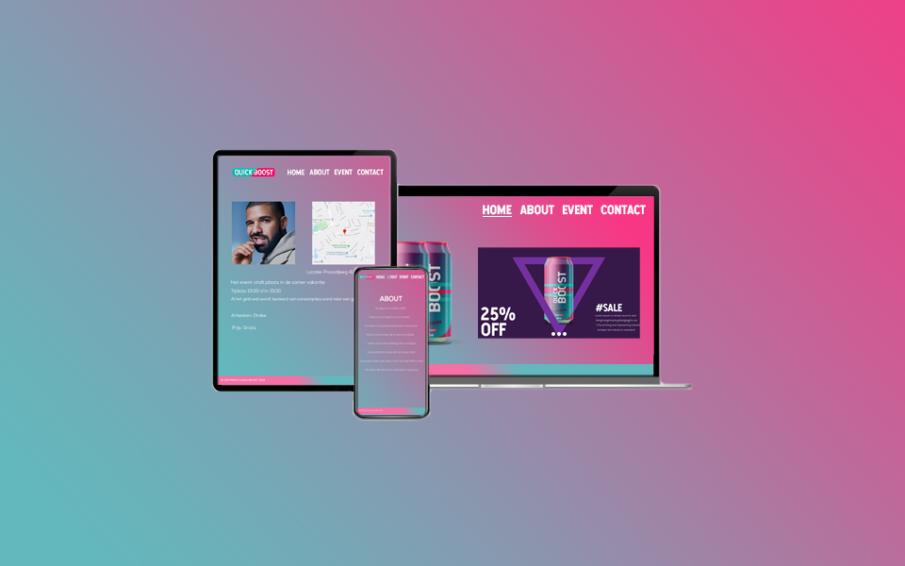
FINAL DESIGN

