Slide 1

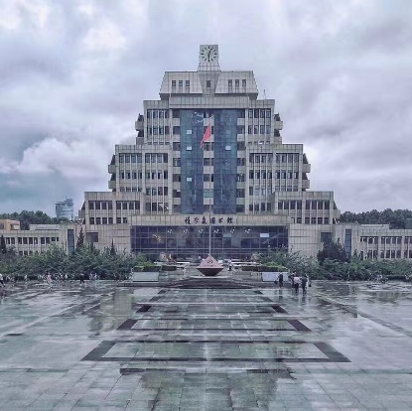
What is the future of international travel?
汇报人：周高升
2
0
2
1

Slide 2

Development of international travel
COVID-19 and international travel
Diversified ways of international travel
Purposes of international travel

Slide 3

01
Development of international travel

Slide 4
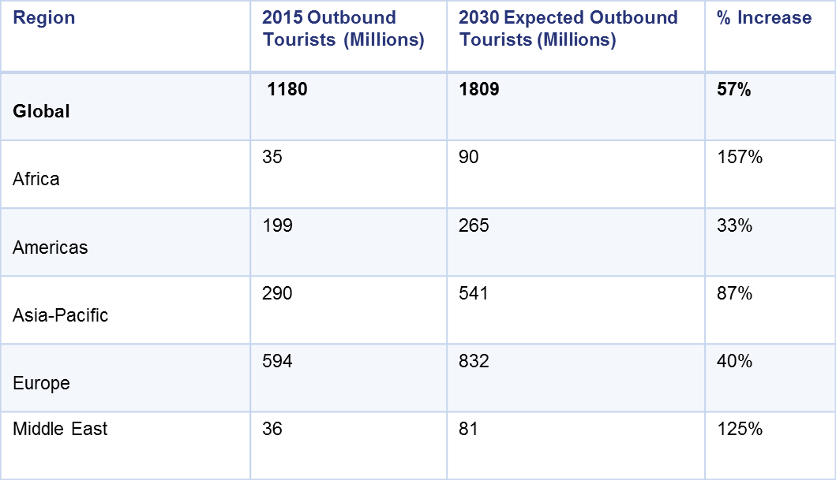
Development of international travel
the development of international travel
According to the data from UNWTO,the travel and tourism industry has grown dramatically in the past decades, reaching nearly 1.2 billion international arrivals in 2015, compared to 25 million in 1950. That’s a growth of 4,700% – and this number is only expected to get bigger, reaching 1.8 billion international arrivals by 2030. You might be surprised, but it’s one of the fastest growing economic sectors in the world.

Slide 5
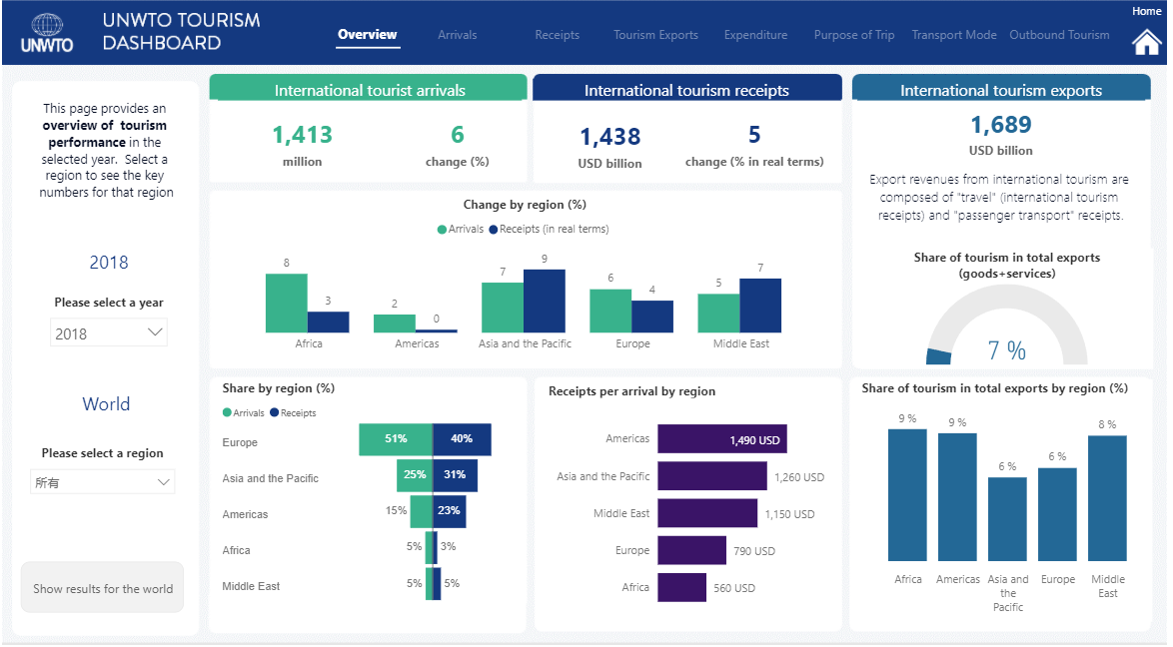
Development of international travel
This is a summary table about the international travel situation in 2018.As we can see, the total number of international tourists in this year reached 1413 billion,with an annual growth rate of 6% .And the total international tourism receipts reached 1438 billion dollars with an annual growth rate of 5%.

Slide 6
Development of international travel
The world's tourism exports account for seven percent of total global exports.
Of all the regions, Europe accounted for the largest share of international tourist arrivals, accounting for more than half of global arrivals. The Asia-Pacific region has the second largest share, with the Middle East and Africa having the fewest.

Slide 7
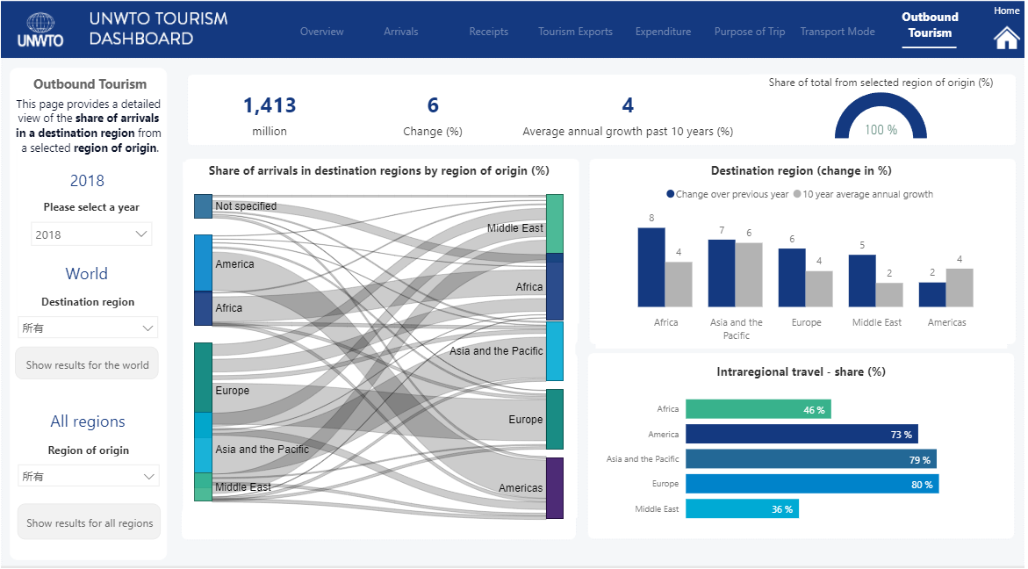
Development of international travel
This is a table about the development of different region’s international travel in 2018. And we can easily find that the number of tourists in each region are increasing year by year. Africa and Asia Pacific are the fastest growing regions.

Slide 8
02
COVID-19 and international travel

Slide 9
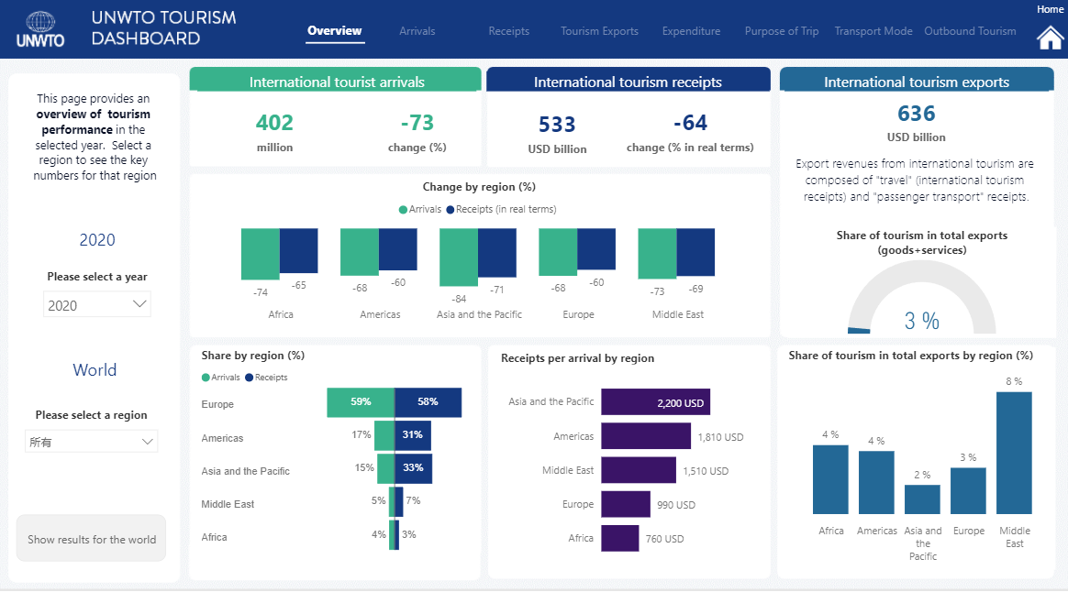
COVID-19 and international travel
This table shows the data of global international tourism in 2020. In comparison with the 2018 figures, it is easy to see that both the number of tourists and the revenue from tourism around the world fell significantly.

Slide 10
COVID-19 and international travel

Slide 11
03
Diversified ways of international travel

Slide 12
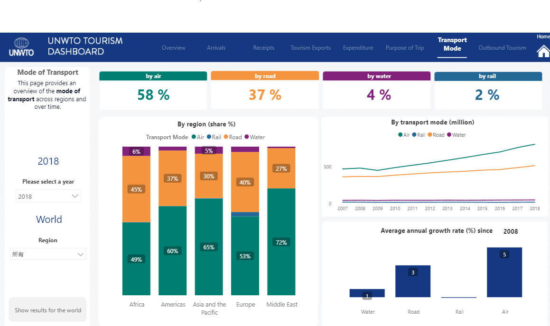
Diversified ways of international travel

Slide 13
04
Purposes of international travel

Slide 14
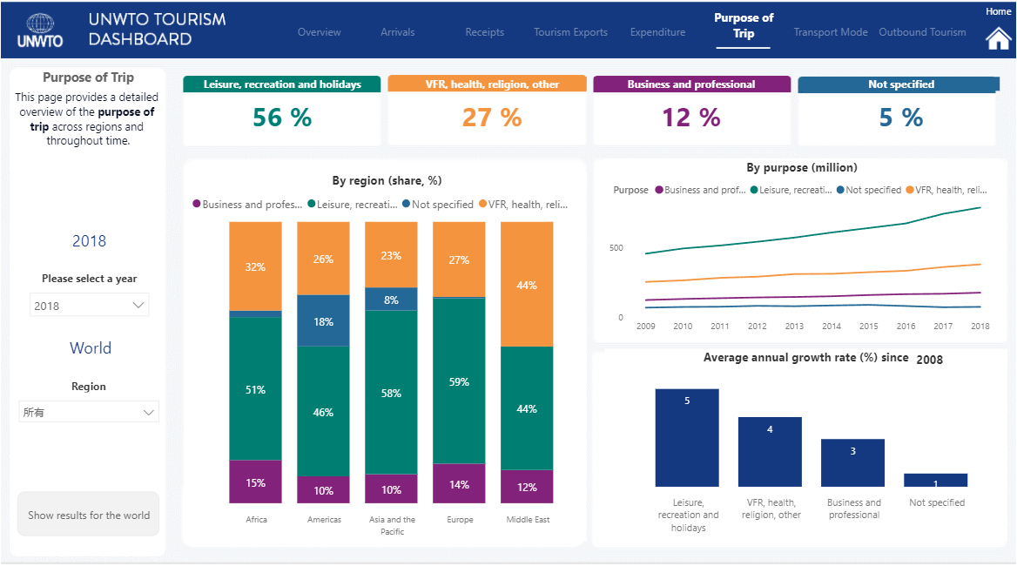
Purposes of international travel

Slide 15
THANKS！
2
0
2
1

