Slide 1


App Development
LESSON :2
Bird And the Balloons

Slide 2
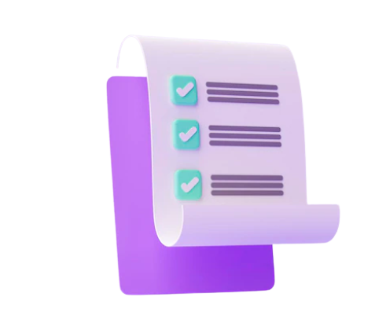

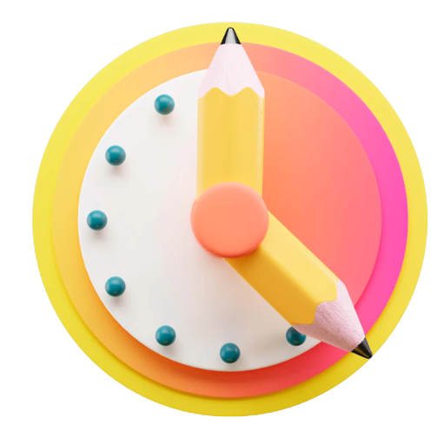

Session Details
Topics Covered
Event blocks, variables, sprites
Objective
Create a ‘Bird and the Balloons’ project using the code blocks.
Time
55 Minutes
Tools Used
Code.org

Slide 3
Class Structure
Topic | Time | Slide Number
Warm-up | 05 Mins | 4
Assignment | 00 Min | Assignment Link
Teacher’s Activity | 05 Mins | 7
Student’s Activity | 05 Mins | 13
Checkpoint 1 | 01 Min | 20
Fun activity 1 | 10 Mins | 22
Checkpoint 2 | 01 Min | 27
Fun activity 2 (optional) | 10 min | 29
Resource Table | 00 Min | 31
Wrap-up | 02 Mins | 32

Slide 4
Warm - up
(05 mins)
Hello, (student’s name)! How are you? How is your day going? Great! Do you remember your previous session?
Let's see how much we remember from our last session!
Question 1: What are the sprites?
*Students reply*
Answer: Sprites are the characters or animations that we add in the project.
Question 2: How can we reduce the problem of writing the same code multiple times?
*Student reply*
Answer: We can make use of the loops.
Question 3: What was your favorite part of creating our project?
*Student reply*
Awesome! You’re all set for today’s session! Let’s begin!
Hello (Name) How are you? What all did you do today ?
Student replies
So, do you remember what we have studied in the last class?
Student replies
(If the student does not recollect, help the student revise the concepts from previous session.)
Ok Great!! So, let us learn something new today!!
OR
Ok Great!! So, let us continue the topic that we were studying in the last class.

Slide 5


Problem Statement
Once upon a time in a colorful and whimsical town called Wonderland, there lived two best friends named Lily and Max. Lily was a talented young artist, and Max was a tech-savvy wizard with a passion for creating fun and educational apps for kids. They both loved nature, especially birds and balloons. One sunny morning, they decided to combine their skills and create something truly magical for children around the world.
"We should create an app that lets kids design their own birds and balloons!" suggested Max, his eyes twinkling with excitement.
Hello (Name) How are you? What all did you do today ?
Student replies
So, do you remember what we have studied in the last class?
Student replies
(If the student does not recollect, help the student revise the concepts from previous session.)
Ok Great!! So, let us learn something new today!!
OR
Ok Great!! So, let us continue the topic that we were studying in the last class.

Slide 6
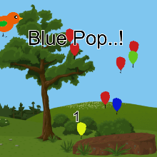
Solution
Lily and Max's dream of combining their love for birds, balloons, and technology came true, bringing joy, wonder, and a touch of magic to children everywhere. The Birds and Balloons app became a timeless favorite, reminding everyone that with a little creativity, friendship, and love for nature, anything was possible in the whimsical world of Wonderland.
Hello (Name) How are you? What all did you do today ?
Student replies
So, do you remember what we have studied in the last class?
Student replies
(If the student does not recollect, help the student revise the concepts from previous session.)
Ok Great!! So, let us learn something new today!!
OR
Ok Great!! So, let us continue the topic that we were studying in the last class.

Slide 7
05 mins
Teacher’s Activity
Bird and the Balloons

Slide 8

Variables
Variables are like magic containers that can hold different values. They are just like your shoe rack at home, where you can keep your favorite pairs of shoes. You can change the shoes whenever you want and place them on any shelf you like.
In the same way, variables are like your own special rack, where you can store different values. It's like having a superpower to update the values whenever you need.

Slide 9
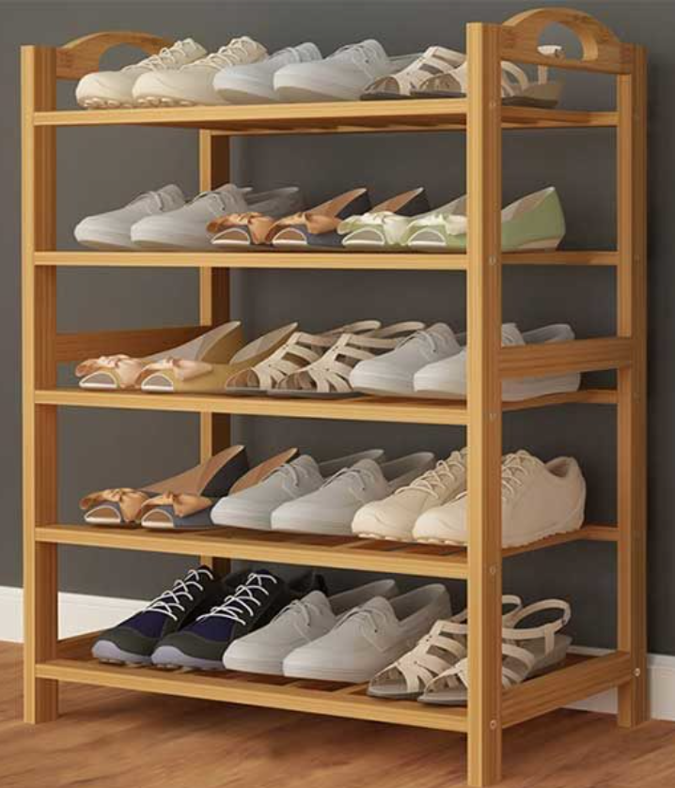
Variables
Shoe Rack
(VARIABLE)
Shoes
(VALUE)

Slide 10
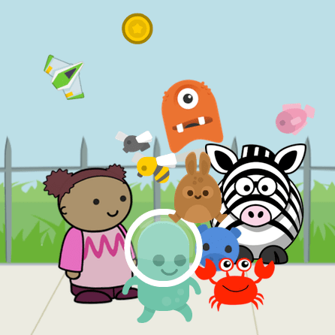

Sprites Lab
Sprite Lab is a block-based programming environment where you can make simple animations and games with objects and characters that interact with each other. Create an animation or game then share your app in seconds.

Slide 11
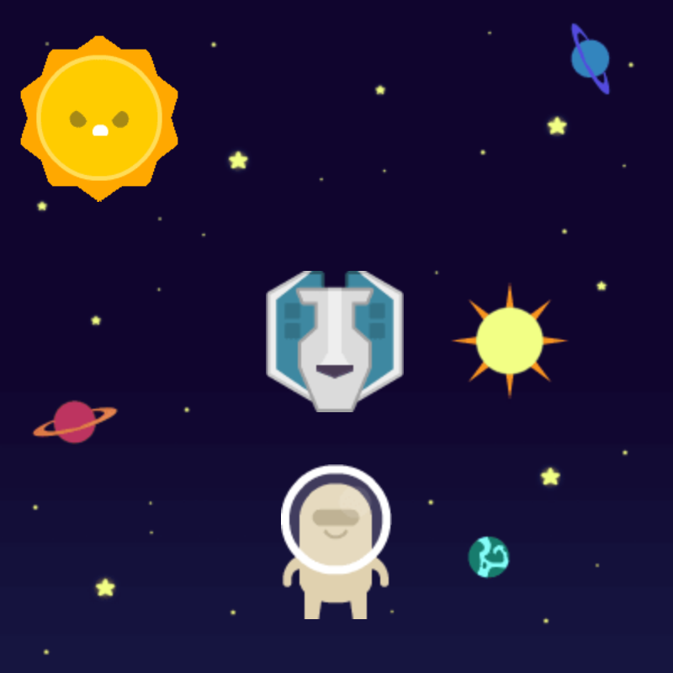
Sprites Lab
A sprite is the name we give to a collection of values in Game Lab that represents a character in a story, animation, or game. A sprite can be stored in a variable with a label, but unlike values you've stored in variables before, such as numbers, a sprite lets you store many related values all under the same label.

Slide 12
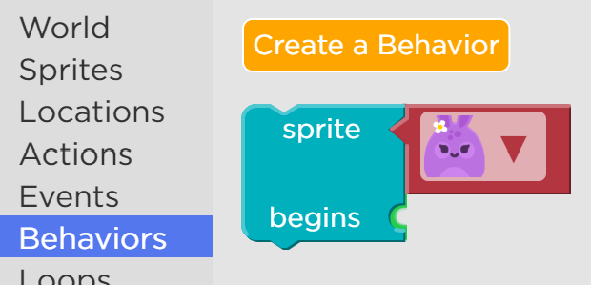
Sprites Behaviors
Behaviors are pre-defined sets of actions that a sprite can perform over and over. When a sprite begins a behavior you are telling the computer to run that set of actions on the sprite over and over until the behavior stops.

Slide 13
5 mins
Student Activity:
Logging into Code.org
LINK : code.org

Slide 14
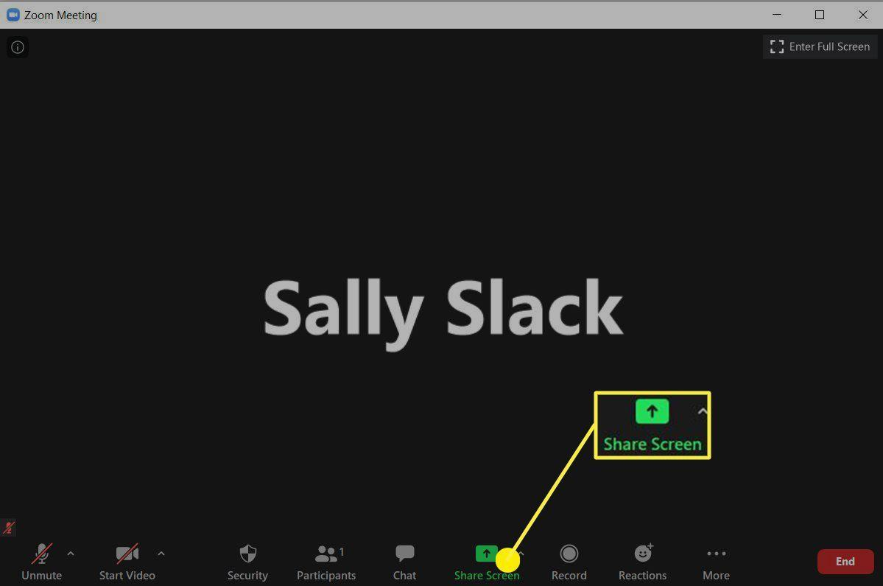
Screen Share
To share screen, click on the “share screen” option.
To share screen:

Slide 15
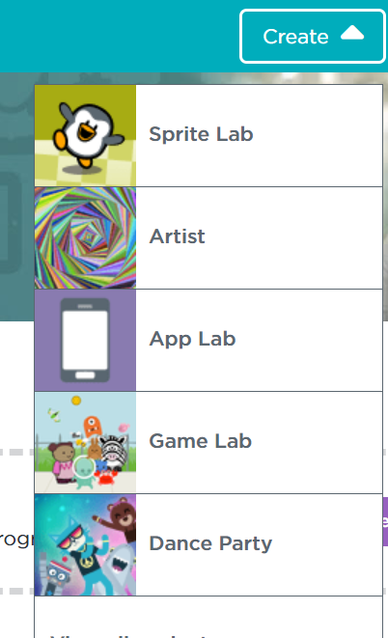
Student Login
Step 1: Sign in to the code.org account.
(Share this link with the students in the comment section).
Link: code.org
Step 2:
Click on the Create and select relevant option.

Slide 16
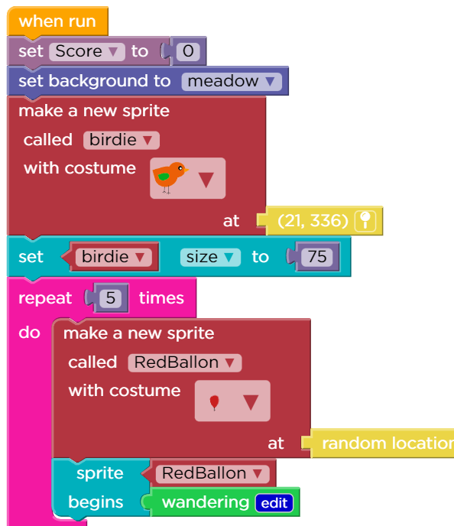
Code Blocks
Code Blocks to Initialise score variable and make new sprites
When run, set score to 0.
Set the background.
Make a new sprite at a specific location and name it.
Set the size of the birdie to 75.
Using repeat block create 5 red balloons at random locations.
Add the wandering behavior to these balloons

Slide 17
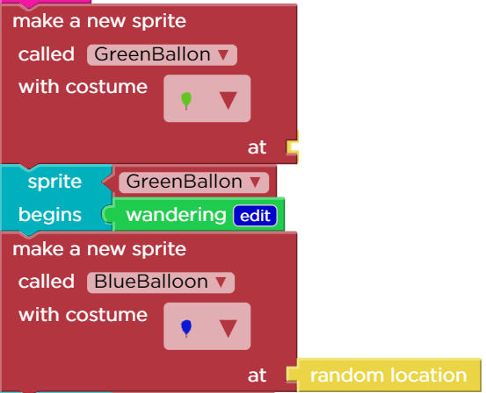
Code Blocks
Code Blocks to make new sprites
create 5 green balloons at random locations.
Add the wandering behavior to these balloons

Slide 18
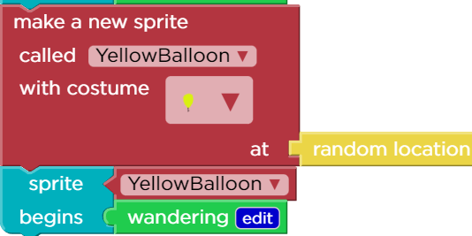
Code Blocks
Code Blocks to make new sprites
create 5 yellow balloons at random locations.
Add the wandering behavior to these balloons

Slide 19
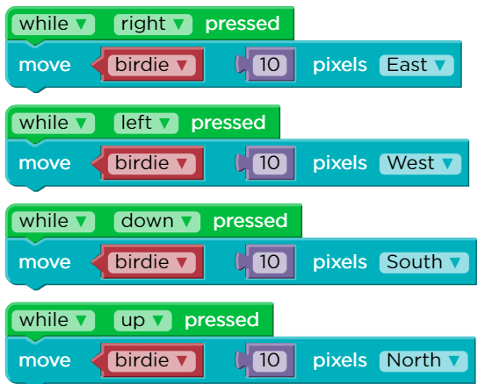
Code Blocks
Code Blocks to move the Birdie sprite in all 4 directions
When right arrow is pressed, move the birdie 10 pixels east direction.
When left arrow is pressed, move the birdie 10 pixels west direction.
When down arrow is pressed, move the birdie 10 pixels south direction
When up arrow is pressed, move the birdie 10 pixels north direction.

Slide 20
Assessment 1
Ask students the following questions to check the pace of the learner.
Which loop is used in the project ? [2 marks] Answer: Repeat loop.
What are sprite behaviors?[2 marks]Answer: Behaviors are pre-defined sets of actions that a sprite can perform over and over.
Where did we store the game points? [2 marks]
Answer:In a score variable.
What are the different types of events added to move the bird ? [2 marks]
Answer: Key pressed events.
(This is an assessment to recall the concepts learnt so far. Follow the checkpoint after this).

Slide 21
1 min
Checkpoint 1
Evaluate the understanding / learning level of the student.
If the Score is between 0-3 then he/she is a slow learner. Explain the concepts again according to Assessment 1 and then go to this slide.
If the Score is between 4-5 then the learner is a medium learner. Keep working on
the activities in natural flow. Go to this slide.
If the Score is between 6-8 then the learner is a fast learner. Keep working on
the activities in natural flow. Go to this slide.

Slide 22
10 mins
Fun Activity 1

Slide 23
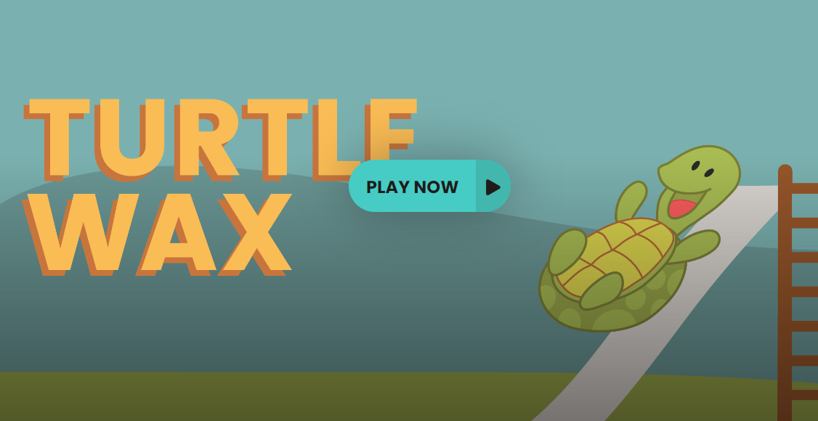
Fun Activity 1
It’s time to refresh ourselves with a cool activity! I have a
“Turtle Wax” for you!
(Share the link with the student & Ask the student to open the link).
Click and drag the turtle to adjust the slide. Release to send the turtle down the slide.
Adjust the height of the ladder to try to land on the target. Land on the target three times to win!

Slide 24
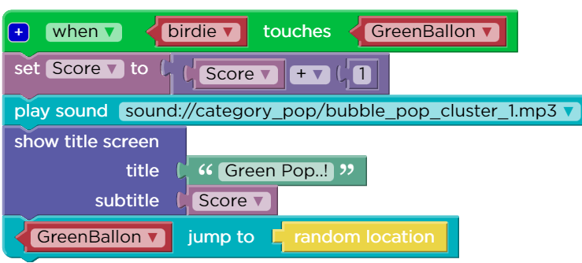
Coding the App
Code Blocks when Birdie touches GreenBallooon
When the birdie touches green balloon, increment the score by 1.
Play a bubble pop sound
Display which color balloon is popped !
Display the score also.
Make the balloon jump to random locations.

Slide 25
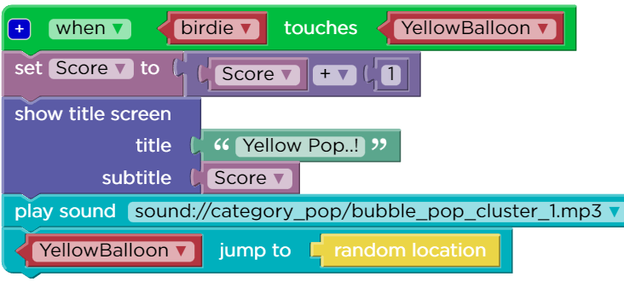
Coding the App
Code Blocks when Birdie touches YellowBallooon
When the birdie touches yellow balloon, increment the score by 1.
Play a bubble pop sound
Display which color balloon is popped !
Display the score also.
Make the balloon jump to random locations.

Slide 26
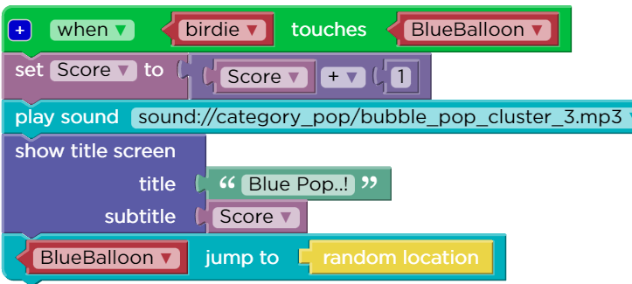
Coding the App
Code Blocks when Birdie touches BlueBallooon
When the birdie touches blue balloon, increment the score by 1.
Play a bubble pop sound
Display which color balloon is popped !
Display the score also.
Make the balloon jump to random locations.

Slide 27
Assessment 2
Ask the student the following questions to check the pace of the learner.
Create a simple screen with a few balloons sprites in it. If any of these balloons touch the edges of the screen then a balloon pop sound should be heard.
[8 marks]
(This is an assessment to recall the concepts learnt so far. Follow the checkpoint after this).

Slide 28
1 min
Checkpoint 2
Evaluate the understanding / learning level of the student.
If the Score is between 0-3 then learner is a slow learner,explain the concepts again according to Assessment 2 and then go to this slide.
If the Score is between 4-5 then the learner is a medium learner. Keep working on
the activities in natural flow. Go to this slide .
If the Score is between 6-8 then the learner is a fast learner. Keep working on
the activities in natural flow. Go to this slide .

Slide 29
10 mins
Optional
Fun Activity 2

Slide 30
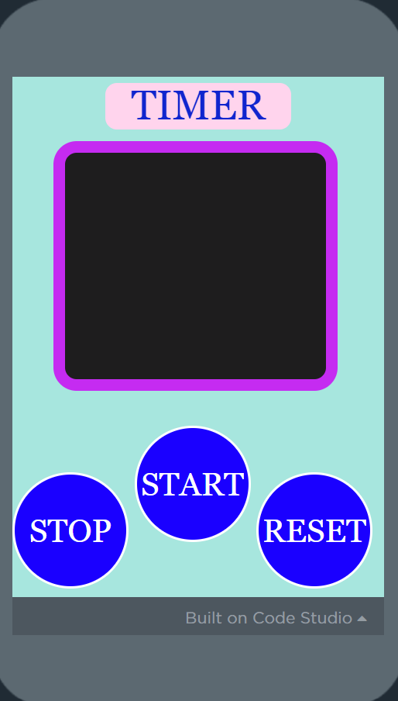
Fun Activity 2
It’s time to refresh ourselves with a cool activity! I have a
“Timer app” for you!
(Share the link with the student & Ask the student to open the link).

Slide 31
Resource Table
Activity | Activity Name | Link
Student Activity Link | Code.org | Code.org Platform
Teacher Activity Link | Completed Project | Bird and the Balloons
Student Assignment | Assignment | Assignment Link

Slide 32

Wrap - Up
Okay, so this leads us to the end of the session. Congratulations! You did very well in the class today.
How about we revise what we studied today?
What type of events are used in the project today?
What is the significance of a Variable?
How to create multiple sprites?
What are the uses of using a loop?

Slide 33
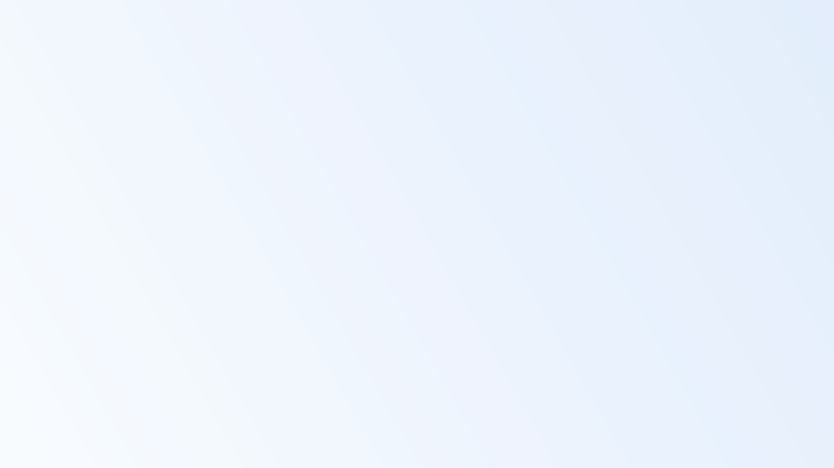








Thank You !
See you in the next session

