Slide 1
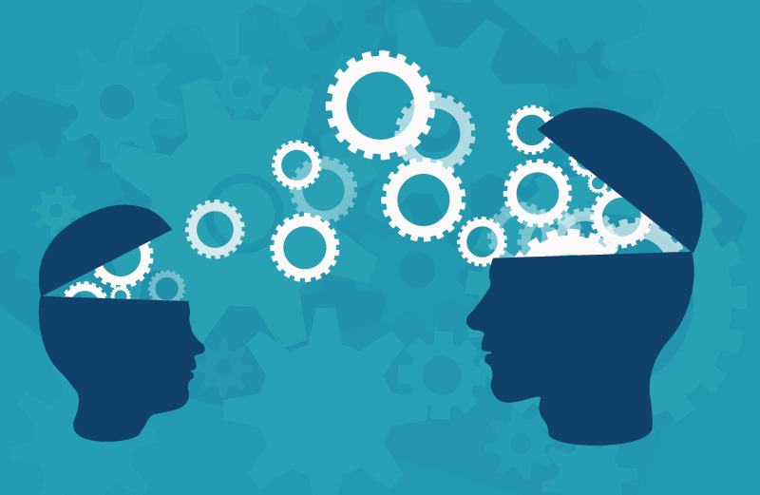
TRANSFER LEARNING
DAO THI TRUC LOAN
Tuesday, November 23th, 2021

Slide 2
Outline
1. What is Transfer Learning?
2. Why is use Transfer Learning?
3. How transferable are features?
4. Approaches to Transfer Learning
5. Experimental
6. Conclusions

Slide 3
Outline
1. What is Transfer Learning?

Slide 4

1. What is Transfer Learning?

Slide 5

1. What is Transfer Learning?

Slide 6
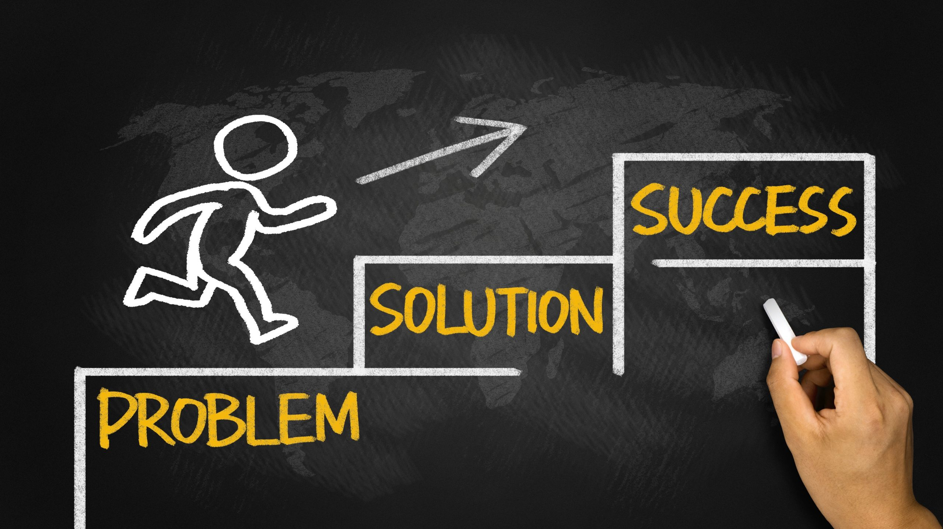
1. What is Transfer Learning?

Slide 7

1. What is Transfer Learning?

Slide 8
1. What is Transfer Learning?

Slide 9
1. What is Transfer Learning?
Learning from Scratch
Transfer Learning

Slide 10
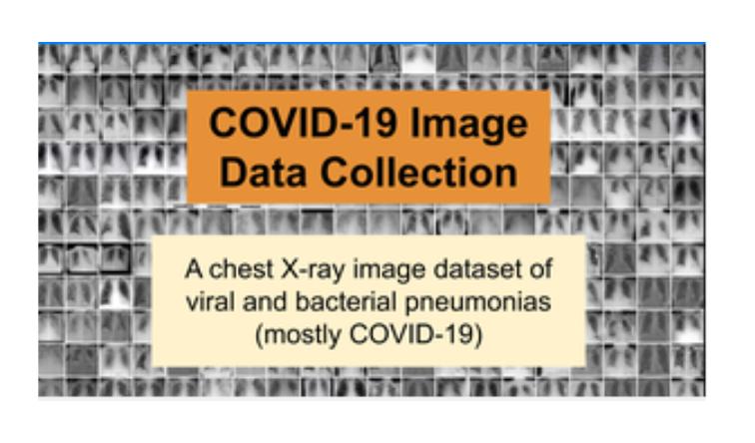
1. What is Transfer Learning?

Slide 11
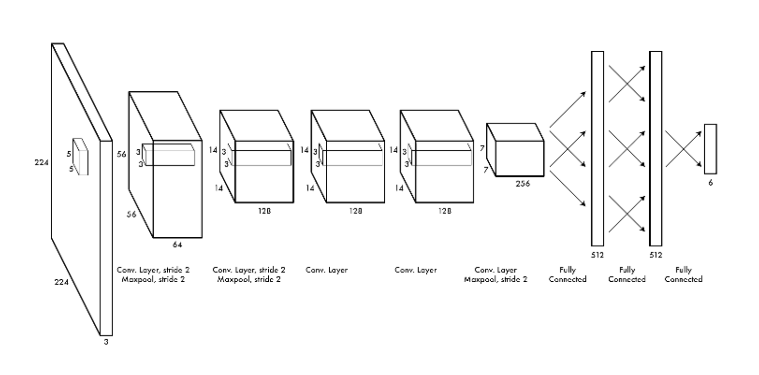
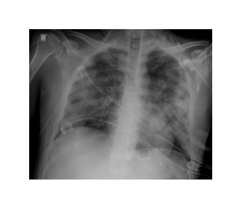
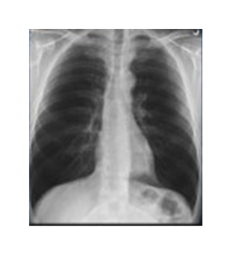
1. What is Transfer Learning?
Covid-19
Normal
CNN model

Slide 12
1. What is Transfer Learning?
Training from Scratch
Covid-19
Normal
CNN model

Slide 13
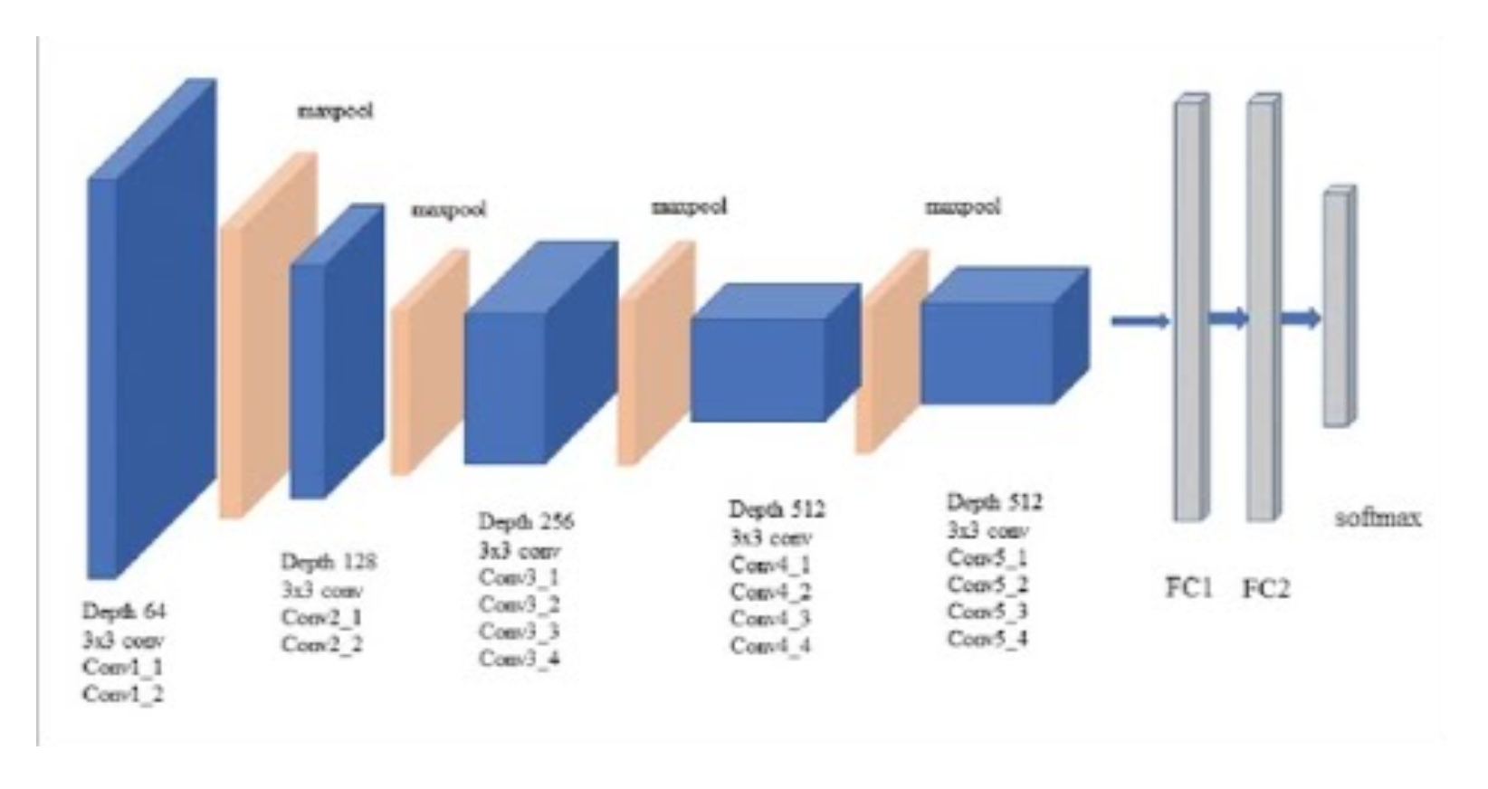
1. What is Transfer Learning?
Training from Scratch
Covid-19
Normal
CNN model
Transfer Learning
Covid-19
Normal
Pre-trained VGG-19 on ImageNet

Slide 14
1. What is Transfer Learning?
Training from Scratch
Covid-19
Normal
CNN model
Transfer Learning
Covid-19
Normal
Pre-trained VGG-19 on ImageNet
Transfer learning is a method of reusing a model or knowledge for another related task

Slide 15
1. What is Transfer Learning?
Feature
Extractor
Handcrated
Features
model
Task Target
Input
Traditional Learning Flow
Transfered (Learned Features) + model
Task Target
Input
Transfer Learning Flow

Slide 16
Outline
1. What is Transfer Learning?
2. Why is use Transfer Learning?

Slide 17
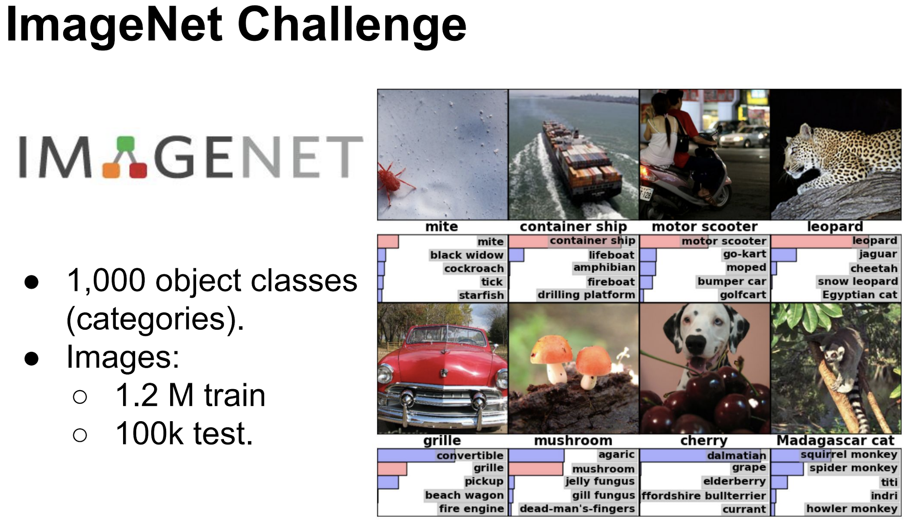
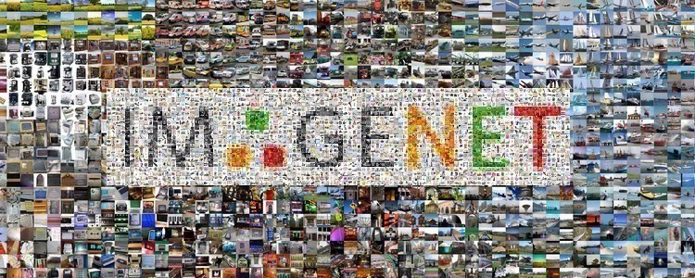
2. Why is use Transfer Learning?
High-quality dataset consisting of a large amount of data

Slide 18
2. Why is use Transfer Learning?
High-quality dataset consisting of a large amount of data
Training
VGG-19-BN
High performance

Slide 19

2. Why is use Transfer Learning?
High-quality dataset consisting of a large amount of data
Dataset consisting of a small amount of data
Training
Training
VGG-19-BN
CNN model
High performance
Low performance

Slide 20
2. Why is use Transfer Learning?
High-quality dataset consisting of a large amount of data
Dataset consisting of a small amount of data
Reuse
Training
Training
VGG-19-BN
VGG-19-BN
High performance
High performance

Slide 21
2. Why is use Transfer Learning?
High-quality dataset consisting of a large amount of data
Dataset consisting of a small amount of data
1. Not needing
a lot of data
Reuse
Training
Training
VGG-19-BN
VGG-19-BN
High performance
High performance

Slide 22
2. Why is use Transfer Learning?
High-quality dataset consisting of a large amount of data
Dataset consisting of a small amount of data
1. Not needing
a lot of data
Reuse
Training
Training
2. Saving
training time
VGG-19-BN
VGG-19-BN
High performance
High performance

Slide 23
2. Why is use Transfer Learning?
High-quality dataset consisting of a large amount of data
Dataset consisting of a small amount of data
1. Not needing
a lot of data
Reuse
Training
Training
2. Saving
training time
VGG-19-BN
VGG-19-BN
High performance
3. Better
performance
High performance

Slide 24
Outline
1. What is Transfer Learning?
2. Why is use Transfer Learning?
3. How transferable are features?

Slide 25
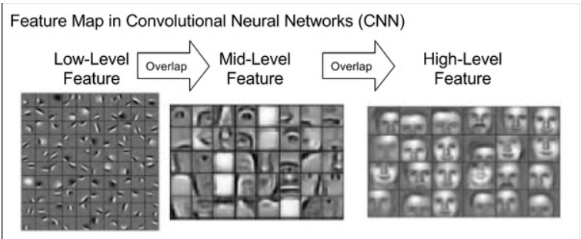
3. How transferable are features?
https://phamdinhkhanh.github.io/2020/04/15/TransferLearning.html

Slide 26
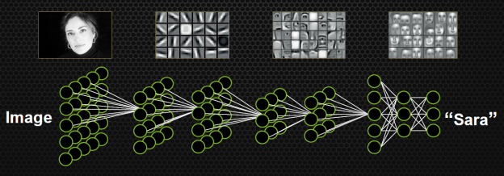
https://developer.nvidia.com/blog/accelerate-machine-learning-cudnn-deep-neural-network-library/

Slide 27
Detect edges in the earlier layers
https://developer.nvidia.com/blog/accelerate-machine-learning-cudnn-deep-neural-network-library/

Slide 28
Detect edges in the earlier layers, shapes in the middle layer
https://developer.nvidia.com/blog/accelerate-machine-learning-cudnn-deep-neural-network-library/

Slide 29
Detect edges in the earlier layers, shapes in the middle layer and some task-specific features in the later layers
https://developer.nvidia.com/blog/accelerate-machine-learning-cudnn-deep-neural-network-library/

Slide 30
Outline
1. What is Transfer Learning?
2. Why is use Transfer Learning?
3. How transferable are features?
4. Approaches to Transfer Learning

Slide 31
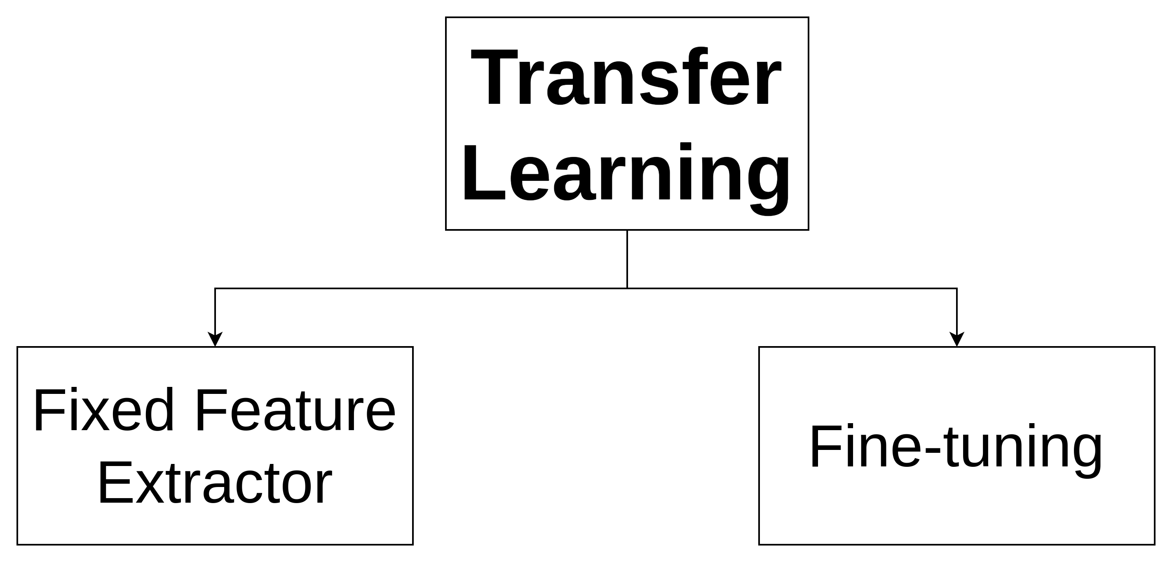
4. Approaches to Transfer Learning

Slide 32
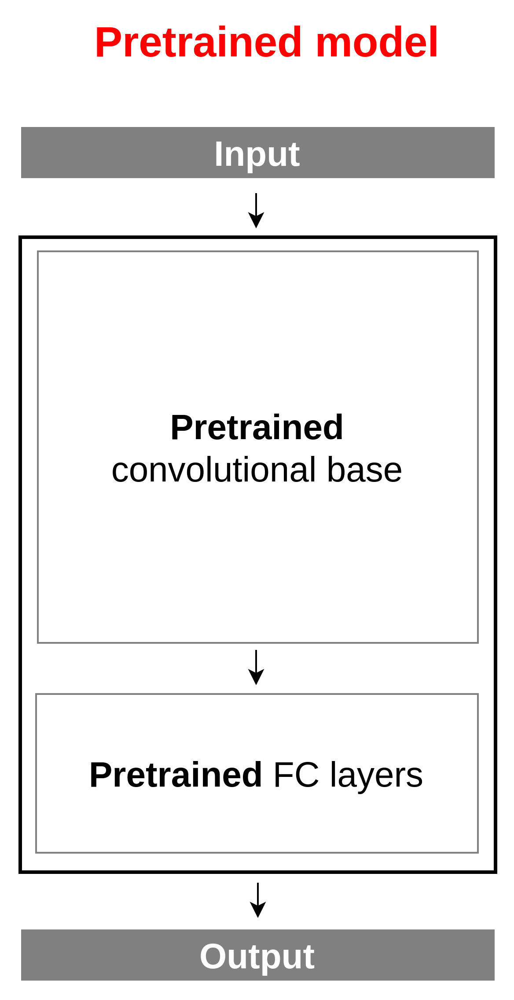
4. Approaches to Transfer Learning
Adapted and modified from source : https://insightsimaging.springeropen.com/articles/10.1007/s13244-018-0639-9

Slide 33

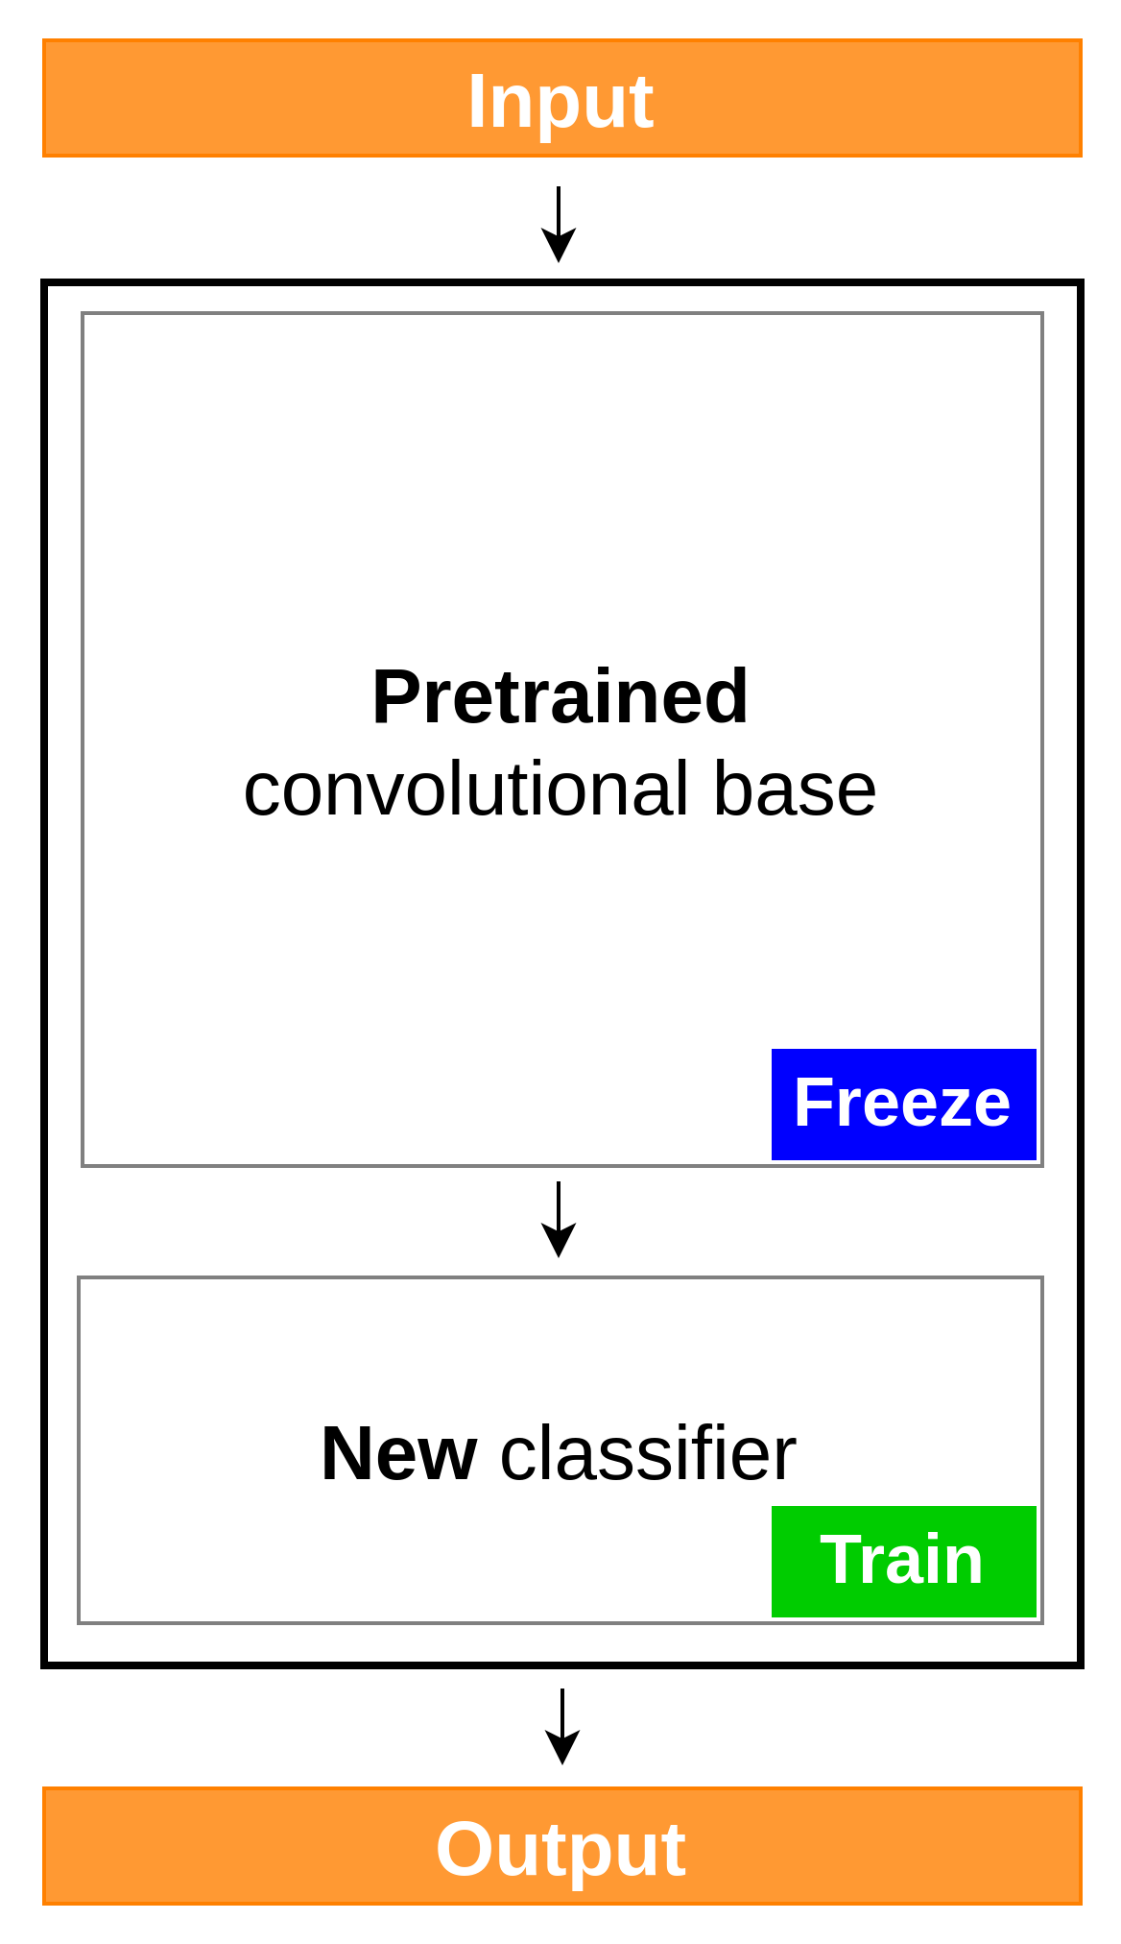
4. Approaches to Transfer Learning
Adapted and modified from source : https://insightsimaging.springeropen.com/articles/10.1007/s13244-018-0639-9

Slide 34
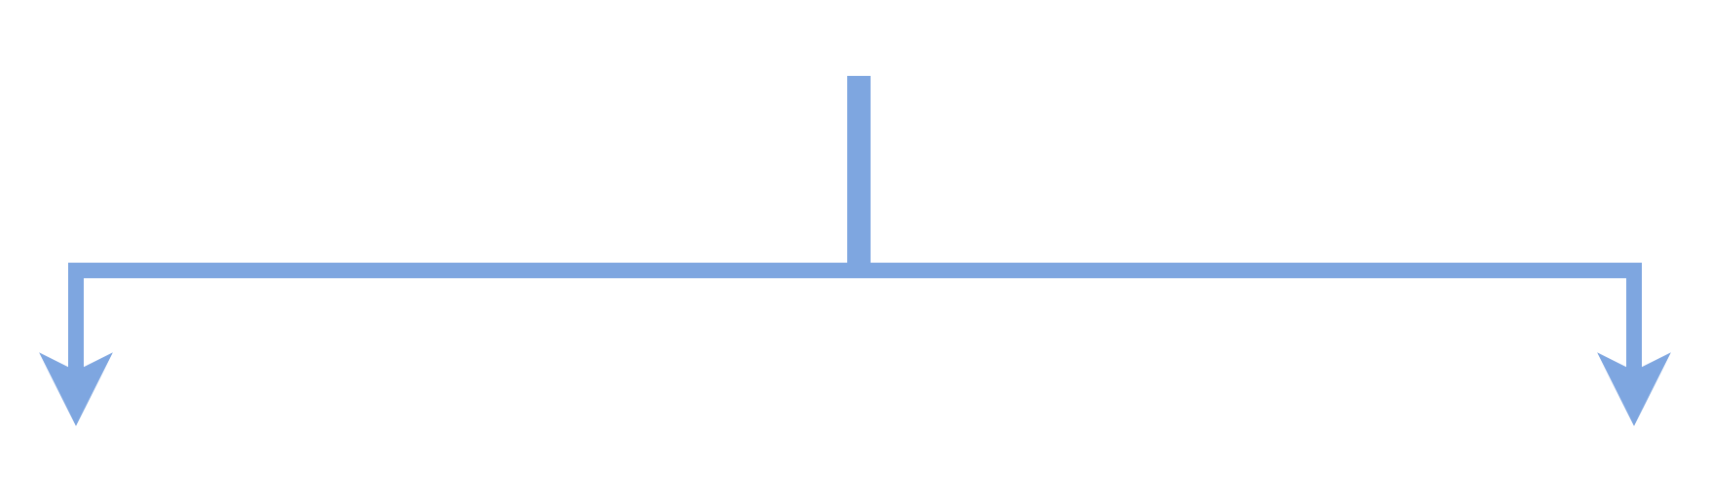
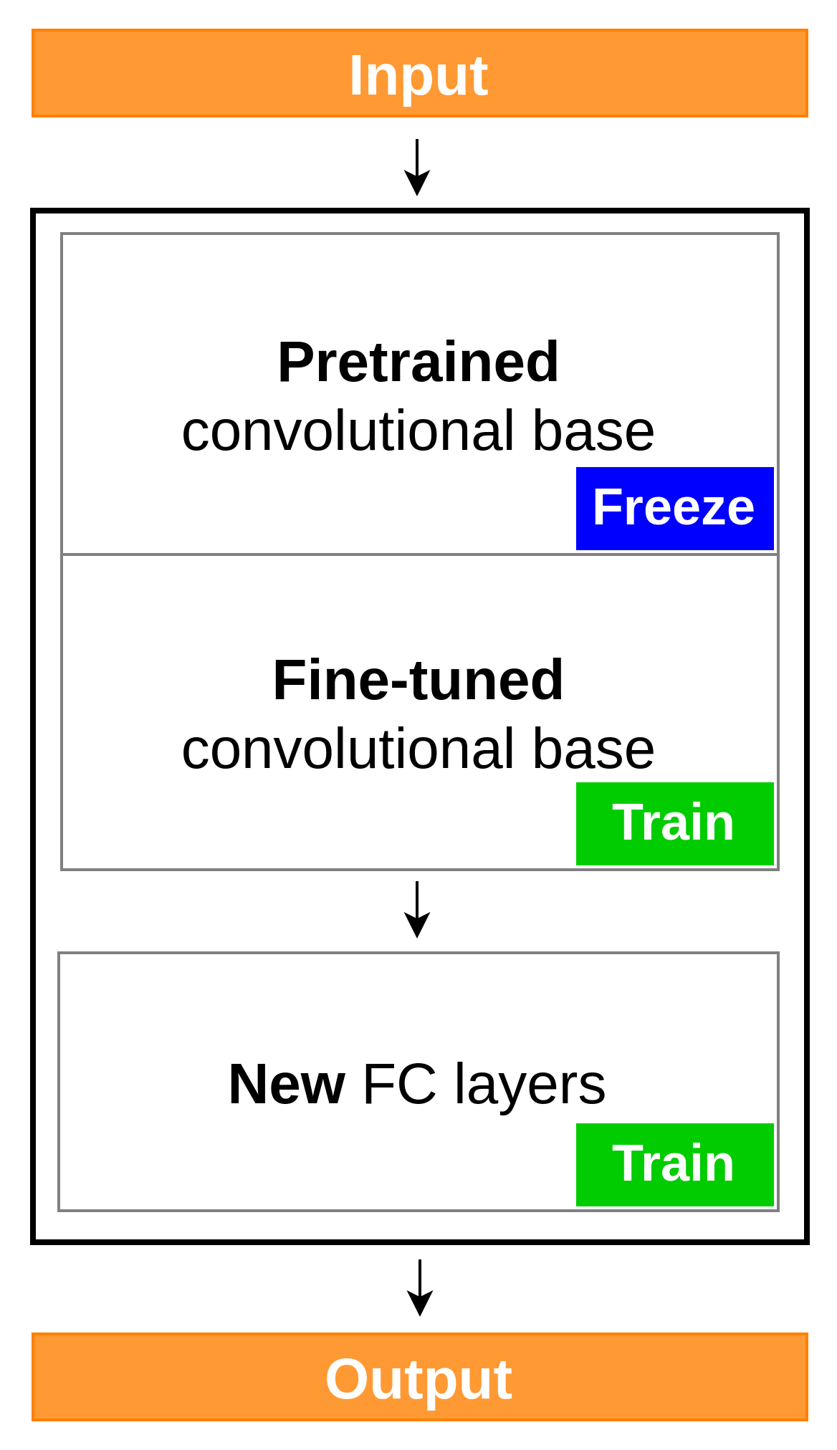
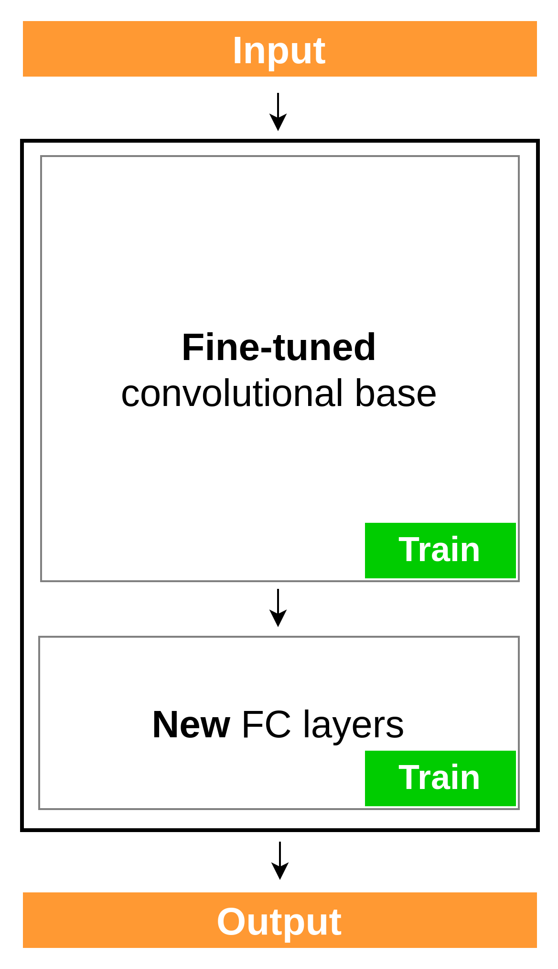
4. Approaches to Transfer Learning
Adapted and modified from source : https://insightsimaging.springeropen.com/articles/10.1007/s13244-018-0639-9

Slide 35
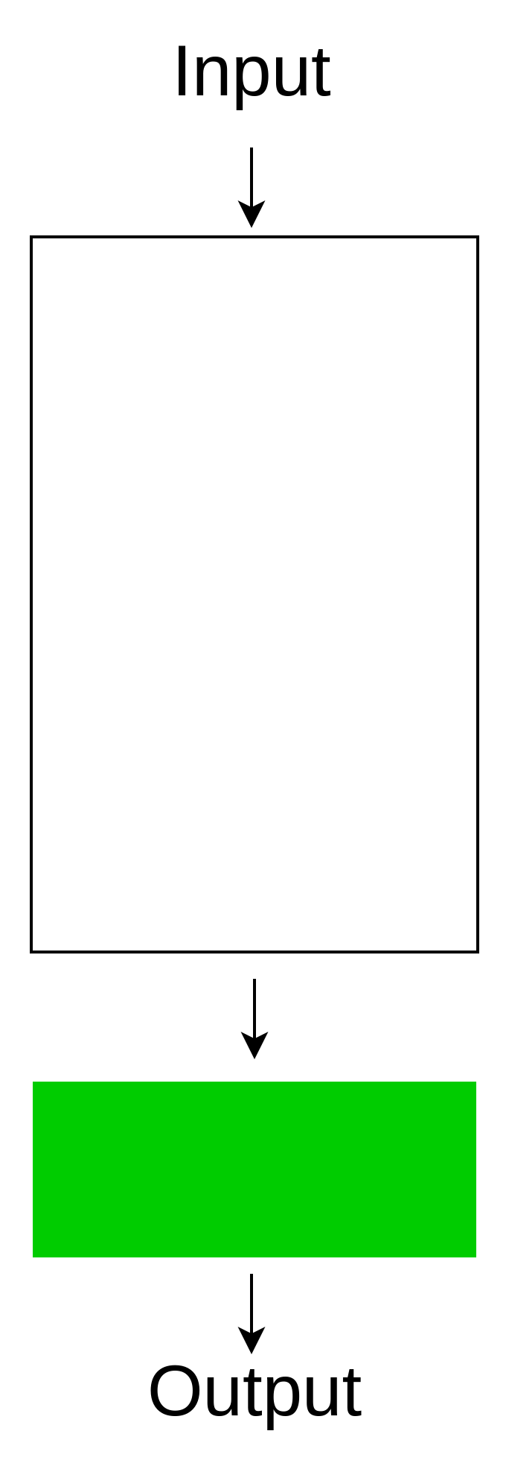
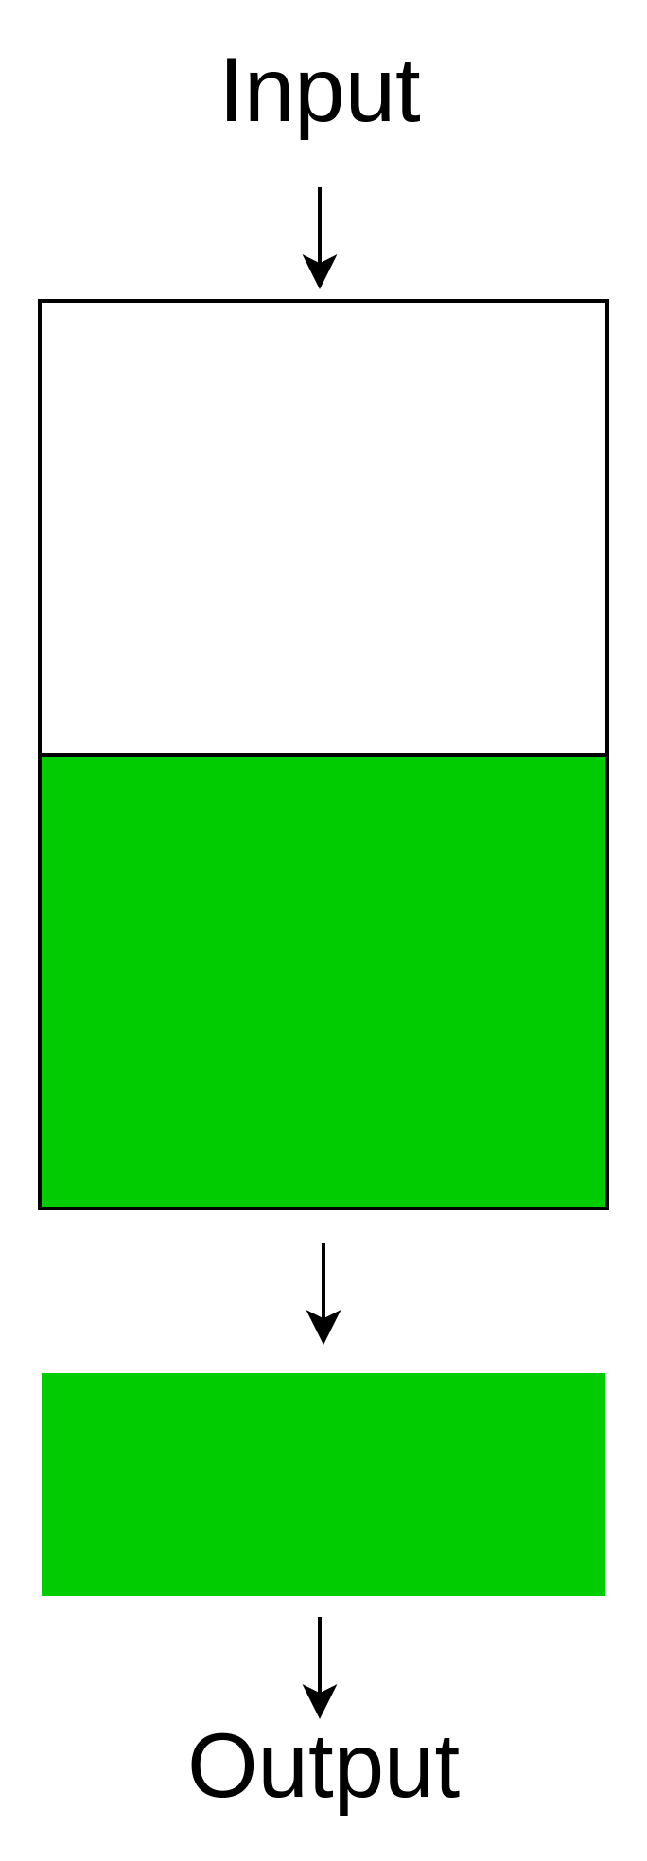
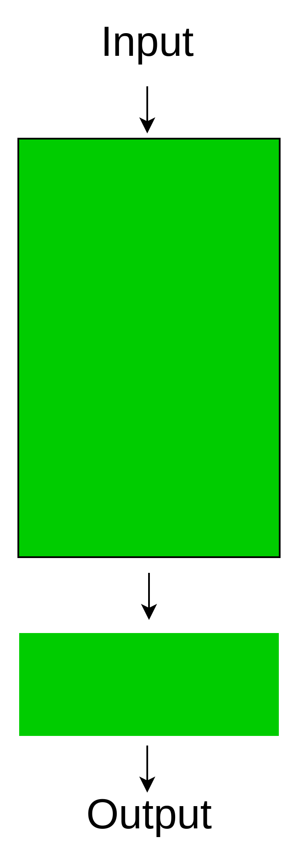
4. Approaches to Transfer Learning
Freeze the convolutional base
Train some layers and
leave the others frozen
Train the entire model

Slide 36
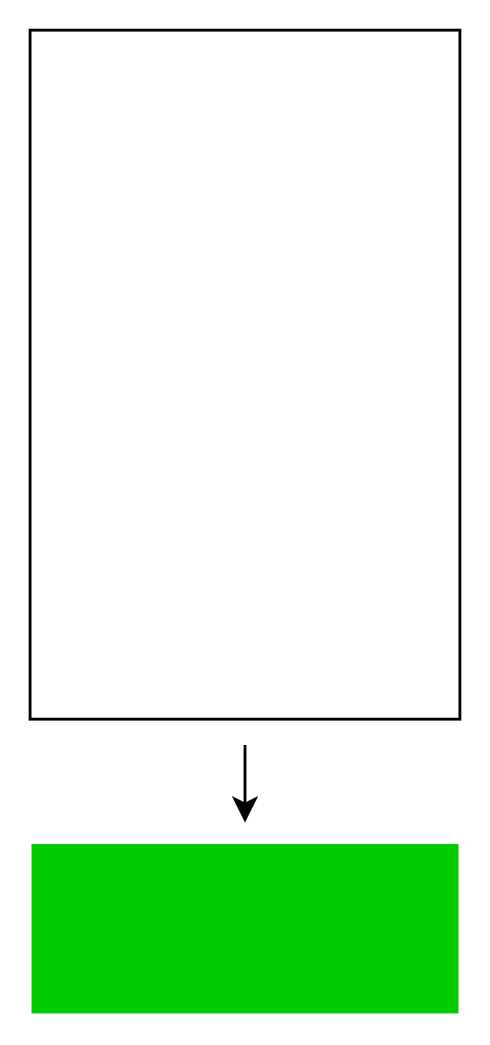
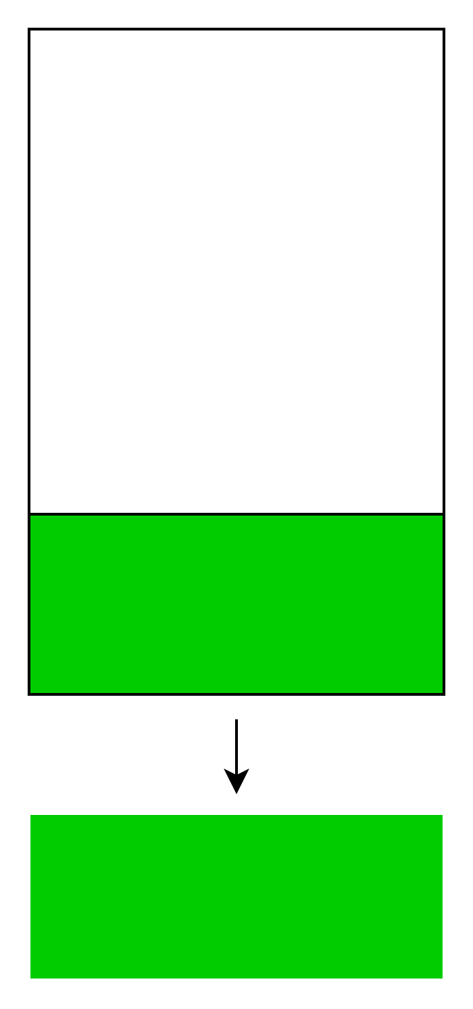


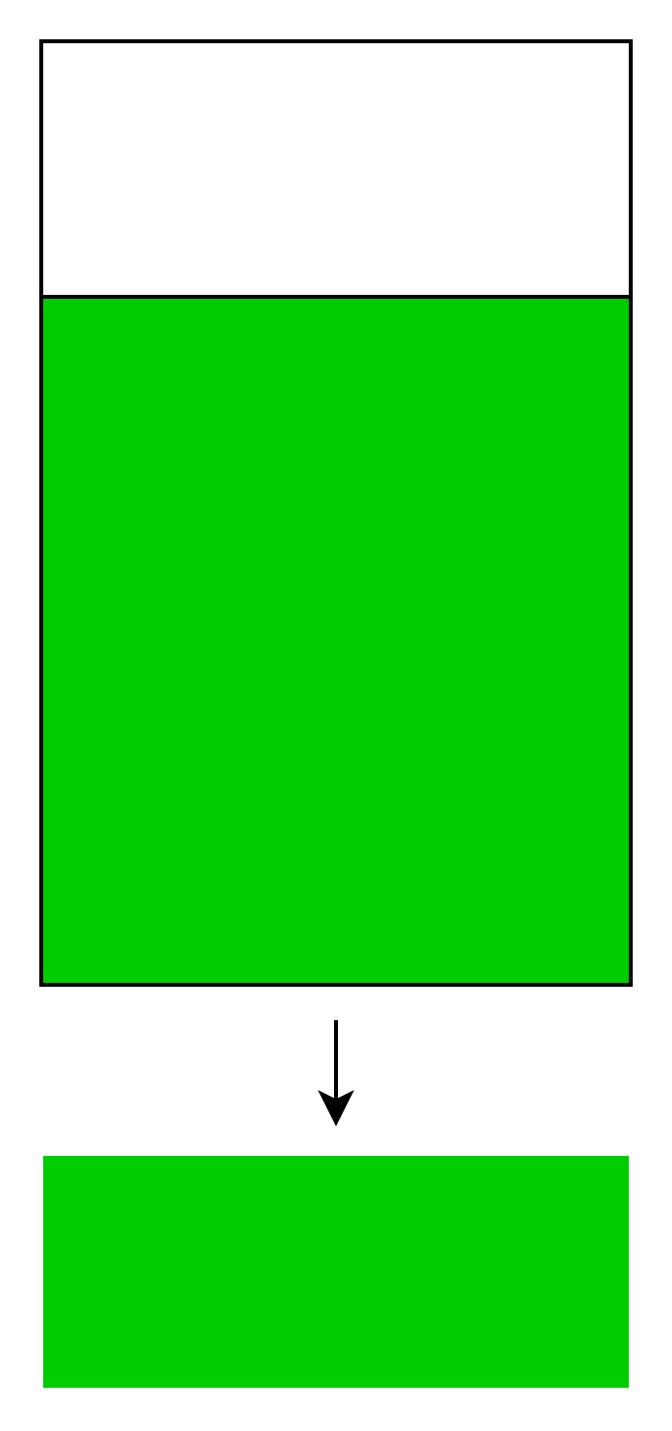
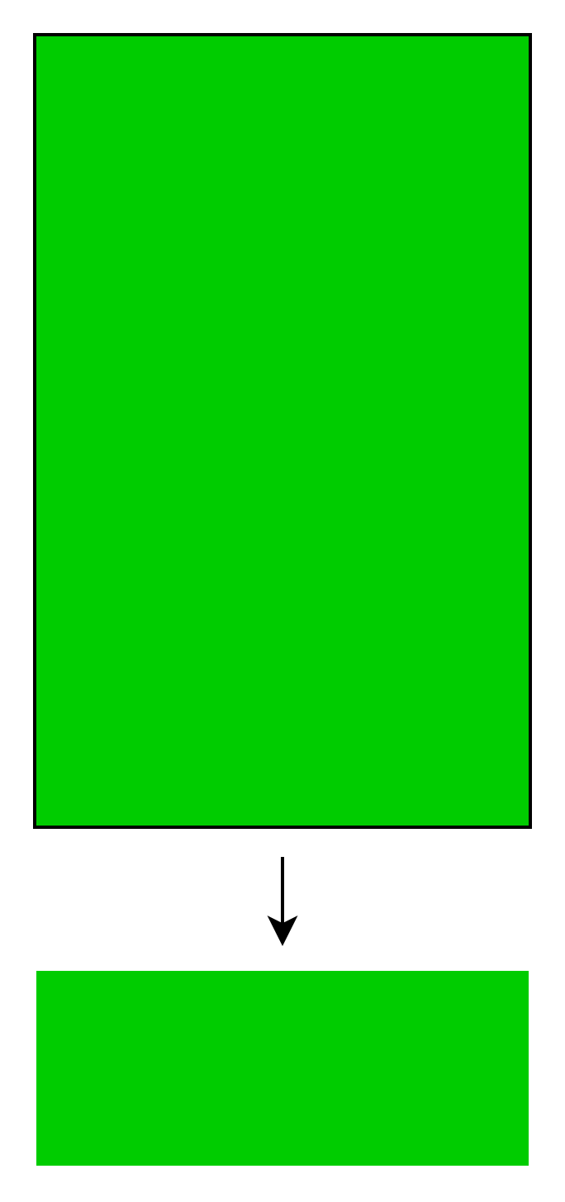

4. Approaches to Transfer Learning
New dataset size
Small
Large
Freeze
Train

Slide 37
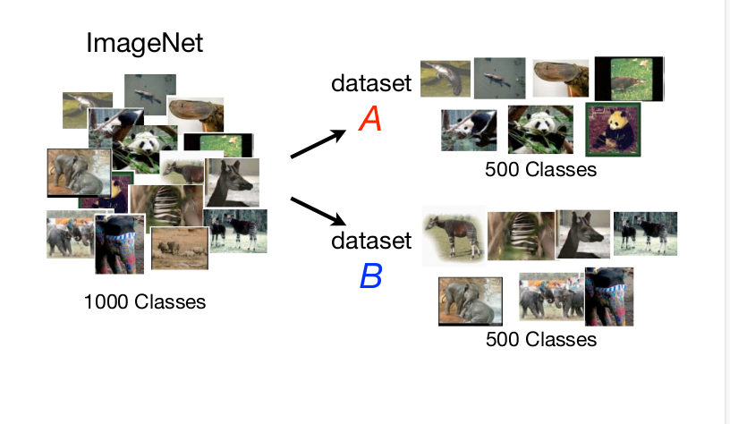
4. Approaches to Transfer Learning
https://s.yosinski.com/yosinski_141209_nips.pdf

Slide 38
4. Approaches to Transfer Learning
https://s.yosinski.com/yosinski_141209_nips.pdf

Slide 39
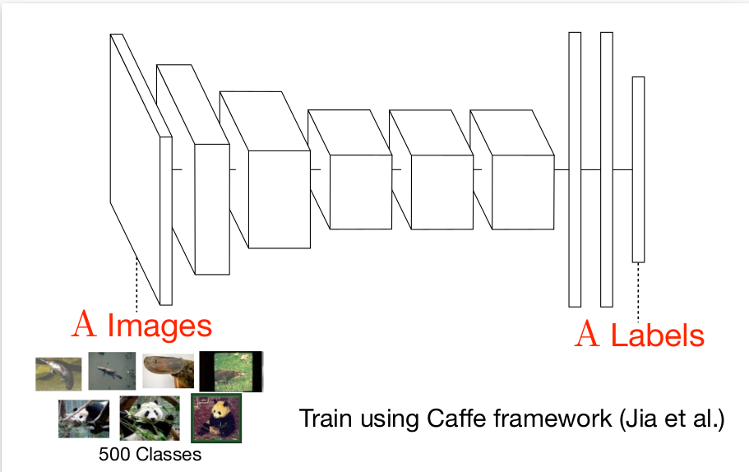
4. Approaches to Transfer Learning
ALEXNET
Image
Labels
https://s.yosinski.com/yosinski_141209_nips.pdf

Slide 40
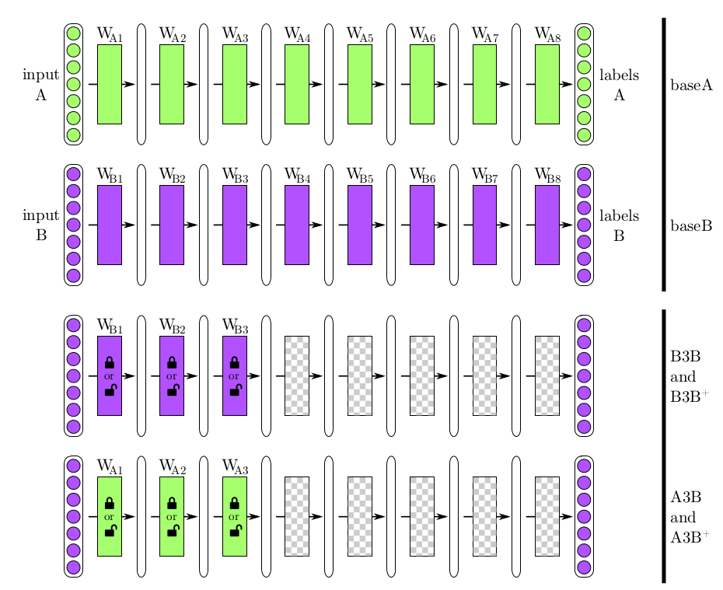
4. Approaches to Transfer Learning
https://s.yosinski.com/yosinski_141209_nips.pdf

Slide 41
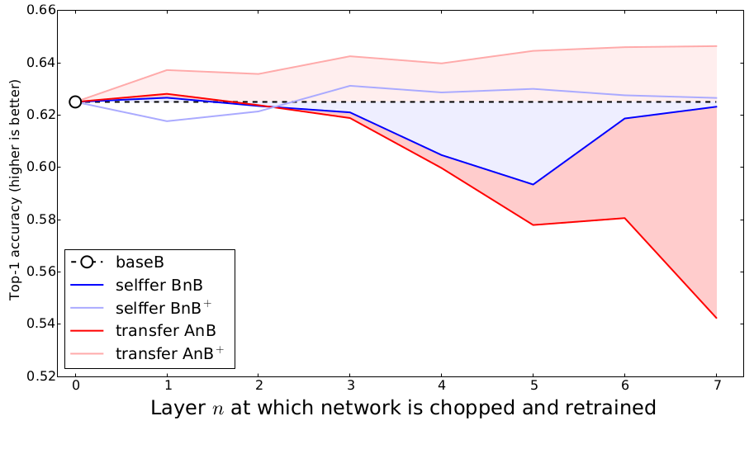
4. Approaches to Transfer Learning
https://s.yosinski.com/yosinski_141209_nips.pdf

Slide 42
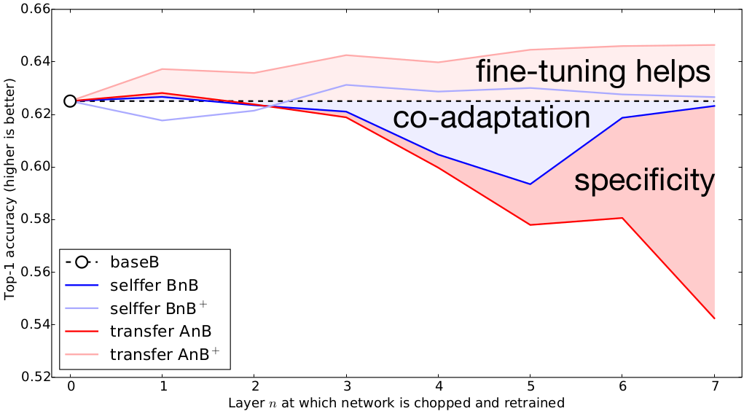
4. Approaches to Transfer Learning
https://s.yosinski.com/yosinski_141209_nips.pdf

Slide 43
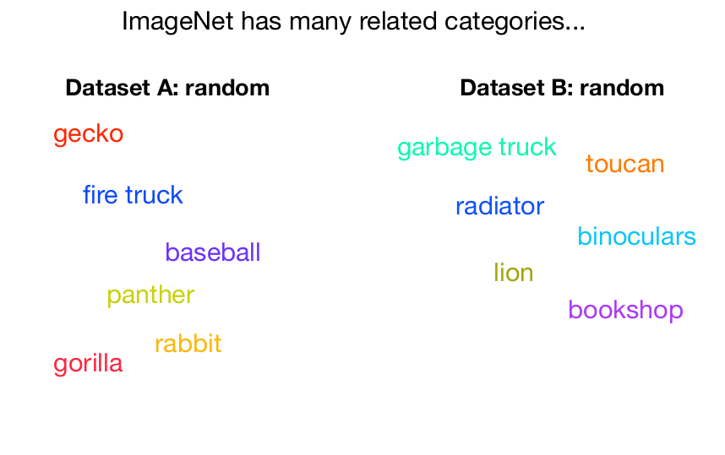
4. Approaches to Transfer Learning
https://s.yosinski.com/yosinski_141209_nips.pdf

Slide 44
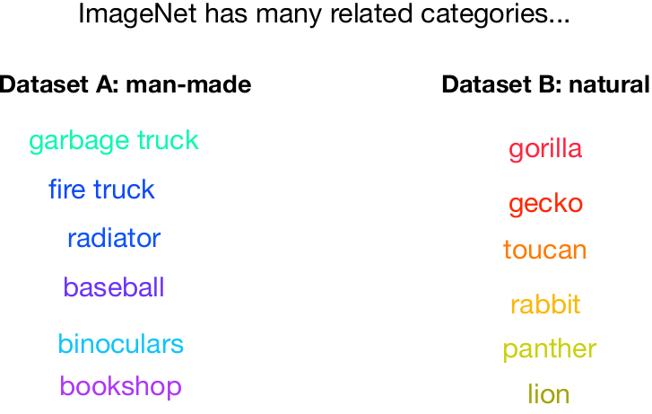
4. Approaches to Transfer Learning
https://s.yosinski.com/yosinski_141209_nips.pdf

Slide 45
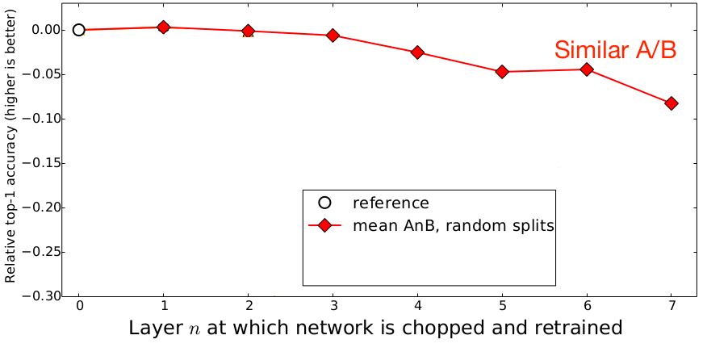
4. Approaches to Transfer Learning
https://s.yosinski.com/yosinski_141209_nips.pdf

Slide 46
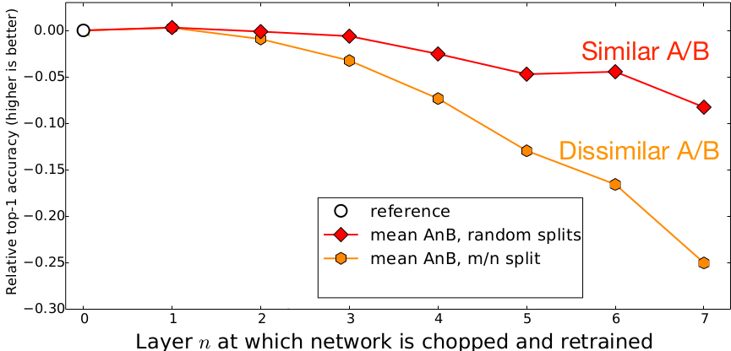
4. Approaches to Transfer Learning
https://s.yosinski.com/yosinski_141209_nips.pdf

Slide 47
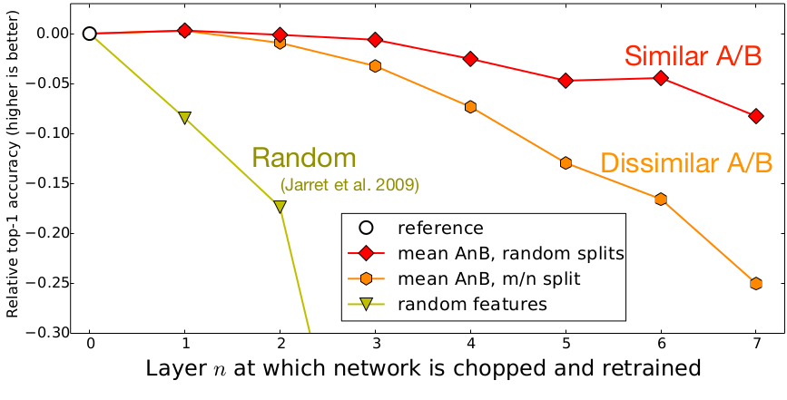
4. Approaches to Transfer Learning
https://s.yosinski.com/yosinski_141209_nips.pdf

Slide 48
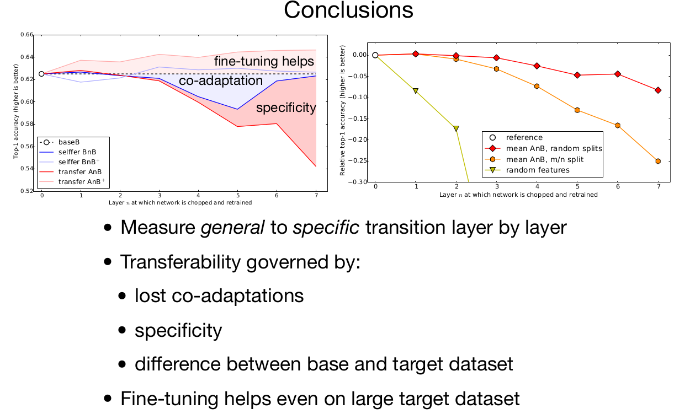
4. Approaches to Transfer Learning
https://s.yosinski.com/yosinski_141209_nips.pdf

Slide 49
Outline
1. What is Transfer Learning?
2. Why is use Transfer Learning?
3. How transferable are features?
4. Approaches to Transfer Learning
5. Experimental

Slide 50
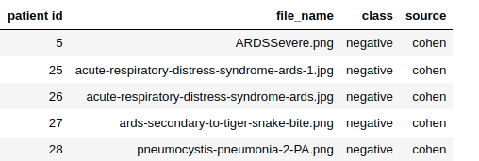
5. Experimental
Dataset: https://www.kaggle.com/andyczhao/covidx-cxr2?select=train.txt
Data Structure

Slide 51
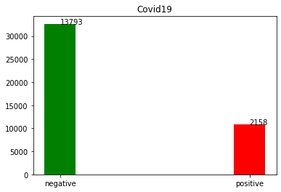
5. Experimental
Dataset: https://www.kaggle.com/andyczhao/covidx-cxr2?select=train.txt
Data Structure

Slide 52
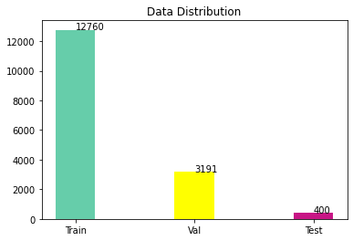
5. Experimental
Dataset: https://www.kaggle.com/andyczhao/covidx-cxr2?select=train.txt
Data Structure

Slide 53
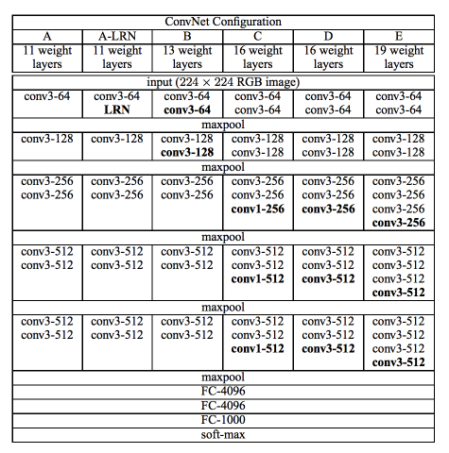
5. Experimental
VGG-NETS
https://pytorch.org/hub/pytorch_vision_vgg/

Slide 54
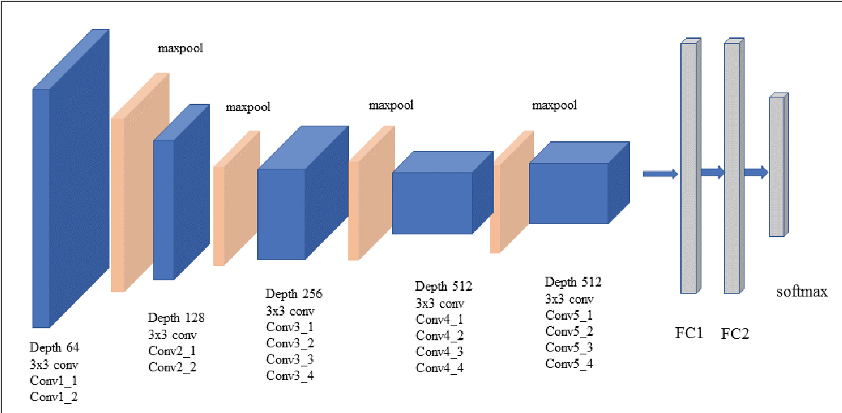
5. Experimental
VGG19
https://morioh.com/p/383582dc31a6

Slide 55
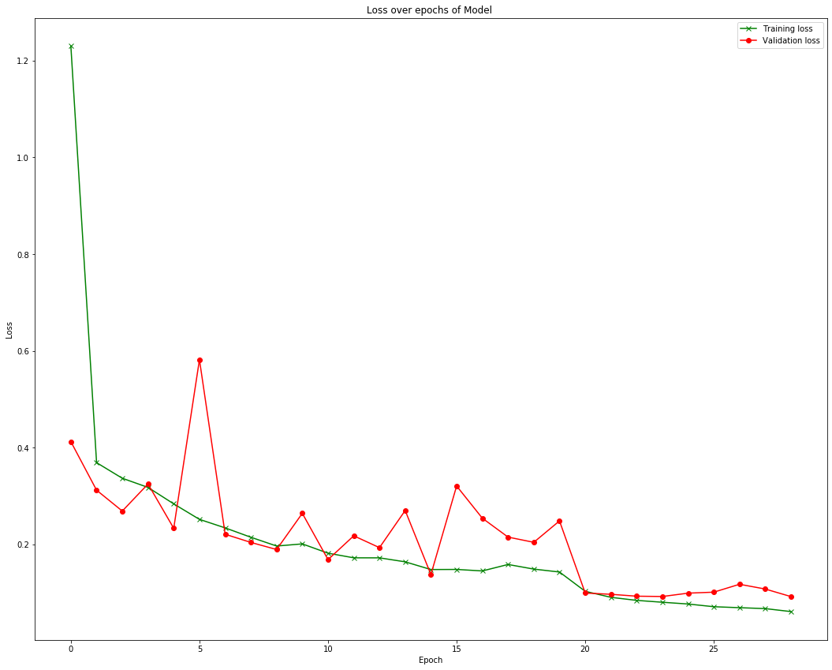
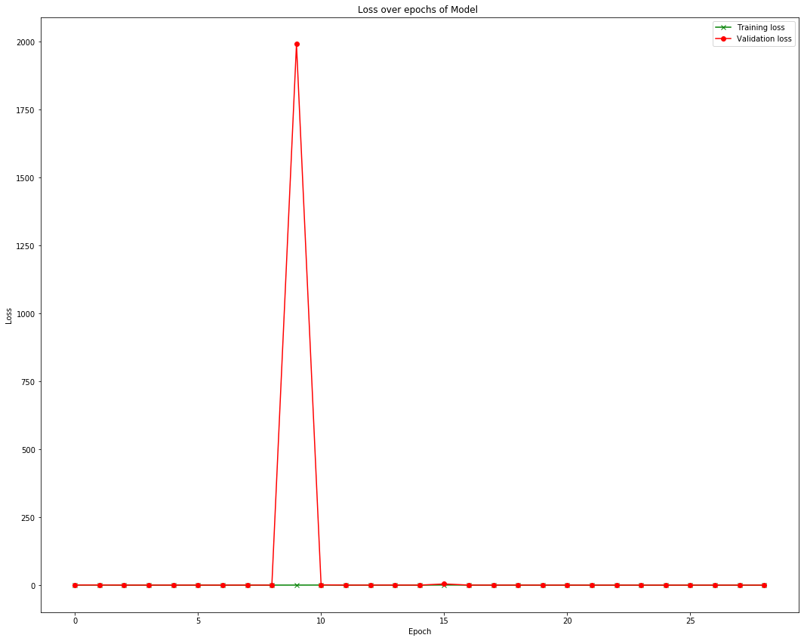
5. Experimental
From the scratch: in 162m 38s
Transfer Learning: in 164m 26s

Slide 56
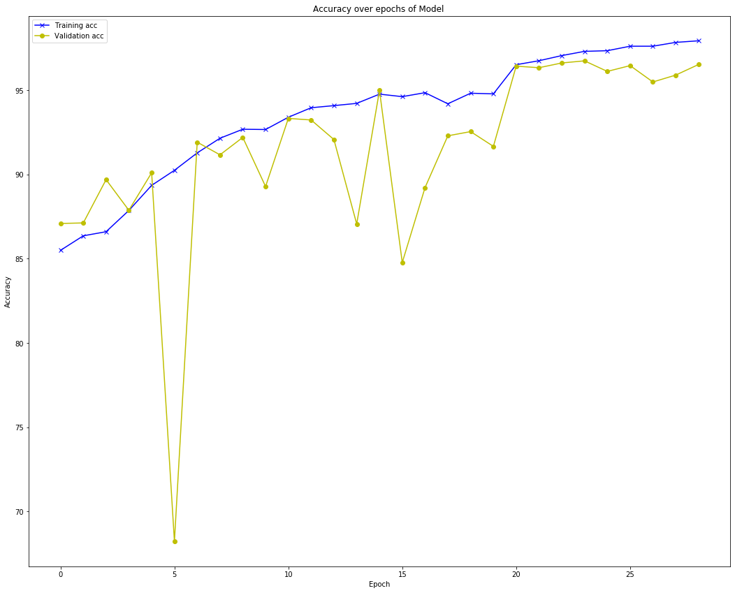
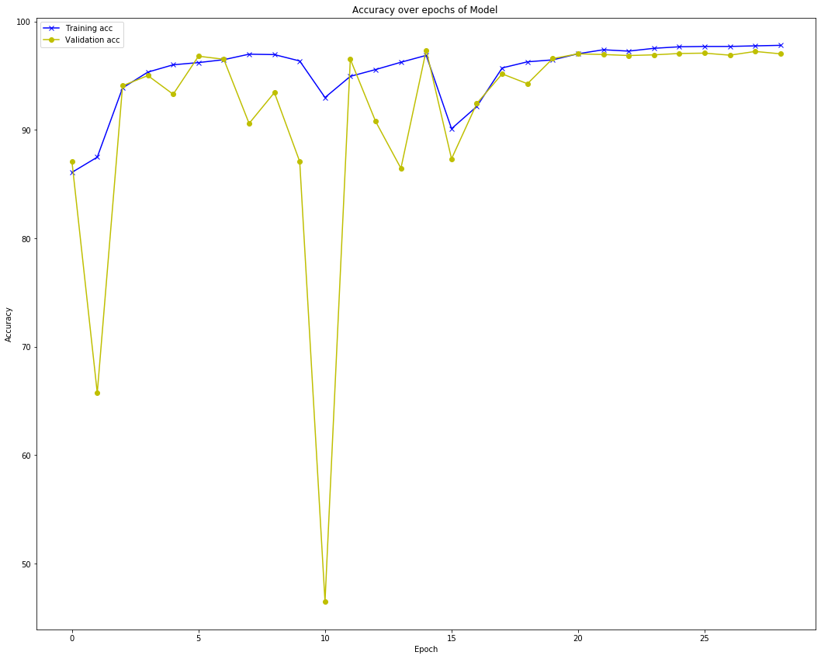
5. Experimental
From the scratch: in 162m 38s
Transfer Learning: in 164m 26s

Slide 57
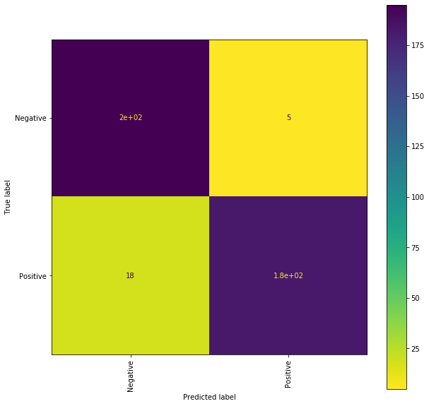

5. Experimental
From the scratch: in 162m 38s
Transfer Learning: in 164m 26s

Slide 58
Outline
1. What is Transfer Learning?
2. Why is use Transfer Learning?
3. How transferable are features?
4. Approaches to Transfer Learning
5. Experimental
6. Conclusions

Slide 59
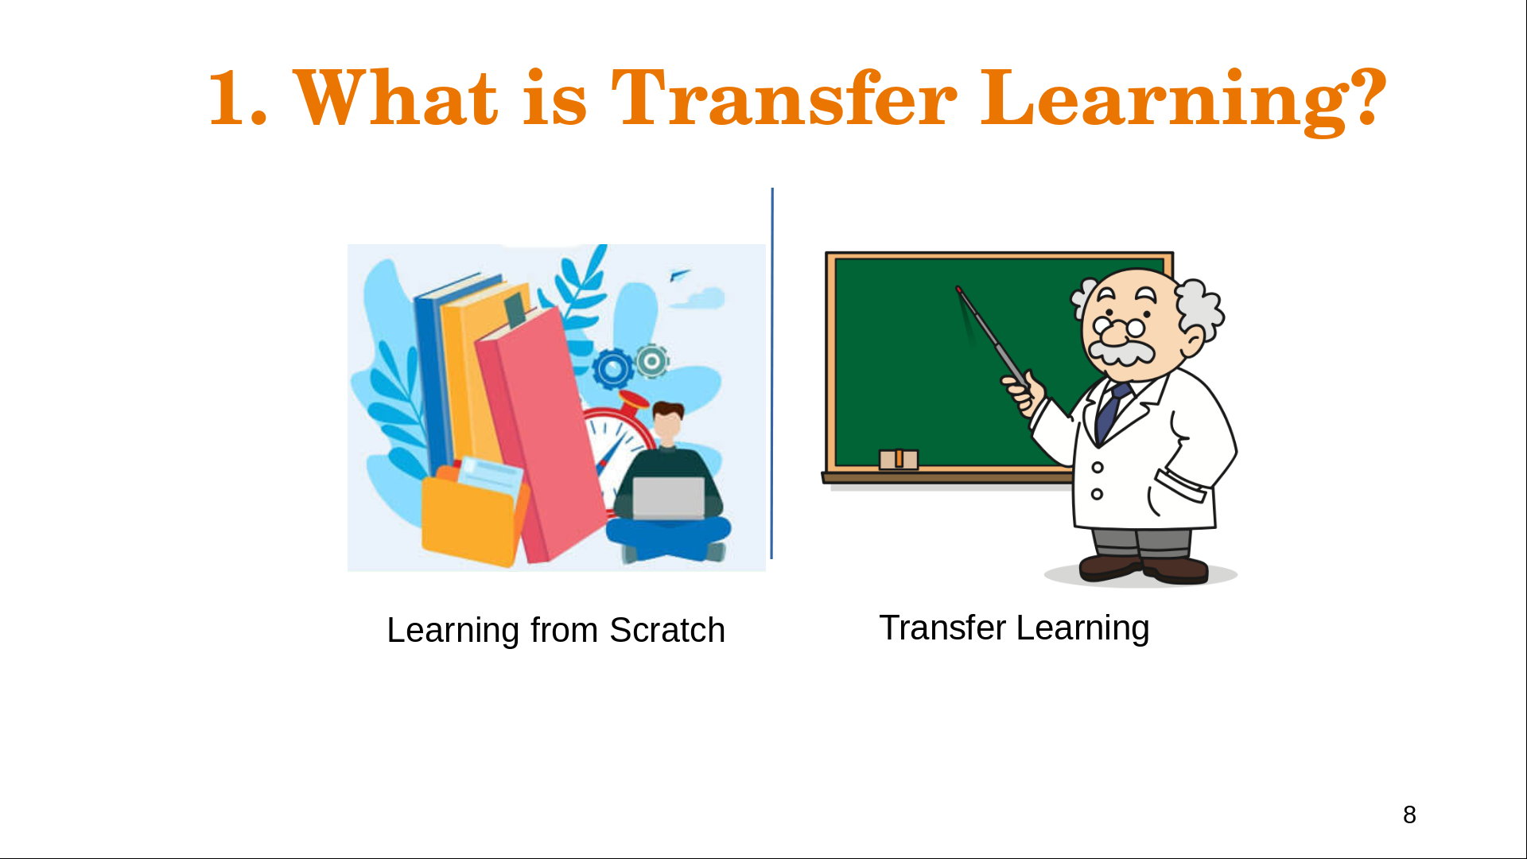
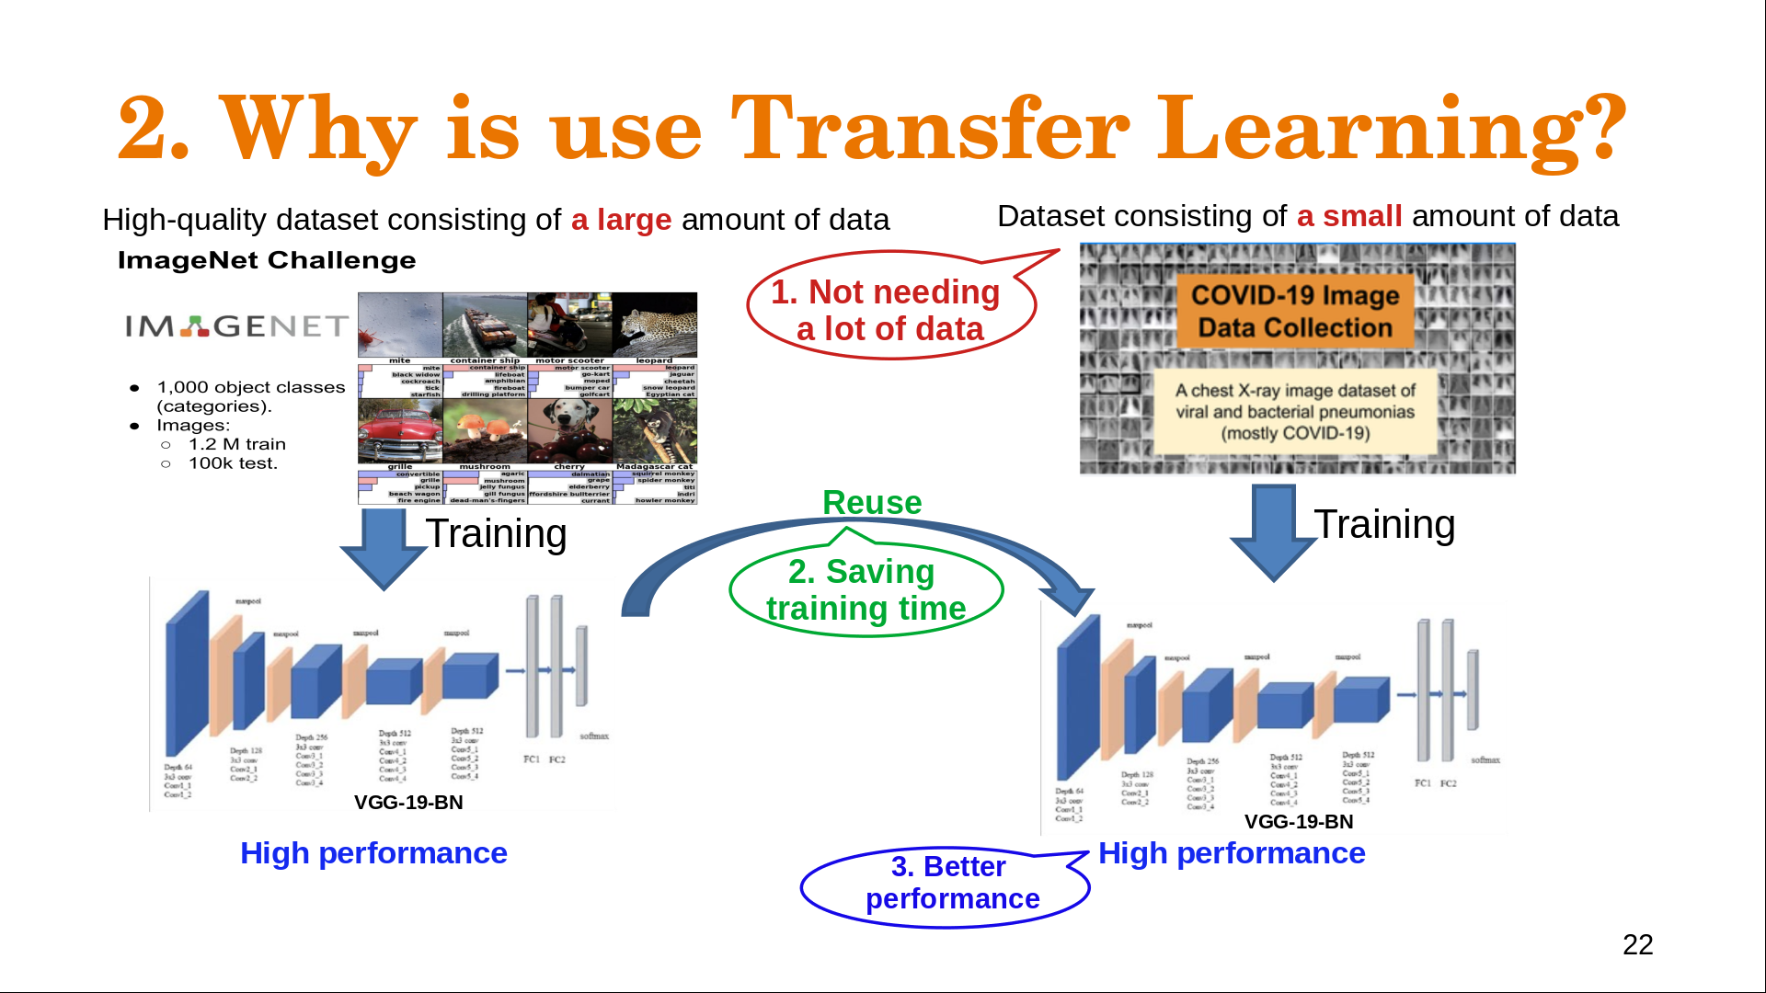
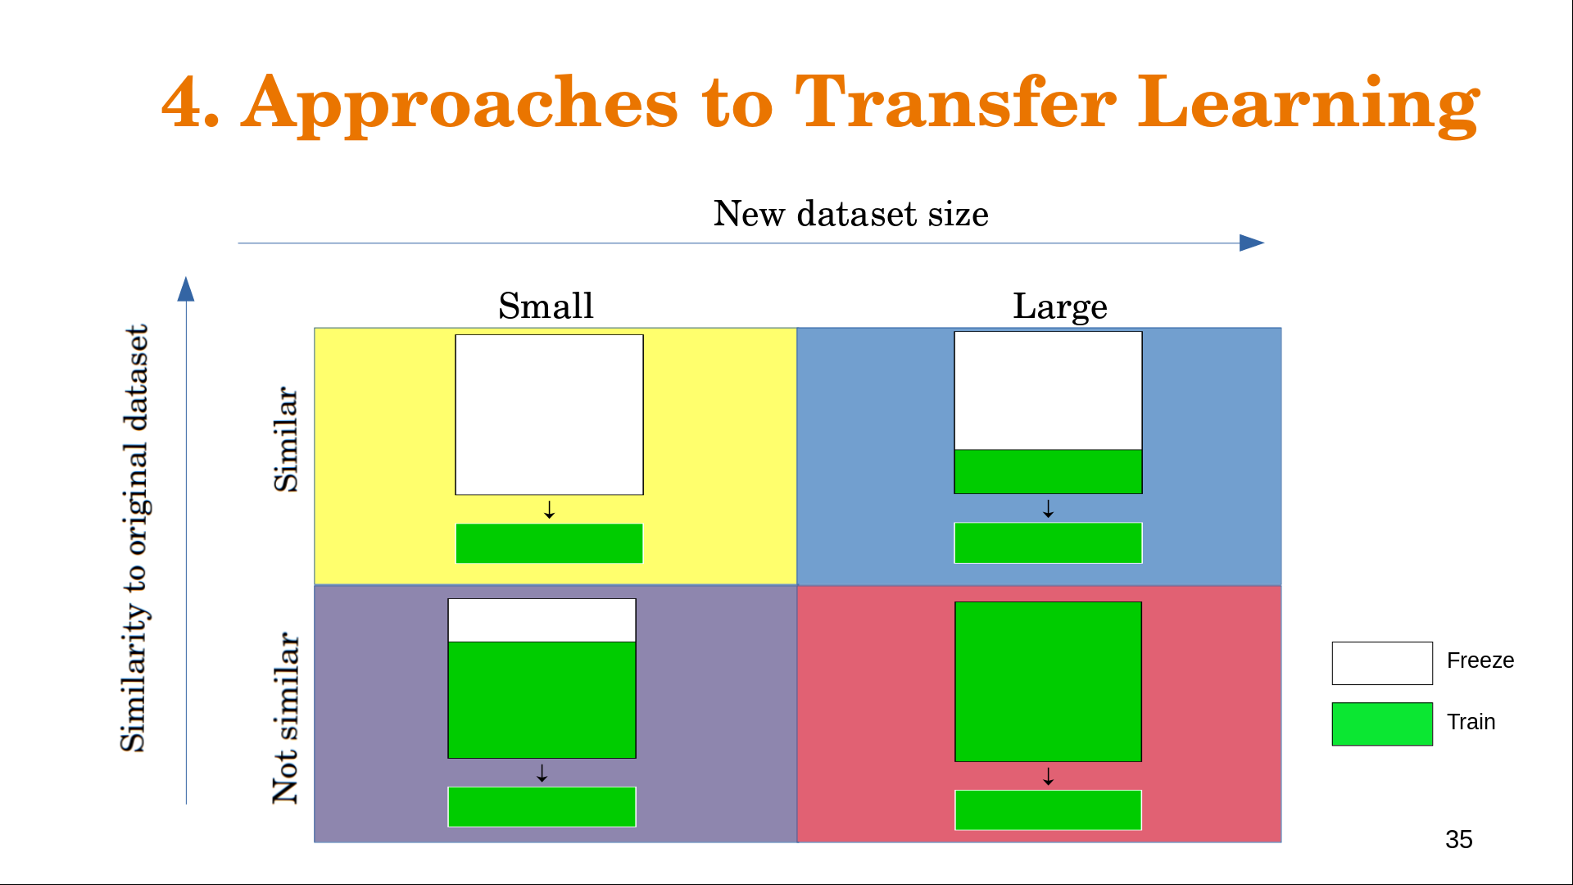
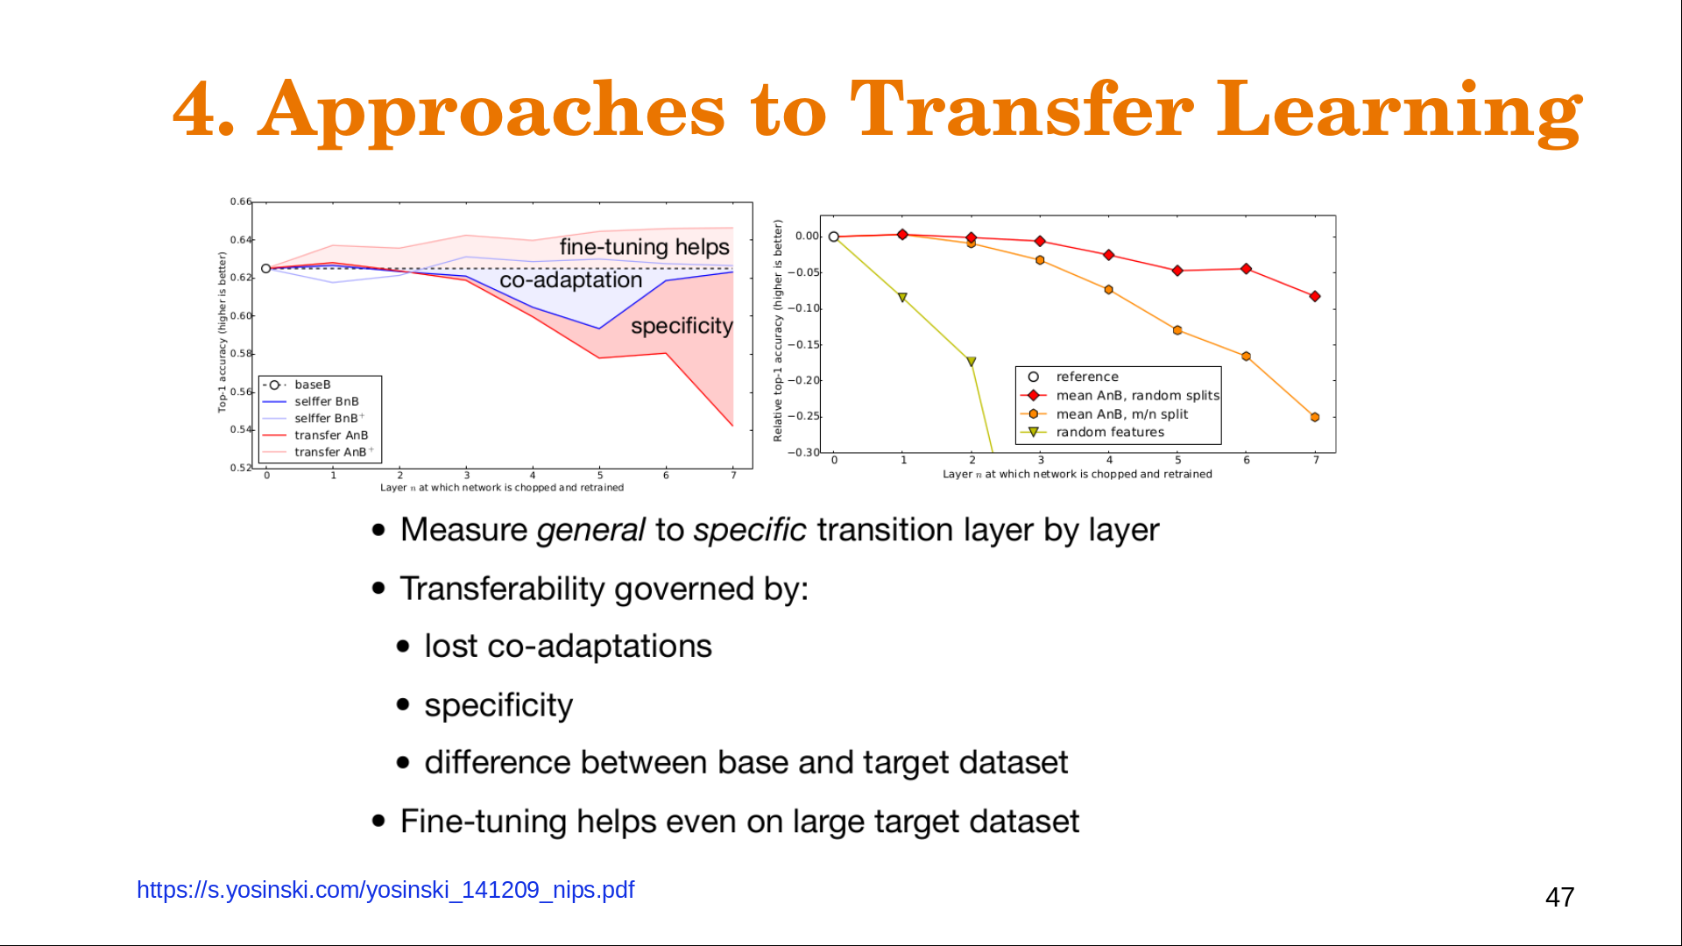
Conclusions

Slide 60
References
https://towardsdatascience.com/a-practical-example-in-transfer-learning-with-pytorch-846bb835f2db
https://yosinski.com/transfer
https://www.analyticsvidhya.com/blog/2019/10/how-to-master-transfer-learning-using-pytorch/
https://pytorch.org/tutorials/beginner/transfer_learning_tutorial.html
https://hackernoon.com/transfer-learning-approaches-and-empirical-observations-efeff9dfeca6
https://towardsdatascience.com/transfer-learning-from-pre-trained-models-f2393f124751
https://pytorch.org/tutorials/beginner/finetuning_torchvision_models_tutorial.html

Slide 61


