Slide 1
Scaling Up Membership Inference:
When and How Attacks Succeed on Large Language Models
Authors: Haritz Puerto, Martin Gubri, Sangdoo Yun, Seong Joon Oh

Slide 2
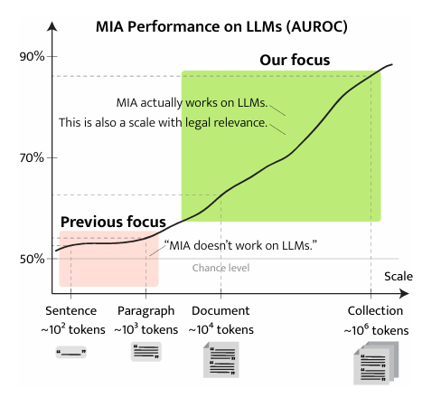
1. Introduction
MIA (Membership Inference Attacks) were considered ineffective against LLMs
Previous studies on short sequences : Low AUROC (50-60%)
The authors' thesis: MIA is effective, but only on larger scale data

Slide 3
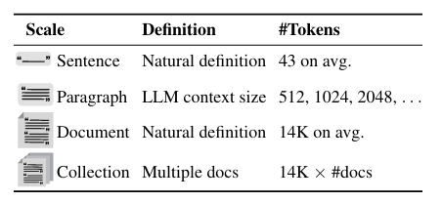
2. The Multi-Scale Protocol
Small Scales : Sentence & Paragraph
Larger Scales : Document & Colletion

Slide 4
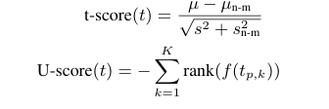
3. The Aggregation Method
1. Break document into small paragraphs.
2. Compute weak MIA scores for each paragraph.
3. Use Statistical Testing (t-test/U-test) to aggregate scores against a non-member baseline.

Slide 5
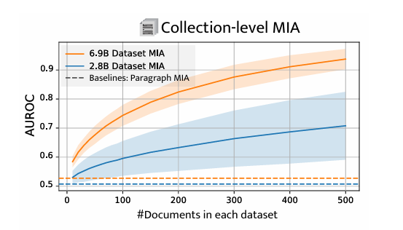
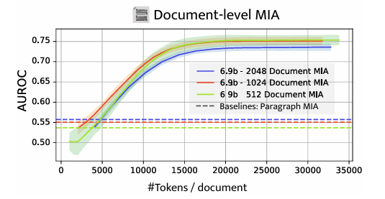
4. Key Results and Compounding effect
Failure at Small Scale: 50-55% AUROC
Document-level MIA : 0.75 AUROC
Collection-level MIA : 0.94 AUROC.

Slide 6
5. Different training stages
Key question : Does the efficacy of MIA change based on the specific stage of the model's training?
Key motivation : Later stages (Continual Learning / End-Task Fine-Tuning) use smaller datasets, meaning each new data point has a more significant influence.
Results : Performance for Collection MIA on continually trained and end-task fine-tuned models reached an AUROC of 0.997.

Slide 7
Conclusion
A summary presented by: Loan Perrard

