Slide 1
Manga Colorization
Team haripraveen_subramanian_cool_boss
TA Mentor: Adhithya Arun
Haripraveen Subramanian (2018102031),
Jayant Duneja (201802003),
Loay Rashid (2018102008),
Rishabh Daga (2018101015)
Repo: https://github.com/Digital-Image-Processing-IIITH/project-haripraveen_subramanian_cool_boss

Slide 2
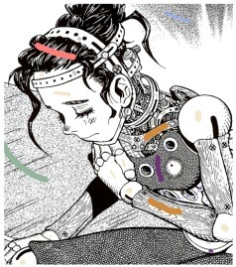
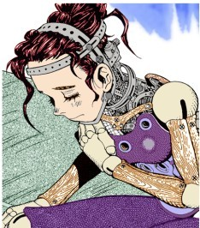

MANGA COLORIZATION
Manga (Japanese comic books) are usually in black and white and heavily rely upon hatching and screening, which makes colorization of these black and white comics difficult.
We aim to implement colorization of the sort shown below.

Slide 3
BASIC STEPS:
In short, the process is highlighted below
The user first selects a region of interest and scribbles the color of choice in that region.
The boundaries of the region selected by the user are decided and the region is segmented out on the basis of intensity or pattern continuity.
The segmented region is then colored using one of the methods described in the paper:
Flood-fill sort of algorithm
Stroke preservation
Pattern to shading

Slide 4
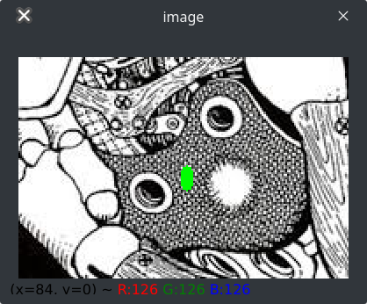
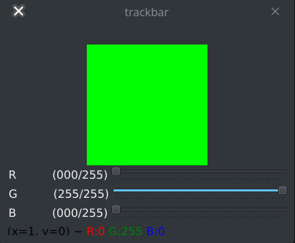
STEP 1: TAKING INPUT
The application provides the user with a trackbar to select an RGB value, and allows the user to make a scribble on the input image. Segmentation then happens on the basis of this scribble.

Slide 5
STEP 2: IMAGE SEGMENTATION
Usually, to express detail in the lack of color, manga artists make use of the following techniques to convey artistic details.
Hatching
Screening
Half-toning
These regions have pattern continuity which we have exploited in order to segment these regions. Similarly, images can also have intensity continuity.

Slide 6
STEP 2: IMAGE SEGMENTATION
There can be two types of regions in manga:
Intensity continuous regions
Pattern continuous regions
The segmentation and colorization of the image depends on the type of region you wish to do colorization on.

Slide 7

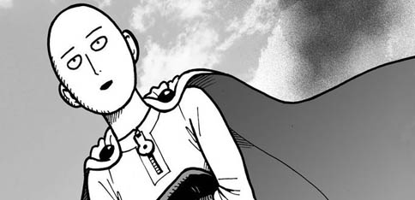
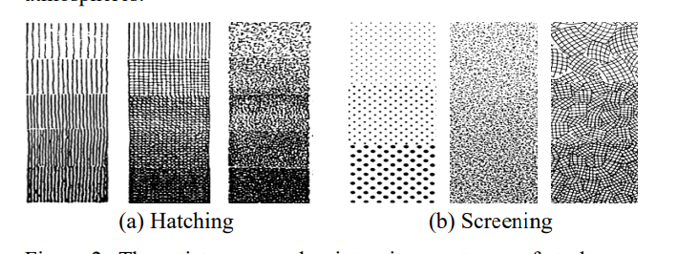
An Intensity Continuous region
A Pattern Continuous Region
Examples of Hatching and Screening

Slide 8
LEVEL
SETS

Slide 9
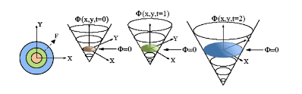
LEVEL SET: INTRODUCTION
Fundamental idea is to raise the modeling of boundaries from a 2D planar curve into a three-dimensional curved surface, by taking the curves as the zero level set of a higher dimensional surface .
We start from the user scribble and then propagate the level set to reach all boundaries of the part to be coloured.
This offers several advantages, including parameter-free representation and capability in dealing with local deformation.

Slide 10

LEVEL SETS
For finding the boundary of the region scribbled on by the user (to carry out image segmentation), we use the concept of level set propagation. According to the paper, level set propagation can be done by solving the following PDE:
However, due to this method had quite a few disadvantages, and the outputs after implementing this method were nowhere as clean as we wanted them to be.
To overcome this, we used the Distance Regularized Level Set Method (DRLSE). The DRLSE method avoids the difficulties of level set method by introducing a regularization term.

Slide 11
DRLSE
The distance regularization term is defined with a potential function
We provide a double-well potential for the distance regularization term, T
The level set evolution is derived as a gradient flow that minimizes this energy functional.
The regularity of the LSF is maintained by a forward-and-backward (FAB) diffusion derived from the distance regularization term
Thus distance regularization completely eliminates the need for reinitialization in a principled way, and avoids the undesirable side effect introduced by the penalty term.

Slide 12
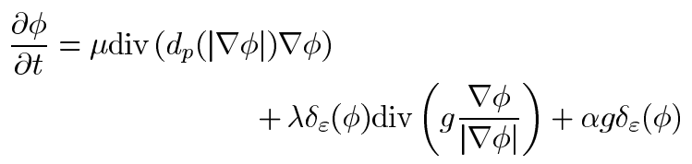
DRLSE
The DRLSE PDE is given by:

Slide 13
PATTERN AND
INTENSITY CONTINUITY

Slide 14

PATTERN CONTINUOUS REGIONS
To detect changes in pattern in the image, we exploit pattern continuity. We measure the changes in pattern features at the level set boundary and at the scribble region to estimate when changes in pattern have taken place.
‘Gabor Wavelet Transform’ is used to obtain these features.
When there is a sudden change in pattern, the filter stops the propagation.

Slide 15
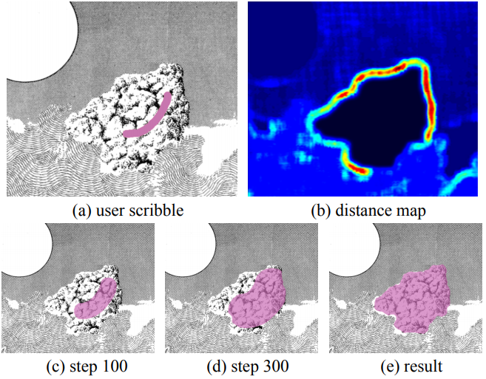

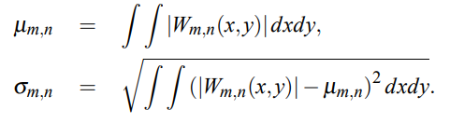

PATTERN CONTINUOUS REGIONS
To generate the pattern features,

Slide 16


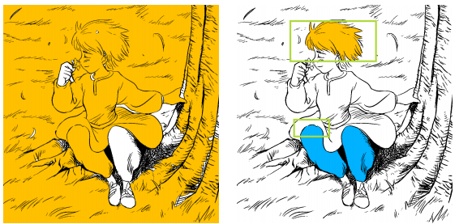

INTENSITY CONTINUOUS REGIONS
Segmenting such regions is fairly easy as compared to pattern continuous regions. Halting coefficient defined for such regions depend on the smoothing of the image with a gaussian filter.
In order to implement leak proofing, we add another term to the speed function F:

Slide 17
COLORIZATION

Slide 18
STEP 3: COLORIZATION
We have implemented following three methods of colorization after the region is segmented
Color replacement
This is a simple flood fill-type algorithm, used for intensity continuous regions. For such regions, filling color can be trivially done by replacing the black or white color by the user color on the scribble.
Stroke preserving
Pattern to shading

Slide 19
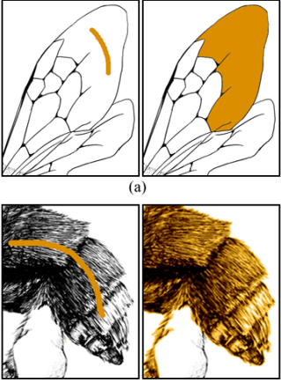
An example of intensity continuous vs. pattern continuous colorization (with stroke preserving)

Slide 20
STROKE PRESERVING
AND
PATTERN TO SHADING

Slide 21

STROKE PRESERVING
Pattern continuous regions are colorized by bleeding colors out of the strokes/patterns and filling it across the regions which have pattern matching to the part where user scribbles. This is done by converting the image to YUV spcae and:

Slide 22
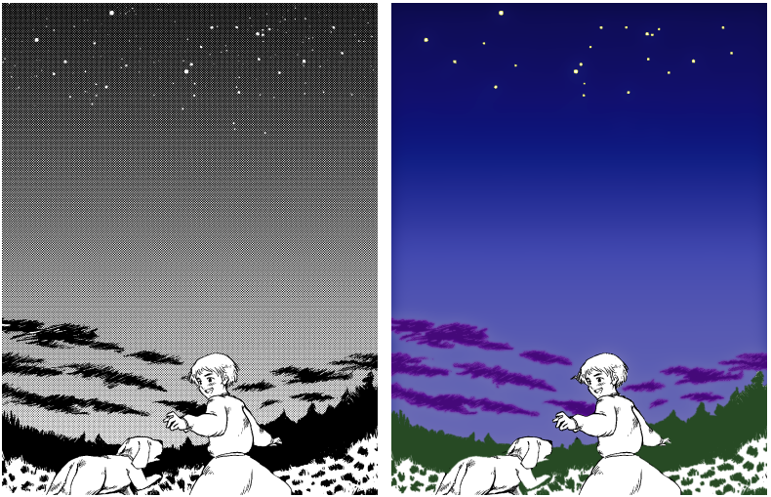

PATTERN TO SHADING
This method allow us to fill color as if we are shading, i.e., it fills color according to density of pattern in pattern continuous regions. Mathematics behind it,

Slide 23
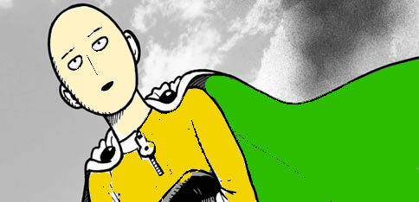
RESULTS

Slide 24
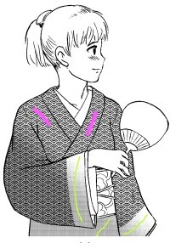
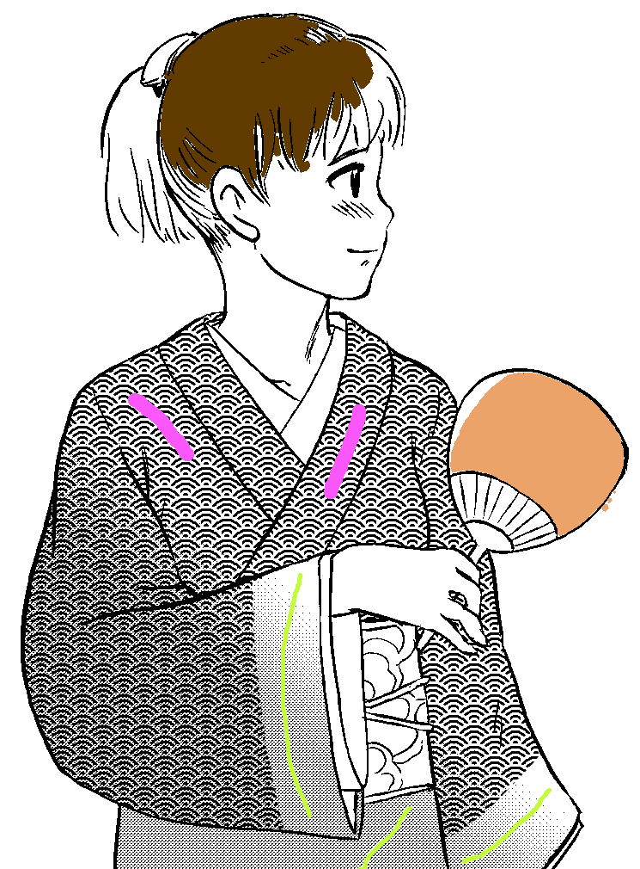
RESULTS

Slide 25
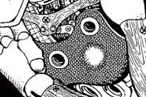
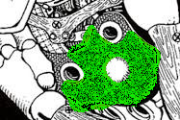
RESULTS

Slide 26
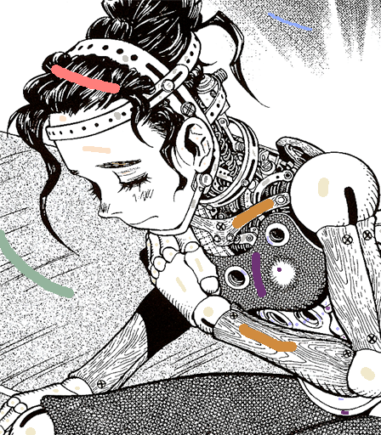
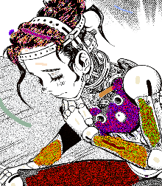
RESULTS

Slide 27
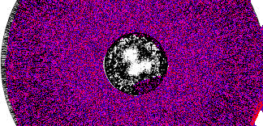
LIMITATIONS AND FAILURES:
If patterns overlap, then the code completely fails as this is the corner stone of our method. The code usually fails to separate the patterns in the image. The overlapped pattern is considered to be a separate pattern and the filter halts.
This is an example of how our code fails at pattern continuous regions.

Slide 28
PAPERS USED
Manga Colorization: http://www.cse.cuhk.edu.hk/~ttwong/papers/manga/manga.pdf
Distance Regularized Level Set Evolution and Its Application to Image Segmentation: https://ieeexplore.ieee.org/stamp/stamp.jsp?arnumber=5557813

Slide 29
DIVISION OF WORK
Loay, Rishabh
Understanding implementation specifics
Searching for alternative implementations of level set , understanding and implementing DRLSE propagation
Intensity continuous propagation, stroke preservation, pattern to shading
Making the presentation
Hari, Jayant:
Level set propagation implementation
Pattern Continuous propagation, flood fill algorithm
Implementing the GUI for the application for scribbling on image using mouse
Writing the readme

