Slide 1
Montre & Parle
CP14 Lot 1 - Asset
Product : Emily Stevens
Dev : Clément Pilon / Antoine Gay
QA : Fabien Riondel /David Foucaud
April 2015

Slide 2
Business context
Source new columns the Asset D1, and Asset D2O report added in the CP14 updates

Slide 3
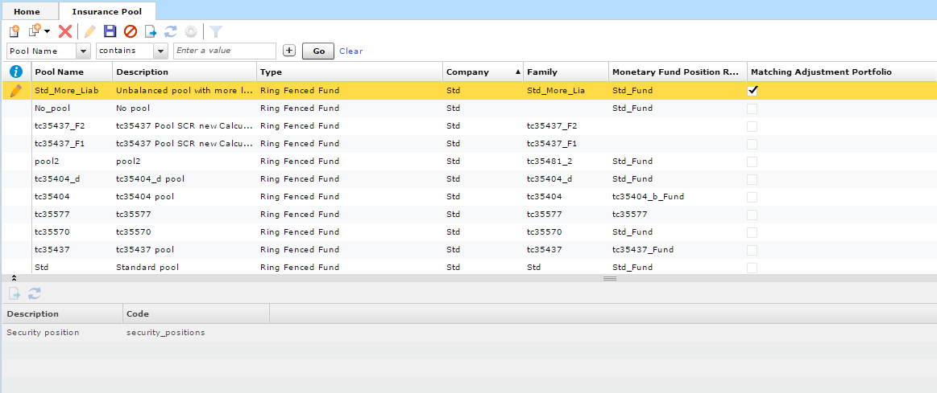
1) Indicate and identify matching portfolios

Slide 4
2) New fields for ASSET Reporting : creation of SII_ASSET_ATTRIBUTES table
Column_name | Data_type | Column_desc
Table_name | TBC | Unique code that identifies the security
Contract_reference | VARCHAR2(101) | Unique code that identifies the contract.
CIC code | VARCHAR2(10) | Indicates the category and sub-category of the asset or derivative
Valuation method | VARCHAR2(20) | Indicates the valuation method used. Possible values: - QMP: Quoted market price in active markets for the same assets - QMPS: Quoted market price in active markets for similar assets - AVM: Alternative valuation methods - AEM: Adjusted equity methods (applicable for the valuation of participations) - IEM: IFRS equity methods () (applicable for the valuation of participations
Custodian | VARCHAR2(100) | Name of the financial institution that is the custodian.
3) Source Credit Quality Code

Slide 5
Questions & Answers

